Slide 1




Summary of Preliminary Design Review
Satoshi YANO
Hiroshima University and RIKEN

Slide 2
Regarding the comments and suggestions received at the recent PDR, we need to address these issues by the next review, which will take place at the end of this year.
The main purpose of this Workfest is to identify the areas that require the most attention, set priorities, and clarify who is responsible for each topic.

Slide 3
Schedule (Calendar Year)
2026
2027
2028
2029
2030
2031
2032
2033
PDR
CD2
CD3
Install
>60%
>90%
Preproduction
10%
Production
90%
Today
CD-2: Baseline Approval (~60% maturity)
CD-3: Construction Start (~90% maturity)

Slide 4
Preliminary Design Review
PDR was held on 3-4 June by the following reviewers
  Koji Nakamura (KEK)
  Stefania Bufalino (Torino)
  Giovanni Pinaroli (BNL)
This review was an assessment of the readiness of these detectors towards the upcoming project reviews for CD2 anticipated to be late 2026/early 2027
  The expected design maturity at that stage is 60% or higher, with still some 1-1.5 years for design completion remaining before start of construction anticipated in 2028

Slide 5
Comments/Recommendation from Reviewers (1)
Document the allowable material budget estimation for both bTOF and fTOF.
For ease of external reviewers, the requirements can be stated more clearly, and presenters should coordinate and keep consistency through all presentations. We suggest this to include:
  The physics requirement for the timing performance needed to achieve the science goals
  The engineering target for the timing performance that is realistically acceptable for the instrument
A full simulation, including all material budgets, to ensure the detectors achieve the requirements needs to be performed and documented. This should also address the number of dead channels and staves that can be tolerated without impacting the science
Next actions
  Full simulation with realistic condition (Kentaro)
    With PWGs: Estimation of detector performance impact on physics results
    With other subsystems: Estimation of detector material impact on the other subsystems, hpDIRC and BIC

Slide 6
Comments/Recommendation from Reviewers (1)
Document the allowable material budget estimation for both bTOF and fTOF.
For ease of external reviewers, the requirements can be stated more clearly, and presenters should coordinate and keep consistency through all presentations. We suggest this to include:
  The physics requirement for the timing performance needed to achieve the science goals
  The engineering target for the timing performance that is realistically acceptable for the instrument
A full simulation, including all material budgets, to ensure the detectors achieve the requirements needs to be performed and documented. This should also address the number of dead channels and staves that can be tolerated without impacting the science
Next actions
  Full simulation with realistic condition (Kentaro)
    With PWGs: Estimation of detector performance impact on physics results
    With other subsystems: Estimation of detector material impact on the other subsystems, hpDIRC and BIC

Slide 7
Comments/Recommendation from Reviewers (2)
Improve the estimation of the work force needed for future construction and acceptance stages
Perform a more conservative estimation for the overall detector yield (sensors, module and mechanical assembly/installation).
Include precise statements on the acceptance criteria for component quality assurance (e.g., on alignment, glue fill factor, dead channels).
Complete a simulation of the minimum acceptable glue fill factor for the wire bonding.
The reviewers suggest to incorporate a precise statement on acceptance criteria for QA (alignment, glue fill factor, dead channels).
Next actions
  Brash up assembly procedure (Simone)
    At first, the procedure is imported from ATLAS ITK, sPHENIX INTT, and CMS ETL
    Then it is tuned for AC-LGAD TOF
  Demonstrate the assembly procedure (Grigory)
  Make QA list and procedure (Jennifer and Simone)
    At first, list and procedure are imported from ATLAS ITK, sPHENIX INTT, and CMS ETL
    Then it is tuned for AC-LGAD TOF

Slide 8
Comments/Recommendation from Reviewers (2)
Improve the estimation of the work force needed for future construction and acceptance stages
Perform a more conservative estimation for the overall detector yield (sensors, module and mechanical assembly/installation).
Include precise statements on the acceptance criteria for component quality assurance (e.g., on alignment, glue fill factor, dead channels).
Complete a simulation of the minimum acceptable glue fill factor for the wire bonding.
The reviewers suggest to incorporate a precise statement on acceptance criteria for QA (alignment, glue fill factor, dead channels).
Next actions
  Brash up assembly procedure (Simone)
    At first, the procedure is imported from ATLAS ITK, sPHENIX INTT, and CMS ETL
    Then it is tuned for AC-LGAD TOF
  Demonstrate the assembly procedure (Grigory)
  Make QA list and procedure (Jennifer and Simone)
    At first, list and procedure are imported from ATLAS ITK, sPHENIX INTT, and CMS ETL
    Then it is tuned for AC-LGAD TOF

Slide 9
Comments/Recommendation from Reviewers (3)
Improve and complete a more realistic thermal model for both bTOF and fTOF.
Include a detailed analysis of the detector powering scheme for the bTOF.
A realistic thermal model for both fTOF and bTOF should be completed to ensure a workable engineering design and to get a realistic estimate for the material budget coming from the cooling system.
Next actions
  Determine the sensor's operating target temperature (Satoshi)
    Data with changing temperature has been taken at KEK
    Preparations are underway to measure temperature dependence using TCT-Scan and Sr-90
  FEA analysis with realistic parameters (Rachid)
    Parameters of support structure, FPC, interposer, Service-Hybrid (PB+RDO), and ASIC designer
  Demonstrate FEA analysis result (Itaru)
    Real material FPC/interposer, glue, mimic ASIC by thermocouple
    If actual size is demonstrated, it would be more convincing
  Designing and making FPC (Takashi)
    Designing FPC with simulation
    Demonstrate the performance with mimic signals and power supply

Slide 10
Comments/Recommendation from Reviewers (3)
Improve and complete a more realistic thermal model for both bTOF and fTOF.
Include a detailed analysis of the detector powering scheme for the bTOF.
A realistic thermal model for both fTOF and bTOF should be completed to ensure a workable engineering design and to get a realistic estimate for the material budget coming from the cooling system.
Next actions
  Determine the target of sensor's operating temperature (Satoshi)
    Data with changing temperature has been taken at KEK
    Preparations are underway to measure temperature dependence using TCT-Scan and Sr-90
  FEA analysis with realistic parameters (Rachid)
    Parameters of support structure, FPC, interposer, Service-Hybrid (PB+RDO), and ASIC designer
  Demonstrate FEA analysis result (Itaru)
    Real material FPC/interposer, glue, mimic ASIC by thermocouple
    If actual size is demonstrated, it would be more convincing
  Designing and making FPC (Takashi)
    Designing FPC with simulation
    Demonstrate the performance with mimic signals and power supply

Slide 11
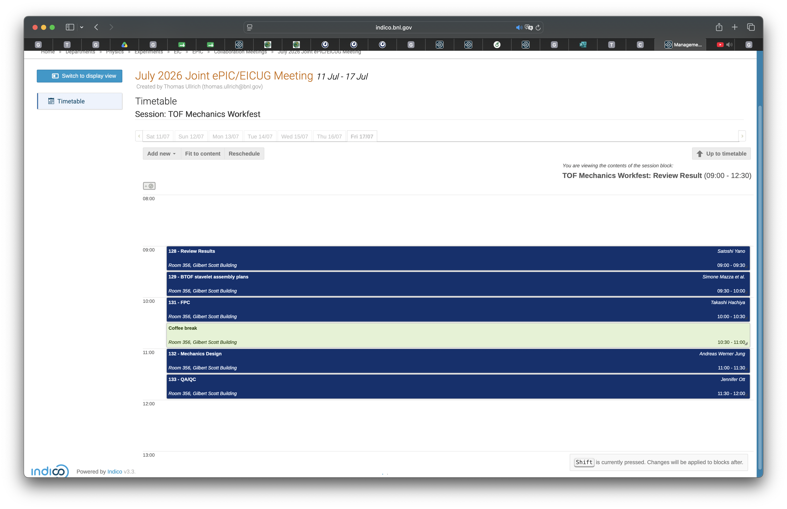

Slide 12
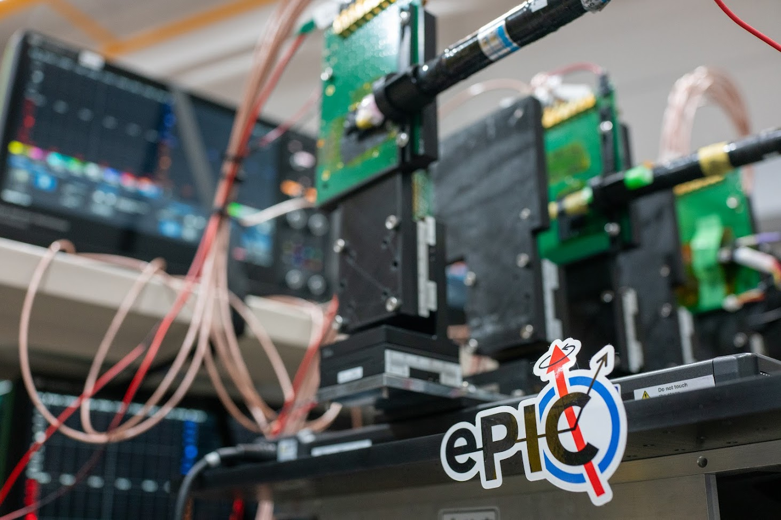
Extra

