Slide 1
Quantum observables at colliders (and the quest for toponium)
R. Demina
University of Rochester
03/24/2026

Slide 2
How “quantum” is the behavior of elementary particles?

Slide 3
The world of elementary particles
In APS the name DPF - the division of particles and fields emphasizes the dual (quantum) nature of elementary particles
Their behavior is described by quantum field theories: QED and QCD
Quantumness should be engrained in the behavior of elementary particles
Yet, it is not so easy to demonstrate
For a typical momentum of 100 GeV/c the precision of measurement is ~1GeV/c, typical position precision is 100 um
We are ~10 orders of magnitude away from the uncertainty principle

Slide 4
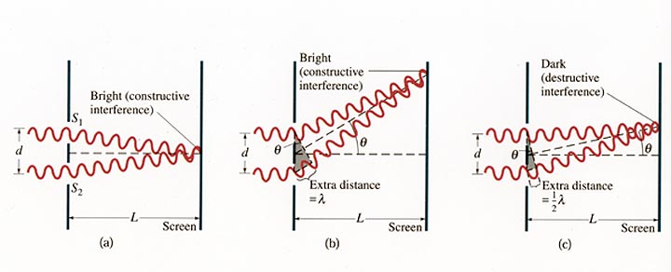
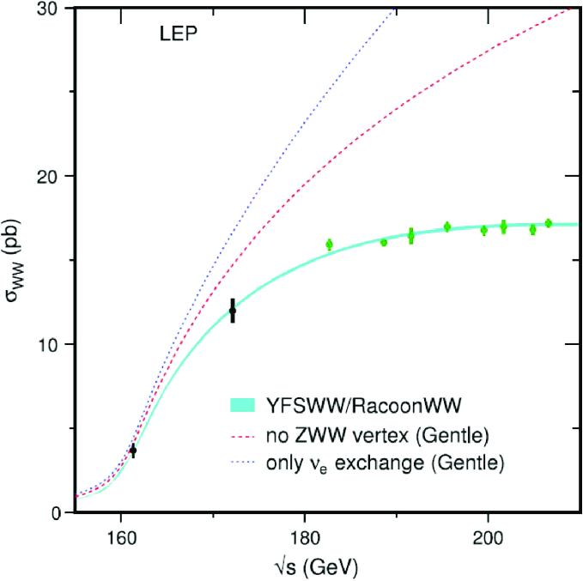
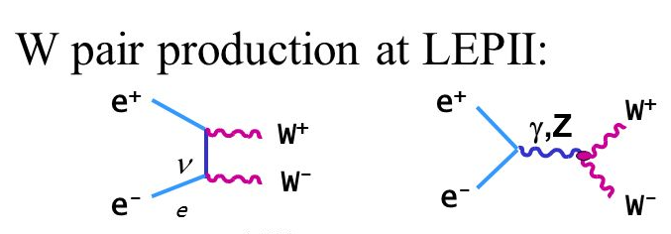
“Double slit experiment”
Interference is observed in multiple processes
And then there is spin

Slide 5
Top quark-antiquark pair at LHC

Slide 6
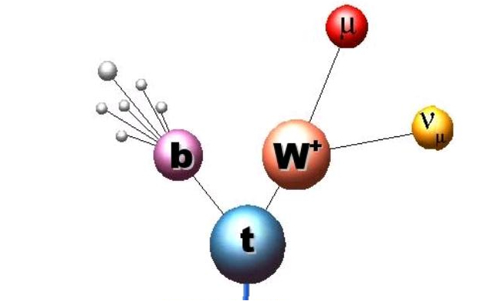
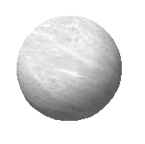
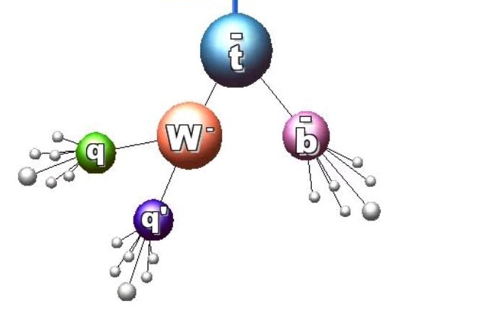
Top-antitop quark pair is a two qubit system
Top quark has s=1/2, it is a qubit
Top-antitop quark pair is a two-qubit system
Top quark is very short-lived O(10⁻²⁵s)< hadronization time O(10⁻²⁴s), so it decays unlike other quarks before hadronizing (picking up a light quark from “vacuum” to form a bound state – a hadron)
Top quark spin information is preserved in the angular correlation of its decay products t→Wb, W→lν – or – qq’ (=udbar, or csbar)
When both W bosons decay leptonically
– dilepton channel
When one W boson decays
leptonically and the other
one hadronically –
lepton+jets channel

Slide 7
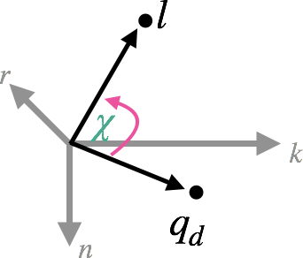
Spin correlation and entanglement
Polarization, P and spin correlation matrix, C determines the angular distribution of the decay products in the helicity basis as in [1212.4888]
- spin analyzing power of top/antitop decay products – max for charged leptons and d-type quarks (d or s)
Ω – unit vector in the direction of the decay product
2^{X}3(P)+3^{X}3(C) =15 coefficients Q_{m}
There is a shortcut: use χ –opening angle between the two decay products in rotated tt frame (a.k.a helicity angle)
and χ, where the sign of n-component in one of the decay products is inverted:
~

Slide 8
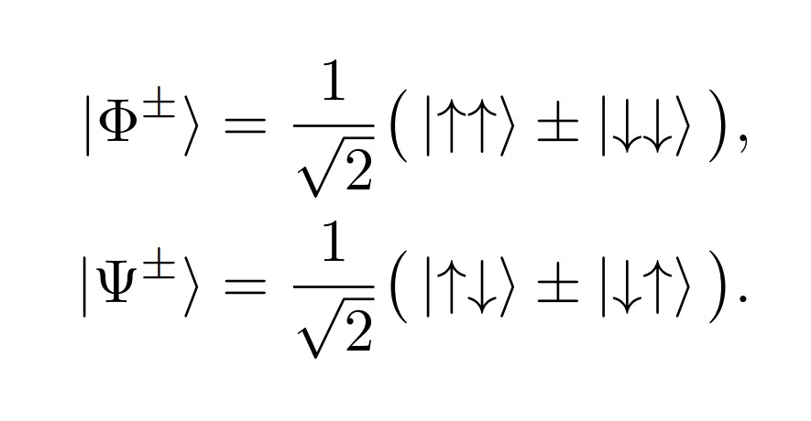
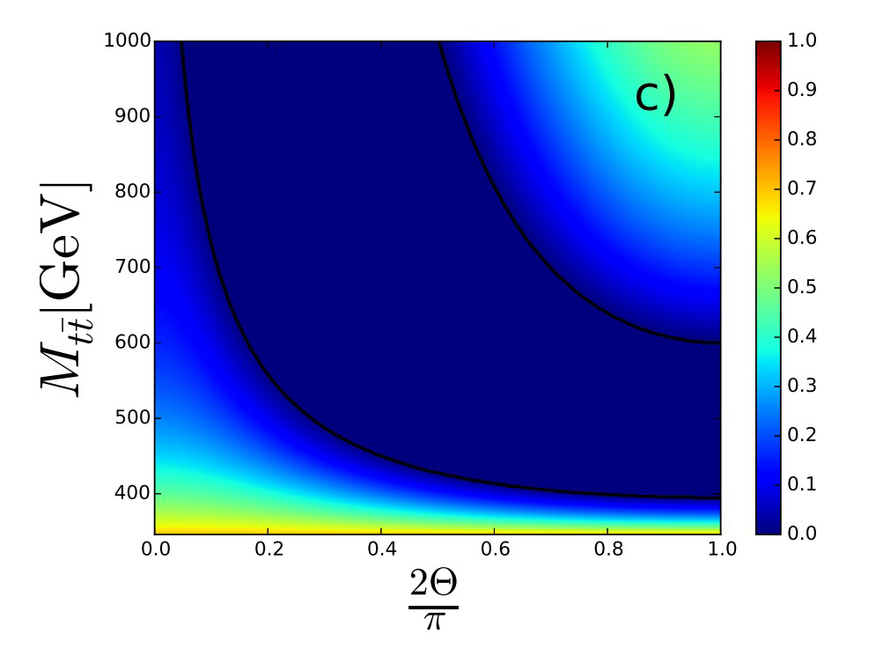
Spin correlation and entanglement in ttbar system
The system is considered separable if its density matrix can be factored into individual states
Otherwise, it is considered entangled → Peres-Horodecki criterion [2003.02280]
A. Peres, Phys. Rev. Lett. 77, 1413 (1996). P. Horodecki, Physics Letters A 232, 333 (1997)
Entanglement is a result of spin correlation,
hence it is a quantum property of the system
There are four pure maximally entangled (Bell) states:
at high triplet vector state
(Φ⁺-Φ⁻, Ψ⁺, Φ⁺+Φ⁻)
Peres-Horodecki criterion
at low singlet pseudoscalar state Ψ⁻
Peres-Horodecki criterion
Plot from Afik, De Nova
EPJP136(2021)9,907
hep-ph:2003.02280
Top angle with the beam axis

Slide 9
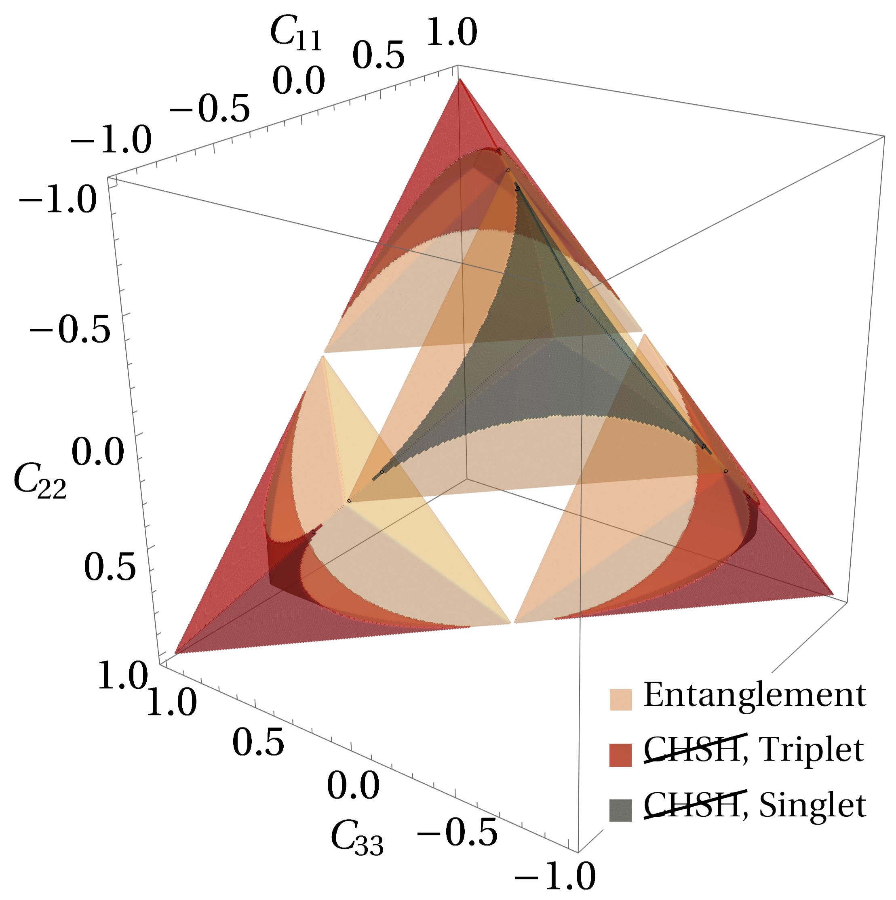
Bell inequality
Bell inequality is formulated based on conventional logic, which is violated in QM
Entanglement is a necessary but not sufficient condition for Bell inequality violation
As such entanglement is not a test of Bell non-locality
It can be phrased in terms of Clauser, Horne, Shimony, and Holt (CHSH) inequality [PRL, 23(15), 1969] which states that measurements a, a’ and b, b’ on subsystems A and B, respectively (with absolute values <=1) classically must satisfy:
For ttbar system the CHSH can formatted as
2 leading conditions for CHSH violation
C Severi et al. arXiv:2110.10112v2 [hep-ph]

Slide 10
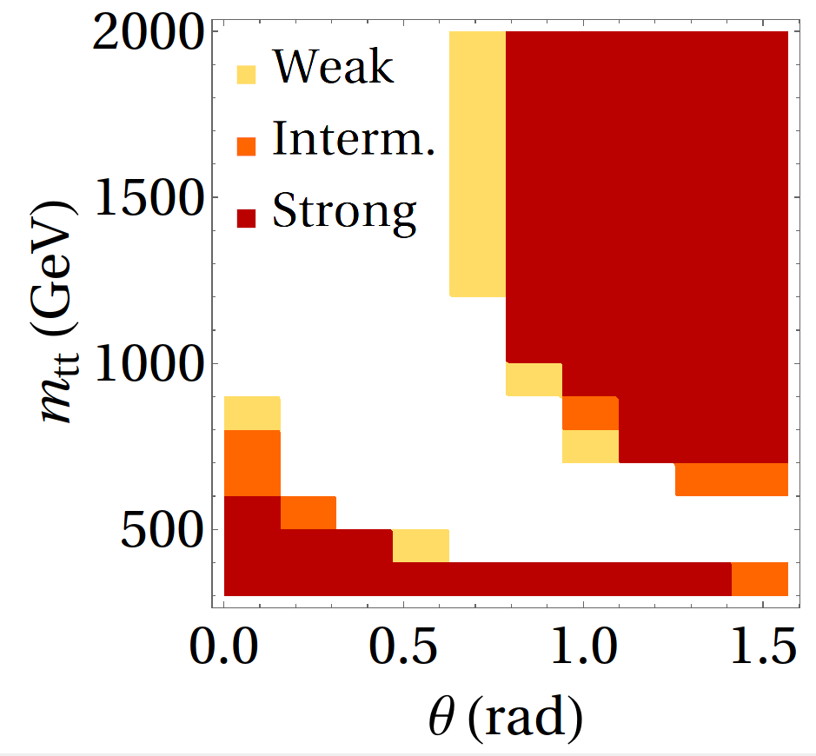
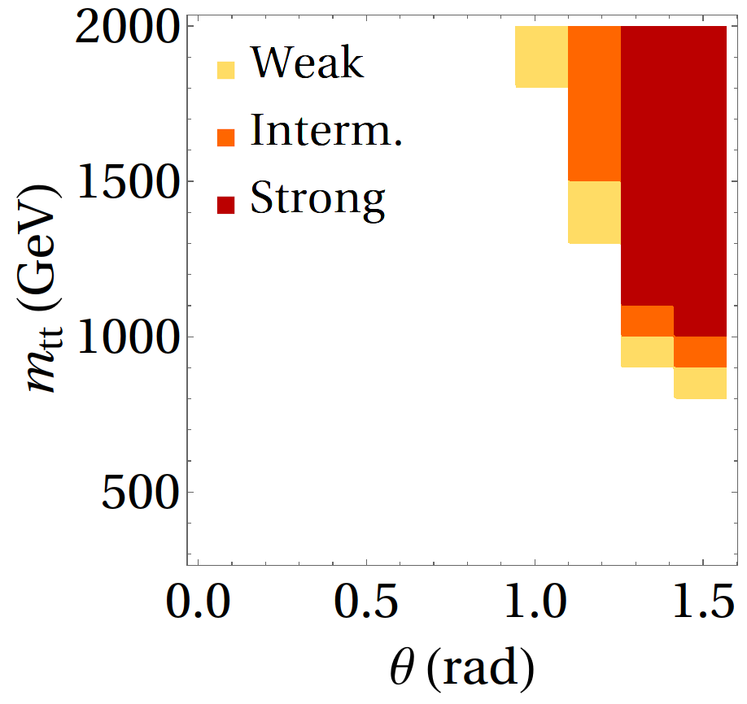
Entanglement Bell inequality violation
C Severi et al. arXiv:2110.10112v2 [hep-ph]
While entanglement can be observed at the threshold (singlet) and in high Mtt (triplet) regions, for the conditions for Bell inequality violation exist only at higher Mtt (>1TeV), central production

Slide 11
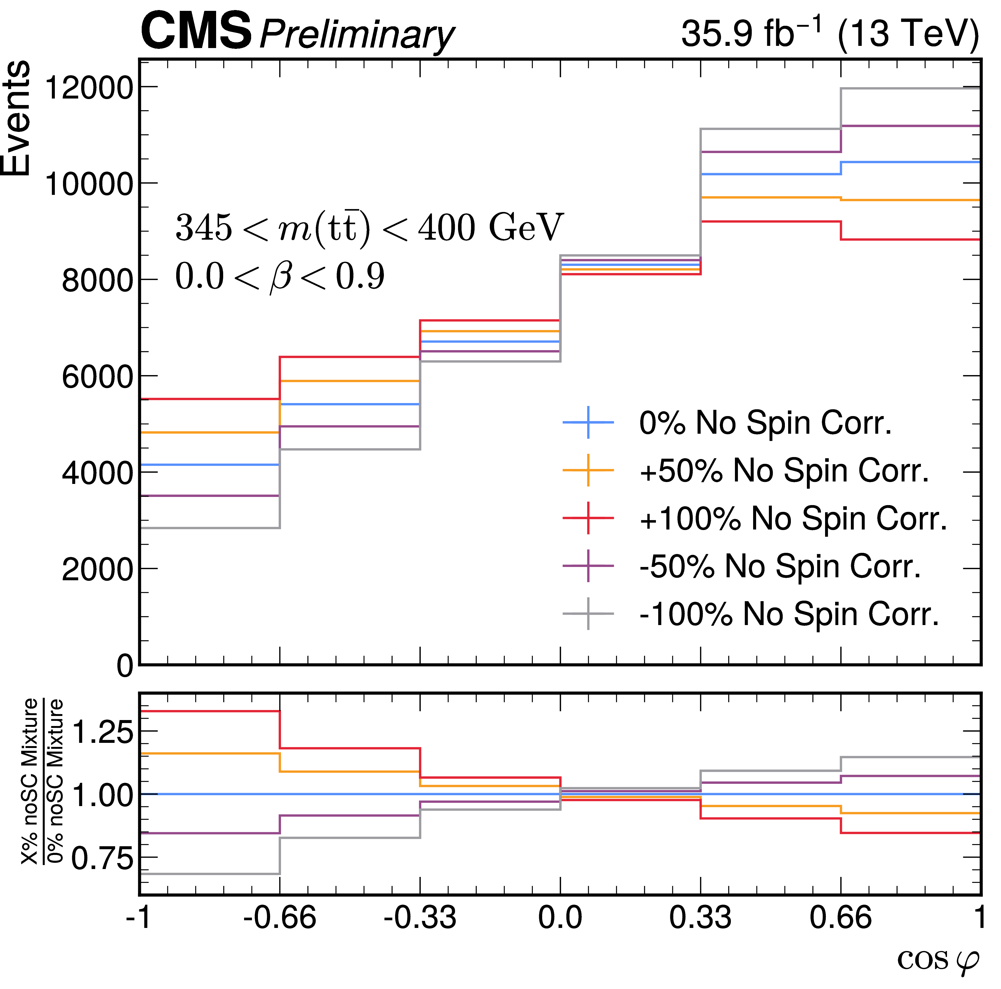
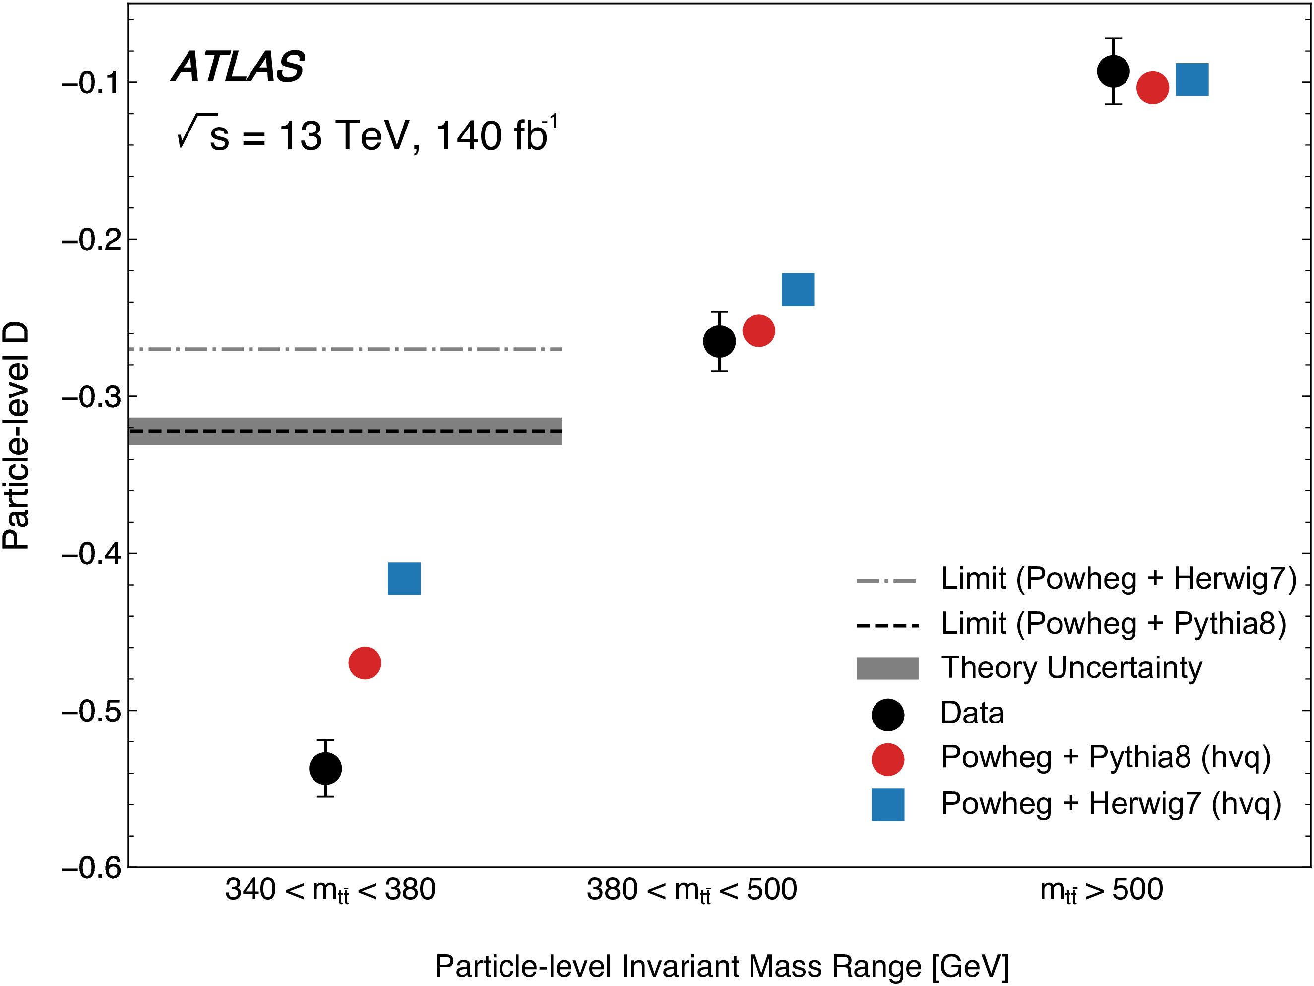
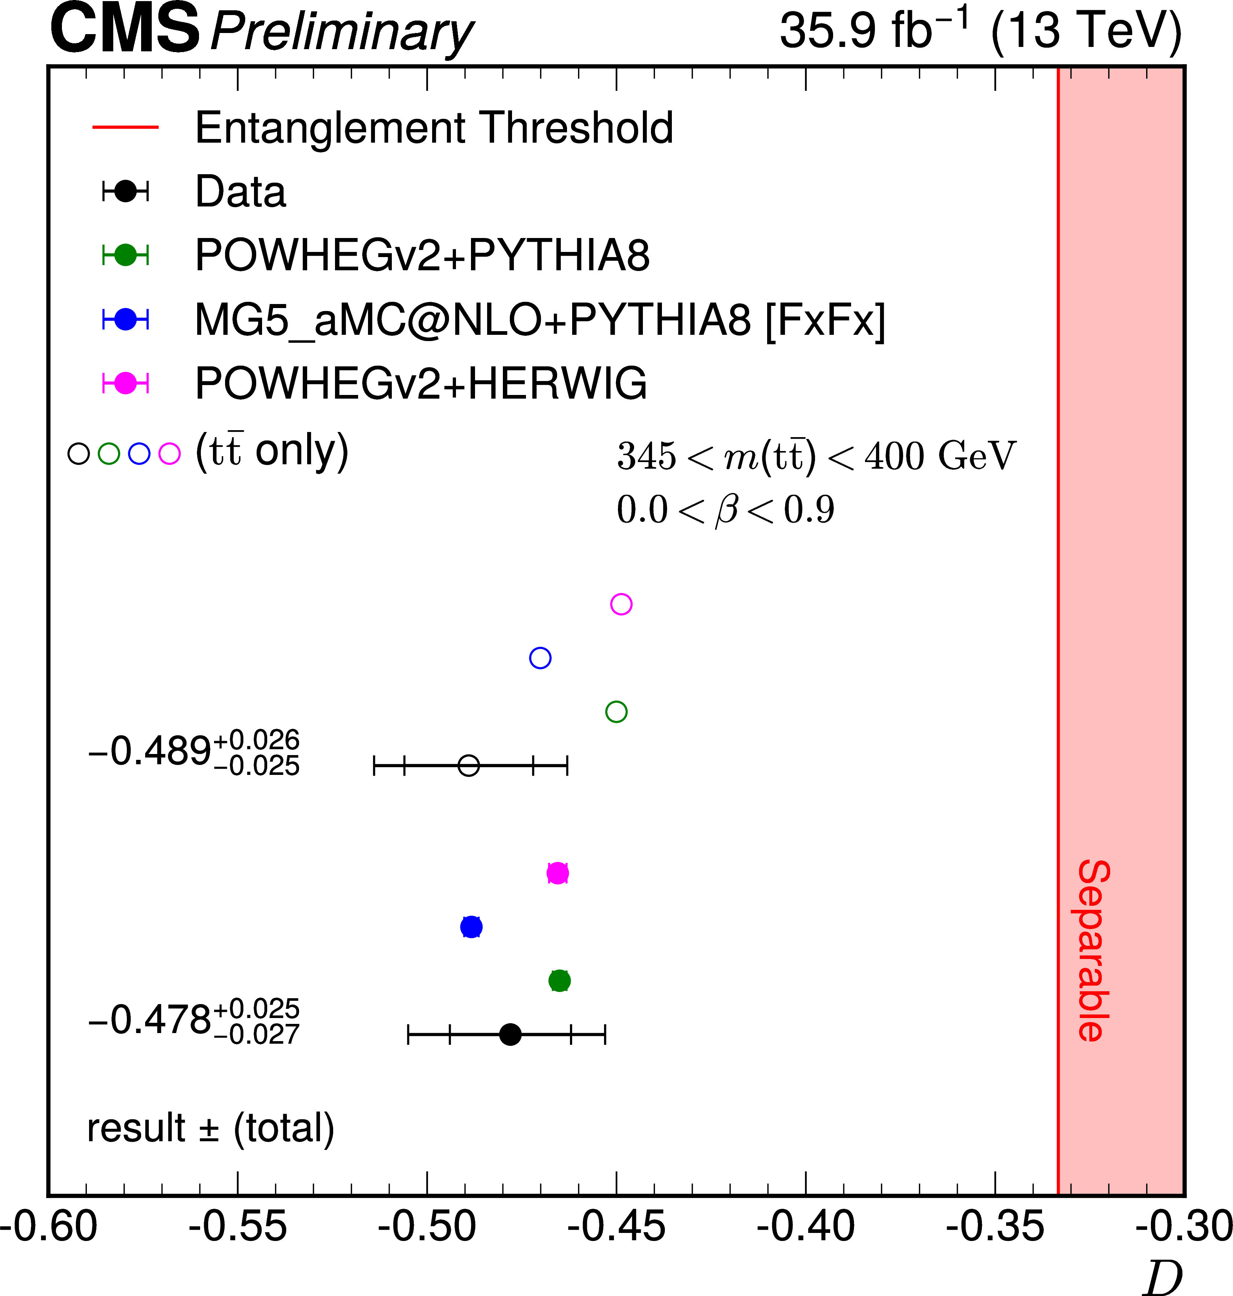
Dilepton channel ROPP 87 (2024) 117801
Advantages of dilepton channel: clean, have 2 charged leptons(max spin analyzing power)
To extract D we measure the distribution in the sensitive variable – cos χ – fit for the slope
The ttbar entanglement is observed (expected) at the 5.0(4.7)𝜎 level for 345<Mtt<400 GeV, β<0.9

Slide 12
L+jets channel PRD 110 (2024) 112016
We pursue both strategies – evaluation of the full correlation matrix C and polarization vectors P as well as D and D~ measurements
The measurements are done inclusively and differentially in bins of M_{tt}, cosθ and top quark p_{T}
Event reconstruction (jet-parton assignment) is performed using NN
Lepton+jets have higher statistics and better Mtt resolution, but
Major challenge – identify d-type jets from W boson decay
Divide events into categories based on lepton flavor, number of b-tags, and NN score
Fraction of tt events with correctly assigned jets to partons including d-type quark

Slide 13
Extraction of spin correlation
We observe the distribution over top quark decay products:
Full measurement of the vectors P and matrix C is performed using templates defined based on the functions of angles of top and antitop decay products
The total cross section is a linear combination of these templates with coefficients Q_{m} that are the components of P and C
Σ_{m} Theoretically predicted distributions in angles of decay products
T_{m} Reconstruction level distributions, which take into the account selection criteria, efficiency and resolution of the detector.
In other words, encode the effects of the environment
Data distribution is fit the sum of T_{m} with free coefficients – P_{i} and C_{ij}
PRD 110 (2024) 112016

Slide 14

Spin correlation matrix measurement
Full measurement of the P and C is performed inclusively and differentially in bins of M_{tt}, cosθ and top p_{T}
Full covariance matrix will be provided with the published result
A good agreement with the SM prediction is observed
The full anatomy of the ttbar process - You can do a lot of physics with this object!

Slide 15
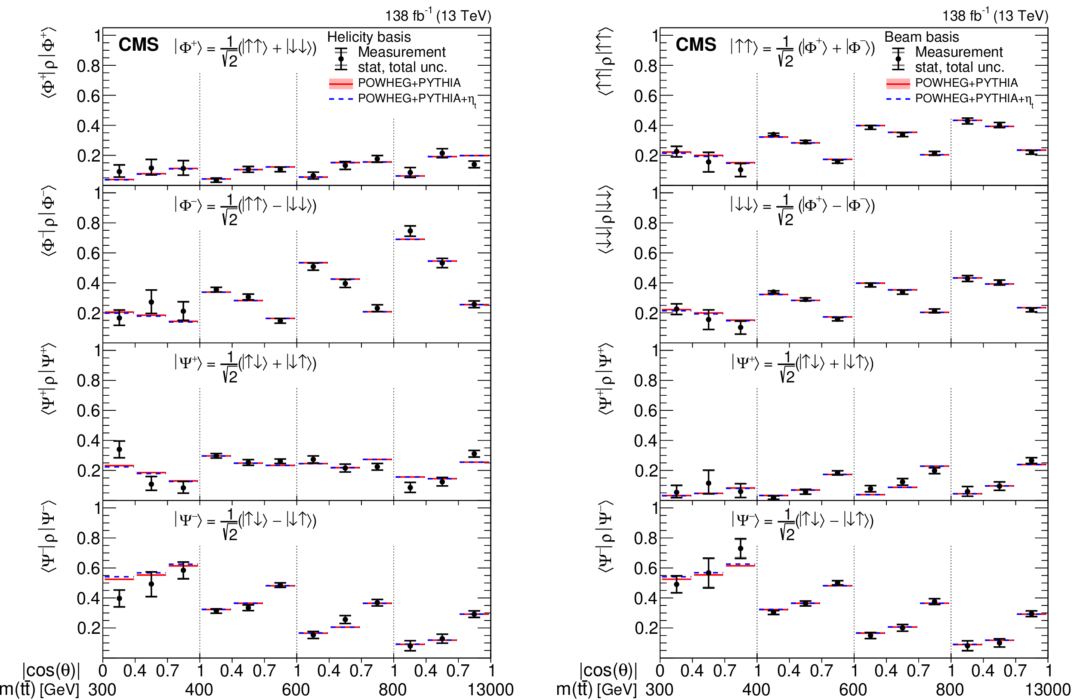
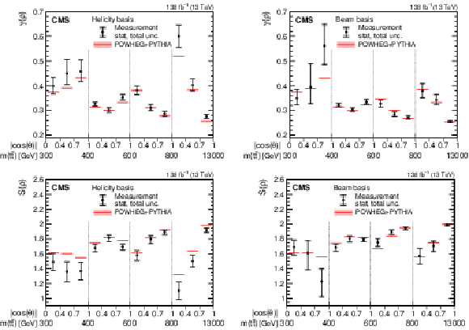
Decomposition into eigenstates
Based on the measured polarizations and full spin correlation matrix we can construct the probability density matrix and decompose it into its eigenstates, evaluate properties like purity and von Neumann entropy Phys. Rev. D 113, L051101 – DOI: https://doi.org/10.1103/hkgw-dztk
At the threshold – mostly pseudoscalar
At high Mtt – mostly vector, highest purity and lowest entropy

Slide 16
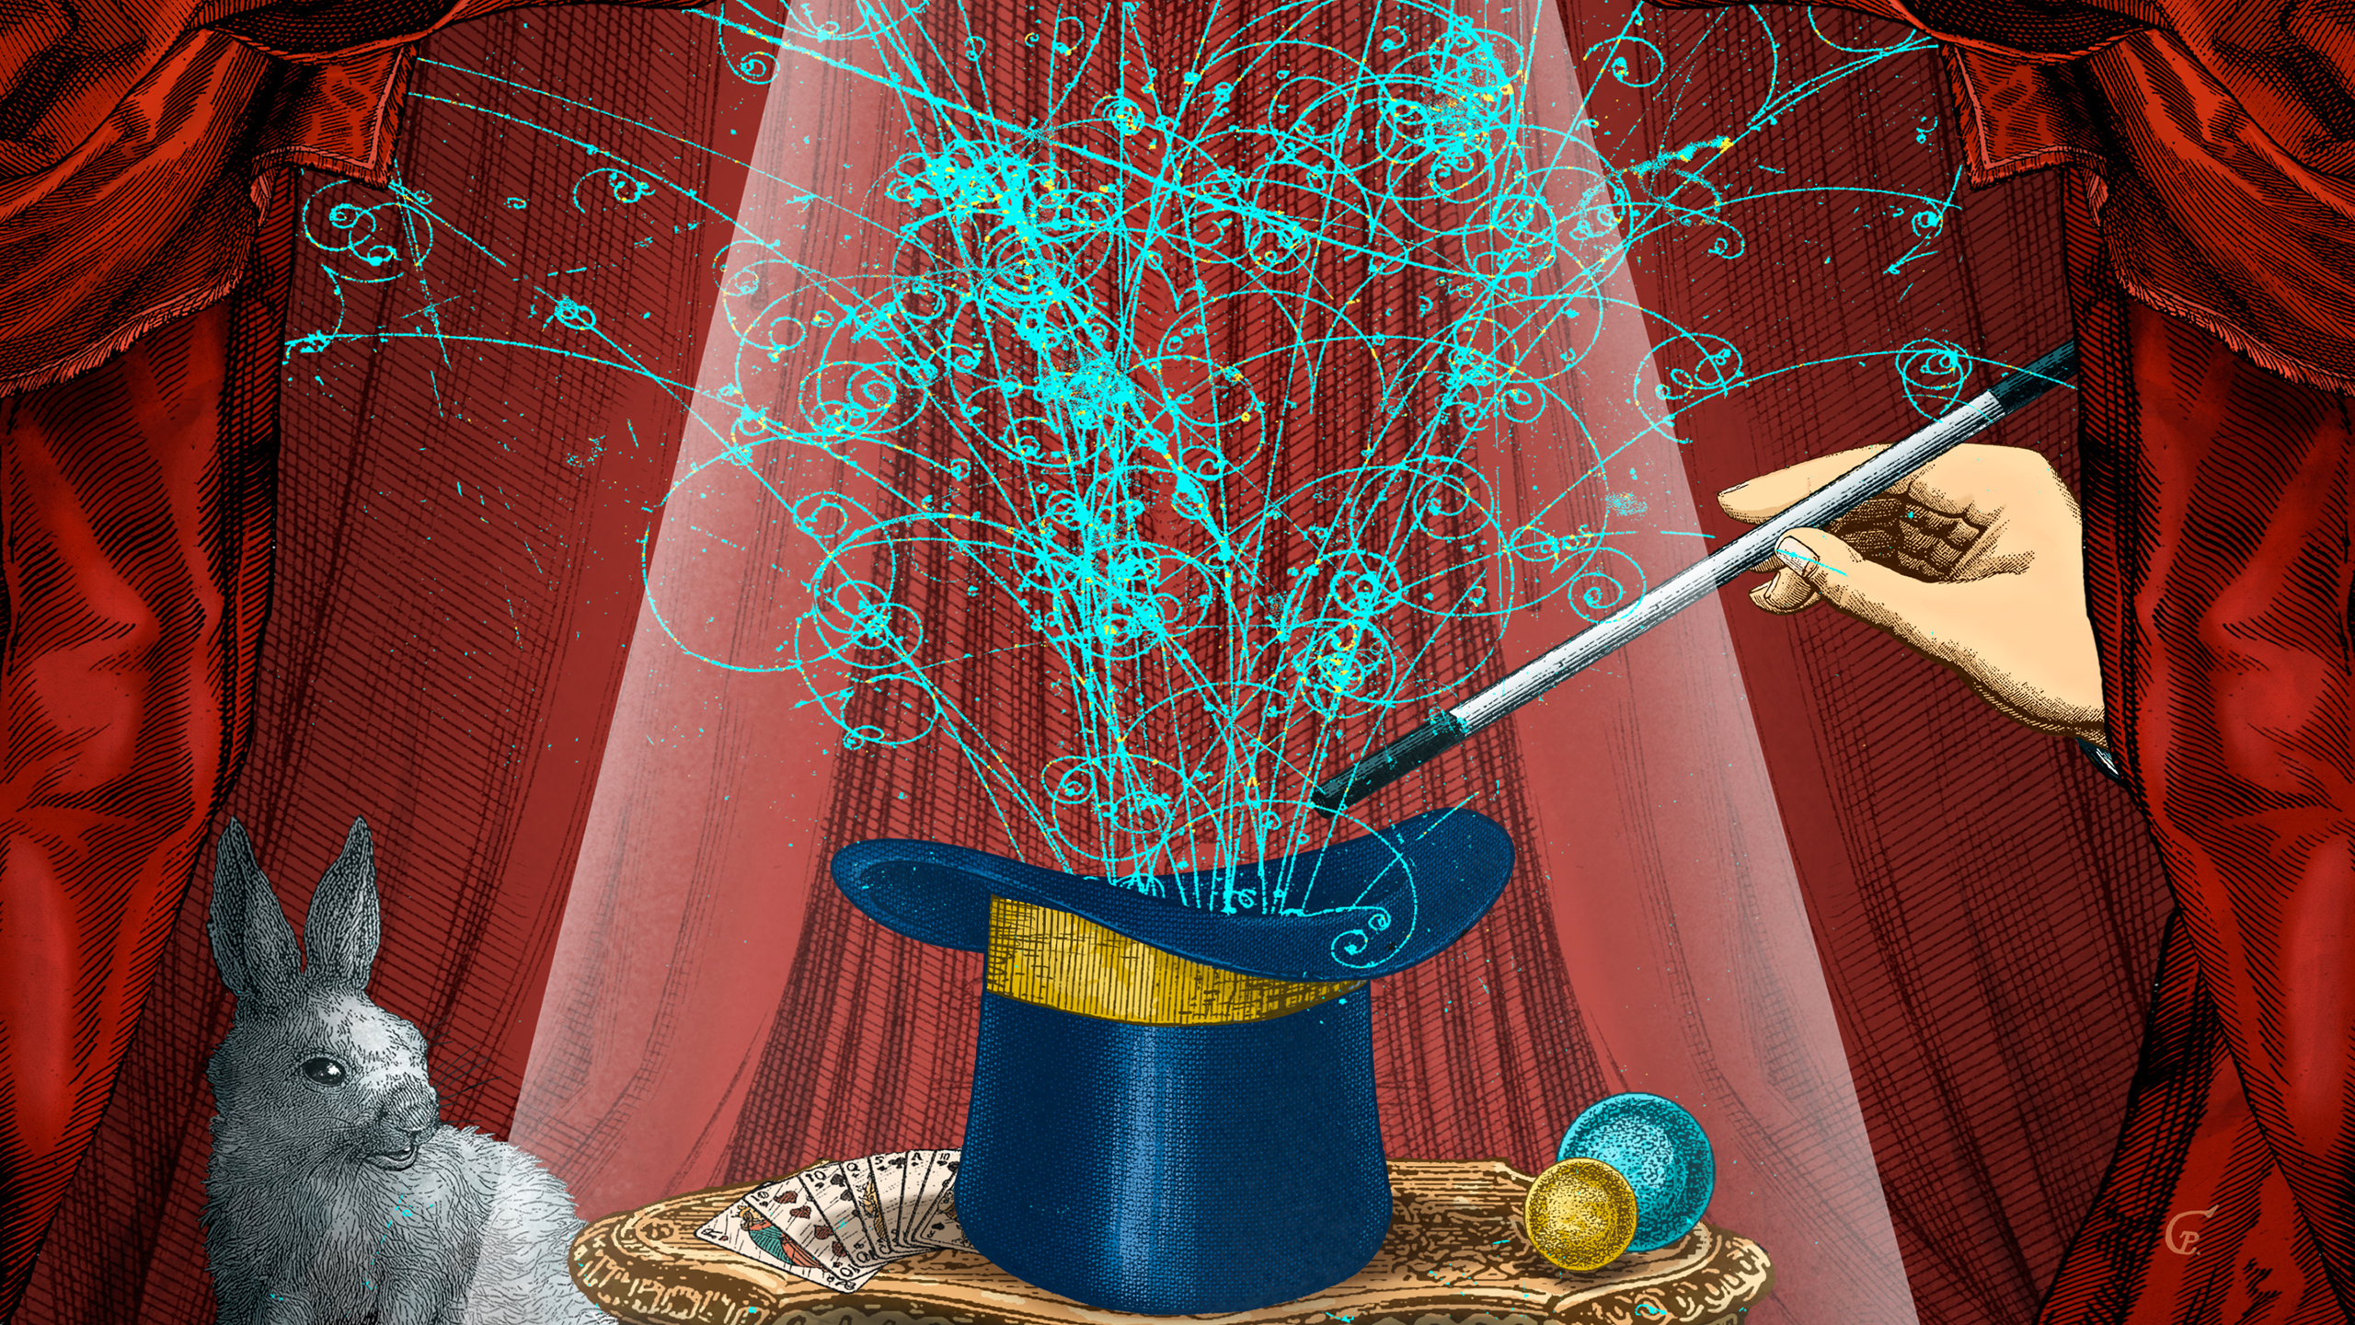
Quantum magic
Quantum computers are expected to vastly outperform classical computers.
Naïvely, this is due to quantum superposition and entanglement.
However, this not quite true.
To see why, we need the concept of a stabiliser state
Gottesman-Knill theorem: For every quantum computer containing stabiliser states only, there is a classical computer that is just as efficient!
Need quantum magic - Stabilizer Rényi Entropies
Magic for top – calculation done by C&M White Phys.Rev.D 110 (2024) 11, 116016
Measurement using CMS data – in 2602.15115
Magic – story got picked up by Quanta Magazine

Slide 17
More QIS from ttbar (2602.15115)
Discord entanglement steering Bell inequality
Discord – a measure of correlation beyond classical mutual information, is the most basic observable of quantum nature
Entanglement = non-separability
Steerability – ability to influence (or steer) the result of the measurement on the “Bob” (top antiquark) part of the system by observing “Alice” (top)
Bell inequality violation marker – if above 1 – BIV can be observed in this region of phase space

Slide 18
Hierarchy of quantum correlations
First bin (beam basis) 300<Mtt<400GeV, |cosθ|>0.7 – demonstrates the hierarchy of quantum correlations
Second bin (helicity basis) 400<Mtt<600GeV, 0.4<|cosθ|<0.7 – separable state, but significant discord (quantum correlation)
Third bin (helicity basis) Mtt>800GeV, cosθ|<0.4 – entangled state, significant discord, steering with >3σ significance, highest Bell marker, but not above 1.

Slide 19
What can we do at Belle II?

Slide 20
The system of τ leptons
The system of ττ is very similar to tt from the point of view of QIS – also 2 qubit system
Spin correlation matrix
Concurrence, if >0– entangled state
K. Ehat¨aht, M. Fabbrichesi, L. Marzola, and C. Veelken, Phys. Rev. D 109, 032005 (2024), arXiv:2311.17555 [hep-ph]

Slide 21
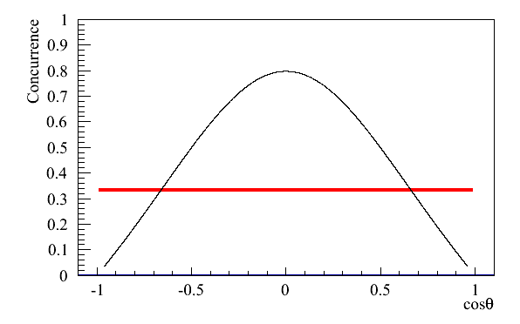
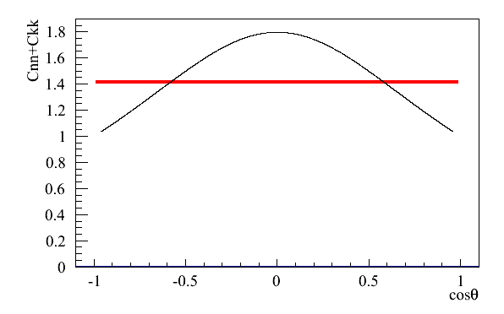
Analysis strategy for time-independent entanglement and Bell inequality test
Peres-Horodecki test for entanglement
τ→πν (~10.8%)
τ→ρν→ππ⁰ν (~25.5%)
τ+→h+h-h+ν (~15%)
Use π, ρ, as polarimeters → >1/2 of τ decays, → 1/4 of τ τ are analyzable
Define basis based on the τ direction, boost decay products in the rest frame of parent τ
Design templates based on the angles of polarimeters at reconstruction level
Divide the sample into bins of cosθ (how good is this resolution?)
Account for migration across bins in the templates
Fit for the full spin correlation matrix
Evaluate the concurrence and check for entanglement, Bell inequality violation (BIV)
Expect to observe both
entangled
separable
CHSH test for Bell inequality violation
BIV

Slide 22
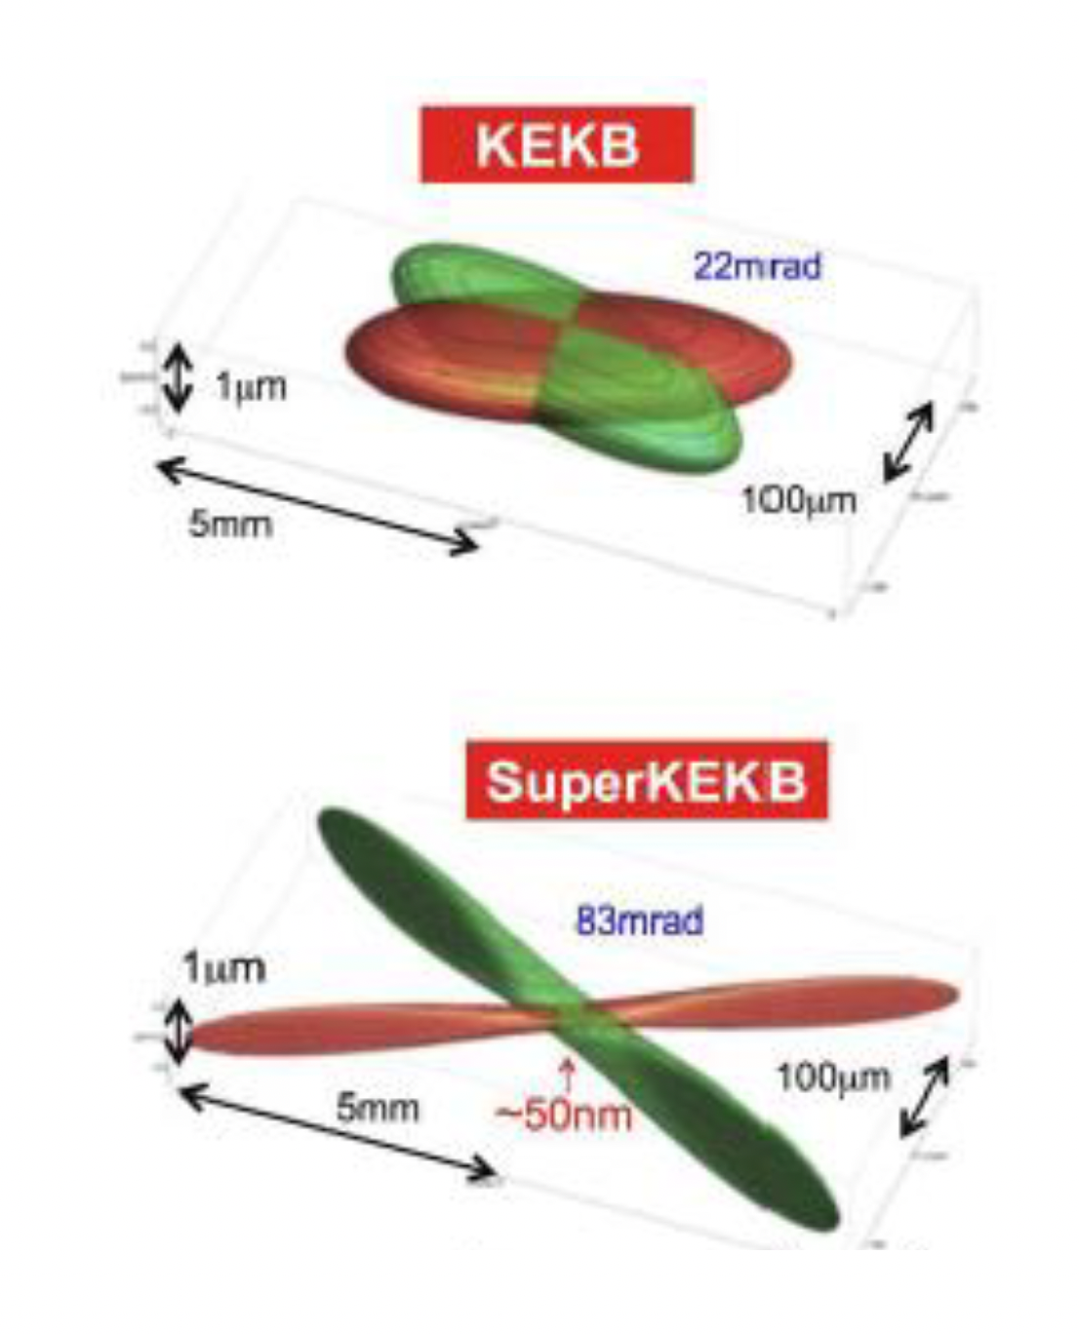
Time dependence
Account for decoherence (quantum-to-classical transition due to the interaction with the environment) using Lindblad master equation t=min(t₁,t₂), decoherence length L_{decoh} is a free parameter
τ leptons have an advantage over top quarks since their lifetime (cτ=87 μm) is long enough to be measured, but not so long that the decay happens outside of the detector volume
SuperKEKB has a very small beam spot and BelleII has excellent Pixel Vertex detector (PXD)
Nevertheless, time resolution cannot be neglected
The approach that we used in CMS to account for migration across bins (in Mtt) can be applied here for migration across time bins

Slide 23
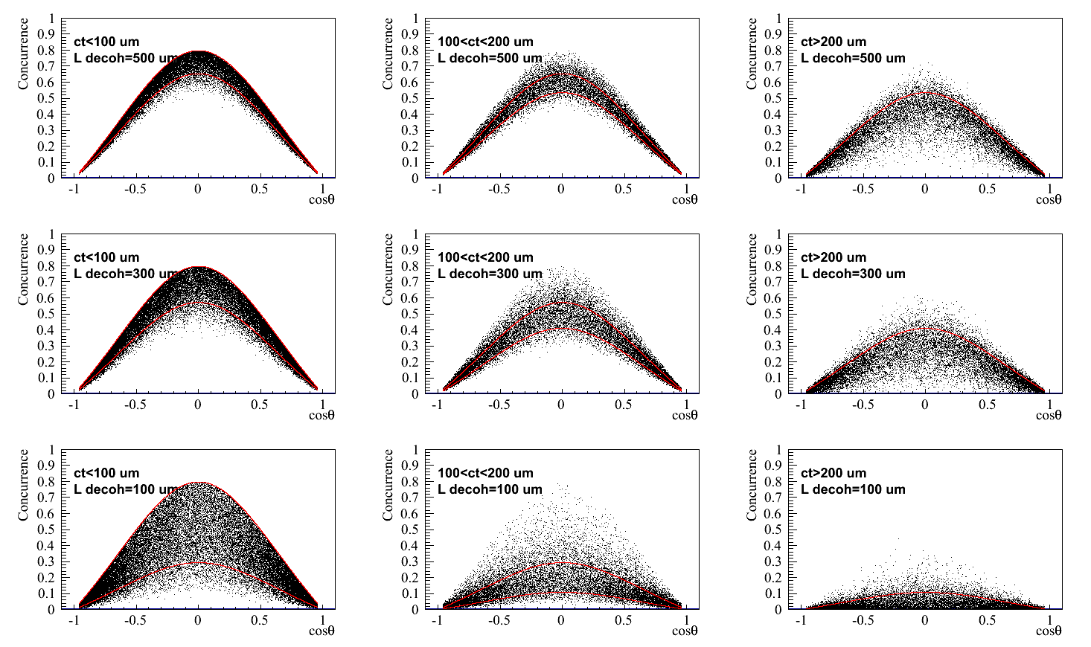
Concurrence vs time
Decoherence →
Assumed resolution on decay length of 50 μm
ct_min
ct_max
Effects of resolution
Each point is not one event – it is concurrence evaluated on an ensemble of events

Slide 24
Beyond top and tau

Slide 25
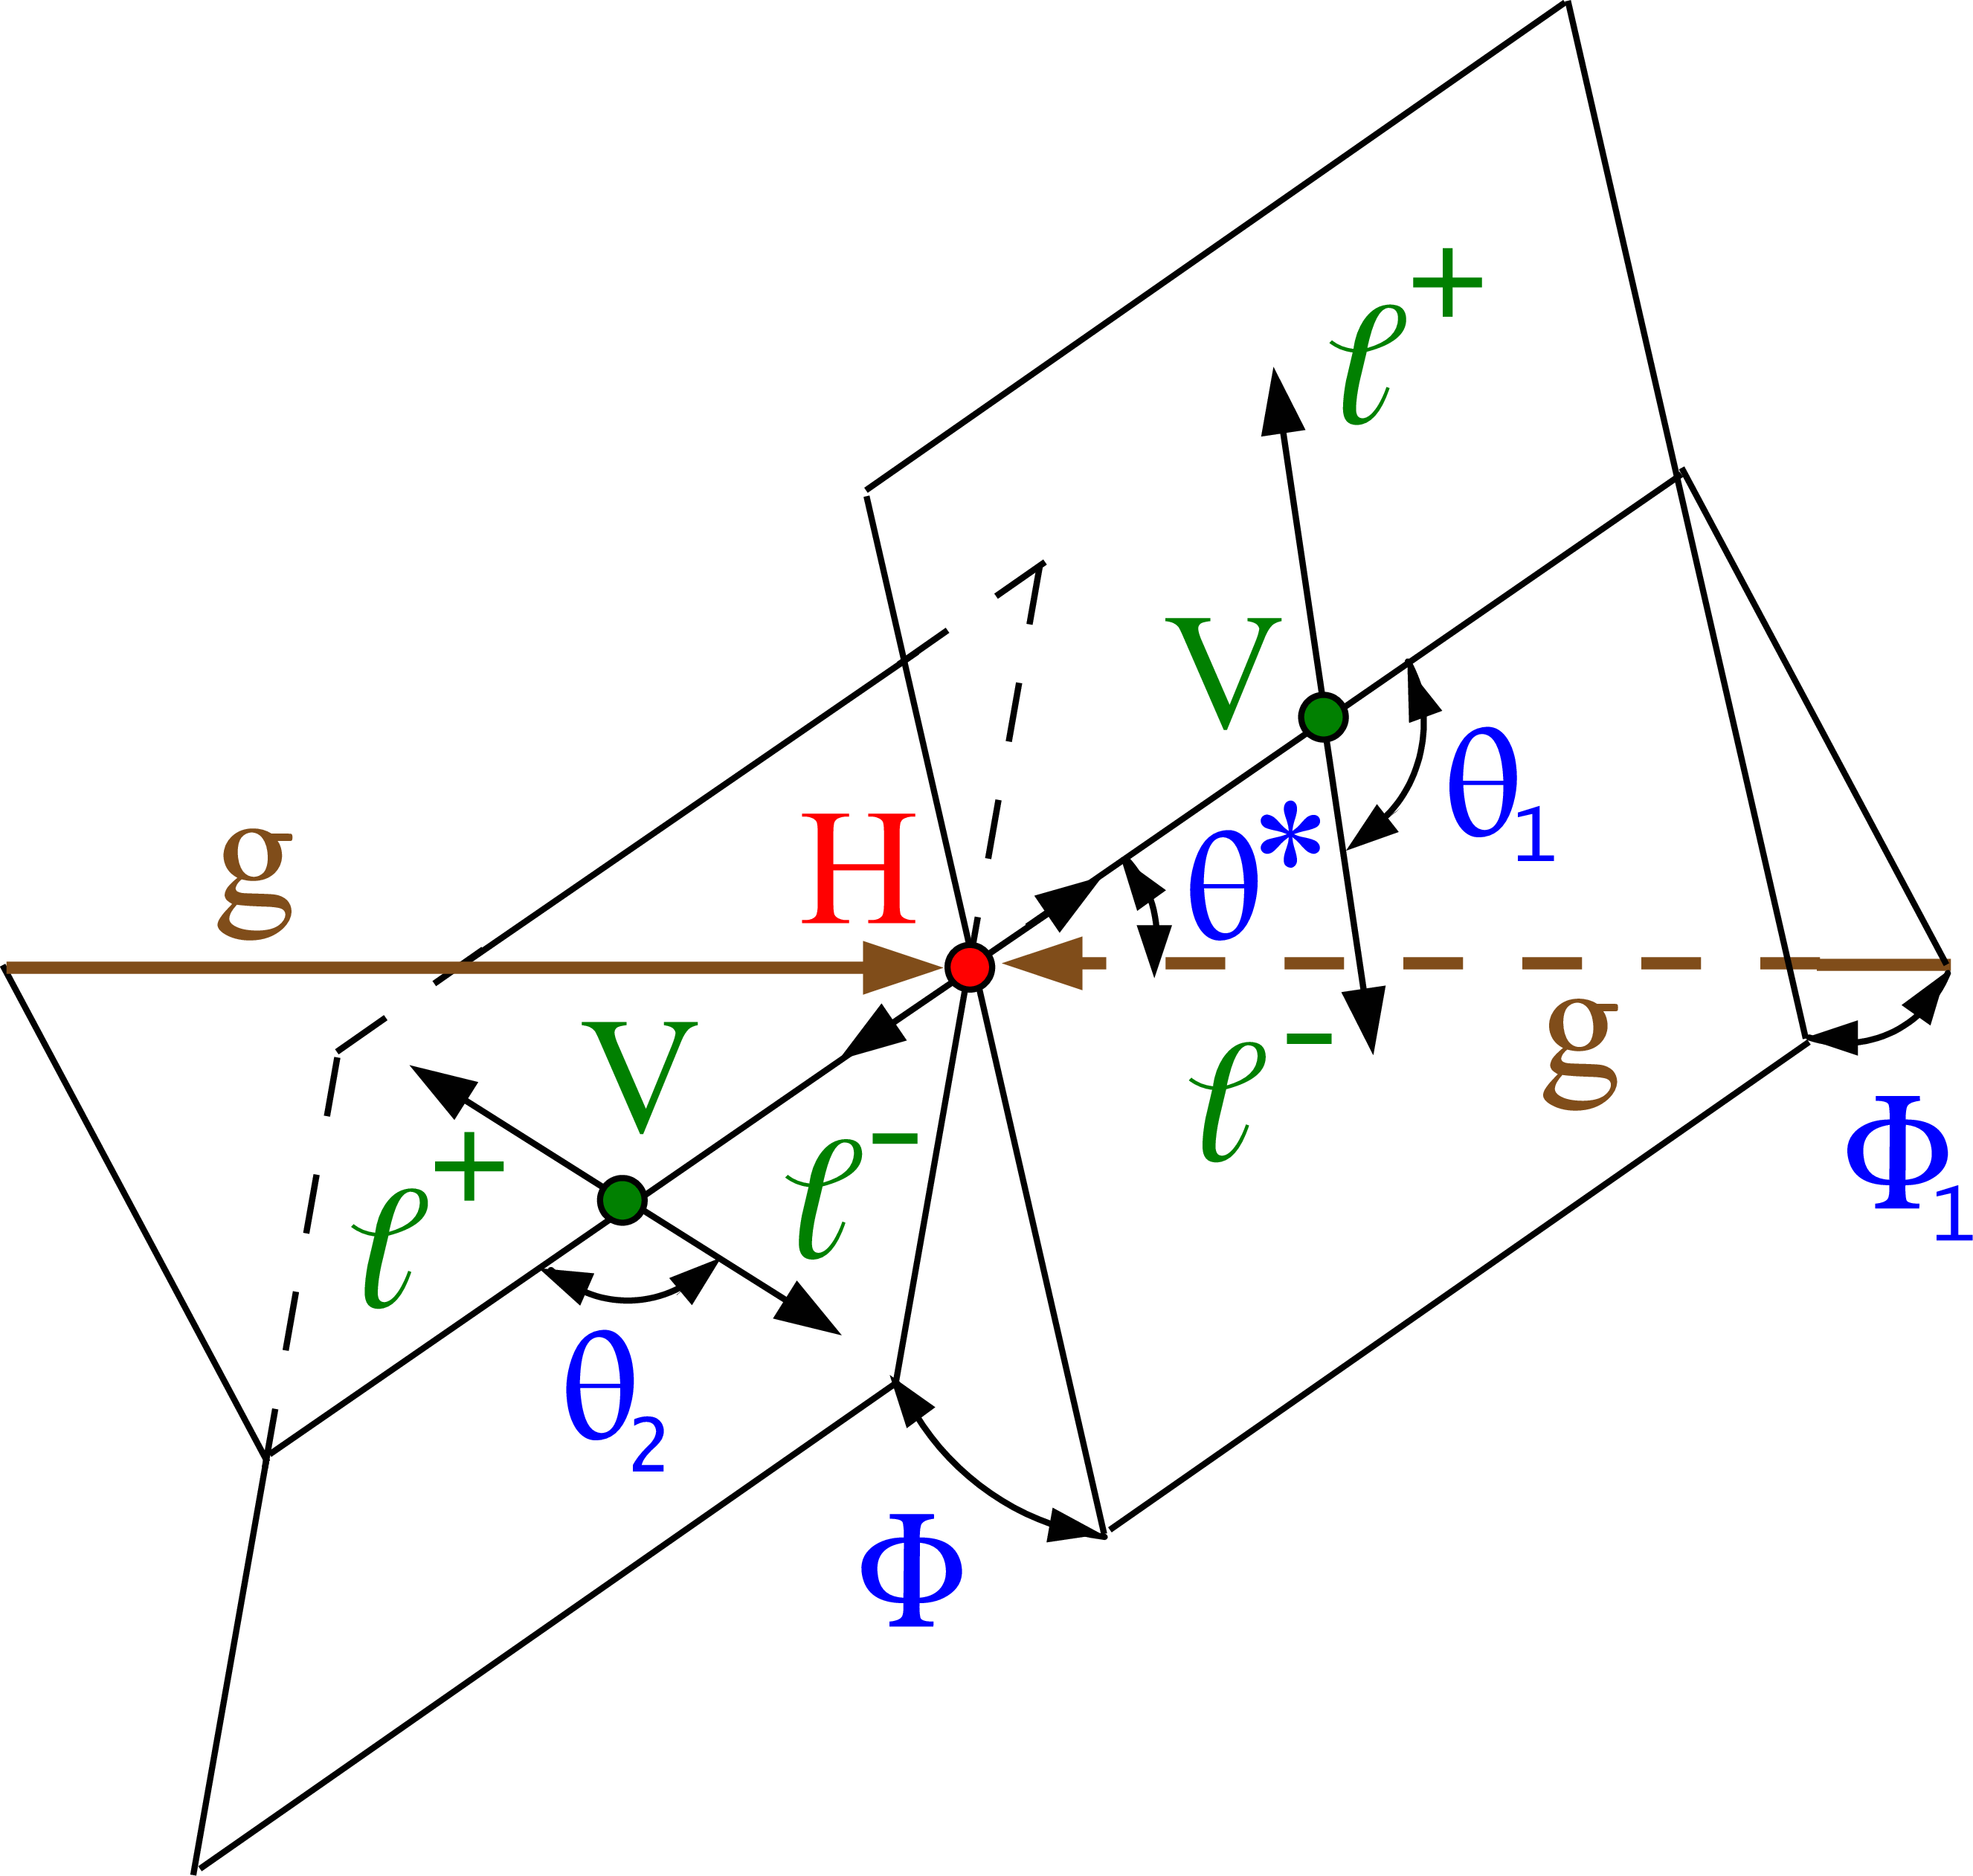
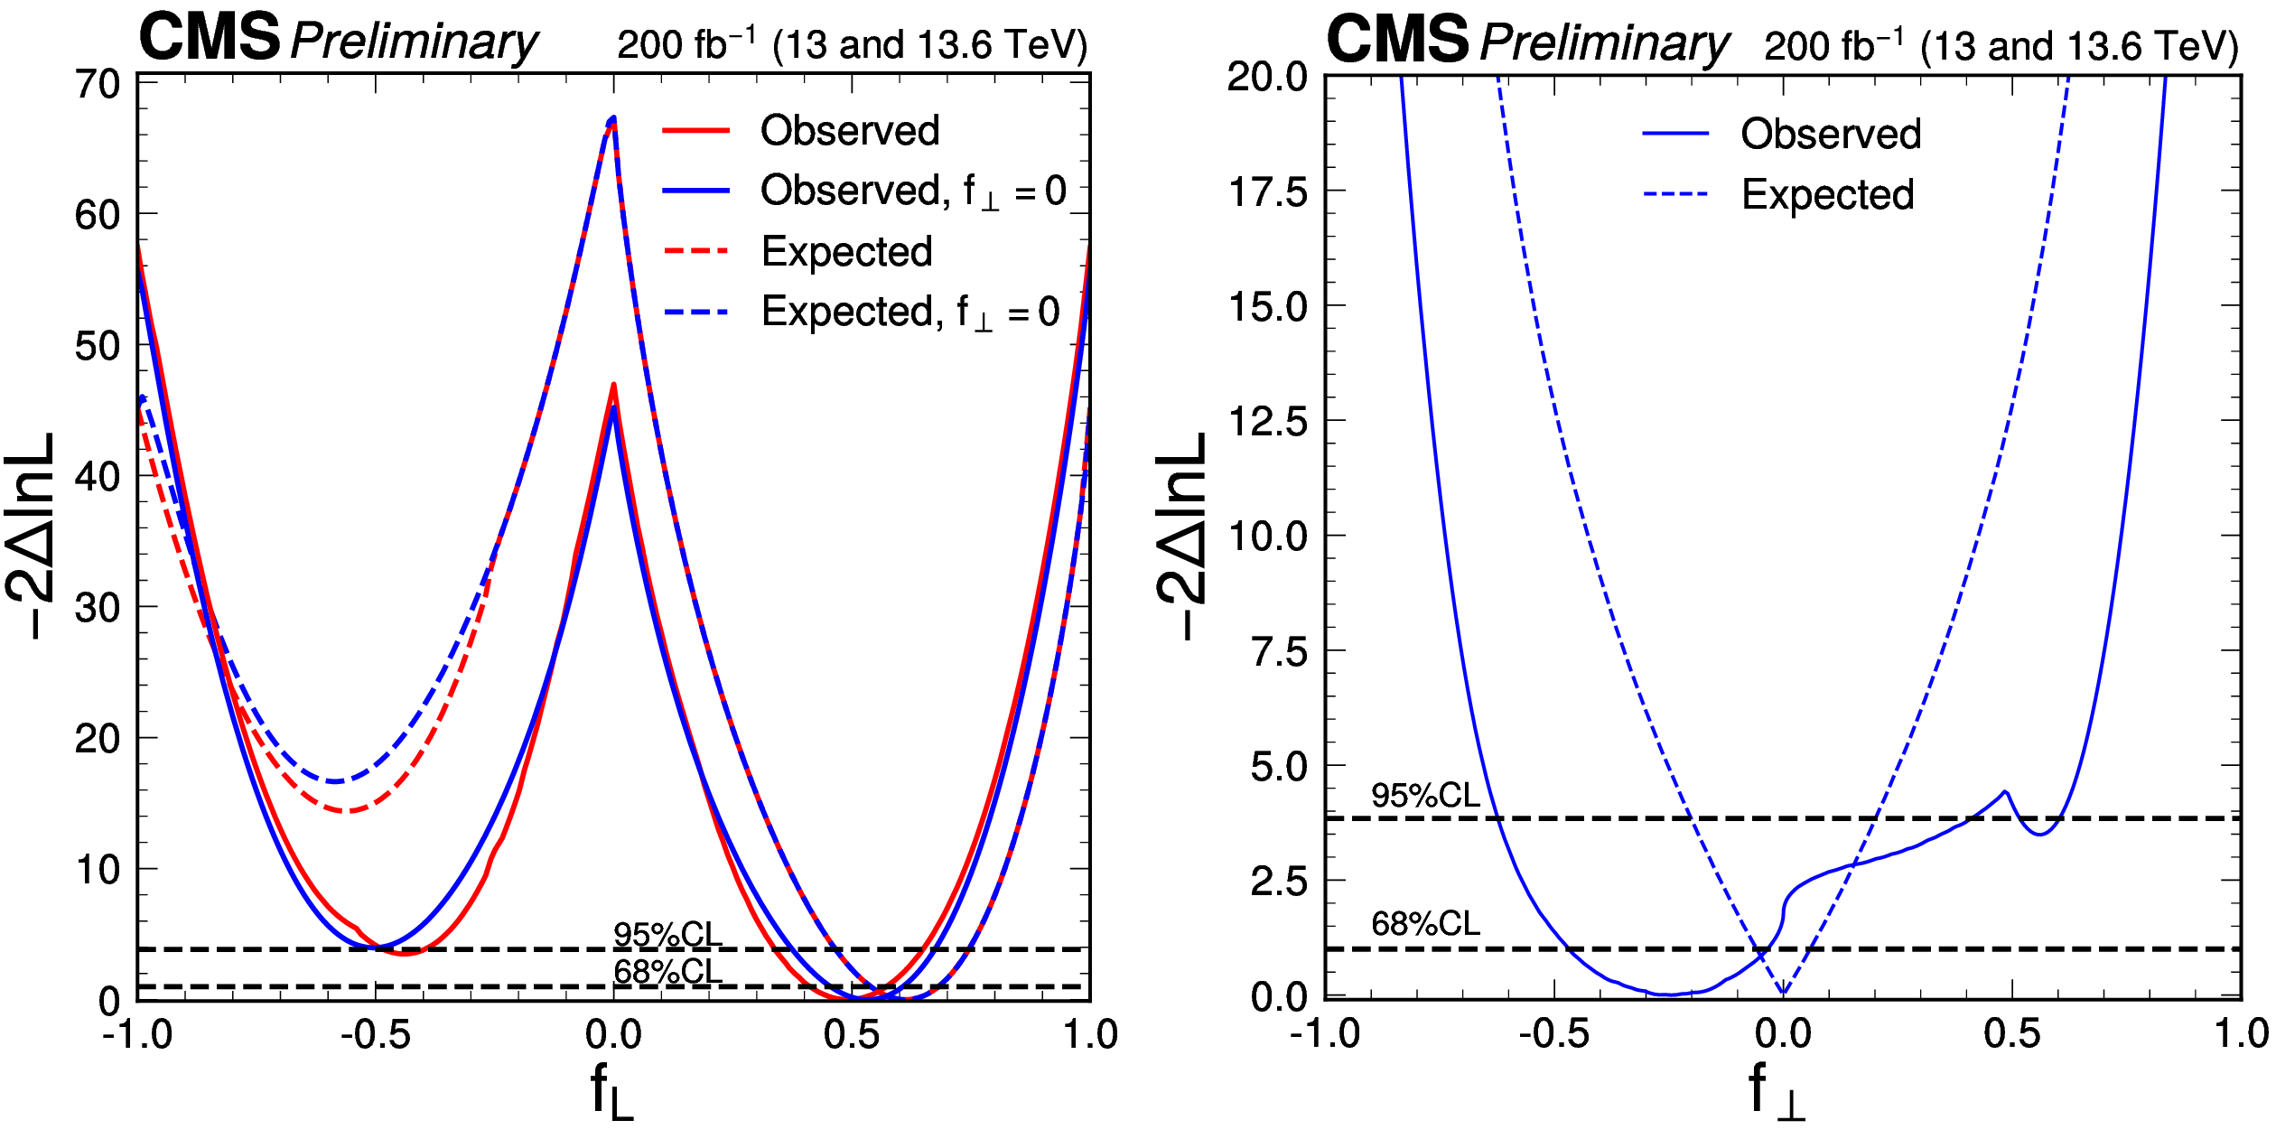
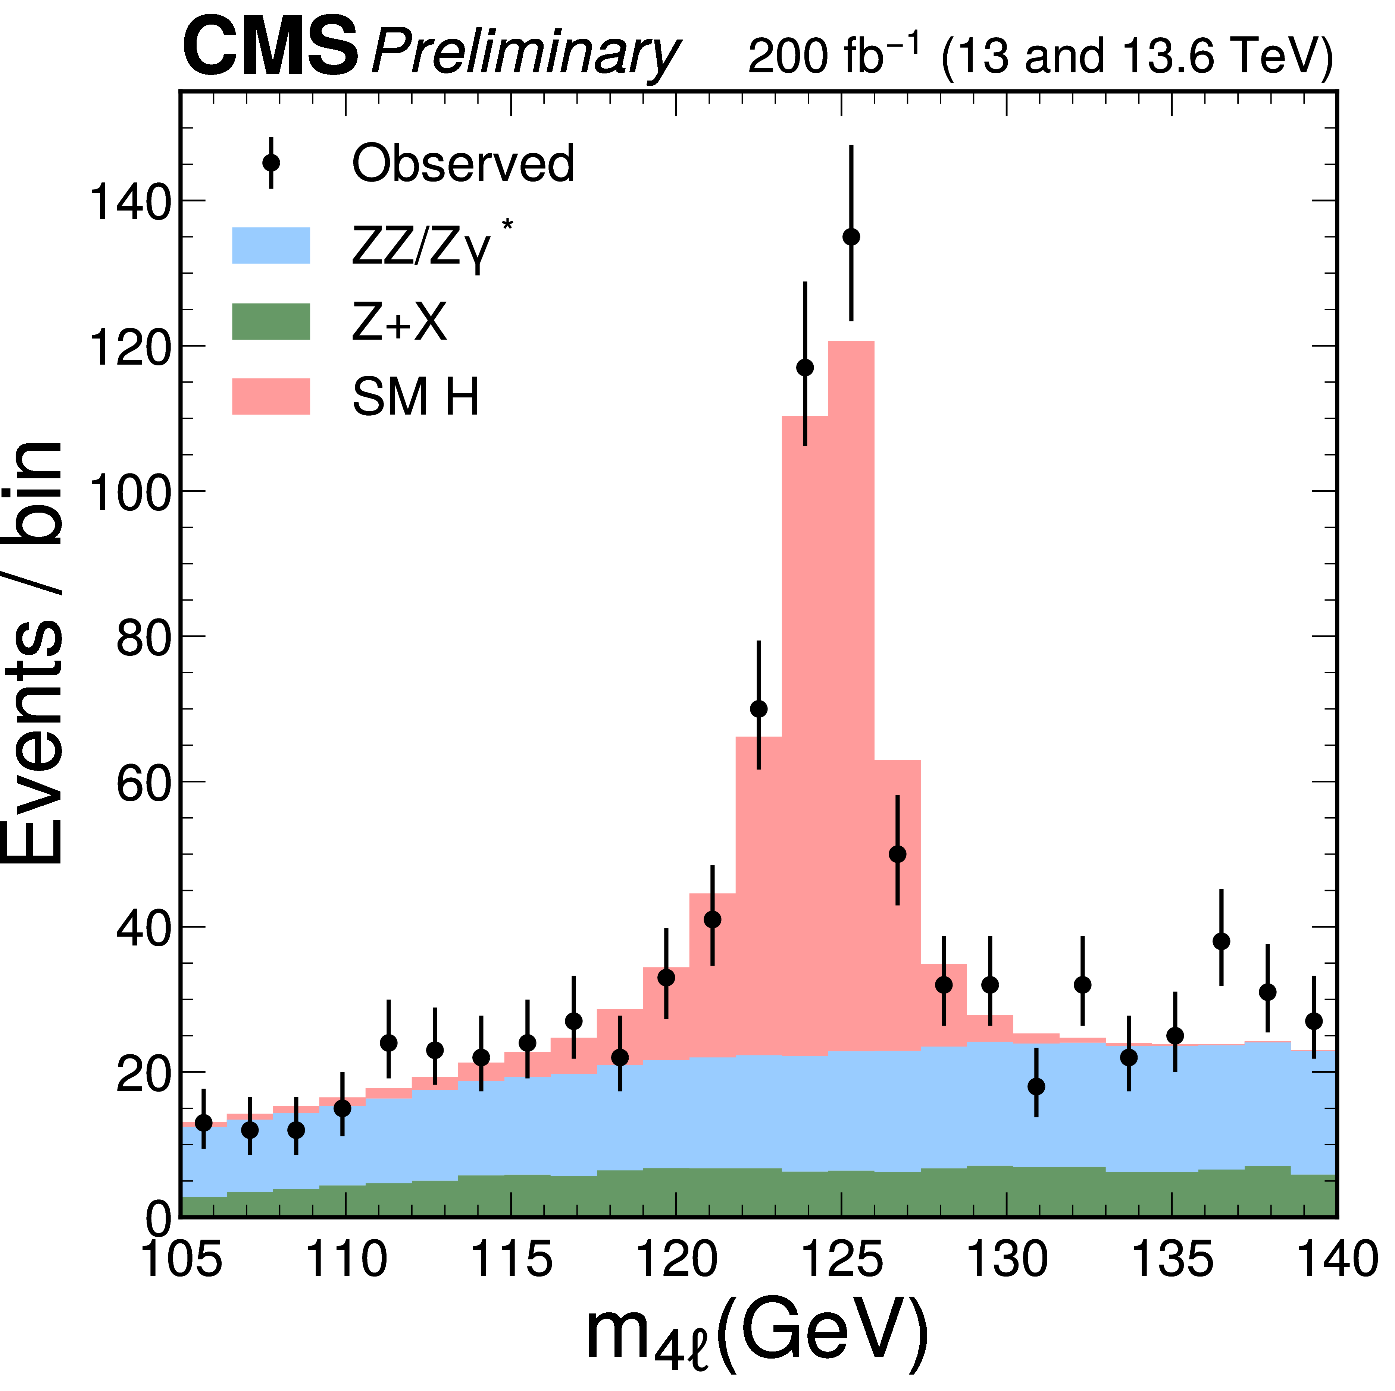
Another system H→ZZ→4l
The fully longitudinal and fully transverse polarization of the Z bosons are excluded at more than 6σ. This establishes the entangled state of qutrits under the assumptions of Quantum Mechanics and CP conservation. With an additional assumption of large coherence of the transverse and longitudinal amplitudes, it has been established that conditions exist for measuring violation of the Bell-type inequality in the H→ZZ decays.
CMS-PAS-HIG-25-011

Slide 26
Can QIS tools be used for HEP purpose, i.e. to search for new physics?

Slide 27
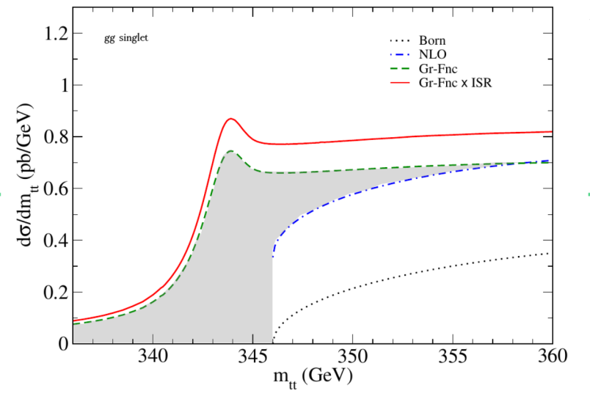
Toponium predictions
Top quark is very short-lived O(10⁻²⁵s)< hadronization time O(10⁻²⁴s)
It is not expected to form bound states, but, in quantum mechanics what is not forbidden is allowed
A small contribution from the ttbar bound state (pseudoscalar color singlet)
[Z. Phys. C 48 (1990) 613] hypothesized before top quark discovery
Expected just below the production threshold K. Hagiwara et al. PLB 666 (2008) 71
More recent works: B. Fuks et al Phys.Rev.D 104 (2021) 3, 034023 – Green function reweighting, Wan-Li Ju et al. [2004.03088] use NR-QCD
Small and narrow color-singlet pseudoscalar resonance with a mass of 343 GeV and a width of 2Γ_{t,} σ=7 pb.
ttbar +toponium resonance
For 14 TeV: total effect 336–346 GeV is about 6.5 pb [K. Hagiwara et al. PLB 666 (2008) 71] with gg singlet Green-function about 4.2 pb (grey area)

Slide 28
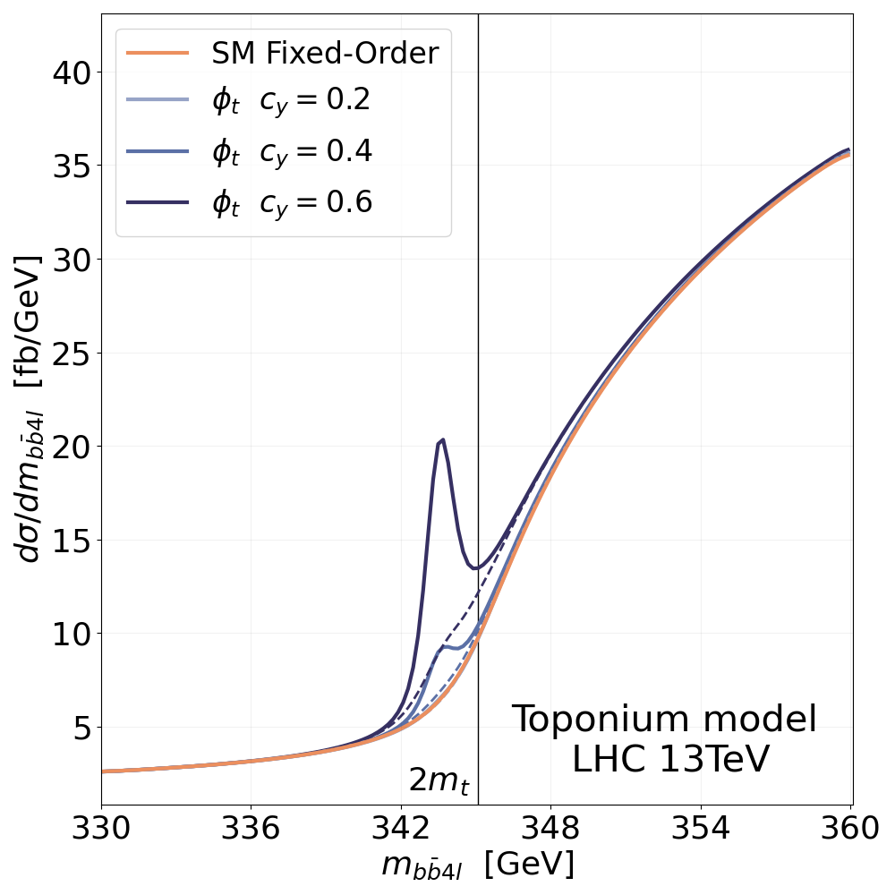
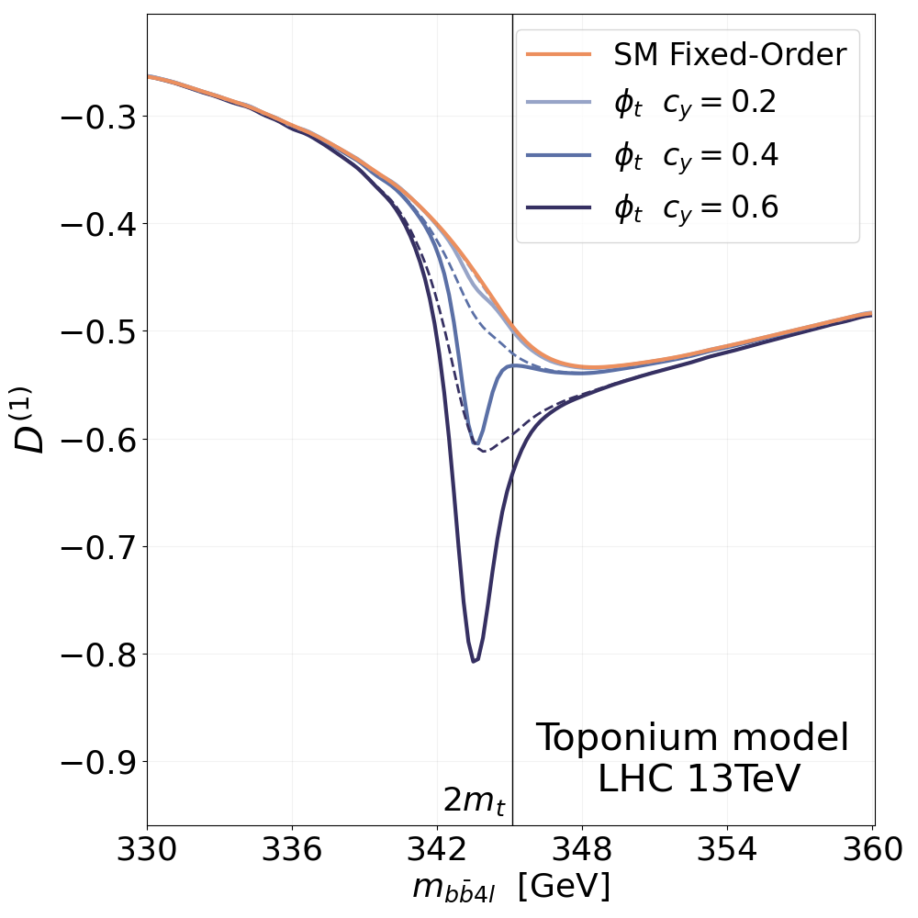
Toponium and entanglement
Toponium (pseudo-scalar color singlet predicted by non-relativistic QCD)
M(toponium)-344 GeV, σ=~6.5pb
Sumino, Fujii, Hagiwara, Murayama & Ng (PRD`93)
Jezabek, Kuhn & Teubner (Z.Phys.C`92)
B. Fuks et al. (PRD 104 (2021) 034023)
Toponium affects both the invariant mass distribution and entanglement at the threshold, but
Full spin correlations provide better sensitivity, than one compound property – entanglement
c_{y} – coefficient in Lagrangian
F. Maltoni et al. JHEP03(2024)099

Slide 29
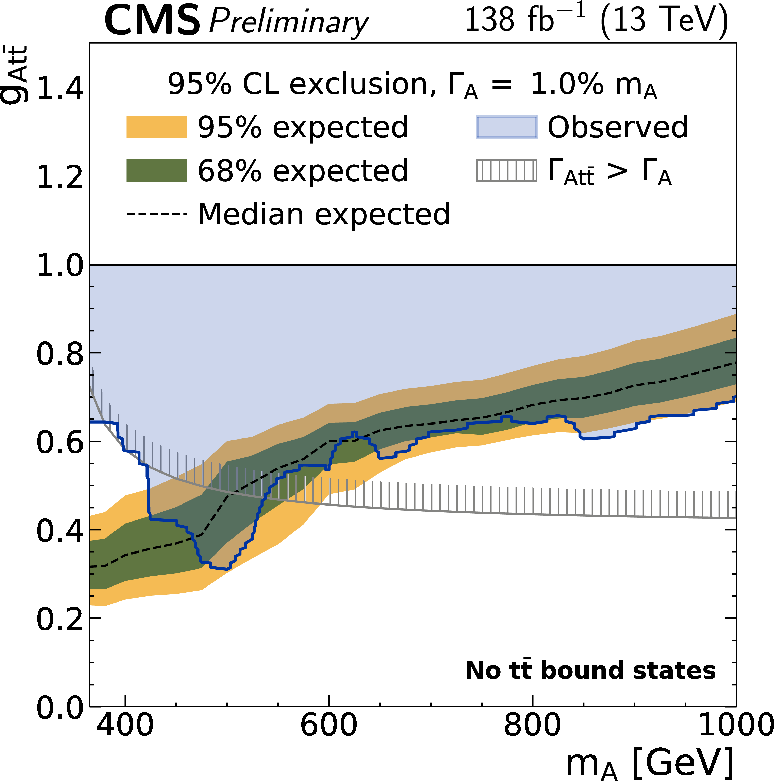
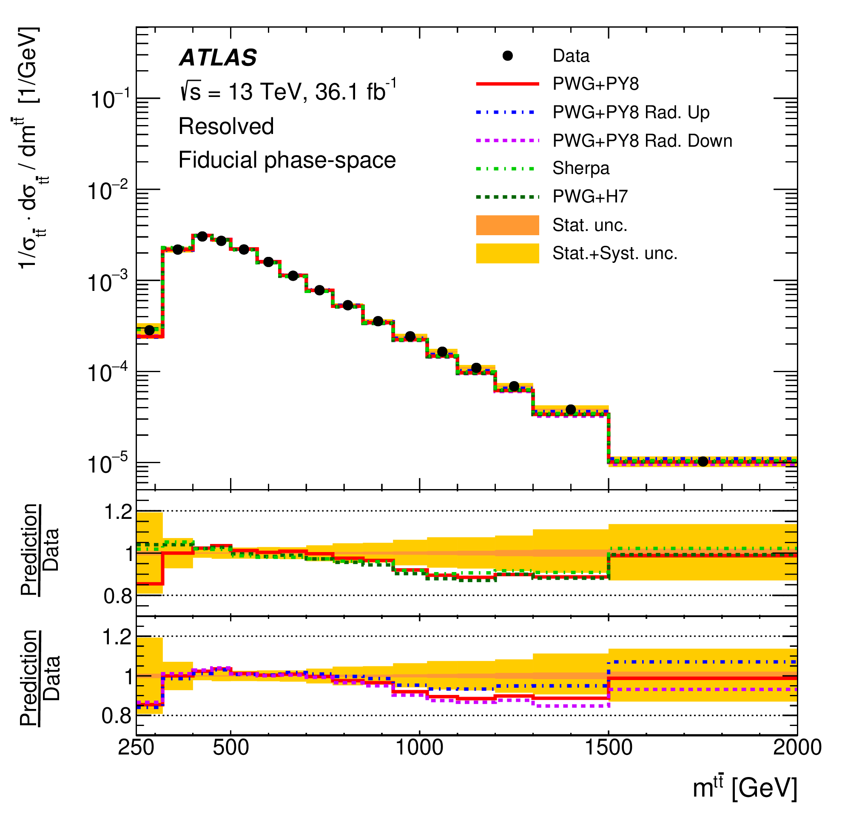
Nature’s hints
w/out Toponium
w/ Toponium
~1.5𝜎 tension with the expectation if toponium is not included – one of many hints (differential cross section, weakened limits in A/H→tt)
Eur. Phys. J. C 79 (2019) 1028
CMS-PAS-HIG-22-013
Submitted to ROPP

Slide 30
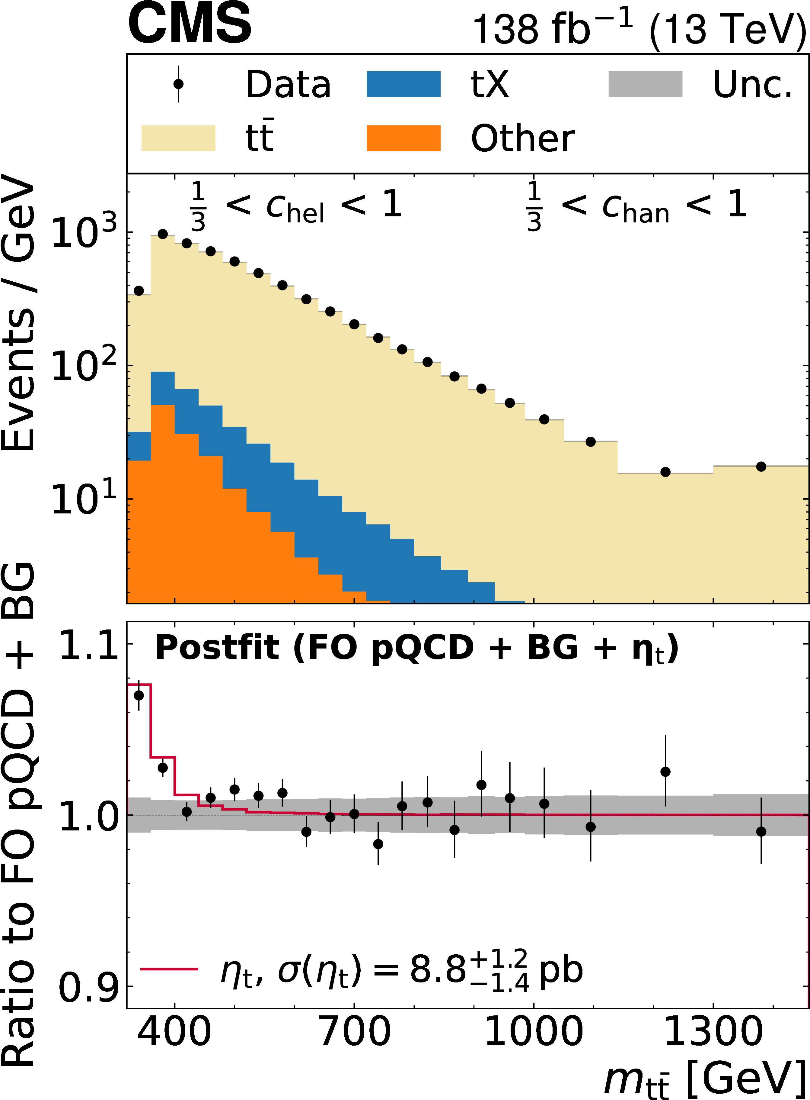
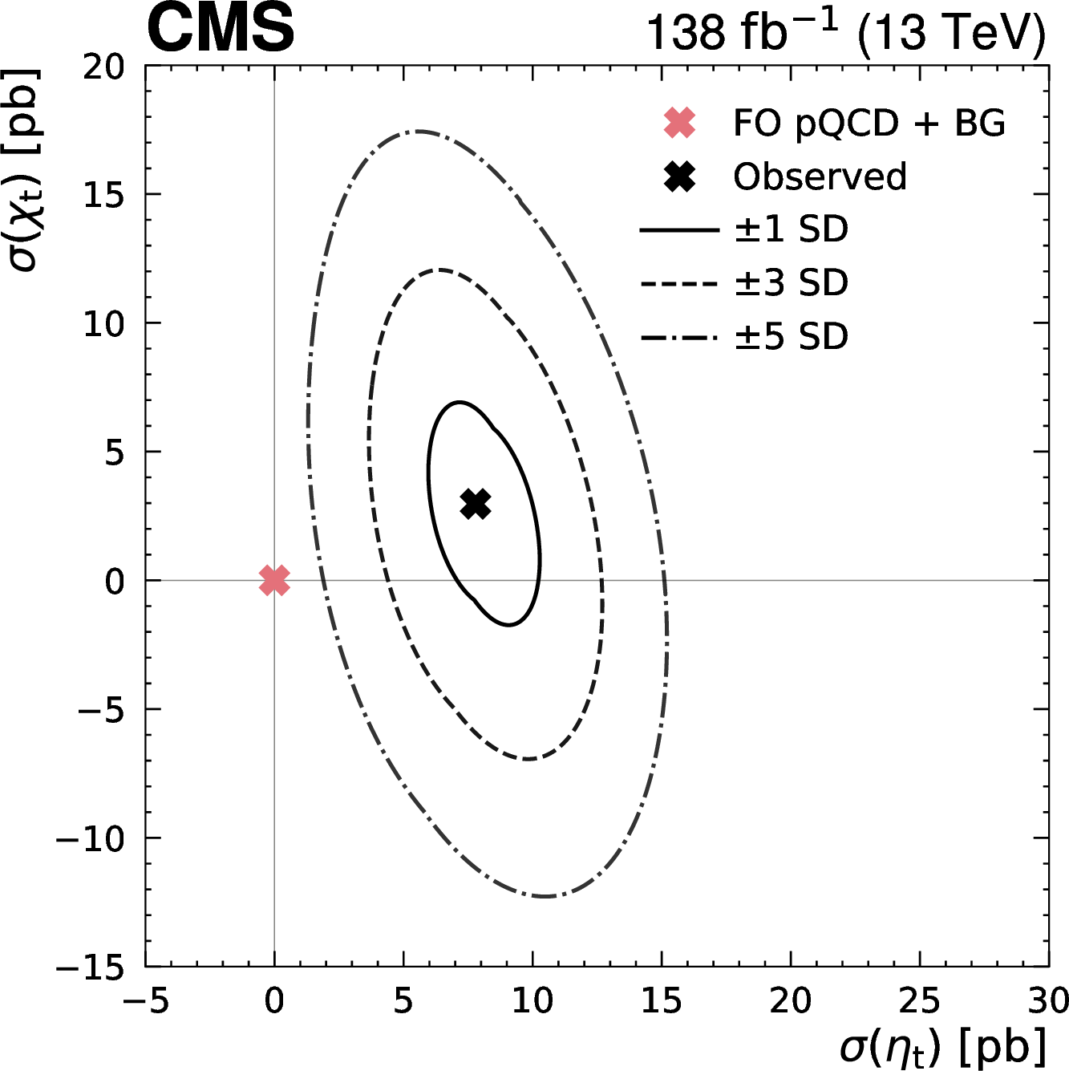
Dilepton channel - CMS
Dilepton channel: Rep. Prog. Phys, 88 (2025) 087801 A significant excess is observed near the t¯t threshold compared to the non-resonant production (pQCD), consistent with the production of a color-singlet pseudoscalar quasi-bound toponium state, predicted by NRQCD.
σ=8.8 +1.2−1.4 pb.

Slide 31
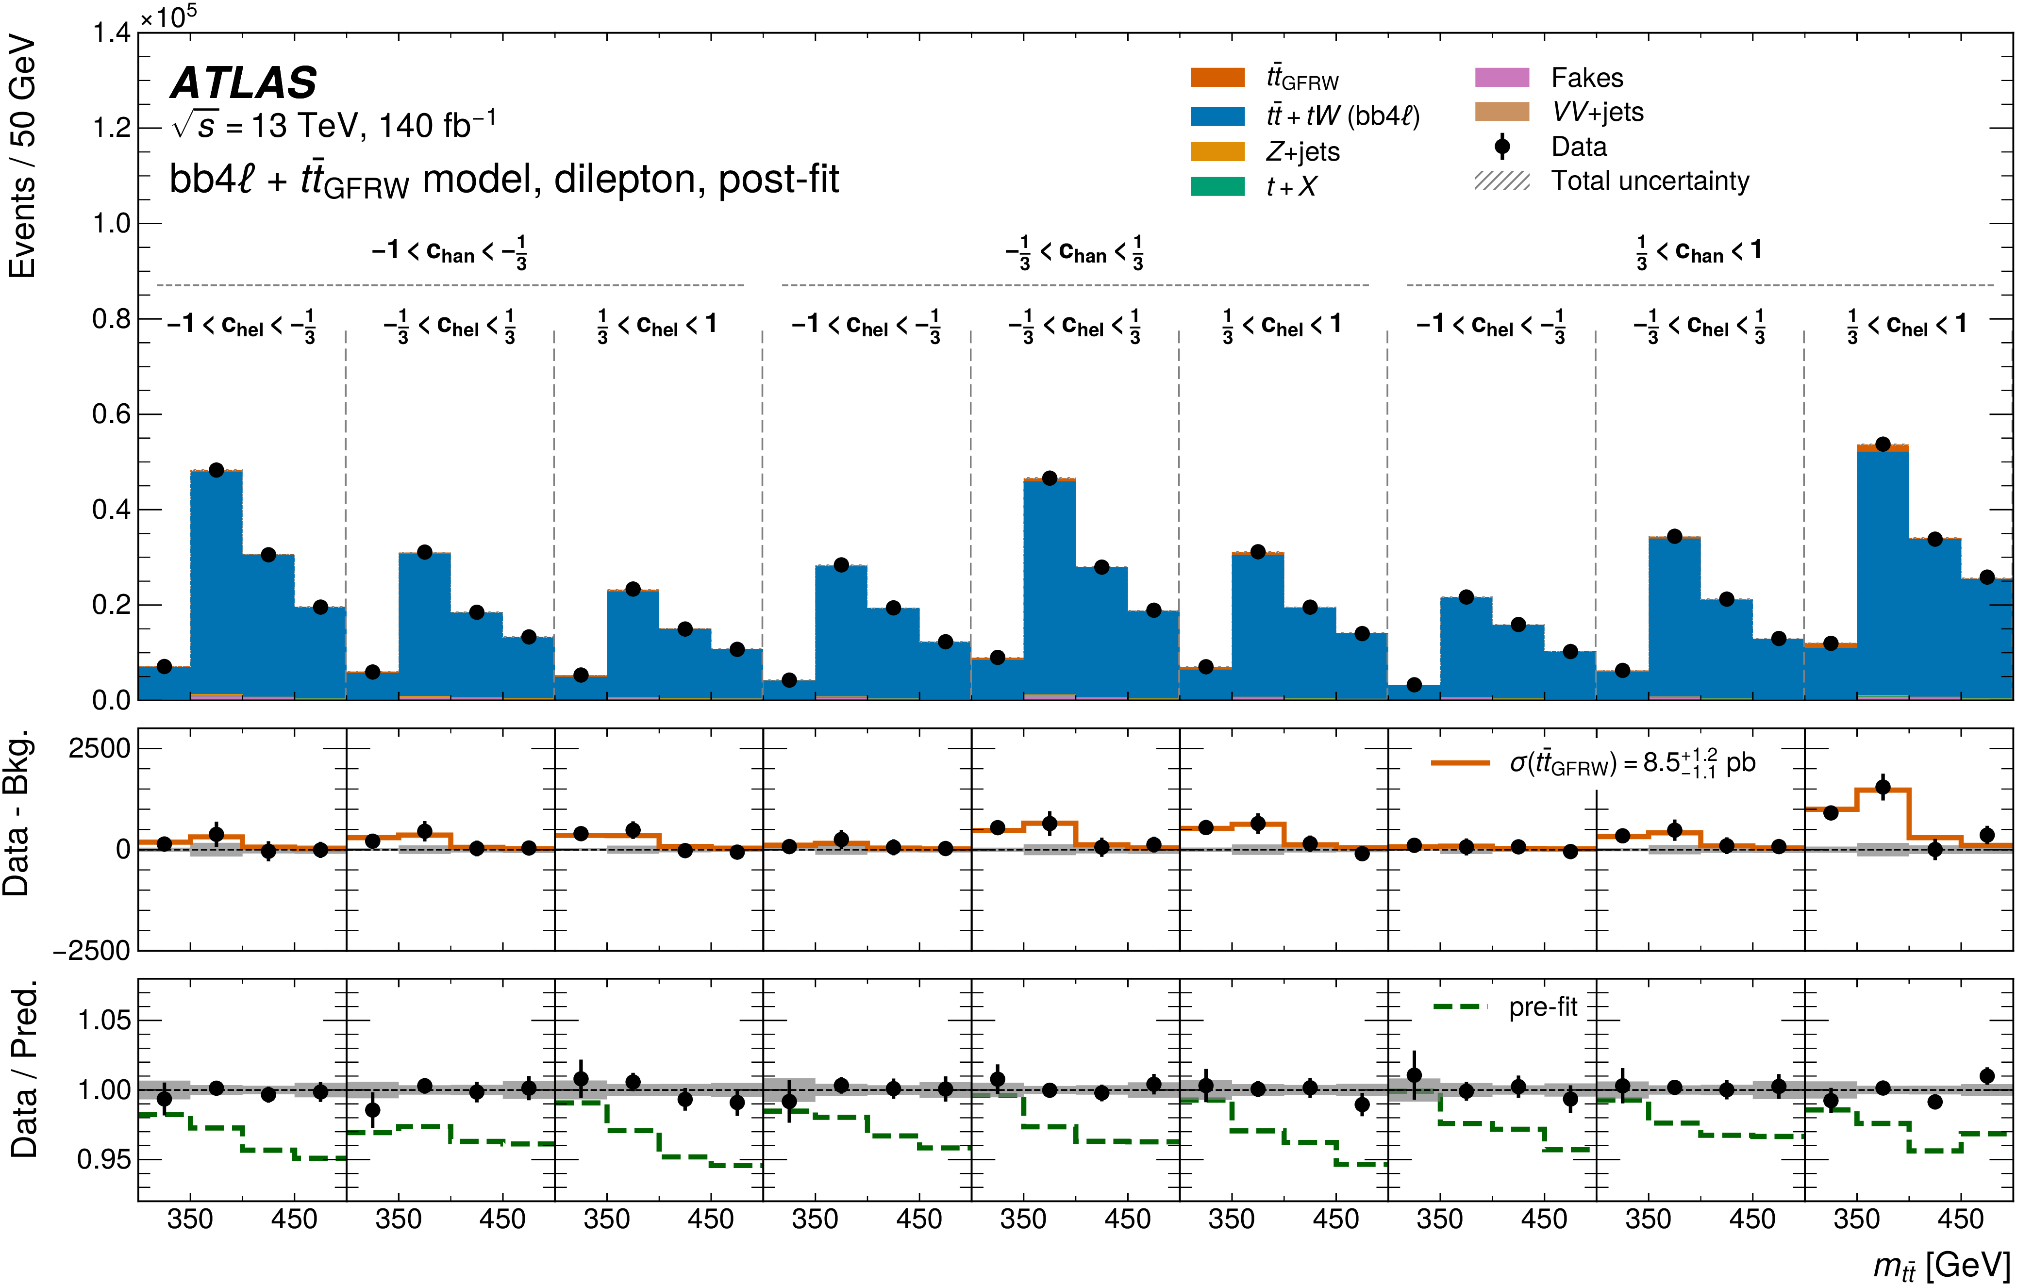
Dilepton channel – Atlas
This excess is consistent with the formation of colour-singlet and spin-singlet quasi-bound states, as predicted by non-relativistic QCD, and corresponds to an observed cross-section of 9.3+1.4-1.3pb.
arXiv:2601.11780

Slide 32
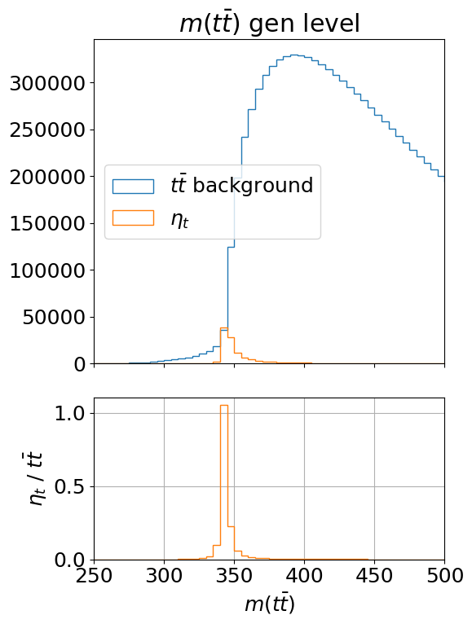
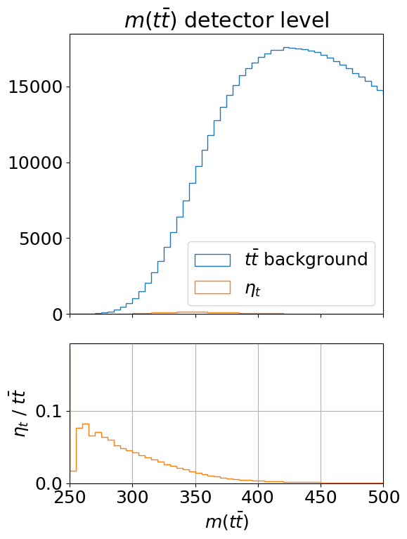
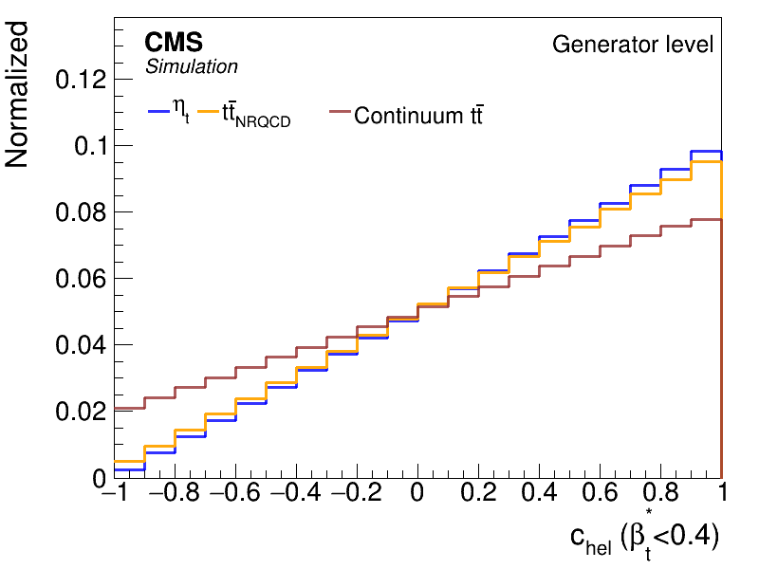
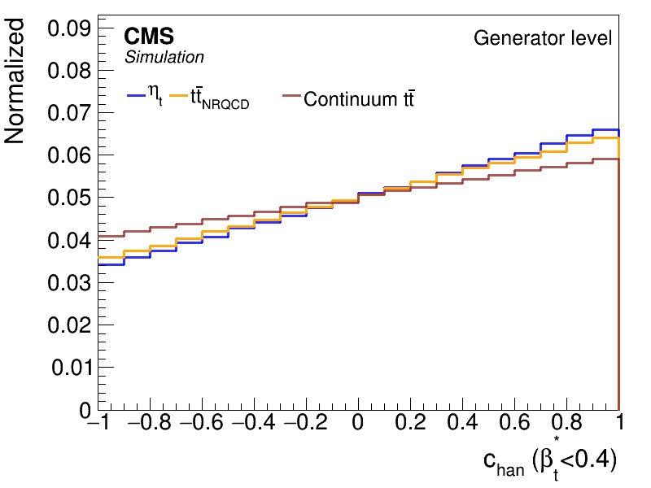
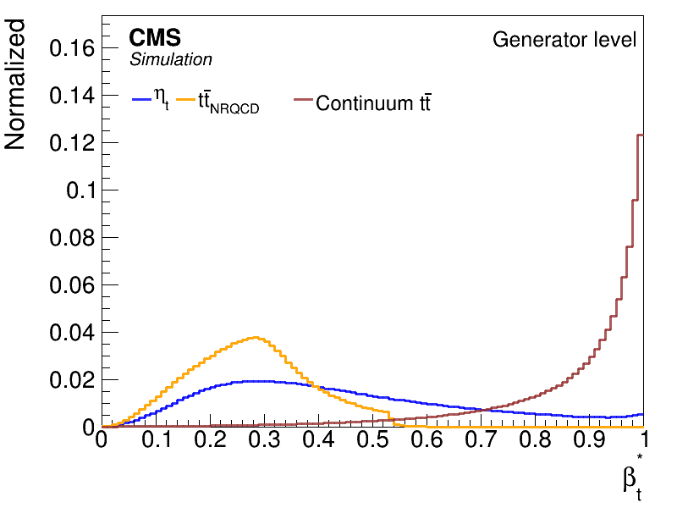
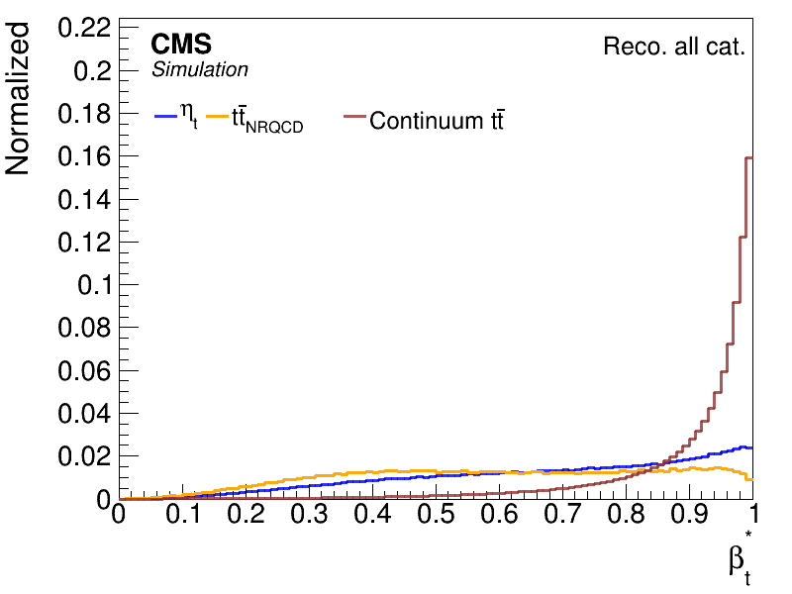
CMS: lepton+jets channel – new!!! CMS-PAS-Top-25-002
Mtt, the ttbar invariant mass → β*, the velocity of the top relative to antitop
Several systematic uncertainties (mt, JES, JER) are minimized, if not cancelled

Slide 33
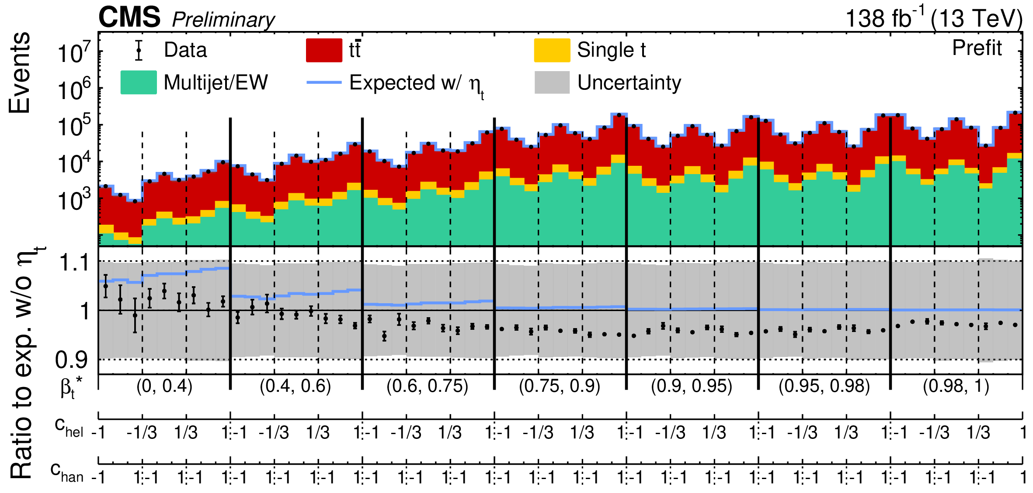
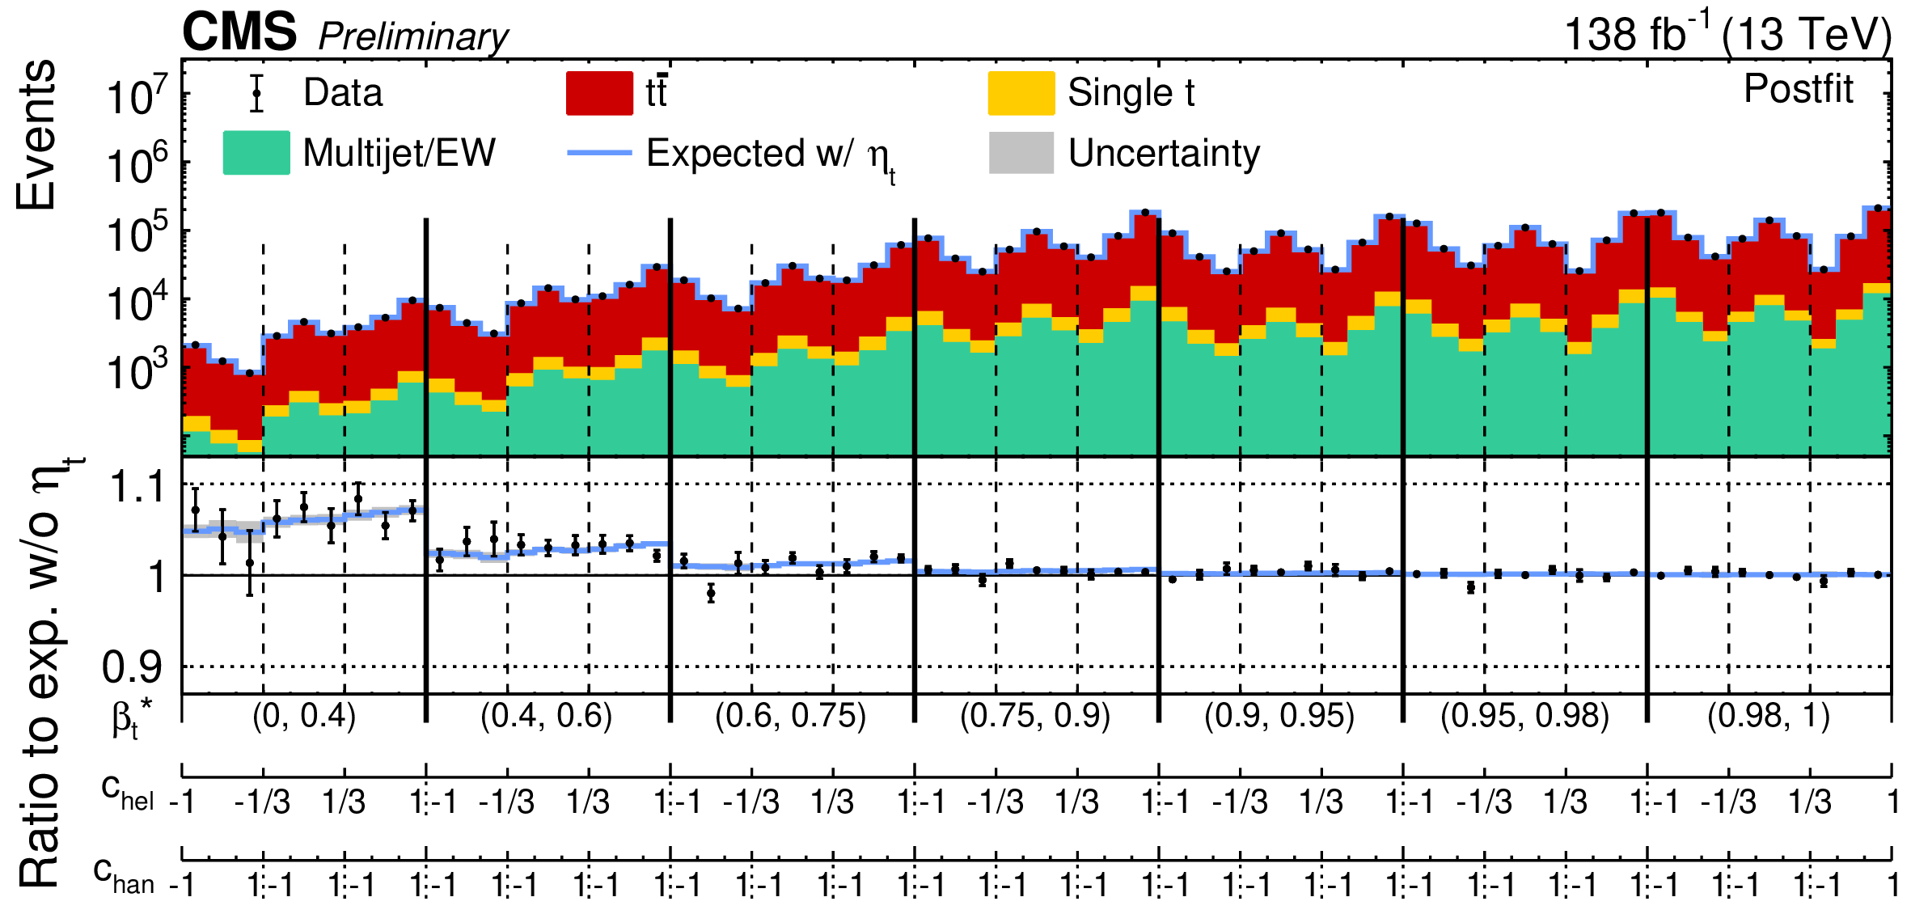
Pseudo scalar excess in lepton+jets
Pre and post-fit “rolled out” distributions in β*, chel, chan
For the baseline use theoretical top pair production σ _{NNLO} =832+40-46 pb
Measured in l+jets σ _{CMS} = 791+-25 pb
Excess of events over the continuum tt production is observed with low β* (~2 first large bins)
σ _{obs}(η_{t}) =5.14+0.85-87 pb
Consistent with predicted
_{exp}(η_{t}) =6.43 pb
[2102.11281, 2401.08751]
Significance 6.07

Slide 34
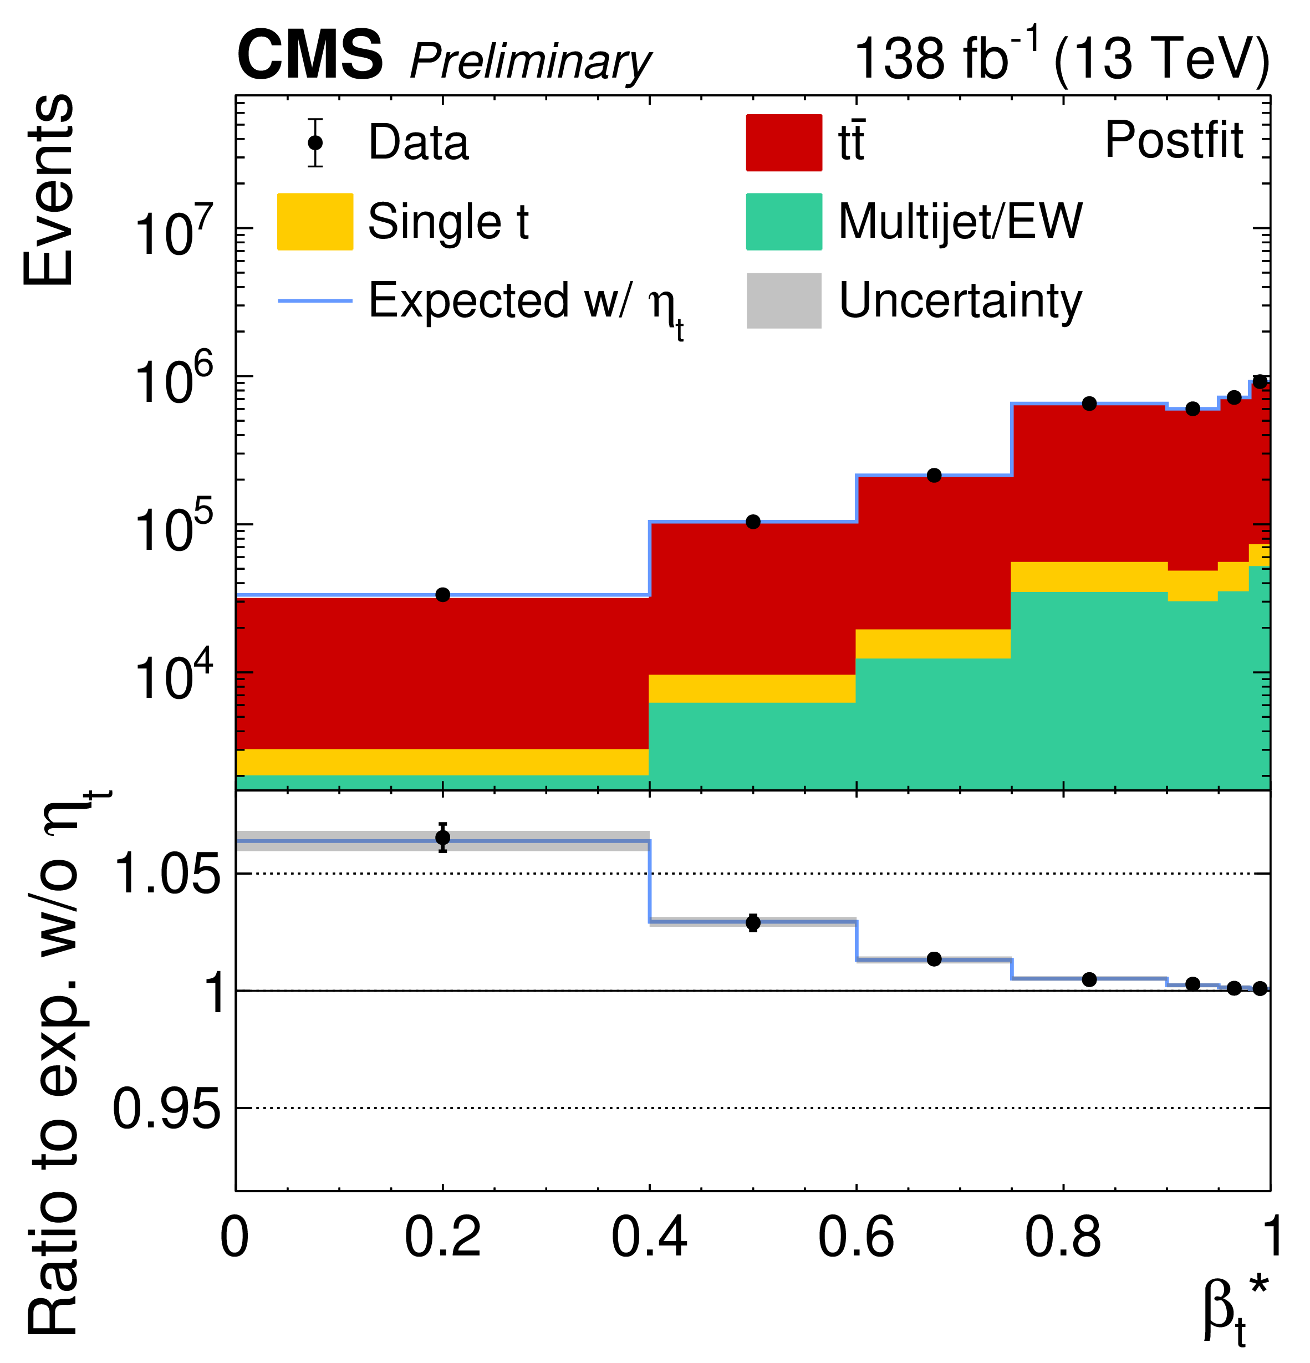
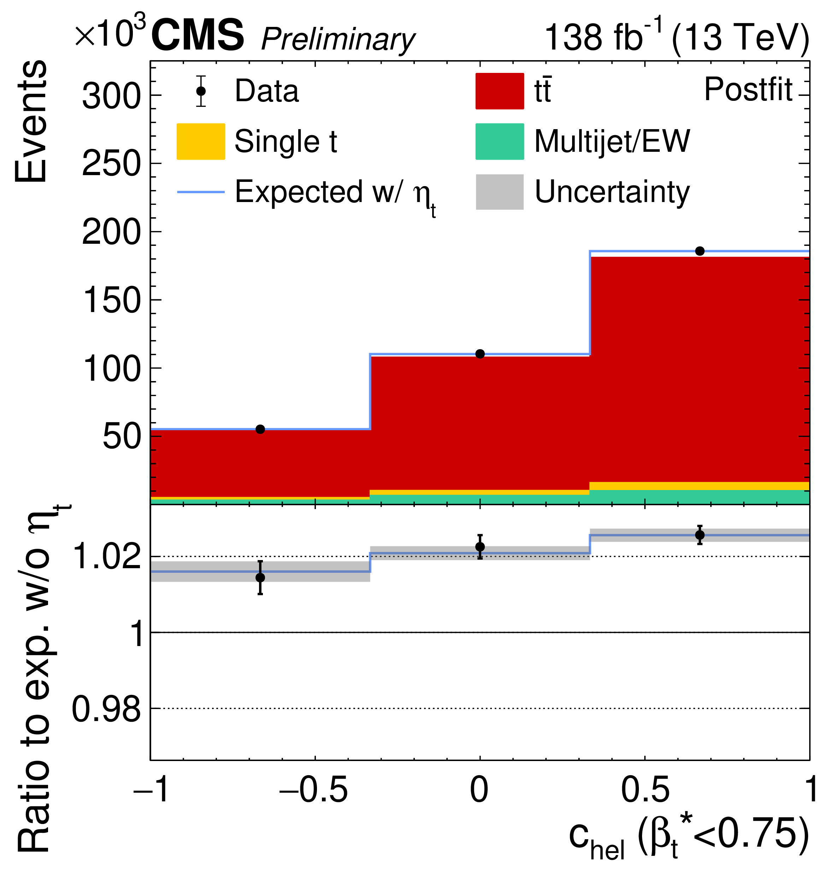
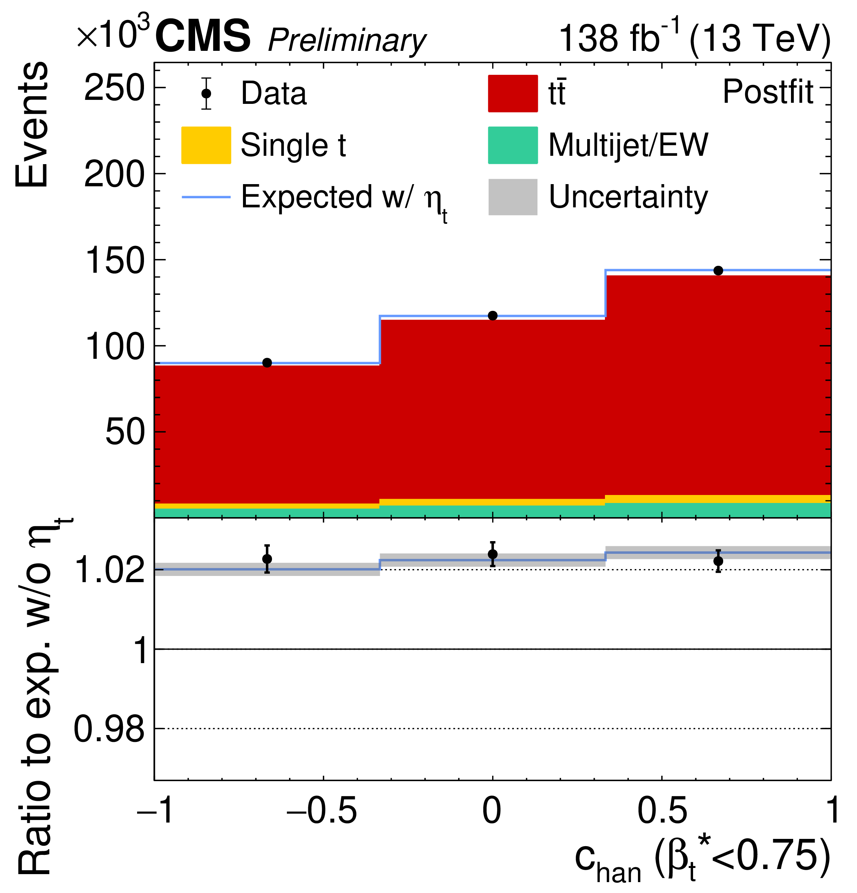
Pseudoscalar excess in lepton+jets
Distributions in β*, chel, chan
integrated over other variables
Not used to the fit, just an illustration
Agreement with the pseudoscalar nature of excess
Excess of events at low β* Angular distributions consistent with pseudoscalar

Slide 35
Have we discovered toponium?
Toponium – a pseudoscalar ttbar bound state, a.k.a η_{t} is predicted by non-relativistic QCD with a mass of 343 GeV – It would be nice to discover η_{t}
In 2002, a team of Russian and American scientists created the first ever atom of oganesson (Og), which is the heaviest chemical element ever recorded to date. This nucleus, which consists of 118 protons and 161 neutrons, has a mass number of 279
If confirmed toponium would be the heaviest particle ever observed
The existing evidence is tantalizing
Entanglement and spin correlation play an important role in this observation
More studies are needed to confirm the nature of the excess

Slide 36
Conclusion
Entanglement in tt system is established by LHC
Quantum tomography opens new possibilities to study new effects (e.g. toponium) and the foundations of quantum mechanics in systems of unstable relativistic particles
Belle II is ideally suited for several of such studies
The study of quantum effects at colliders is in its infancy
It is an exciting new field at the intersection of particle physics and quantum informatics
A new community is forming – a workshop at CERN in April, following a series of workshops held in Florence, Oxford, Shanghai
Upcoming Workshop at CERN 04/20-24/26: https://indico.cern.ch/event/1603106/
Quantum Information meets High-Energy Physics: Input to the update of the European Strategy for Particle Physics 2504.00086

