Slide 1
ePIC MPGD Trackers Test beam Plans & Other ongoing R&Ds
Kondo Gnanvo, Surabhi Tarafdar, Annalisa D’Angelo, Stefano Gramigna, Francesco Bossu, Fabien Jeanneau
7th DRD1 Collaboration Meeting - February 23 – 27, 2026, CERN

Slide 2
Outline
Overview of ePIC MPGD Trackers & Test beam
CyMBaL: Module description – Test beam plans, goals & requirements
MPGD-BOT: Module description – Test beam plans, goals & requirements
MPGD-ECT: Module description – Test beam plans, goals & requirements
Double-side Thin-Gap GEM-μRWELL Prototypes
R&D goals and test beam plans, goals & requirements
μRWELL-PICOSEC Prototypes
R&D goals and test beam plans, goals & requirements

Slide 3
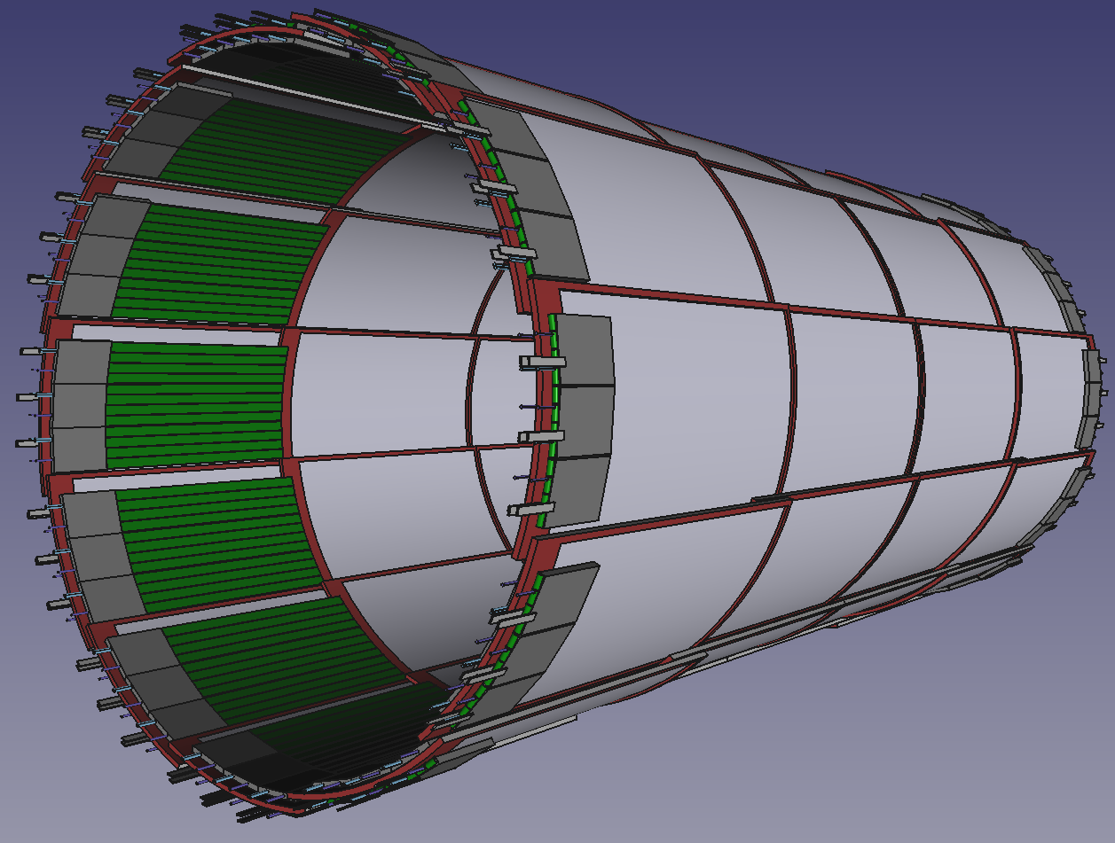
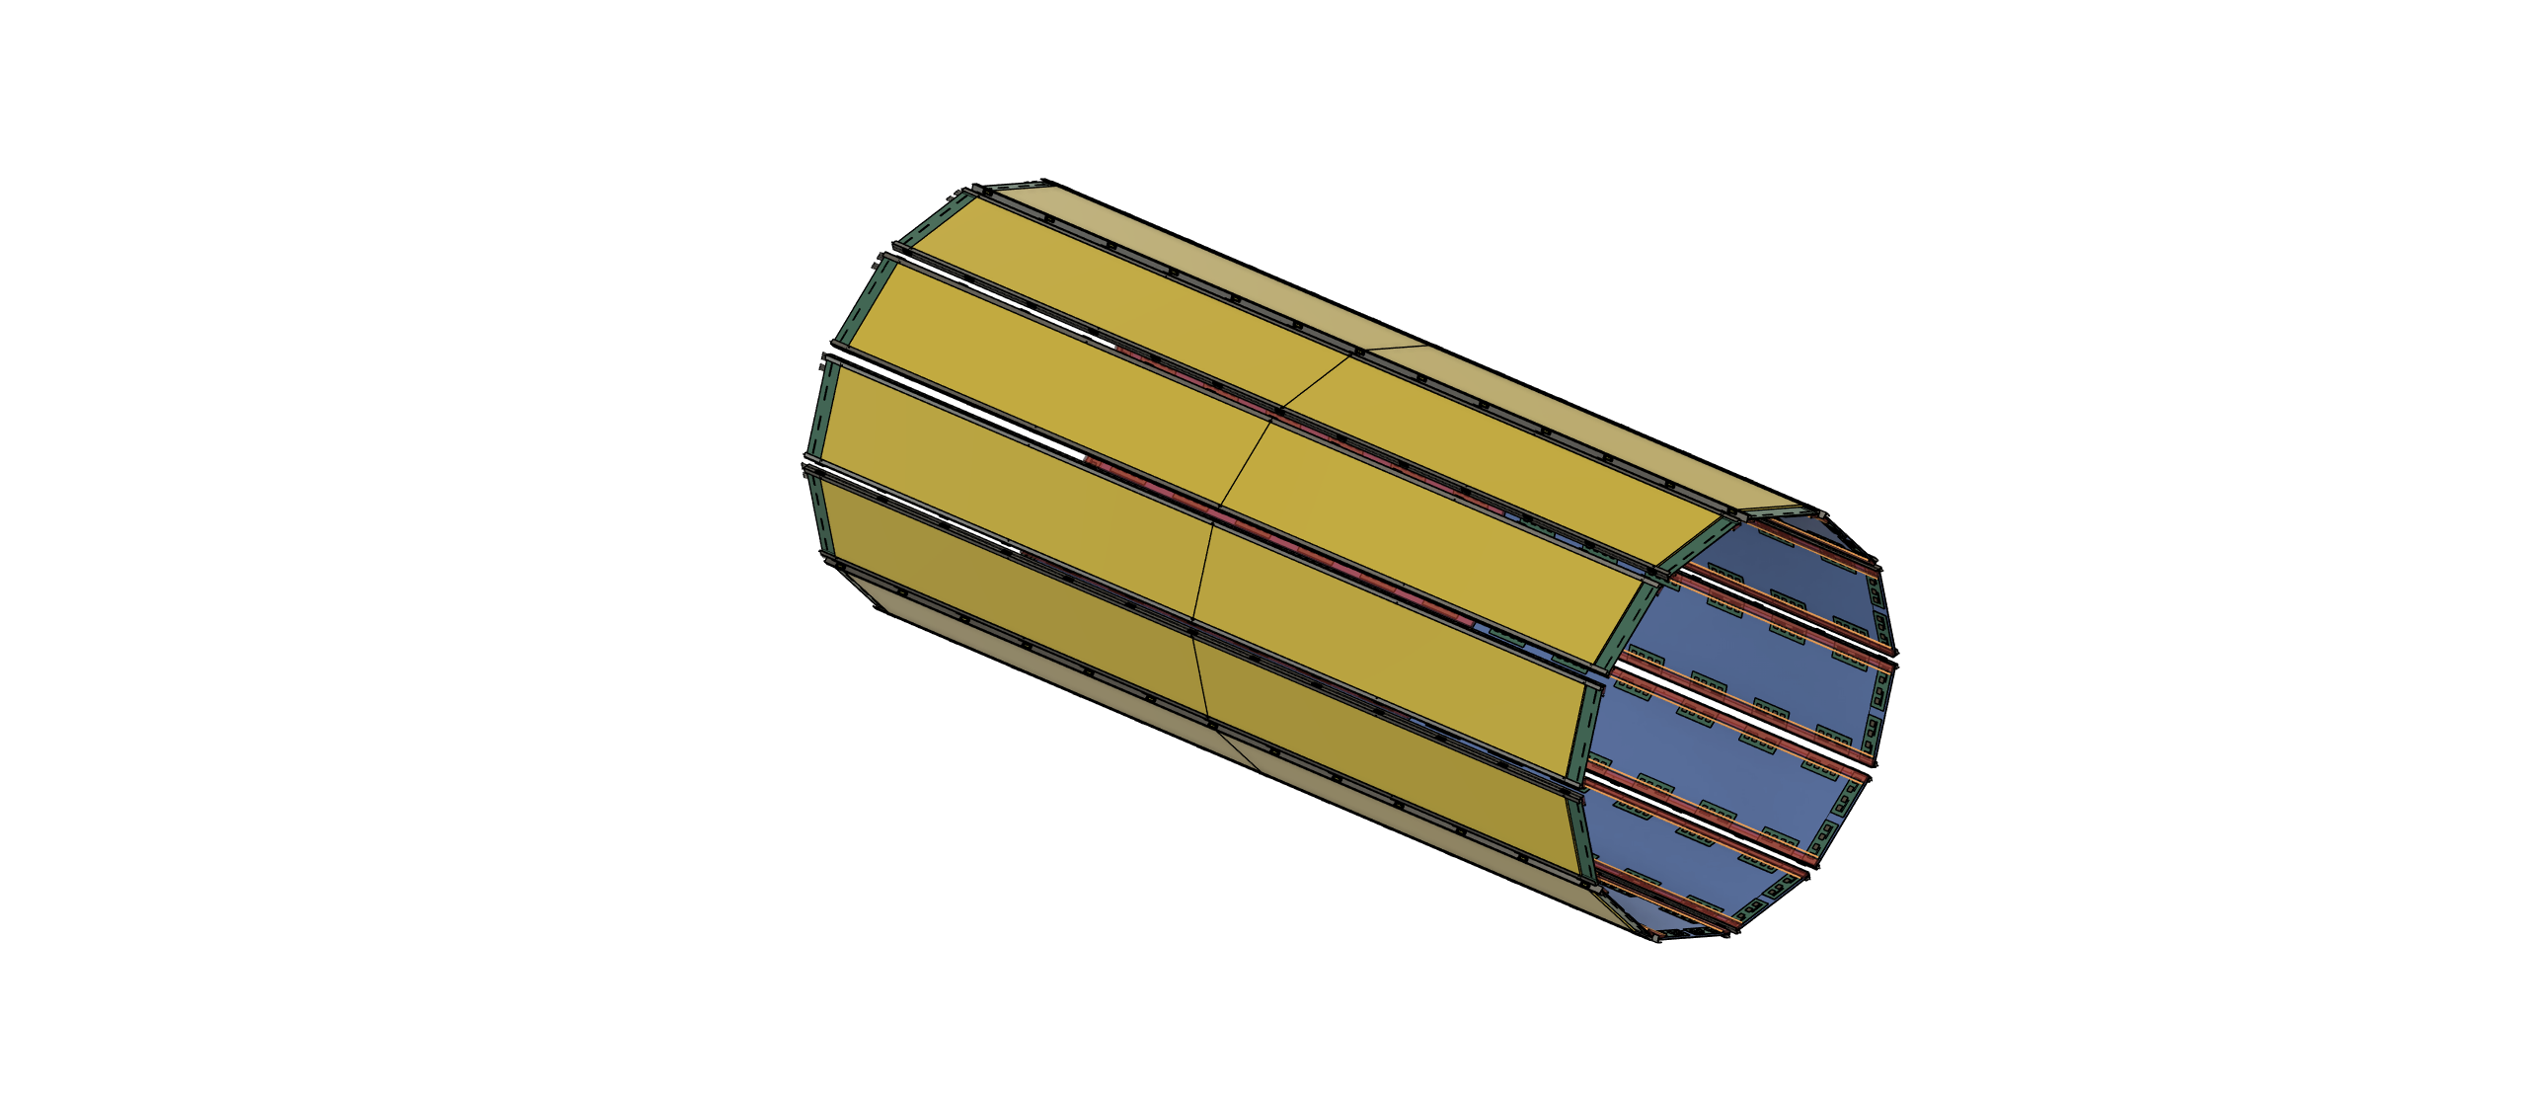
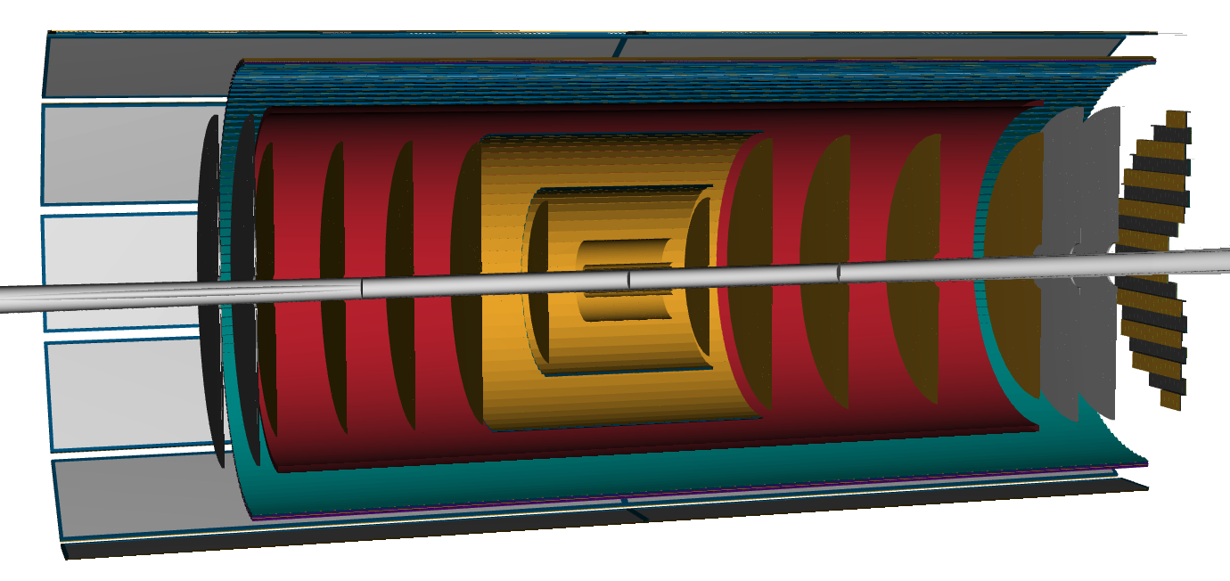
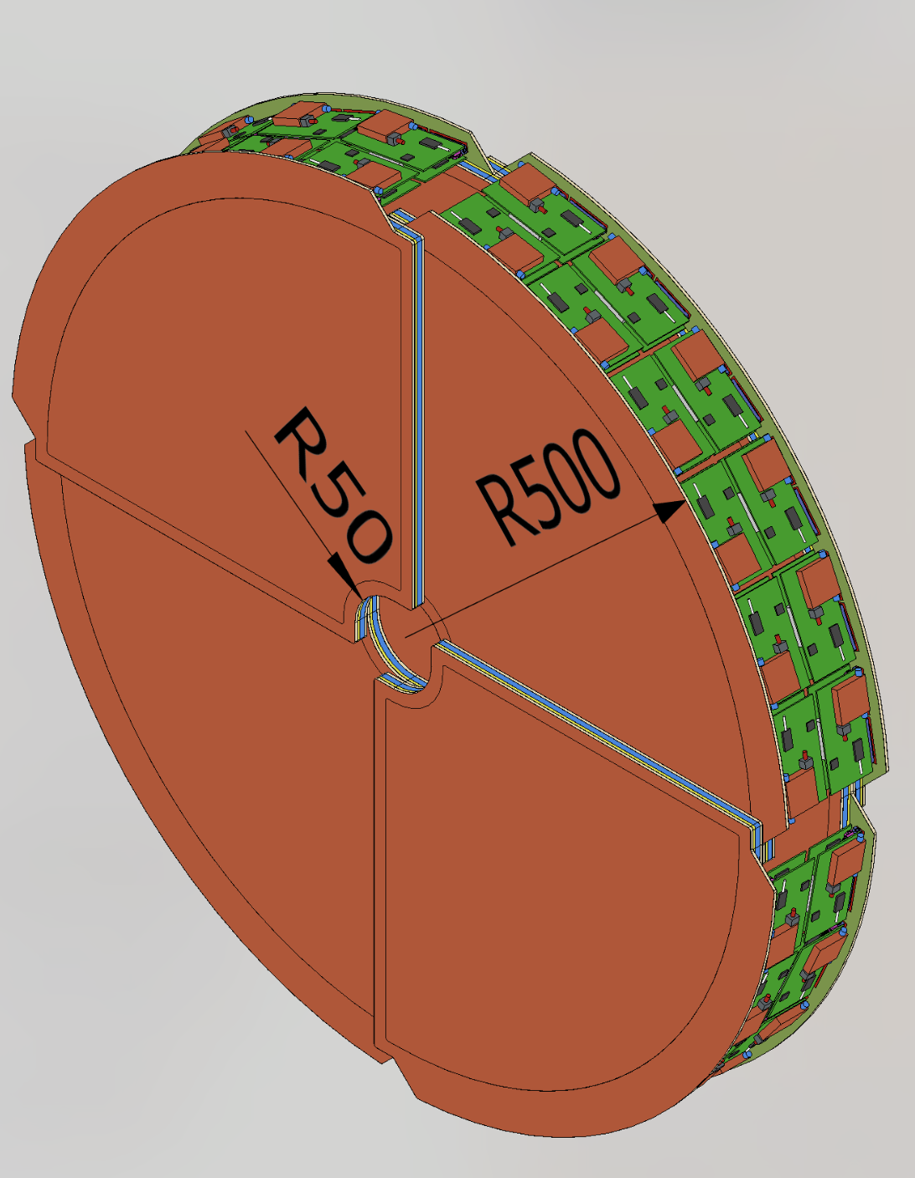
MPGD Trackers in ePIC Central Tracker @ the EIC
CyMBaL
Barrel Trackers
CyMBaL: Cylindrical Micromegas Barrel Layer​
Micromegas based​
MPGD- BOT: Barrel Outer Tracker​
Thin gap GEM-µRWELL hybrid based​
MPGD-BOT
​End cap trackers
MPGD- ECT: End Cap Tracker​
GEM-µRWELL based​
Lepton MPGD-ECT
Hadron MPGD-ECT

Slide 4
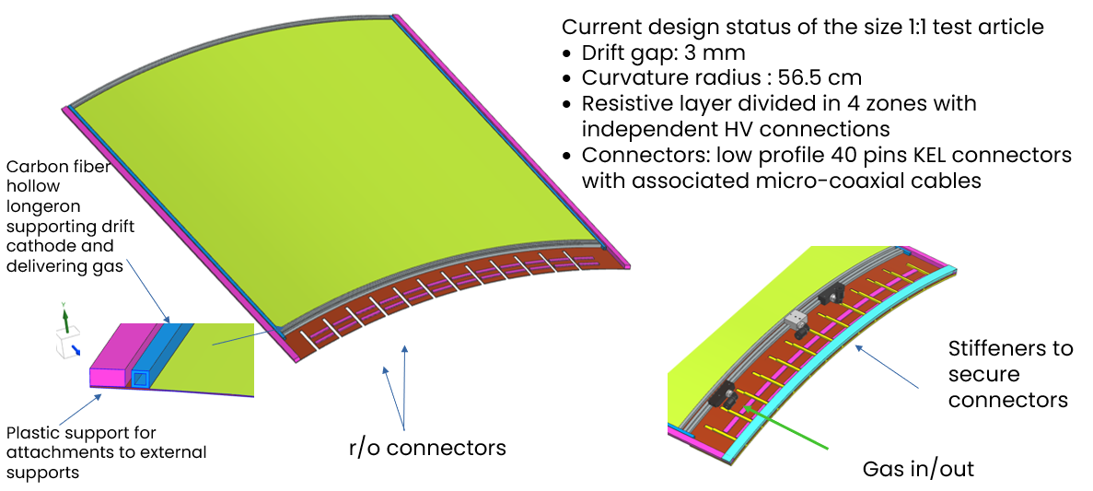
CyMBaL: Cylindrical Micromegas Barrel Layer

Slide 5
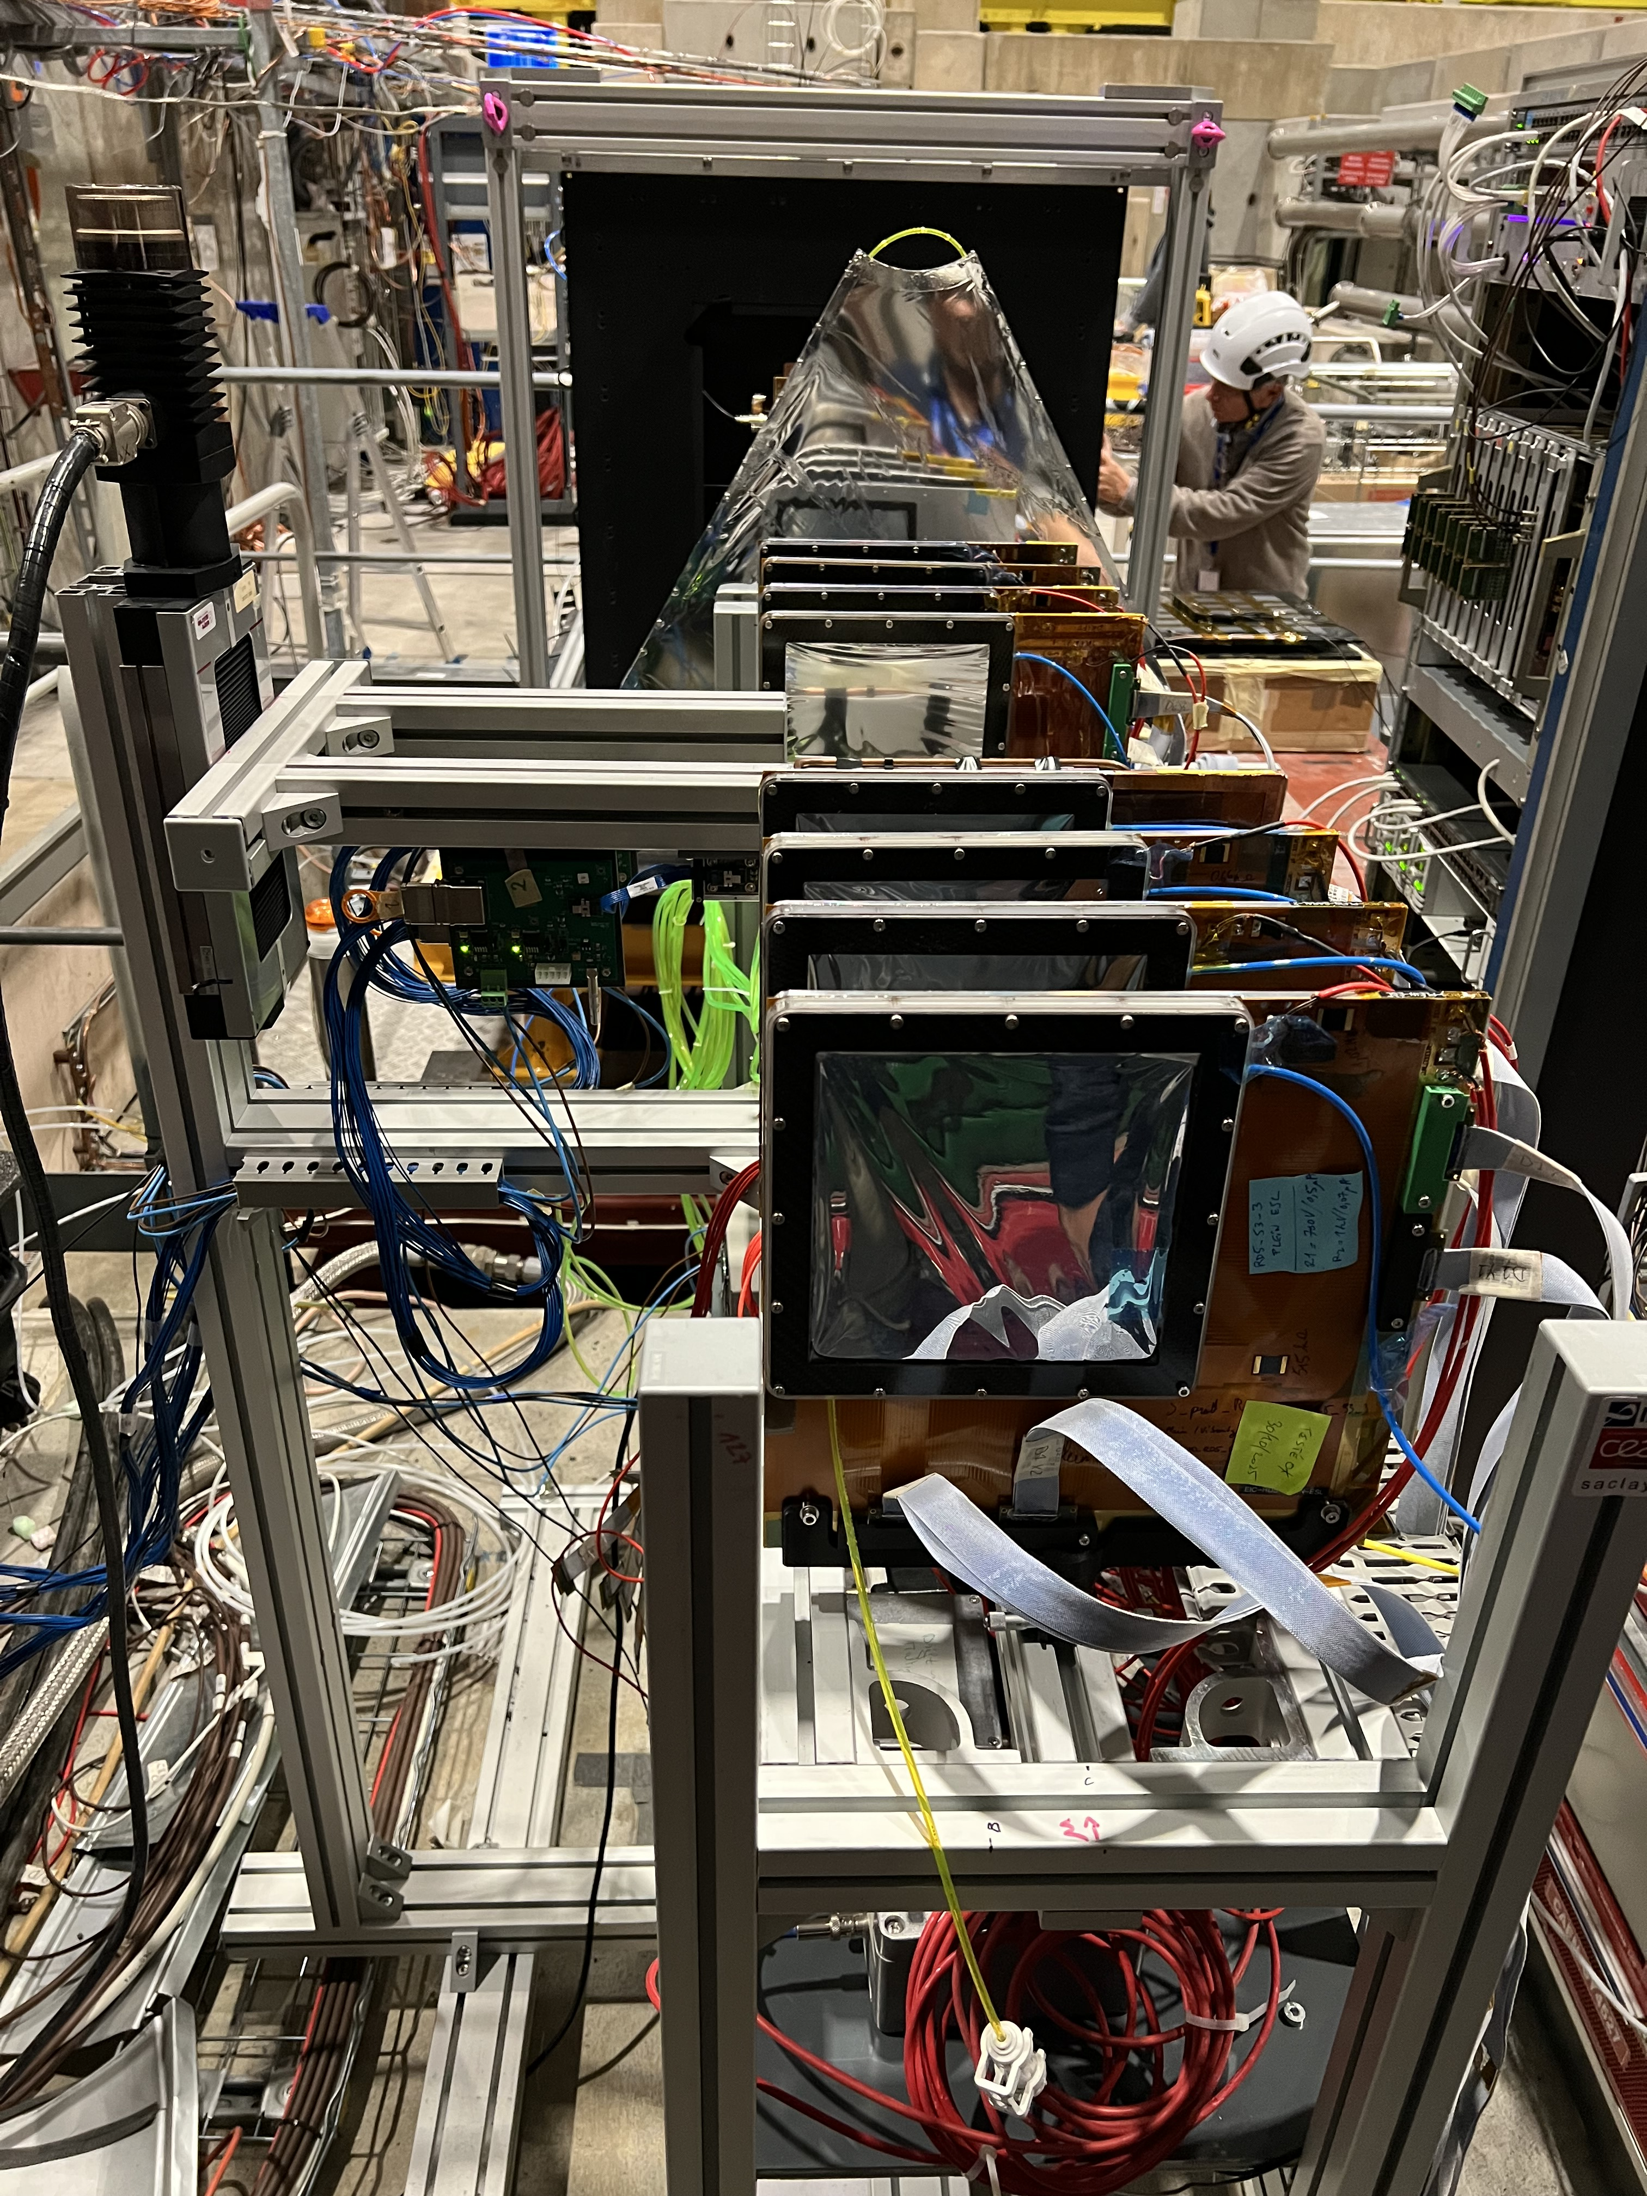
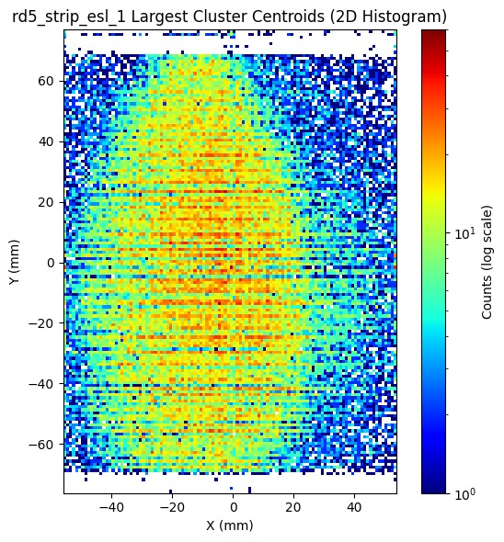
CyMBaL: Setup and Goals and requirements
Goals
Test of the scale 1 prototype (see previous slide)
Spatial resolution and efficiency studies
Time resolution?
Inclined tracks reconstruction
1 mm and 3 mm drift gaps
Reqiruements
Trigger from DRD1
Ar/CO2/ISO (93/5/2
Silicon pixel reference
Readout with DREAM electronics
Test bench like in November 2025
DESY table desirable for position scan

Slide 6
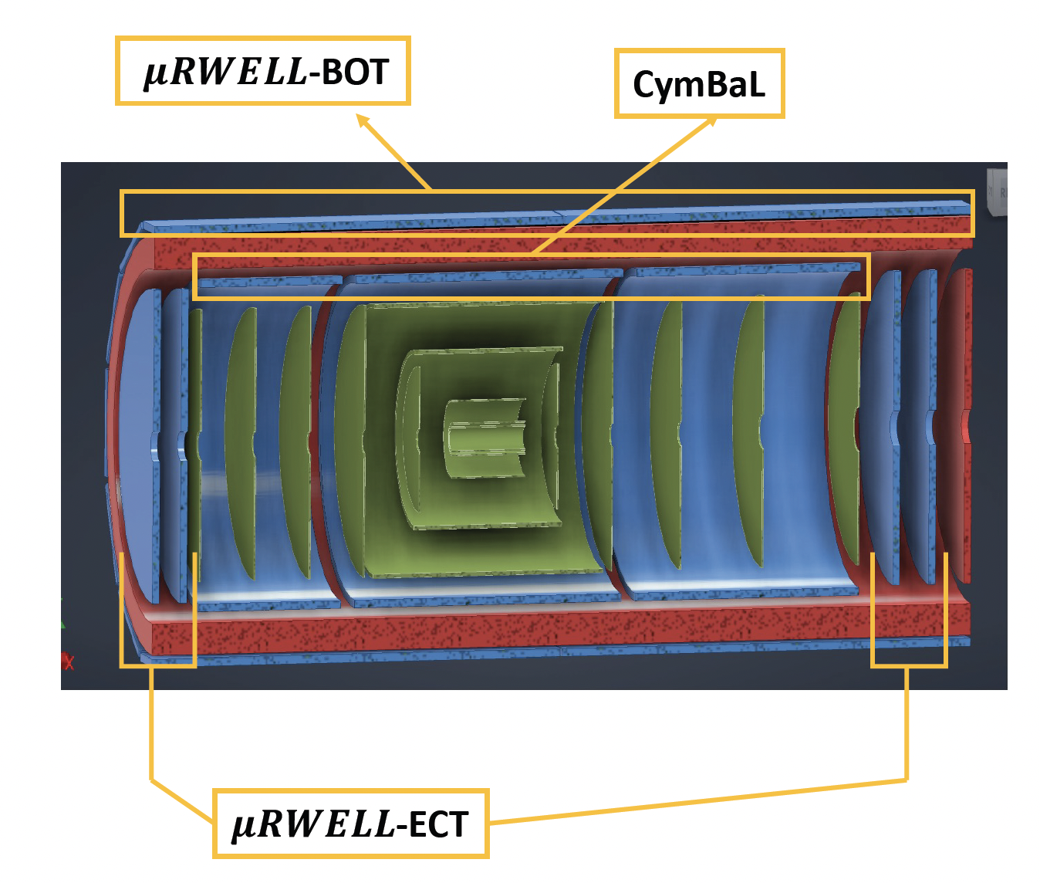
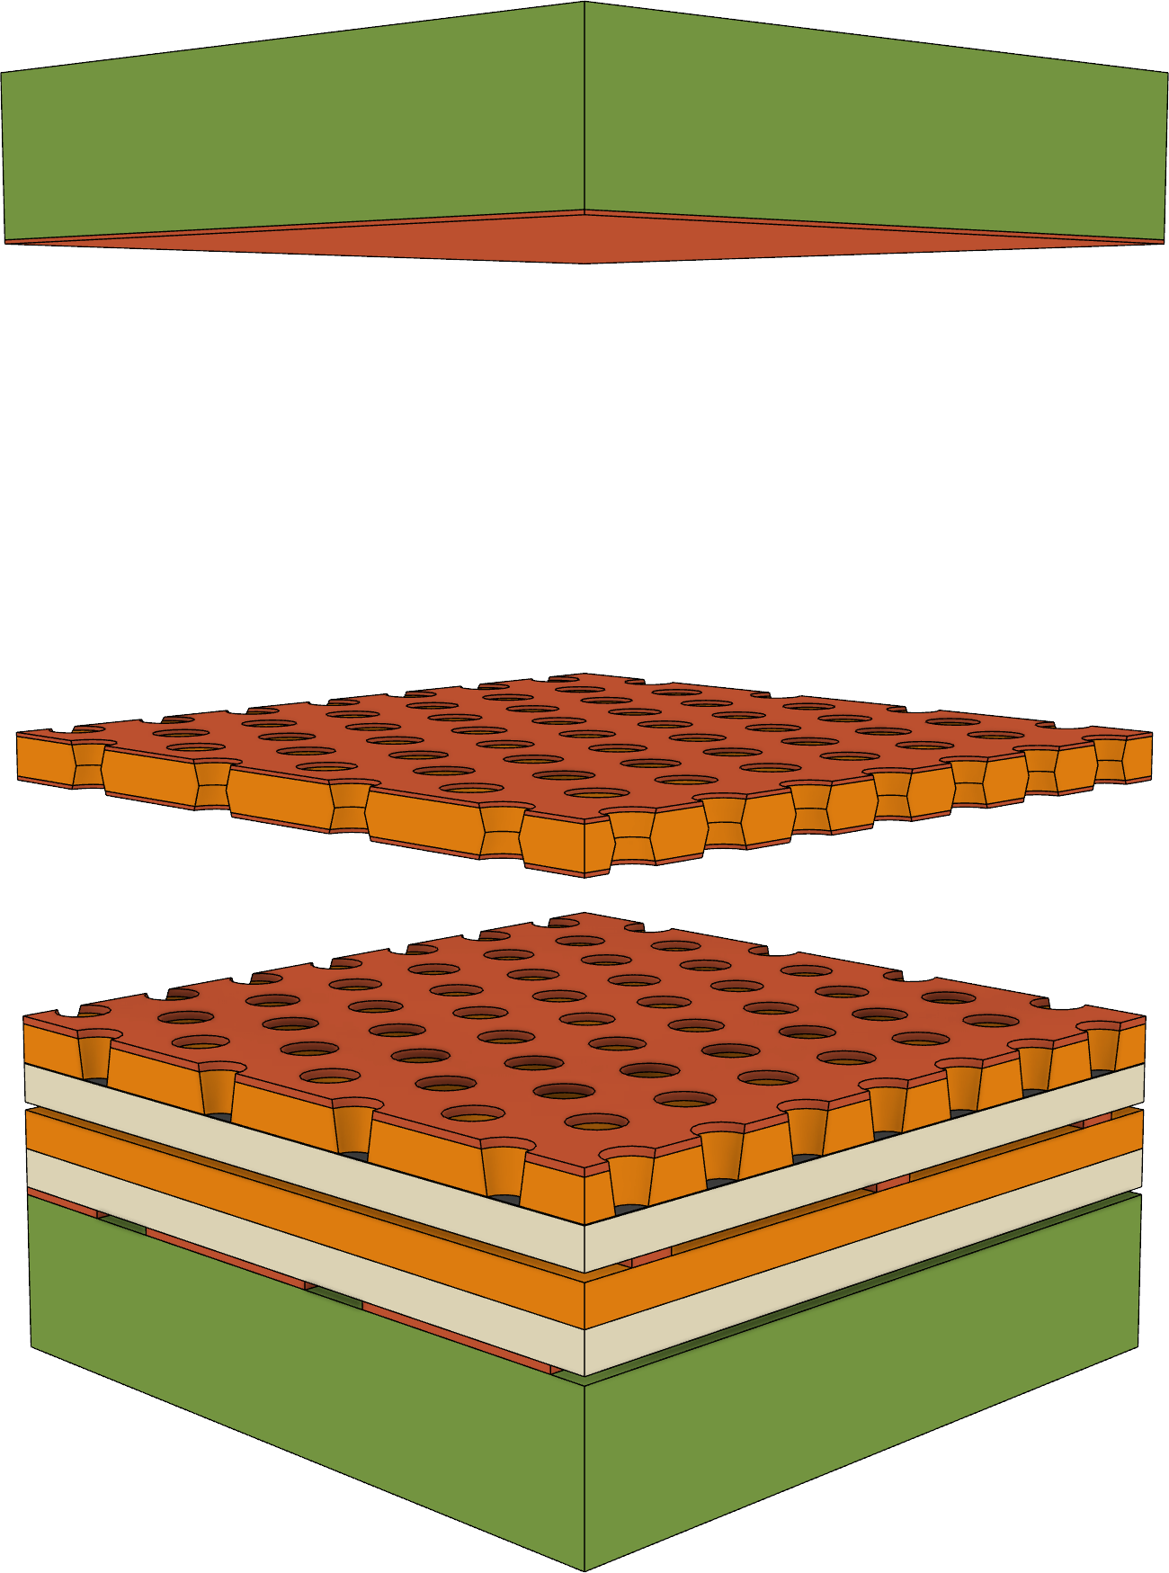
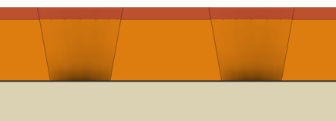

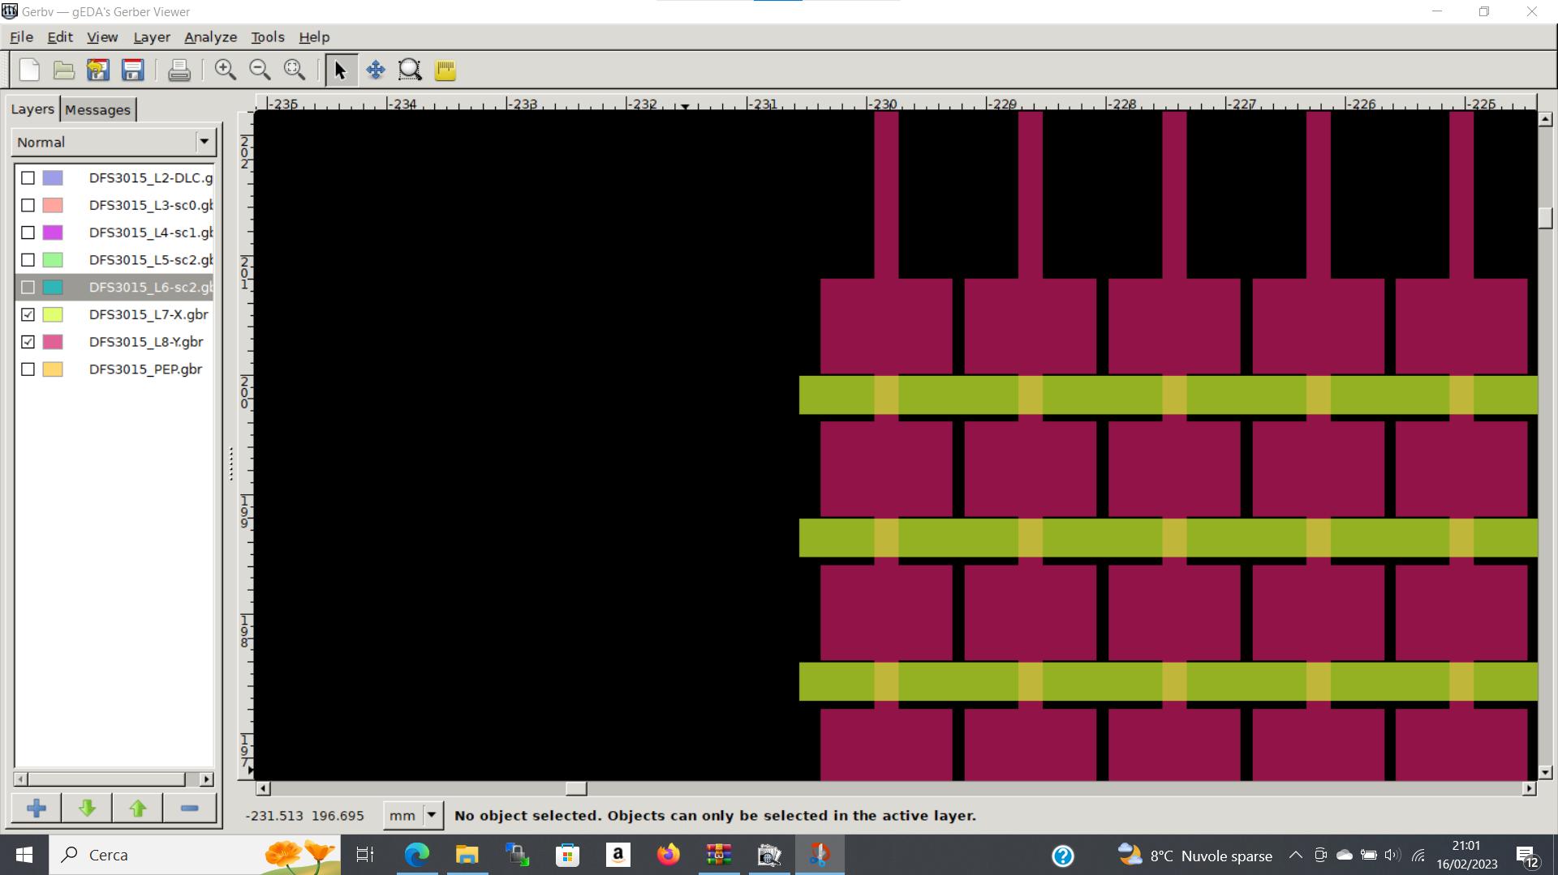

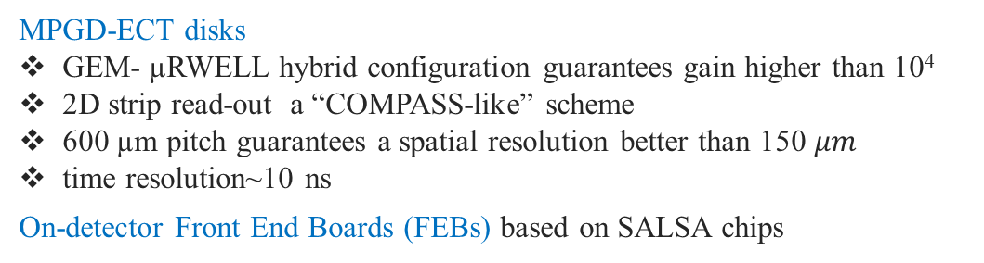

ePIC MPGD Endcap Trackers: MPGD-ECT
GEM – µRWELL technology
Light weight CATHODE
DRIFT
6 mm
GEM
50 µm Kapton
TRANSFER
3 mm
µ-RWELL
Readout
2D strip layout, 600 µm pitch
-3.5$<η<−1.8$
NOT IN SCALE
1.9$<η<$3.2
×20
Lepton Endcap
Disks
Hadron Endcap
Disks
Two MPGD Endcap Tracking (ECT) disks both in the hadronic and in the leptonic regions increase the number of hits in the |η| > 2 region to improve pattern recognition.
×1000
MPGD-ECT disks
GEM- µRWELL hybrid configuration guarantees gain higher than 10⁴
2D strip read-out a “COMPASS-like” scheme
600 µm pitch guarantees a spatial resolution better than 150 $μm$
time resolution~10 ns
On-detector Front End Boards (FEBs) based on SALSA chips
X-Y readout

Slide 7
MPGD-ECT: Setup, Goals & Requirements
Objectives:
Performance studies with different gas mixtures
Performance mapping with standard gas mixture (position scan)
Angle of incidence scan with standard gas mixture
Time performance studies
Requests:
5 gas lines (4 IN, 1 OUT)
Gas needs
Ar, CO₂, CF₄, N₂
Premix Ar:CO₂:CF₄ (45:40:15) or Ar:CO₂ (80:20)
Premix to test Ar:CO₂:iC₄H₁₀ (93:2:5) + TBD
Large red moving table!!! (For position scans with our large setup)
TRG + 2×TRK
QUAD×2
CS×2
TRG + 2×TRK
H = 1112 mm
W = 1000 mm
L = 1927 mm

Slide 8
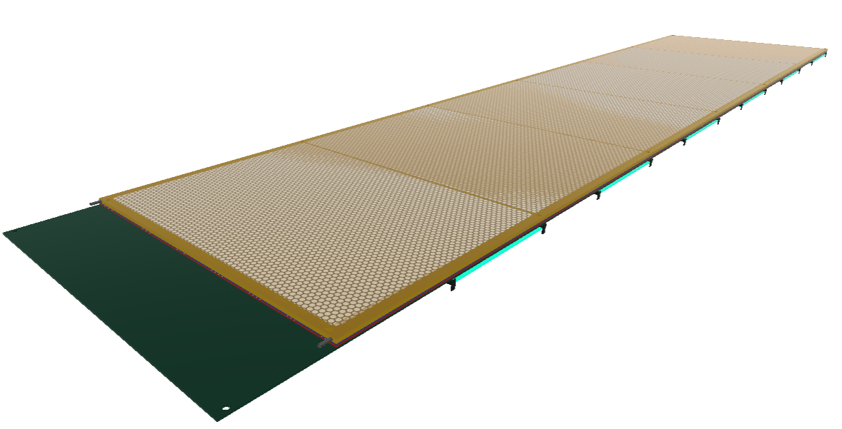
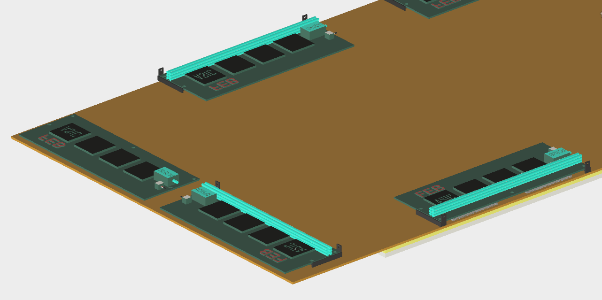
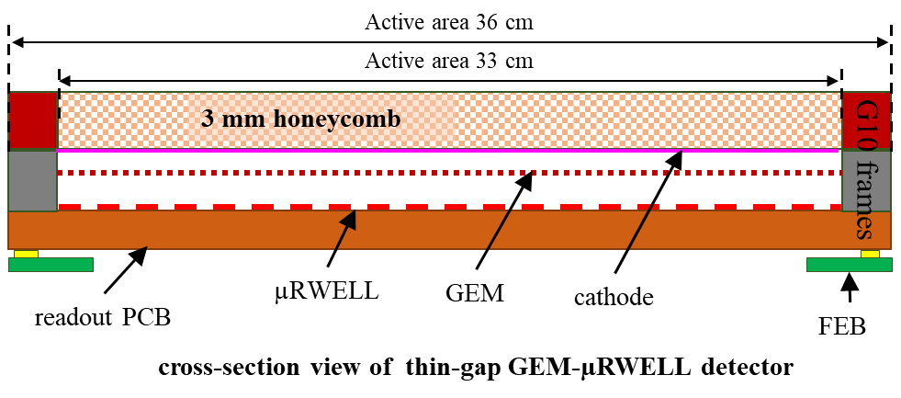
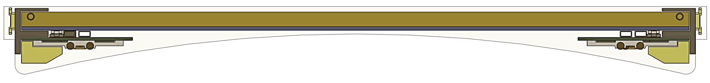
MPGD-BOT: Overview & PED test article
1800 mm
Left module
1700 mm
Right module
FEBs
330 mm
360 mm
Working detector
MPGD Barrel Outer Tracker (MPGD-BOT)
MPGD-BOT module: Full scale test article (aka prototype)
Detector Envelope
MPGD chamber
cooling tubing for the 2nd module behind
Mounting Frame
Heatsink with tubing
FEB
drift
induction
Service Area
Thin-gap GEM-μRWELL Hybrid Detector
MPGD-BOT module cross sectional view
https://www.jlab.org/sites/default/files/eic_rd_prgm/files/2023_Proposals/20230714_eRD_tgMPGD_Proposal_FY23_Final_EICGENRandD2023_16.pdf

Slide 9
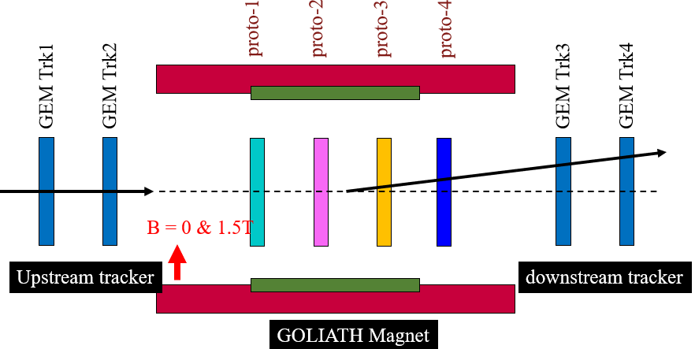
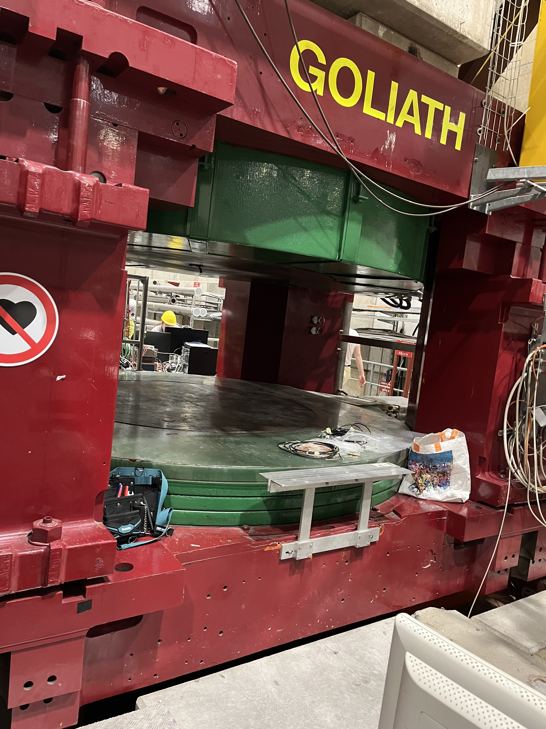
MPGD-BOT: Setup, Goals & Requirements
MPGD-BOT prototype beam test goals
HV scans for spatial resolution & efficiency studies
Performance in magnetic field up 1.5 T field (pions beam)
Gas mixtures studies: stability vs. performance
Setup: MPGD-BOT prototype inside GOLIATH magnet
MPGD-BOT support frame: ~200 cm × 40 cm × 40 cm (in GOLIATH)
Upstream & downstream GEM frames: Two ~40 cm × 40 cm × 20 cm
Readout with APV25+SRS with JLab CODA DAQ
Scintillator / PMT coincidence trigger
Requirements
Access to GOLIATH magnet (all beam time if possible)
Two fixed stands upstream & downstream GOLIATH magnet for the GEM trackers
Gas needs:
Ar:CO₂ 80/20, Ar:CO₂:iC₄H₁₀ 93:2:5 (or 93:5:2 if flammable or availability concerns)
Will use gases from INFN mixing system if operational for performance studies in gas
Layout of beam test setup
Scint / trig1
Scint / trig2

Slide 10
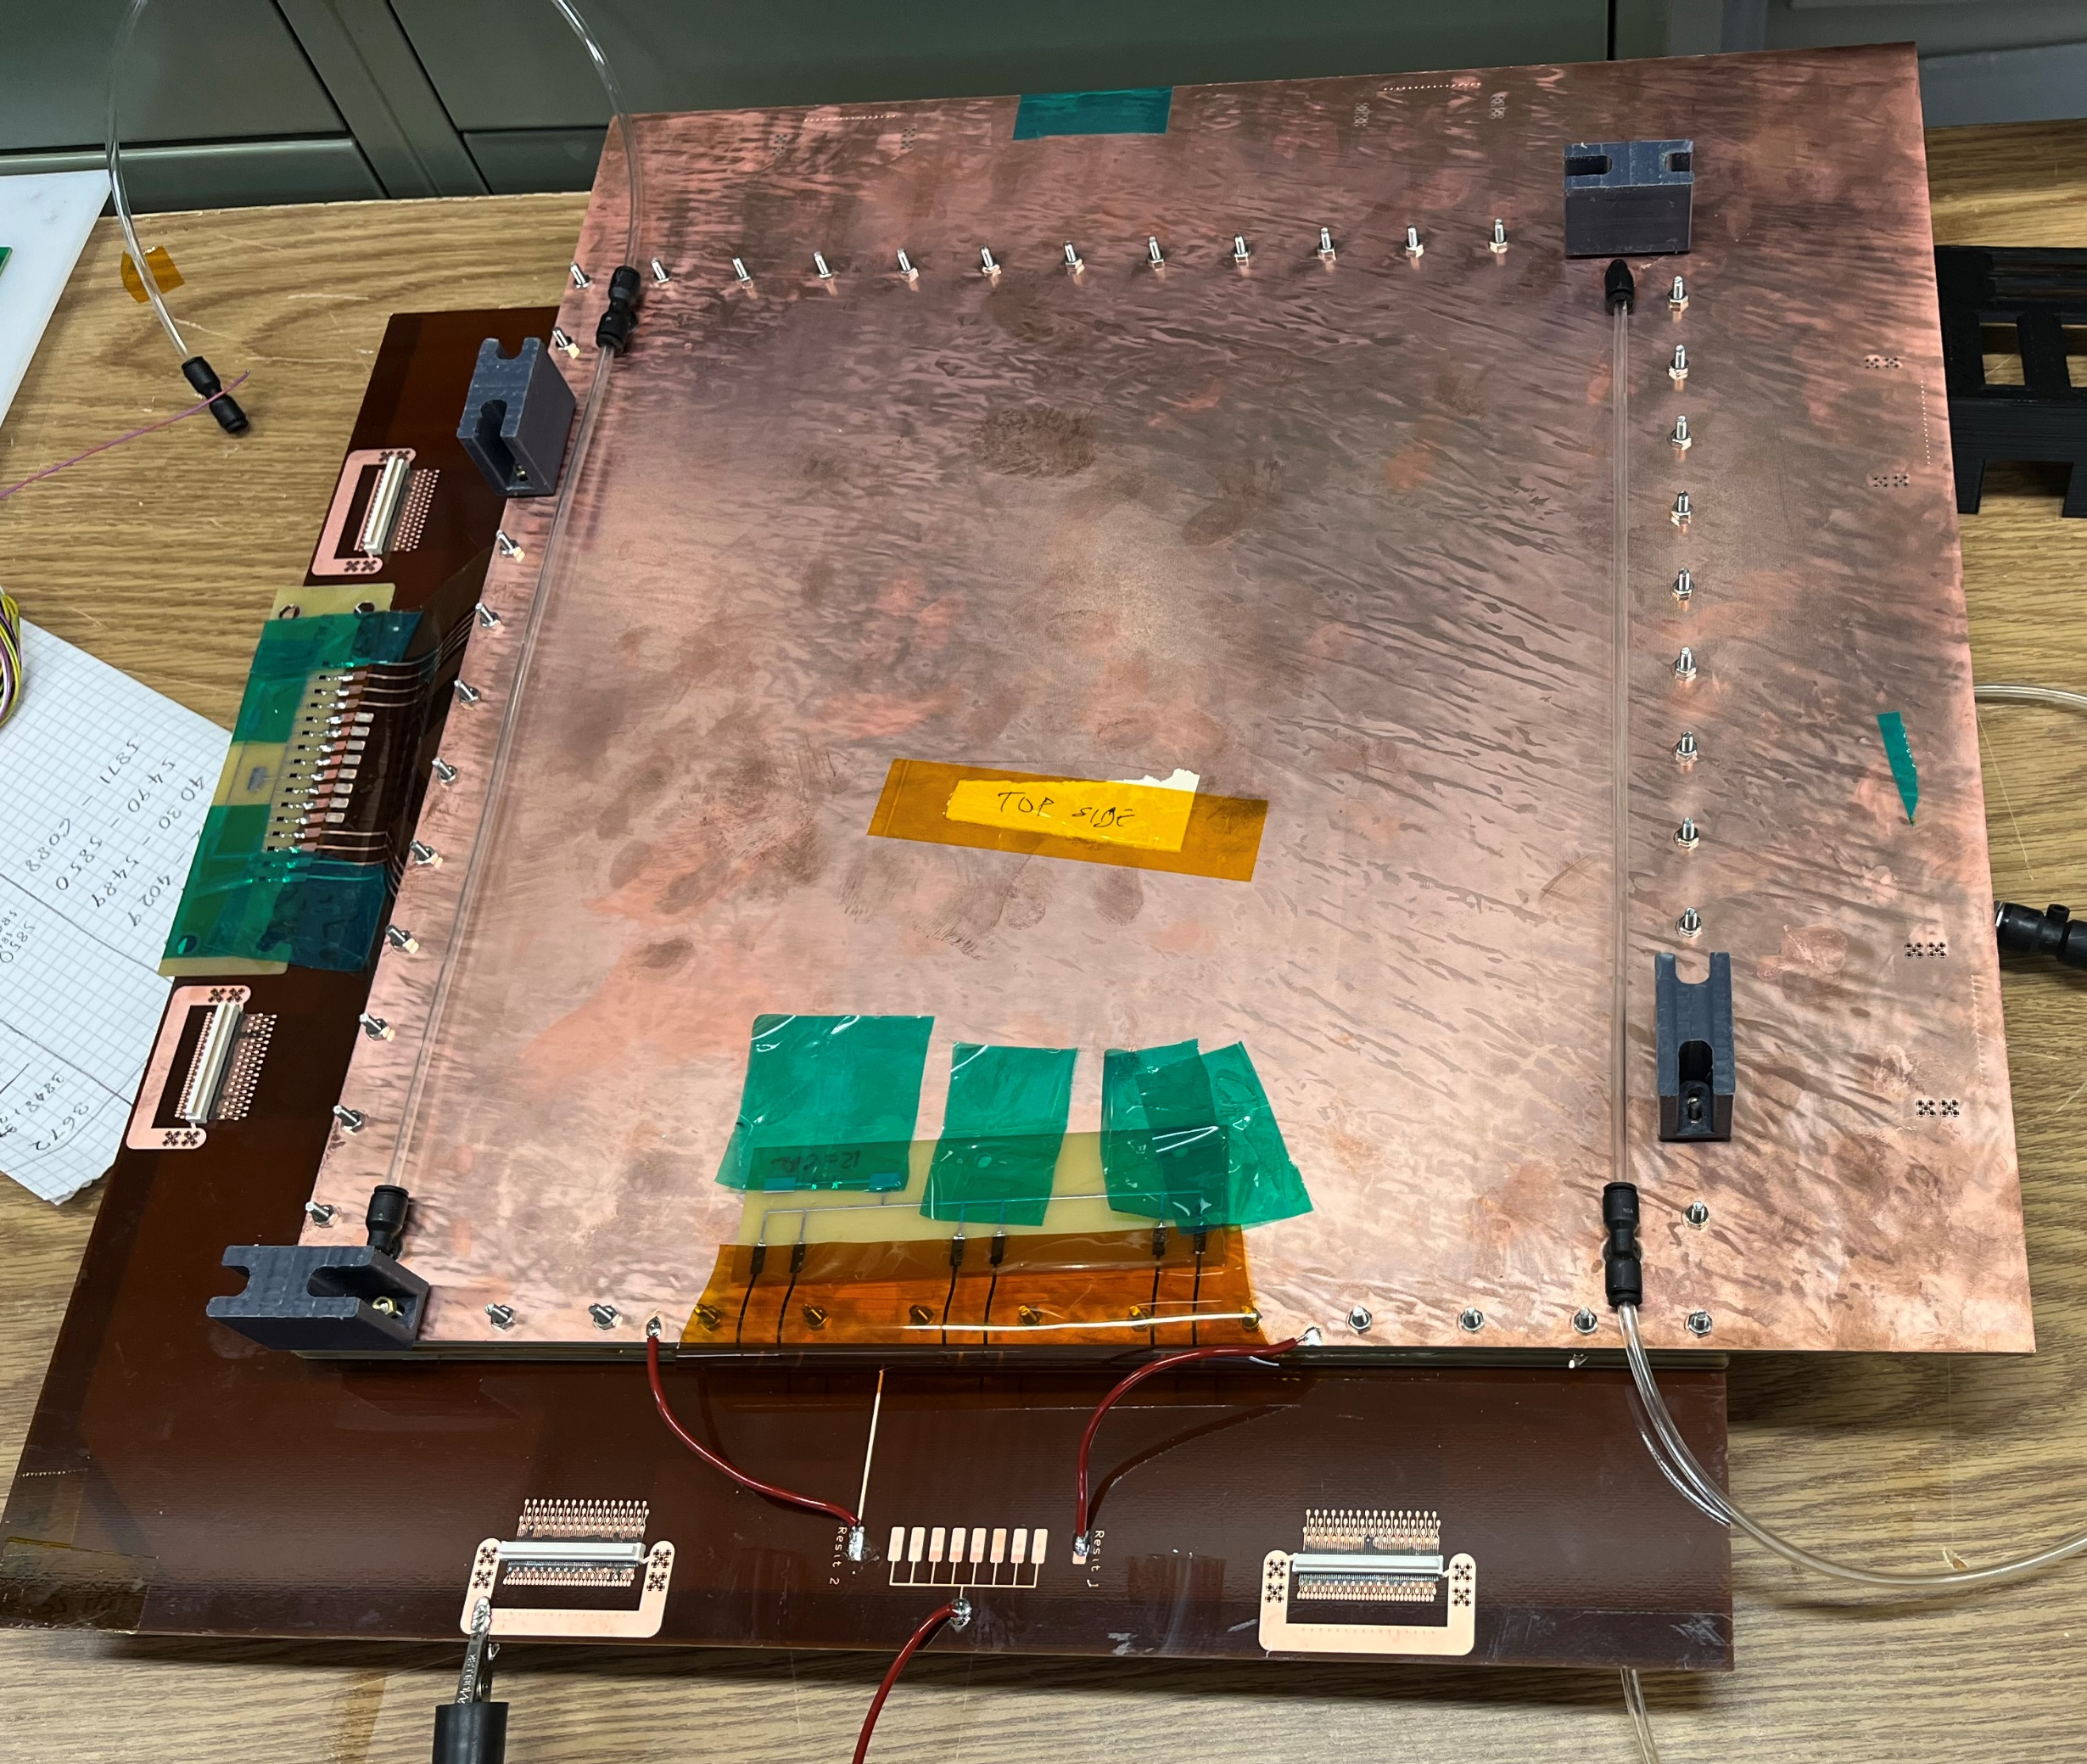
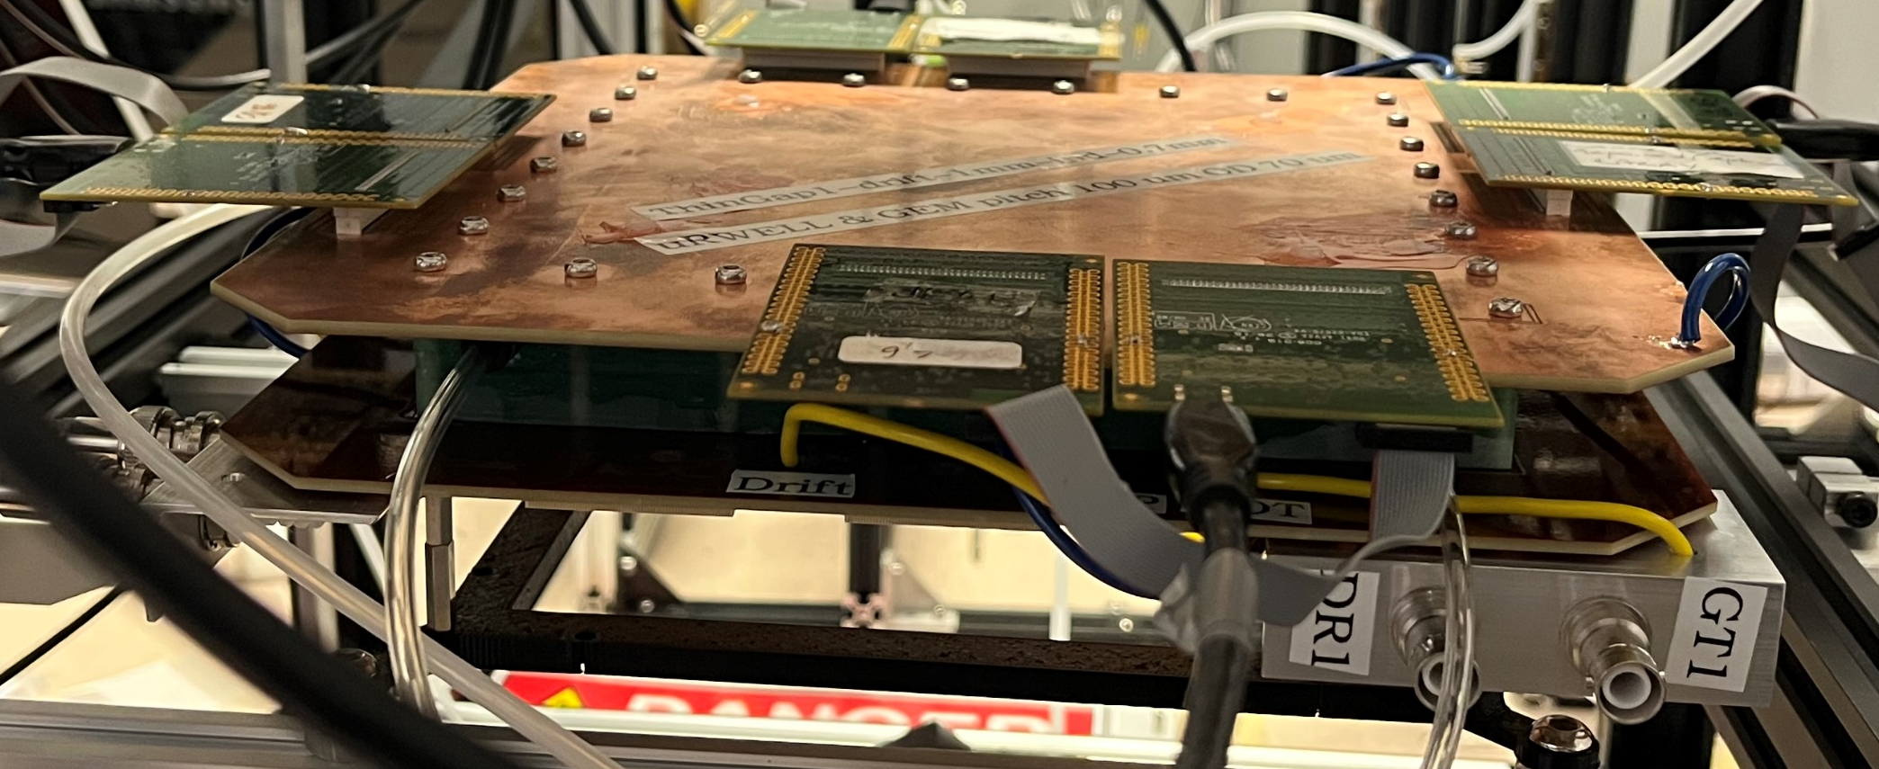
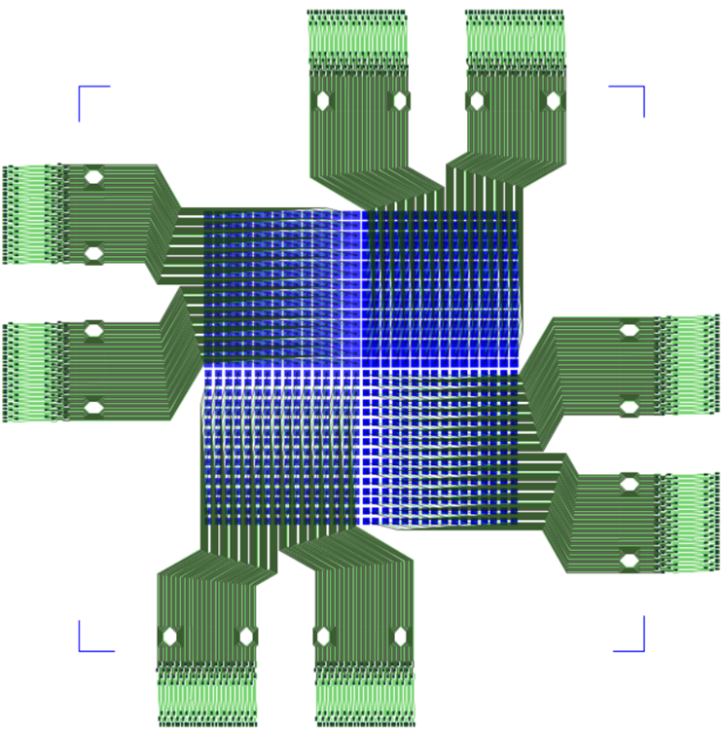
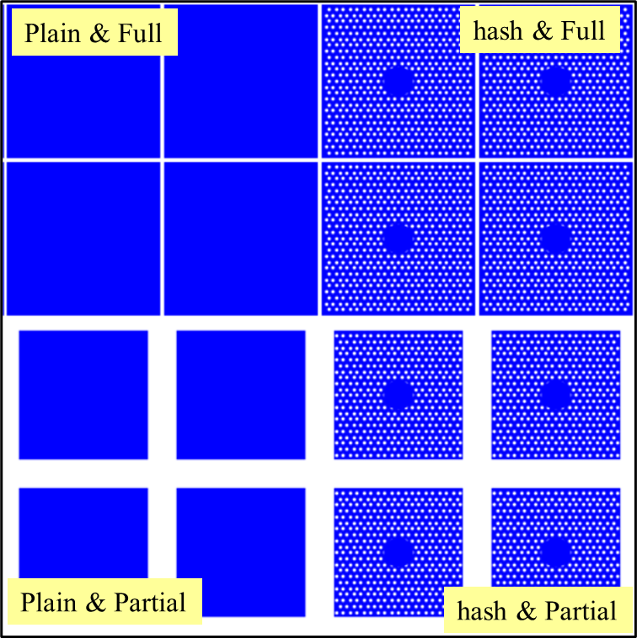
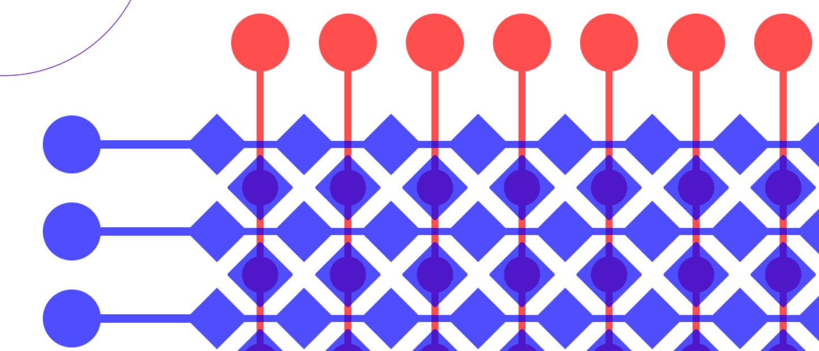
Generic R&D: Double Thin-gap GEM-μRWELL
S. Tarafdar - PI (JLab)
Medium prototype with X-Y strip readout
Small prototype with pad readout
1 mm
1 mm
30 cm
30 cm
1 mm
1 mm
Double-sided thin-gap GEM- µRWELL hybrid detectors with capacitive-sharing readout.
Two prototypes in beam test
Position resolution & HV scan
Performance in B-field
Share setup and gas needs with MPGD-BOT
X-strips
1.2 mm
Y-strips
Pad readout PCBs
3.2 mm pitch
4 quadrants with pad patterns
ASACUSA pattern X-Y-strip
https://www.jlab.org/sites/default/files/eic_rd_prgm/files/2023_Proposals/20230714_eRD_tgMPGD_Proposal_FY23_Final_EICGENRandD2023_16.pdf

Slide 11
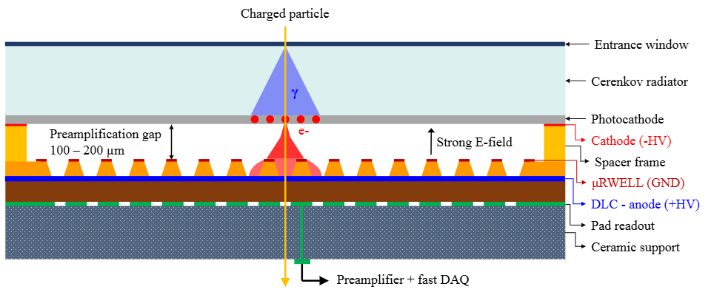
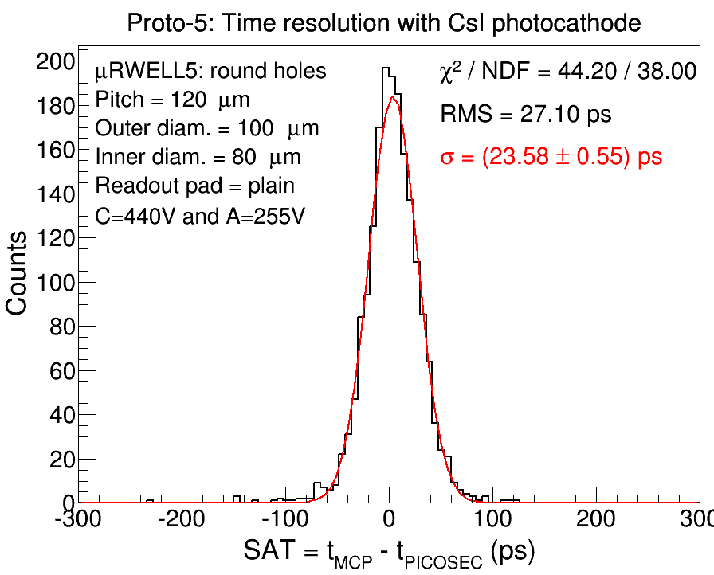
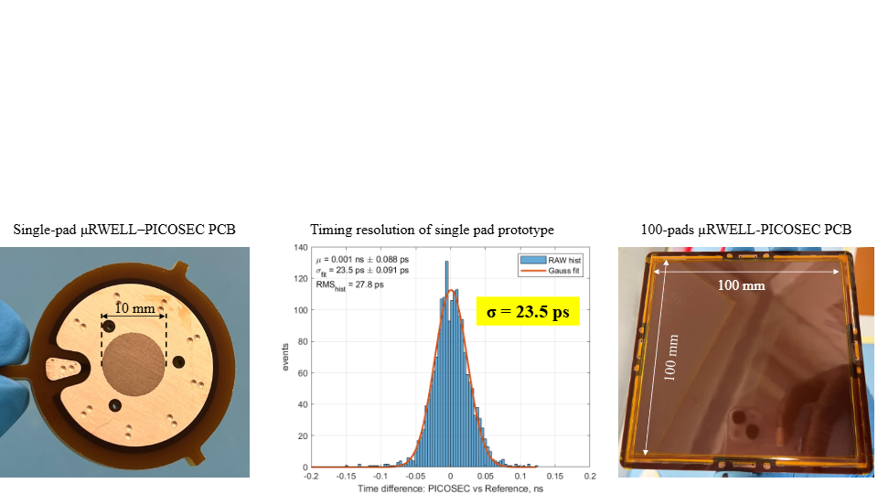
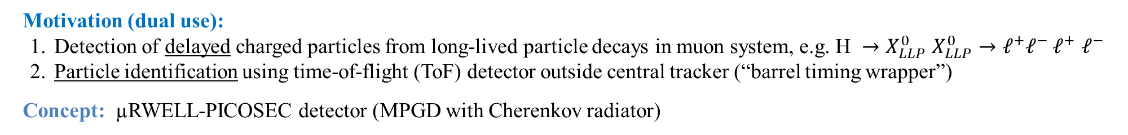
µRWELL-PICOSEC Technology @ the Future FCC-ee: Precision Muon Timing and ToF-based PID
M. Hohlmann - PI (FIT) & K. Gnanvo (JLAB)
Motivation (dual use):
Detection of delayed charged particles from long-lived particle decays in muon system, e.g. $\text{H} →X_{LLP}^{0}$ $X_{LLP}^{0}→ℓ^{+}ℓ^{−}$ $ℓ^{+}$ $ℓ^{−}$
Particle identification using time-of-flight (ToF) detector outside central tracker (“barrel timing wrapper”)
Concept: µRWELL-PICOSEC detector (MPGD with Cherenkov radiator)
First beam test results with single-pad μRWELL-PICOSEC prototype
Approach:
Design, construction, & test of 10cm×10cm prototype with 100 channels
Photocathode:
non-hygroscopic Diamond-like Carbon (DLC) instead of CsI
Beam test at CERN in summer 2026

Slide 12
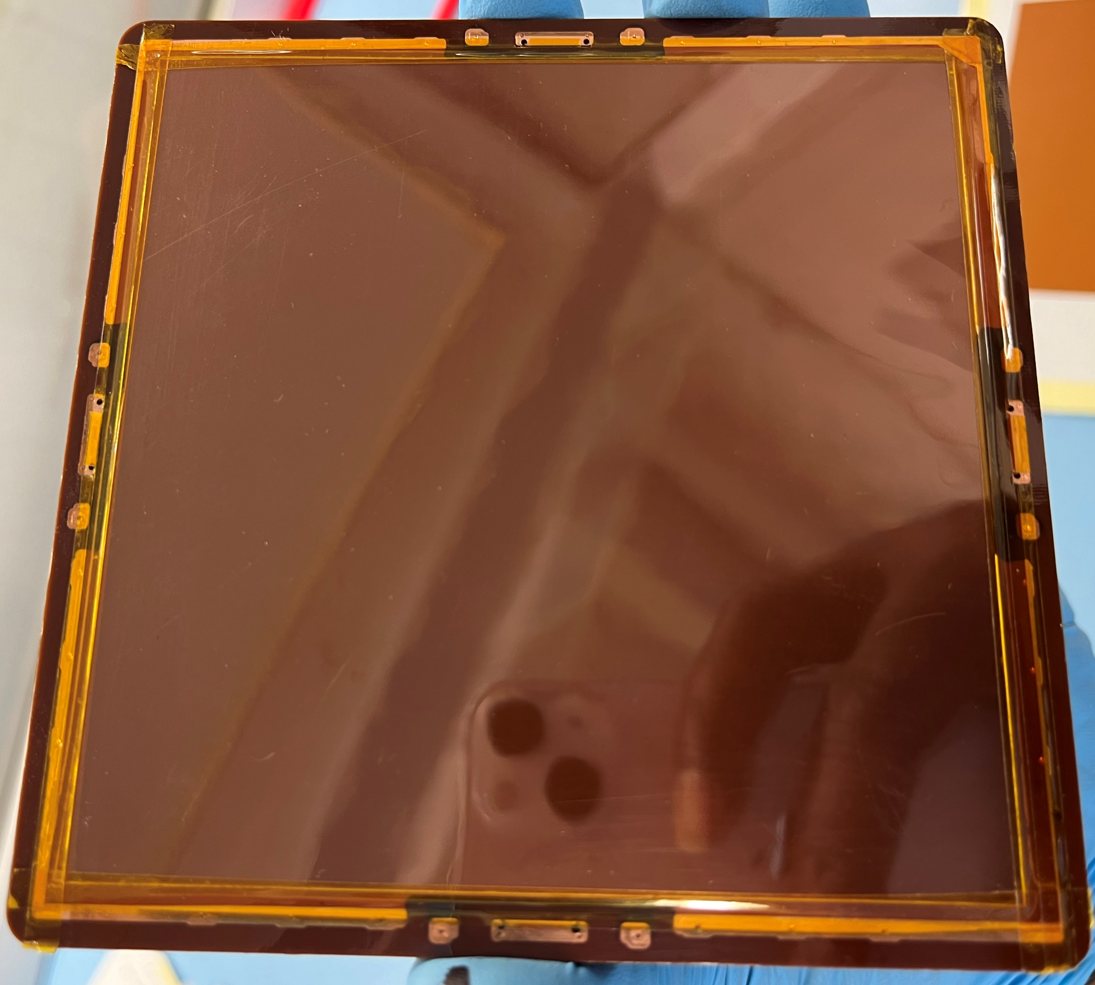
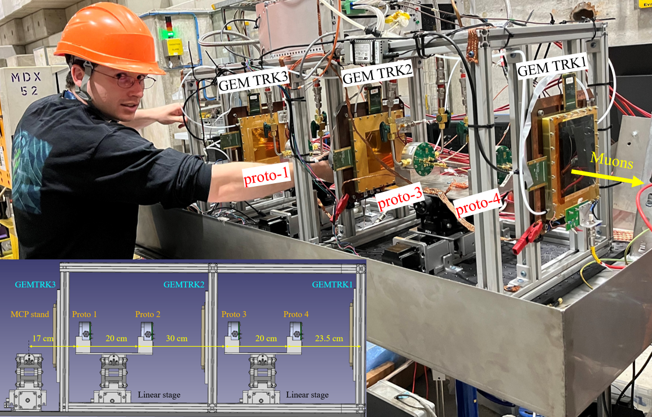
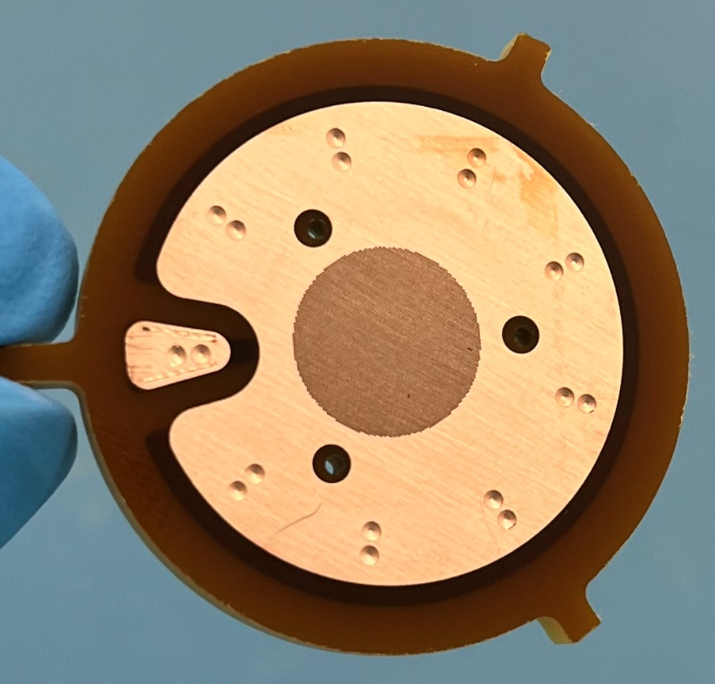
µRWELL-PICOSEC Prototypes: 2026 beam test plans
Ground ring
Active area
10 cm
1 cm
10 cm
DLC HV
Single-pad prototype
Large prototype (100-pads readout)
JLab PICOSEC telescope
Large prototype: (preferably in CERN PICOSEC Telescope)
New prototype with some minor modifications (HV contacts)
Test primarily with DLC photocathode
Single & Multi-channels with SAMPIC
Voltage and Position scans for response uniformity
Drift gap studies
Single-pad prototypes: (JLab PICOSEC-MM Telescope)
50 µm and new 75 µm μRWELL prototypes
Primarily with DLC photocathode
Voltage and Position scans for response uniformity
μRWELL hole geometry and sizes
Drift gap studies

Slide 13
Summary of July 2006 beam test requests
Physics Scope and planned measurements: Characterization of ePIC MPGD tracker full scale 1:1 PED test articles
MPGD-BOT setup: Standalone telescopes (include Generic R&D double thin-gap protos) ➔ thin gap hybrid GEM-μRWELL test article
MPGD-ECT setup: Standalone telescope for hybrid GEM-μRWELL full scale engineering test article + 46 cm × 40 cm prototypes
CyMBaL setup: Standalone telescope for curved full size Micromegas + small prototypes
Measurements: Efficiency, timing and position resolution studies through
HV scans, position scan, angle scan, gas mixture studies (timing)
performance in magnetic field (GOLIATH Magnet for MPGD-BOT setup)
Beam requirements when relevant (muons, pions, electrons, momentum, polarity, rate – high/low/scan)
High momentum muons, narrow pions and (electrons?) all OK ➔ rate scan desirable at the beginning of the test beam campaign
Required gas (mixtures and approximate amount – important to know asap)
Ar-CO₂ (80/20) for the reference trackers (2 -3 bottles) & Ar-CO₂-CF₄ 45/10/45 (existing bottle)
Ar-CO₂-iC₄H₁₀ 93/2/5 (3 bottles) or 93/5/2 (2 bottles)
Alternatively: Ar ( 3 bottles) , CO (2 bottles), iC₄H₁₀ (2 bottles) for the INFN 3-gas mixing system ➔ will benefit JLab and Saclay as well
Required infrastructure:
Two DESY tables (if possible) for MPGD-ECT and CyMBaL setups
DRD1 Trigger signal for CyMBaL setup
Two stands upstream & downstream GOLIATH magnets for MPGD-BOT setup

Slide 14
BACKUP

Slide 15
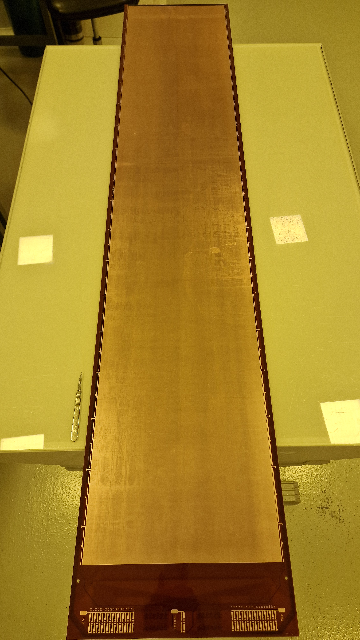
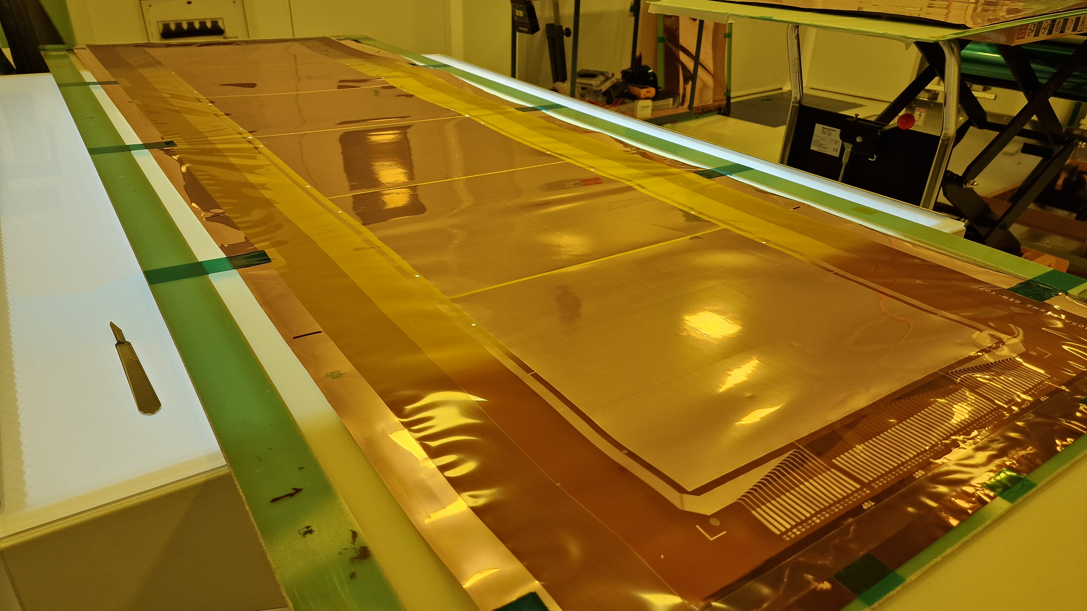
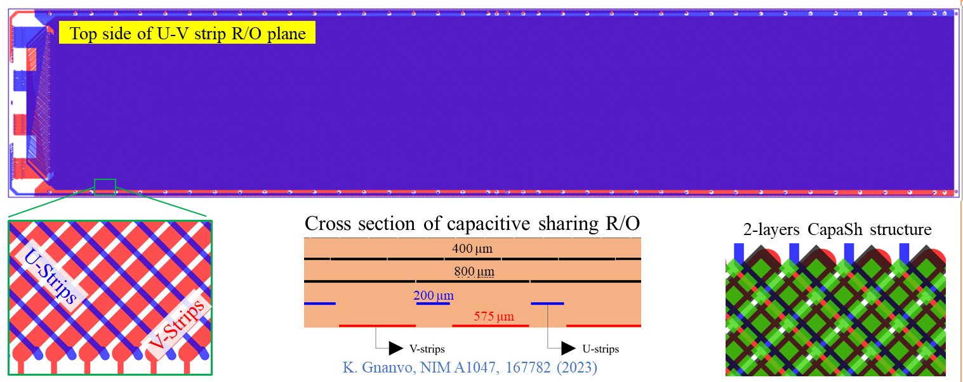
MPGD-BOT Test Article: Project Engineering Design
Detector major components are ready
GEM foil, μRWELL / CapaSh-X-Y strip readout PCB and detector support frames are all in hand at JLab
Clean room infrastructure and equipment at JLab almost complete
Assembly start week of Oct.13th ➔ Completed by December 15th
Plan to test performance in beam in Spring-Summer 2026
Test article validation in 2026 ➔ Pre-production modules in 2027
μRWELL / CapaSh readout PCB: Front view
Capacitive sharing readout with X-Y strips @ 45º
GEM foil

Slide 16
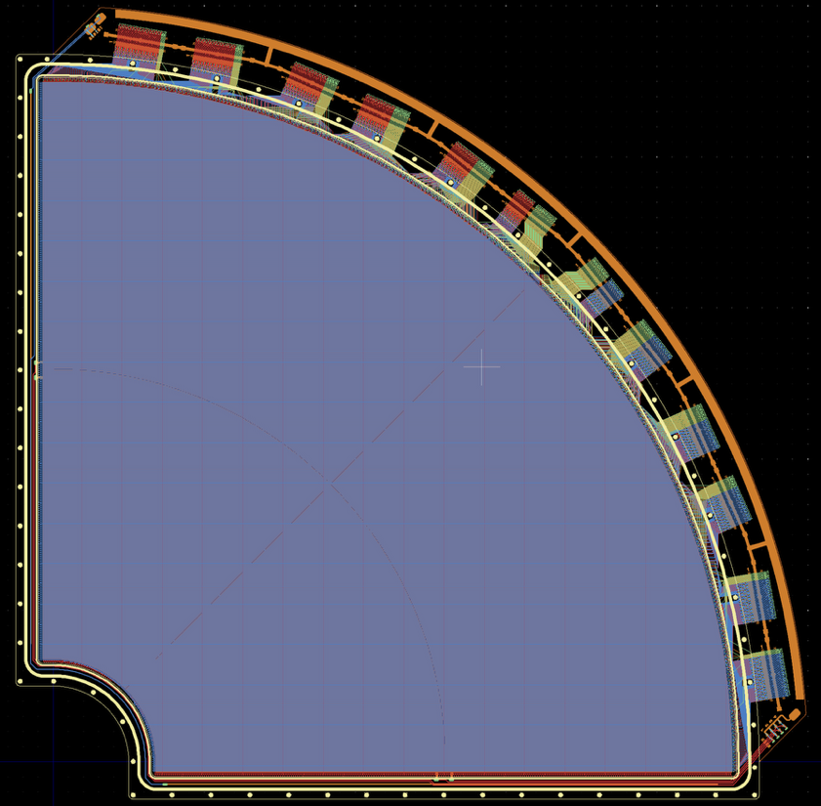
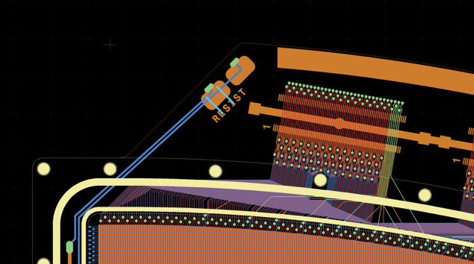
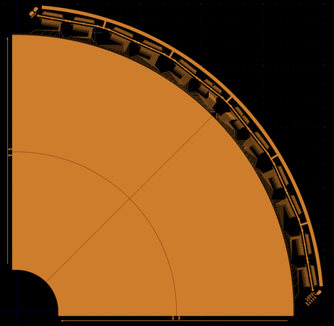
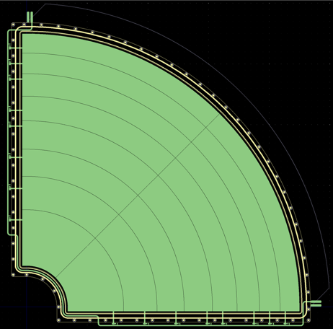
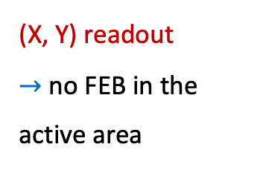

ePIC MPGD Endcap Trackers: µRWELL-ECT
PED Test Article Module to be delivered and characterized in November Test Beam at CERN-SPS NA H4
$$µRWELL readout$$
Strips routing
(X, Y) readout
$→$ no FEB in the active area
X/Y strips
600 µm pitch

Slide 17
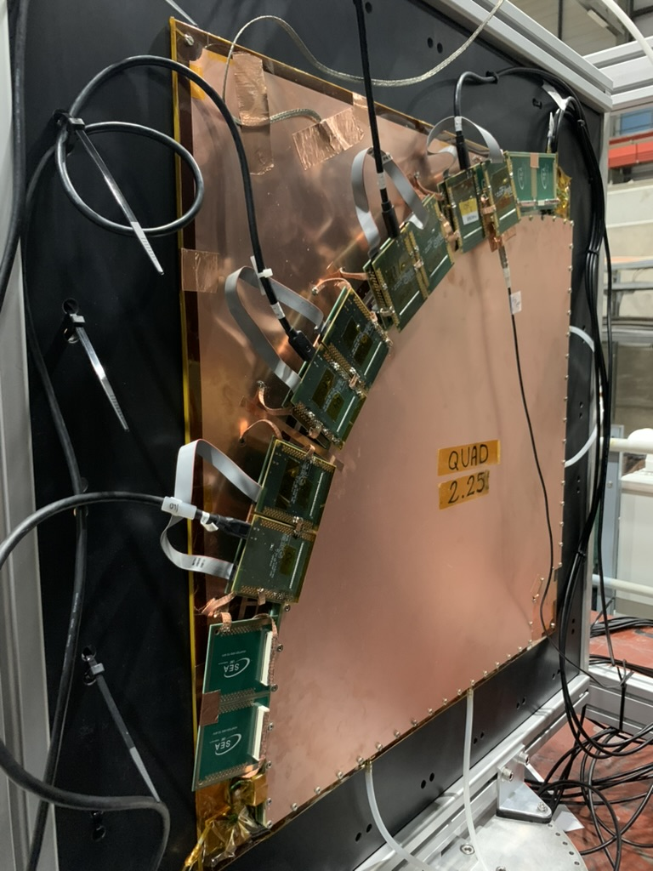
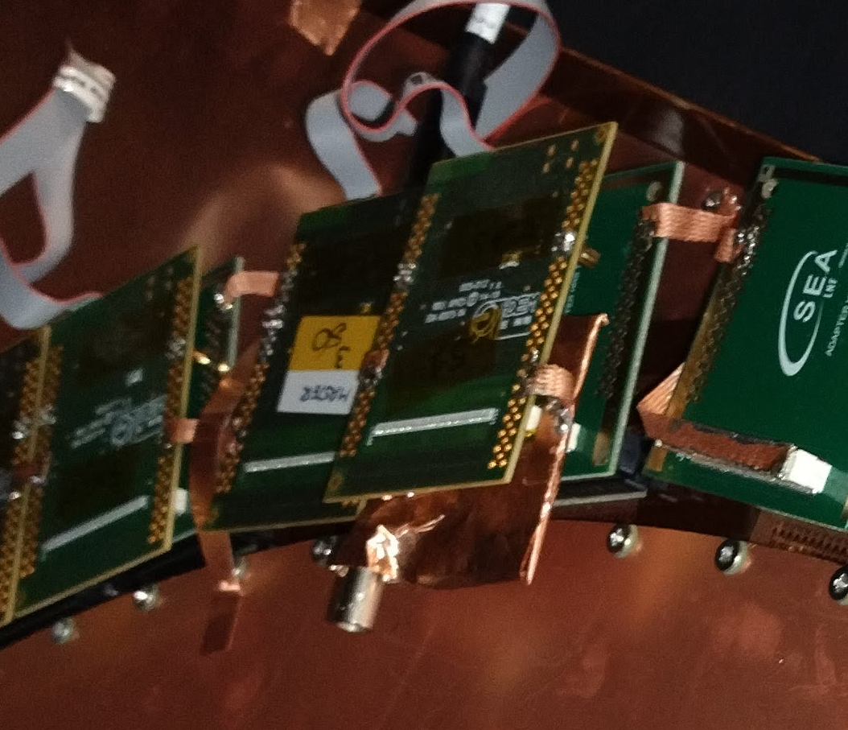
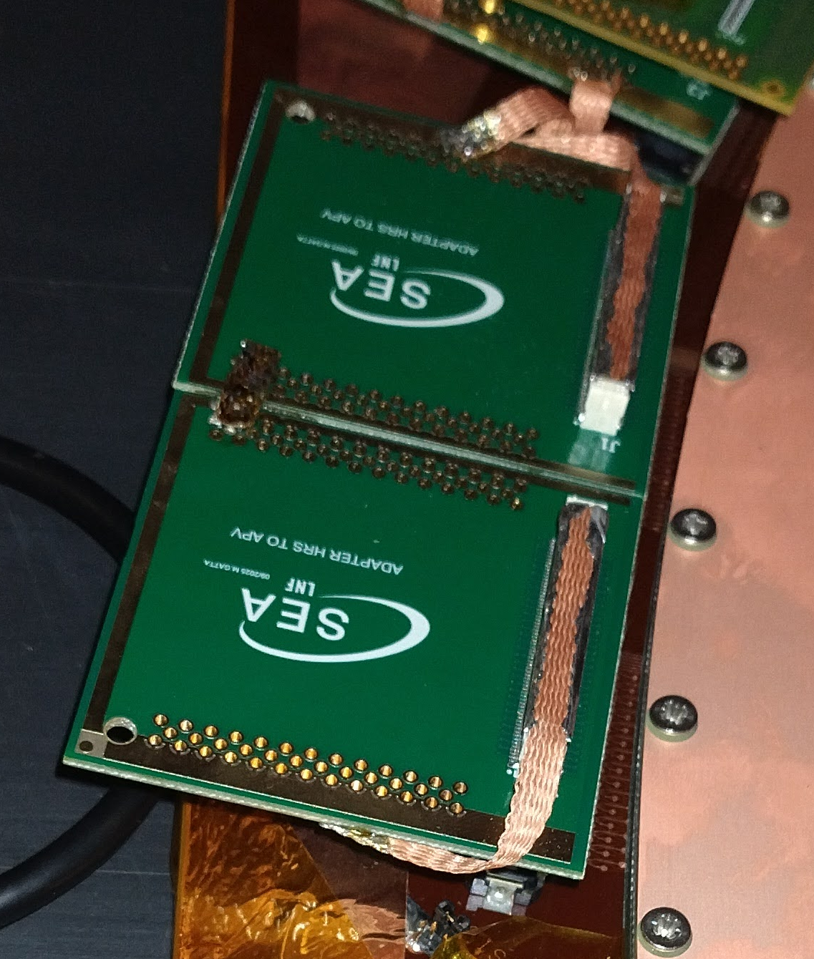
DAQ
Trigger Signal
Injection Board
Data Pipeline
Detector
APV25
SRS
mmDAQ3
HIROSE to Panasonic
Transition Board
Corryvreckan

Slide 18
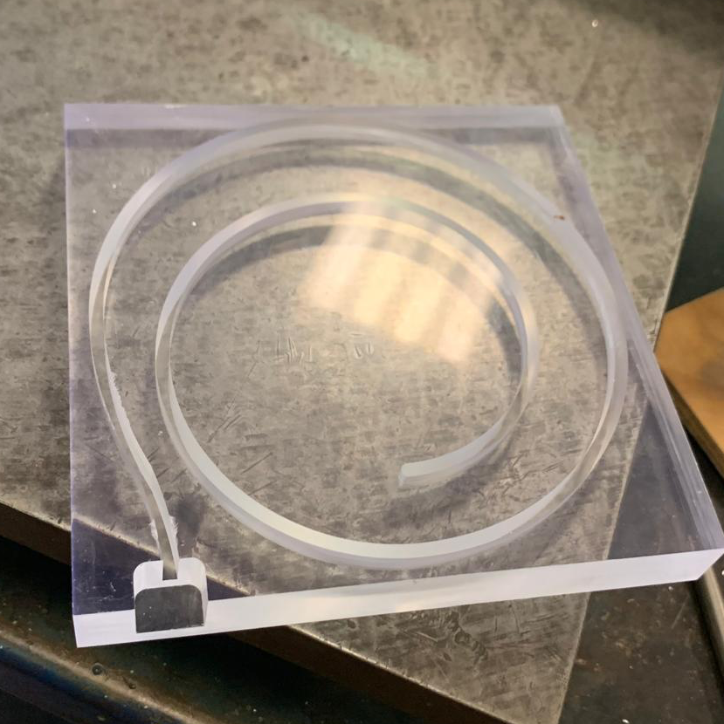
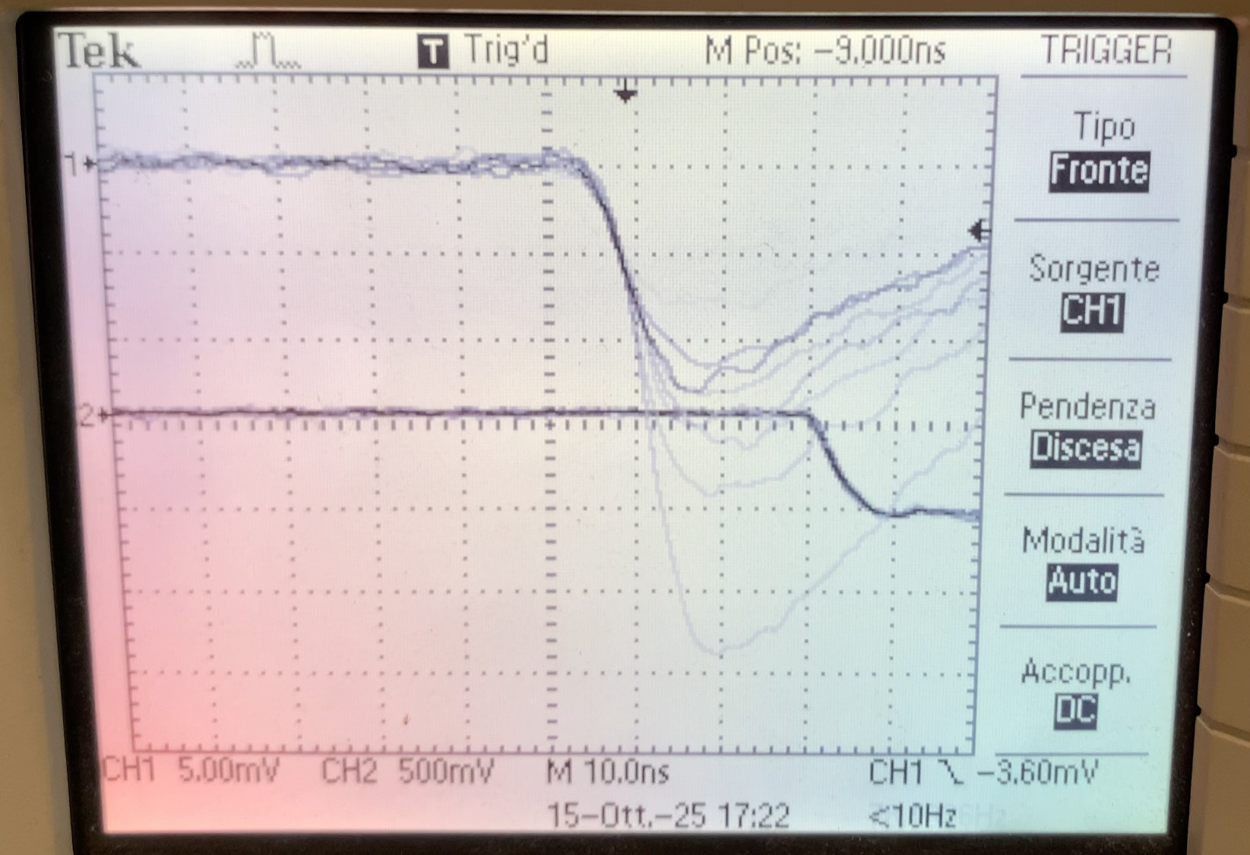
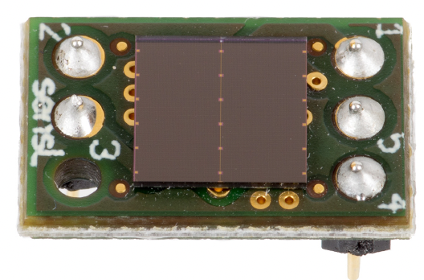
Trigger
×9 Ø1 mm wavelength shifter fibers
Bundled and embedded in the groove
Onsemi J-Series 30020
3x3 mm² SiPM Area
Non-amplified signal output
from cosmic rays
Also provides a time reference (t₀) to selected APVs for µTPC reconstruction

Slide 19
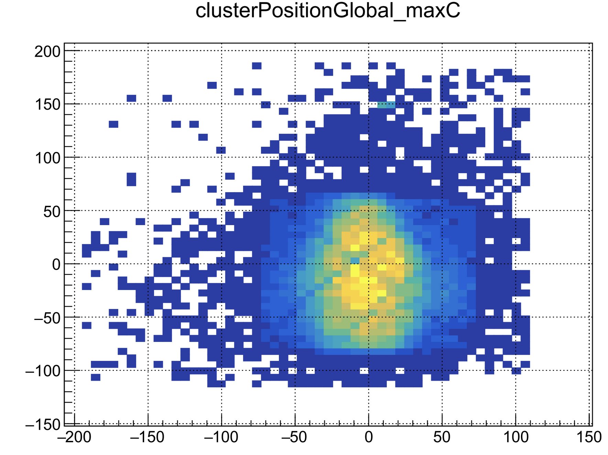
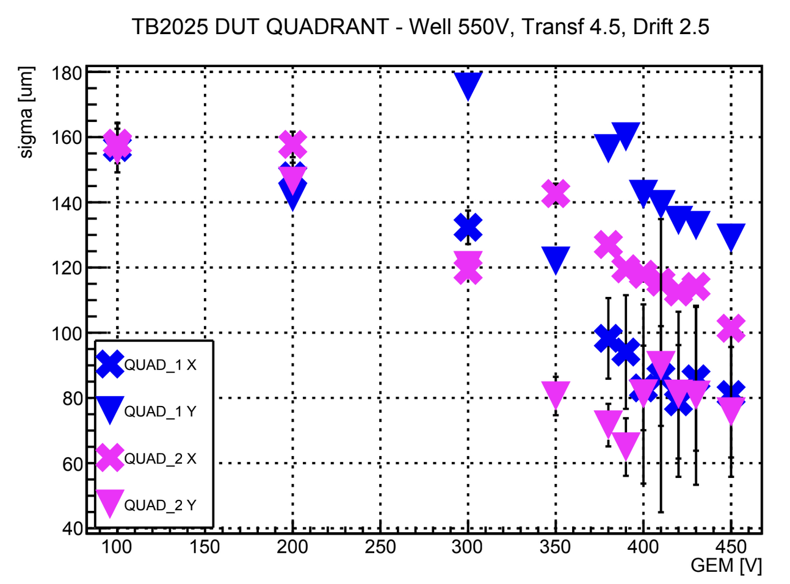
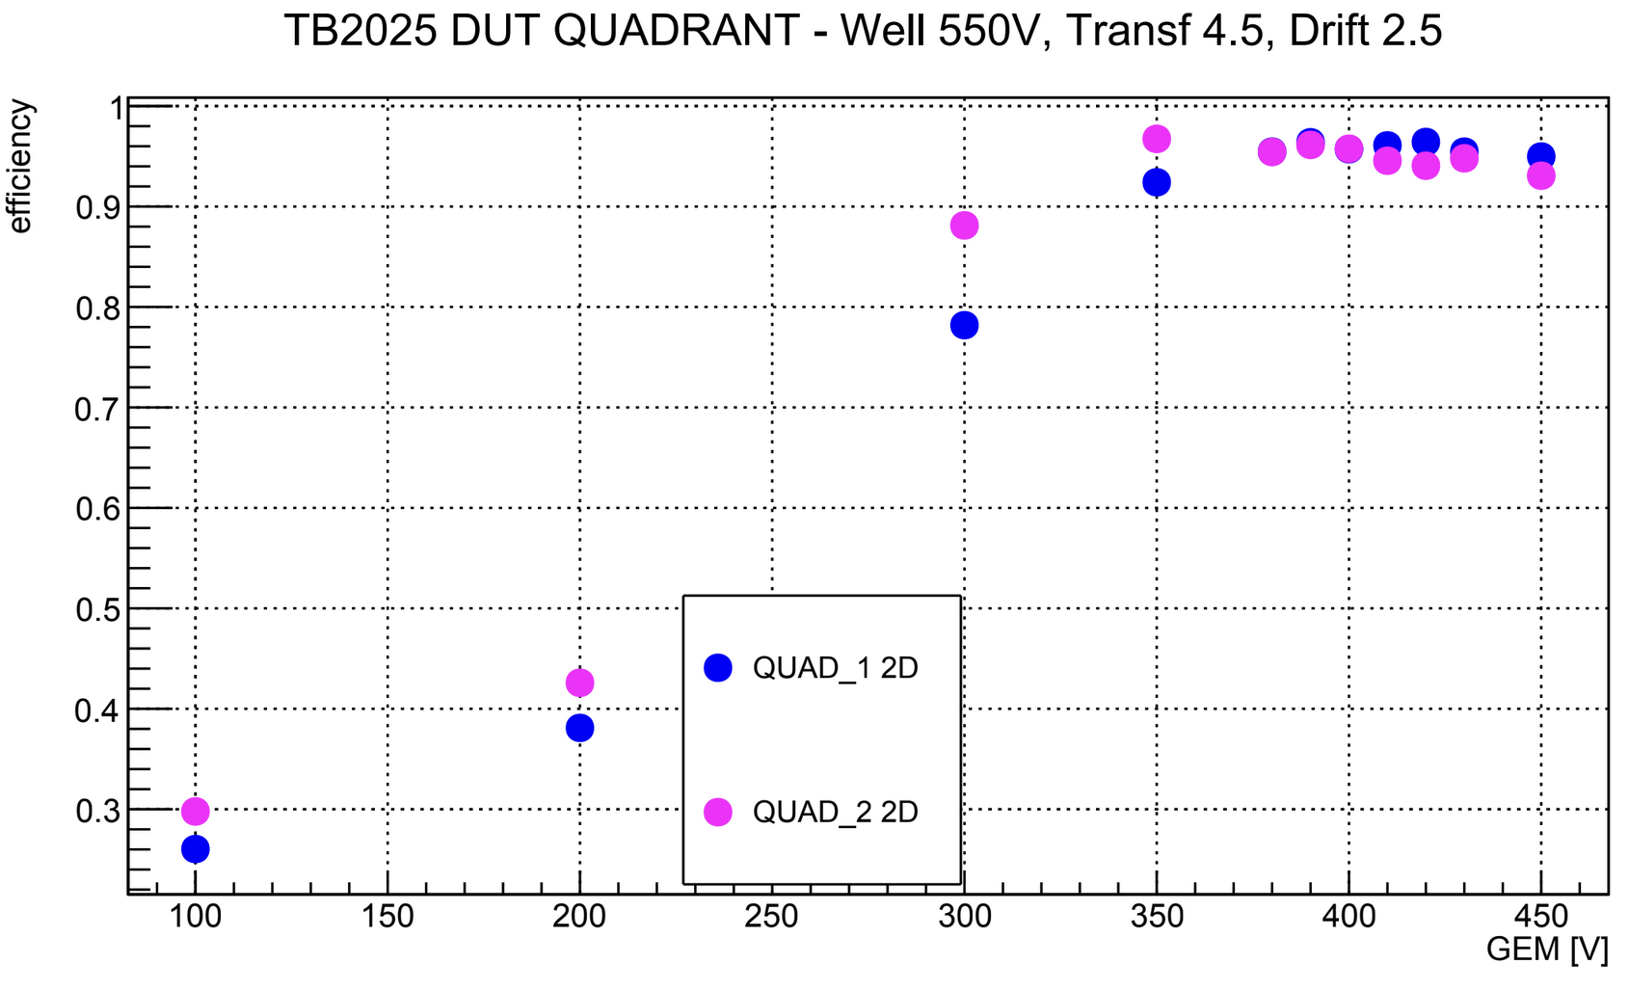
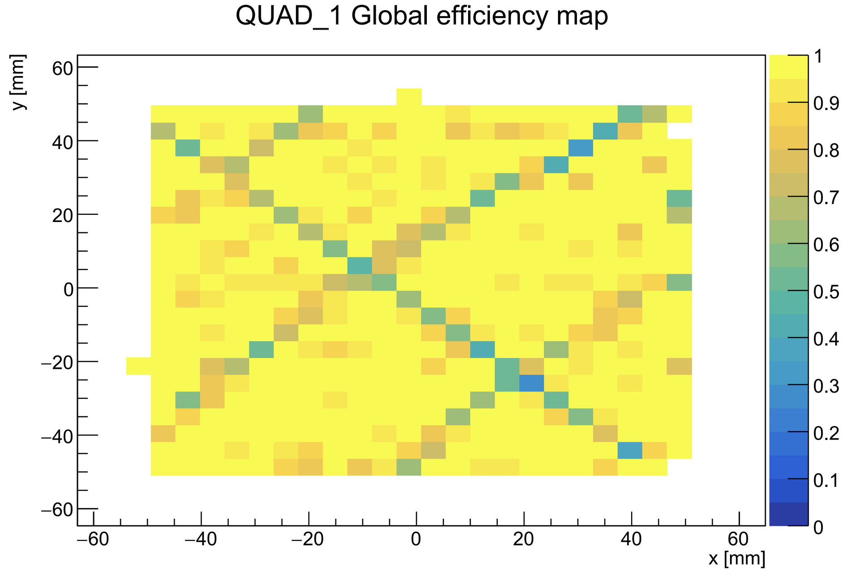
Preliminary Results from TB-2025 Data
Highest charge cluster position QUAD1 (w/ grids)
Residuals’ σ VS GEM Voltage *
PRELIMINARY
PRELIMINARY
2D Efficiency [1x1 cm²] VS GEM Voltage *
PRELIMINARY
PRELIMINARY
Preliminary performance satisfy requirements @ HV GEM = 350V
Generous leeway for safe detector operation and optimization
* WELL = 550 V
TRSF = 4.5 kV/cm
DRFT = 2.5 kV/cm

Slide 20
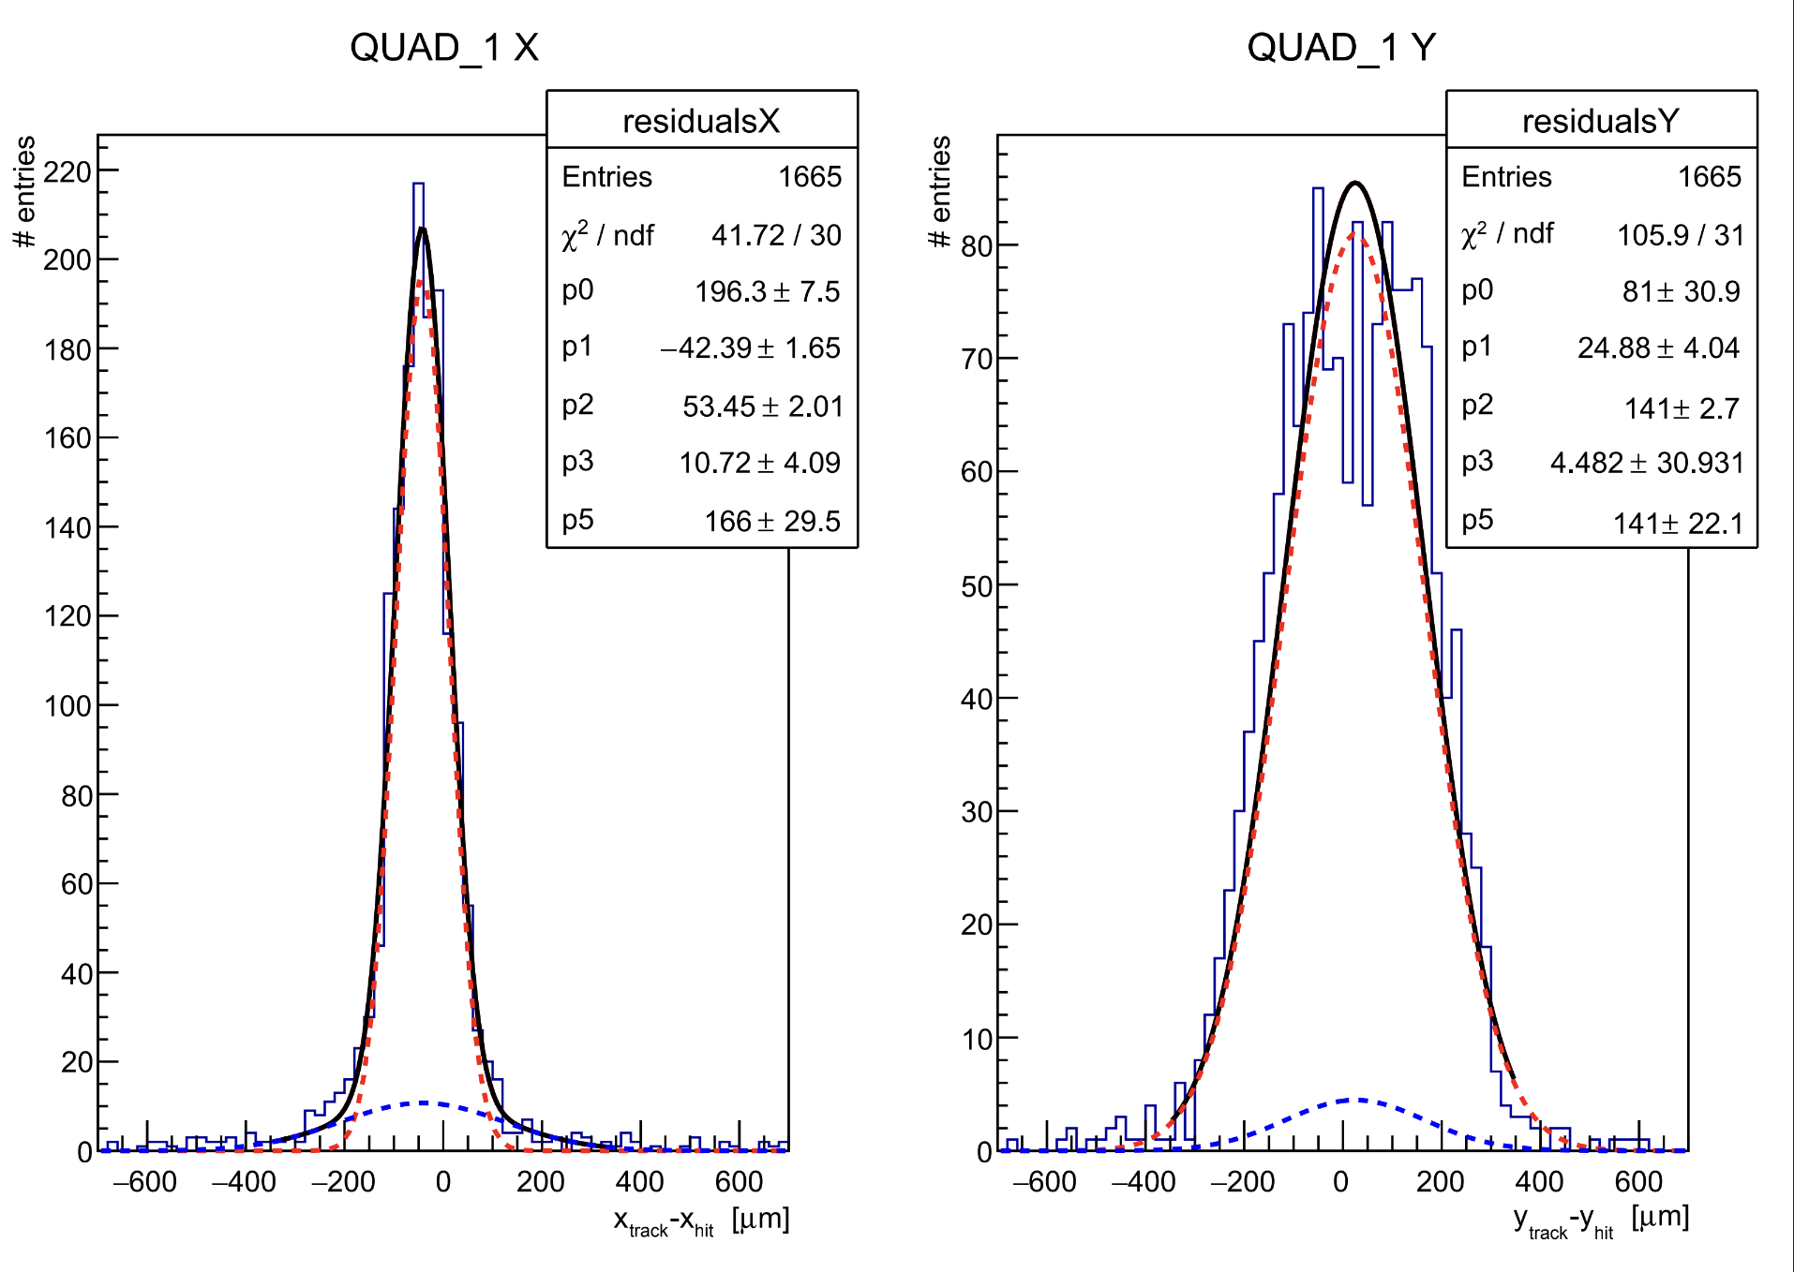
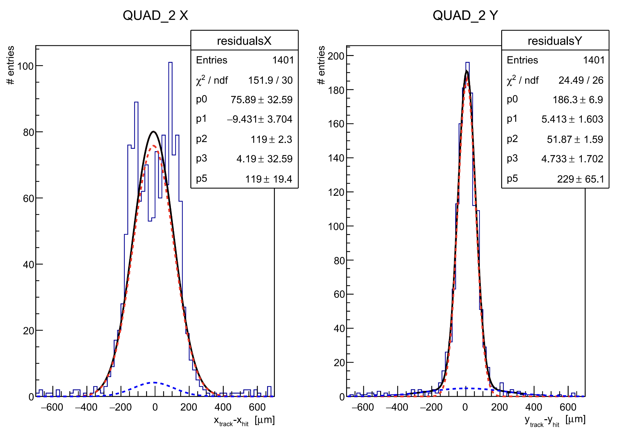




Residuals Distributions
PRELIMINARY
$$σ_{x eff}=\text{80}μm$$
$$σ_{y eff}=\text{141}μm$$
$$σ_{x eff}=\text{1}20 μm$$
$$σ_{y eff}=\text{88} μm$$
Lower view
520 μm strips width
Upper view
90 μm strip width
Upper view
90 μm strip width
Lower view
520 μm strip width
The two quadrants are rotated by 90 degrees with respect to each other, hence the X-Y exchange

Slide 21

Size and Charge of the Signal Clusters
Cluster Size VS GEM Voltage *
Cluster Charge VS GEM Voltage *
QUAD1
QUAD2
Cluster Size
Cluster Charge
PRELIMINARY
PRELIMINARY
Charge sharing visibly skewed in favor of the wider strips of the lower view
* WELL = 550 V
TRSF = 4.5 kV/cm
DRFT = 2.5 kV/cm

