Slide 1
Electronics and DAQ WG Meeting (3/5/2026) – MAPS Slow Control Links
Announcements, Schedule, News
MAPS slow control links:
Jo Schambach - Architecture of the MAPS detector links / Aggregators
Grzegorz Deputch - Needs of the links
Discussion…

Slide 2
Schedule
CD-3B approval (Feb 6th)
Detector Baseline Review: February 3-5, 2026
E & DAQ Meetings:
2/25 E & DAQ WG: Polarimetry
3/5 E & DAQ WG: SVT Slow Controls Links
3/12 – No E & DAQ Meeting due to Director’s EIC Review
3/19 – E & DAQ WG: ASICs and Electronics Monthly Meeting
3/26 – E & DAQ WG: Felix Test Development / Test Stands
Reviews
Director’s EIC Review: March 9-12, 2026
DOE Independent Project Review of the EIC Project Status: 4/28-5/1, 2026
DOE CD-2 Review for DET subproject (Goal is by end of 2026)
PDR → Peer Review for Slow Controls (~June 2026)
Global Interlocks (Not currently under Slow Controls P6 but also not anywhere else)
Goal for CD-3 is by end of 2027 – need to start planning for FDR’s and expect similar review schedule in 2027 aimed towards CD-3

Slide 3
Other Activities
Tasks in TBD:
Develop a summary document for Supported Data Volumes / Rates
Project effort to understand heat load in detector.
Packages In Use – Thanks!
VHDL: Vivado (licenses need to include Versal Support), Quartus (Where do we have Altera?)
HOG (HDL on Git) not in use by anyone but suggested as possible method for handling GIT along with Vivado/IDE’s source control. Scripts store/rebuild projects so that the full project files don’t need to be stored in GIT.
PCB Design: PADS, Altium
Simulation Tools:
Questasim,
Riviera Pro,
Symplify Premier
Simbeor (3D simulations for signal integrity)
Fernando: Power Distribution Tree’s
Fernando: Peer-review (strawman schedule)
Discrete – 25 March
EICROC – 1 April
CALOROC – 8 April
FCFD – 15 April
ALCOR – 22 April
SALSA – 6 May
Other Business?

Slide 4
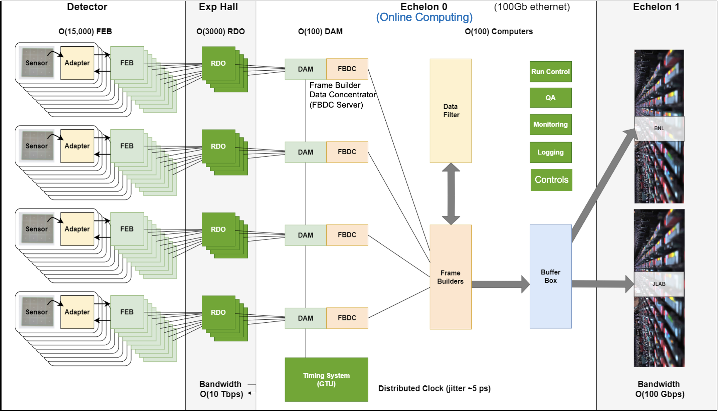
General Detector Fiber Links
Down-links:
Fiber link from FELIX to RDO/FEB is only information link planned for FEB slow controls
Link shares “fast commands”, slow controls, and configuration information
No other information downlinks planned
Power links are not handled through this interface, nor systems (e.g. gas/cooling) not embedded on FEBs. Control for such are handled off-detector at power supply locations.
Up-links:
Primarily for data
Multiplex results of slow controls commands
3-Downlink Mechanisms:
Fast commands “triggered” by GTU syncrhonised to bunch crossings (restricted to every 5th 100 MHz clock tic/every 2nd 40 MHz clock tic)
Configuration “triggered” by GTU but managed by each specific detector’s FELIX board/computer. Can be private to each detector.
Slow Controls triggered by IOC communicating with EPICs. IOC runs on FELIX board/computer and can use detector specific features &/or I2C
Up-link
Down-link

Slide 5
MAPS detectors – DAQ Perspective (Part 1)
SVT has a complex setup as the readout and the slow controls are more separate than for other detectors
For SVT they are decoupled:
Delivery of Clock / Fast Commands/ Config Info hasn’t been described in detail within the DAQ group (Jo has presented many details, but full picture isn’t completely understood for many non-SVT experts…)
Typical ePIC readout chains provide each component with a downlink and one/many uplinks:
FEB
FELIX
187 x lpGBT
Aggregator
xN
(or)
FELIX
RDO
?
?
FEB
FELIX
xN
(…)
FEB
1579 x VTRX+
Aggregator
xN
xN

Slide 6
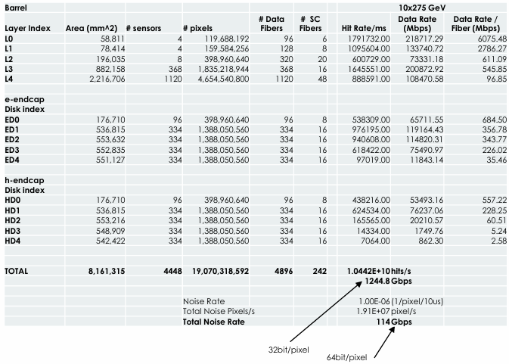
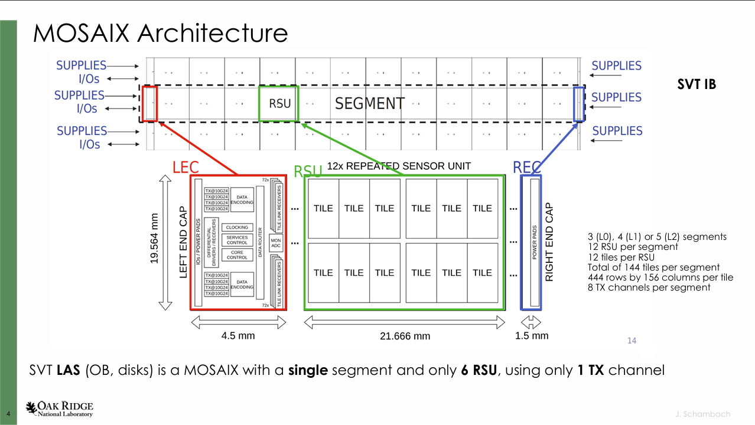
MAPS detectors – DAQ Perspective (Part 2)
SVT has an enormous number of pixels (16B) (each of which can be independently controlled to some extent)
SVT has a huge variation in rates throughout the detector resulting in a variable aggregation scheme
Configuration / Calibration
Average Detector Fiber Use:
78M pixel / SC Fiber
3M pixel / Data Fiber
How do RDO/aggregators effect this? Nominal plan is 12:1 TX fiber aggregation.
Are rates for calibration and/or configuration problematic?

Slide 7
MAPS detectors – DAQ Perspective (Part 3)
Integration Time (2us?). Do the standard timing interfaces / Fast command expectations apply? Eg rev-tic? Timing Reference Start? Trigger to give Timing Reference value?
Are the 2us integration times synchronized or not (within the same tile)
Are the 2us integration times synchronized for tiles within the same RSU?
Are the 2us integration times synchronized for RSU’s in same segment?
Are the 2us integration times synchronized for segments in same MOSAIX?
Are the 2us integration times synchronized for separate fibers in same MOSAIX?
Are data integration boundaries synchronized with same 2us integration time bunch borders provided by GTU for sensors detector-wide?
What are the specific rules/boundary conditions for the mapping between time of a hit and the 2us window(s) the hit is assigned to?
Mapping of RDO / slow controls links. At ~>400 RDO and 187 downlinks many RDO’s have no downlink. The mapping between RDO and downlink is not understood. The mapping of FELIX to downlink is also not understood.
Can we enumeratate the calibration / configuration needs?

