Slide 1
ePIC DAQ setup at BNL_510_1-231

Slide 2
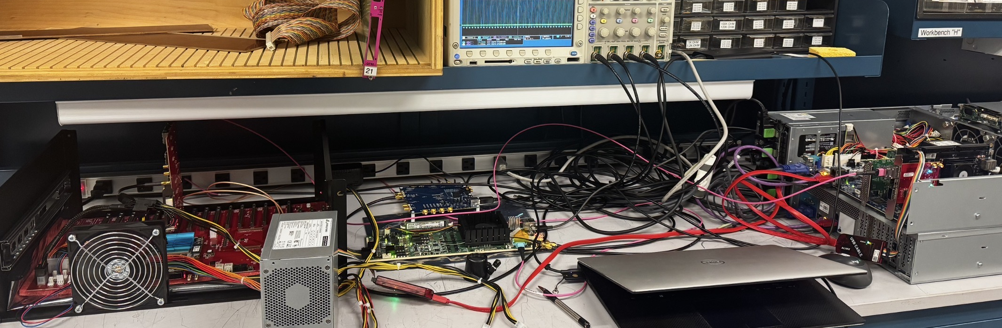
opticPlugInGTU
FADEonAXU15
protoGTU
Si5344H
GTU02
GTU01.phy.bnl.gov
FLX155
JTAGcables

Slide 3
ALMAlinux 10
/tools/Xilinx/Vivado/Vitis 2024.1 license @maia.phy.bnl.gov
/home/jwillgu/PCIeControl/Axu15DAM on GTU02 xdma software/driver
/home/jwillgu/fpga_v2024/GTUzu19 on GTU01 xczu19EG firmware
Axu15DAM on GTU02 xcau15p firmware
Flx155DAM on GTU02 xcvp1552 firmware
GTU01.phy.bnl.gov
GTU02.phy.bnl.gov
USB
JTAG
USB
UART
USB
JTAG
PCIe3x4
USB
(JTAG)
PCIe5x8
PCIe5x8
Si5344H
Clock
protoGTU
FADEonAXU15
FLX155
opticPlugInGTU
MTP fibers
RDOs
RDOs

Slide 4
Thank you
The firmware and software are starting

Slide 5
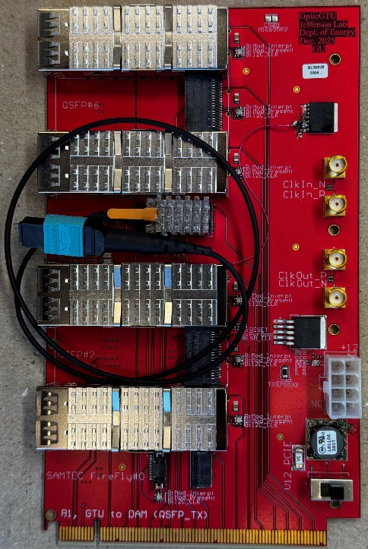
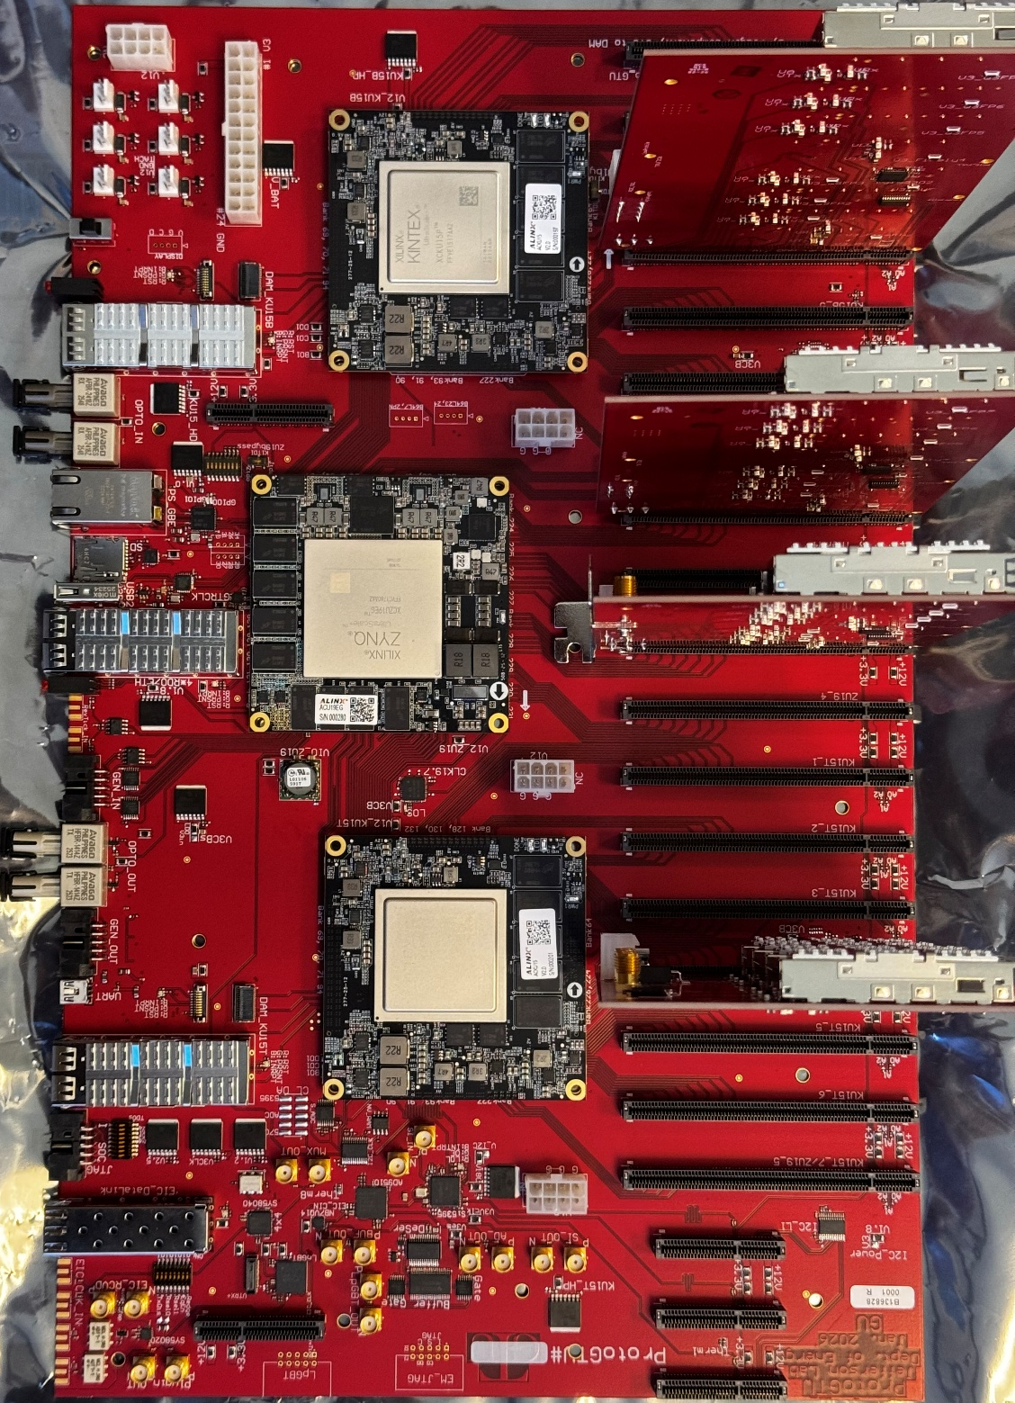
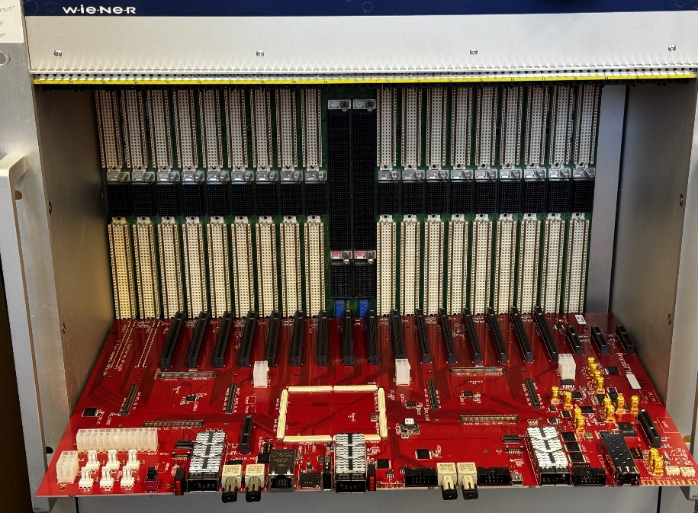

Slide 6
The ePIC clocks:
Single clock source, distributed to the whole system
* * * * * * * *
* * * * * * * *
* * * * * * * *
1 1 1 1
1 1 1 1 1 1 1 1 1 1 1 1
1 1 1 1
2 2 2 2
1 1 1 1 1 1 1 1 1 1 1 1
2 2 2 2
EIC_beam_orbit
5 5 5 6
5 5 5 5 5 5 5 6 6 6 6 6
5 5 5 6
7 8 9 0
1 2 3 4 5 6 7 8
3 4 5 6 7 8 9 0 1 2 3 4
7 8 9 0
1 2 3 4
1160 (all or 1/4 with beam)
100 (no-beam /gap)
EIC_BX_Clock, 98.5 MHz
GTU→DAM, 19.7 MHz
(Frequency divided by 5)
ePIC system clock
Fixed delay (divider, cable, PCB delays)
The phase (divider) is determined by the orbit information
39.4 MHz
DAM rec. Clock
98.5 MHz
others

Slide 7


The ePIC downlink (fast controls)
ePIC system clock
(19.7 MHz)
GP_{N-1}
GP_{N}¹
GP_{N}²
GP_{N}³
GP_{N}⁴
GP_{N}⁵
GP_{N+1}
GP_{N}, Five 64-bit words, 8b/10b encoding, ➔ 7.88 Gbps, 320-bit per ePIC system clock cycle
The DownLink, DAM → LpGBT (39.4 MHz)
DgP_{N-1}
DgP_{N}¹
DgP_{N}²
DgP_{N+1}
DgP_{N}
LpGBT and VTRx+ dictated package format, extracted (repackaged) from GP_{N}
The DownLink, DAM → RDO (non-LpGBT) (98.5 MHz for example)
DrP_{N-1}
DrP_{N}¹
DrP_{N}²
DrP_{N}³
DrP_{N}⁴
DrP_{N}⁵
DrP_{N+1}
DrP_{N}
RDO dictated package format, extracted (repackaged) from GP_{N}

