Slide 1
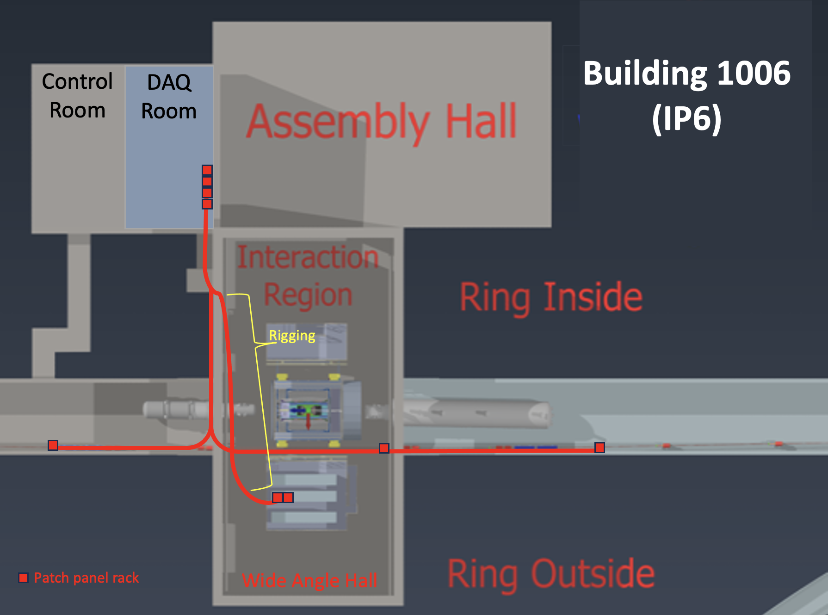
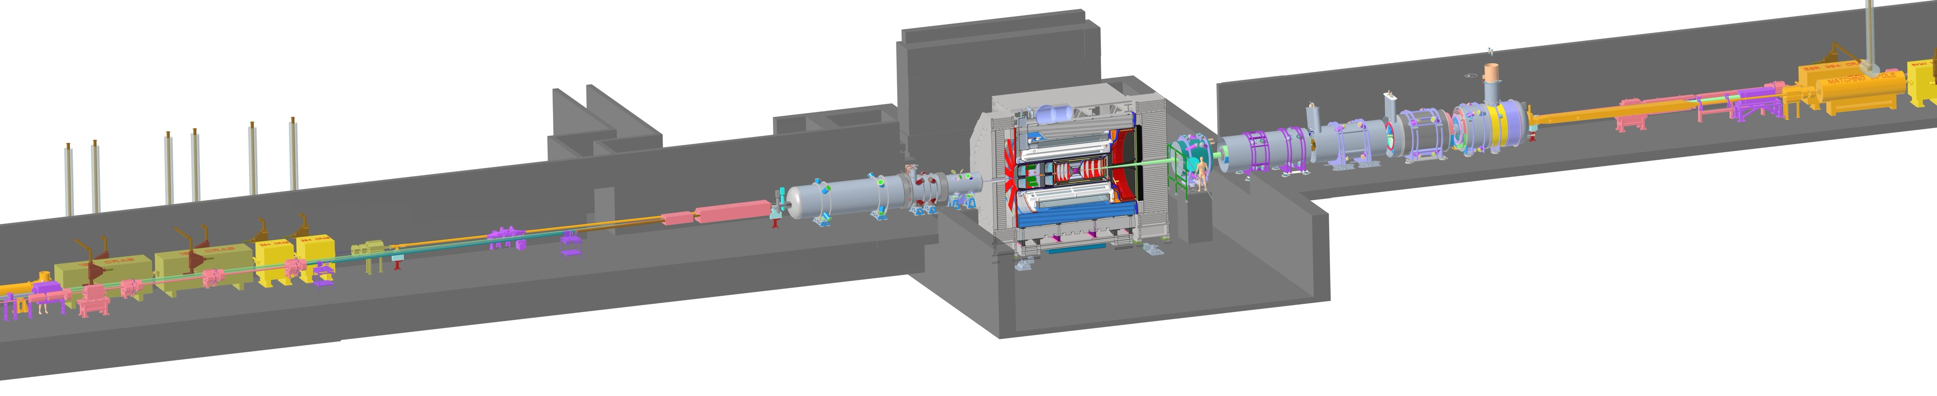

IP6 – ePIC Detector Subsystems
26 Total Detector Subsystems: Bunch crossing : ~100MHz Interaction rate : ~500kHz
Zero Degree Calorimeter
electron beam
Luminosity
System
p/A beam
Low-Q2 Taggers
Roman Pots (RPs) and
Off-Momentum Detectors (OMDs)
B0 Magnet
Spectrometer

Slide 2
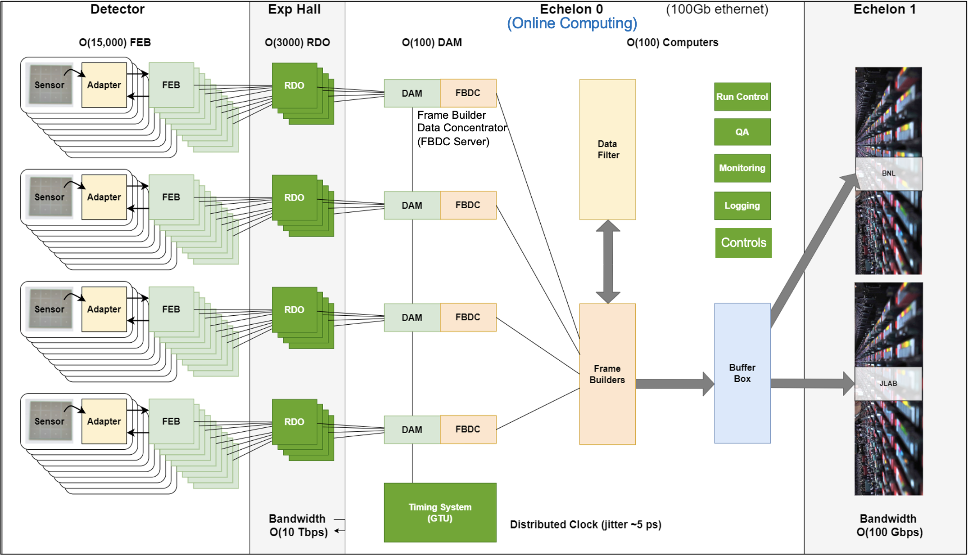
ePIC Detector
Hardware interface with Front-End electronics: ~120 Data Aggregation and Management boards – DAM
Roughly 8000 data path fibers connecting DAM boards to the detector readout electronics
COTS computing: Echelon 0 ~140 computing nodes interconnected with a 100/400Gb ethernet network.
Electronics racks for mounting all components in the experimental areas and for Echelon 0 computing (roughly 25-30 total racks).
Detectors and Electronics
WBS
DAQ/Computing
WBS
Off Project

Slide 3

Splitting of Echelon 0
ePIC DAQ and computing will require network connectivity at BNL between resources in IP-6, SCDF as well as development labs that is bandwidth guaranteed and minimizes routing.
Early DAQ & Electronics development will be in labs (Physics, starting early 2026).
Initial computing needs for development would best be placed in a central location (SCDF, initially one rack, by Q1 FY27).
DAQ production and interface with Echelon 1 can be worked out with test beds in labs and the SCDF. (Q2 FY27 – Q1 FY30)
When beneficial occupancy at IP-6 is attained, additional Echelon 0 computing resources can be placed in both sites (5-6 racks total at SCDF, Q2 FY30).
For production running it is important to all network infrastructure in place (Q2 FY33) and have equal and transparent network access from SCDF to both Echelon 1 sites (BNL and JLAB)
SCDF
ESNET
To JLAB
ePIC (Echelon 1)
400 Gb/s
ePIC DAQ
Enclave
( ~70 computers)
BNL ePIC
Echelon 1
400
Gb/s
~2km BNL Campus
IP-6
4Tbps
(10x400 Gb/s)
DAQ Room
(~70 computers)
Up to
100Gbps
Lab
Lab
Lab
Green indicated network & computers owned/administered by ePIC.
Physics
34

