Slide 1
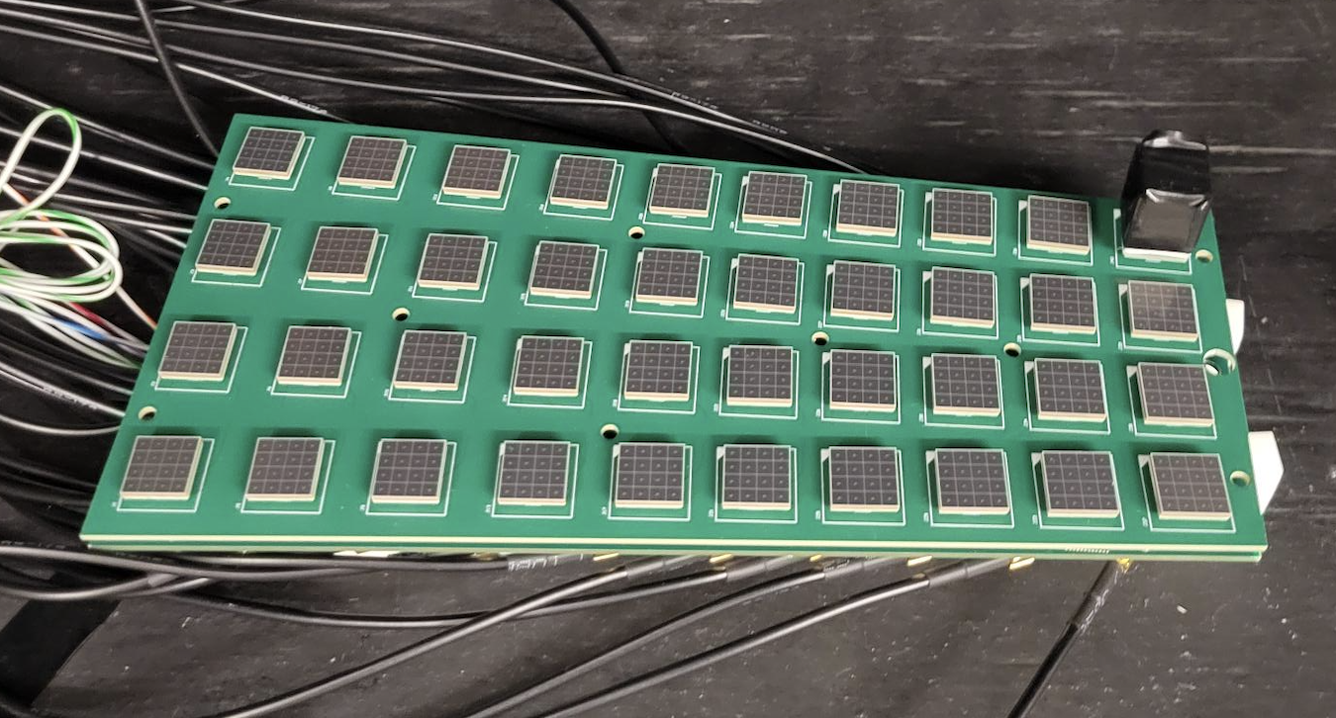
Baby BCAL new Boards
(for beam test in Hall D)
Barrel Imaging Calorimeter
Halen Davies
ESB/DAQ Meeting
University of Regina
March 3, 2026

Slide 2
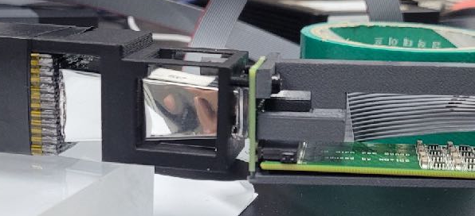
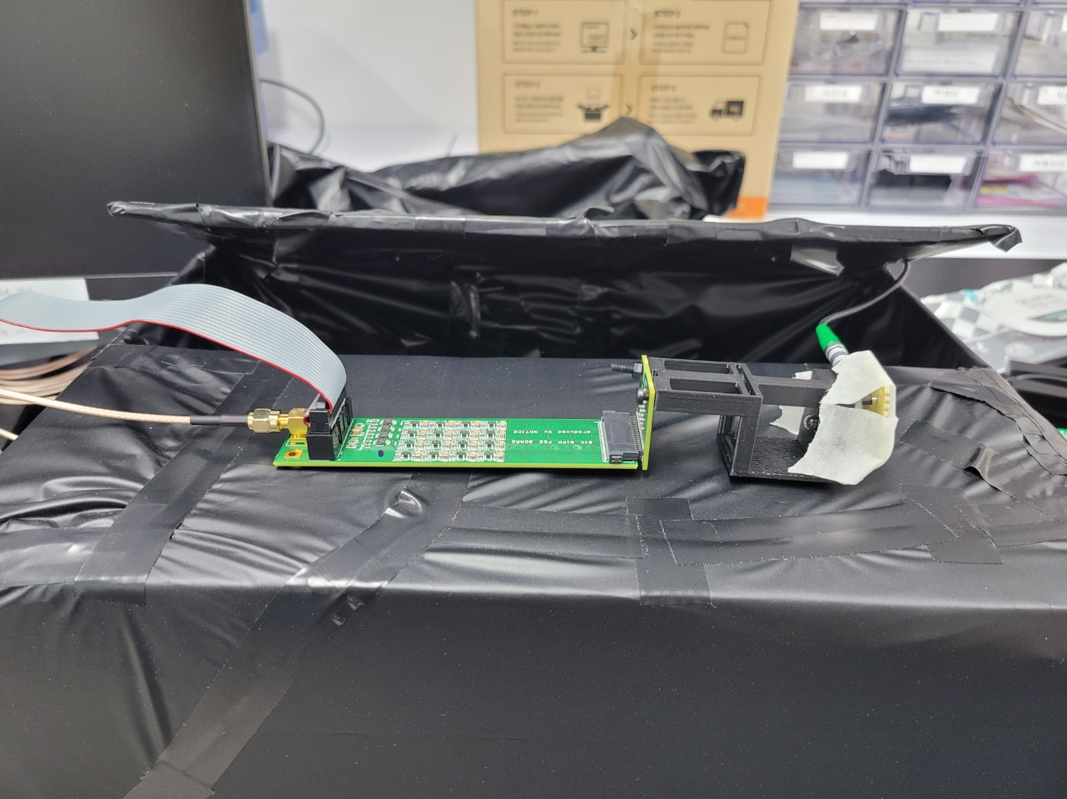
Ongoing Activities
SiPM:
  Mini connectors & reflow; Gain tests and QC procedure (100 SiPMs on hand)
Cables:
  80 MCX-to-LEMO cables on hand for Baby BCAL with new amp/sum boards
Light Guides & Cookies:
  Source+GAGG/Scint tests with samples to study light transmission
  LG: reflector material to be investigated; Cookies on hand
SiPM
Calorimeter
LG
SiPM
LED
Cookie

Slide 3
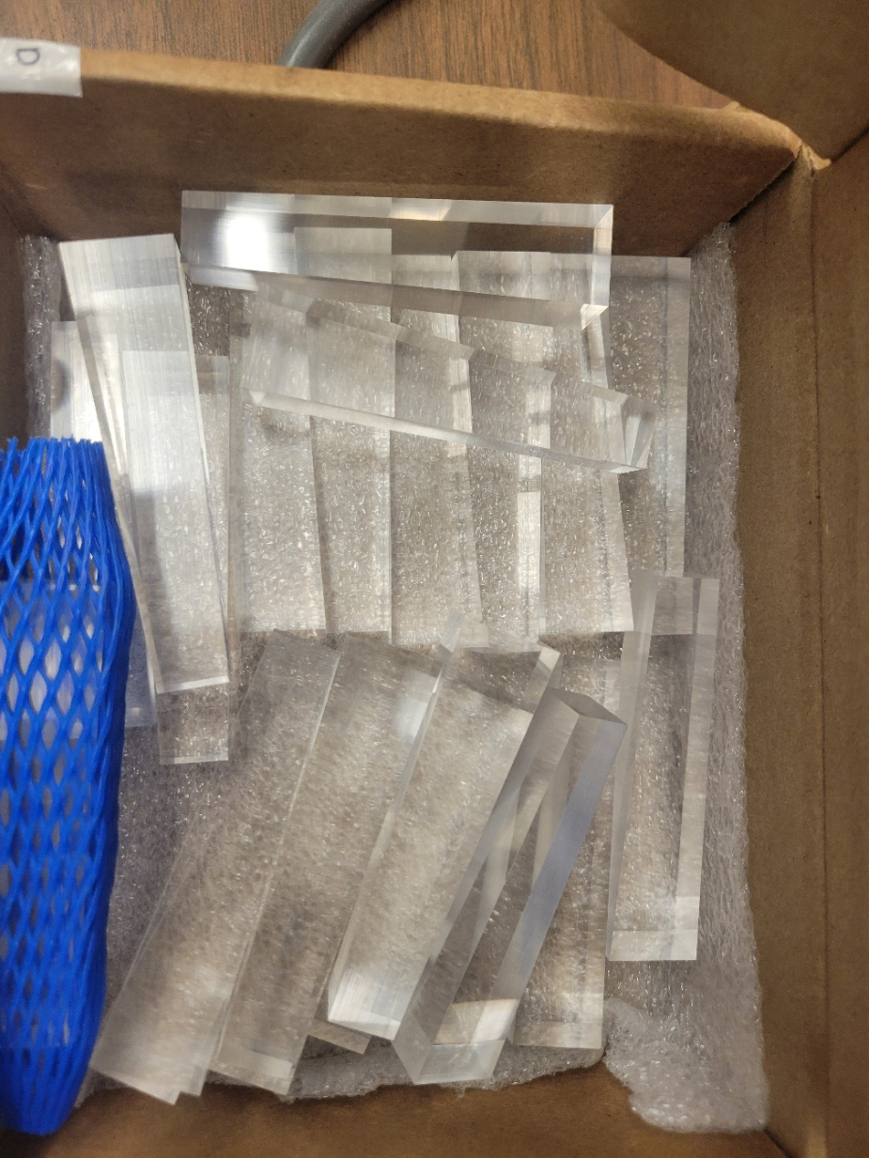
Cookies & Light Guides
20 new 80mm light guides were fabricated by Ross Machine Shop will be tested on new boards in the next 1-2 days
3mm and 1mm optical cookies transmission to be compared & vs air gap
New 80-mm square-to-square-entrance Light Guides

Slide 4
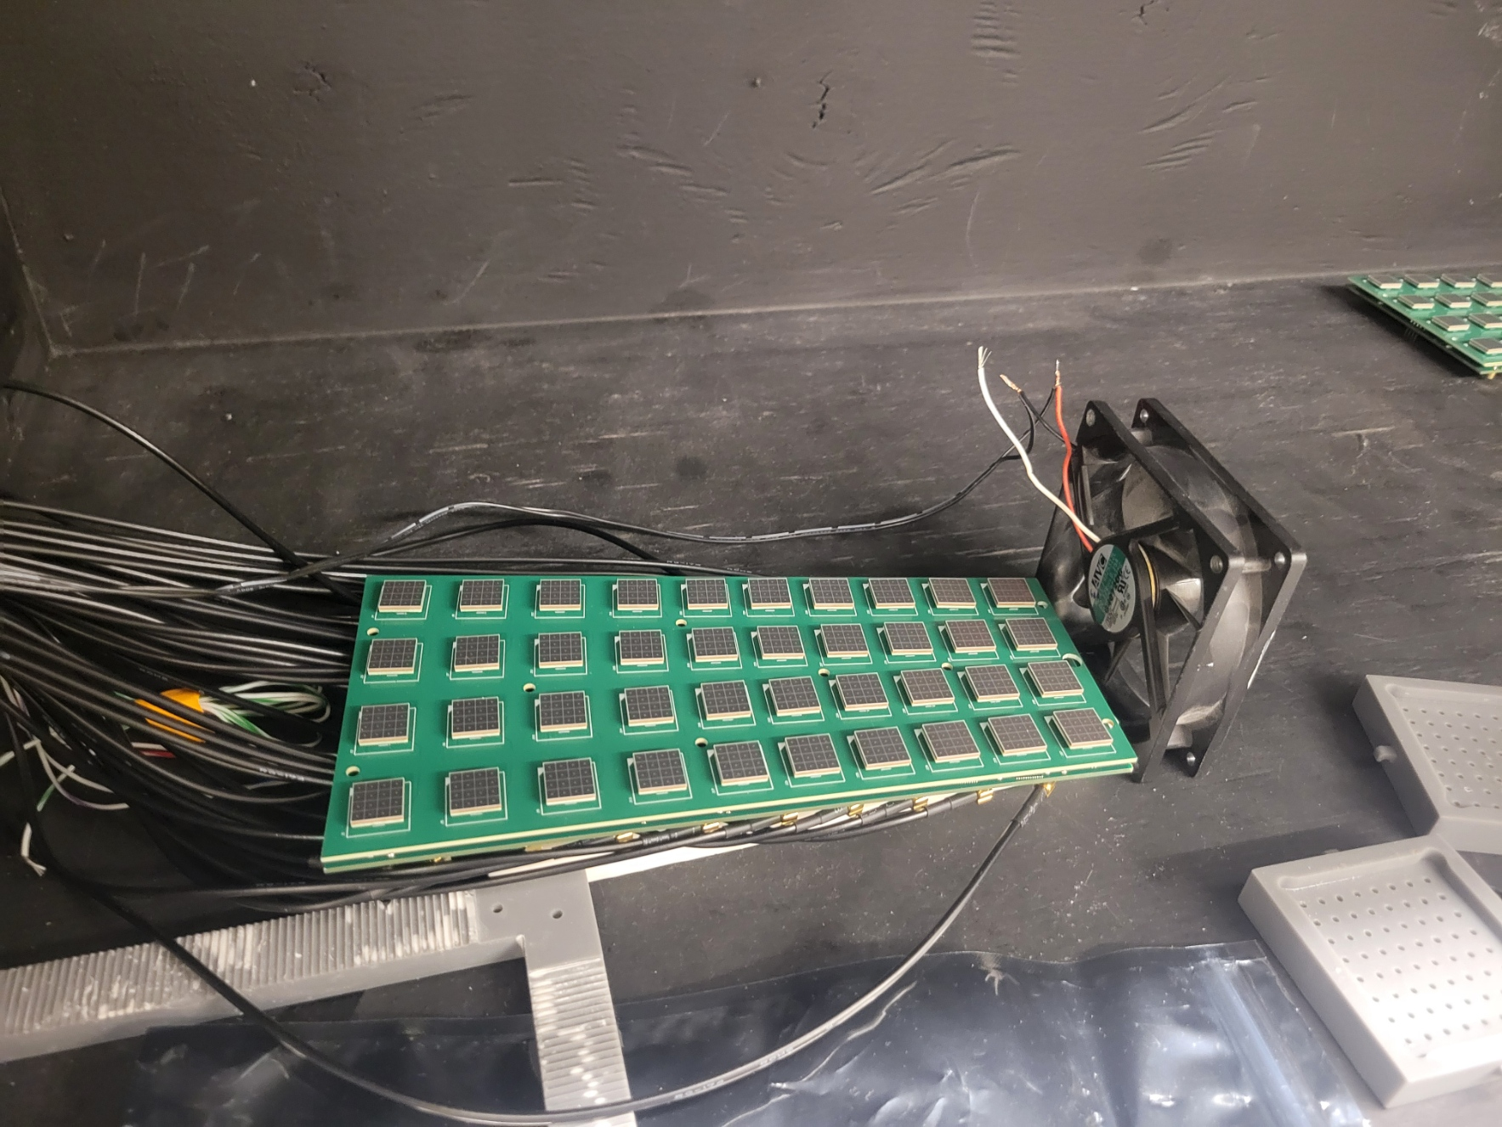
Cooling
Bias voltage and amplifier voltages:
  Values set to give the best resolution scale. Initial values: VBIAS = 40.7V, and Vamp = ±3V
  These values when left running for extended periods caused the system to overheat and saturate the electronics
  A simple 12V fan was added at the base of the board to assist in cooling, which resulted in a stable current draw over long term. Overall current does increase initially, but stabilizes after constant running
Board with fan attached

Slide 5
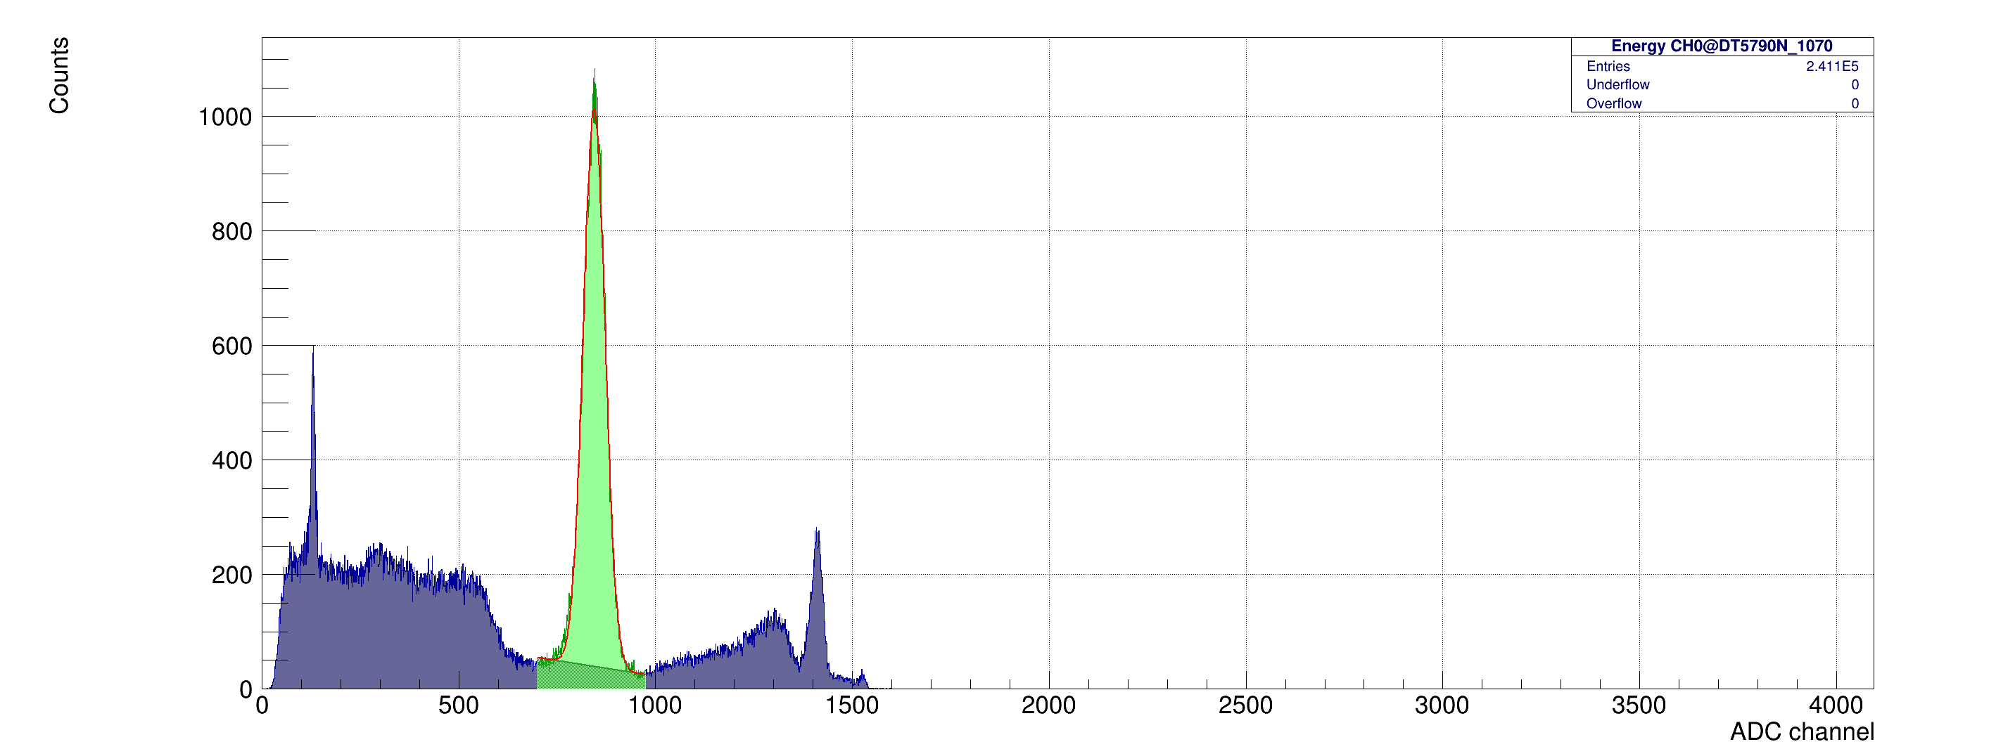
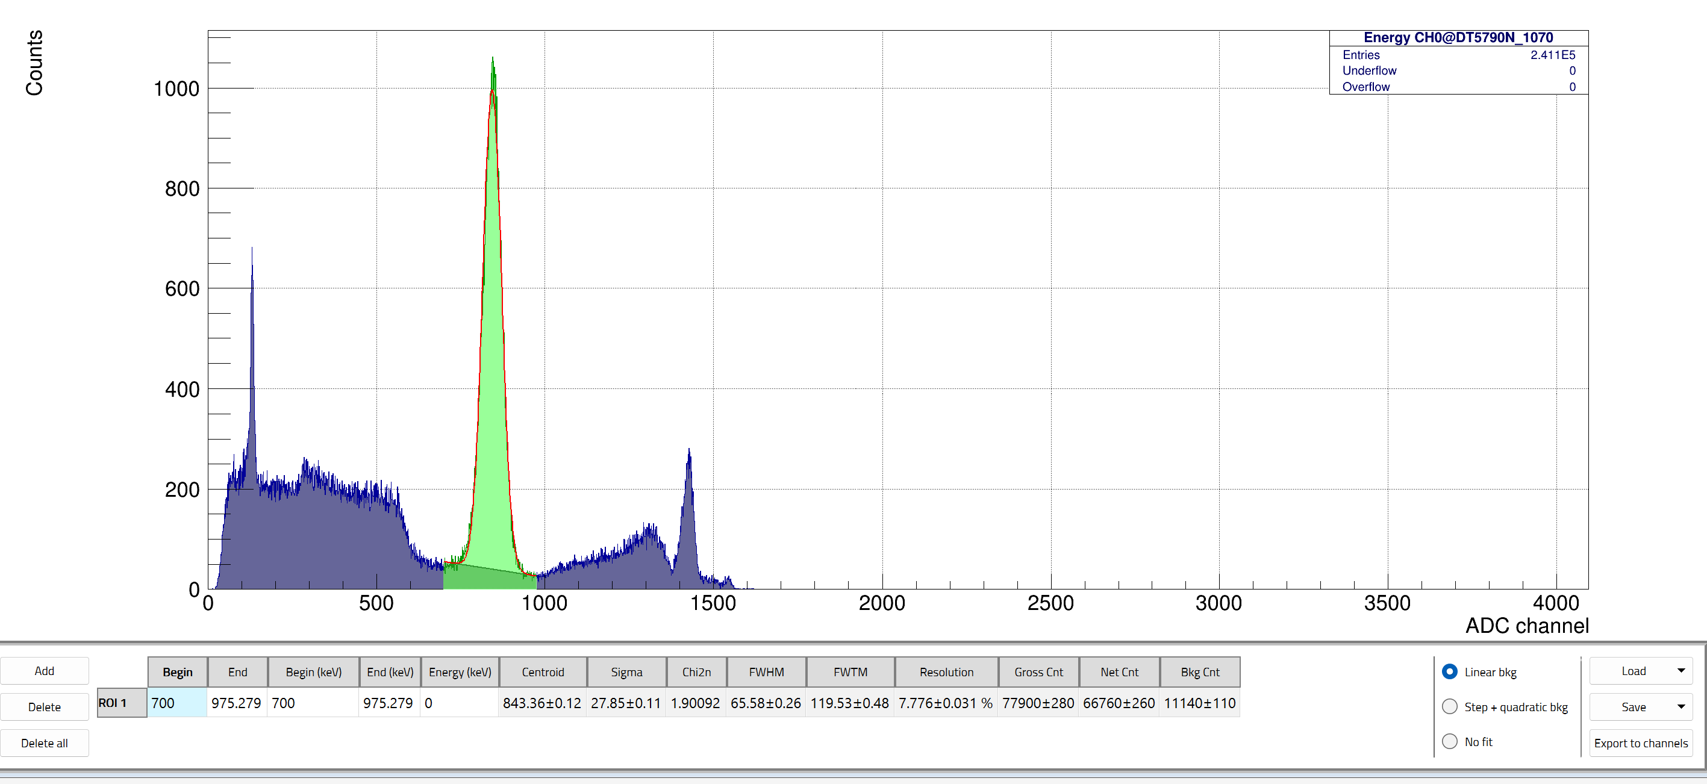
Cooling
Spectrum Analysis Temperature Dependence
Initial Centroid: 851.6±0.12
Final Centroid: 843.4±0.12
At turn on
After continuous 25-min running
Time between runs: 25 Minutes

Slide 6
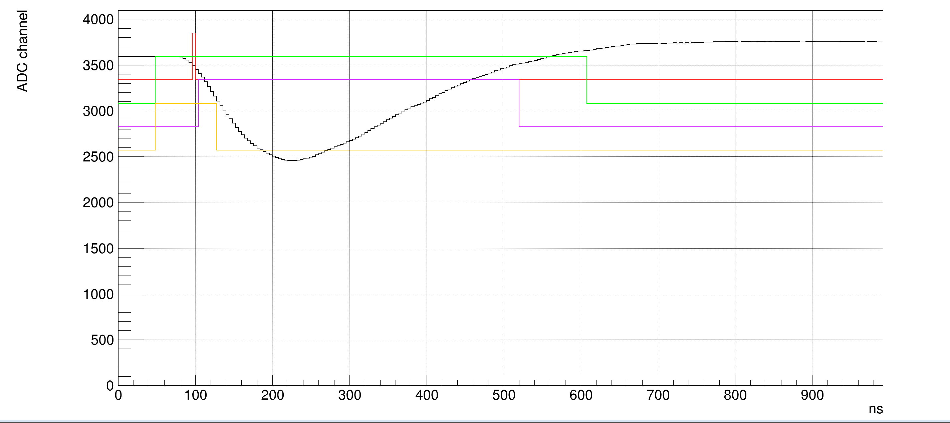
SiPM’s
100 SiPM’s reflowed and soldered; 40 connected to window+amp board
SiPM QC: test signal output along with the connected MCX to LEMO cable
Signal Voltage(mV) vs Signal Time (ns)

Slide 7
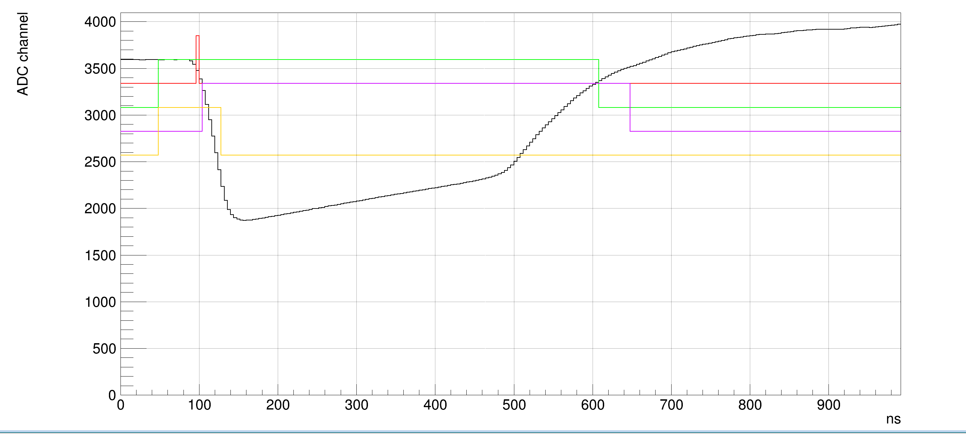
SiPM’s
Signal Saturation
During this QC saturation can be observed in the waveforms, this is taken into consideration by adjusting the Bias and amplifier voltages
The current chosen values are VBIAS = 40.7V, and Vamp = ±2.5V are used instead to minimize the signal saturation
Non-Saturated Signal Saturated Signal

Slide 8
Next Steps
Timeline for this week:
Full QC on the 100 SiPM’s in preparation for beam testing
Full QC of the MCX to LEMO cable for boards
Light guide testing using QC’d SiPM’s

Slide 9
Thank you!

Slide 10
Backup slides

Slide 11
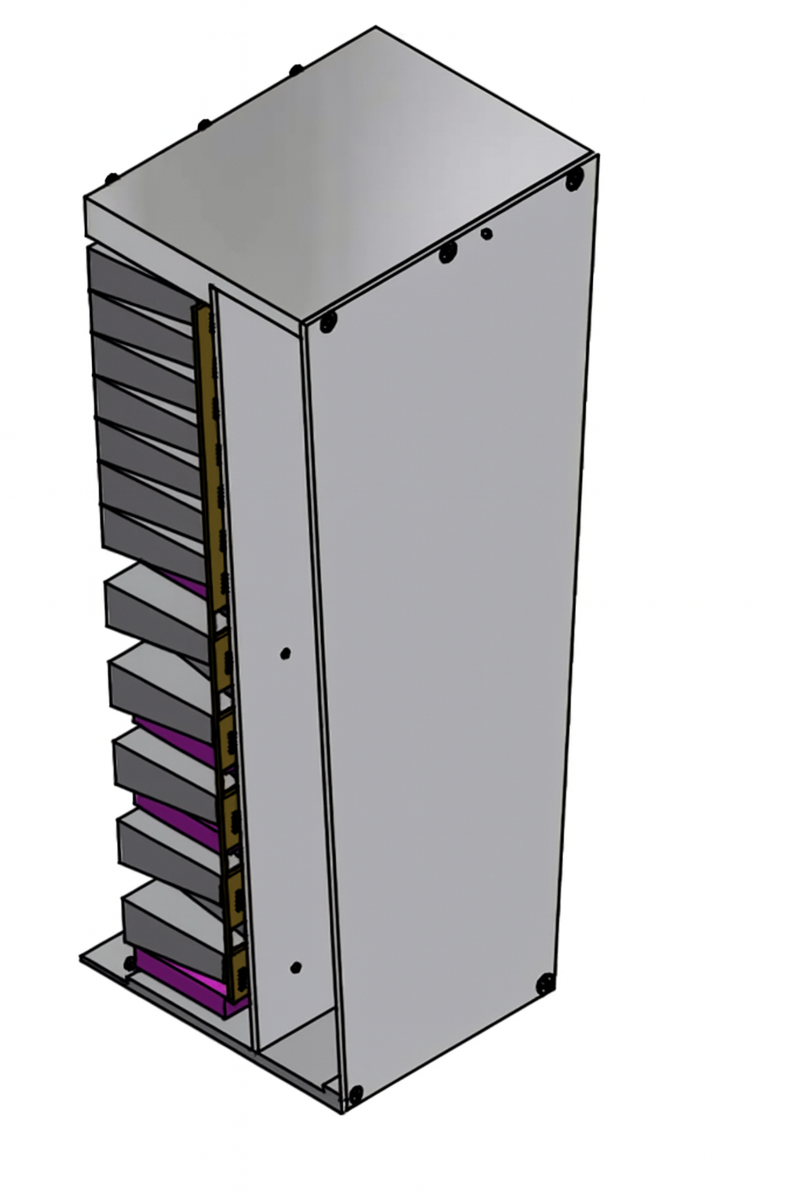
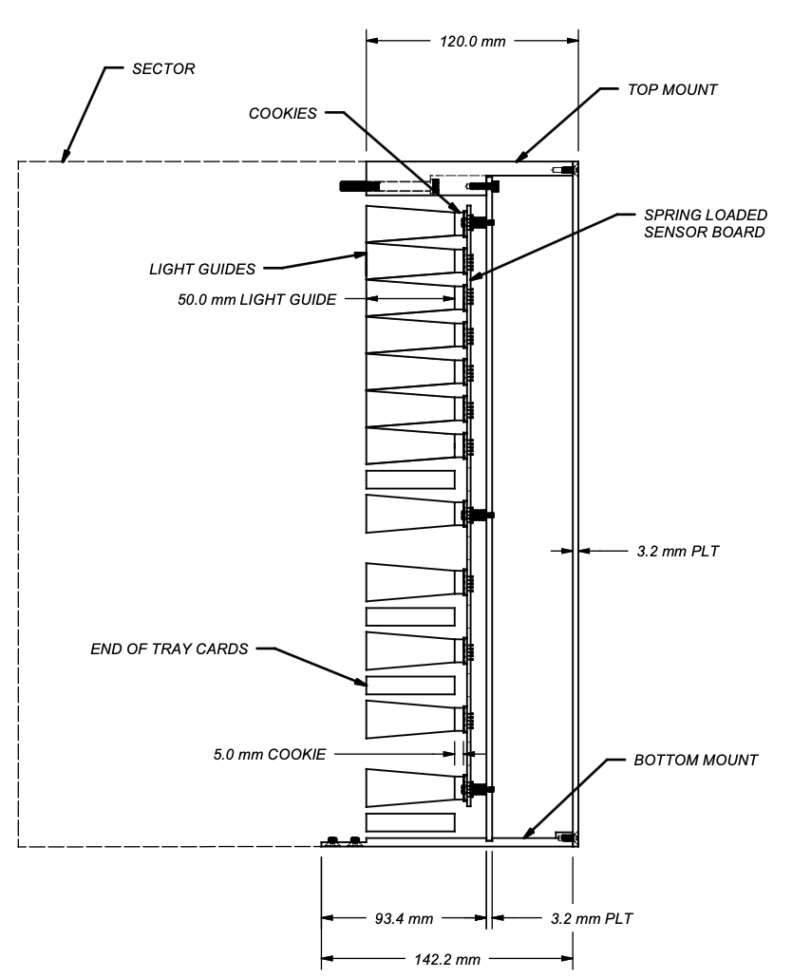
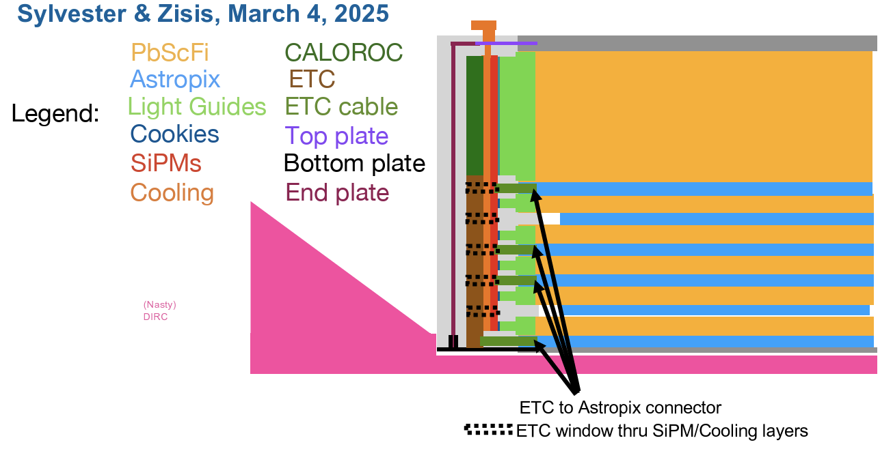
End-of-Sector Boxes
Light guides, cookies, SiPMs, CALOROC, ETC
Manages all powering and data collection on-detector
Interfaces for envelope, services and cooling with ePIC
  envelope & integration procedure nearly final
  provide electrical cabling service requirements, cooling, and other DAQ needs to ePIC
CALOROC for SiPM readout, then common RDO to FELIX
  Light guide option finalized; Cookie under final check; SiPM selection finalized
  CALOROC design being submitted now, evolution of H2GCROC used by CMS, ALICE
End of Tray Card (ETC) to readout AstroPix to FELIX
  ETC to be designed by NASA Goddard Space Flight Center (GSFC), but work has not started due to extensive delays in processing the interagency agreement. GSFC has designed similar FPGA boards for AstroPix, so they will be able to start from existing designs
DIRC

Slide 12
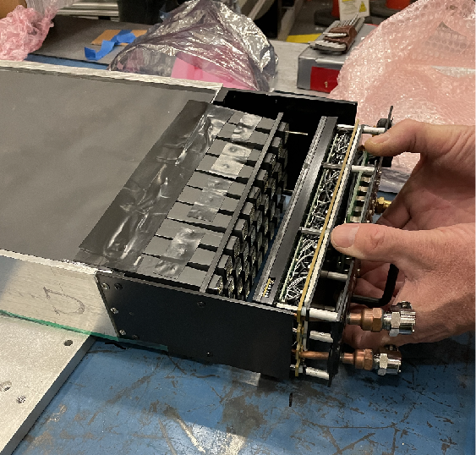
ESB Progression
GlueX used as staged model for BIC ESB
GlueX Wedge Baby BCAL
  8-cm-long LGs (80)
  0.5-mm air gap
  Hamamatsu S10 SiPMs
  JLab PCB Analog Electronics
  Cooling
  Plug-N-play assembly
BIC ESB Test Article Baby BCAL
  8-cm-long LGs (80)
  3-mm optical cookie
  Hamamatsu S14 SiPMs
  New PCB + HGCROC
  No cooling
  Plug-N-play assembly
BIC ESB Test Article ANL SciFi
  5-cm-long LGs (120)
  3-mm optical cookie
  Hamamatsu S14 SiPMs
  New PCB + HGCROC/ETC
  Cooling
  Plug-N-play assembly
N2 gas
Water cooling
Baby BCAL & Wedges are at ANL on loan
Notes:
The GlueX ESB was one piece that just slid in as shown in the photo, and then bolted to the black metal frames. BIC will me more complex to remove when the DIRC is there. We hope for a solution that will satisfy both the electron and hadron ends, so that we do not have to come up with two drastically different designs.

Slide 13
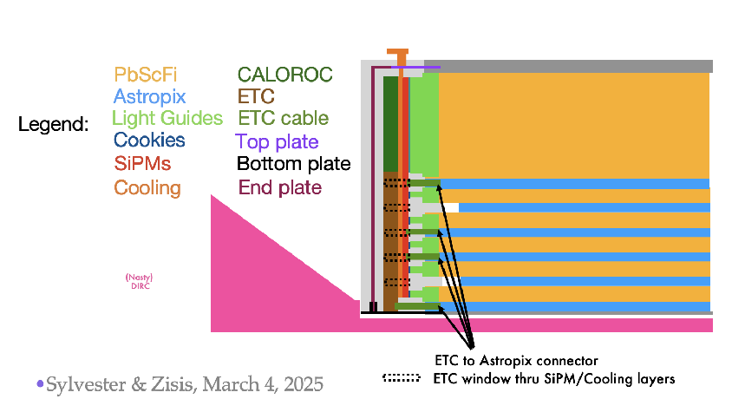
ESB Integration: Envelope and Access
Design is mature and is being further refined
Envelope is 12 cm
1.5-cm space to DIRC:
  Pull back, rotate
  Lift out radially
Cooling:
  Outer Al plate
  ESB internal conduction
12cm
DIRC
Recommendation: SciFi/Pb: Check integration problems in the cabling of the two front parts of each module wedge.
Response: The layout of the ESB design accounts for AstroPix module and tray integration and readout through End-of-Tray card with power routing provided by the Front-End Board.
Notes:
We received an extra 1.5 cm space between the end of the ESB and the DIRC prism (pink volume in sketch).

Slide 14
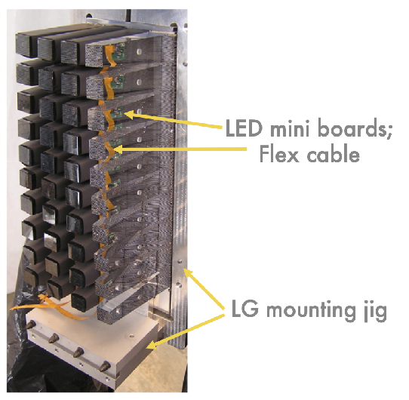

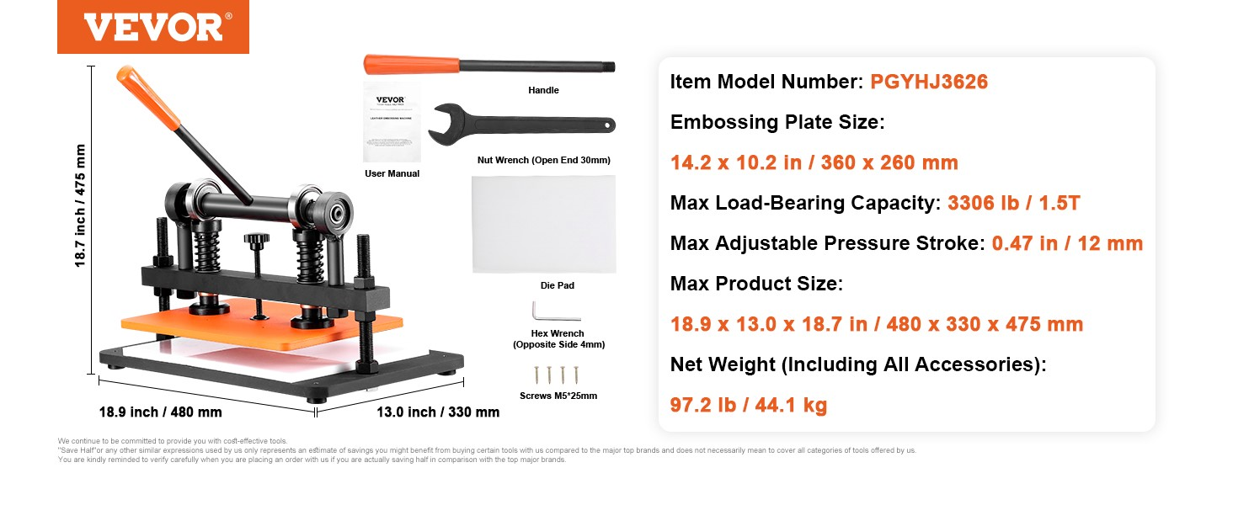
Optical
GlueX “wedge”
Light Guides and Cookies
Cast acrylic
  Polishing established
  Will be wrapped
Eljen Silicone Rubber Optical Interface (EJ-560)
  3-mm sheets (baseline),
  1-mm (under test)
  ~250 Cookies cut at a time
LED LMS – will follow GlueX BCAL
Notes:
3-mm tested. 1-mm still to be tested. Cast appears to be the correct choice; extruded has dimension-limitations; cast has better transmittance? (Shinhyung to verify). We make the cookies in Regina. Seems to work well.
PDMS (Polydimethylsiloxane)

Slide 15
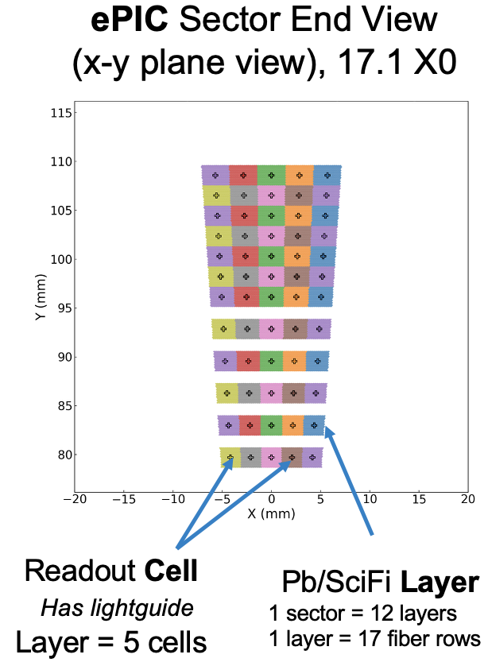
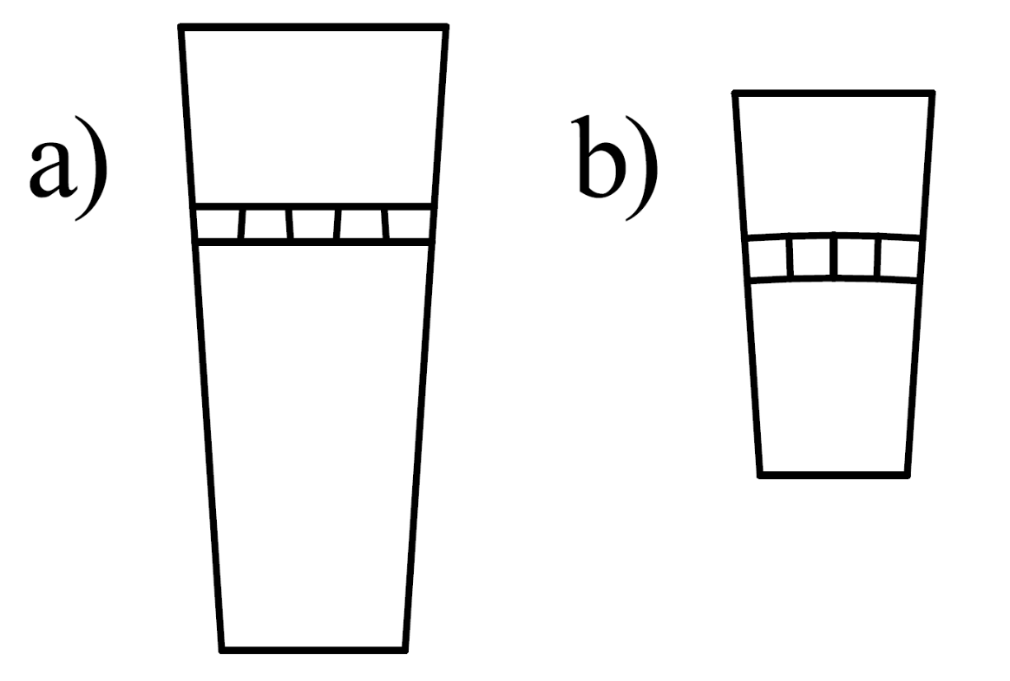
BIC Light Guides
Sector end view
Geometry:
  12 layers (radial)
  5 columns (azimuthal)
  Alternating orientation
  60 LGs per ESB
Row gaps for AstroPix
BIC
GlueX

