Slide 1
Integration, Installation and Infrastructure (Triple I Group)
TIC Update
Roland Wimmer

Slide 2
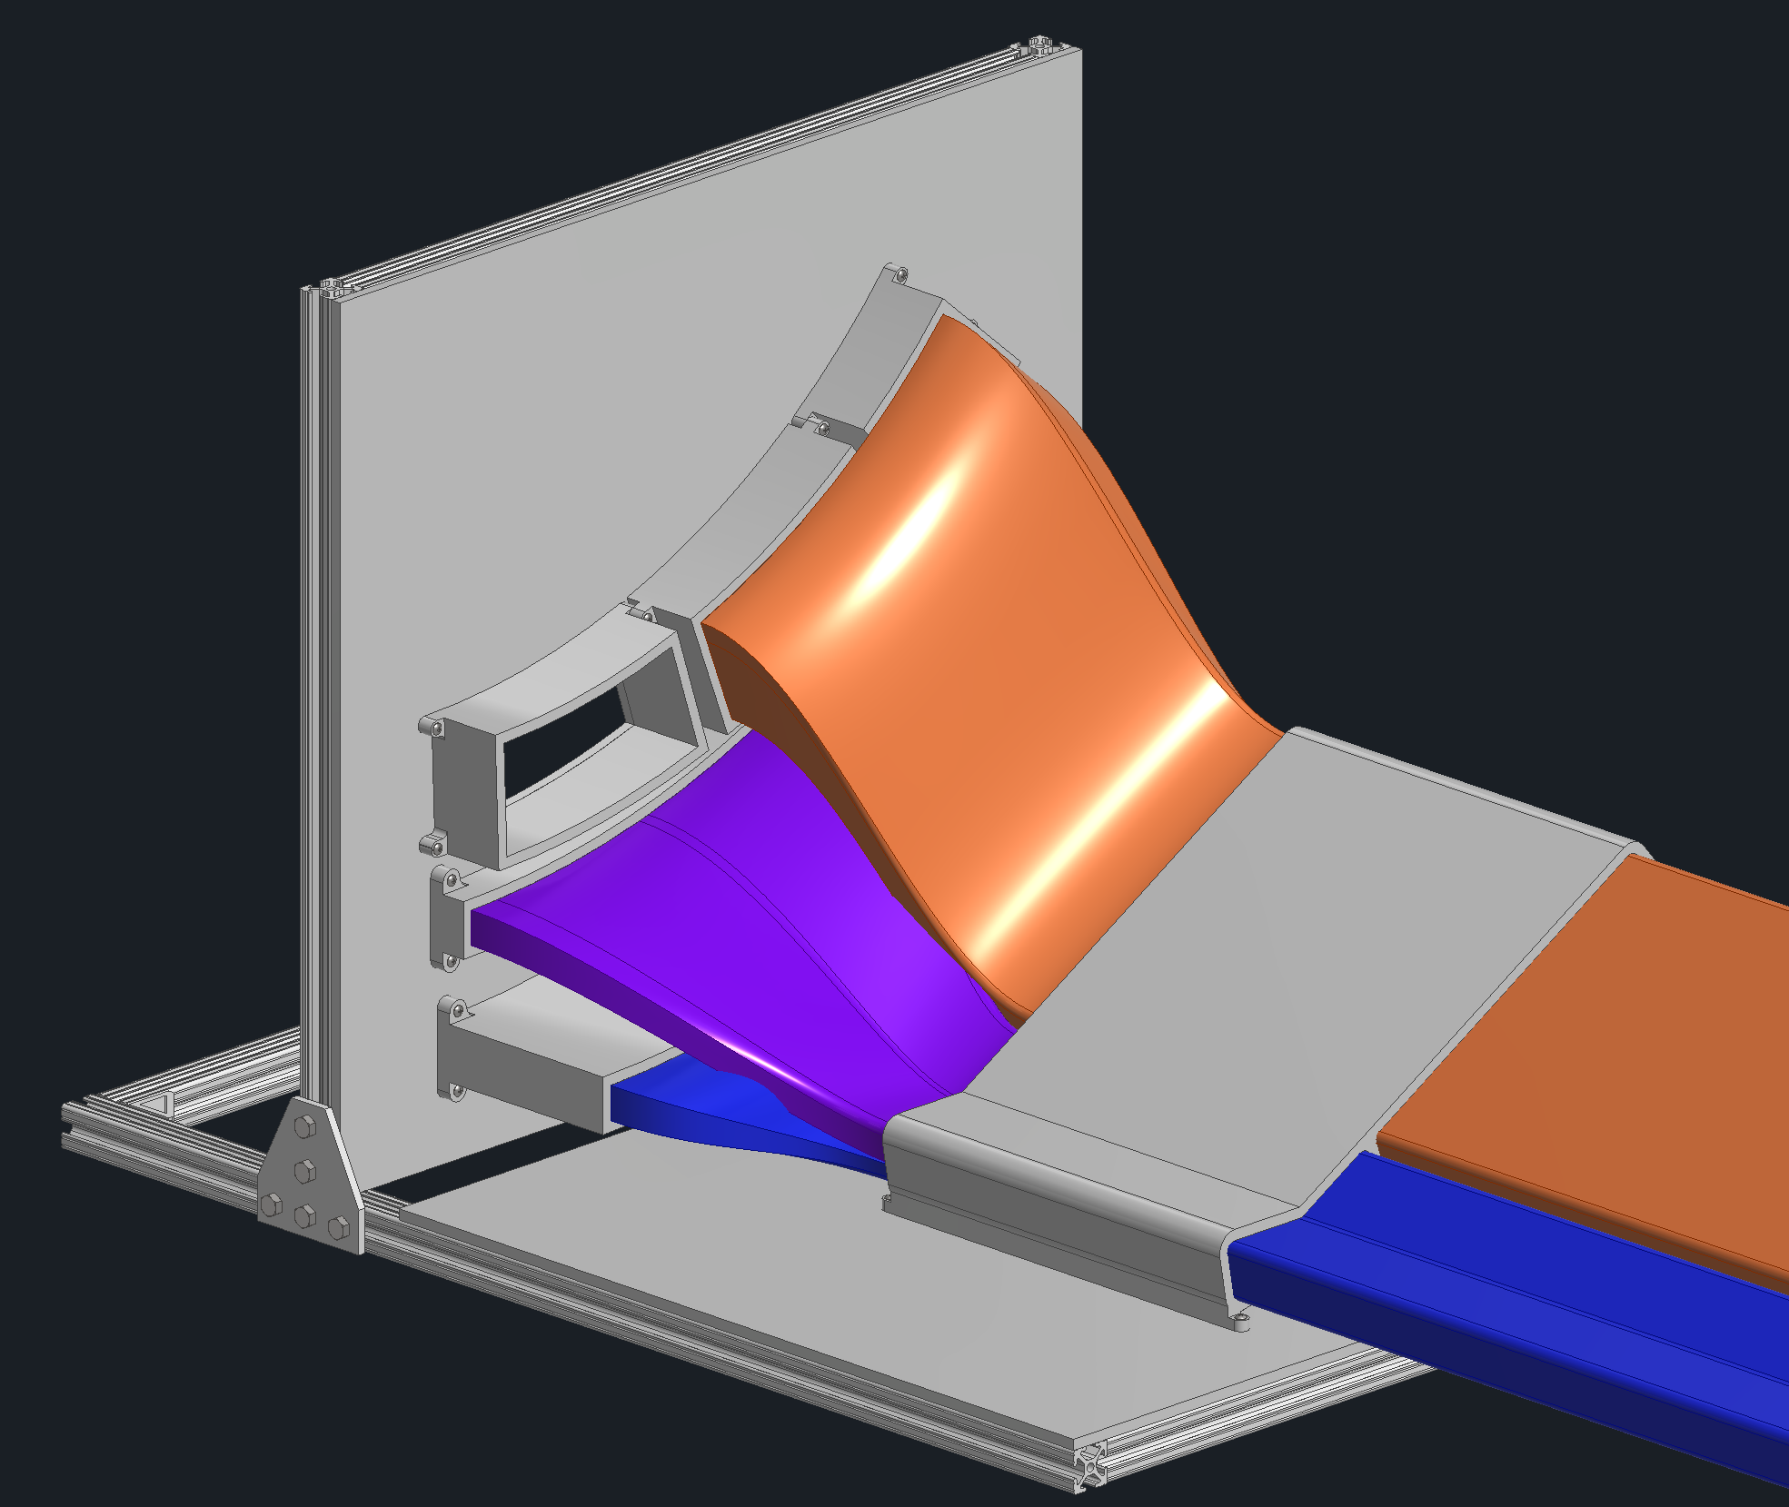
Detector Updates
Recommendations from previous reviews
Services Mock up
GST Updates

Slide 3
Recommendations from previous reviews
The status of the Cradle, Moving Mechanism and Barrel Access Platforms subsystem is still in a very preliminary state. It is important that the project address this issue by providing additional staff to the engineering lead. 1. Assign additional help to complete the design and analysis of the cradle system 2. Moving the detector assembly from the IR to the assembly hall after initial magnet testing will have a time critical element to keep the MARCO magnet cool. Consider adding redundancy in the air castor system.
Mockup a portion of the services runs to ensure there is enough space to install all services as soon as reasonably possible.
Expedite the analysis and modifications to the floor structure. Ensure a POC is identified to coordinate and lead this deliverable.
Integration and mechanics: Coordinate interfaces, cross sections and assembly procedures with the neighboring systems at an early stage with an interface control drawing and a detailed assembly sequence. Maintenance should be addressed taking accessibility and expected potential failure rates into account.

Slide 4
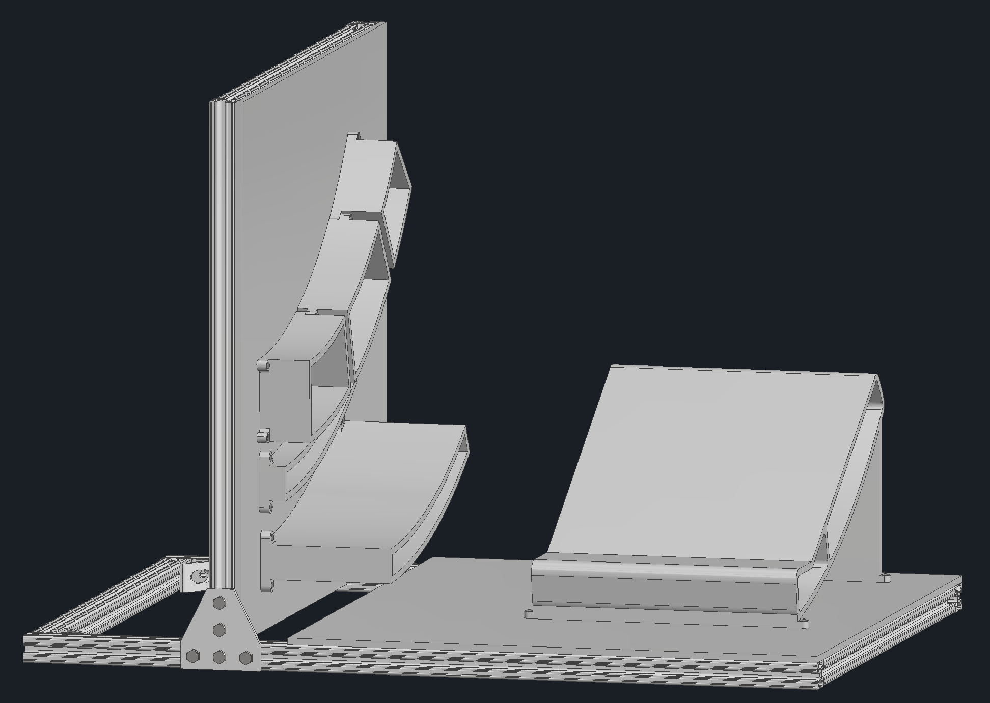
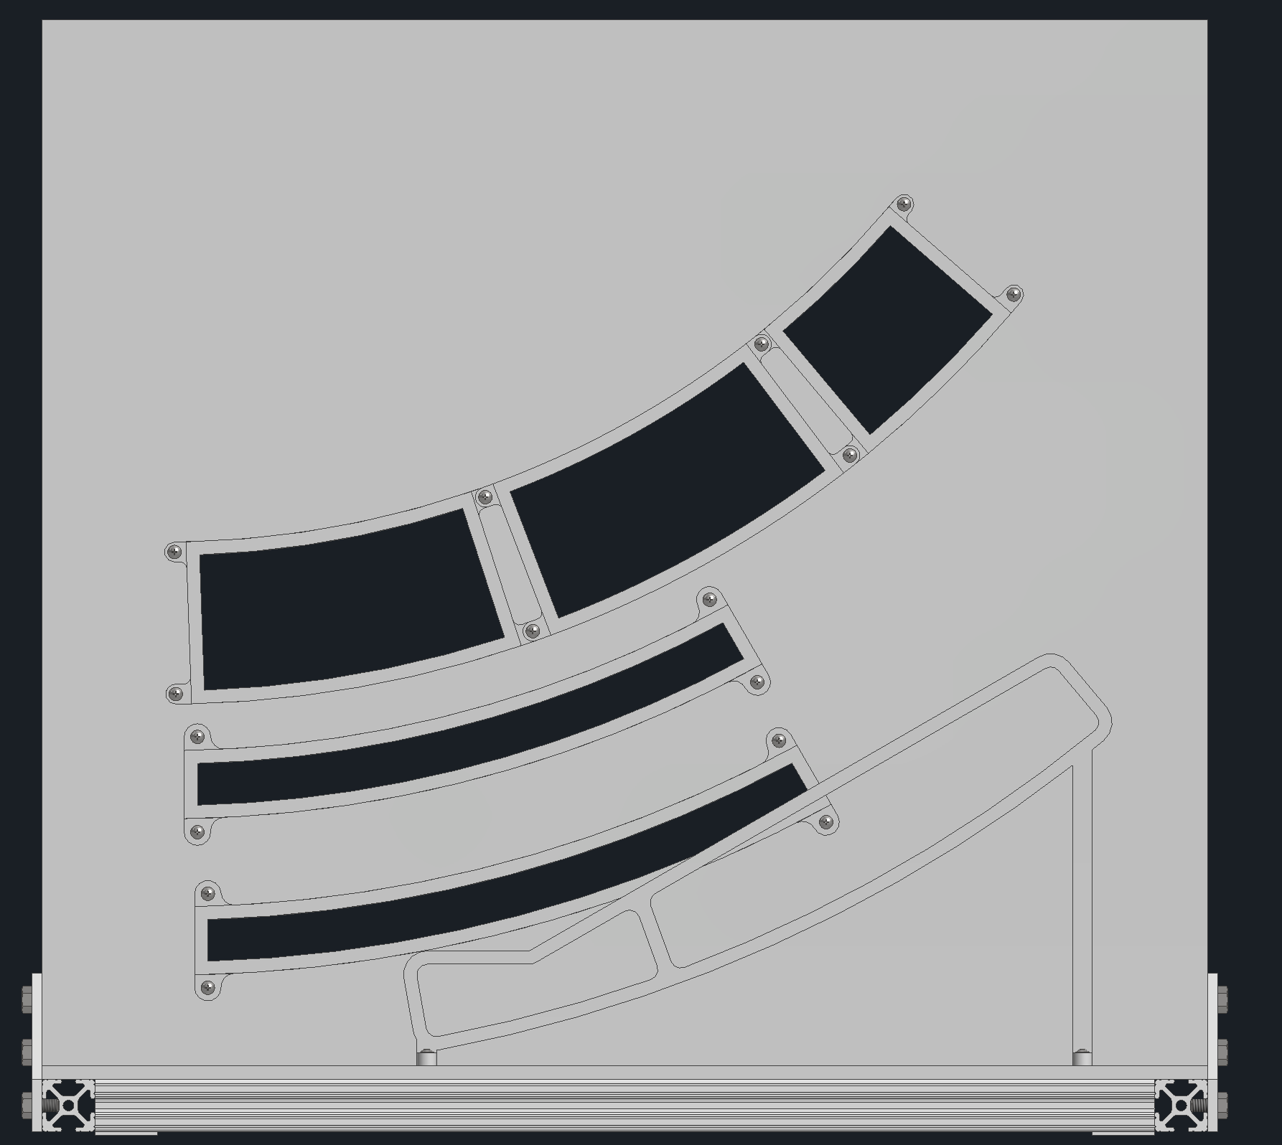
Backwards Services Mock-Up
The ends of the detectors will be 3d printed and attached to an 80/20 frame
1/12th of the services coming out of the inner trackers will be mocked up
Will use old cables from sPHENIX which are similar to what will be used for EIC
Will be checking amount of space used by the services along with bend radii
End of PST
Inner Tracker Services
End of CYMBAL
End of ToF
Service Trays

Slide 5
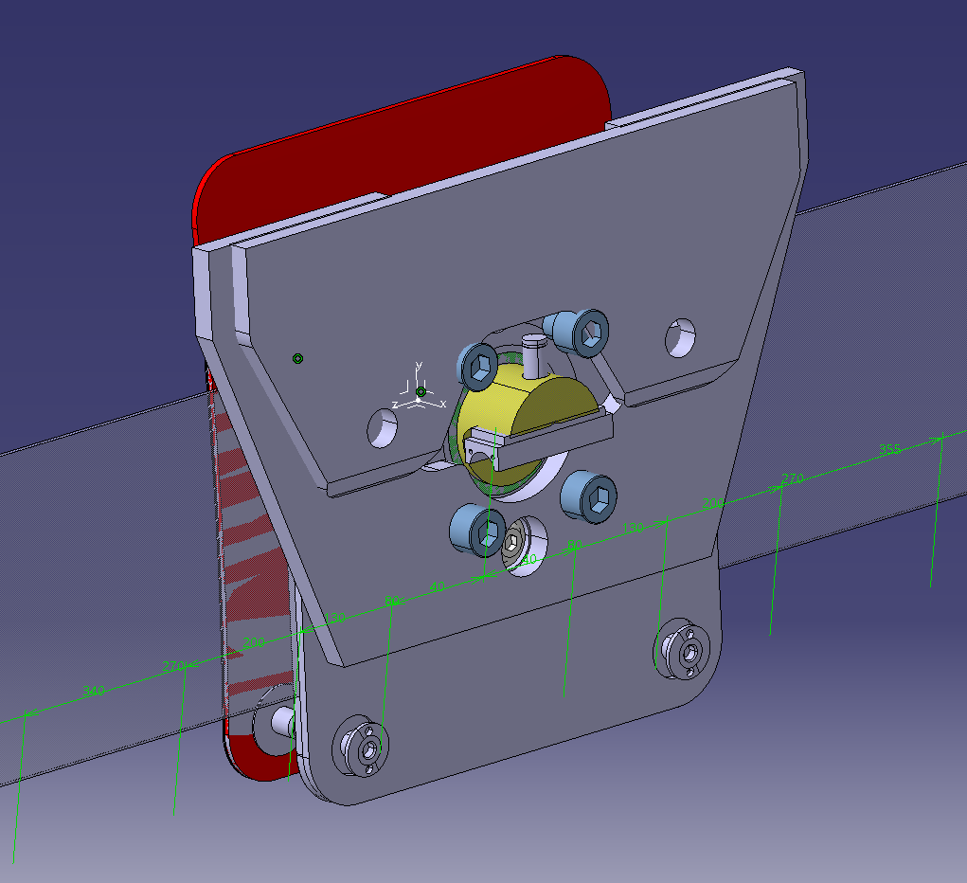
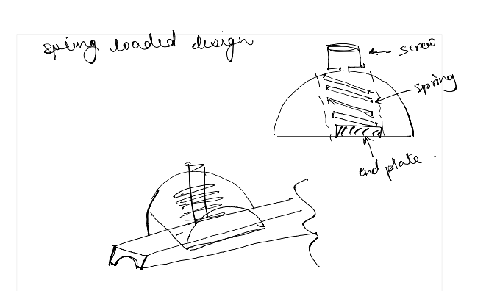
Version 3 of the slider foot concept
The red plate attaches to the EEEMcal structure
Comments received on this version –
Need it to be a “rolling” foot instead of a sliding foot
The adjustment for EEEMCal is just to get it “in the volume”
Adjustment for PST package needs to be more accurate since that has the beam pipe
Ignore this plate… just realized I forgot to hide this when taking a screenshot
Spring loaded mechanism to ensure that the sliding mechanism is always in contact with the Rails and does not “jump” while sliding along Z
These 4 bolts allow for movement in the X-axis
These two bolts allow for rotation about local the “z” axis

Slide 6
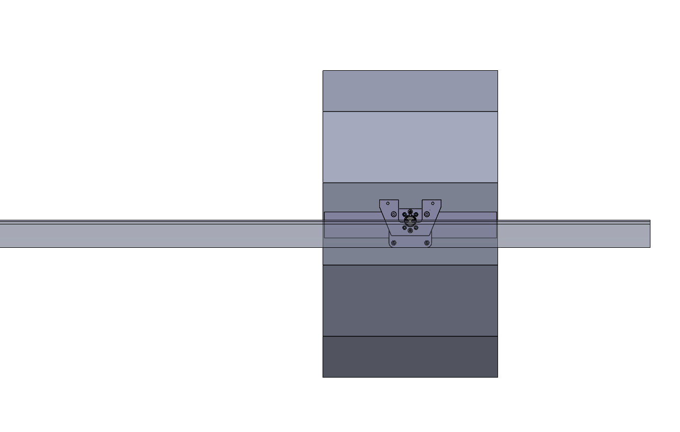
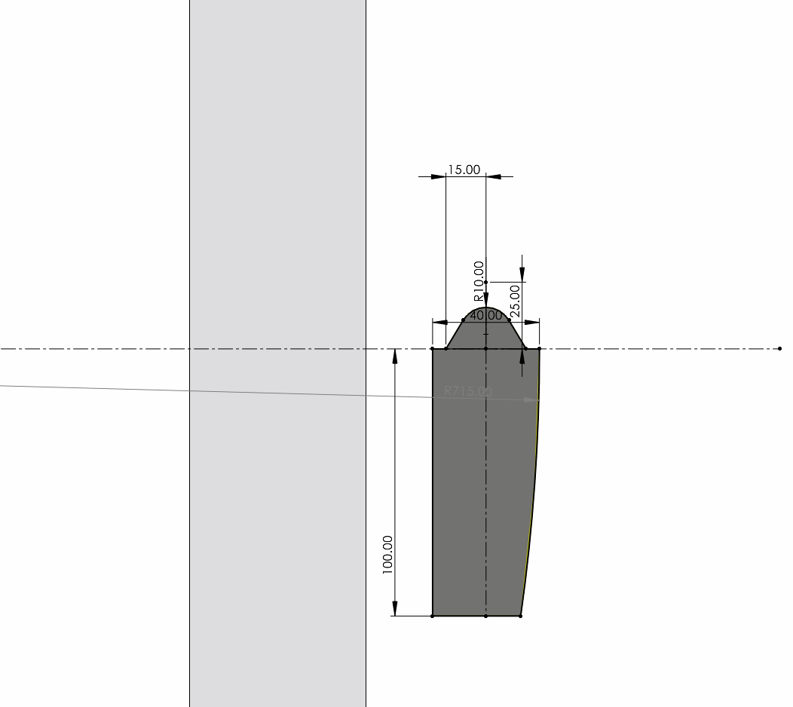
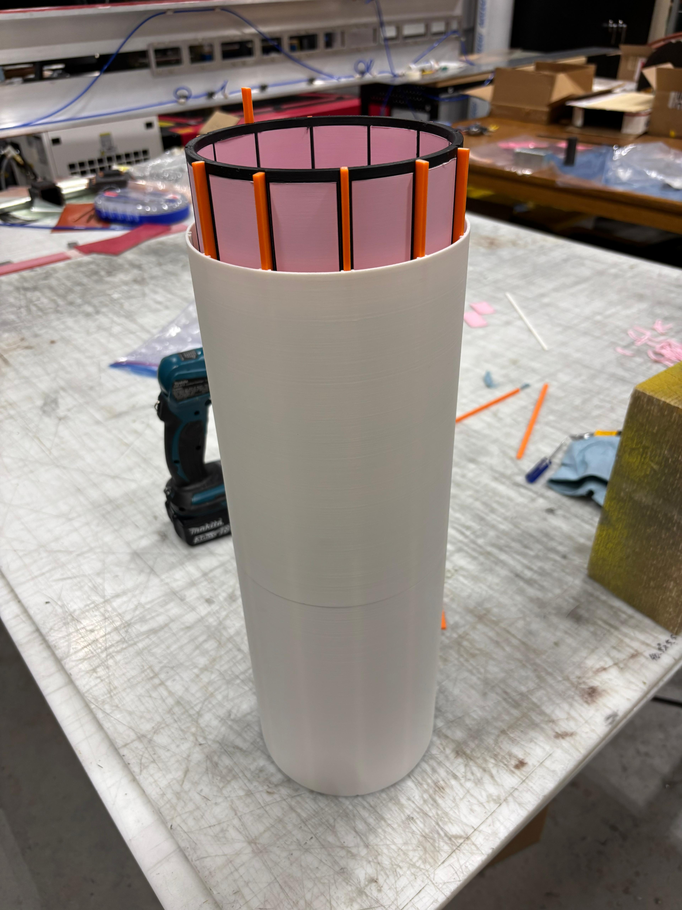
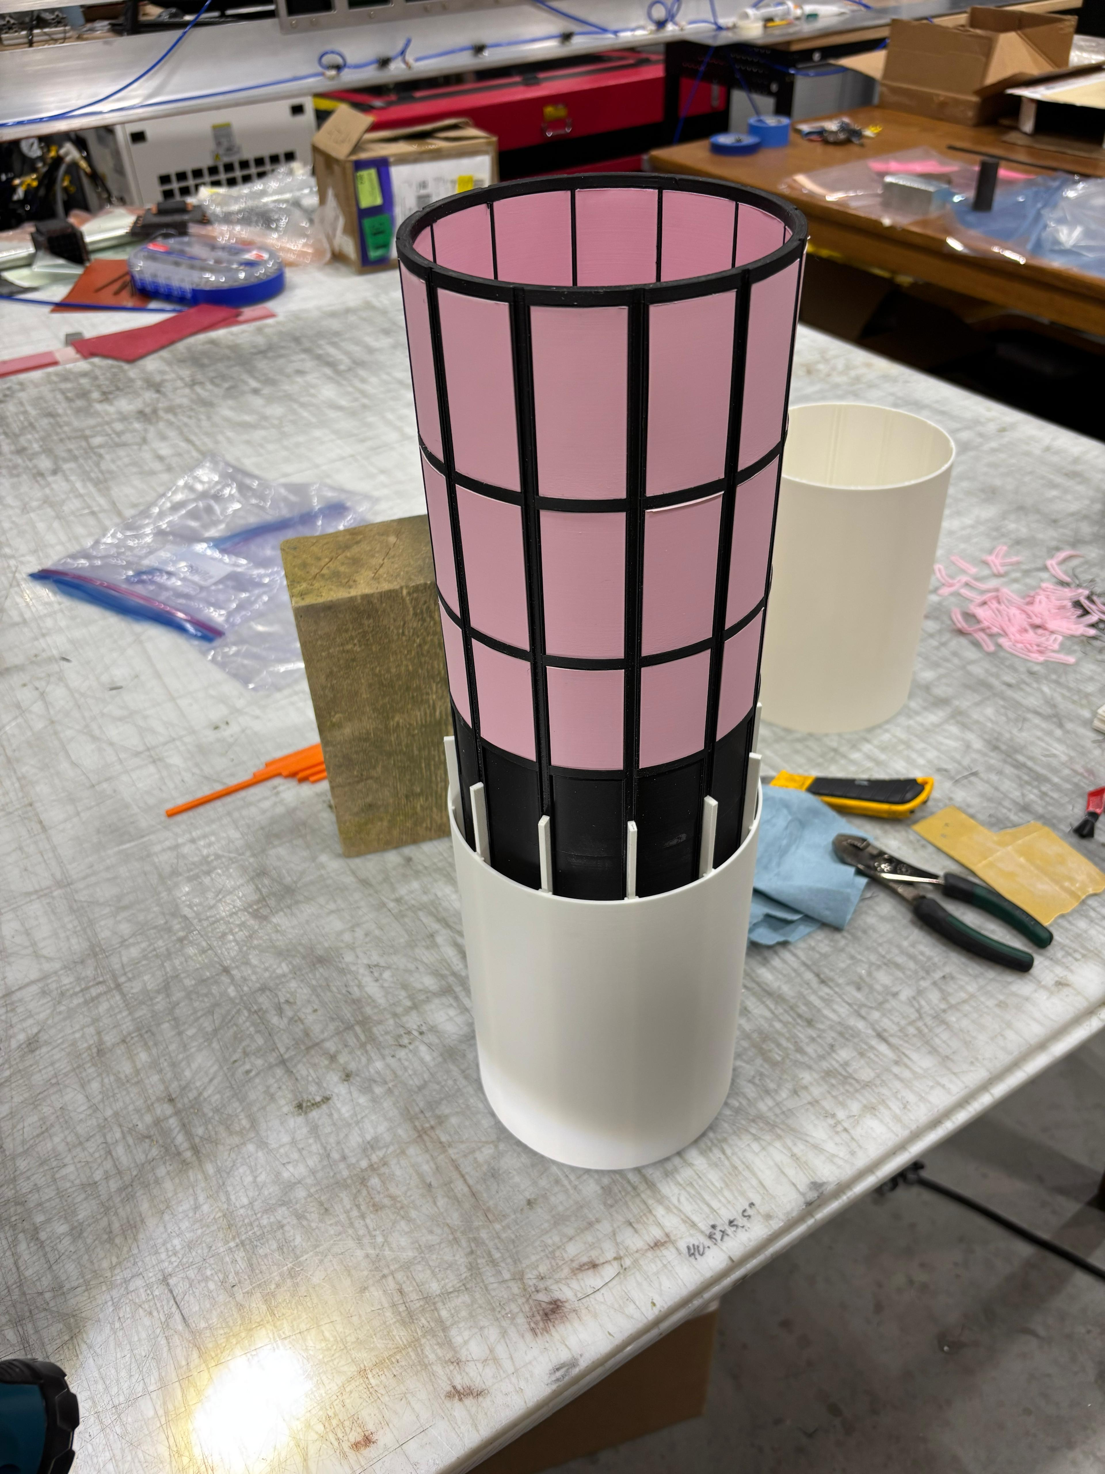
Prototyping progress at Purdue
This is what the design in the EEEMCal geometry looks like.
You can have 1 foot per side – or 2 foot per side – being decided by the FEA and prototypes currently in progress at Purdue
On-going work –
FEA of the new conical rails for GST
Prototyping of the mounting mechanism in 1:10 scale including rails and adjustment mechanism of the GST
Refinement of the mounting mechanism for the EEEMCal and other inner detectors
1:10 scale 3D printed prototype

Slide 7
Backup Slides

