Slide 1
DAQ data volume documentation plans

Slide 2
ASIC / Digitizer Limitations
ASIC | Charge Share | Times Readout | Formula | Bits / Hit FEB | Old HitSize | Bits / Noise FEB | Bits / DAQ Output | Max Rate
ITS-3 | 4 | 1 | 16 x (C+3) | 112 | 128 | 64 | 128 | Not simple
Discrete (FECAL) | 4 | 5 | 12 x C x (5 x T + 7) | 576 | 144 | 144 | 128 | 50 kHz / ch
CALOROC | 4 | 5 | 32 x T x (4 + C) | 1280 | 480 | 800 | 128 | 50 kHz / ch
EcalBarrelScFi | 4 | 5 | 2 x ( 32 x T x (4 x C) ) | 2560 | 960 | 800 | 128 | 50 kHz / ch
EICROC1 | 128 | 8 | (T x 24 + 8) x C | 25600 | 576 |  |  | 12 hz / ch
EICROC2 | 9 | 5 | (60 + T x 8) x C | 900 | 576 | 900 | 128 | 350 hz / ch
FCFD | 4 | 5 | 32 x T x (4 + C) | 1280 | 192 | 800 | 128 | 50 kHz / ch
ALCOR | 1 | 1 |  | 64 | 64 | 64 | 64 | 300 kHz / ch
SALSA | 4 | 5 | C * (T + 4) * 32 | 1152 | 320 | 288 | 128 | 25 kHz / ch
Slide from last year’s collaboration meeting:
  Need to check for changes → ASIC internal reviews planned for (Almost weekly) from April 1 – May 13
  Need additional information
    Astropix
    Timepix
  This information is complex, but we need meaningfull but simple declarative statements, and these numbers are our best ones!
    → However…
ASIC/Digitizer limitations:
  Internal analog/digitization effects can prevent distinguishing repeated hits same channel.
    Salsa channel reset
    ITS-3 integration time (2us-8us?)
  Digital algorithm also limits same-channel hit differentiation (the hit must be readout before another hit on same channel can activate threshold)
  We should document these better, but generally these are short O(100 ns) effects, and effect single channels or groups of channels. They aren’t the limitations we are likely to face.
    Potential exceptions: lumi detectors, polarimeters
    Calibration runs: low threshold = constant hits. Need strategies, e.g enable small sections and repeat scans
Data Volume Limitations:
The more significant limitations of our ASICs come from the output links. Most are not capable of reading out black streams! The constraints are complicated:
  The data produced by a hit depends on number of nearby channels hit (for most of our ASICs)
  The data producted by a hit depends upon user-specified values (The number of timebins readout)
  The amount of noise, and number of taken hits will likely depend upon the thresholds specified
  We will have some ability to dial rates taken, but requiring experience with detectors &/or suffering potential data quality ramifications

Slide 3
Data Volume Limits (RDO → DAM)
RDO / DAM supports 10 Gb/sec links (Can increase to 25 Gb/sec – but not in cost estimates)
  In radiation environment, VTRX+ / lpGBT have worse performance
  lpGBT rates are 5.12 Gb/sec or 10.24 Gb/sec. Choose 5.12 Gb/sec at LHC radiation levels
    FEC 5 limits10.24 Gb/sec links to 8.96 Gb/sec for data.
    FEC 10 limits 10.24 Gb/sec link to 7.68 Gb/sec for data.
  FLX-155 with FULL protocol should recover 10 Gb/sec
We have for a long time had RDO Counts:
  Need detector specific back propagation of fiber rates to contribution rates at the ASICs to modify values on previous slide where agregation limts are lower than ASIC limits
  Specific mapping of fibers to detector locations has a large affect for many detectors
Effects of Exceeding Bandwidth on RDO/DAM fiber links
  Data will be truncated, data truncated will be labeled such
  Need to provide global busy in order to guarantee no negative / coherent effects of truncation.

Slide 4
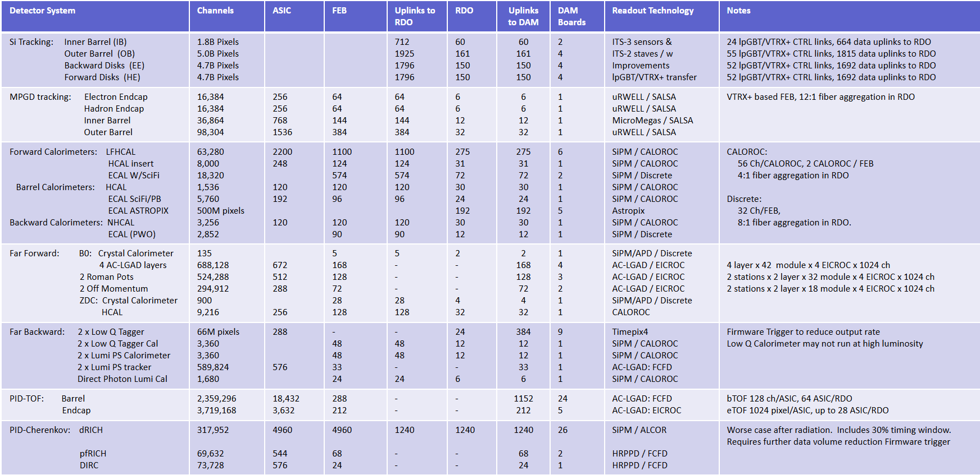
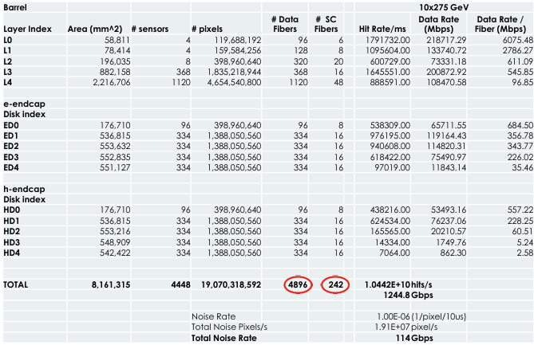
Data Volume Limits (RDO→DAM)

Slide 5
Computing / Sinking Rates to Echelon 1
Nominal Data Sinking Rate to Echelon 1 → 2 x 100 Gb/sec
  Depending on backgrounds this estimate might be low
    Synchrotron Radiation is the current limitation
    Heavily targets SVT
    Dominates data volume estimates (~400 Gb/sec) but waiting for better estimates
  Project requirements list throughput to Echelon 1 requirement as 2 x 400 Gb/sec
    400 Gb/sec links seems consistent with network plans for ESNET / Computing facilities
    Higher rates would have significant impact on Echelon 1 computing / storage
    Relevant network issues:
      Separation of dataflow from external traffic to guerentee bandwith usable at all times
      Multiple physical data paths to ensure robust connectivity

