Slide 1

TIC Meeting
Background Impact on Lumi Systems
Stephen Kay
30th March 2026

Slide 2
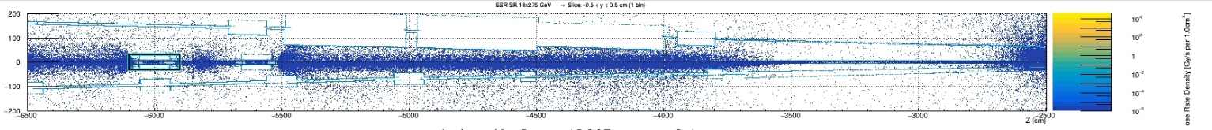

Background on the Lumi Systems
Lumi system nominally in path of SR fan
BUT, vertically displaced, specifically 5𝜎 clear of main fan
SR/Beam BG was a recent cause for concern re:Lumi Magnets though
Andrii ran simulation studies for SR load on front (sweeper) magnet
See slides here
Studies indicated shielding around vacuum pipe will be needed
Majority of dose/heat deposited on sweeper magnet and vacuum entrance window
Start at beampipe exit window - 1cm diamond

Slide 3
Background on the Lumi Systems
But, what about the detectors themselves?
Tried using Alex’s files…
But they don’t extend to Lumi region
Based upon Andrii’s studies, remaining dose (once shielding, collimator etc) in place is minimal on PS system
DPD, higher dose - but specifically studied and evaluated to deal with SR load
SR filters built into design too
Updated geometry/design of magnets, shielding, collimator not in standard configuration geometry yet
Evaluate rates/doses when this is in place - Andrii has updated DD4HEP geom
Make PR and merge in?
Need to finalise collimator
Is ~1cm diamond beamline exit window in “standard” geometry?

Slide 4
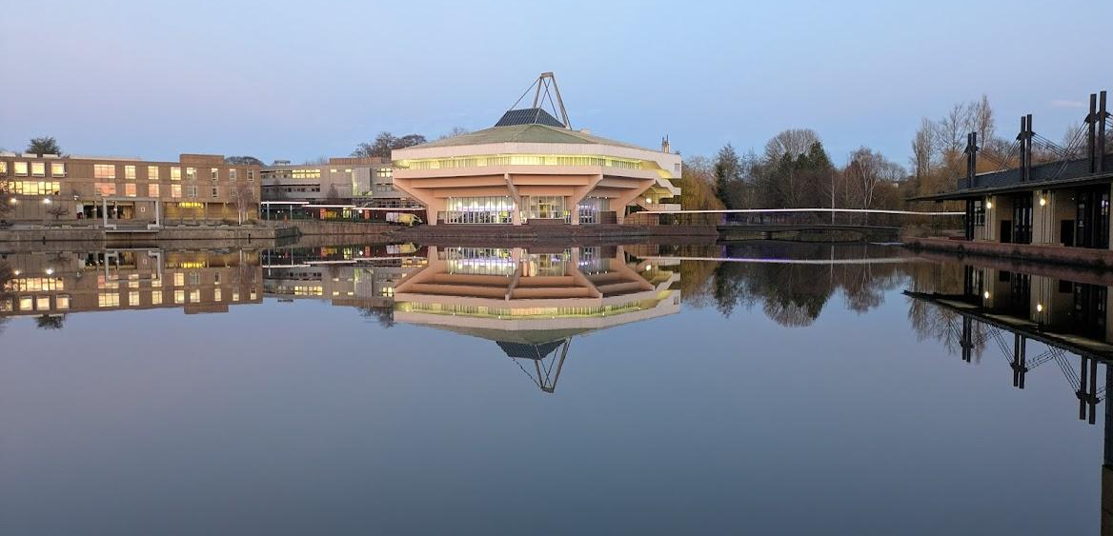
Thanks! Any questions?

