Slide 1


Oxygen–Oxygen Collisions: A New Window on the System-Size Evolution of QCD Matter at RHIC and LHC
Uttam Acharya
HP2026 Satellite workshop on Jets and Heavy Flavor Physics
June 27 - June 28
Georgia State University

Slide 2
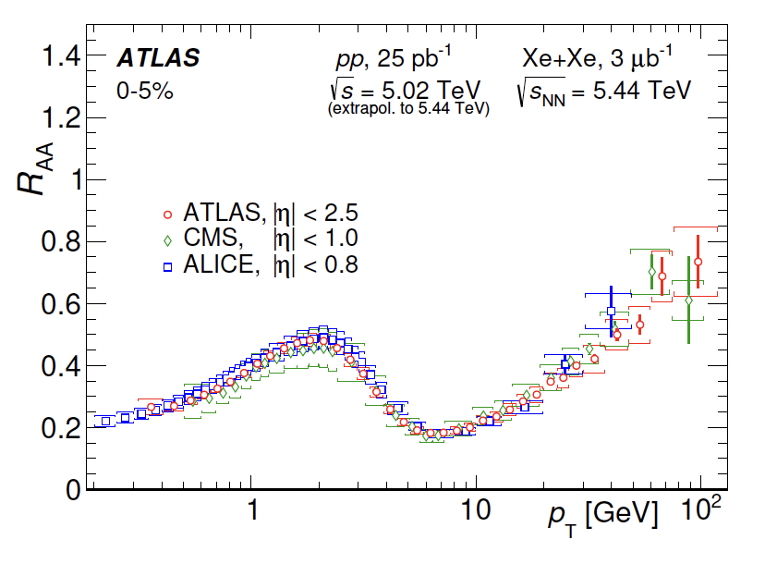
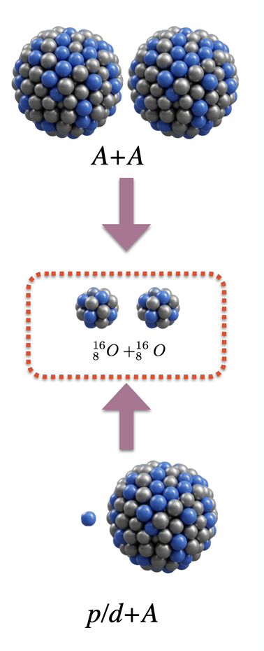
System size and Quark Gluon Plasma
Large system:
  Jet quenching is well established.
  Collective nature of QGP, particle production, model prediction.
JHEP07(2023)074

Slide 3
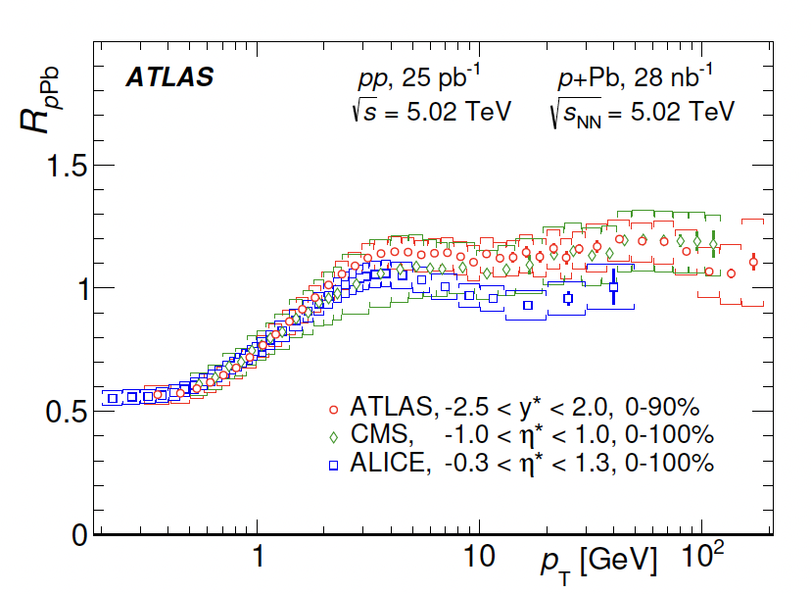
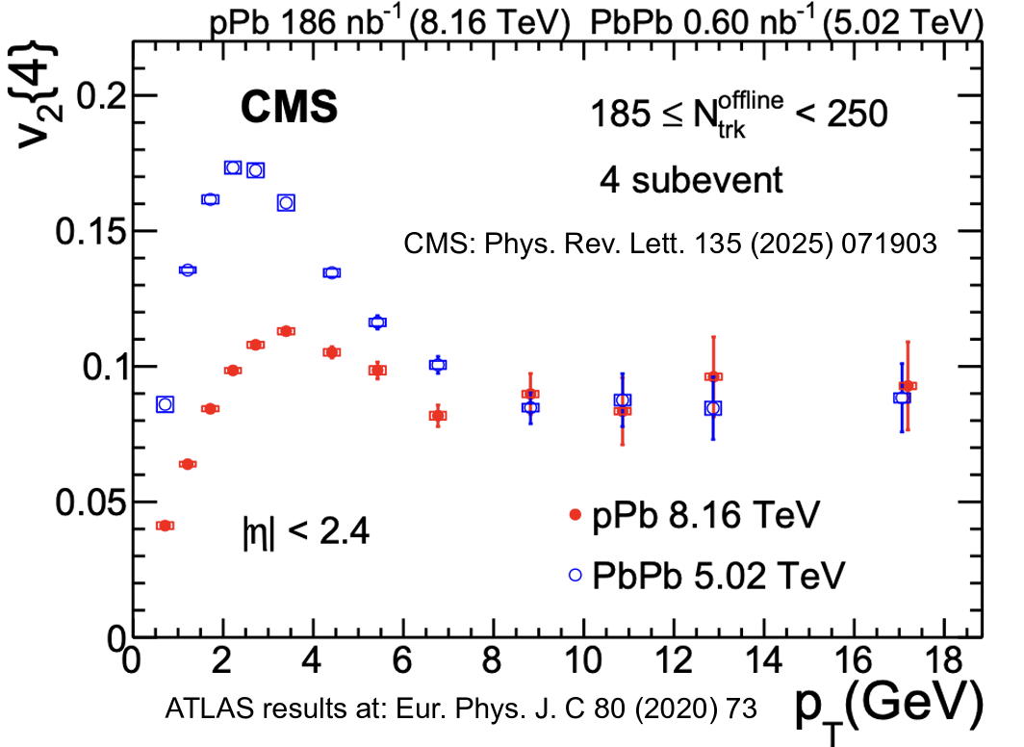
System size and Quark Gluon Plasma
Small system:
  No sign of QGP formation.
  Initial state effect such as CNM well understood.
  No clear jet quenching at high p_{T} but significant positive V_{2.}
  If not the jet quenching , what is the origin of high p_{T} V₂ in small system!!!
JHEP07(2023)074

Slide 4
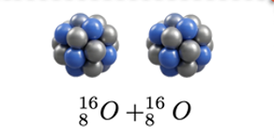
System size and Quark Gluon Plasma
System Size
Intermediate system
Positioned between small system pp/pA and large system like AuAu/PbPb.
How does the parton loss energy occur with the system size?
Is it possible to produce QGP?

Slide 5
System size and Quark Gluon Plasma
System Size
Intermediate system
Positioned between small system pp/pA and large system like AuAu/PbPb.
How does the parton loss energy occur with the system size?
Is it possible to produce QGP?

Slide 6
So Why light ions collision?
Search for the medium effect in the small collision system so far observed in HI:
  No unambiguous quenching in pA.
  Mitigate the event selection bias in peripheral HI.
Probe our understanding of nature of QGP like signals in HI by:
  Decoupling geometry and multiplicity
  Larger transverse size, better defined initial geometry and more comparable longitudinal structure than high-multiplicity pp and pA
Clear collision geometry.
Sweet spot for the jet quenching
Extend the capability of the existing theory model framework versus the system size.

Slide 7
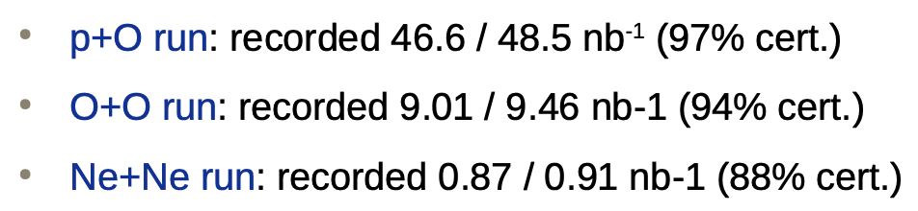
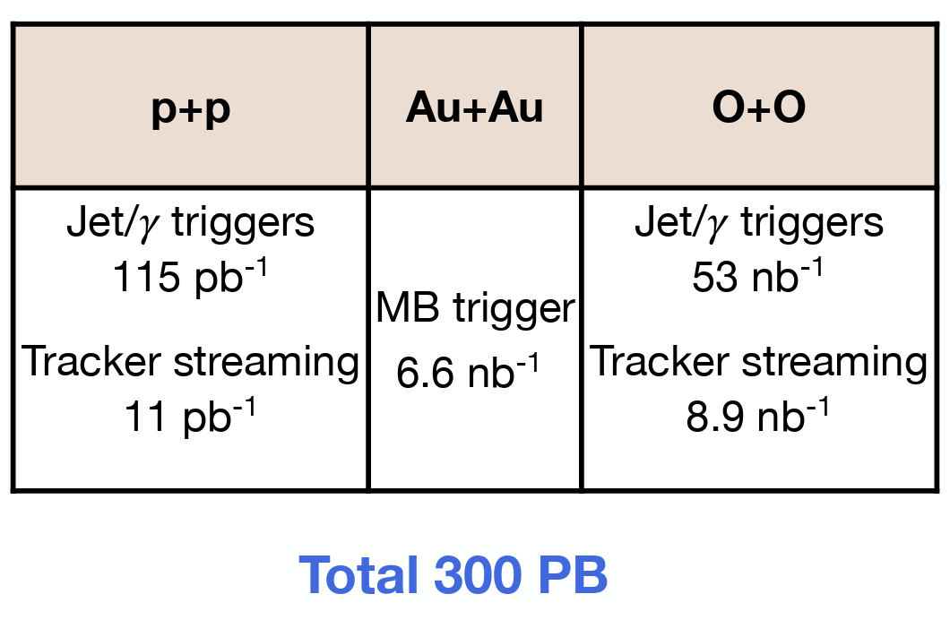
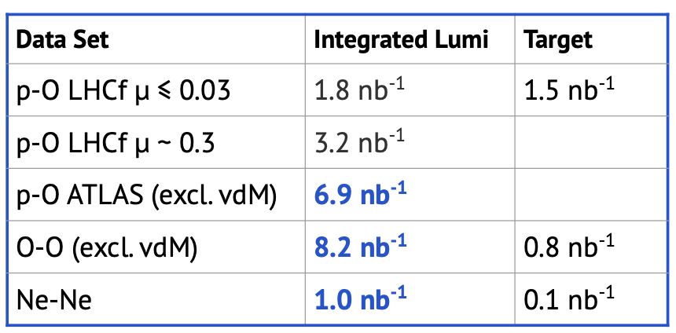
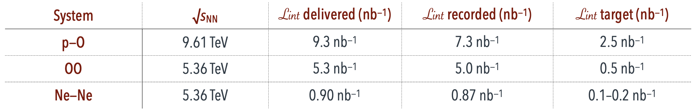
Luminosity recorded in different experiments at LHC and RHIC
CMS
sPHENIX
ATLAS
ALICE

Slide 8
How dense is OO system?

Slide 9
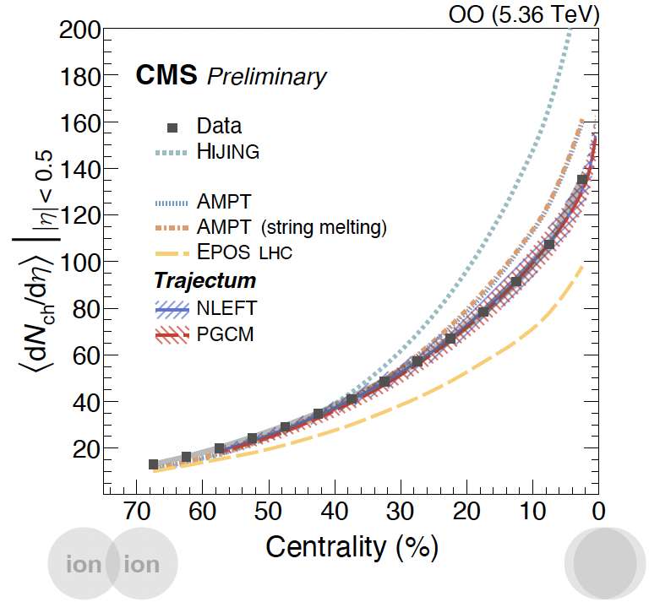
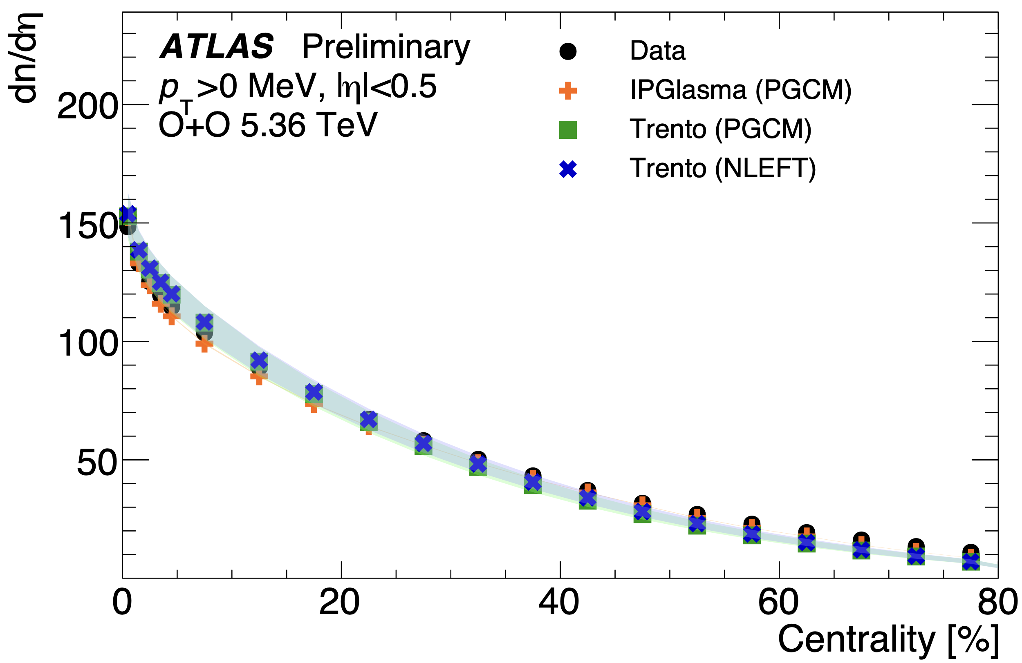
Charge Multiplicity dN/d𝜂
Fundamental observable to understand the particle production mechanism.
Close association with the initial energy density and the entropy density during the hadronization in the plasma.
ATLAS CONF-2026-004
Important input for constraining theoretical models.

Slide 10
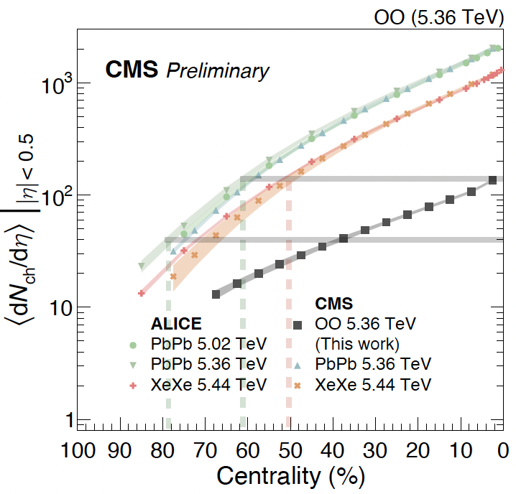
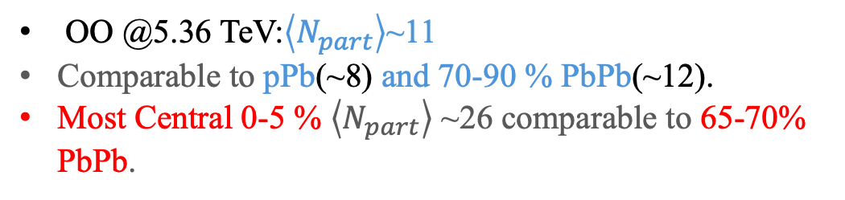
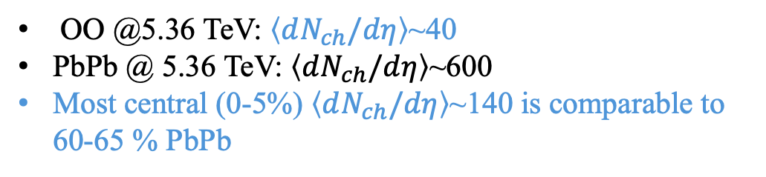
Charge Multiplicity dN/d𝜂
ATLAS CONF-2026-004
OO @5.36 TeV: $\left\langle dN_{ch}/dη\right\rangle$~40
PbPb @ 5.36 TeV: $\left\langle dN_{ch}/dη\right\rangle$~600
Most central (0-5%) $\left\langle dN_{ch}/dη\right\rangle$~140 is comparable to 60-65 % PbPb
OO @5.36 TeV:$\left\langle N_{part}\right\rangle$~11
Comparable to pPb(~8) and 70-90 % PbPb(~12).
Most Central 0-5 % $\left\langle N_{part}\right\rangle$ ~26 comparable to 65-70% PbPb.

Slide 11
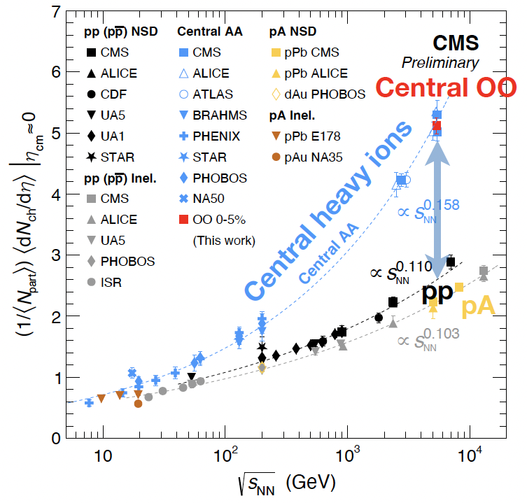
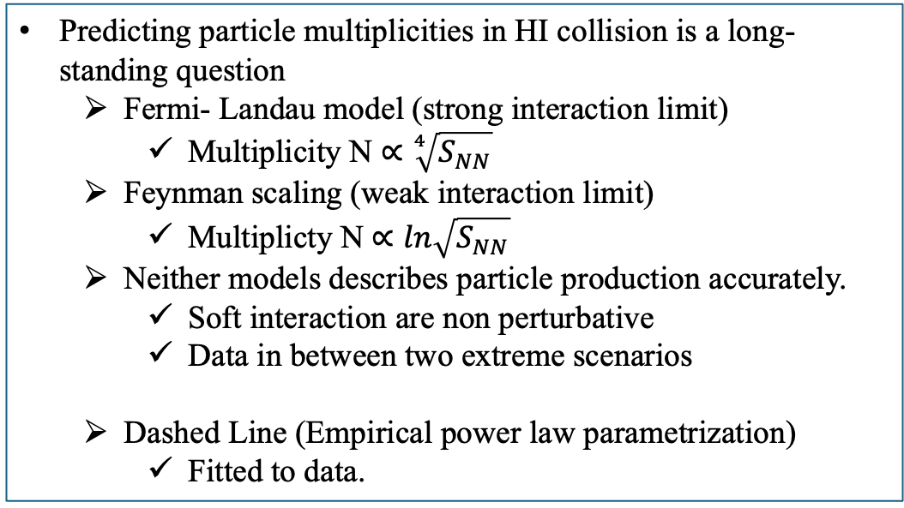
Energy to entropy Per Participant dN/d𝜂
Multiplicity per participant nucleon
Predicting particle multiplicities in HI collision is a long-standing question
  Fermi- Landau model (strong interaction limit)
    Multiplicity N $∝$ $\sqrt[4]{S_{NN}}$
  Feynman scaling (weak interaction limit)
    Multiplicty N $∝ln\sqrt{S_{NN}}$
  Neither models describes particle production accurately.
    Soft interaction are non perturbative
    Data in between two extreme scenarios
  Dashed Line (Empirical power law parametrization)
    Fitted to data.
Central Heavy – ion collisions are higher than pp at given S_{NN} ⟹ More Efficient to transfer energy to entropy.
Most central OO follows the scaling of heavy ion central AA.
  Transition to QGP?
CMS PAS-HIN-25-010

Slide 12
Collective expansion of QGP

Slide 13
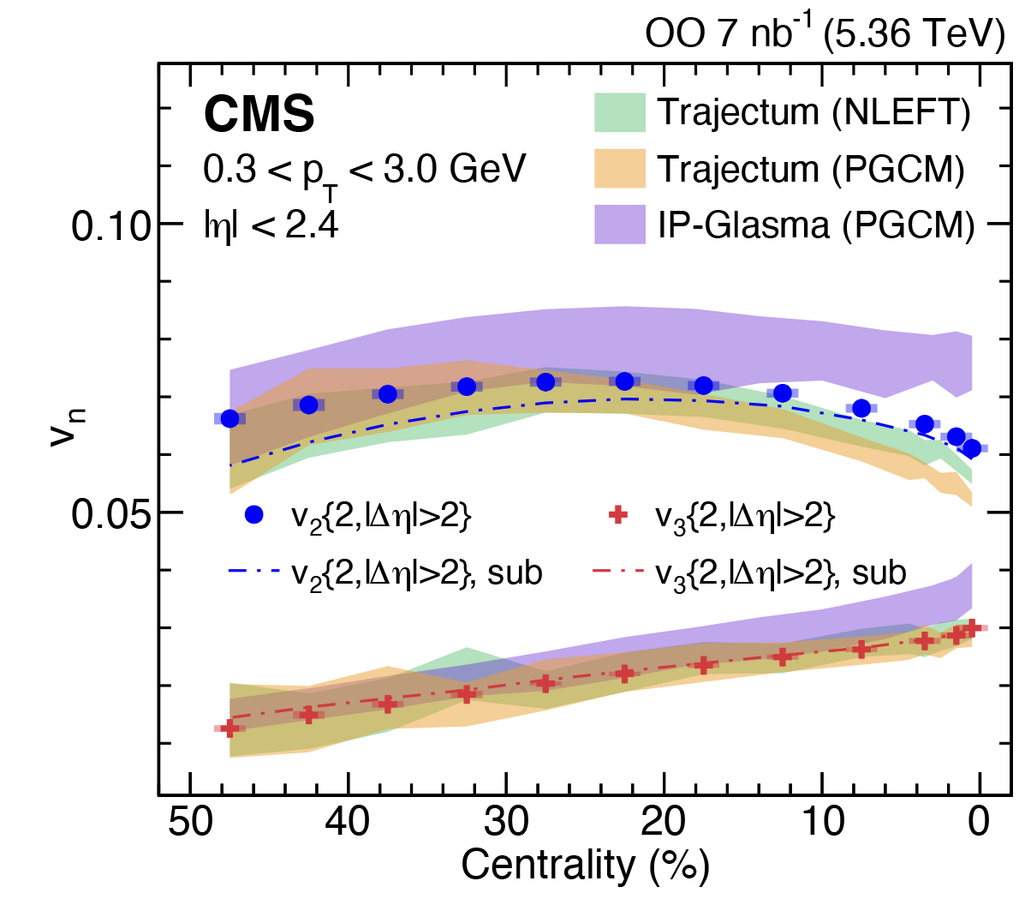
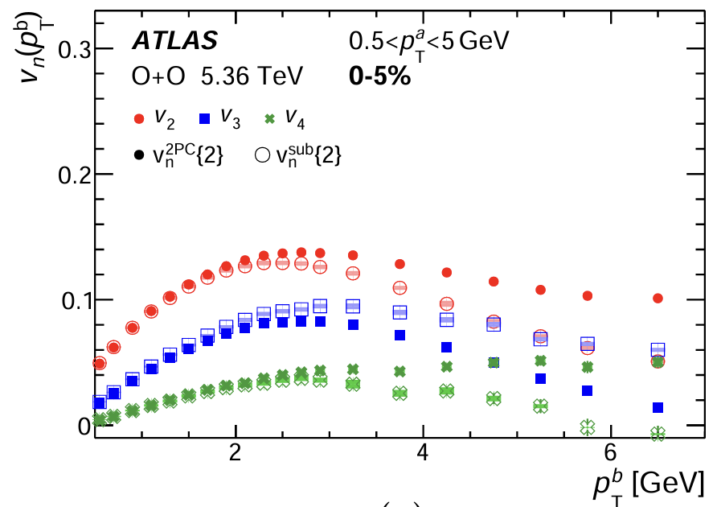
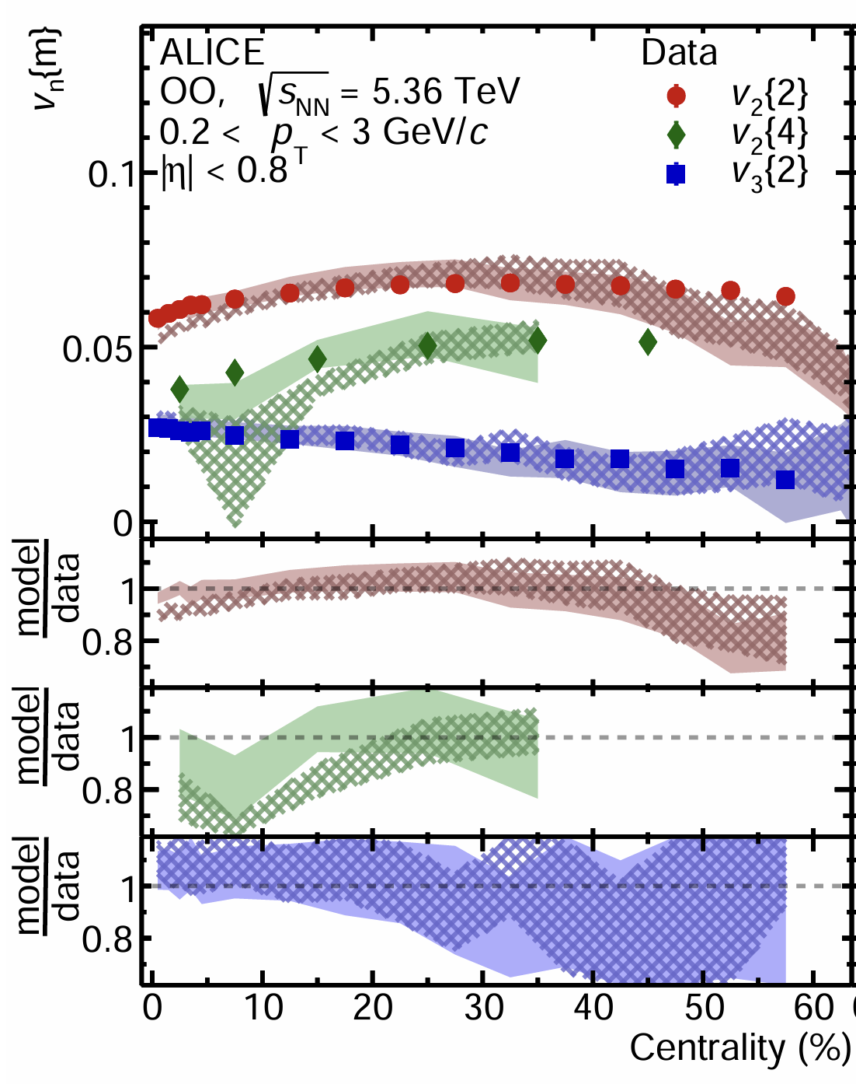
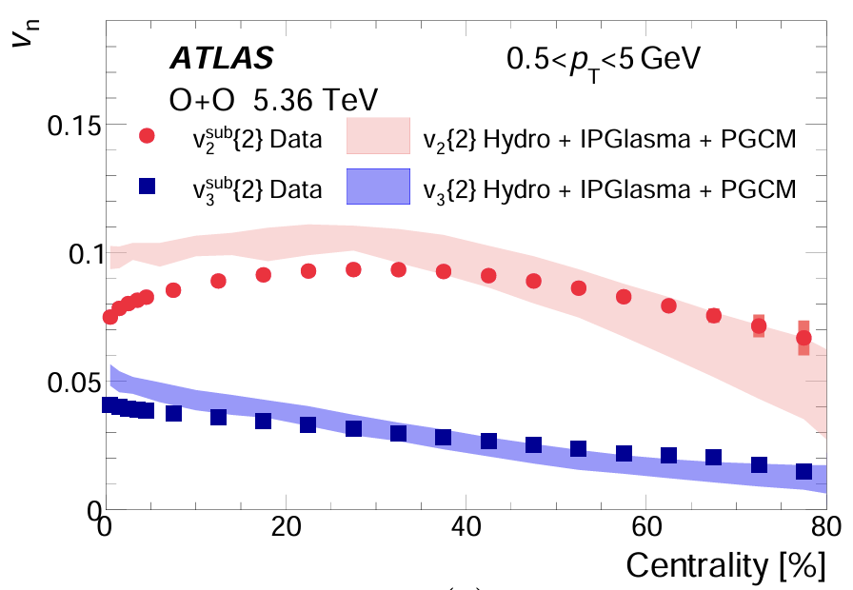
Azimuthal Anisotropy V_{n} in OO
arXiv:2509.05171
arXiv:2509.06428
arXiv:2510.02580
V₂ and V₃ in OO measured in high precisions.
  For central events, a bit discrepancy as predicted by hydro models.
  V₂ in OO has milder centrality dependence than heavy ions-> possibly due to lumpier initial shapes.
arXiv:2509.05171

Slide 14
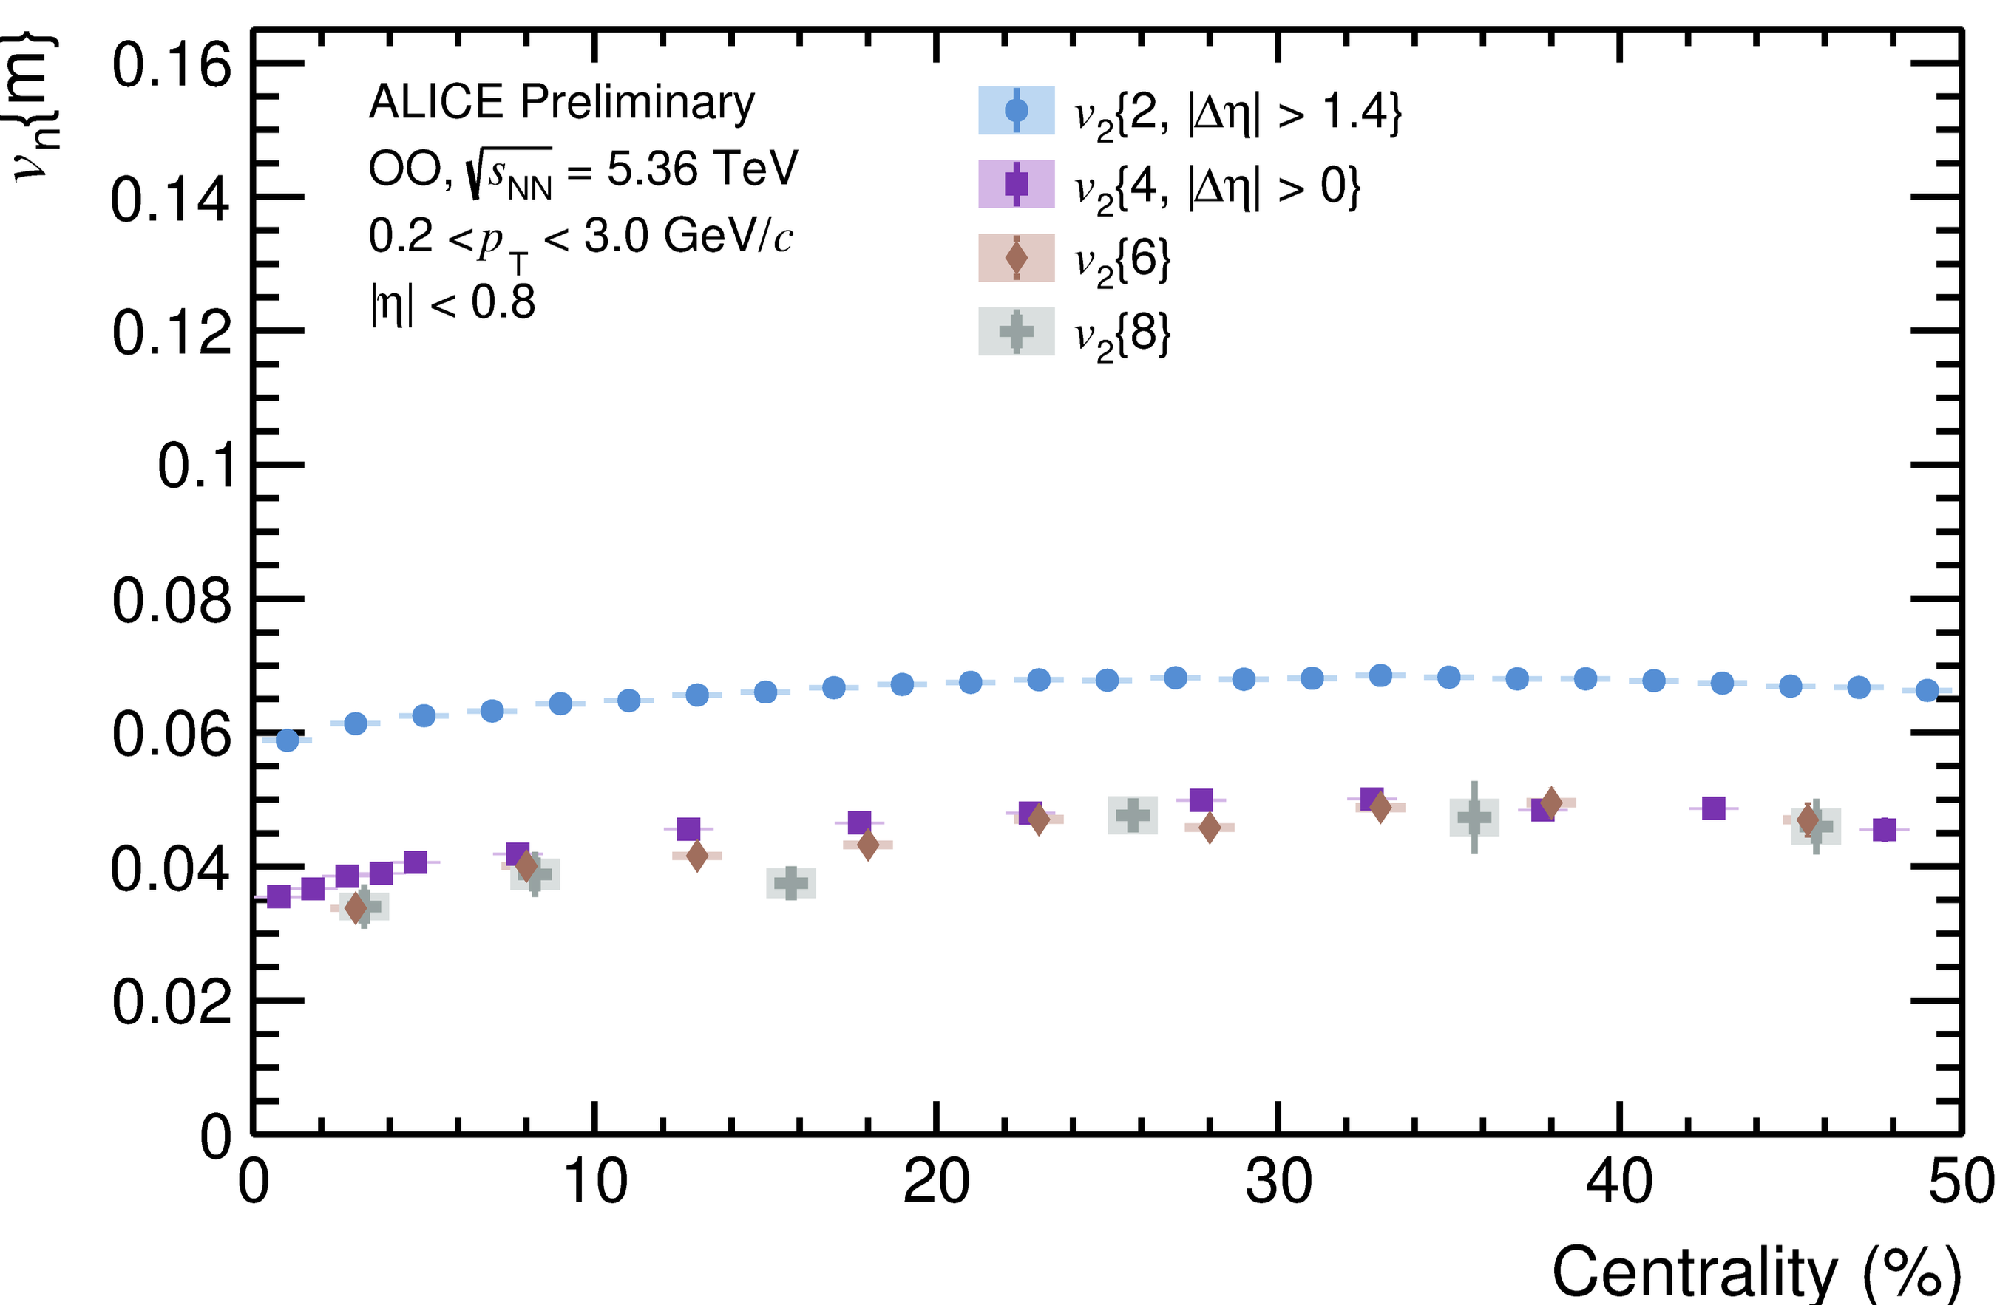
Azimuthal Anisotropy V_{n} in OO:
Collectivity and Fluctuations (Multi - particle correlation)
Same behavior of multi-particle correlation in OO as in heavy ion collisions.
  v₂{4} ≈ v₂{6} ≈ v₂{8} indicates collective nature of the correlation involving multiple particles
    observed anisotropy originates from a collective many-particle phenomenon rather than from a few correlated particles.
  v₂{2} > v₂{4} features event by event fluctuations in hydrodynamic context
arXiv:2509.06428
v₂{2}
v₂{4} ≈ v₂{6} ≈ v₂{8}

Slide 15
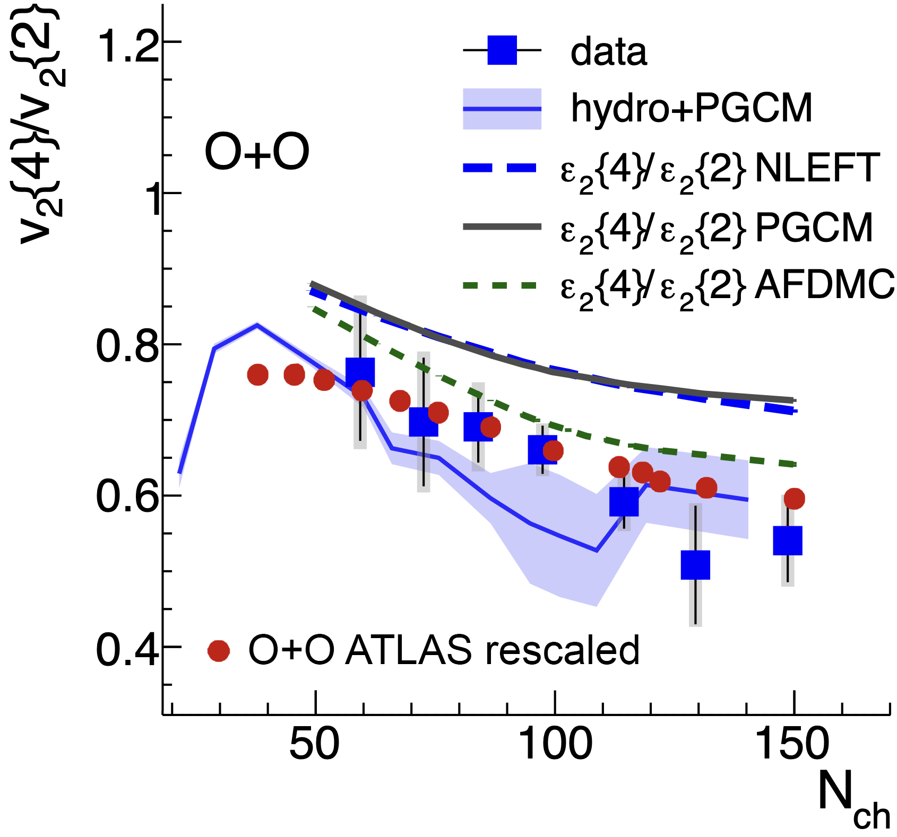
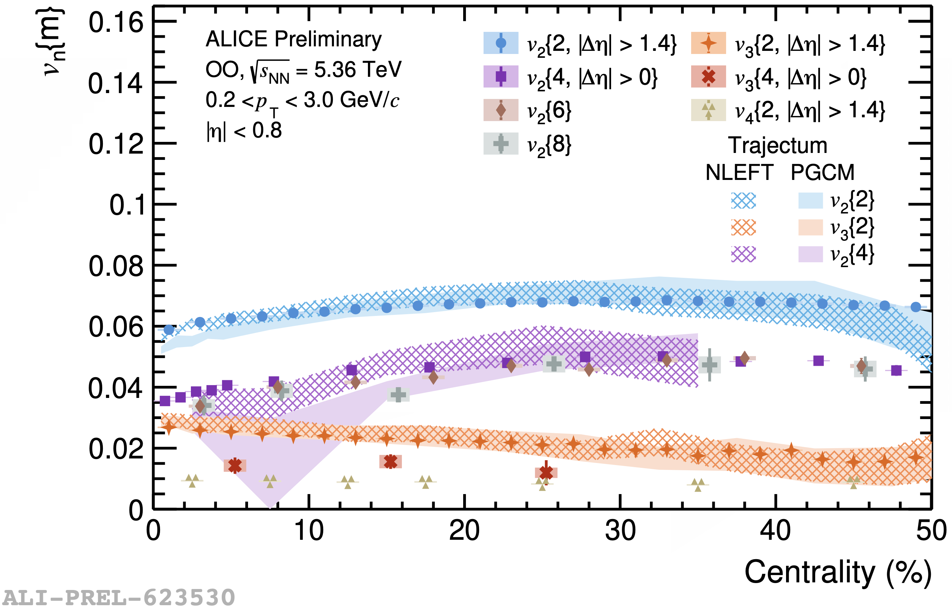
Azimuthal Anisotropy V_{n} in OO:
Fluctuations (Multi - particle correlation)
arXiv:2510.19645
STAR
200 GeV
arXiv:2509.06428
v₂{4}
v₂{4} / v₂{2} cancels hydro response reflecting eccentricity fluctuations
At both RHIC and LHC energy for a given centrality, similar eccentricity fluctuation observed.
Hydro models predicts fairly well in both collision energies.
Initial geometry fluctuation drives the collective flow.

Slide 16
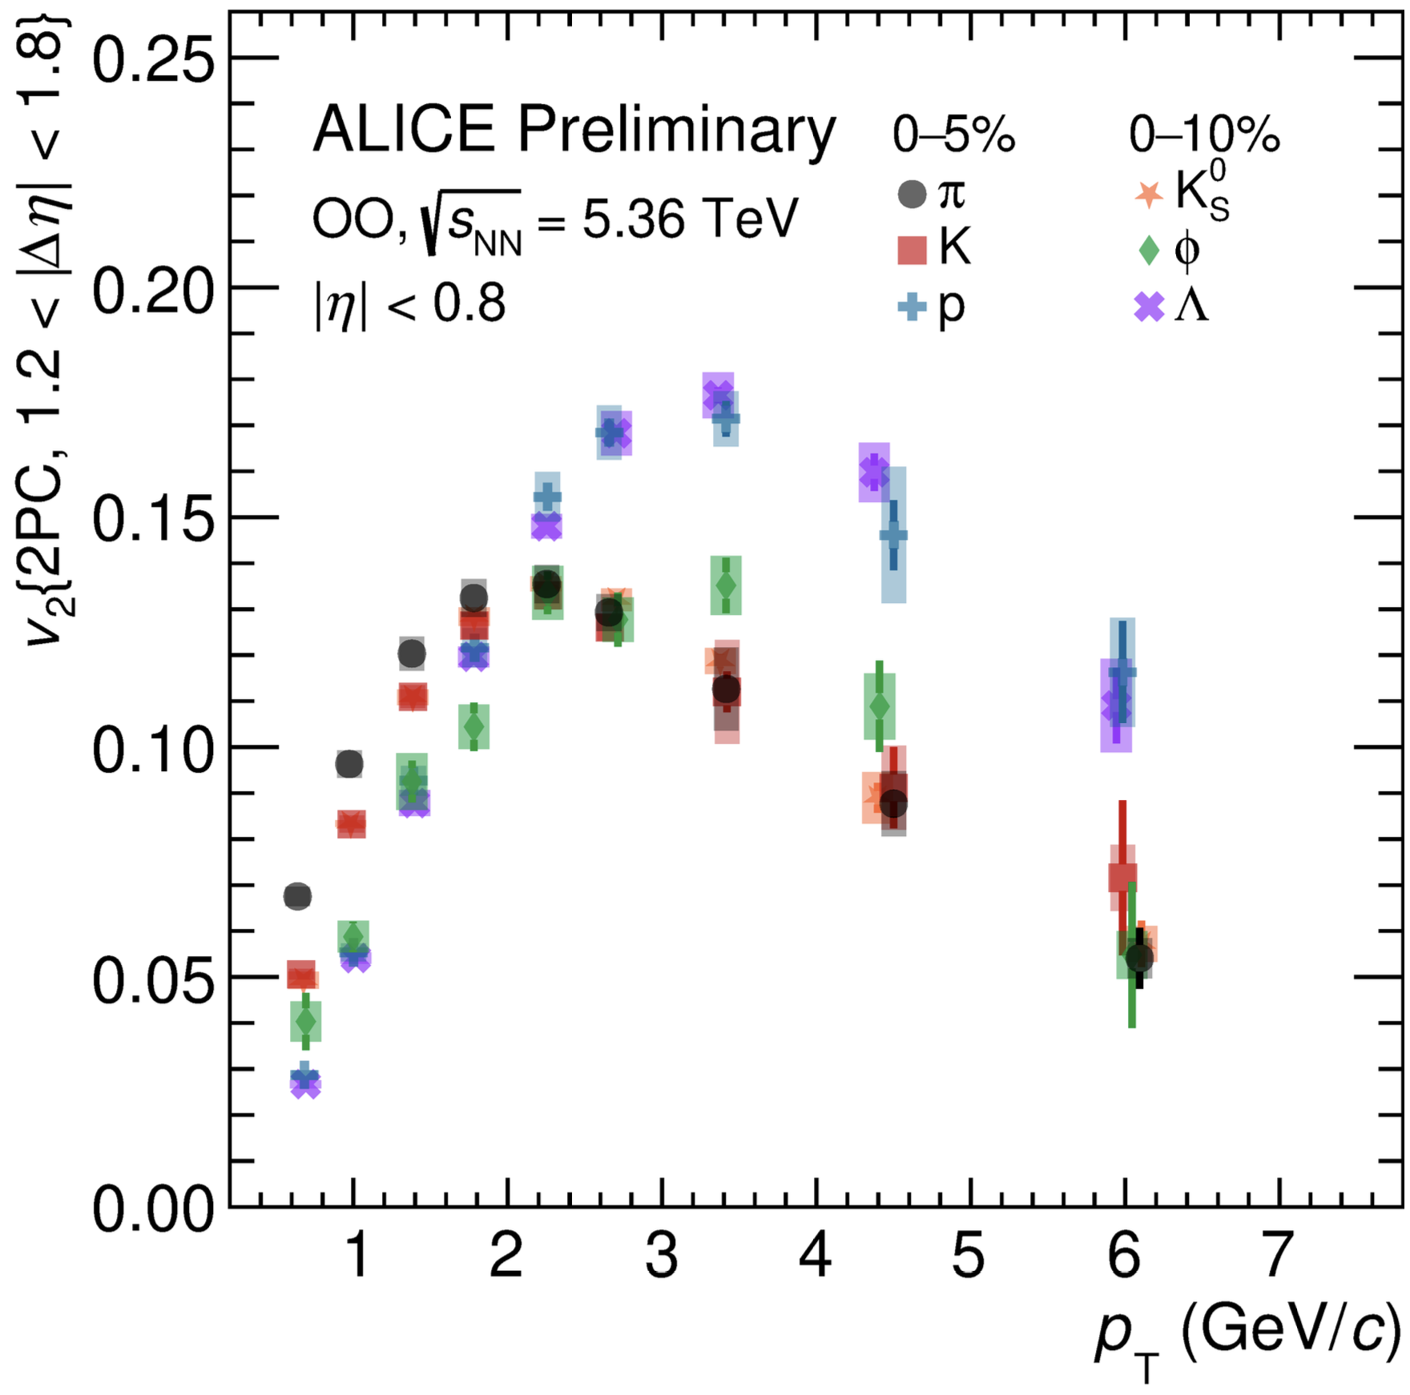
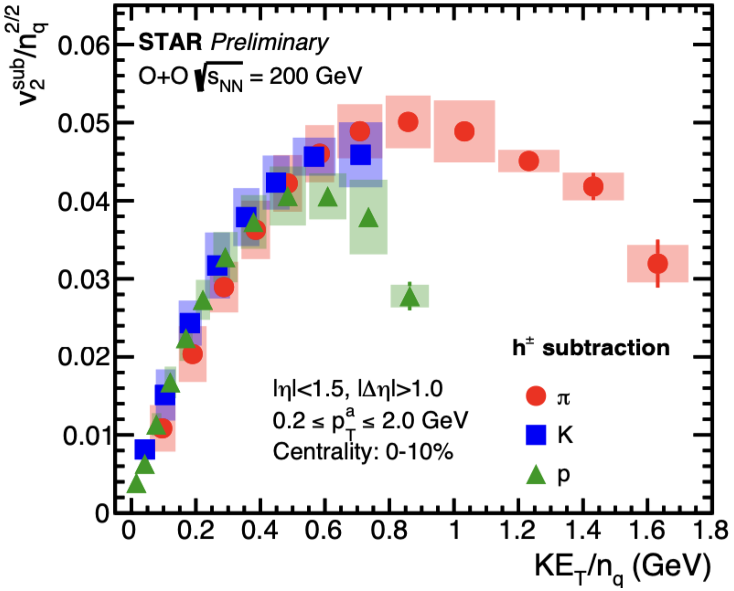
Partonic flow Evidence: Identified Hadron V₂
SQM 26
arXiv:2411.09323
Similar observation in OO at RHIC
Scaled by number of constituent quark (NCQ).
Evidence of flow carried by partons
Separation of V₂ into distinct meson and baryons group at intermediate p_{T}
  Flow adds when nearby quarks are combined in coalescence picture(quarks acquire flow before hadronization).
Mass hierarchy of V₂ at low p_{T}
  At given p_{T} heavier particles have lower flow velocity.
Same behavior seen in heavy ions and high- multiplicity pp, pPb.

Slide 17
Particle Production

Slide 18
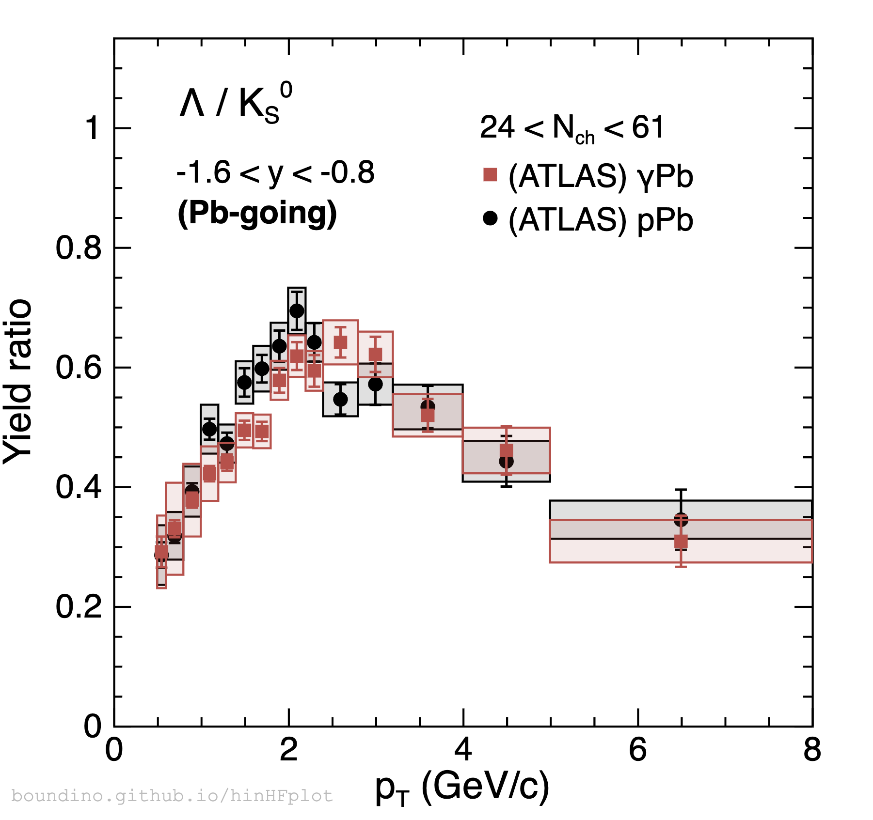
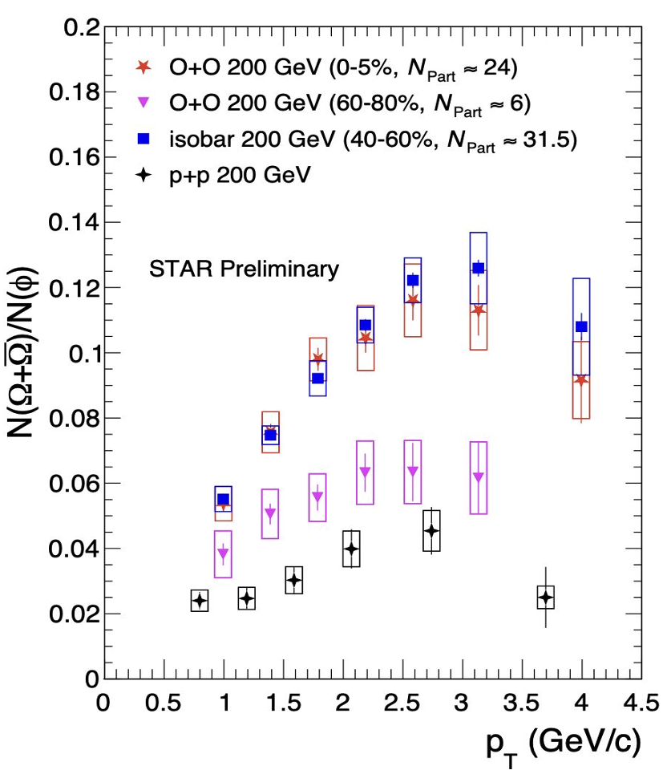
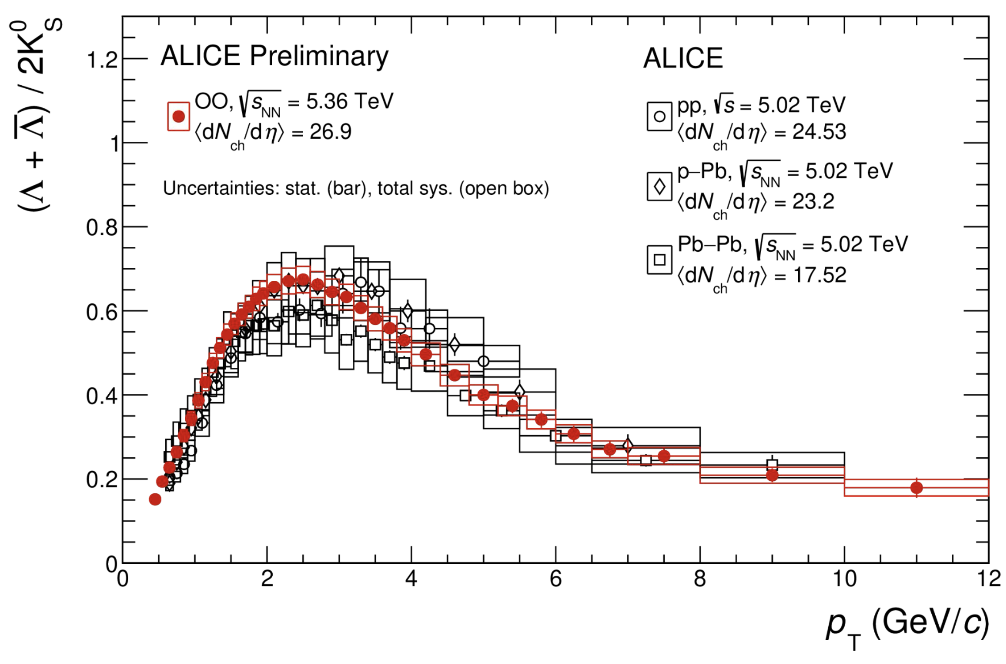
Coalescence: Baryon-to-Meson Ratio
RuRu +ZrZr
Recombination (Coalescence)
𝛾Pb(Pb-going)
Fragmentation
Thermalization
pPb(pPb-going)
SQM 26
SQM 26
PRC 111 (2025) 064908
Baryon-to-meson ratio in OO are consistent with an interplay of hydrodynamic expansion and coalescence.
  Hydrodynamics dominates at low p_{T} as particles are produced thermally.
  Coalescence in a medium enhances baryon product at intermediate p_{T}: Quark recombination
Universal behavior in multiple systems as long as matching high-enough multiplicity/Npart .
Integrated yield show that OO bridge small and large collision systems.

Slide 19
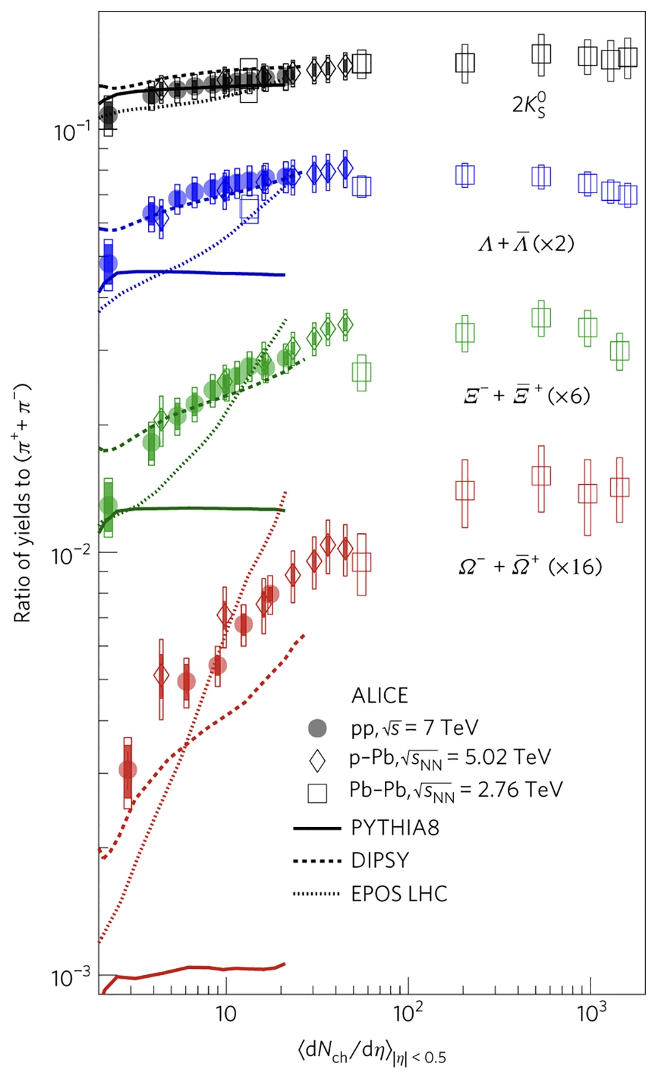
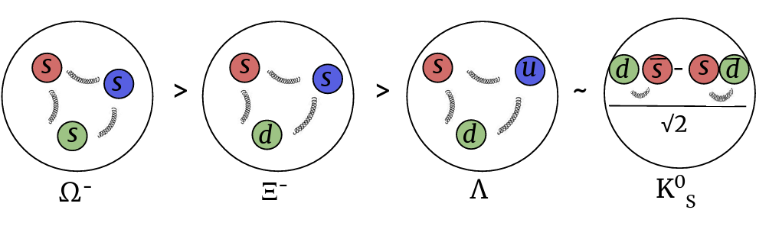
Strangeness Enhancement
Nature Phys 13 (2017) 535
Multiplicity evolution of (multi-) strange hadron across different collision systems.
High multiplicity limit: Saturation at PbPb can be well explained by statistical models.
Low multiplicity limit: smooth increase in pp can be explained by strings models ,e.g, rope, close-packing.
Core coronal model have a unified description for the intermediate region.
S=1
S=2
S=3

Slide 20
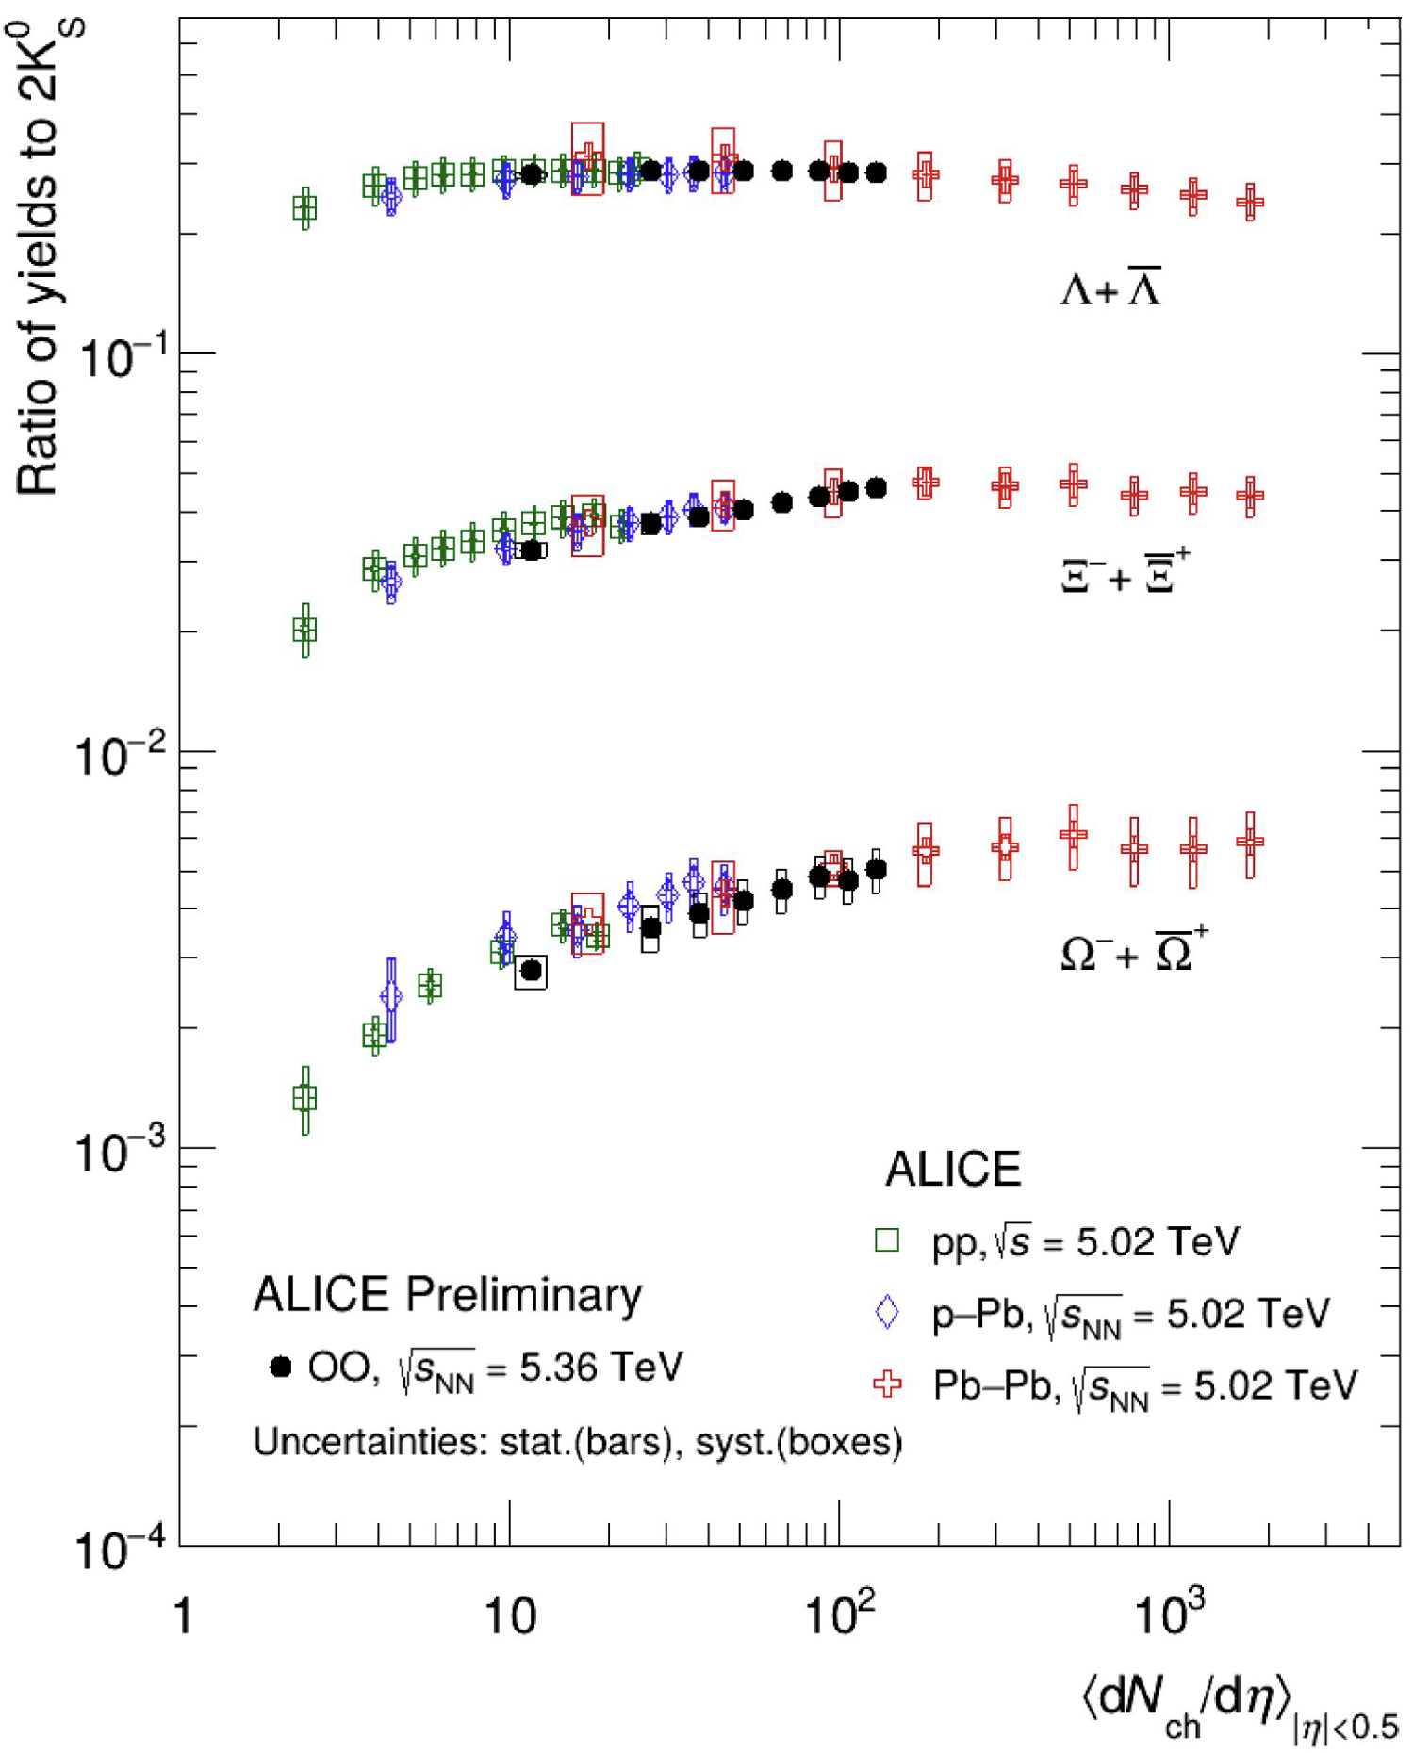
Strangeness Enhancement
ALICE SQM 26
Multiplicity evolution of (multi-) strange hadron across different collision systems.
High multiplicity limit: Saturation at PbPb can be well explained by statistical models.
Low multiplicity limit: smooth increase in pp can be explained by strings models ,e.g, rope, close-packing.
Core coronal model have a unified description for the intermediate region.
S=1
S=2
OO follows common strangeness-driven scaling across colliding systems, with a stronger enhancement for higher strangeness content.
  High multiplicity OO doesn’t reach saturation: Will core coronal models describe the data well??
S=3

Slide 21
Parton Energy loss: Jet Quenching

Slide 22
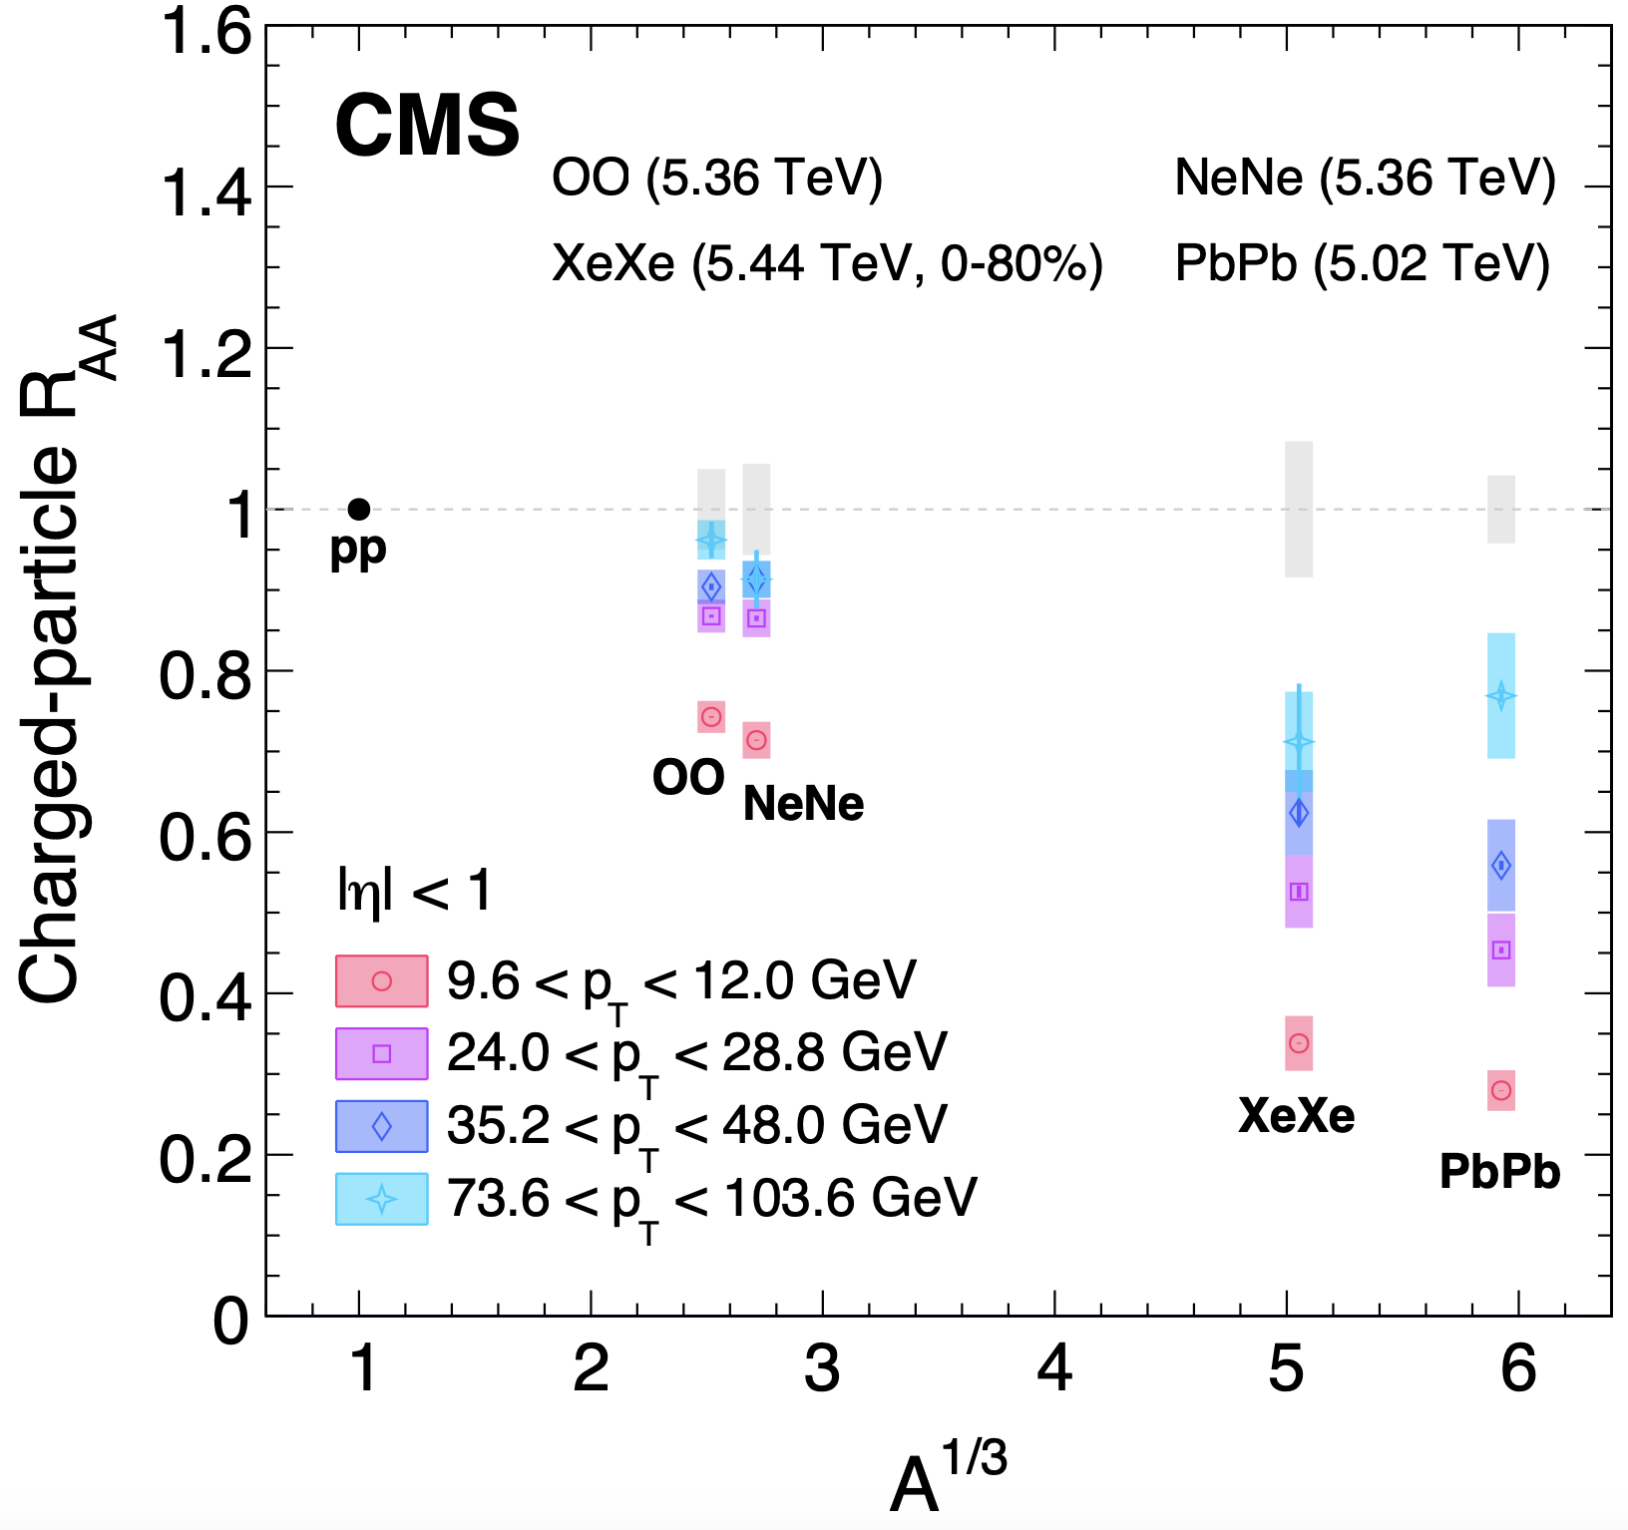
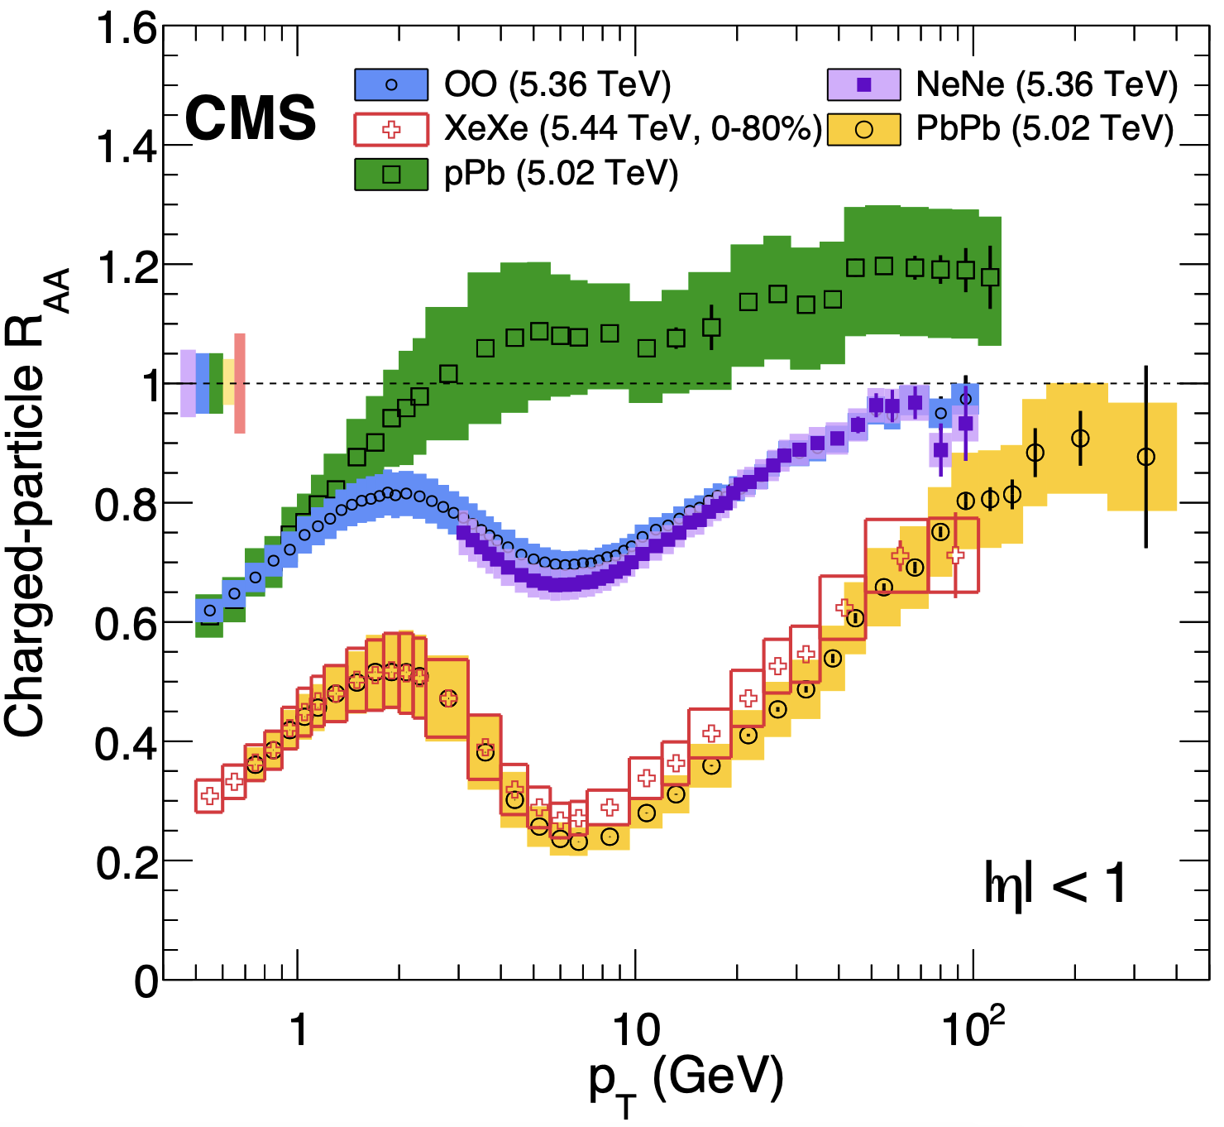
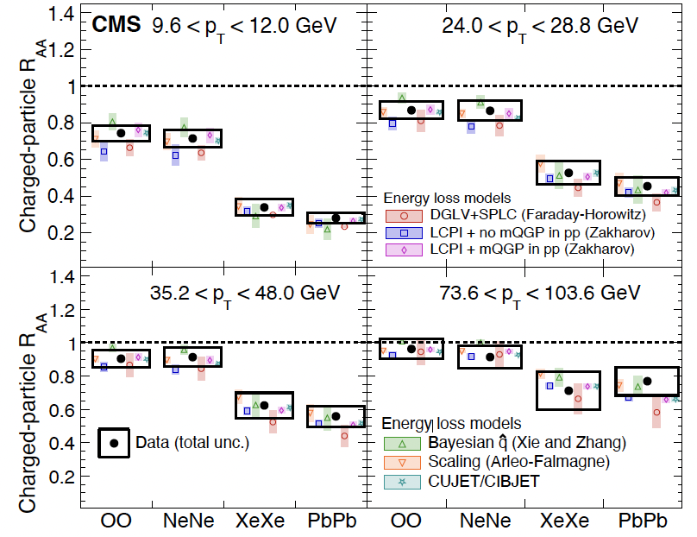
Charged particle R_{AA}
R_{AA} suppression follows a smooth evolution with A^{1/3}
Enables a direct model-independent comparison of nuclear suppression effects with the system size.
System Size Dependence of Energy loss/Suppression
arXiv:2602.21325
arXiv:2602.21325
Quenching models with scan of a big range of collision systems at LHC at same energy .
Dominant uncertainty from luminosity is included
Charged particle R_{AA} in OO significantly smaller than unity.
First time ever suppression observed in the collision of smallest system.

Slide 23
Charged particle R_{AA} :Model Prediction
Charged particle R_{AA} in OO significantly smaller than unity.
Different models comparison:
  Insufficient to explain observed suppression compared to nPDF(cold nuclear effect).
  With the energy loss models comparison, amount of constraint needed in the model can be established.
arXiv:2510.09864

Slide 24
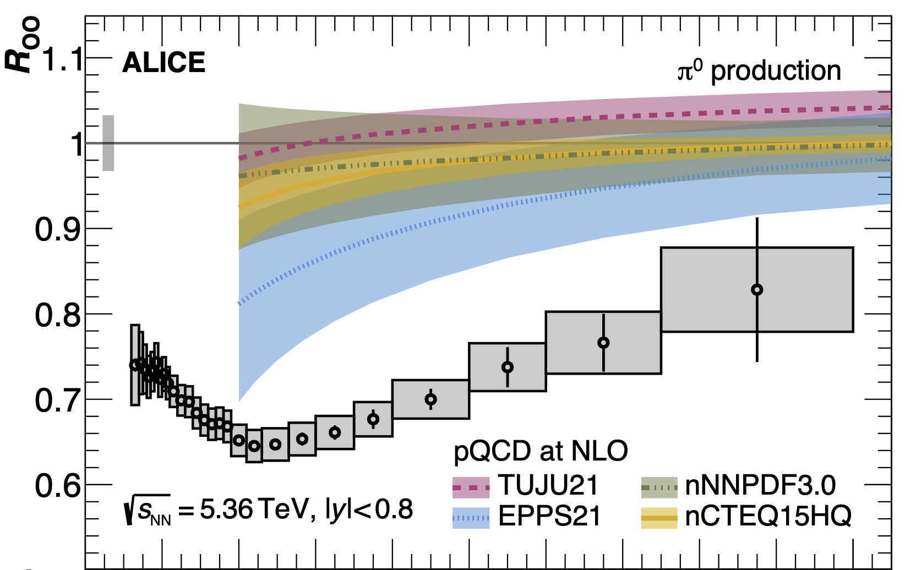
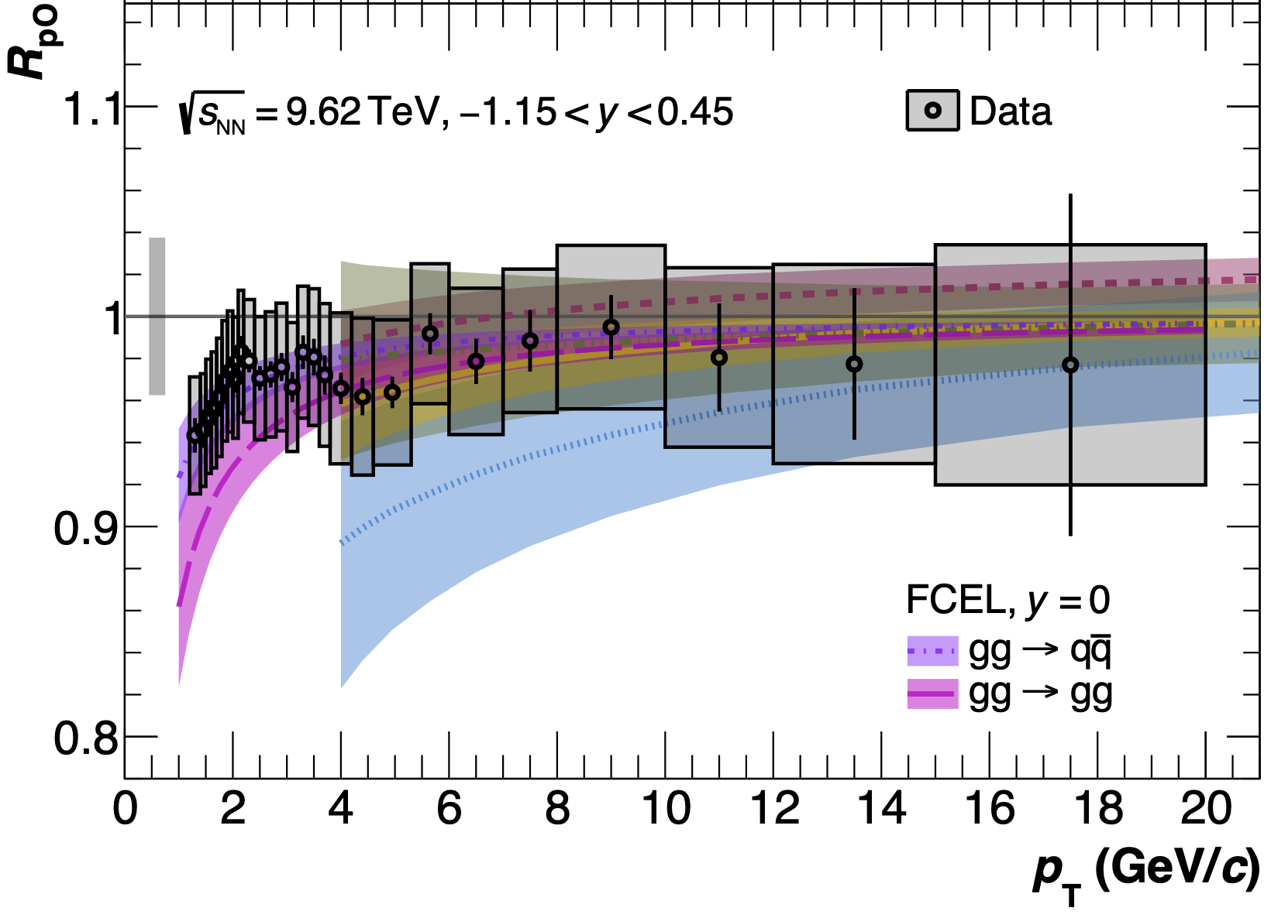
Charged particle R_{AA}
ALICE performed Charged hadron R_{AA} in OO and pO in π⁰ → γγ production.
R_{pO} compatible with unity, well behaved like RpPb.
arXiv:2606.19967
arXiv:2606.19967
9𝜎
1.8𝜎
First data driven reference of CNM in oxygen projectile.

Slide 25
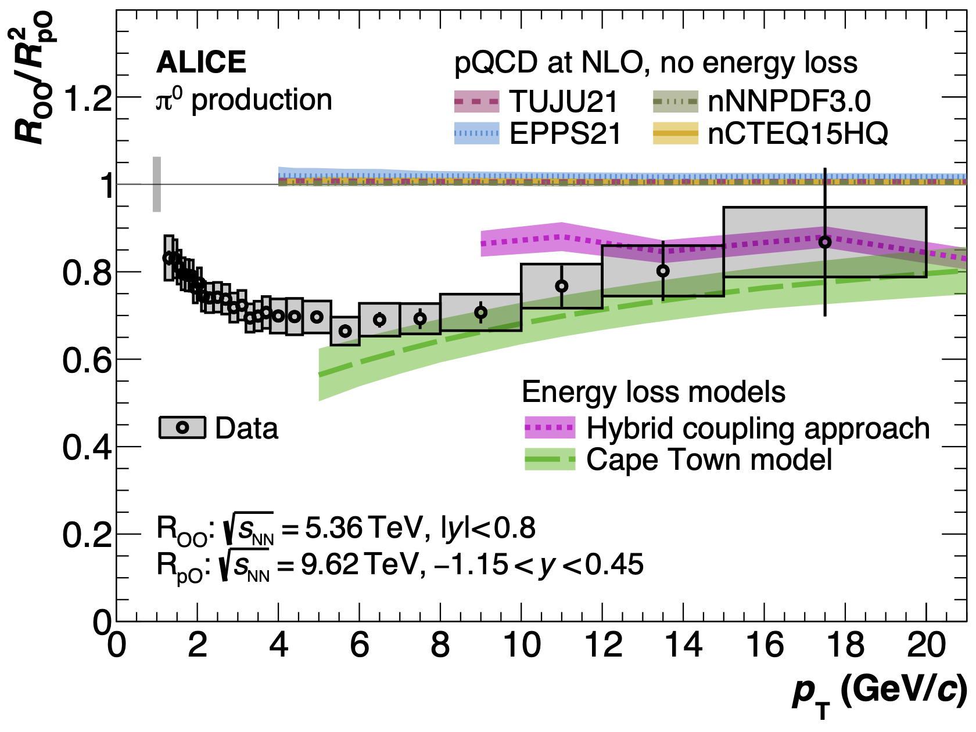
Charged particle R_{AA}
R_{OO}/R²_{pO} does not contain CNM effect
Favors energy loss prediction more clearly.
Observed modification cannot be fully explained by the CNM effect alone: 4.9𝜎 is evidence of parton energy loss in OO collision
4.9𝜎
arXiv:2606.19967

Slide 26
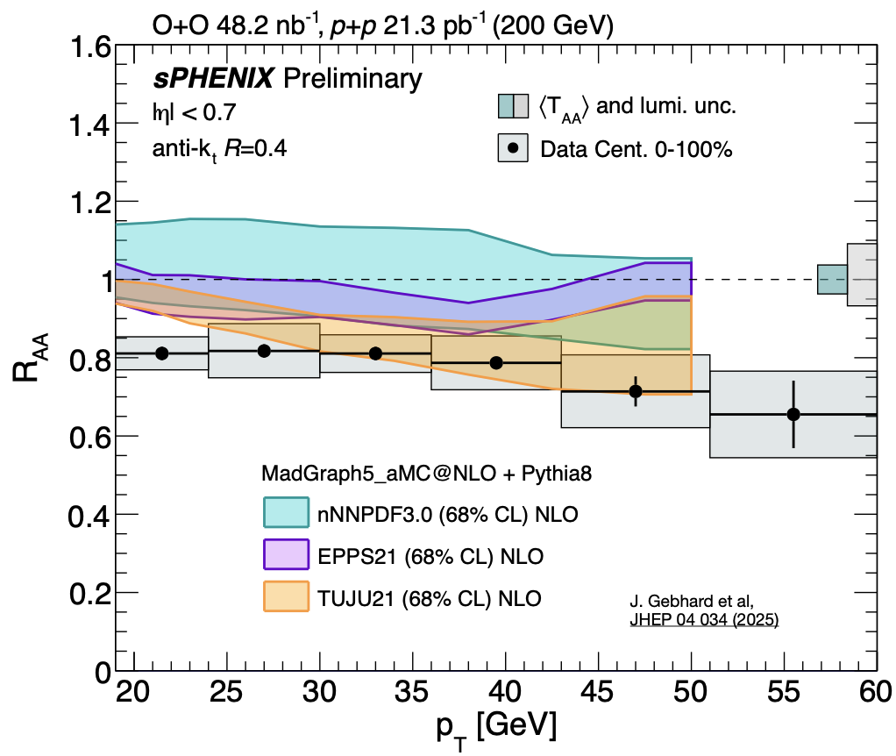
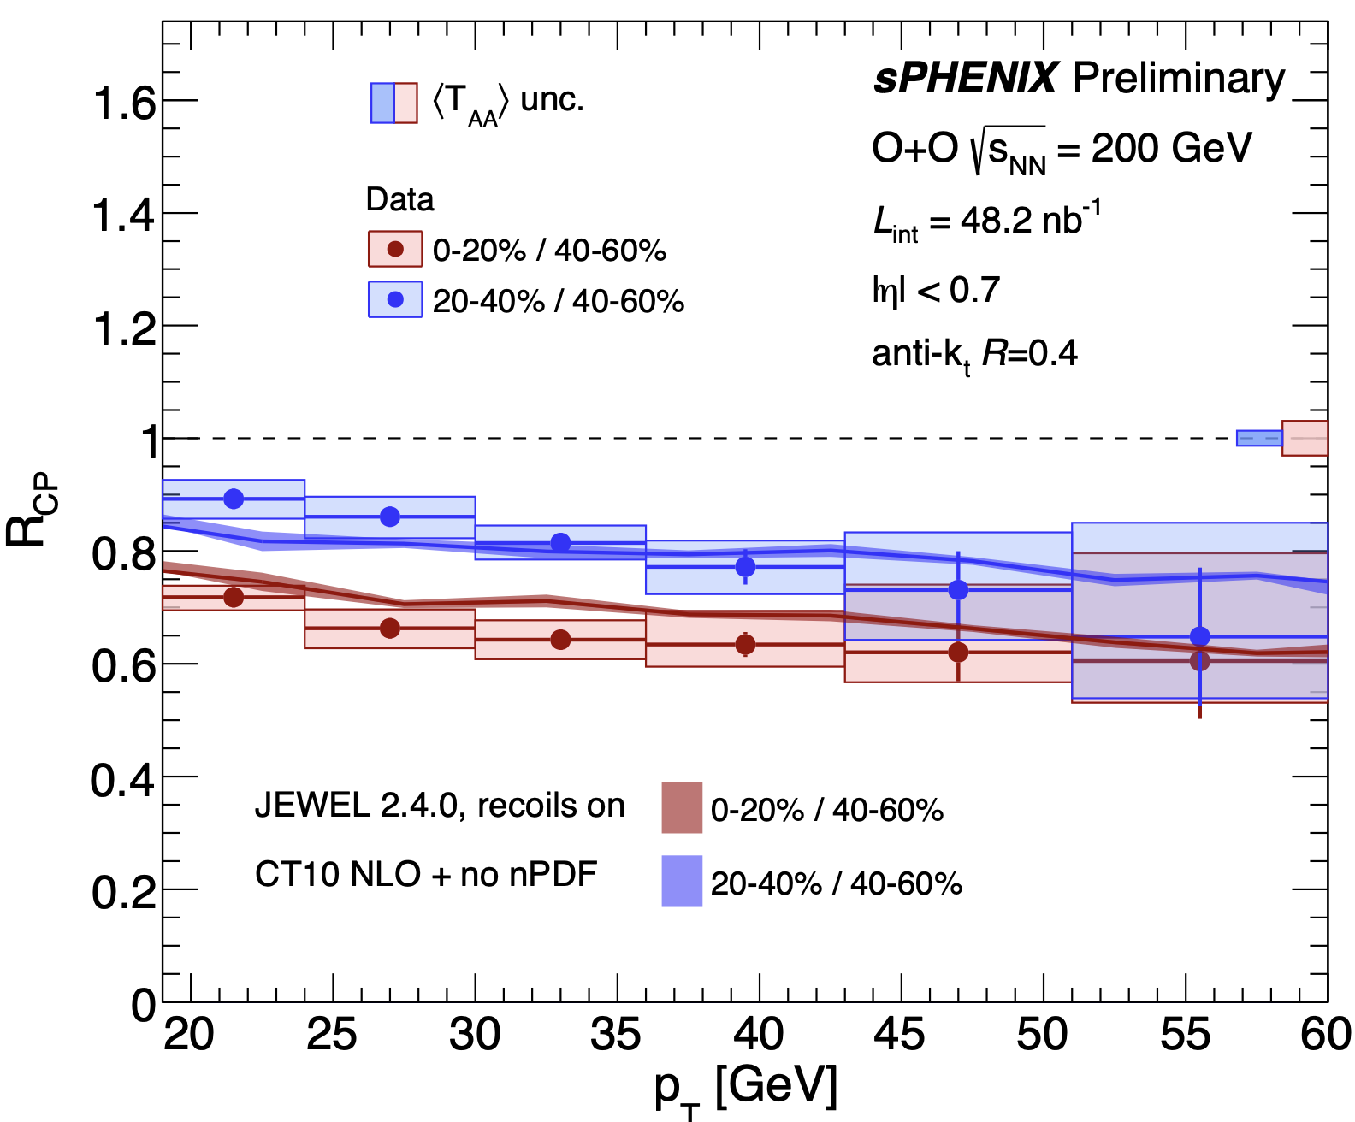
Jet Modification
[sPH-CONF-JET-2026-02]
Clear hierarchy towards centrql collisions in RCP with reduced uncertainty.
RCP resilient to nPDF uncertainty and Glauber modeling uncertainties.
Suppresses across all Jet p_{T}.
Favors parton energy loss at RHIC energies.

Slide 27
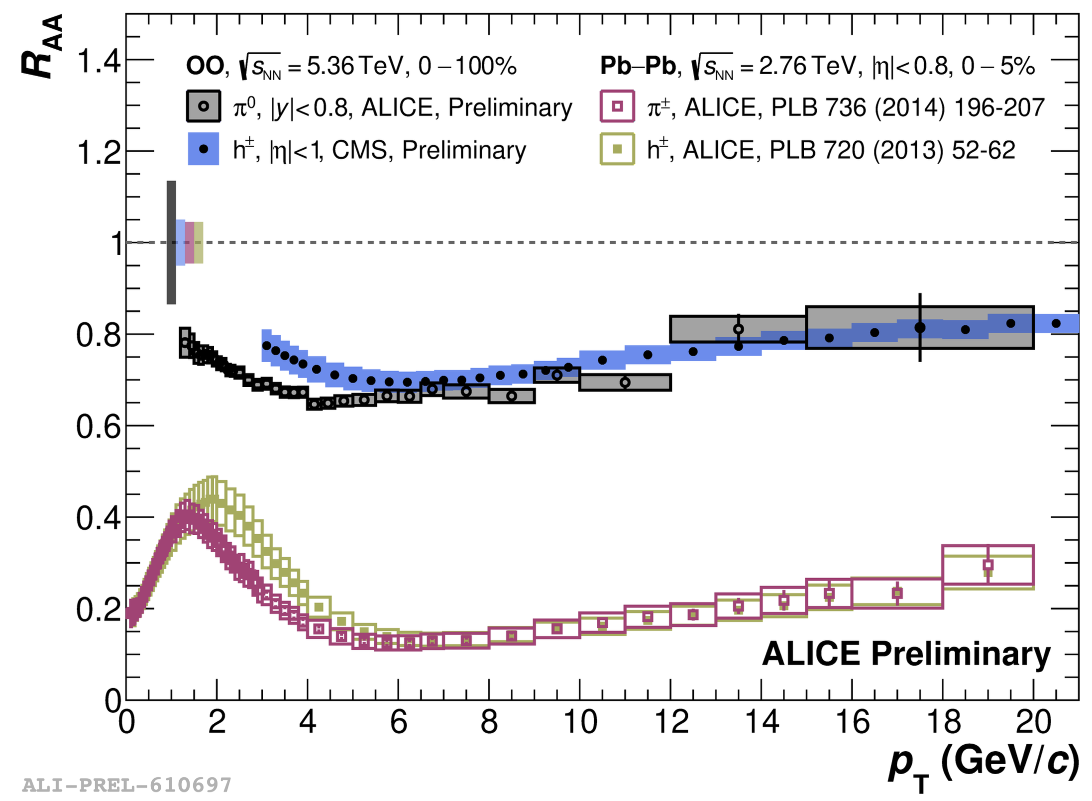
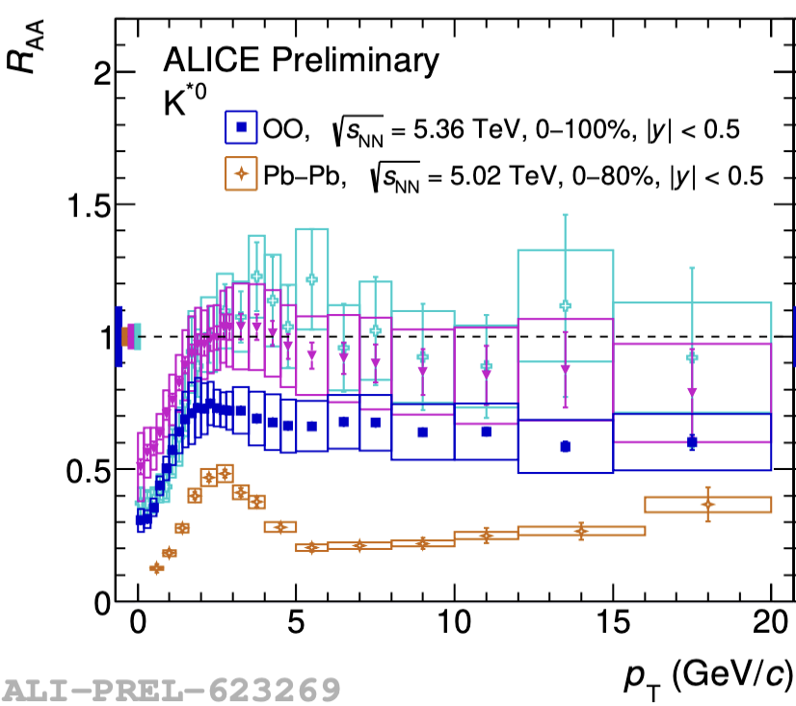
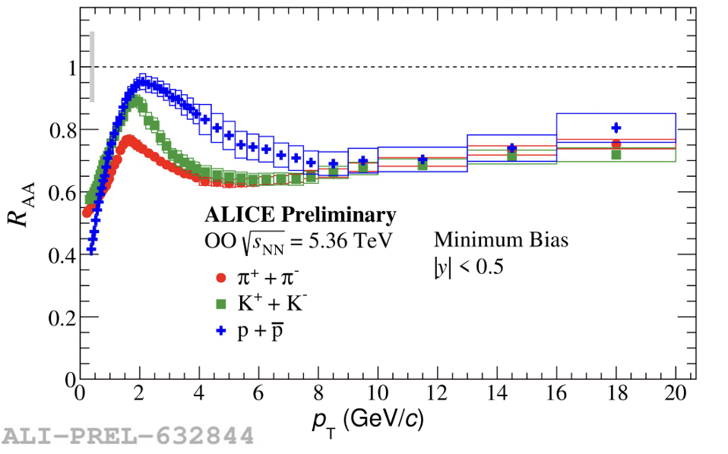
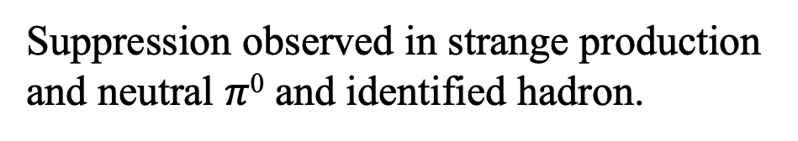
Strange and Neutral and Identified Hadron R_{OO}
The difference at low p_{T} is due to different masses
arXiv:2606.19967
Suppression observed in strange production and neutral $π$⁰ and identified hadron.

Slide 28
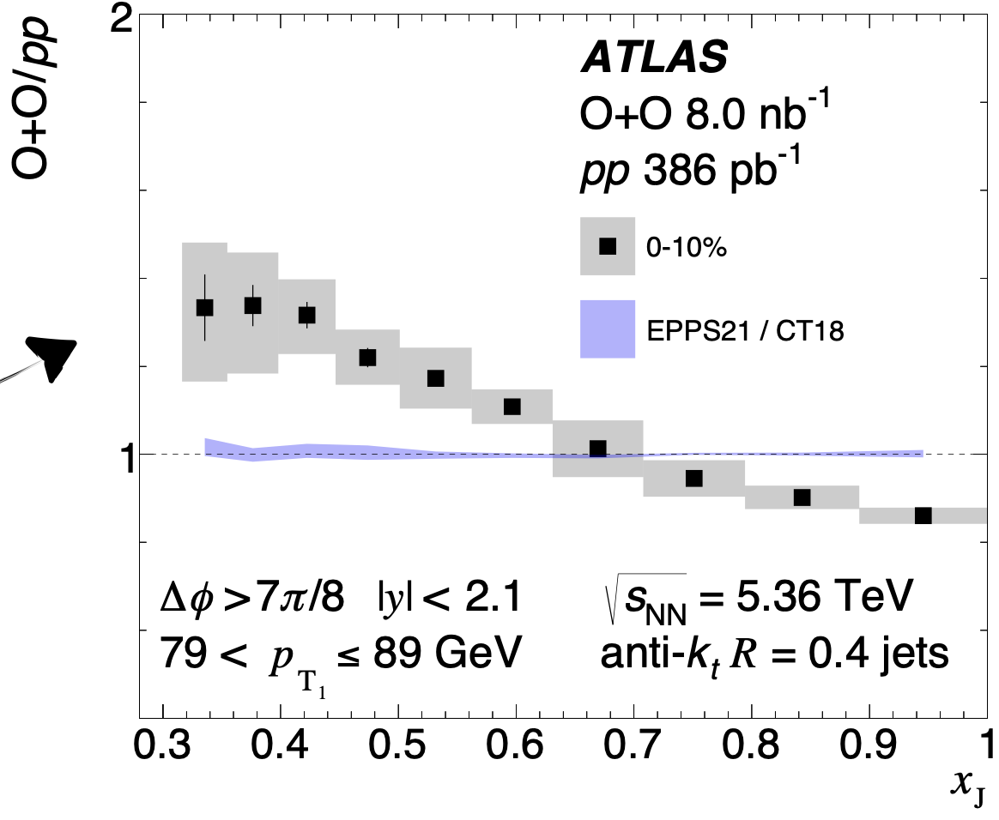
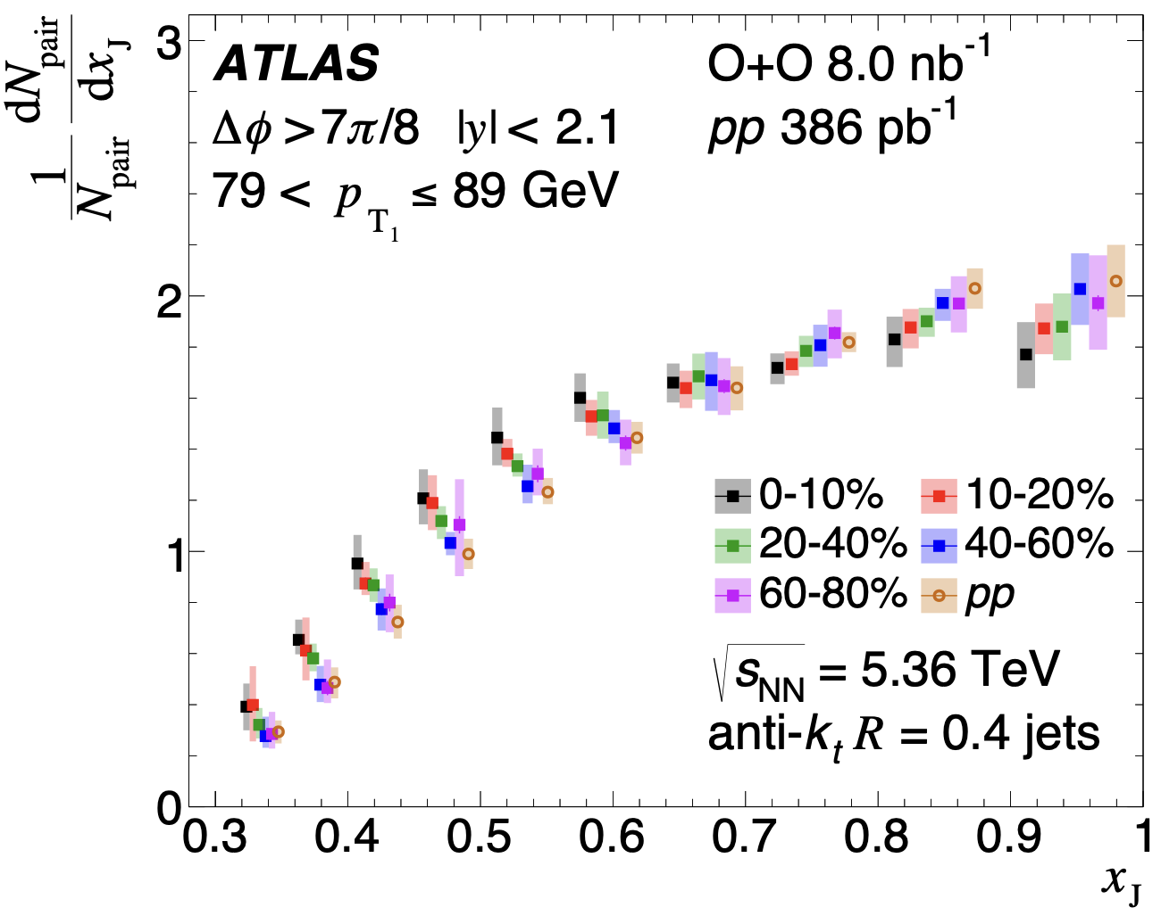
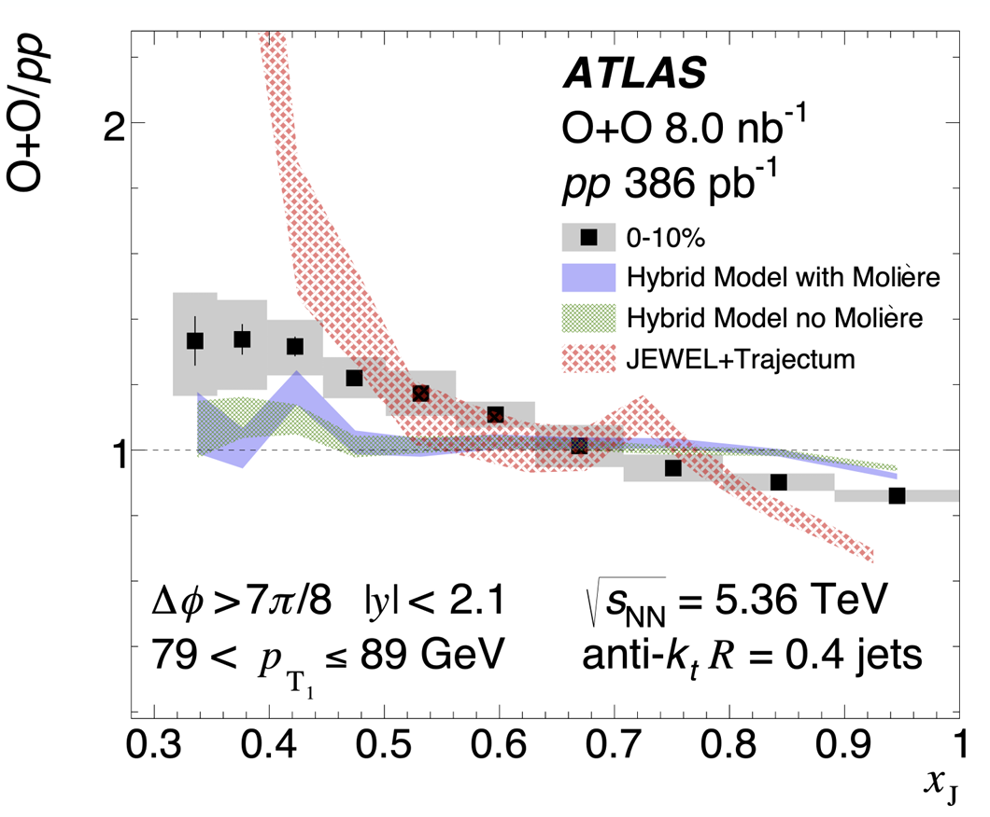
Dijet Imbalance(x_{J})
arXiv:2606.20463
arXiv:2606.20463
Indication of more imbalance in central OO than pp.
Cold nuclear matter effects cannot explain the observed trend.
Strong evidence of energy loss in light ion collisions.

Slide 29
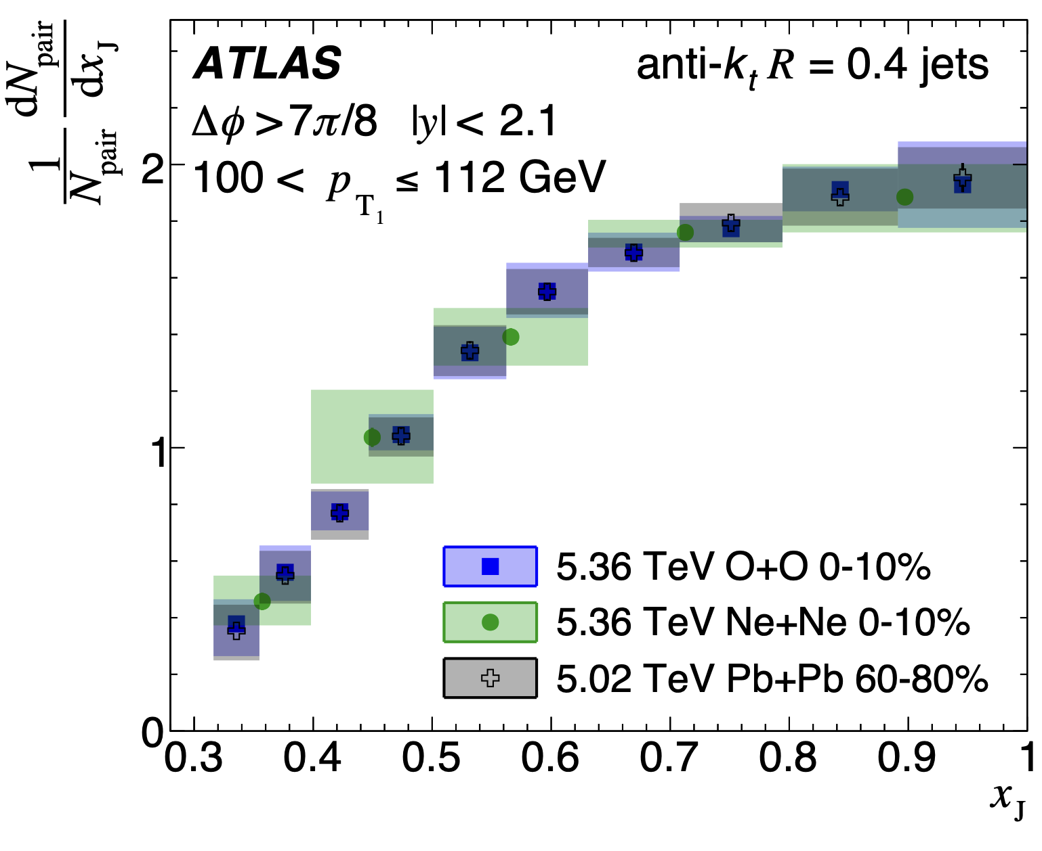
Dijet Imbalance(x_{J})
arXiv:2606.20463
Central OO and NeNe collisions behave like the peripheral PbPb collsion (based on event activity)

Slide 30
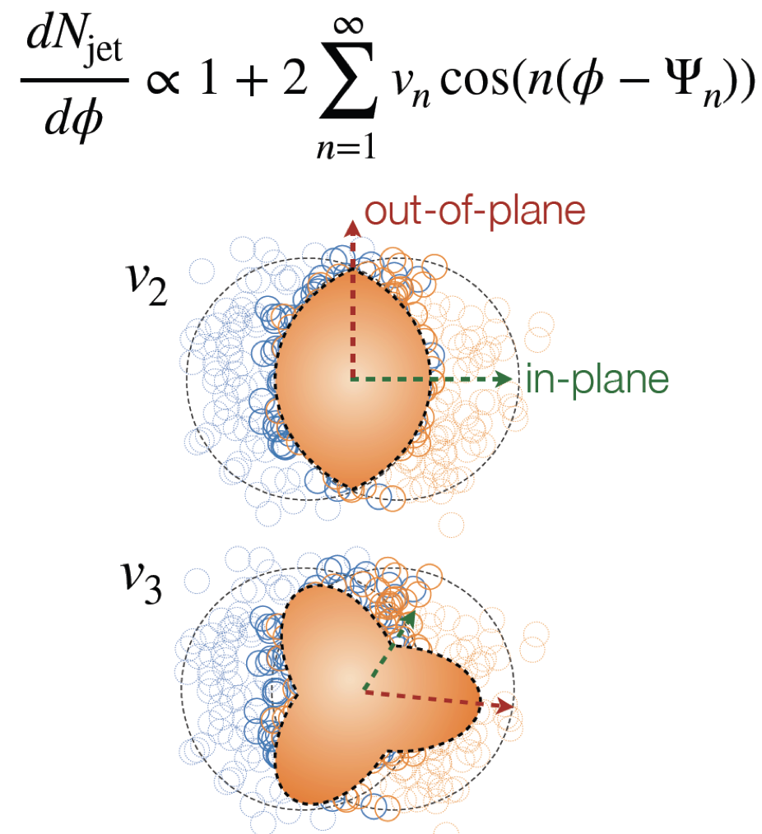
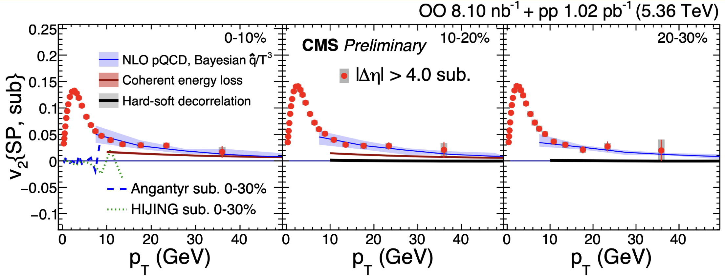
Path-length dependence of energy loss in OO
CMS-PAS-HIN-26-005
V₂ signal for high p_{T} charged particles
  Nonflow subtraction: Angantyr subtraction.
  Energy loss model describes data well.

Slide 31
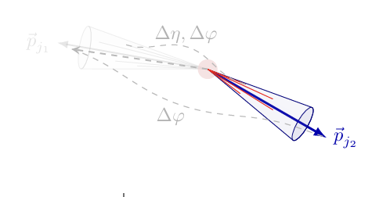




Hadron – Hadron, Jet - hadron Correlation
Central peripheral(40-60%) ratio
ALICE HP2026
Away side yield
arXiv:2604.13935
4.3 𝜎
Indication of enhancement at low p_{T} while gradual decreasing trend at high p_{T}
For central collisions, I_{PbPb}< I_{oo}
nPDF models cannot explain the suppression pattern.

Slide 32



Photon-tagged hadron yield
ATLAS-CONF-2026-007
ATLAS-CONF-2026-007
In more central OO collision,
Increased suppression of high p_{T} – hadrons: path length dependence of E-Loss.
Growing relative enhancement of low over high p_{T} hadrons.
Help constrain absolution parton energy loss as well as constituent level effect.

Slide 33




Heavy Flavor production in OO: Inclusive J/𝜓 suppression
J/psi suppressed in OO.
Similar pattern of suppression in peripheral PbPb.
Contribution of regeneration from uncorrelated charm is relatively low.
Regeneration in OO seems weaker than model expectation.

Slide 34




Sequential suppression of $Υ(nS)$
Sequential suppression of excited states thought to be related to QGP temperature.
Observed in heavy ions and small system.
Could be from CNM effect or from the hot medium created in small system??
OO Υ(2s)/Υ(1s)
OO Υ(3s)/Υ(1s)
First evidence of sequential suppression in OO.
  Potentially indicates the creation of denser QGP than peripheral PbPb at fixed Ntrk?

Slide 35





Outlook
Jet Substructure in light ions
Comparative study between LHC and RHIC
Same collision system for the first time in LHC and RHIC
J/Psi R_{OO} comparison
Jet R_{OO} comparison
Strong QGO interaction, high UE activity
Challenging to do large R jets, aggressive grooming (Zcut=0.2)
Cautious about selection bias
Weak QGP induced modification , less UE activity.
Is it viable to to large R jet substructure?
Less energy loss, less selection bias.
Many other studies to cover in OO collisions.
Medim responses such as Jet Diffusion wake using z-hadron correlation.
Energy energy correlations.
Moliere scattering in OO collision
We should move to characterizing QGP via jet substructure measurements

Slide 36
Summary
OO behave as a small collision system in all aspect so far.
Collective nature is suggested in bulk observables
  v2{4} ≈ v2{6} ≈ v2{8} suggests multiple particle involved correlation
  Meson-baryon splitting + grouping in identified hadron v2 (approximate NCQ scaling) suggests parton carrying flow before recombination
  Heavy-ion scaled mean pT increase vs multiplicity suggests radial flow
The smallest system where quenching is (almost) observed
Significant suppression of high-pT charged hadrons observed in RAA
More dijet imbalance in central events.
J/Psi Suppression
Not all the observations in OO results have to result from QGP
Continuous multiplicity evolution of strangeness enhancement as inspected from pp, pA,OO,AuAu,PbPb
  Coalescence to color reconnection/rope/MPI
Universal baryon-to-meson ratio enhancement at mid p_{T} with high-multiplicity in pp, pPb, OO, ZuZu+ArAr, PbPb, γPb .
  Coalescence vs color reconnection
Baryon-meson splitting and grouping in v2 is also observed in pp and pPb
Theory Predictions capable in light ion collision as well.
Hydrodynamic models predicted most bulk observables pretty well
Particle production, two- and multi- particle correlation, mean pT, v0, …
Nuclear profile was (partially) unknown info before data

Slide 37
BackUp

Slide 38



How dense is OO system?
OO @5.36 TeV:$\left\langle N_{part}\right\rangle$~11
Comparable to pPb(~8) and 70-90 % PbPb(~12).
Most Central 0-5 % $\left\langle N_{part}\right\rangle$~11 ~26 comparable to 65-70% PbPb.
Charge Multiplicity dN/d𝜂
Fundamental observable to understand the particle production mechanism.
Close association with the initial energy density and the entropy density during the hydrodynamization in the plasma.
Important input for constraining theatrical models.
OO @5.36 TeV: $\left\langle dN_{ch}/dη\right\rangle$~40
PbPb @ 5.36 TeV: $\left\langle dN_{ch}/dη\right\rangle$~600
Most central (0-5%) $\left\langle dN_{ch}/dη\right\rangle$~140 is comparable to 60-65 % PbPb
ALICE Preliminary
ATLAS CONF-2026-004

Slide 39


Modification of pi0 in OO collision

Slide 40


Slide 41


