Slide 1
EIC Project News
E.C. Aschenauer (BNL), R. Ent (JLab)
Co-Associate Directors for the EIC Experimental Program
ePIC Bi-Weekly General Meeting
March 27th, 2026

Slide 2
Outline
Planning for 2026
March 9-12 Director’s Review
Project Plan Updates
IR Layout Update

Slide 3
Update on Reviews – Path to Baselining CD-2
Preliminary Design Reviews (60% design maturity equivalent, called PDR, PDR2 or PDR3, pending the subsystem)
  PDR2: Silicon Tracking Detectors (6.03.01.02.01) – Jan. 27-28, 2026
  PDR2: Polarimetry (6.03.01.11) – February 18, 2026
  Peer Review: DAQ-Slow Controls (6.03.01.08.02) – May 2026 – Separated from electronics/DAQ to ensure integration in collider common platform, we only have Slow Controls Integration and the controls relies on scope in various areas
  PDR3: IR Integration and Auxiliary Detectors (6.03.01.10) – April 20, 2026 – Low-Q2, ZDC, includes 6.10.14 lumi detector
  PDR3: IR Integration and Auxiliary Detectors (6.03.01.10) – July (?) 2026 – B0, RPs, OMDs – Exact Dates TBD
  PDR2: AC-LGAD-based Particle Identification Detectors (6.10.04; BTOF, FTOF, common systems) – June 3-4, 2026
Final Design Reviews (FDR):
  FDR: Backward EM Calorimetry (6.03.01.04.01) – May 26, 2026
  More FDRs planning ongoing – see next slide
Project Reviews:
  Detector Baseline Readiness Review Feb 3 – 5, 2026
  BNL Director’s Review – Comprehensive, Mar. 9-12, 2026
  DOE OPA Status Review April 28-May 1, 2026 → September 15-18, 2026
  DAC – Summer/Fall 2026 – aim is to let DAC review all (PDR and DAC) recommendations that need completion by CD-2 and the status towards CD-3
  CD2 IPR & ICR Fall 2026?
Other Meetings:
  7th RRB Meeting: June 9-10, 2026 – MEXT, Tokyo

Slide 4
Detector Technical Readiness for Baselining
Detector has been technically baselined since Spring 2024
Project Detector R&D has been completed (see backup slide)
June 11-13, 2025: Comprehensive Design Review by DAC
All Subsystems have had several PDRs (40 %, 50% & 60%) → March 2026: 3 final Preliminary (60%) Design Reviews remain
Subsystem | PDR Completed | PDR Scheduled | FDR Completed
Tracking | 40% & 60% Si, 40% & 60% MPGD
PID | 40% & 60% hpDIRC, pfRICH, dRICH ToF 40%, TOF Peer review | 60% TOF PDR: June 3-4, 2026 | DIRC Bar refurbishment
ECals | 60% bECal, BECal, fECal |  | SiPM & SciFi fECal, BEcal SiPM & PbW04 bECal
HCals | 40% & 60% BHCal & fHCal 40% & 50% bHCal |  | SiPM bHcal & fHcal Lead blocks fHCal
Solenoid | 60% PDR Cryogenics |  | Magnet, Conductor and Power Supply
Electronics | 40%, 50% & 60% |  | VTRX+ & lpGBT
DAQ | 40%, 50% & 60%
Integration- Installation - infrastructure | 60% Inner and outer Barrel support-structures |  | electron and hadron endcap support structures
Auxiliary Detectors | 40% & 50% RP, B0, ZDC, Low Q2-Tagger, Lumi. | 60% ZDC, Low Q2-Tagger, Lumi: April 20 2026 60% B0, RP/OMD: aim for July 2026
Polarimetry | 40% & 60% RCS & ESR Compton Polarimeter & HSR Polarimeters

Slide 5
Update on Reviews – Planning for CD-3
Final Design Reviews (FDR):
  FDR 6.03.01.04.01: Backward EM Calorimetry – May 26, 2026
Planning for Final Design Reviews before CD-3: (dates given are what was before in P6 and what is now)
  FDR 6.03.01.02.01: MPGDs – January 2027 → move to March 2027
  FDR 6.03.01.02.02: SVTs – August 2027
  FDR: hpDIRC – August 2026 → hpDIRC, dRICH and pfRICH – February 2027
  FDR: dRICH – January 2027 → hpDIRC, dRICH and pfRICH – February 2027
  FDR: pfRICH – February 2027 → hpDIRC, dRICH and pfRICH – February 2027
  FDR: TOF – June 2027
  FDR: Barrel EM Calorimetry – September 2026
  FDR: Forward EM Calorimetry – September 2026 → combine with Barrel HCAL and LFHCAL?
  FDR: Barrel HCAL – October 2026 → September 2026, combine with Forward EMCal and LFHCAL?
  FDR: LFHCAL – September 2026 → combine with Forward EM Cal and Barrel HCAL?
  FDR: Magnet Cryo – link to integral review with accelerator/cryo, July 2026
  FDR 6.03.01.07: Electronics – September 2026 → Electronics and DAQ/Computing September 2026
  FDR 6.03.01.08: DAQ/Computing – July 2026 → Electronics and DAQ/Computing September 2026
  FDR: I3 Barrel Detector Structures – February 2027
  FDR: I3 Detector Infrastructure and Utilities Integration – July 2027
  Missing: FDR: Installation (includes also Magnet Installation)
  FDR: Auxiliary Detectors, B0 – July 2027 → B0 and RP/OMD – July 2027
  FDR: Auxiliary Detectors, RP/OMD – July 2027 → BO and RP/OMD
  FDR: Auxiliary Detectors, ZDC – July 2027 → ZDC, lumi & low-Q2 – April 2027
  FDR: Auxiliary Detectors, Low-Q2 – March 2027 → ZDC, lumi & low-Q2 – April 2027
  FDR: Auxiliary Detectors, Lumi Monitor – October 2026 → ZDC, lumi & low-Q2 – April 2027
  FDR 6.03.01.11.02: Hadron Polarimetry – March 2027 → Hadron and Electron Polarimetry – May 2027
  FDR 6.03.01.11.01: Electron Polarimetry – May 2027 → Hadron and Electron Polarimetry – May 2027
  Missing: (FDR or perhaps rather) Peer Review: Commissioning – November 2027
  FDR: HRPPDs – September 2026
  FDR: Mirrors & Aerogel – September 2026
  FDR: GEMs & PCBs – needs results of 1st and likely 2nd engineering test article → Remove from CD-3C
Assumption: DET CD-3 in Q1/FY28
→ DOE Review ~ October 2027
FDRs need completion ~ July 2027
BUT: There are subsystems that benefit from FDR this CY might there be a CD-3C. E.g., EM calorimetry, forward HCAL, gaseous-based PID detectors, and scope such as HRPPDs, SiPM boards
PEMP deliverable - objective 2.1:
“Prepare a table of design reviews necessary to attain CD-2 and CD-3 for each subproject indicating what reviews have covered which scope and when, and when future reviews of specified scope will occur. Actively maintain this table. Indicate scope by citing work breakdown structure elements.”

Slide 6
Director’s Review

Slide 7
Director's Review of the Electron-Ion Collider (EIC) Project
Closeout Report
T. Glasmacher, MSU-FRIB, Co-Chair
Mark Reichanadter, SLAC Retired, Co-Chair
Director’s Review of the EIC Project Closeout
March 12, 2026

Slide 8
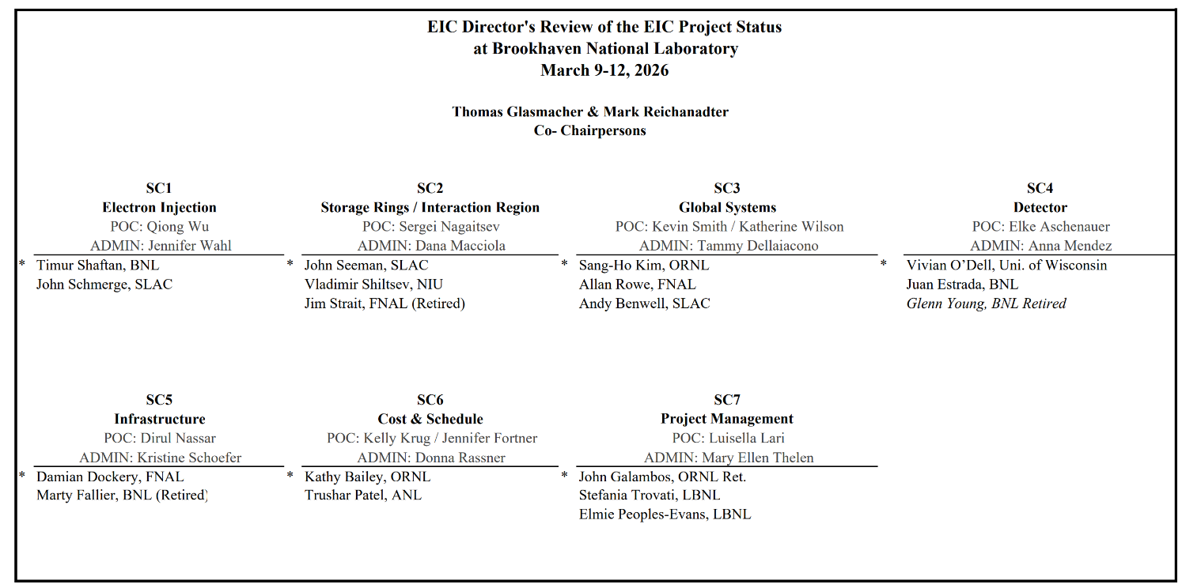
Review Committee
20 Committee Members
* Subcommittee Chair
ITA Remote Participant
T. Glasmacher/M. Reichanadter

Slide 9
Charge Questions Addressed
Is the project team effectively executing the work, including long-lead procurements? Is the project positioned to complete long-lead procurements within the established schedule and cost baseline? Are technical issues across all subprojects appropriately and proactively addressed?
Is the project team on track to present performance baselines for the first two subprojects it has proposed, the Accelerator Storage Rings and Detector subprojects, by the end of 2026? Is the team making adequate progress developing the performance baseline for the other subprojects it has proposed? Is each subproject scope well and logically defined? Are the subprojects ordered and phased optimally? Are subproject interfaces understood and clearly delineated at this stage of design? Are the schedules and cost estimates credible for the current stage of each subproject? Do plans include adequate scope, schedule, and cost contingency?
Are the key performance parameters and scope for each subproject well documented, traceable, reasonable, and justifiable? Does the roll-up of subproject scope unambiguously compose a complete and responsive Electron-Ion Collider facility? Would attainment of the key performance parameters of all subprojects indicate delivery of the mission need?
Are ES&H and QA properly addressed given the project’s current stage of development?
Is the project properly managed? Are risks being effectively managed? Is a management team in place to successfully execute the project including long-lead procurements? Are roles and responsibilities documented and understood?
Has the project team satisfactorily addressed recommendations from previous DOE SC reviews?

Slide 10
Director’s Review Conclusions (ChatGPT)
The EIC Project has made strong technical progress and demonstrates the capability to deliver the facility.
The primary challenge is no longer technical feasibility, but:
Establishing a credible, fully integrated baseline and aligning scope, cost, schedule, and risk management to meet the $3B cap while preserving mission need.
Focused effort on completing and defending the integrated baseline is now the single highest priority for project success.
Technical progress across all subprojects is strong and in many areas supports CD-2/3 technical readiness.
The project lacks a fully integrated, resource-loaded preliminary baseline, limiting cost and schedule credibility.
Current estimates exceed the $3B cap; systematic cost reductions tied to a defensible baseline are required.
Key leadership positions must be made permanent.
Completing the integrated baseline and quantifying risk-based contingency is the critical next step toward a successful DOE review.

Slide 11
SC4 – Detectors
Sample of findings as they present a nice summary about the status and work
Findings
The team gave clear presentations and were very responsive to homework. They demonstrated a clear understanding of all technical aspects of the project, and have made substantial process towards documenting a baseline plan compliant with DOE requirements.
The detector collaboration presented an overview of the ePIC detector design, including subsystem status, integration planning, cost structure, and their plans to CD-2. The presentations demonstrated significant progress in the technical development of several detector subsystems since the previous review.
The detector design is largely based on mature technologies, including silicon tracking, MPGD detectors, calorimetry systems, and RICH-based particle identification. Many subsystems have progressed through prototype development and are advancing toward engineering designs suitable for large-scale production.
The detector group presented a mature design, covering needed functionality and selection of sensing technology, angular and spatial coverage and segmentation, channel counts, interfaces, readout method and electronics sensitivities and resolutions needed, a prototyping sequence and schedule and acceptance criteria, and the various services needs (HV, LV, bias, cable counts, support and survey needs, gas, cooling and the like).
An installation sequence and initial timeline were presented, together with an initial list of resulting deliver-by schedule constraints for subsystems. Adaptive reuse is made of some existing large steel items and the full panoply of Building 1006 services. Engineering studies are underway to address floor loading and provision of needed power.
The detector project relies significantly on international in-kind contributions for several detector subsystems. These contributions represent a substantial fraction of the detector cost and schedule profile.
Several detector subsystems rely on the development and production of custom ASICs. Multiple ASIC designs are currently in various stages of development, including design, prototyping, and testing. The successful completion of these ASIC developments is therefore an important element for the readiness of several detector subsystems.
Front-end board development is not as far along due to the need for initial ASICs but even so is advancing, with initial coupling to prototype detectors performed.
Several detector subsystems involve complex international production and distributed fabrication. These activities will require coordinated quality assurance, logistics planning, and integration testing.
The project presented a structured system engineering framework including configuration management, requirements tracking, and interface control. This framework was used by the L3 subsystem managers in the discussion of their projects during the review, providing a common structure for describing subsystem requirements, interfaces, and integration planning.

Slide 12
SC4 – Detectors
Response to Assigned Charge Questions
Is the project team effectively executing the work, including long-lead procurements? Yes, but see comments Is the project positioned to complete long-lead procurements within the established schedule and cost baseline? Mostly, but need to finalize CERN/DOE agreement. Are technical issues across all subprojects appropriately and proactively addressed? Mostly, but see comments on the IR interface.
Is the project team on track to present performance baselines for the first two subprojects it has proposed, the Accelerator Storage Rings and Detector subprojects, by the end of 2026? It will be a heavy lift. They need to settle on a baseline design, complete preliminary reviews (eg electronics), and complete a defensible RLS. Is the team making adequate progress developing the performance baseline for the other subprojects it has proposed? N/A. Is each subproject scope well and logically defined? Yes. Are the subprojects ordered and phased optimally? Yes, but see comment on critical path. Are subproject interfaces understood and clearly delineated at this stage of design? Not yet, see recommendation on machine interfaces. Are the schedules and cost estimates credible for the current stage of each subproject? Yes, but RLS needs scrubbing, and contingencies better defined. Do plans include adequate scope, schedule, and cost contingency? No. There is some scope contingency, but it needs fleshing out. We were not shown any schedule contingency (i.e. no risk MC that shows what the schedule contingency needs to be). The overall cost contingency seems reasonable, although it is not from an MC.
Are the key performance parameters and scope for each subproject well documented, traceable, reasonable, and justifiable? Yes. Does the roll-up of subproject scope unambiguously compose a complete and responsive Electron-Ion Collider facility? N/A. Would attainment of the key performance parameters of all subprojects indicate delivery of the mission need? N/A.
Is the project properly managed? Not yet, management is interim, and detector needs subproject manager Are risks being effectively managed? Yes, but see comments. Is a management team in place to successfully execute the project including long-lead procurements? Yes, but see comments from management…Are roles and responsibilities documented and understood? Yes, but see comments.
Has the project team satisfactorily addressed recommendations from previous DOE SC reviews? Yes.

Slide 13
SC4 – Detectors
Sample of comments coming back to the replies to the charge questions
Comments
  Testing information/results for all the components should be summarized, perhaps as part of PDRs, in a summarized way that can be shared with reviewers.
  Each L3 should show their schedule drivers and describe how far they are from the Critical Path (CP). This is particularly important for the ASICS, where prototypes are needed for early testing and prototyping of the detector components. All subsystems should know their “need by” dates for installation and the schedule float they have with respect to that. It should be clear that the CP comes from P6.
  First silicon is in hand for all 6 of the ASICs needed, and testing is underway for all. Completing testing is key to making progress on the associated detectors and electronics. This testing needs to be pursued vigorously to let the DET move fully out of R&D mode and completely into production engineering. It is difficult to prepare a complete baseline cost and schedule absent this.
  The highest risk in the risk register is the risk that the accelerator & detector scope are not aligned and coupled correctly. This is only a risk in the detector subproject, not project wide, and has a probability of 30%, a cost impact of (low/likely/high) $10/$30/$100M, and schedule impact of 12/36/48 Months.This must be addressed now at the overall project level.
  Risks must be separated for the various in-kind contributions. This will make retiring individual risks straightforward, as some in-kind contributions are more secure than others. In the case that an in-kind contribution is in a particular subproject, that subproject should be able to speak to it. (doesn't mean they negotiate the in-kind, just that they know what the possible impact is). Each CAM should be able to speak to all risks for their subsystem.

Slide 14
SC4 – Detectors
Recommendations
Finish testing ASICs, then ASICs together with their FEBs, and produce a brief summary of the testing results. Update the P6 baseline based on the results in case of needing further prototyping steps.
Produce a more fine-grained risk registry with each risk assigned to the CAM in charge of that area. Split up the in-kind risks for each funding agency and relevant subsystem areas. This should be done before the next DOE review.
The highest risk is the interface between the accelerator and detector and must be further mitigated at the overall Project level. Progess on the mitigation and the plan to keep this risk low must be presented before the next DOE review.
Identify non-interim management for the detector subproject before the baseline review, including identifying and on-boarding a subproject manager with experience in large 413.b projects to augment and work with the technical management.
Run QA on detector P6 RLS (i.e. Acumen Fuze or similar) and fix all missing and incomplete links. Review schedule estimates and practice CAM drill downs. Ensure CD3A / CD3B (LLP) links are included.

Slide 15
SC7 – Project Management
Comments
  Getting the TPC within the $3B limit will require effort and dedication to this goal from technical leaders and management within the project, as well as lab leadership.
  RHIC ceased operation on Feb. 6, 2026 and EIC now represents the focus of the BNL NP program. The bulk of the BNL NP operating budget should be transitioned to address EIC scope.
  A traceable and defensible, fully integrated RLS is required for the committee to effectively assess the status and readiness of the project for CD-2/3. In the absence of such a baseline, the committee cannot reasonably verify the credibility or reasonableness of key project elements (see below). Without these fundamental elements, it is difficult to determine whether the project is being effectively managed. Without an established preliminary baseline, it becomes extremely challenging for the project team to align execution with management’s vision and direction.
    RLS
    LLP performance impacts
    Funding profile
    BA/BO profiles
    Risk assessment and contingency levels
    Basis of estimates
    Project processes and procedures
    Overall execution strategy

Slide 16
SC7 – Project Management
Comments
  Rather than use a cost target approach for reducing the TPC, start from a preliminary baseline and systematically adopt and document cost reduction measures.
  The committee agrees that the alternative execution strategy of pursuing a CD-3C to advance construction is a reasonable approach. But first create a preliminary baseline and then use this tool and the items stated above to determine the efficacy of all execution strategies (CD-2/3 vs CD-3C, subprojects, etc.)
  Beam loss scenarios for the ASR scope should be identified quickly to enable radiation safety analyses. Existing tunnel shielding may be adequate, but that needs to be demonstrated. Old and new penetrations need evaluation, considering also the increased synchrotron radiation risks posed by the new electron ring. New risks may impact areas previously unaffected during RHIC operations. See recommendation.
  The future one-ESHQ structure for EIC and NPP department is commendable. This comprehensive approach is expected to eliminate ambiguities regarding roles and responsibilities between Project and Operations.

Slide 17
SC7 – Project Management
Key Takeaway Comment
  5 yrs after CD-1, with a staff of ~350 FTE and with ~$379M spent, tremendous effort has been put into developing a preliminary baseline, however it is not completed. The project needs to immediately create a preliminary baseline to present at the upcoming IPR.
    Focus project activities on getting the baseline done as the main priority for the entire project and performing cost reductions, the other activities are distracting from the main task the project needs to complete (e.g. other reviews)
  This effort will require an intense effort but will provide an important reward: a common framework the team can use to systematically bring the TPC to an acceptable level and to analyze alternate execution strategies.

Slide 18
SC7 – Project Management
Recommendations
Complete the development of the resource loaded schedule preliminary baseline that captures the entire EIC Project scope by the upcoming IPR in April 2026.
By August 2026, after establishing the fully integrated RLS, complete cost cutting activities to ensure the preliminary baseline is below the $3B cap and establish risk based verifiable contingency need for cost and schedule, BA/BO curves, required funding profile and confirm the project's execution strategy.
Increase the transfer of NP operational funding towards EIC scope as part of the cost reduction effort.
Identify before CD-2 beam loss scenarios for the ASR scope to enable radiation safety analyses to assess validity of existing shielding and to define new shielding requirements.

Slide 19
EIC Project Plan Update

Slide 20
EIC Project Update – March 15 after DR & Strategy Meeting
From: Yeck, Jim <jyeck@bnl.gov>
Date: Sunday, March 15, 2026 at 2:14 PM
Subject: Summary of March 13 Discussion on EIC Cost Reduction Plans
Dear Colleagues,
Thank you for the productive discussion during our meeting in Washington on March 13.
We aligned on proceeding with the full set of cost-reduction opportunities identified in the project’s cost reduction plan presented at the Director’s Review (DR). As summarized in the presentation, these opportunities fall into two categories: Class 1 actions, which reduce cost without impacting expected performance and will be implemented through normal project change control; and Class 2 actions, which involve elements of the original design that would be deferred for installation during the early operations period. We will continue to identify additional opportunities for cost reduction as the project progresses.
EIC annual operations are assumed to be approximately $250–300M per year. Within this amount, up to $50M annually would be allocated to progressively provide the hardware complement required to achieve the EIC’s ultimate performance parameters. The only EIC upgrade currently envisioned is the addition of a second interaction region and detector.
Your alignment on this path forward is greatly appreciated, and we will continue refining the details as the project advances.
I will request DOE support for rescheduling the IPR to September. The Director’s Review provided a comprehensive evaluation of the project, and we need time to address the issues identified by the committee, including the priority placed on establishing the preliminary baseline.
We will plan a visit to the DOE Office of Nuclear Physics (ONP) at the end of April. This visit will provide a snapshot of progress and plans, including:
  progress toward the TPC point estimate goal,
  status of the preliminary baseline,
  IPR preparation and responses to the DR review, and
  the proposal for CD-3C and a limited CD-2/3 construction start at the end of 2026.
The dates for the April visit and the IPR will be finalized as soon as possible.
Sincerely,
Jim

Slide 21
Mission Need Parameters
A high degree of beam polarization* ( ~ 70%) for electrons and light ions
Availability of ion beams from deuterons to the heaviest stable nuclei
Variable center of mass energies ~20-100 GeV, upgradable to ~140 GeV (e-p)
High collision luminosity* ~10³³⁻³⁴ cm⁻²s⁻¹
Possibly more than one interaction region
* Both luminosity and polarization are interpreted as average polarization and luminosity over a fill.

Slide 22
Director’s Review Follow-Up – 03-17 e-mail
Our primary challenge is to establish a credible, fully integrated baseline that aligns scope, cost, schedule, and risk management within the $3B cost cap while preserving the capabilities required to meet the EIC Mission Need.
Establishing a credible integrated baseline is the highest priority for the project.
We will meet with DOE leadership at the end of April in Germantown to provide an update on project status, including progress toward establishing the preliminary baseline, the path to achieving the TPC point estimate, and the proposed approach for project execution.
During the next three months, the focus will be on establishing a well-defined preliminary baseline that supports the TPC point-estimate goals and this overall approach.

Slide 23
EIC Project Update – Mail March 24
Dear EIC Project Team,
As promised, attached are slides that should help clarify and show what remains within the project baseline and what may be deferred to early operations.
Please review the slides, a Q&A Microsoft Form has been generated to capture any questions the team needs clarification on, a Q&A session will also be held Monday, March 30th at 11am for an open discussion to address any questions.
Depending on scope, the individual responsible for managing that scope will set up meetings with their team to discuss how the cost-reduction actions will be implemented and the process for achieving a baseline-ready P6 schedule.
The date to update P6 is NLT mid-June (notionally 12th).
Thank you,
Jim Yeck & the EIC Executive Management Team

Slide 24
EIC Implementation Options
Also known as getting the point estimate in the $3B box!
K. Smith on behalf of the EIC EMT

Slide 25
Cost Reduction Actions
We have developed a comprehensive list of potential cost reduction opportunities aimed at achieving a $3B cost estimate target for the project, organized into two main classes.
  Class 1
  Actions that reduce cost without impact to ultimate performance capabilities. For example:
    Design Optimization / Value Engineering
    Cost Scrubbing
    Realignment of the scope On-Project and Off-Project
    Procurement optimized to maximize best value opportunities
  Class 2
  Actions that reduce cost and scope by deferring ultimate performance capabilities.
    Scope Deferred to Initial Operations Period
    Example: Construction and installation of the full ESR RF system buildout during initial operations.

Slide 26
Cost Reduction Boundary Conditions
Boundary conditions to guide cost reduction:
  “Upgrades” are not currently part of the discussion. The only upgrade currently envisioned beyond EIC project CD-4 is the 2nd Detector and experimental IR.
  Rather than “upgrade” – think about “adiabatic” evolution of the EIC facility capabilities achieved through construction and installation of deferred scope during the initial operations period.
  Assume conventional facilities scope (e.g. support buildings, penetrations, etc.) needed to support deferred scope must be delivered on project.
  In-Kind contributions of accelerator and detector equipment during the initial operations period are appropriate goals.

Slide 27
Plan to Achieve Total Project Cost Estimate Goal ($3B)
“Scenario 2”: Implement Class 1 and Class 2 Cost Reduction Actions
Class 1: (many items, full list in backup slides)
  Maximum electron beam energy reduced to 9 GeV.
    This requires that the respective PS in the HSR to support 275 GeV are upgraded to meet CM energy range.
  ESR Main SRF systems are relocated from the currently planned IR-10 location to IR-08.
    Potential 2nd detector location would move to IR-12​
    Would require a new Hall at IR-12 for a later EIC Detector 2 project​
  Many others …
Class 2:
  Four elements deferred to NP / EIC OPS – see next slides.
  A fifth element, defer installation of the EIN-BAR, was considered and rejected. The cost-benefit was very poor. Lumi plots in Slide 10 will be updated, to do a consistent simulation for all scenarios

Slide 28
Plan to Achieve Total Project Cost Estimate Goal ($3B)
Class 2 actions => elements provided during initial operations by NP / EIC OPS:
  4x ESR Main SRF Systems deferred.
    Installation reduced from 6x SRF CM systems to 2x systems.
    Maximum bunch charge is reduced by ~3x from 28nC/bunch to 10nC/bunch at 9 GeV.
  Low Energy Cooling deferred.
    Reduces maximum average luminosity capability by 2x to 3x.
  394 MHz IR Crab Systems deferred.
    Reduces maximum hadron bunch charge by 2x.
  41 GeV HSR Bypass Line deferred.
    Minimum achievable CoM collision energy reach increases to 45 GeV from 29 GeV.
This assumes all infrastructure work and engineering designs will be completed within the EIC Project scope to allow an adiabatic installation of these 4 items during EIC operations phase.
Note that luminosity reductions (next slide) do not scale simply/linearly with the reductions shown here. They are for reference only.

Slide 29
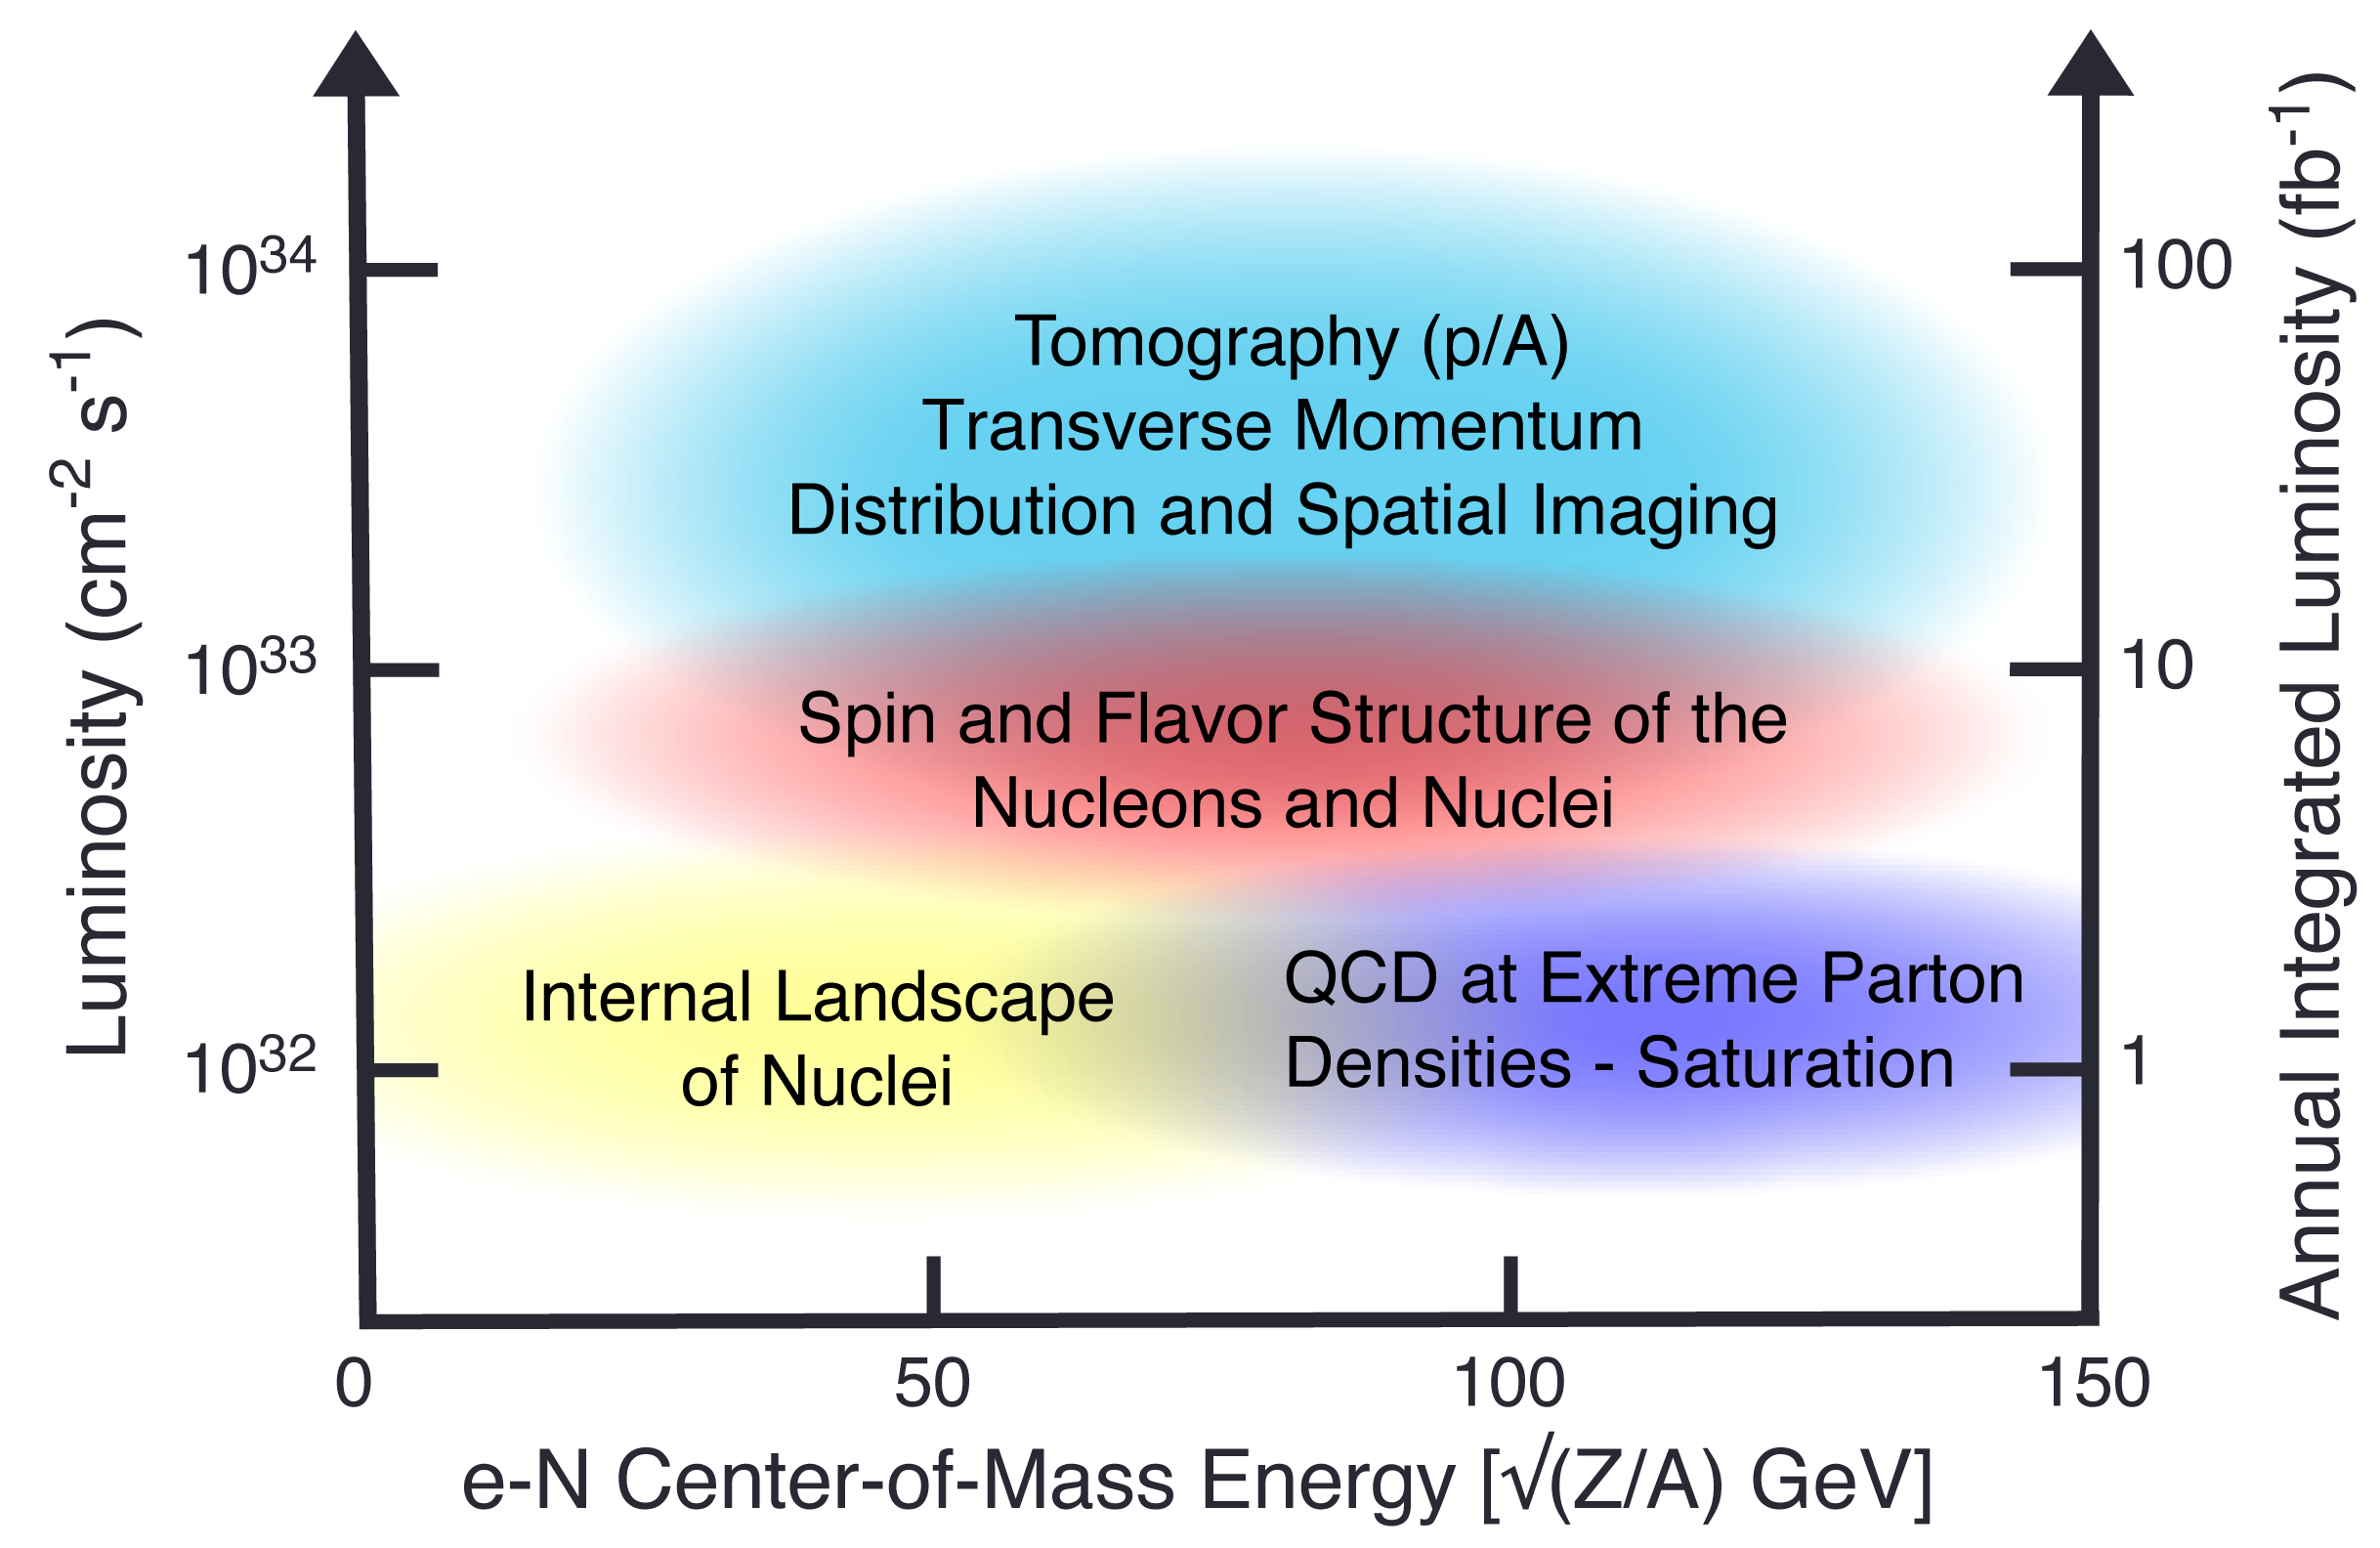
EIC Science Reach for ep vs Deferred Scope
+
EIC Full Capability
Implementation of Class 1 items (Scenario 1)
5 GeV x 100 GeV
+
EIC
RF for 7nC/bunch
+
EIC
RF for 7nC/bunch
no 394 MHz crab cavities
+
+
+
+
Average Luminosity (cm⁻² s⁻¹)
+
EIC
Implementation of all Class 1 & 2 Items (Scenario 2)
RF for 7nC/bunch
no 394 MHz crab cavities
no low energy cooling
no 41 GeV bypass
+
+
+
+
+
+
+
+
+
+
EIC (rejected)
RF for 7nC/bunch
no 394 MHz crab cavities
no low energy cooling
no 41 GeV bypass
no Beam Accumulator Ring (rejected)
+
+
e-p Center-of-Mass Energy [GeV]

Slide 30
Summary
The project leadership team identified cost-reduction opportunities.
  Scenario 1: Only Class 1 Actions
    Only cost reduction items with No Impact to EIC Performance Capabilities
    TPC Estimate: $3.51B
  Scenario 2: Class 1 and 2 Actions
    Includes cost reduction items with Significant Impact to EIC Performance Capabilities
    TPC Estimate: $3.15B
Path Forward
  Scenario 2: Implement Class 1 and Class 2 Actions – $3.15B TPC Estimate
  Class 2 scope required to meet the EIC ultimate capabilities planned as capital improvements during the five-year initial operations period (assumed at <$50M/yr).
  Transparent engagement with stakeholders on plans
The identified cost-reduction opportunities currently do not meet the $3B TPC target goal and the funding profile requirements that are not aligned with a technical-driven schedule.
To address these challenges, it is imperative to continue our efforts to identify additional cost-saving opportunities. Consequently, specific task forces will be established, commencing with those tasked with reevaluating the infrastructure scope.

Slide 31
IR Layout Update

Slide 32
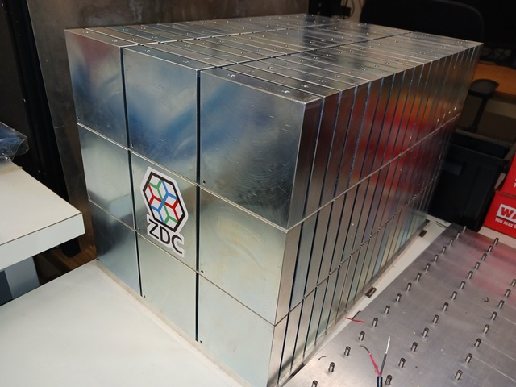
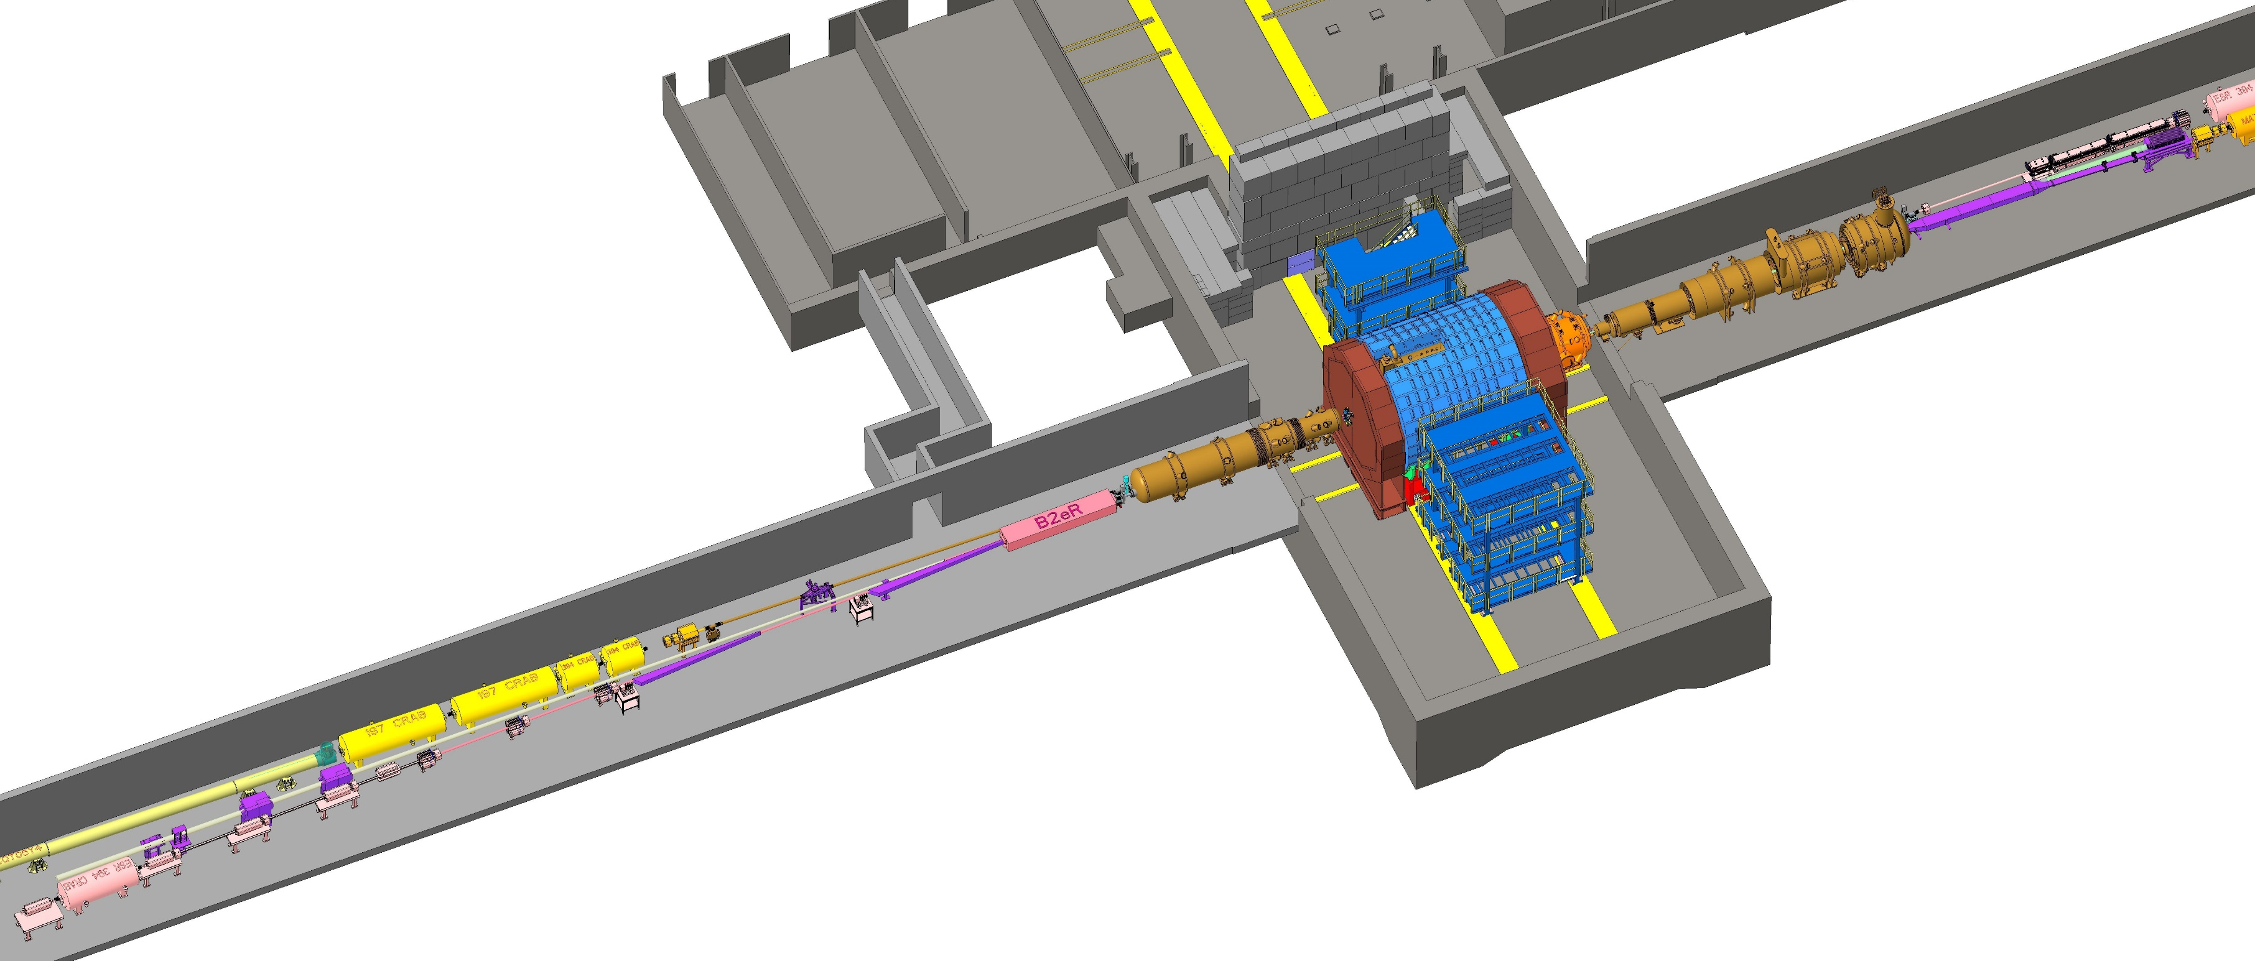
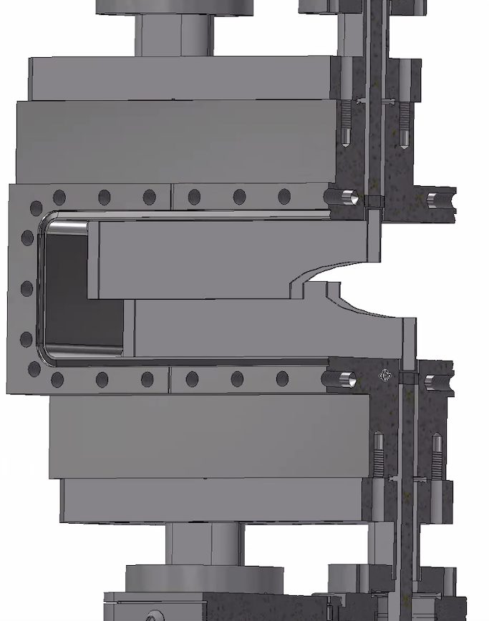

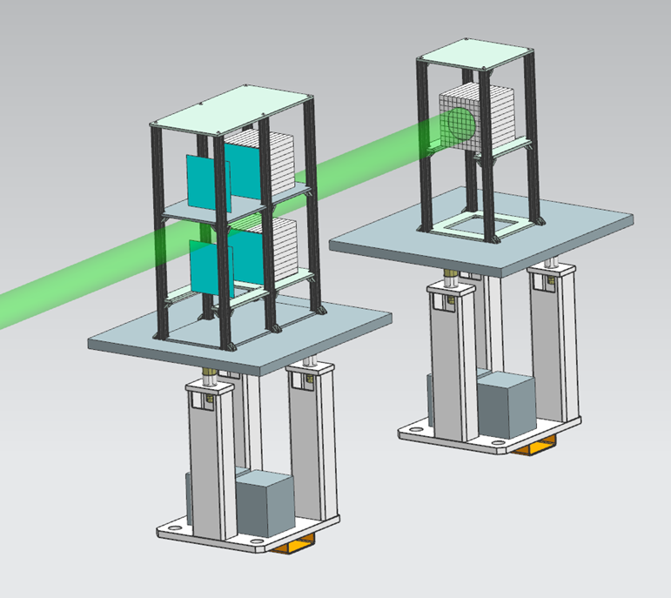
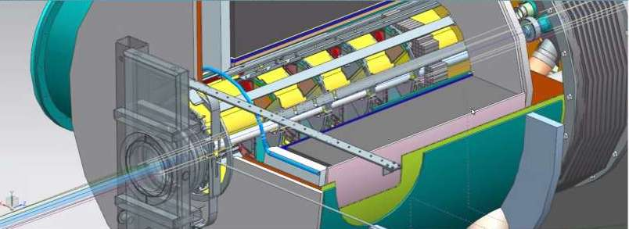
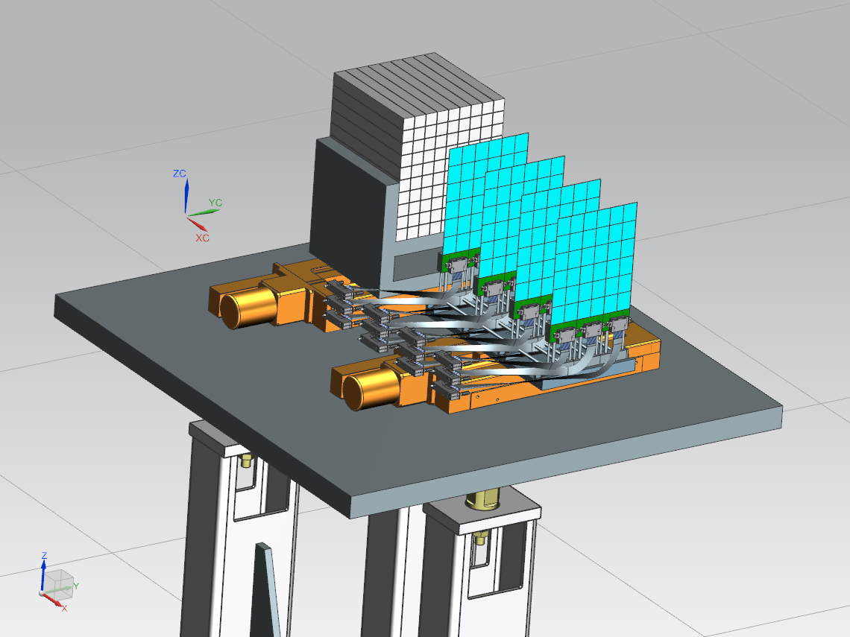
Current IR Layout
Zero Degree Calorimeter
e beam
Roman Pots and
Off-Momentum Detectors
B0 Magnet Spectrometer
p/A beam
Luminosity System
 | Particles | Angle [mrad] |  | Distance from IP
B0-tracker | Charged particles Photons ( tagged) | 5.5 - 20 |  | ca 6-7 m
Off-momentum | Charged particles | 0-5.0 | 0.4< xL< 0.65 | ca 23-25 m
Roman Pots | Protons Light nuclei | 0*-5.0 | 0.6 < xL< 0.95 | ca 27-30 m
ZDC | Neutrons Photons | 0-4.0 (5.5) |  | ca 35 m
Low-Q2 Taggers

Slide 33
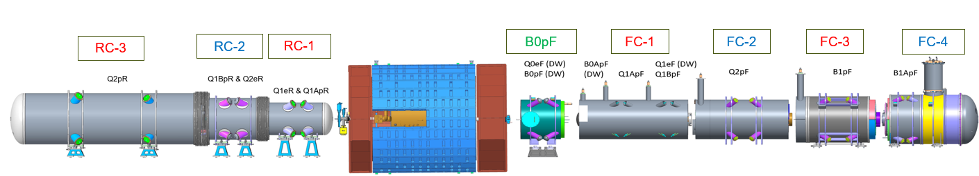
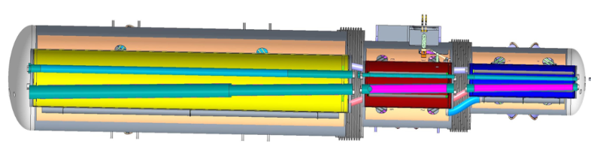
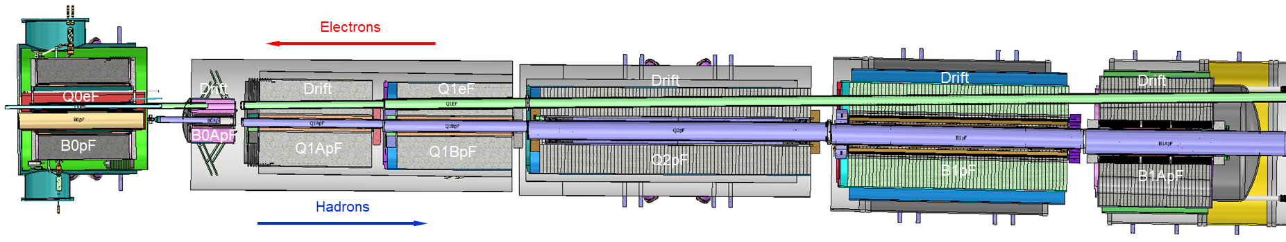
Front and Rear cryo-assemblies
In the front side, all cold-masses and cryo-assemblies from FC#1 to FC#4 will be connected in one full length cold-mass and one full length cryo-assembly
In the rear side, the cold-masses from RC#1 to RC#3 will be separated, and the cryo-assemblies will be connected in one full length cryo-assembly

Slide 34
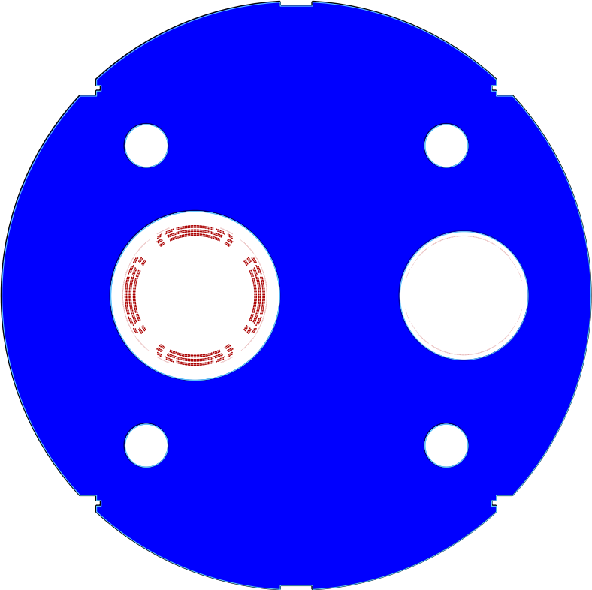
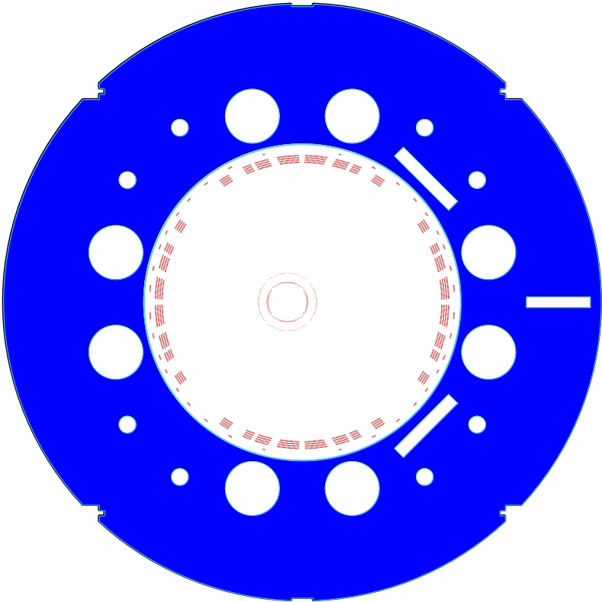
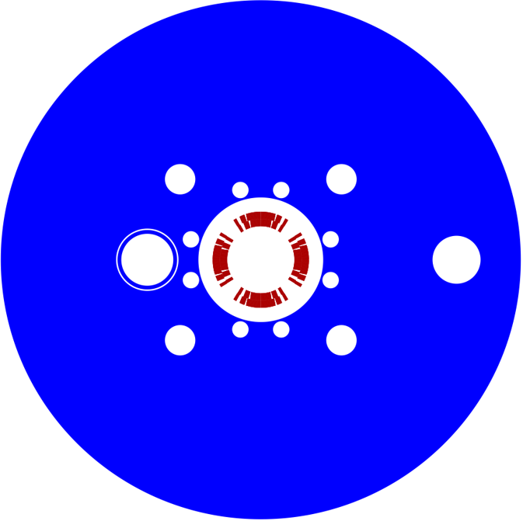
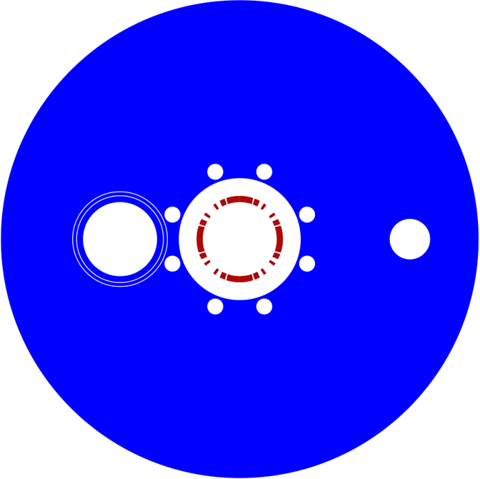
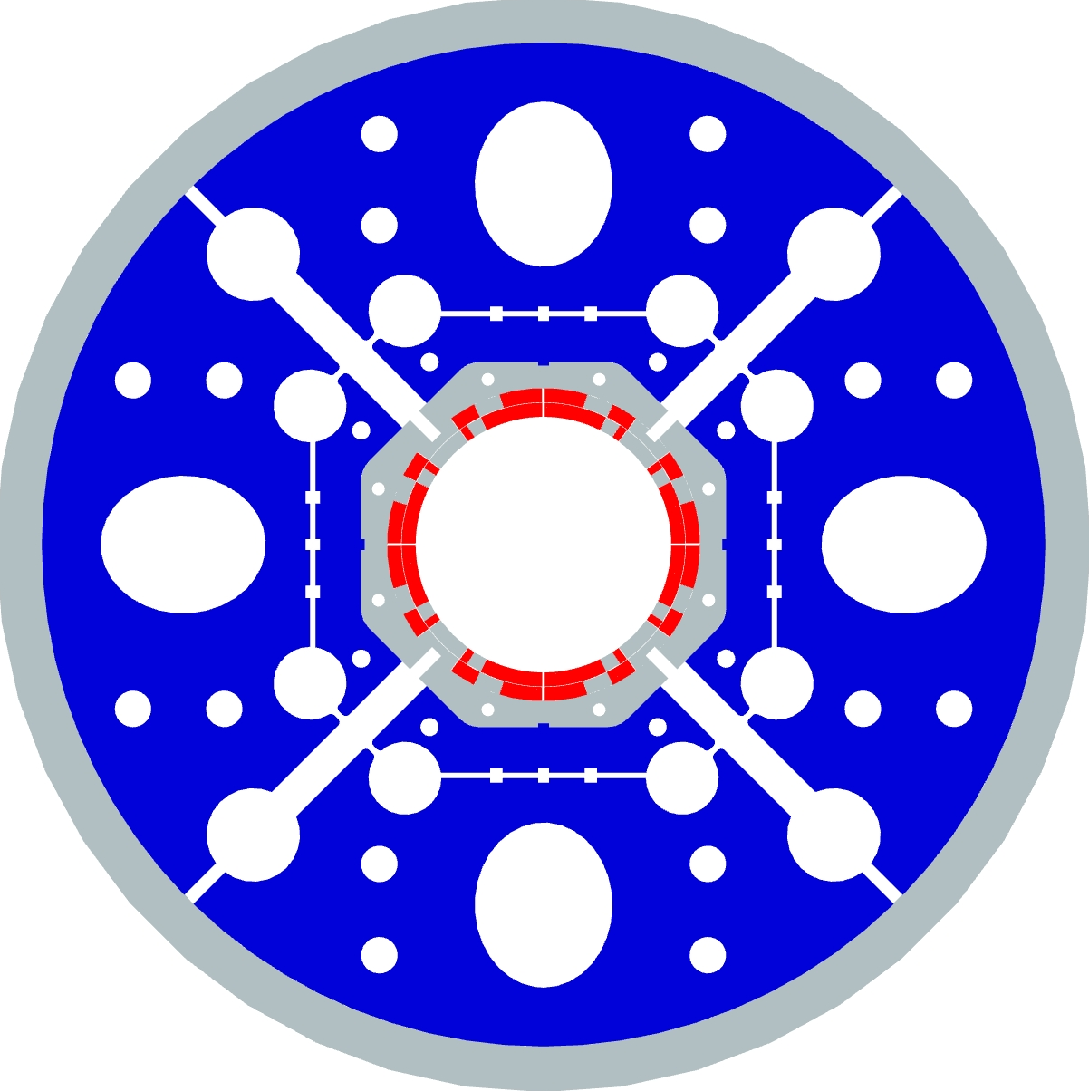
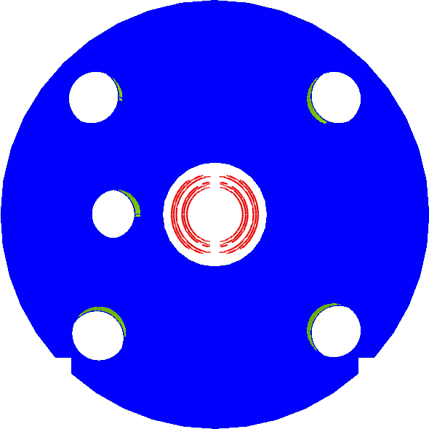
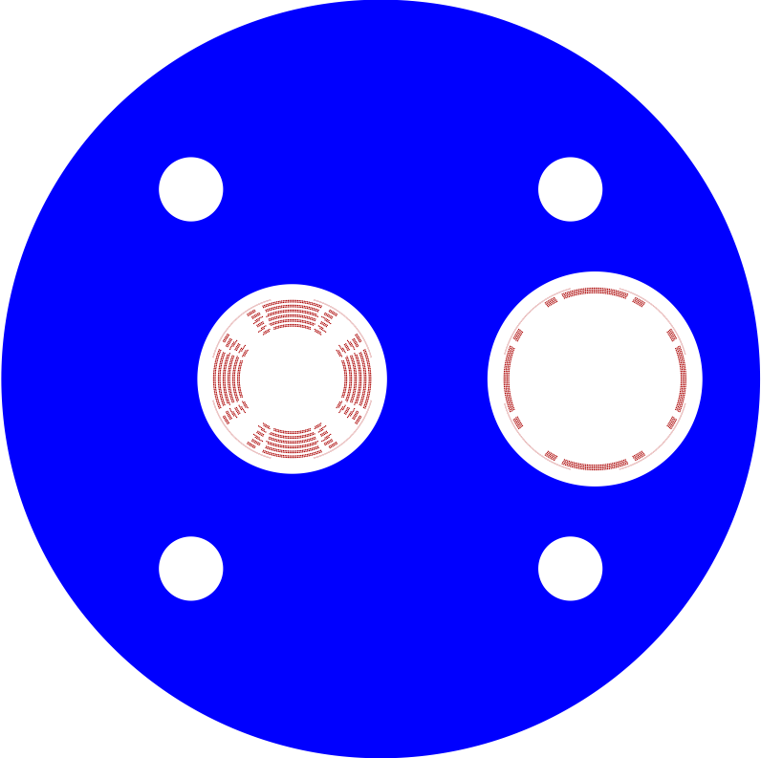
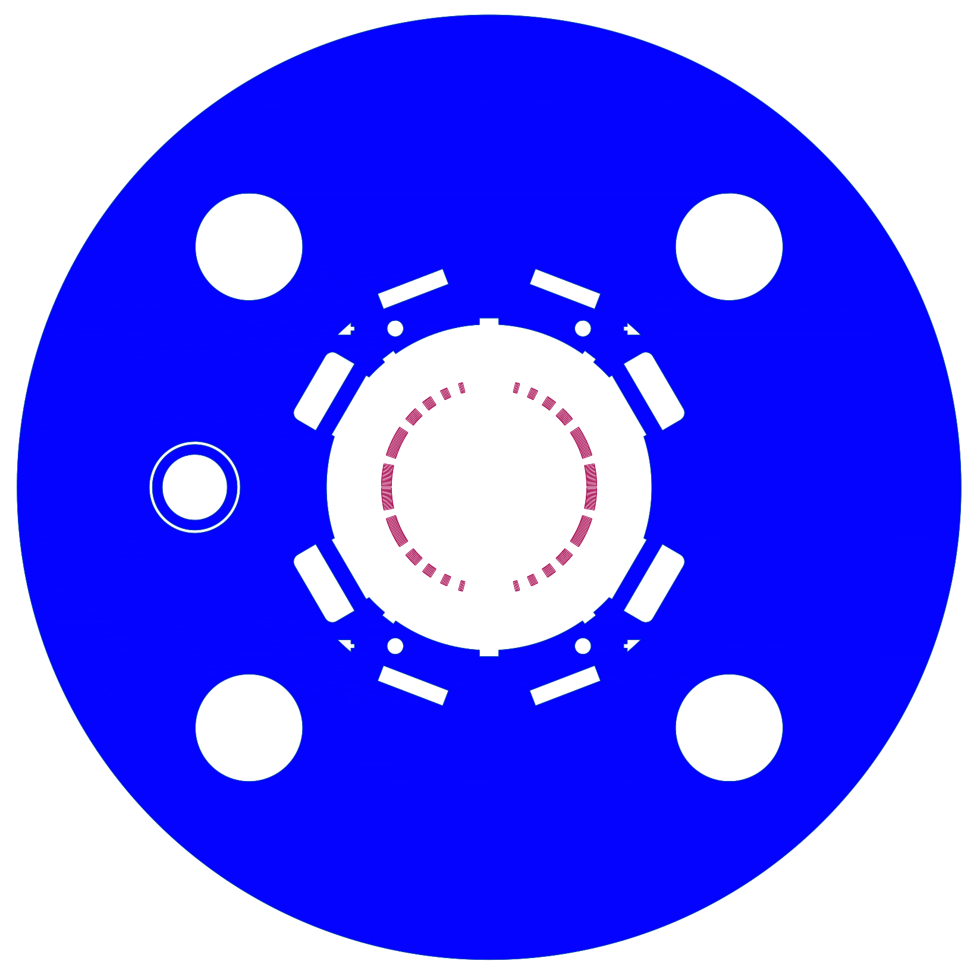
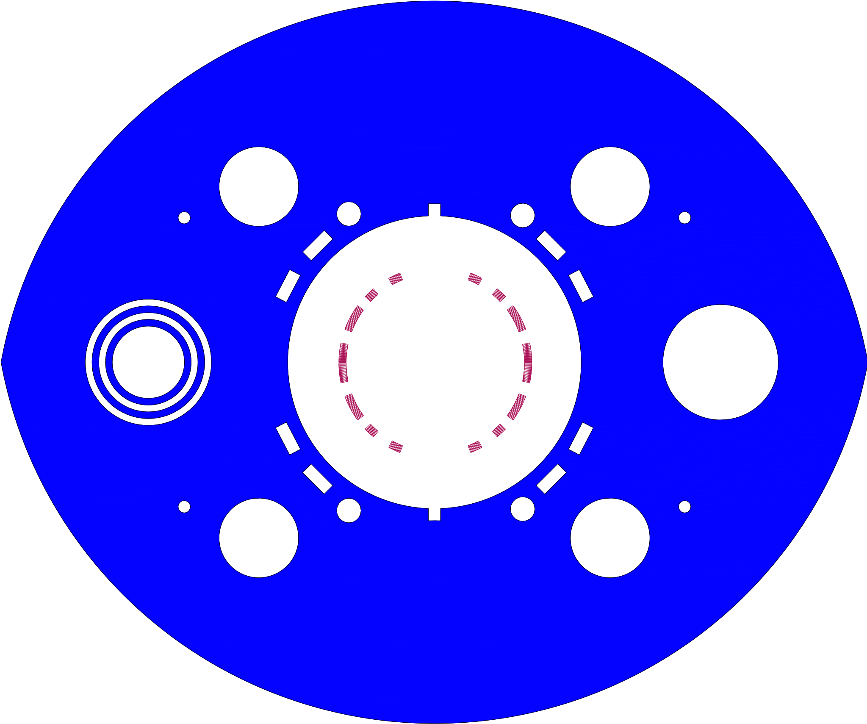

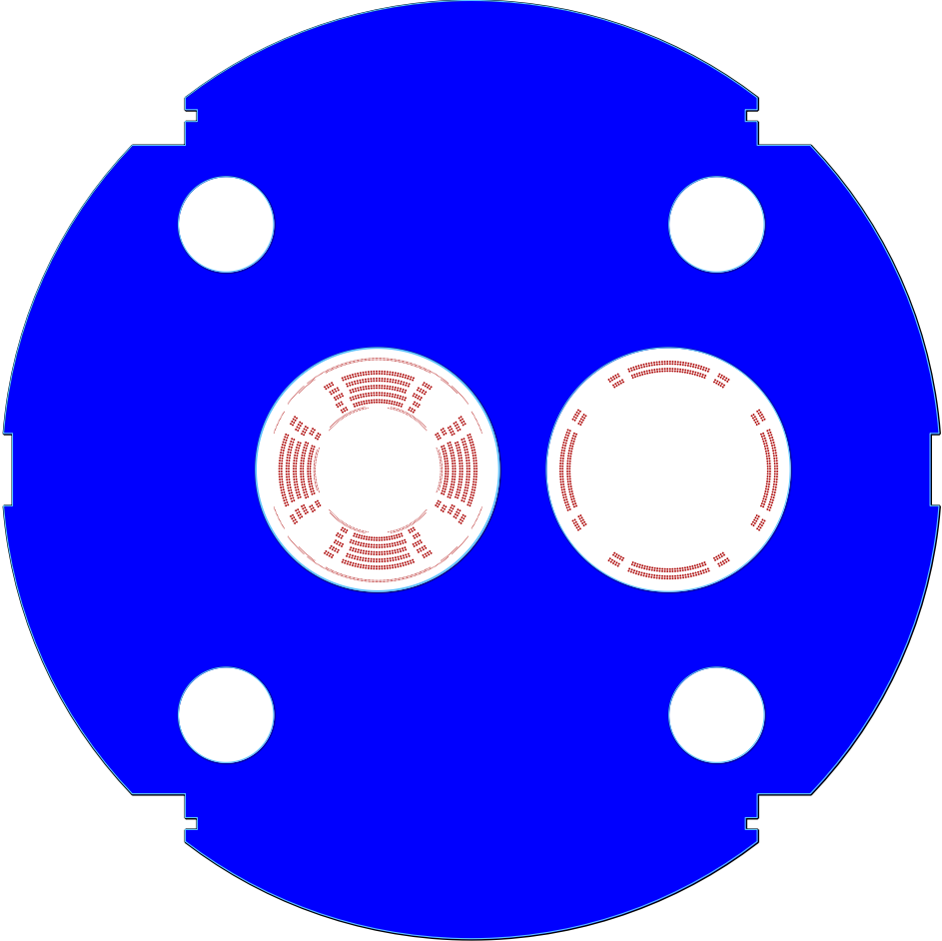
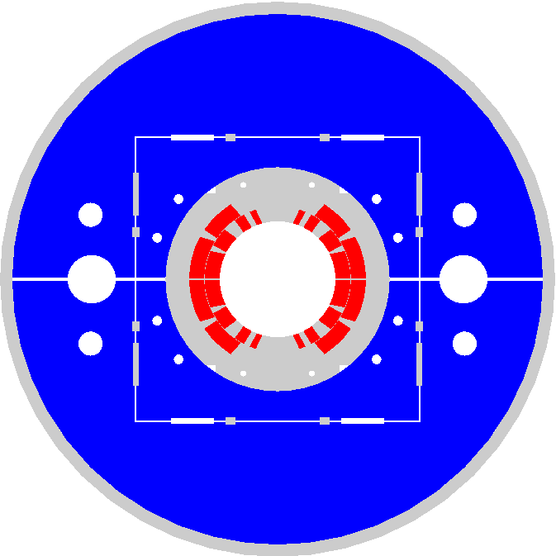
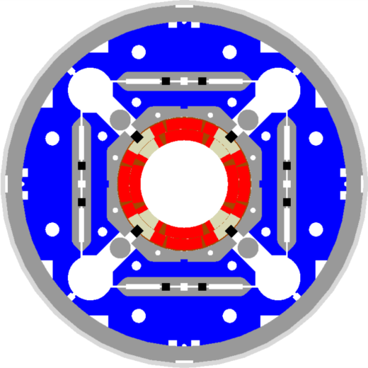
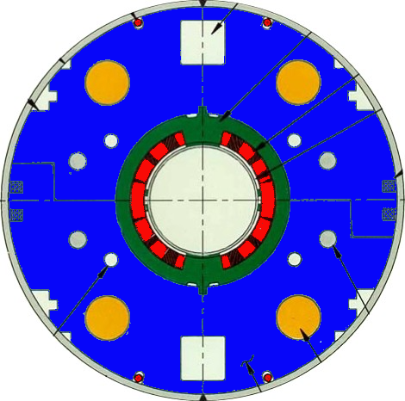
EIC IR Superconducting Magnets
Charge #1, #3
View from the IP
Q2pR-eDrift
  The EIC SC magnets are all one of a kind with a high risk and a high cost
  Can we make things easier?
B0ApF-eDrift
Q1ApF-eDrift
Q1BpF-Q1eF
Q2pF-eDrift
B0pF-Q0eF
Q1BpR-Q2eR
LHC MB
MQXF
B2pF
Q1ApR-Q1eR
Spin rotator
RHIC MB
B1pF-eDrift
B1ApF-eDrift

Slide 35
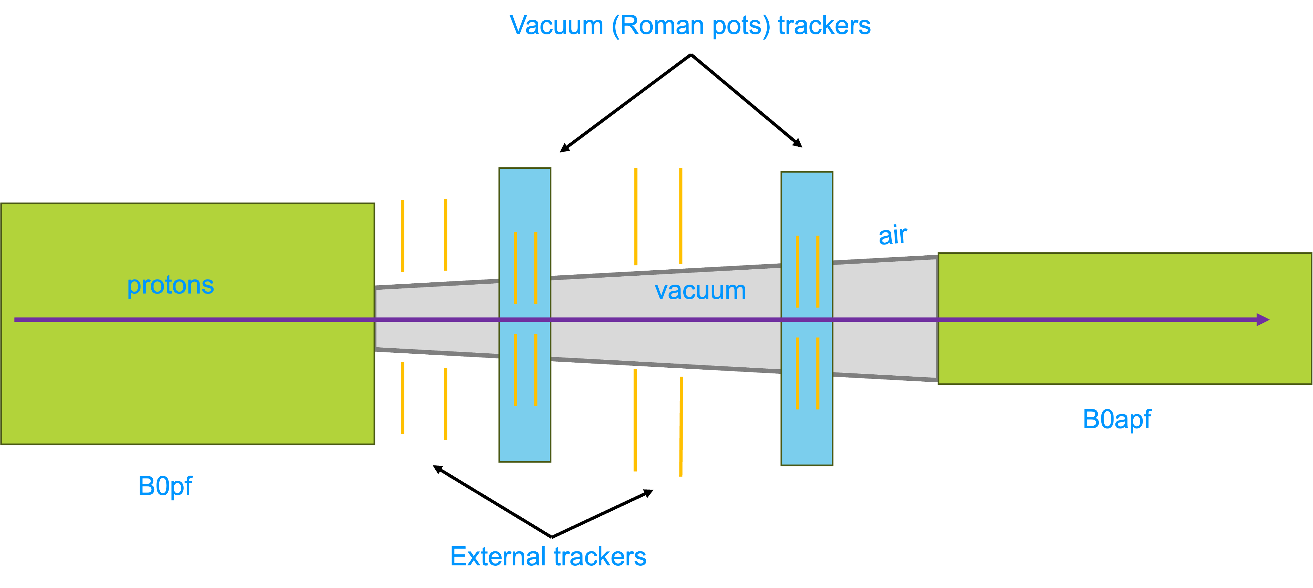
New IR layout to reduce Risk and Cost of SC Magnets
Magnet apertures mostly come from transverse momentum requirement to capture particles with pT < 1.3 GeV in forward detectors → see slide 3
General Idea: Capture transverse momentum earlier between B0ApF and B0pF
→ Add space between B0pF and B0ApF and Increase B0pF integrated field
  → Integral field from B0pF of 2.4 T·m
  → reduce B0 aperture to 15 mrad and remove trackers and ECal
1.5 m after B0pF for detector hardware → Roman Pots, Off momentum detectors and B0 detectors
Important;
  Need sufficient separation between circulating beam and ZDC
  Need sufficient separation between HSR and ESR at crab cavities
Investigate right now if there is a real gain to apertures, if we transport only the 4mrad neutron cone to the ZDC
PbWO4
calorimeter

Slide 36
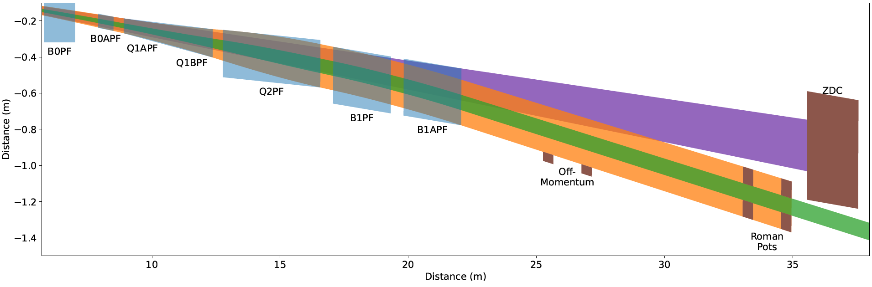
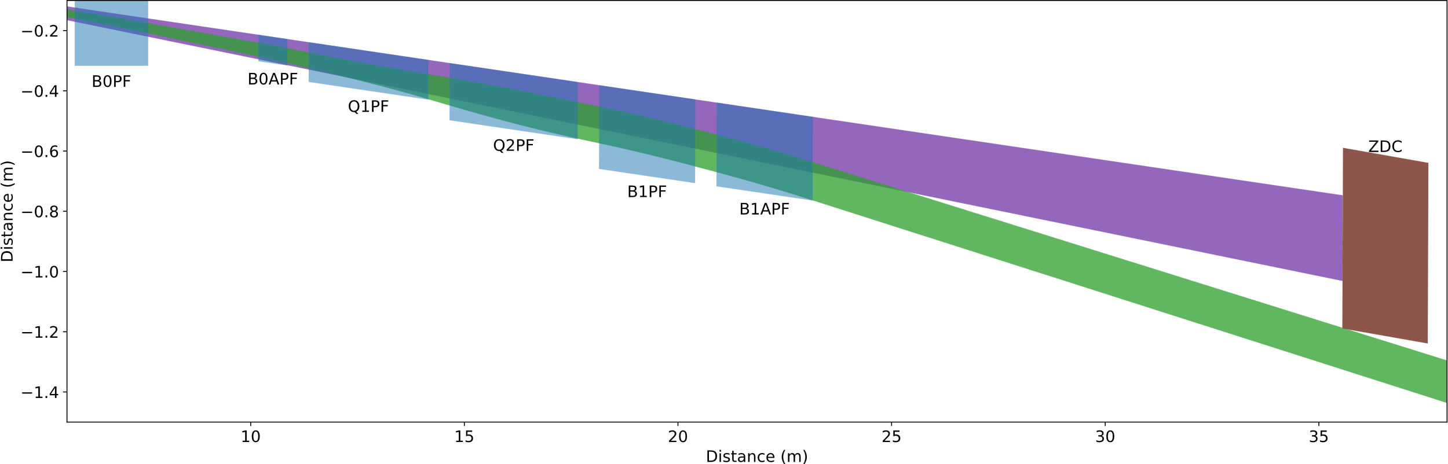
From Now to Layout 3
Add 1.5 m of drift between B0pF and B0ApF for detector
No longer need to transmit high transverse momentum particles
Still must transmit neutral cone
Reduce magnet apertures. Will also reduce quadrupole lengths.
Minimum B0pF integrated gradient 2.4 T·m
B0pF uses the same basic design as the existing one
Remaining magnets have ESR edge along the neutral cone
  Apertures are not aligned
Retain B1pF/B1ApF lengths, common design
Keep fields at beam tube to 4.5 T
Keep ZDC and downstream layout the same
Tried a solution without B0ApF, all bending in B0pF
  B0pF probably too long, difficult quench protection
Haven’t run complete suite of configurations, did some educated guessing → Correct within 20%?
Now
Nothing is decided !!!!!
Will only be done, if there is a significant gain in making the magnets simpler and there is no significant loss in science
New
Still need to investigate luminosity consequences
March 17, 2026
J. Scott Berg

Slide 37


Slide 38
EIC Project Update – Mail March 17
Dear Project Team,
Thank you again for the significant effort that went into preparing for the Director’s Review. The review committee members were consistently complimentary about the technical expertise and quality of the work across the EIC team, which were evident in the presentations and discussions. The review provided valuable feedback that will help strengthen the project plans as we work to prepare the preliminary baseline and define a clear path forward.
The EIC project has made strong technical progress and clearly demonstrates the capability to deliver the facility. Importantly, the Director’s Review confirmed that the project’s technical approach is sound and that the team has the expertise needed to deliver the facility.
The primary challenge is establishing a credible, fully integrated baseline that aligns scope, cost, schedule, and risk management within the $3B cost cap while preserving the capabilities to meet mission need.
Establishing a credible integrated baseline is now the single highest priority for the entire project.
The day following the review, project and laboratory leadership met to assess the results of the Director’s Review and to refine the EIC project baseline and execution strategy. We aligned on proceeding with the set of cost-reduction opportunities identified in the plan presented at the Director’s Review. As discussed during the review, these actions fall into two categories: Class 1 actions, which reduce cost without impacting expected performance which will be implemented and tracked, and Class 2 actions, which involve elements of the design impacting performance that would be deferred for construction and installation during the early operations period.
These actions will be incorporated into the effort now underway to establish a credible integrated project baseline.
We will engage with DOE in the coming weeks to discuss the project’s path forward, including requesting support to reschedule the Independent Project Review (IPR), originally planned for the end of April, to September. The primary reason for the change is to provide adequate time to address the results of the Director’s Review. The answers to all DOE IPR charge questions need to be “Yes!” The IPR in September should be a comprehensive review and set the stage for Critical Decision approvals at the end of 2026.
In practical terms, this corresponds to a significant portion of the Accelerator Storage Rings Subproject scope moving forward under a CD‑3C and a CD-2/3 for an Infrastructure Subproject. The Detector Subproject will continue to press forward with CD-2 baseline preparations.
The Project Organization is currently well aligned with this goal.

Slide 39
EIC Project Update – Mail March 17
We will meet with DOE leadership at the end of April in Germantown to provide an update on project status, including progress toward establishing the preliminary baseline, the path to achieving the TPC point estimate, and the proposed approach for project execution. This discussion will help ensure alignment on the steps needed to prepare for a successful IPR in September.
Over the coming months, our focus will be on establishing a well-defined preliminary baseline that supports the TPC point-estimate goals and this overall approach. And over the course of this week, we will clarify what remains within the project baseline, what may be deferred to early operations, how the cost-reduction actions will be implemented, and the process for achieving a baseline-ready P6 schedule. This will help ensure that work across the project is aligned with the updated priorities.
In the meantime, the following guidance should apply across the project:
  The near-term, highest priority is ensuring that the full project scope is appropriately represented in the integrated schedule (P6), recognizing that adjustments may be required where requirements are evolving.
  Technical reviews should continue as planned, unless otherwise directed.
  As schedules are developed or refined, we will continue to engage external subject‑matter experts to confirm that scope, schedule, and cost assumptions are reasonable and represent the minimum effort necessary to deliver the project objectives.
Where this approach leads to changes in requirements, we will implement those changes promptly so that teams have clear direction and can proceed efficiently. The progress made by the project team to date has been substantial. Achieving a credible integrated baseline will require focused priorities, timely decisions, and coordinated effort across the project. The committee emphasized that our success depends on clear direction and prompt decision-making from project leadership. We take this feedback seriously and will ensure leadership provides the support and decisive guidance needed to empower the team to move forward efficiently and effectively. With clear priorities and coordinated effort, we are well positioned to address the review feedback and prepare for the September review.
Sincerely,
Jim

Slide 40
Electron Beam 18 GeV Capability
Scope for 18 GeV capability lands on both sides of scope that can and can not be considered for “adiabatic” evolution of the EIC facility capabilities during the initial operations period.
Examples:
  RCS 5-Cell SRF Cryomodules => Good target for In-Kind contribution and “adiabatic” installation over standard shutdowns.
  RCS 2K Cryogenic Satellite Plant => Appropriate for an “adiabatic” installation over standard shutdown periods.
  RCS 2K Cryogenic Satellite Plant Support Building => Convention Facilities constructions. Likely needs to be included in project TPC estimate.
  ESR “full 16 cavity” buildout => Under discussion. Considerations are complex.
Message: Work with project management to evaluate 18 GeV on a case-by-case basis.

