Slide 1

ePIC Collaboration News
J. Lajoie, S. Dalla Torre
March 27th, 2026

Slide 2
Hey John, start the recording….

Slide 3
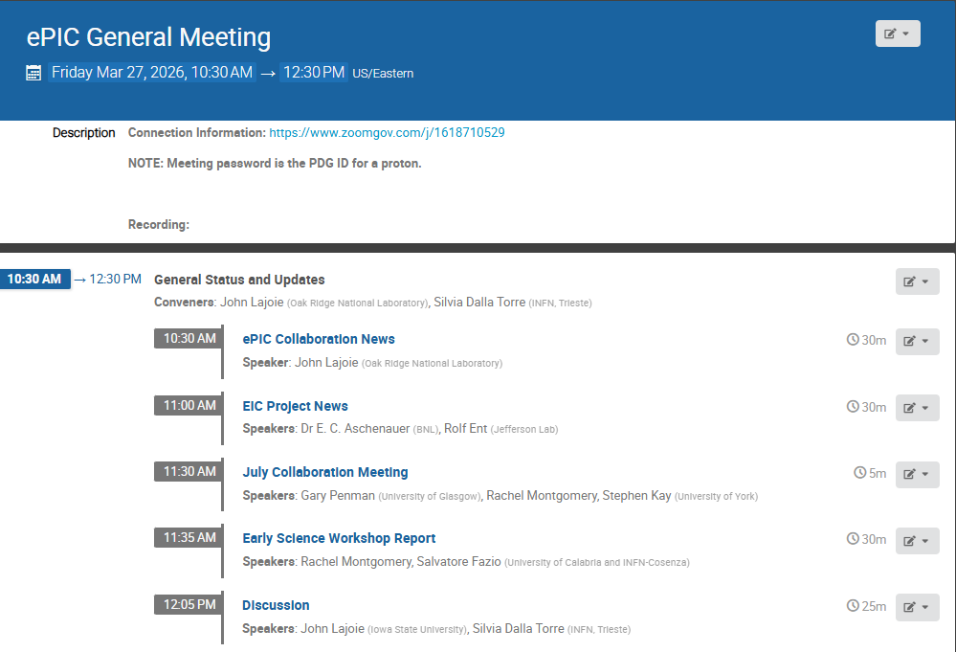
Agenda
Collaboration and Project News
Info for July Collab. Mtg
Report from the Early Science Workshop

Slide 4
Collaboration Goals for the first half of 2026
Support the EIC project and ePIC Technical Design:
Close the design loop with ePIC simulations
Advance the pTDR in preparation for CD-2
Respond to review recommendations
Complete the Early Science whitepaper
Progress in developing a multi-year plan for ePIC Software and Computing
Begin submissions to the NIMA Special Issue

Slide 5
News from the TIC Meetings

Slide 6
Beam Background Challenges for the ePIC Subsystems
Motivations:
Background studies needed for pre TDR (subsystems and physics studies)
The project needs a feedback about the current scheme of collimation and shielding
Kick-off : TIC meeting on February 23Rd, 2026
Initial progress report based on the current simulation campaign: TIC meetings on March 30th and April 13th
Coordination of the test beam activities
Overview of the 2026 ePIC testbeams at CERN (TIC meeting February 23rd):
The coordination effort has made possible to accommodate all ePIC needs!
Status and plans for the coming testbeam efforts:
LHFCAL, TIC meeting March 9th
pfRICH, dRICH, TIC meeting April 20th^{th}
MPGDs, AC-LGAD, TIC meeting April 27th
Future perspective: collecting information for future needs of testbeams at FNAL

Slide 7
Workflow for managing simulation workflow SCC/TC-Office cross-cutting efforts
Motivations:
The need for high fidelity in the geometry used in simulation studies
The need to establish a clear workflow for effectiveness and prompt implementation
Discussion at the TIC meeting on March 23rd
First step toward establishing an effective workflow
All DSCs are requested to provide, by the end of May, a comparison between the geometry currently implemented in the ePIC simulation and the input from the EIC Project engineering team. This comparison should be performed with respect to the September envelopes, which represent the latest version.
DSCs contributions to NIMA special issue
DSLs are requested to send a slide with their planning by April 10th
Discussion at TIC meeting on April 20th
Motivation:
Having a high-level picture of the subsystem contributions to the special issue to understand/cure problematic aspects, if any

Slide 8
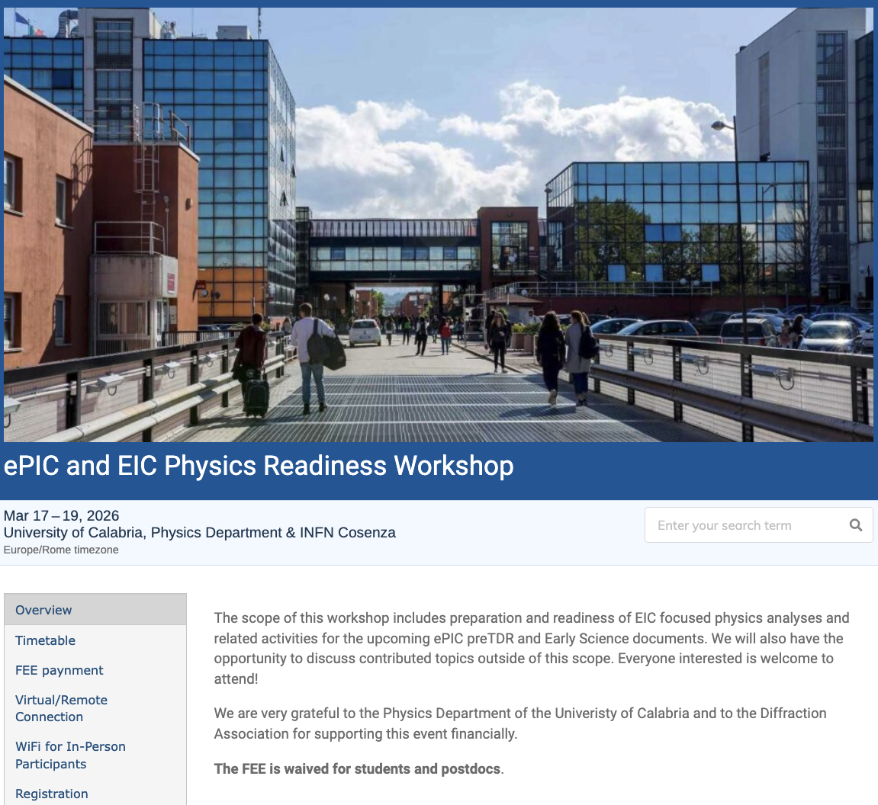

The discussion on performance continues!
Next Physics Readiness Workshop scheduled for March 17-19
Hosted by the University of Calabria & INFN Cosenza
Indico: https://indico.bnl.gov/event/30283/
Hybrid format - Please register even if attending online (select proper option)
The workshop will focus on the finalization of studies and text for the TDR and early science documents
Joint sessions with Software & Computing to discuss reconstruction and simulation priorities
A very successful workshop with great participation held at the University of Calabria! Many thanks to the PACs for organizing, to all the participants, and especially to Sal for hosting!
More in the PAC report later…

Slide 9
Early Science Whitepaper
Excellent discussions on the status of the current draft of the whitepaper, led by comments from review teams.
Two important conclusions:
It will be more flexible to present a list of expected colliding species and integrated luminosities rather than a year-by-year list of runs. The latter implies a degree of specificity that we don’t have.
See following talk from EIC Project and PACs, as well as slides from Workshop: https://indico.bnl.gov/event/30283/timetable/#20260317.detailed
Given the timing of the March simulation campaign and the EIC project’s work to develop a project baseline and implementation plan, we have requested a delay of the deadline for the whitepaper until July 2026.
Do not expect further delays! Important to complete this so we can move on to other priorities.

Slide 10
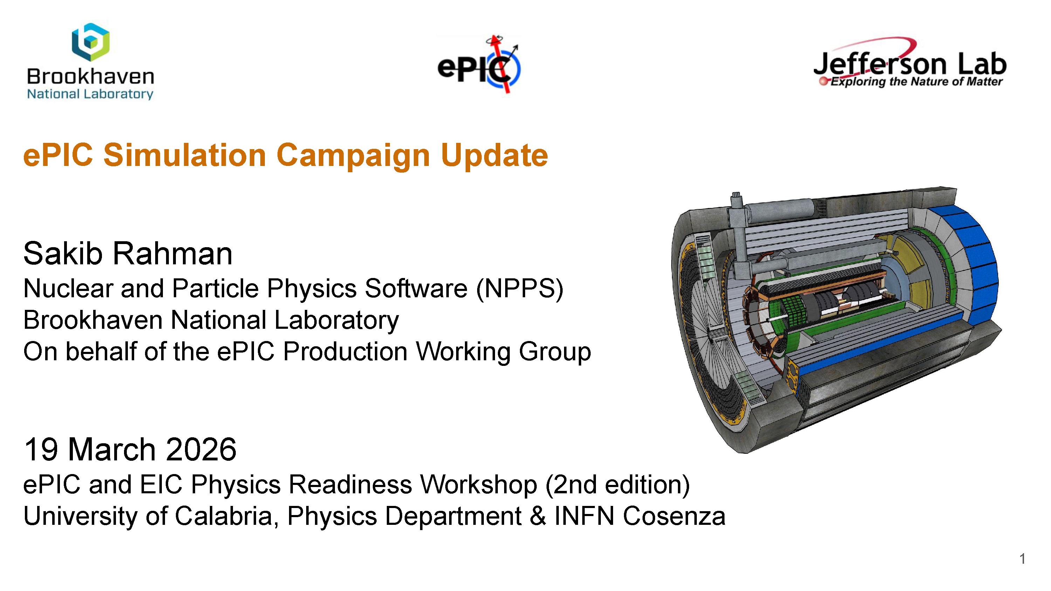
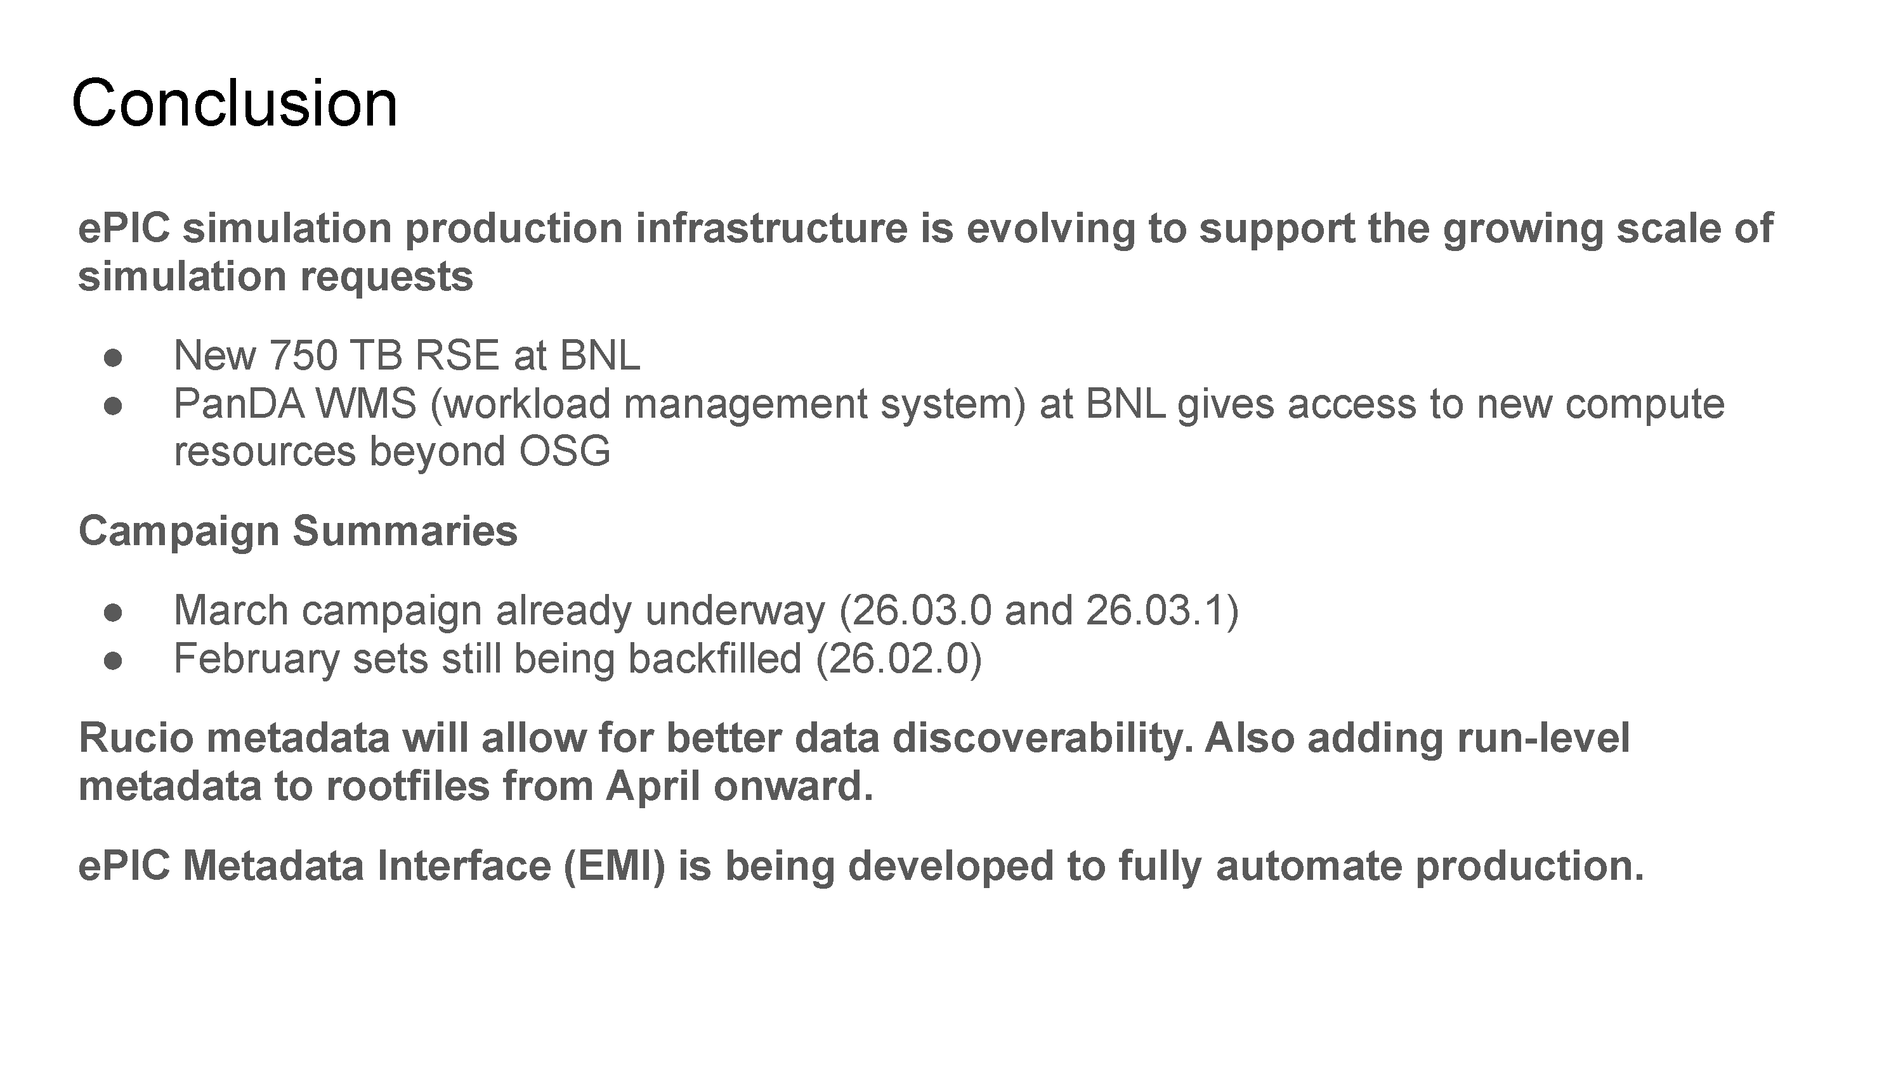
Software and Computing
Early Science Workshop had a joint session with Software and Computing – discussed simulation campaigns, reconstruction, Rucio tutorial, …
Efforts underway to scale our simulation productions and make datasets discoverable.
Software and Computing is extremely active both supporting the simulation effort and planning for the future of S&C in ePIC. Will have a report at the General Meeting on April 24th

Slide 11

ePIC and the Genesis Mission
Working to provide a way to coordinate efforts in ePIC, match up people and proposals. Shared spreadsheet here.
Markus hosted a discussion on coordinating ePIC efforts on the Genesis Mission after the March 25th S&C Meeting.
The Genesis Mission is an opportunity for ePIC. Success depends on alignment with our priorities. We should actively coordinate proposals now.
Opportunities:
Broader engagement with and in ePIC Software & Computing,
Expand our workforce.
Increase visibility of AI within ePIC.
Challenges:
Impact depends on alignment with ePIC priorities.

Slide 12
Discoverability and Reusability for the preTDR and Beyond
Announced March 2nd
We are excited to announce the upcoming online only ePIC Software & Computing Workshop on “Discoverability and Reusability for the preTDR and Beyond”. This workshop will take place Wednesday, April 29th with presentations on the current strategies for software discoverability and will be an open discussion with the community to gather feedback and refine priorities. We invite all in the ePIC Collaboration and EIC Community to join to learn about the current efforts and contribute to the discussions. Please find the agenda and registration on indico: https://indico.bnl.gov/event/31760/
We look forward to your participation,
Holly Szumila-Vance, Stephen Kay, and Sasha Prozorov on behalf of the ePIC User Learning WG

Slide 13
Why a NIMA Special Issue?
At the January 2025 collaboration meeting we discussed how to better engage early career scientists in ePIC:
Need recognition for their efforts
The recognition that matters is publications …
However, we are not an experiment with data (yet)
Started discussions with NIM Editors in Feb 2025
Elsevier expressed an interest in publishing performance studies for the EIC.
Broadened the discussion to a comprehensive issue on the ePIC detector and its capabilities for EIC science.
Subsequently added S&C (Streaming Data Model) to the conversation
Model for this is the NIM Special Issue for RHIC
Submissions will be peer-reviewed
Elsevier editors very encouraging

Slide 14
ePIC NIMA Special Issue
Plan to publish a super-set of the material prepared for the pTDR
ePIC Overview Paper
Subsystem technical papers (derived from pTDR)
Physics performance paper (derived from pTDR)
Early Science Whitepaper
Early Science Physics Appendices
BSM/EW Physics Performance Paper
Streaming Computing Model Paper
Overall 30+ publications
This Special Issue will be an important tool to communicate to the NP community the depth, breadth and excitement for EIC science.
Discussions to follow in the PAC and TIC meetings.

Slide 15
News Items

Slide 16


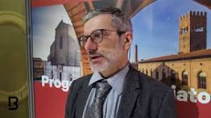
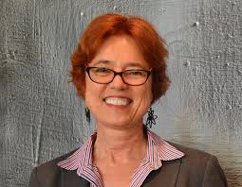

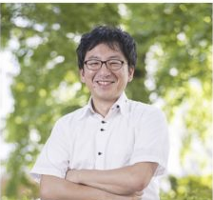
CC Elections
Francesco Bossu (Vice Chair of the Code of Conduct Committee)
Xin Dong (Vice Chair of the Publications Committee)
Pietro Antonioli, Barbara Jacak, and Paul Newman (Executive Board at-large members)
Many thanks to Taku Gunji for his service on the Executive Board

Slide 17
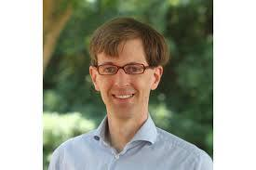
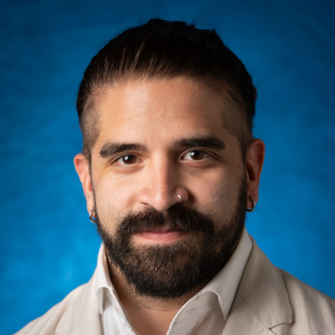
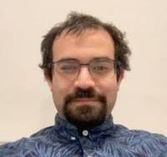
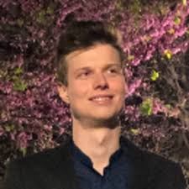

CC Endorsed Nominations
Members of the CTC: Wouter Deconinck (PC Liaison, Manitoba), Fernando Flor (ANL), Xuan Li (LANL), Charles Joseph Naim (Stony Brook), Sebouh Paul (FIU), Nicola Rubini (Bologna)
S&C Physics and Detector Simulation WG: Simon Gardner (Glasgow) as convener
S&C User Learning WG: Sasha Prozorov ( Czech Technical University) as convener

Slide 18


New Institutions
Chung-Ang University and Tokyo City University were endorsed as new ePIC members by the CC.

Slide 19
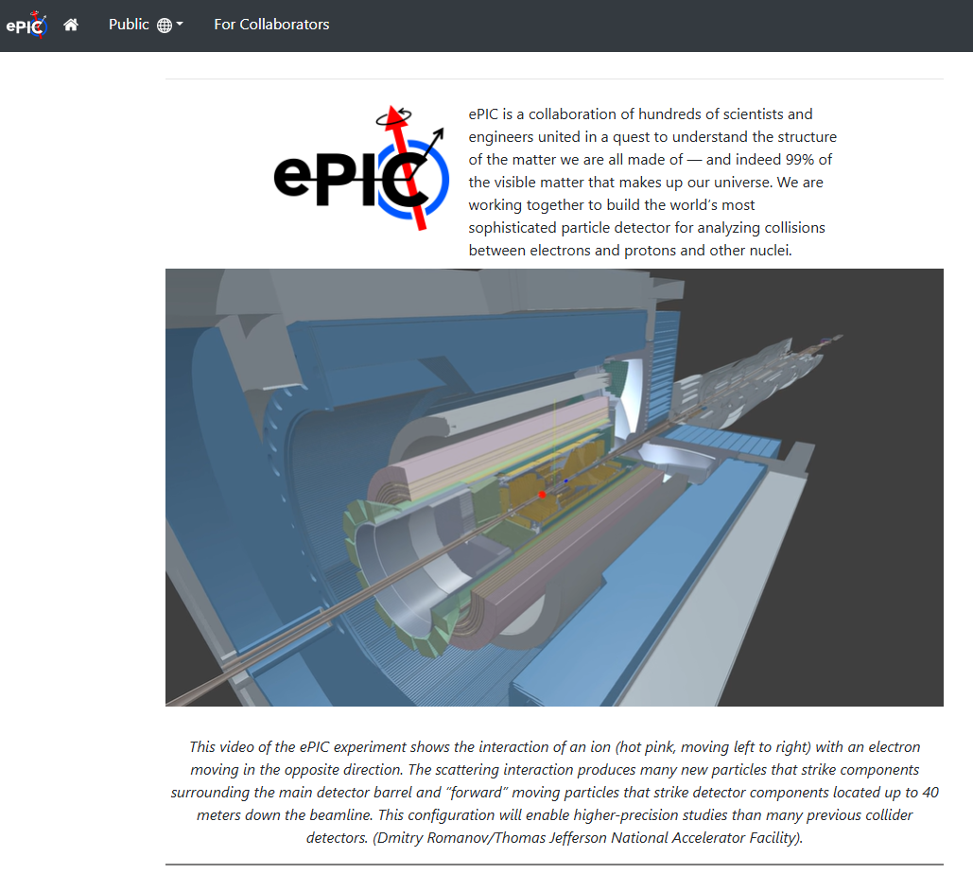
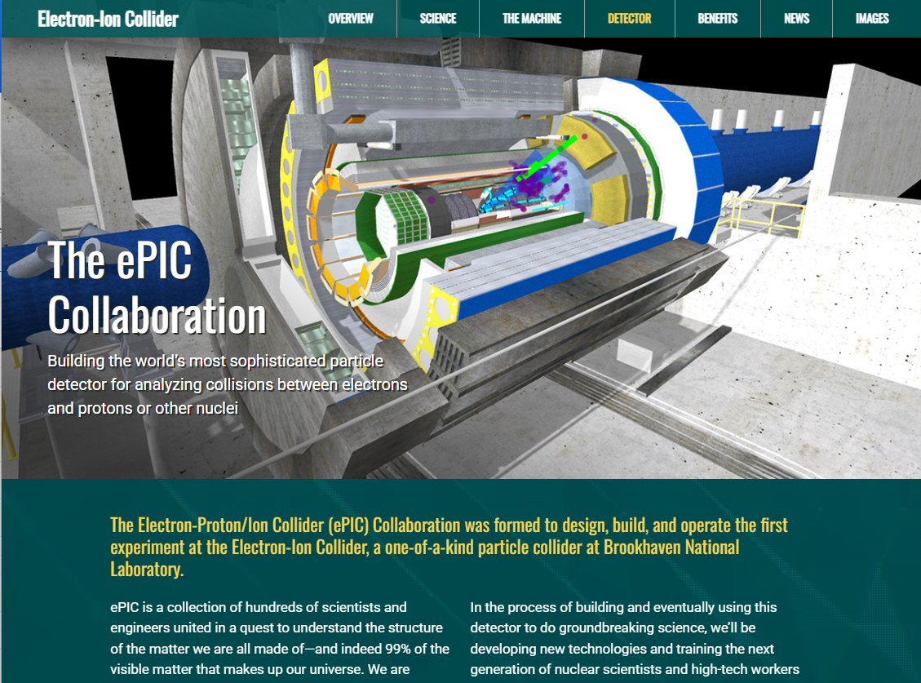
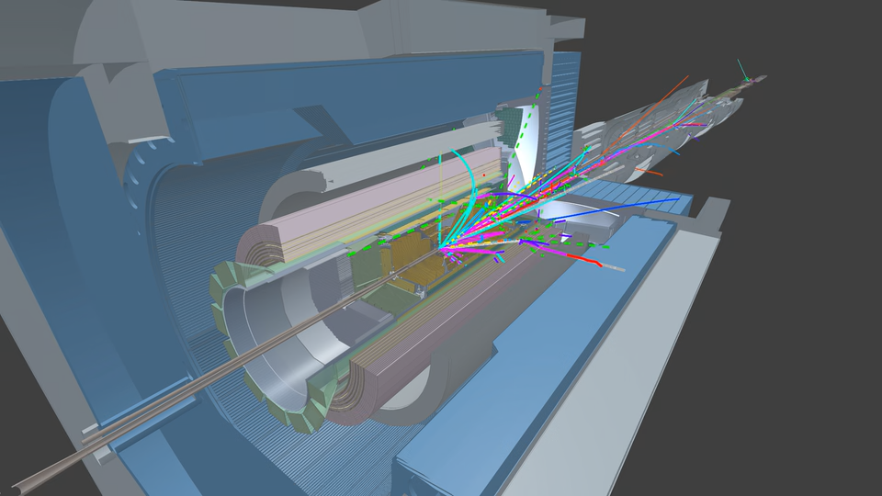
New Firebird Event Videos!
https://www.epic-eic.org/
https://www.bnl.gov/eic/epic.php
Awesome new Firebird event display videos from Dmitry Romanov (JLab) – integrated into ePIC and BNL web pages.
Firebird is the ePIC event display used for both outreach and reconstruction and analysis development:
https://eic.github.io/firebird/
Planning a variety of videos of different physics process to be incorporated into public portion of website.

Slide 20

(Following the 7th RRB June 9-10th at MEXT)

Slide 21

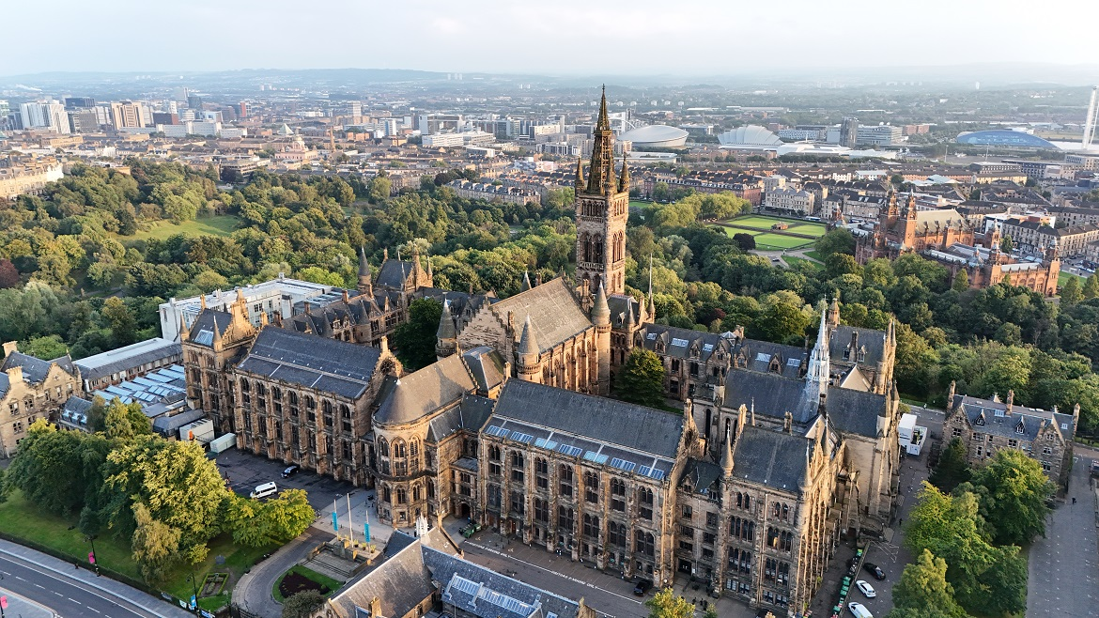
Summer 2026 Joint EICUG/ePIC Meeting
The Summer 2026 joint EICUG/ePIC meeting will be held at the University of Glasgow July 13-17th , 2026.
Indico w/information at: https://indico.bnl.gov/event/31808/
More info later in this session

Slide 22
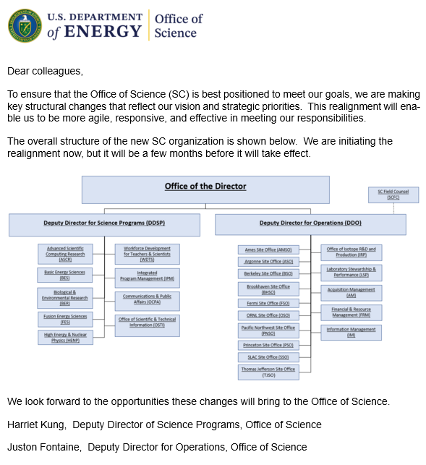

HEP-NP Merger in DOE SC
The long-anticipated merger of HEP and NP in DOE SC was announced March 17th. Regina Rameika will lead the combined office.
Sharon Stephenson discussed the change in the APS DNP business meeting on March 18th. The HEP and NP budget lines will remain separate through FY’27.
HEP and NP were originally together and were separated in 1990-91 under the Office of Energy Research (pre-Office of Science).

Slide 23
Research Funding
As many are aware, DOE NP research budgets are anticipated to decline in FY26
As discussed by Sharon Stephenson in APS DNP Business Meeting:
18% reduction in NP Research Budget
Redirect of ~10% for Genesis Mission
We anticipate this will create hardships for both university and lab research groups working on ePIC
ePIC Leadership needs to be able to communicate clearly the impact that this will have on engagement in ePIC and readiness for baselining and construction
Please contact the SP Office to let us know if budget cuts are forcing you to reduce your commitment to ePIC

Slide 24
Upcoming CC Meetings
Closed Meeting (CC reps only): Friday, April 17th @ 10:30AM ET
Agenda:
Status of non-compliance with required Statements of Service
We will present the current situation and the actions taken so far, and will solicit input from the Council.
Policy updates
Pending approval of the Charter update, we will ask the standing Council Committees to briefly summarize areas where they see a need for changes. This topic will also continue in the follow-up meeting.
Targeted discussion of author lists / limited-author papers
This will be an initial discussion, led by the publication committee, and will be revisited at the subsequent meeting (see below).
Open Meeting (All welcome): Friday, May 29th @ 10:30AM ET
Preliminary agenda:
Report from the CTC
Presentation from institutions applying for membership
Publication policies – author lists / limited-author papers
Policy updates – first draft proposals

Slide 25

Daylight Savings Time in Europe
Daylight Savings Time in the Europe will begin this Sunday March 29th
This will bring the US and Europe “back into sync” with the time differences we are more used to. Keep this in mind for ePIC meeting times!

Slide 26
Comments on EIC Project and ePIC

Slide 27
2026 Timeline Of Major Events (so far…)
EIC Project Strategy Meeting – Dec 4th, 2025
ePIC Collaboration Meeting – Jan 20-23rd
EIC DET Subproject Baseline Review – Feb 3-5th
See Feb 13th GM Report: https://indico.bnl.gov/event/31494/
EIC Director’s Review – Mar 9-12th
Report from the EIC Project in this meeting
Meeting with DOE in Washington D.C. – Mar 13th
EIC Management Team, Lab Directors and ALD’s, ePIC SP
Focus on achieving the EIC baseline and implementation plan
OPA Review postponed until Sept. 13-15th
This review schedule has been a HUGE effort for both the DSC’s and especially the CAMs!

Slide 28
High Level Summary of Where We Are
EIC Mission Need Parameters
A high degree of beam polarization* (~70%) for electrons and light ions
Availability of ion beams from deuterons to the heaviest stable nuclei
Variable center of mass energies ~20–100 GeV, upgradable to ~140 GeV (e-p)
High collision luminosity* ~10³³–10³⁴ cm⁻² s⁻¹
Possibly more than one interaction region (* avg over a fill)
The EIC project must develop a baseline that:
Addresses the EIC CD-0 Mission Need Statement
Start early science within 10 years
Costs less than ~$3B
A baseline that meets these conditions was not presented at the Director’s Review.
When we discussed the EIC baseline at the Collaboration Meeting, I stated “The collaboration must have an opportunity to respond to changes to the baseline that affect EIC science”
The project is working diligently to put together a combined EIC Portfolio (Project, R&R, NYS…) and operations (implementation) plan that meets EIC Mission Need
While this doesn’t yet affect mission need it will likely impact early science
It may mean some redesign or rethinking to reduce cost/risk
We need to be realistic about how both ePIC and the EIC will turn on!
The EIC Project needs to get everything into P6 and use it as a tool
On the positive side – there has been tremendous technical progress
EIC Project Management to meet with DOE at the end of April

Slide 29
Conclusions
The collaboration is making progress on the priorities outlined in Jan.
The ongoing reviews are a process through which the EIC project works to establish the project baseline.
Support for the review process by the collaboration/CAMs has been tremendous!
Be ready to engage with the project to support the EIC science mission
It is critically important that we work to communicate the importance of EIC science to the community!
The Early Science whitepaper and NIMA Special Issue are how we will do this
The hectic pace of the reviews, as well as baselining and creating the implementation plan can generate a lot of noise. We have to stay the course and stay focused on the EIC science mission.

Slide 30


Slide 31
Status of the Special Issue
Special Issue form filed with Elsevier Jan 2026
Organization:
Spokesperson is Executive Guest Editor
Coordinators are Co-Guest Editors
Will manage submissions from their areas and manage reviews with an Elsevier editor
Special Issue is currently open for submissions
Planning for publications to be Open Access
Based on agreements with corresponding author institutions

Slide 32
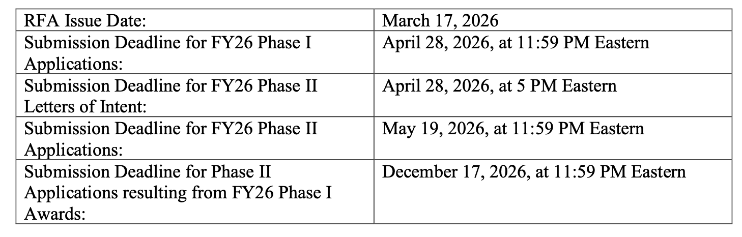
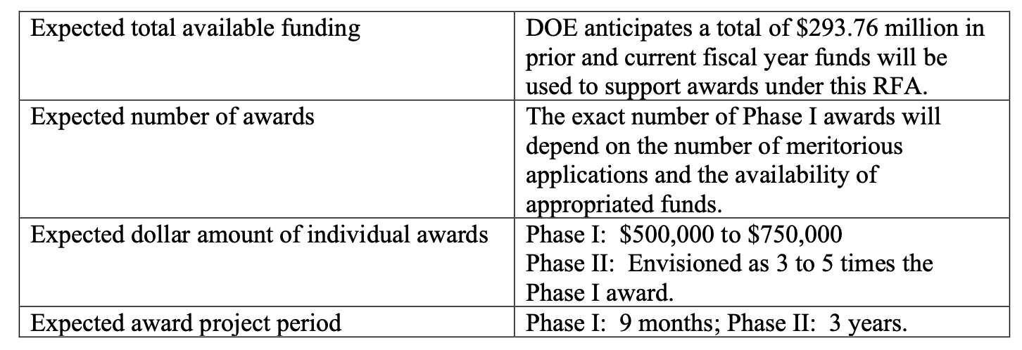
Soliciting applications from interdisciplinary teams addressing the Genesis Mission Challenges to accelerate scientific discovery and R&D workflows using novel AI models and frameworks.

Slide 33
Request to the EIC Project
The outcome of the project baselining exercise can affect the EIC science program in multiple ways:
Changes the scope of the DET subproject
Changes to the ASR, EIN and ISR subprojects (EIC performance)
The collaboration must have an opportunity to respond to changes to the baseline that affect EIC science
We have discussed with Jim Yeck, David Dean, and Abhay a process by which the collaboration is charged to provide a formal, written response on the impact to EIC science once the preliminary baseline is established
The timescale for this will be VERY short!
We hope to have a better understanding of the baselining implications for the EIC collider at the collaboration meeting.
Today the focus is on the detector.

Slide 34

AI Opportunities for ePIC: Examples
From the ePIC Perspective (Not AI-Focused)
14a) Foundation Models of Particle Interactions and Cosmic Physics (HEP, NP)
Foundation models for event reconstruction
Predict event kinematics from cluster and hit data
Next step: Inclusive, semi-inclusive, and exclusive DIS kinematics from EICrecon output.
14c) Expedited Discovery from High-Complexity and Petabyte-Scale Datasets (HEP, NP)
Classify streaming data into physics events and background
Model background for analysis
Next step: Demonstrate improved precision for one example measurement
18b) Automated Scientific Problem-to-Code Generation (ASCR)
Connects to PCS demonstration.
Translate physics requests into executable workflows.
Enable HPC/HTC orchestration.

Slide 35

ePIC Resources
Public Website - https://www.bnl.gov/eic/epic.php
Mailing Lists – https://lists.bnl.gov/mailman/listinfo
Indico Agenda - https://indico.bnl.gov/category/402/
ePIC Software and Computing: https://indico.bnl.gov/category/435/
Wiki - https://wiki.bnl.gov/EPIC
ePIC Software Training:
Landing Page: https://eic.github.io/documentation/landingpage.html
Tutorials: https://eic.github.io/documentation/tutorials.html
Mattermost: https://chat.epic-eic.org
ePIC Zenodo Community: https://zenodo.org/communities/epic

Slide 36


EICUG Membership
The EICUG is a vital organization to promote the interests of the EIC community!
Without the EICUG we would never have gotten far enough to form ePIC!
Please register your institution!
Check with your EICUG IB representative to get registered as a member
https://www.eicug.org/content/join.html

Slide 37
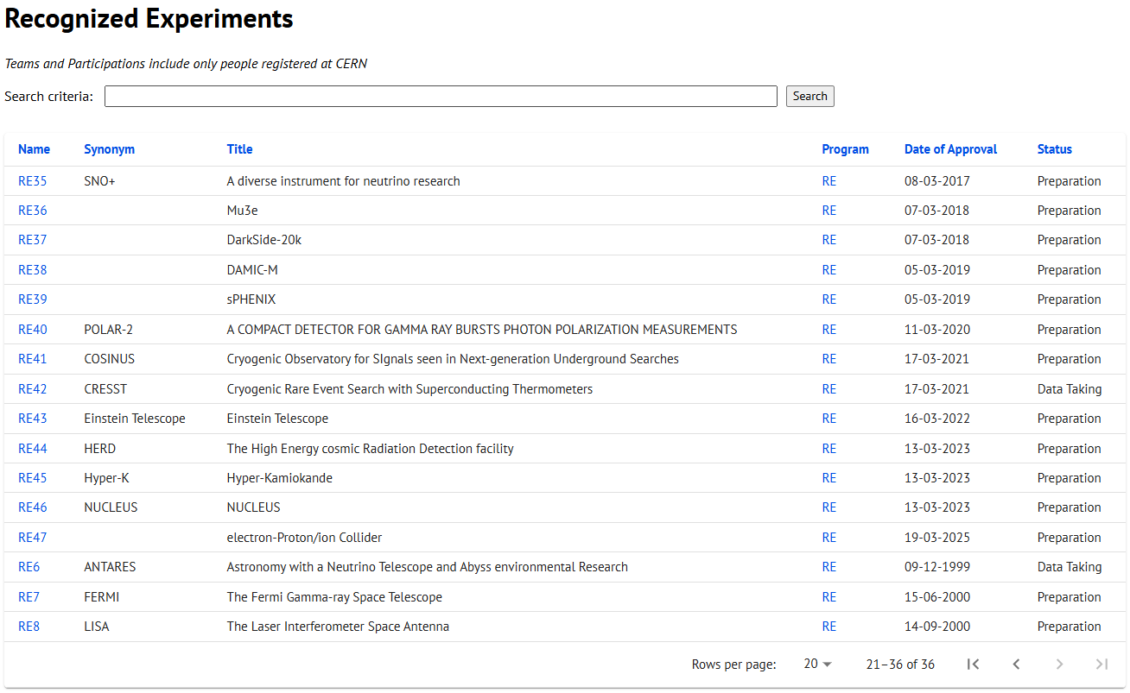
CERN Recognized Experiment Status: RE47
ePIC now appears in the CERN Grey Book database as RE47: https://greybook.cern.ch/experiment/recognized
Two steps to get ePIC Collaborators registered at CERN:
CC Representative needs to register as team leader with CERN Users Office:
https://usersoffice.web.cern.ch/
https://usersoffice.web.cern.ch/team-leaders-corner
Users.Office@cern.ch
CC member can then certify registrations of team members
Contact us if you run into problems!

