Slide 1
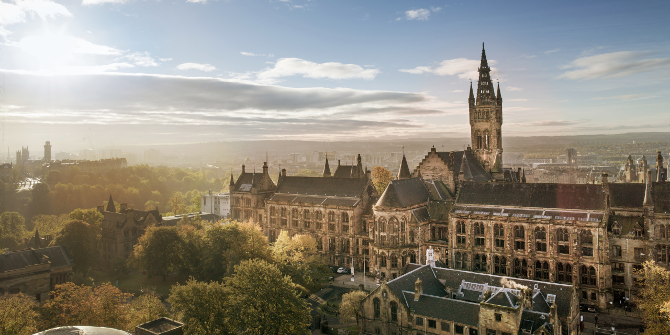


ePIC General Meeting
Update on the July Meeting
Stephen Kay, Rachel Montgomery,
Gary Penman and Daria Sokhan
27th March 2026

Slide 2
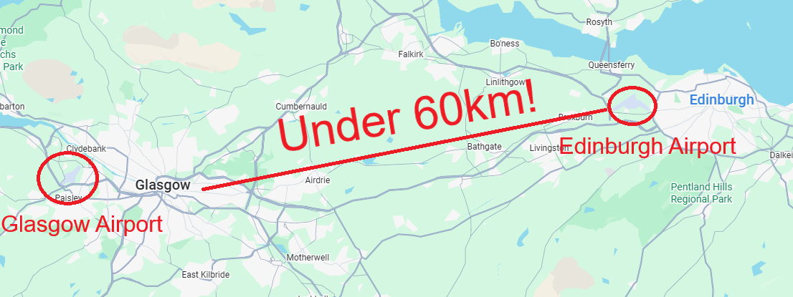

Travel Information
July ePIC/EICUG meeting held in Glasgow on the 13th to 17th of July 2026
  ECR meeting precedes this - 11th and 12th of July
Registration will open soon, but we wanted to share some information now
International travel to Glasgow, recommend Glasgow or Edinburgh airport
  Edinburgh has many direct flights to the US and Canada
  Short transfer to Glasgow via coach/bus/taxi

Slide 3
Visa Information
Check if you need a visa for the UK here - https://www.gov.uk/check-uk-visa
  Citizens of many EU countries, USA, Canada, Australia, Japan, Korea and others will likely only need an Electronic Travel Authorisation (ETA)
    https://www.gov.uk/eta - £20, approval typically <72 hrs
New rules exist for those with dual citizenship with British or Irish citizenship
  Please check here if this may apply to you
If you need a visa, we can provide an invitation letter
Please contact the organisers with the following information once registered:
  Full name and title
  Home institution/employer
  Role/position
  Intended activities as part of participation in meeting
  Funding source(s)
Note, can apply for a visa a maximum of three months in advance

Slide 4
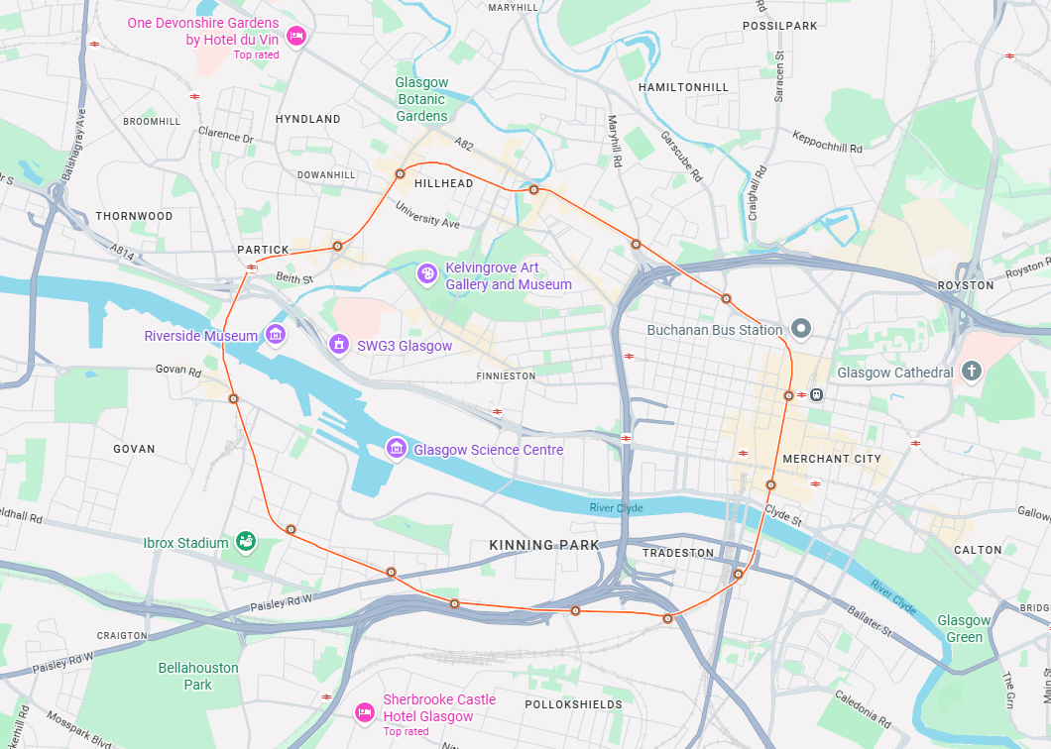
Accomodation
Glasgow is a large city (pop ~1.2m ), many accommodation options available
Venue is the University of Glasgow in the West End
Two clusters of smaller hotels within a 10-15 minute walk
Many, many options including large international chains in the city centre
  Short (<10 minute subway journey)
List of suggestions in backup or on Indico

Slide 5
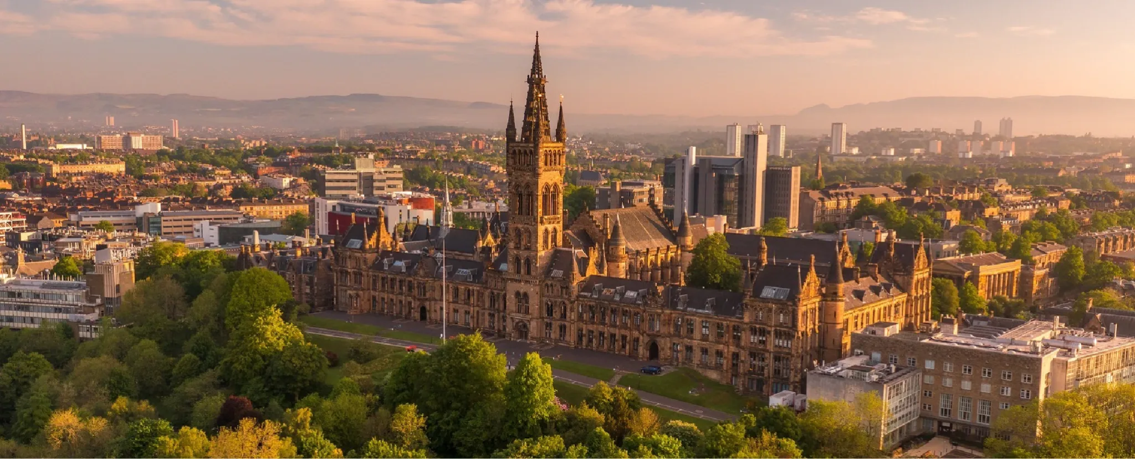
We look forward to welcoming you to Glasgow in July!
Indico now live - Registration opening soon

Slide 6
Accommodation - West End Ideas/Options
Botanical Gardens/Great Western Road
Royal West End Hotel - Approximately a 10 minute walk
Albion Hotel - Approximately a 10 minute walk
Glasgow Grosvenor Hotel - Approximately a 15 minute walk
Ambassador Hotel/Embassy Suites - Approximately a 15-20 minute walk
South of Kelvingrove Park
Alamo Guest House - Approximately a 10-12 minute walk
Argyll Guest House - Approximately a 12 minute walk
Kelvingrove Hotel - Approximately a 12-15 minute walk
Presented in order of walking distance from the plenary venue.

Slide 7
Accommodation - City Centre Ideas
There are a range of hotel options, including major UK and international chains, located in the city centre which is a short subway or bus ride away from the University. Some suggested options that are close to subway stations are included below -
Travelodge Glasgow Queen Street - Major UK budget hotel chain
Maldron Hotel Glasgow City - International chain
Holiday Inn Glasgow City Centre - International chain
Premier Inn, St Enoch Square - Major UK budget hotel chain
Ibis Styles George Square - International chain
These options are presented in no particular order.

