Slide 1
Cherenkov Photon Angle Tables
Cheuk-Ping Wong
02-20-2026

Slide 2

Binning
Four pseudorapidity bins
$−3.5<η<−1.5$with a bin width of $0.5$
Maximum 18 momentum bins
$1<p<10$ GeV/c with a bin width of 0.5 GeV/c

Slide 3
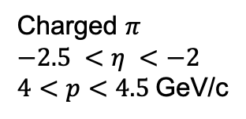

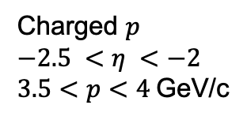
Cherenkov Photon Angle Extraction
Cherenkov photon angle at near threshold momentum
($1σ$)
Charged $p$
$$−2.5 <η <−2$$
$3.5<p<4$GeV/c
Charged $π$
$$−2.5 <η <−2$$
$4<p<4.5$GeV/c

Slide 4
Cherenkov Photon Angle vs Momentum
Vertical error=1 sigma
The Cherenkov photon angles at near threshold momentum (Kaon and Proton in particular) are not Gaussian-like

Slide 5
Table of Cherenkov Photon Angle
================================================================================
Elec
--------------------------------------------------------------------------------
-2 <eta< -1.5 ,nMom= 18
--------------------------------------------------------------------------------
Mom_min(GeV/c) Mom_max(GeV/c) theta_mean(mrad) theta_err_1sigma(mrad)
1 1.5 278.474 2.14102
1.5 2 278.414 2.13448
2 2.5 278.344 2.08476
2.5 3 278.3 2.04348
3 3.5 278.373 2.02016
3.5 4 278.308 2.03625
4 4.5 278.361 1.9624
4.5 5 278.389 1.96865
5 5.5 278.42 1.96074
5.5 6 278.421 1.97795
6 6.5 278.409 2.00523
6.5 7 278.321 2.0312
7 7.5 278.394 2.01803
7.5 8 278.379 2.04021
8 8.5 278.378 2.04606
8.5 9 278.321 1.95728
9 9.5 278.318 1.95733
9.5 10 278.322 1.98464
These numbers are also saved in histogram format:
Angle = h[iParticle][iEtaBin] -> GetBinContent( h[iParticle][iEtaBin] -> FindBin(mom) )

Slide 6
List of files
/gpfs/mnt/gpfs02/eic/pingwong/irt/separationPower/pfRICH_CherenkovAngle.txt
/gpfs/mnt/gpfs02/eic/pingwong/irt/separationPower/pfRICH_CherenkovAngle.root
/gpfs/mnt/gpfs02/eic/pingwong/irt/separationPower/pfRICH_CherenkovAngle.pdf

