Slide 1

University of Birmingham
27th February 2026
Scattered Electron Identification Using ML Techniques at the Electron-Ion Collider
Supervisors: Paul Newman and Stephen Maple
Written by Arthur Guest
Student ID: 2440329
1

Slide 2
01
Physics Context
02
ML Methodology and Feature Engineering
Overview
03
Model Performance
04
Summary and Future Work
2

Slide 3
Physics Context
3

Slide 4
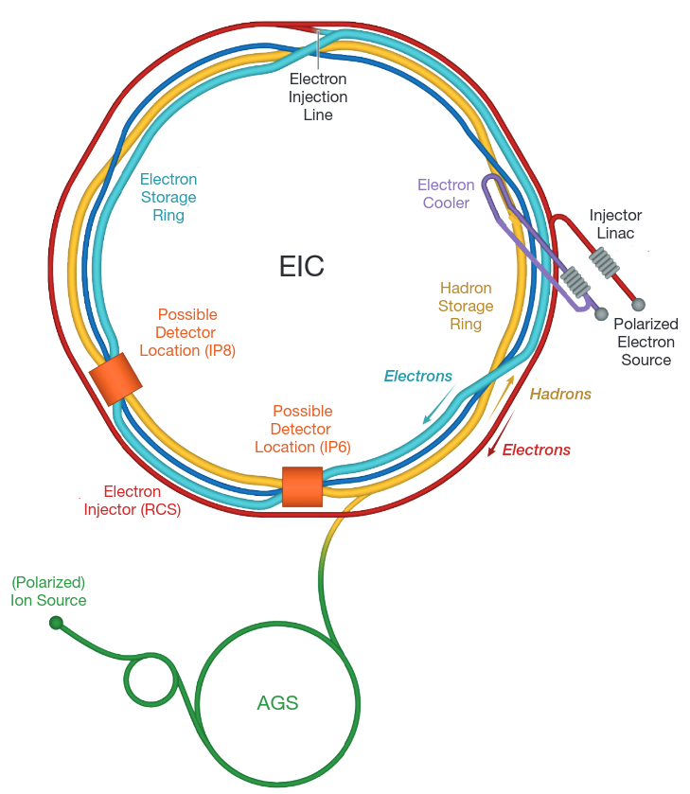
Electron-Ion Collider
The collider is currently being built, and is on track to be operational by the mid 2030's
Seeks to address new physics such as:
The origin of the nucleon mass[1]
The origin of nucleon spin[1]
Emergent properties from a dense system of gluons[1]
Will address these questions mainly by observing Deep Inelastic Scattering (DIS) interactions
Figure 1: Schematic layout of the planned EIC accelerator.[1]
4
Notes:
- operational by 2030's
- investigate these three things
- highly precise measurements on PDF's
- spin -> 30% of proton's spin explained by the intrinsic quarks, what about the rest?
- done through DIS

Slide 5
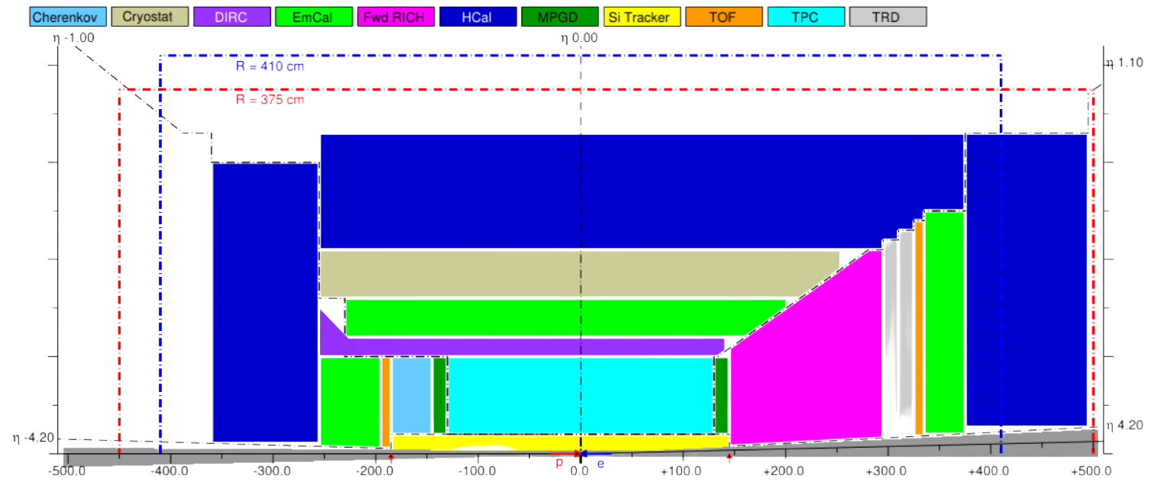
Figure 2: A 2D sketch of a proposed EIC detector layout, cut horizontally across.[1]
5
Notes:
- PID - Cherenkov, ECAL, HCAL, Si Tracker
- will focus on the data from the Si tracker and ECAL
- note the angles of acceptance, important later

Slide 6
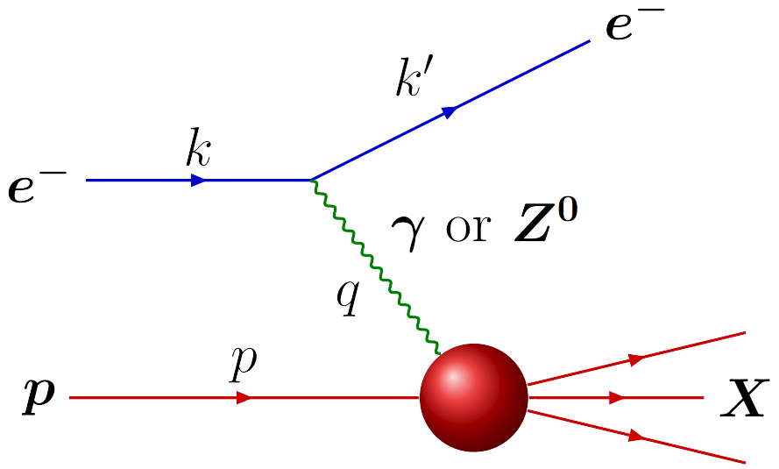
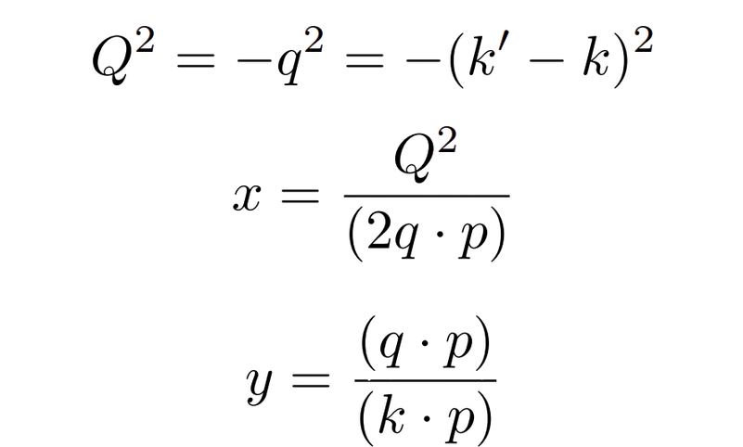
Neutral Current DIS Interactions
A high energy lepton scatters off a parton, mediated by a neutral boson
Events characterised by three Lorentz invariant variables
Figure 3: A diagram showing a neutral current DIS interaction.[1]
6
Notes:
- with a high enough energy, the electron scatters off a quark inside the proton
- photon or Z exchange particle
- knocks a quark out, other partons hadronise
- Q2 is the squared momentum transfer, analagous to resolving power
- x - fraction of the nucleons momentum carried by the struck parton
- y - inelasticity, proton rest frame, just the fraction of the incoming electron energy that gets transferred to split up the system

Slide 7
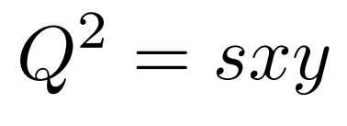
Scattered Electron Identification
Importance of Identification
Challenges of Identification
The Bjorken variables all directly depend on the scattered electron being correctly identified (when using the Electron Method)
The available phase space is often represented through these variables[1]
The scattered electron is just one particle amongst multiple particles from the Hadronic Final State (HFS)
Negative pions and electrons produced in the HFS frequently mimic the scattered electron
Background interactions also picked up in the detector
7
Notes:
- other particles consistently mimic the scattered electron
- need the scattered electron to accurately find the bjorken values per event - crucial to categorising events to learn about them
- using the electron method - solely relies on finding the scattered electron and its scattering angle
- picking wrong particle completely corrupts the phase space
- electron method - highly precise at large y and large Q2, good for the low x measurements, fails at low y, and if the incoming electron radiates beforehand
- JB method - use only the HFS, good at low y

Slide 8
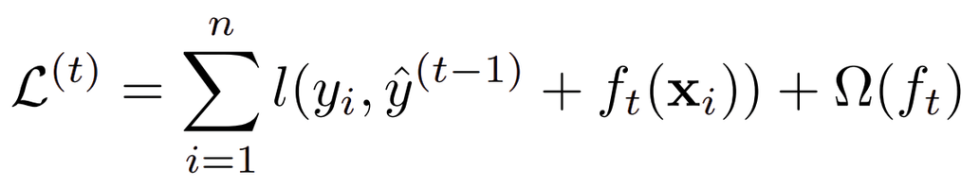
ML Model Choice - XGBoost
The truth label - 1 for scattered electrons.
Classed as a Gradient Boosted Decision Tree (GBDT)[2]
It’s a black box[2]
Model is built by making sequential, rectangular cuts using the input variables
Iteration on the trees allows the model to target particles that were failures to identify in the previous iteration
Penalises complexity to prevent overfitting[2]
Outputs a score for a single particle
The objective function at training iteration t
The current iteration’s output
The regularisation term
The loss function
The prior prediction
8
Notes:
- if y > 0, do x < t
- explain truth labels
- regularisation term for penalising overfitting and learning from statistical distributions of the MC sampling
- we minimise the objective function
- loss function measures the distance between the prediction and truth - log loss
-

Slide 9
Project Aims
Why XGBoost?
BDT’s, such as XGBoost, are already the standard in high-profile HEP experiments (e.g. ATLAS, LHCb)[3]
Potential to learn complex, non-linear relationships between both kinematic and calorimetric variables
Has native support for variable ranking to allow for physical interpretation
Goals of the Project
To develop a working, particle-level electron finder for ePIC using machine learning
To test which scattered electrons were failed to be identified
Possibly adapt the model to work at the event-level
9
Notes:
- want to create a working particle-level finder for ePIC
- want see the regions of phase space where the particles are failed to be picked
- possibly adapt to the event level too

Slide 10
ML Methodology & Feature Engineering
10

Slide 11
Data & Methodology
Datasets: Pythia8 ePIC Monte Carlo samples, separated by beam energy configurations
Focused on the 5x41 GeV and 18x275 GeV datasets thus far - 20 datasets each
Source: Downloaded from the EIC servers at Jefferson Lab
Data Structure
Contains truth-level, reconstructed and raw variables, at the event-level and the particle-level
Datasets split 80/20 for training and evaluation respectively
Candidate particles:
Has a corresponding ECAL cluster
Has a charge
11
Notes:
- focusing on reconstructed and truth level rn, want to implement raw variables soon
- 20 datasets, each dataset contains similar number of events
- trained on particles with a charge and cluster due to the chosen input variables
- 18x275 best for investigating low Q2 events -> gluon density climbs at this region
- DIS ONLY -> come back to later

Slide 12
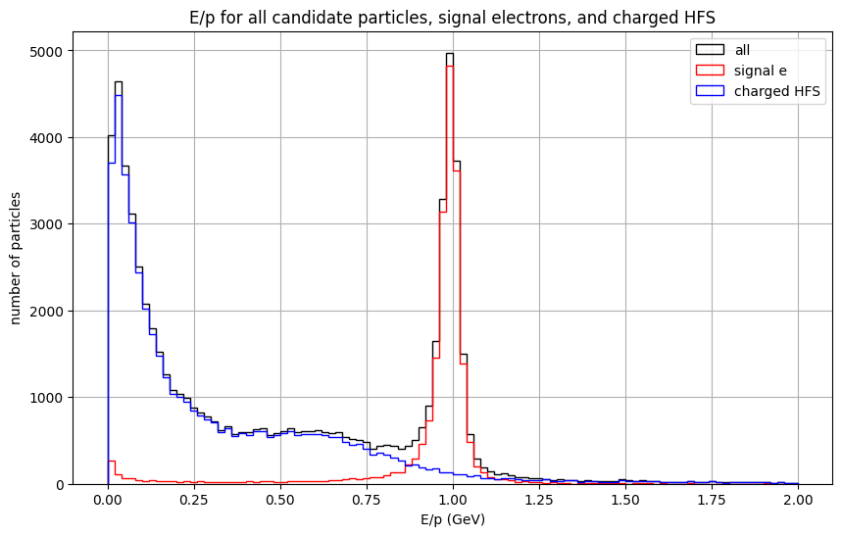
Feature Engineering - E/p
The energy deposited in the ECAL divided by the reconstructed track momentum
Electrons expected to have E/p ~ 1
Hadrons expected to peak at 0, with a tail that decays as E/p increases
Figure 4: The E/p distributions for the 5x41 datasets.
12
Notes:
- Electrons deposit almost all their energy in the ECAL
- tail at 0, is minimum ionisation trail
- some hadrons interact with the ECAL
- unknown signal peak at 0

Slide 13
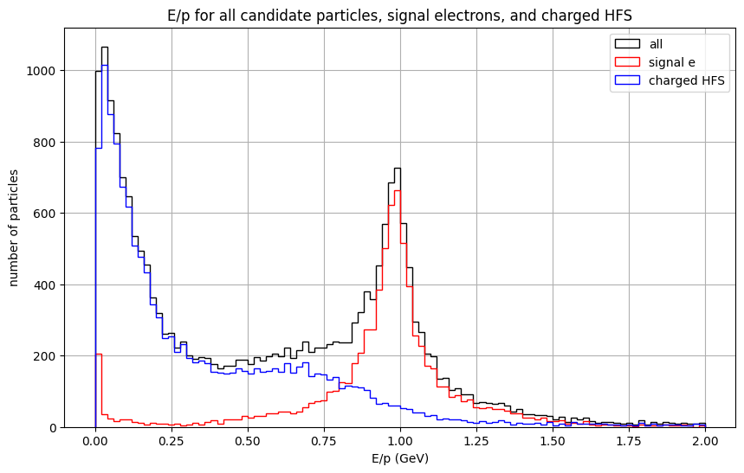
Feature Engineering - E/p
Both show the characteristic peak at E/p ~ 1 for electrons, and E/p ~ 0 for HFS
Both show a hump at E/p ~ 0.6 for the HFS
Much lower statistics for the 18x275 datasets due to detector geometry
Figure 5: The E/p distribution for the 18x275 GeV datasets.
13
Notes:
- same behaviour
- much worse statistics, why?
- detector geometry
- similar ratio of candidate particles to background
- at low Q2, very little deflection, goes straight down beam pipe

Slide 14
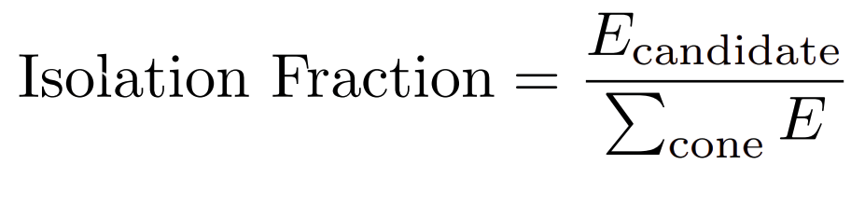
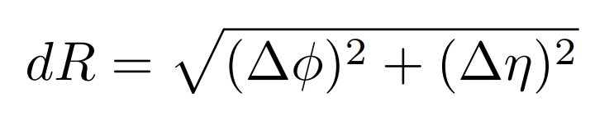
Feature Engineering - Isolation Fraction
Cone defined using pseudorapidity due to its Lorentz Invariance under longitudinal boosts
Potentially useful since the HFS should form a shower that balances the transverse momentum of the scattered electron
14
Notes:
- good for understanding the global context of an event
- define a radius of cone size dR around our particle cluster
- sum all the energy in the cluster including this particle
- divide the candidate
- good for finding particles like high energy pions that look like a scattered electron, but are inside a jet

Slide 15
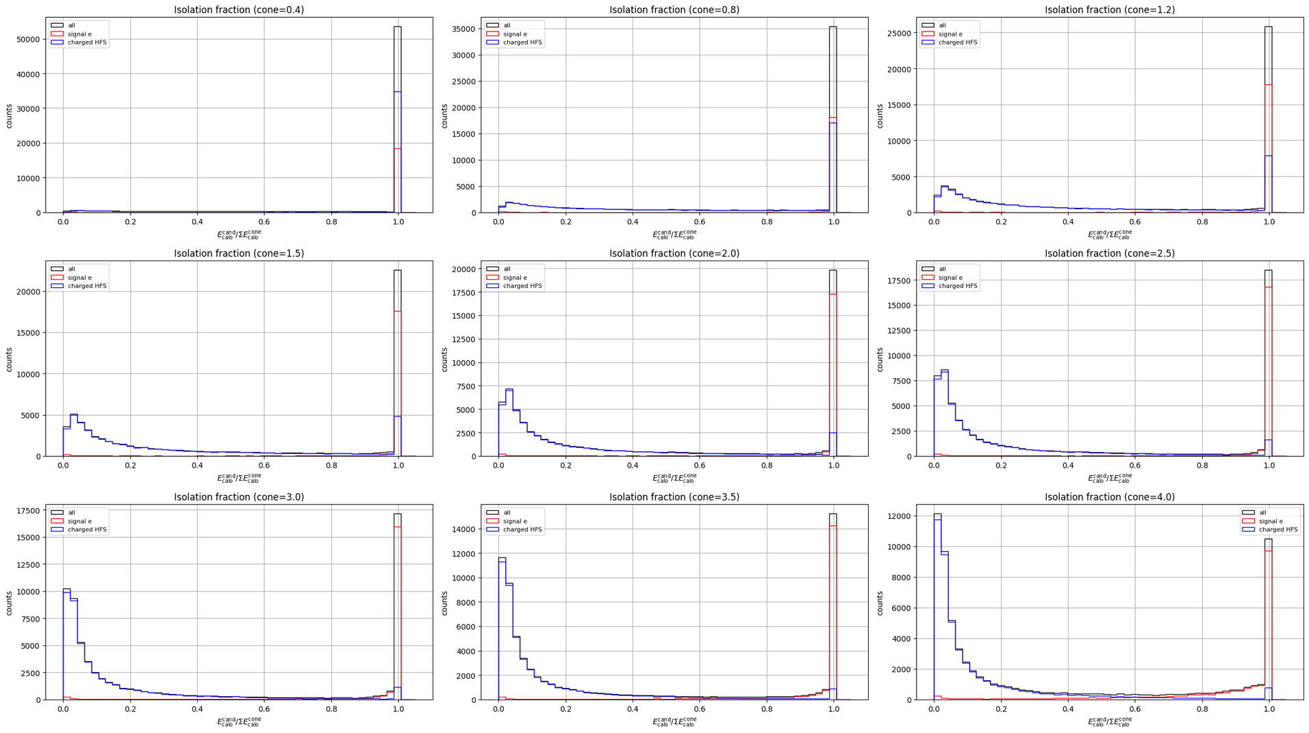
Figure 6: Isolation fraction distributions for the 5x41 GeV datasets for varying cone sizes.
15
Notes:
- started at 0.4, complete failure to discriminate
- using 2.5, its most of the detector, its all the barrel and part of the endcaps
- using 4.0, its the full detector and sweeps back, which 1. isnt physical and is useless, and 2. is essentially a global variable
-

Slide 16
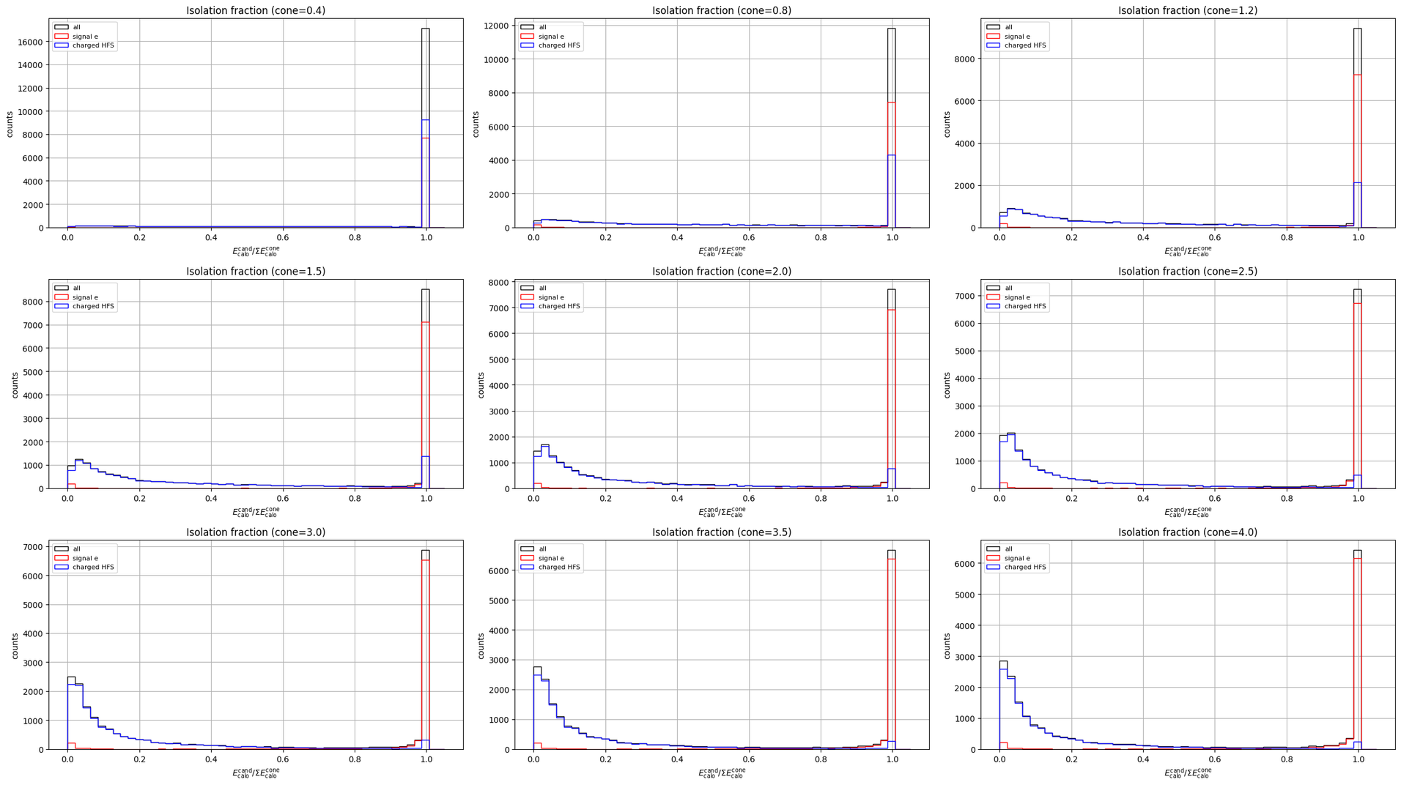
Figure 7: Isolation fraction distributions for the 18x275 GeV datasets for varying cone sizes.
16
Notes:
- similar results for 18x275

Slide 17
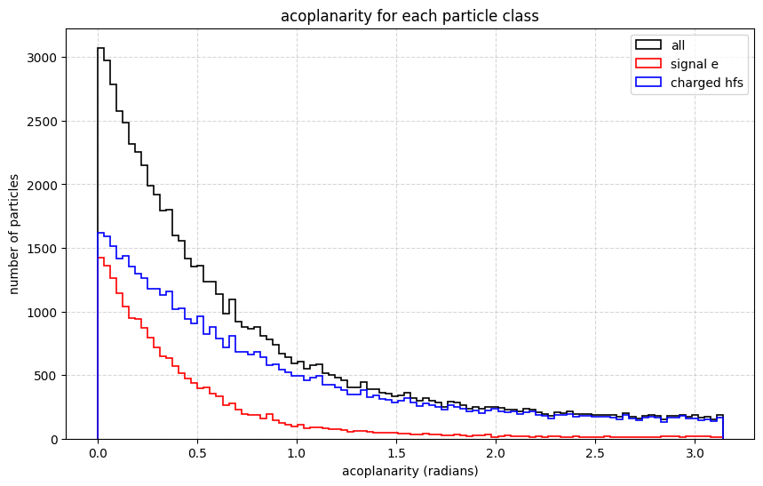
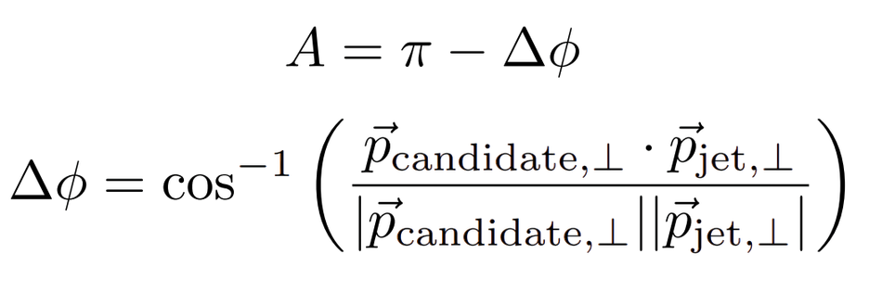
Feature Engineering - Acoplanarity
Expect the scattered electron to peak more sharply at A = 0, as the HFS should form a jet that balances the transverse momentum of the scattered electron
Acoplanarity decays faster for scattered electrons than it does for the HFS
Figure 8: The acoplanarity distribution for the 5x41 GeV datasets.
17
Notes:
- similar to isolation fraction in the reality its trying to measure
- assuming we find all the particles, we expect the transverse mom to balance correctly
- missing particles
- electron has most of the momentum in the event, so missing momentum doesnt affect the percieved angle too much
- for particles in the hfs, the same missing momentum is much more devastating, creating the smear

Slide 18
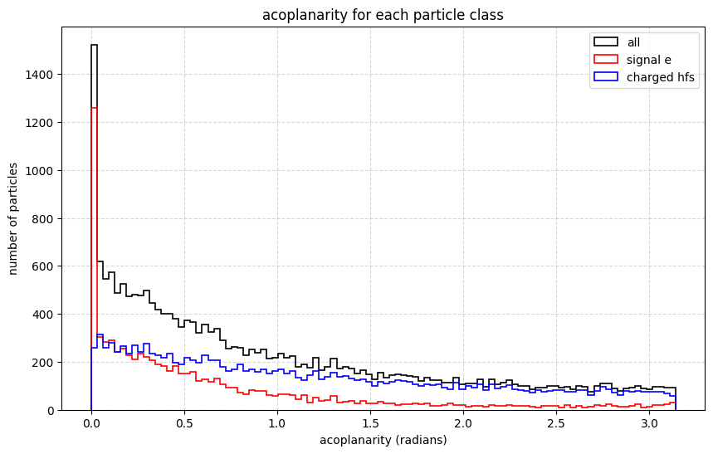
Feature Engineering - Acoplanarity
More pronounced A = 0 peak for scattered electrons for this beam configuration
Faster decay for scattered electrons still present
One would assume that the 18x275 GeV model would use the acoplanarity more for its predictions compared to the 5x41 GeV model
Figure 9: The acoplanarity distribution for the 18x275 GeV datasets.
18
Notes:
- for this reason we see a much more pronounced peak

Slide 19
Other Input Variables
Transverse momentum
Leading Transverse Momentum:
Historically used variable
Electron typically has the greatest transverse momentum per event by momentum conservation
Scalar Transverse Momentum:
Included to allow for the model to learn from the transverse momentum in greater detail
Charge
Scattered electron will always be negative
19
Notes:
- leading transverse momentum is a Boolean
- chosen to also use transverse momentum scalar, as the models can possibly see thresholds that are previously unseen for us

Slide 20
Model Performance
20

Slide 21
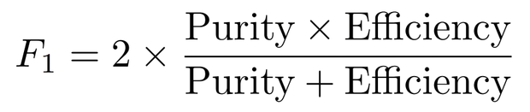
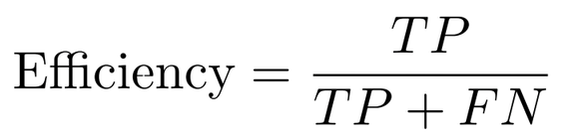
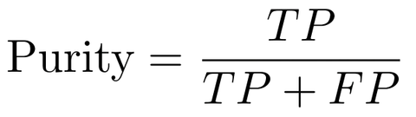
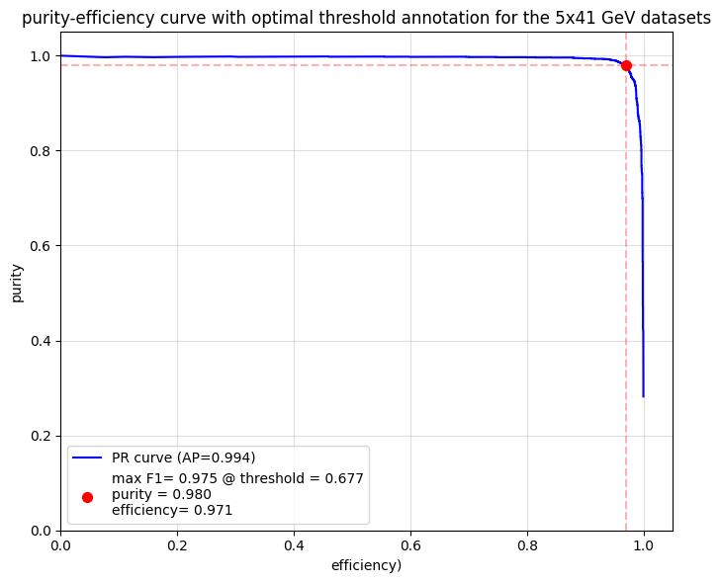
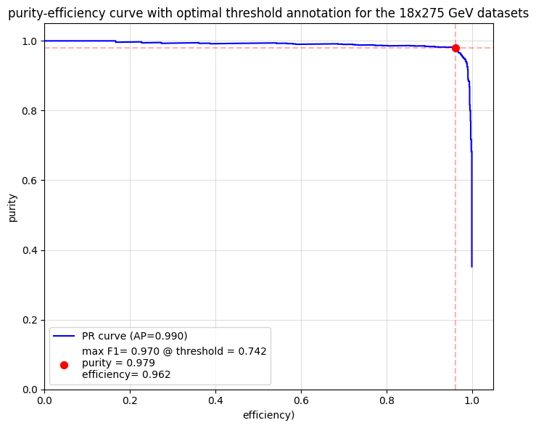
Purity & Efficiency
Figure 10a: The purity-efficiency plot for the 5x41 GeV datasets, along with the purity and efficiency at the “best threshold”.
Figure 10b: The purity-efficiency plot for the 18x275 GeV datasets, along with the purity and efficiency at the “best threshold”.
21
Notes:
- point to purity efficiency
- purity -> of our chosen electrons, how many are right?
- efficiency -> of all the electrons, how many are we finding
- goal is to have a model that performs well in both metrics
- F1 score
- perfect would be a right angle
- both perform very well -> need to further investigate how they perform in certain phase space
- a good score is above 0.8 -> ours is almost too good?
- data leakage and / or lack of noise

Slide 22
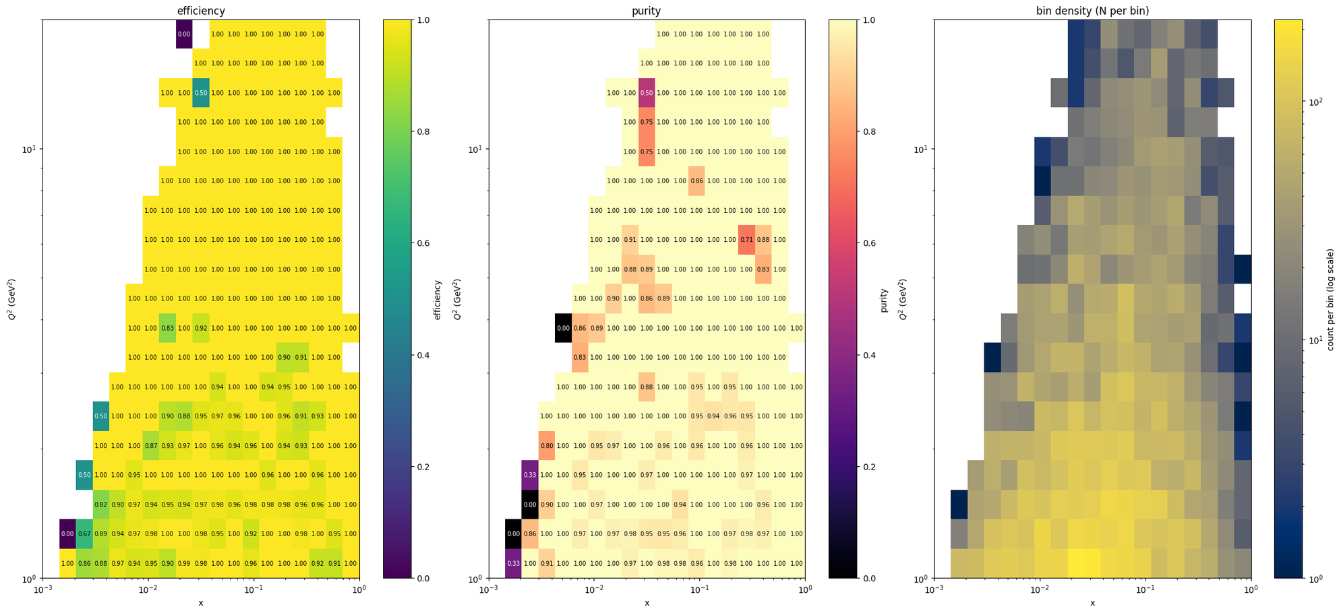
Figure 11: 2D histograms for efficiency (left), purity (middle) and bin density in Q2 - x phase-space, for the 5x41 GeV datasets.
22
Notes:
- the prior curves are good from a ML perspective, need to know how this maps physically
- expect fluctuations at low Q2, these are most interesting too
- almost too good, maybe the MC matching

Slide 23
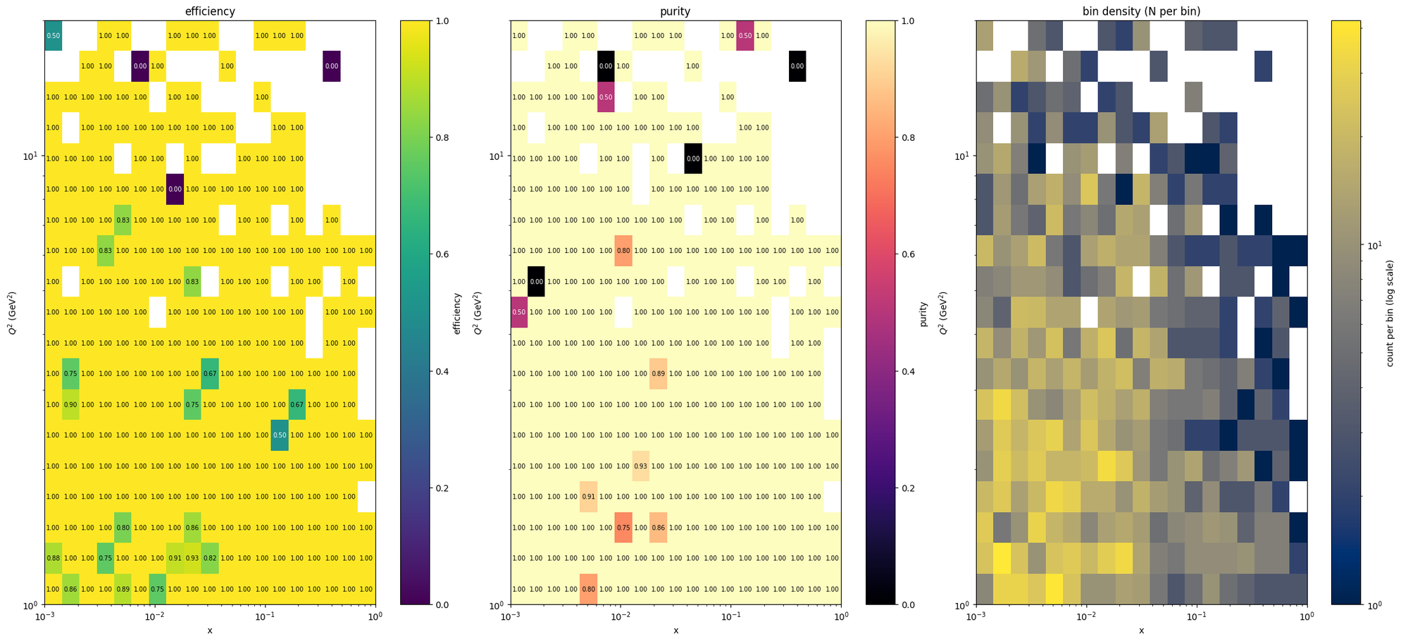
Figure 12: 2D histograms for efficiency (left), purity (middle) and bin density in Q2 - x phase-space, for the 18x275 GeV datasets.
23
Notes:
- the range of Q2 and x is different here
- can reach more low Q2, low x - performs very well
- unfortunately doesnt perform too badly with N bin size - sounds good but points towards lack of noise

Slide 24
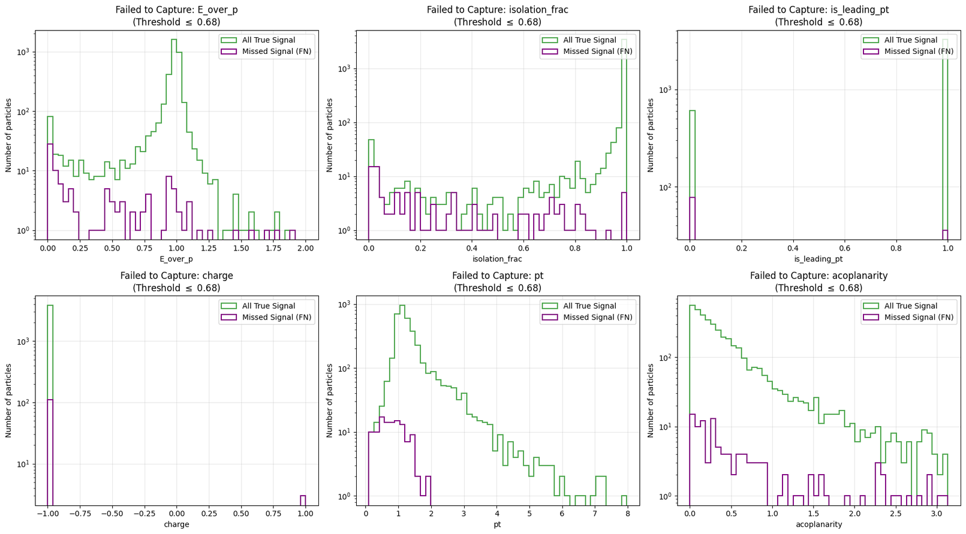
False Negatives
Significant portion of false negatives for scattered electrons with low transverse momentum.
Typically, a low transverse momentum implies a low Q2 event
Leading transverse momentum and isolation fraction fail here
Recommendations
Figure 13: The input variable distributions for false negatives and the true signal, for the 5x41 GeV datasets.
24
Notes:
- low transverse mom fail to capture
- points to isolation fraction and or leading mom failing
- possible that these electrons have lost energy due to radiation beforehand, such as bremsstrahlung
- using reconstructed charge, possible that the particles being counted as +1 charge have p large enough such that the charge is mis constructed
- will do further testing

Slide 25
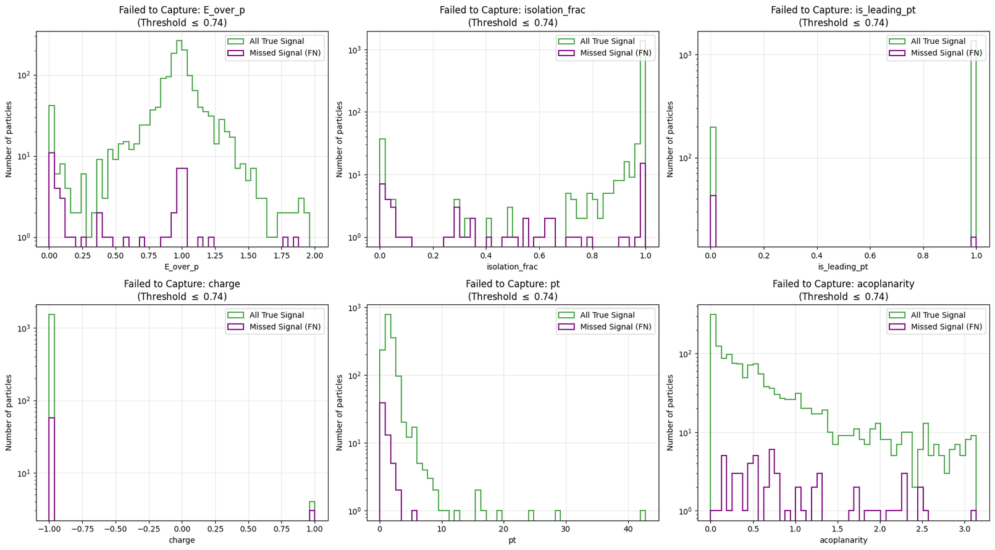
False Negatives
Same low transverse momentum behaviour for this beam configuration
More statistics required to further confirm
Figure 14: The input variable distributions for false negatives and the true signal, for the 18x275 GeV datasets.
25

Slide 26
XGBoost effectively identifies scattered electrons at the particle level, achieving >97% purity and efficiency across varying beam energies.
01
The purity and efficiency of the model shows consistent performance across the accessible Q2 - x phase space.
Conclusion
02
Identified regions of lower performance for certain input variables.
03
26

Slide 27
Further Goals
Immediate Steps
Extended Goals
Pivot from index matching to geometric matching to test the model further
Introduce more discriminating variables, such as E/H
Increase the number of 18x275 GeV datasets used
Reproduce distributions of the Bjorken variables to test for bin migration
Test model on messy datasets that include background processes
Design an event-level model that rejects events with no DIS interaction using E - pz
Consider applying the currently engineered features to a Deep Neural Network (such as PyTorch) if time permits
27
Notes:
- E - pz peaks at 2 x beam energy if the scattered electron didnt go down th beam pipe
-

Slide 28

28

Slide 29
References
Radovic A, Williams M, Rousseau D, Kagan M, Bonacorsi D, Himmel A, et al. Machine learning at the energy and intensity frontiers of particle physics. Nature. 2018 Aug;560(7716):41–8. doi:10.1038/s41586-018-0361-2
Chen T, Guestrin C. XGBoost: A Scalable Tree Boosting System. In: Proceedings of the 22nd ACM SIGKDD International Conference on Knowledge Discovery and Data Mining [Internet]. 2016 [cited 2025 Dec 10]. p. 785–94. Available from: http://arxiv.org/abs/1603.02754 doi:10.1145/2939672.2939785
Khalek RA, Accardi A, Adam J, Adamiak D, Akers W, Albaladejo M, et al. Science Requirements and Detector Concepts for the Electron-Ion Collider: EIC Yellow Report. Nuclear Physics A. 2022 Oct;1026:122447. doi:10.1016/j.nuclphysa.2022.122447
29

Slide 30
Extra Information
30

Slide 31
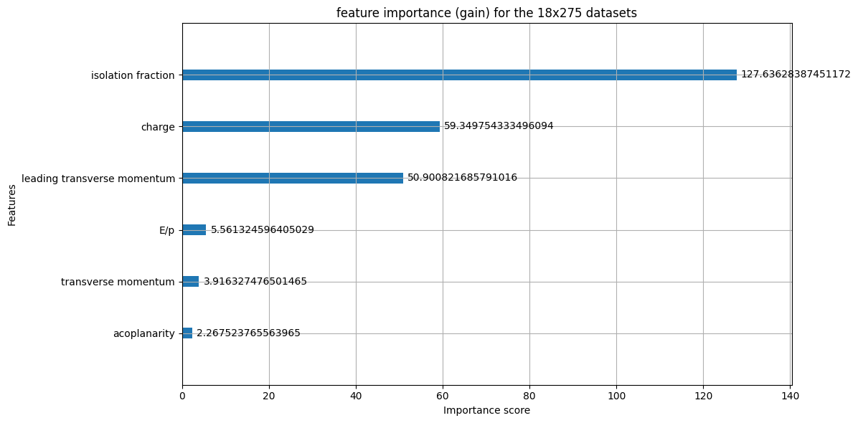
Feature Importance
Figure 15: The gain-type feature importance for the 18x275 datasets.
31

Slide 32
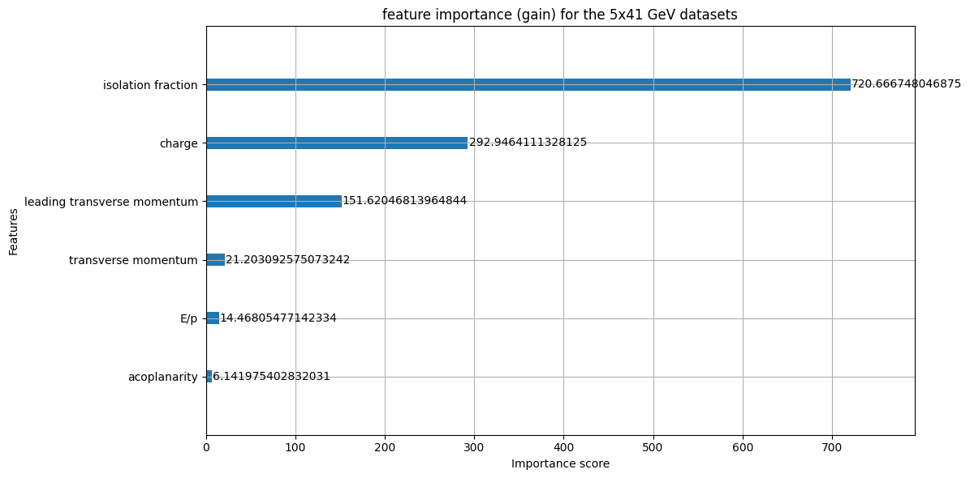
Feature Importance
Figure 16: The gain-type feature importance for the 5x41 datasets.
32

Slide 33
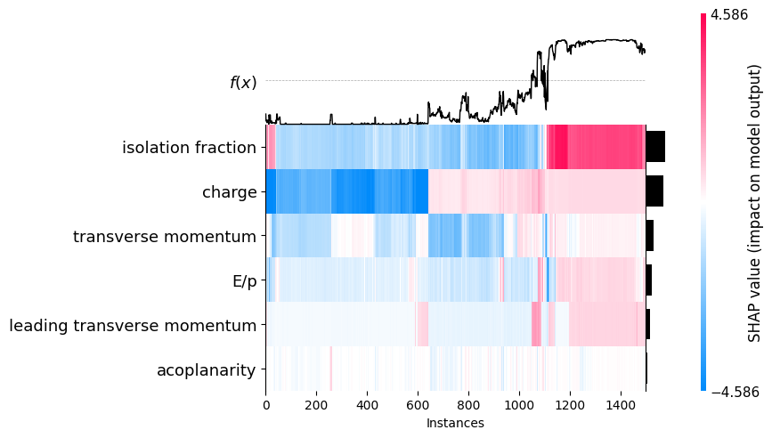
SHAP Heatmap
Figure 17: The SHAP heatmap for the 5x41 GeV datasets.
33

Slide 34
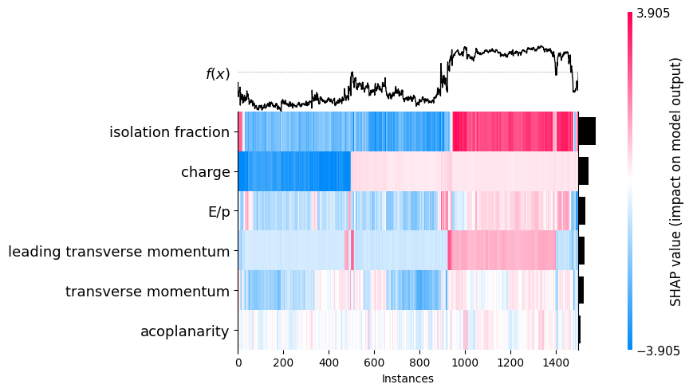
SHAP Heatmap
Figure 18: The SHAP heatmap for the 18x275 GeV datasets.
34

