Slide 1
Electron Finder cluster matching
Diego Cristancho
Barak Schmookler

Slide 2
Truth match method inside the electron finder
-Start from the MC scattered electron.
-Use truth associations to find the matched reconstructed particle in the ReconstructedParticles collection.
-Study the reconstructed tracks and clusters attached to that matched reconstructed particle (electron).

Slide 3
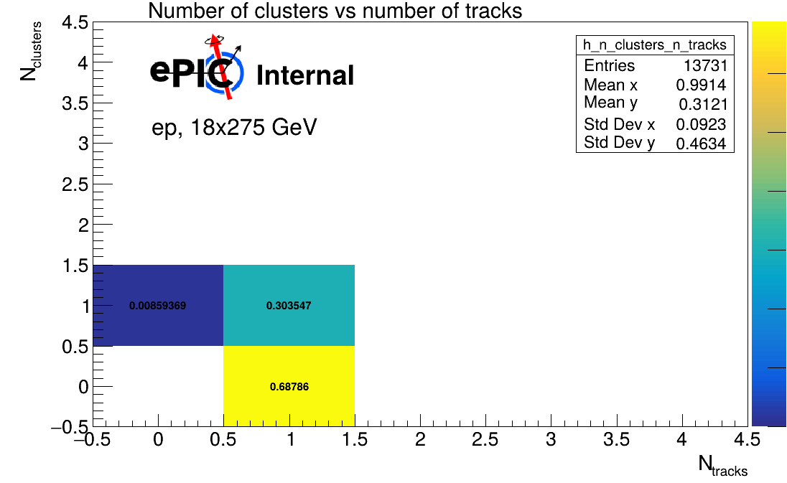
Old Number of clusters vs tracks plot
root://dtn-eic.jlab.org//volatile/eic/EPIC/RECO/25.08.0/epic_craterlake/DIS/NC/18x275/minQ2=100/pythia8NCDIS_18x275_minQ2=100_beamEffects_xAngle=-0.025_hiDiv_1.0000.eicrecon.edm4eic.root
18x275 beams with Q²>100 Gev²
-The dominant population is track-only matched electrons.
-Full track + cluster association is present, but not dominant.
-Cluster-only matched electrons are rare.
0.00859

Slide 4
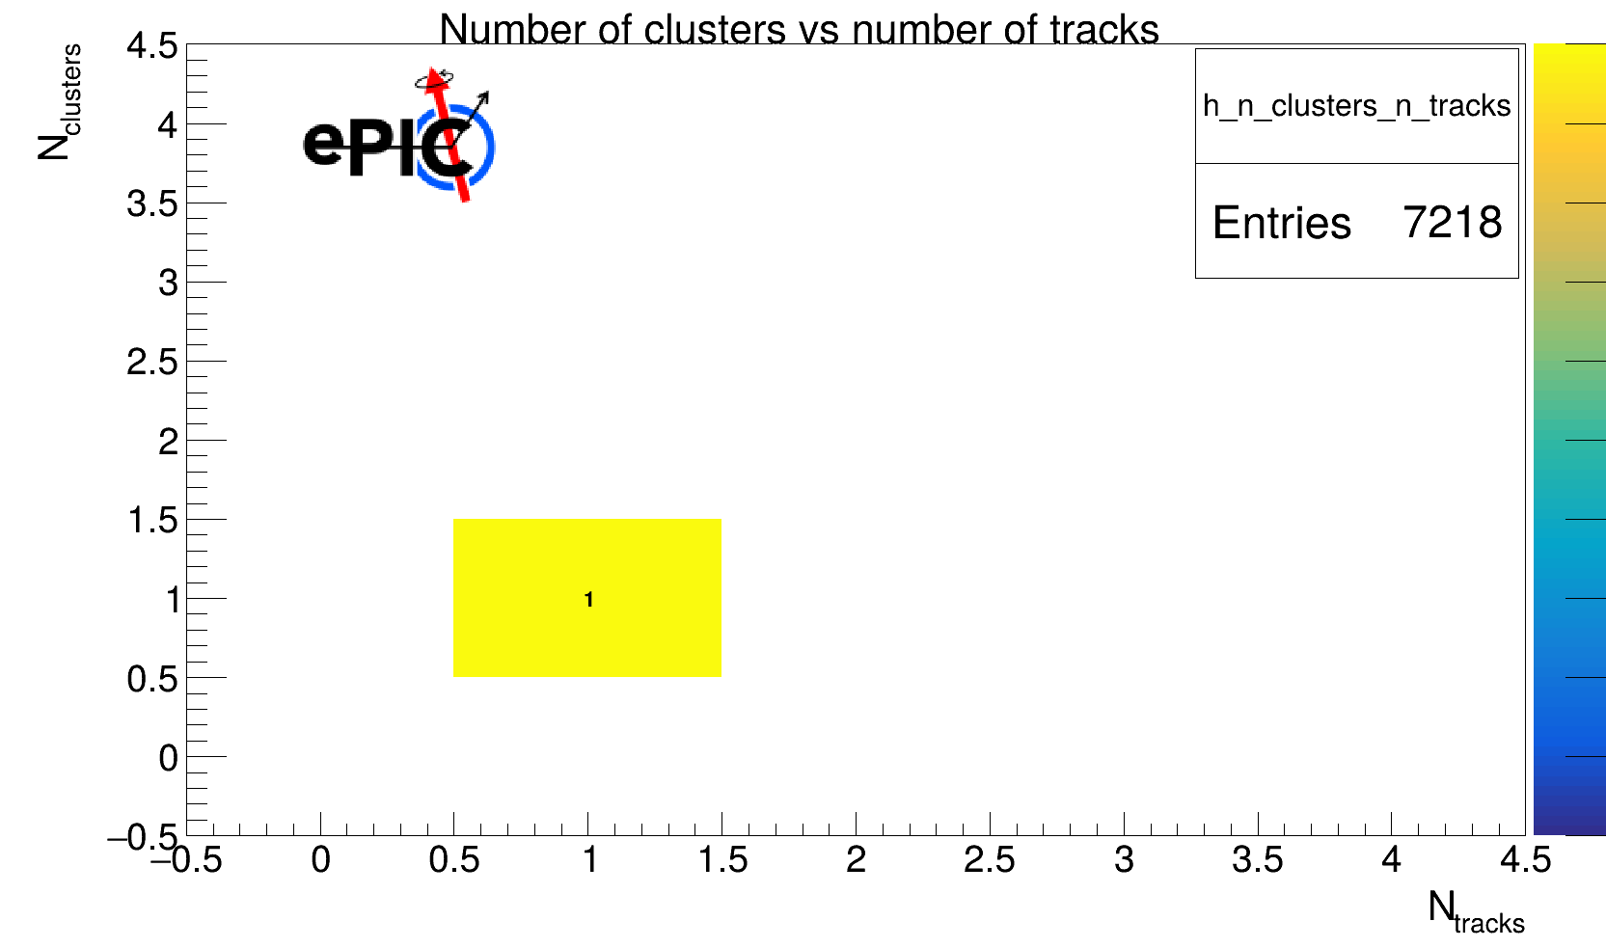
Using single electron simulations
root://dtn-eic.jlab.org//volatile/eic/EPIC/RECO/26.02.0/epic_craterlake/SINGLE/e-/5GeV/45to135deg/e-_5GeV_45to135deg.0000.eicrecon.edm4eic.root
5 Gev single electrons
-In the single-electron sample, all events fall in the (1 track, 1 cluster) bin.
-No track-only or cluster-only matched electrons are observed in this sample.
-The result is consistent with ideal reconstruction and association for isolated single electrons.

Slide 5
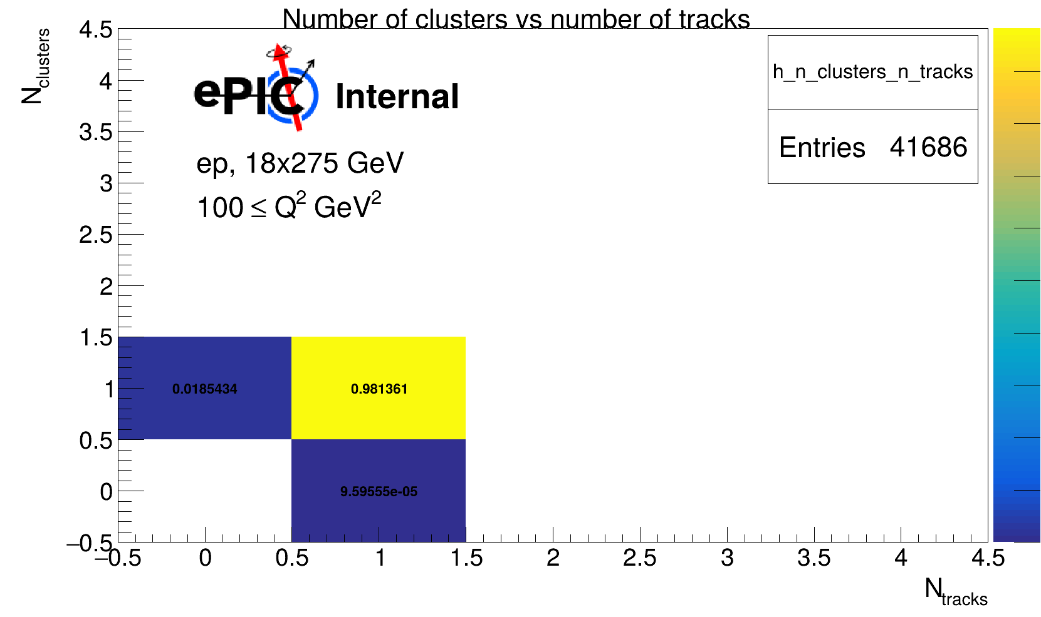
Updated clusters vs number of tracks plot
root://dtn-eic.jlab.org//volatile/eic/EPIC/RECO/26.02.0/epic_craterlake/DIS/NC/18x275/minQ2=100/pythia8NCDIS_18x275_minQ2=100_beamEffects_xAngle=-0.025_hiDiv_1.0000.eicrecon.edm4eic.root
18x275 beams with Q²>100 Gev²
-Compared with the old reconstruction, the dominant population moved from track-only to track + cluster.
-Dominant bin: 1 track, 1 cluster (~98%)
-The new result is much closer to the behavior seen in the single-electron test sample.

Slide 6
For the future
-Use track projections instead of truth matching for the tracks and clusters.
-Estimating the final pion/electron contamination using the low Q² events.

