Slide 1




BTOF loading
Dr. Simone M. Mazza (SCIPP, UC Santa Cruz)
For the BTOF/FTOF group

Slide 2
Questions/Comments
What loading precision do we require?
When Jigs/Tooling need to be ready? Useful to have them while loading the 10 stavelets to develop process
Figure out the material budget impact and if it’s fine
Figure out right carrier for shipping (might know already)
Need to figure out importing if Japan pays for components

Slide 3
Pickup jig
Vacuum jig to pickup loaded stavelet and assemble with stave
UIC first version almost ready
Glue to stave? Assemble with screws?
This step NOT at UCSC, Purdue or BNL? UV glue likely not working
Precision pin
screw?
Vacuum nozzles
Thermal paste
Glue?
Full stave

Slide 4
Loading jig
Component loading jig
Back support (vacuum) with pins
Loading component that goes on pins
Precision pins needed
Other option: pick and place loading
Need pick and place machine
Back jig will stay with stavelet during wire bonding
Component ‘press’ jig
Soft material
ASIC
Sensor
Slots
Precision pin
Deposited glue
Interposer FPC

Slide 5
Shipping jig
Houses multiple stavelets for shipping
Backside and frontside ‘clamping’ with soft material the components
Stavelet

Slide 6
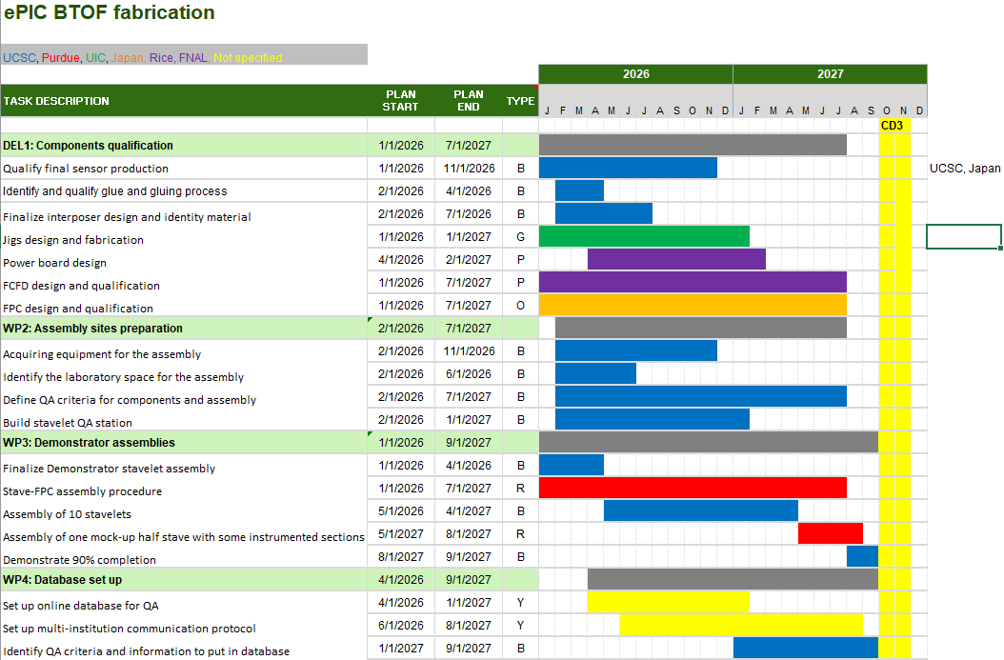

Slide 7
Backup

Slide 8
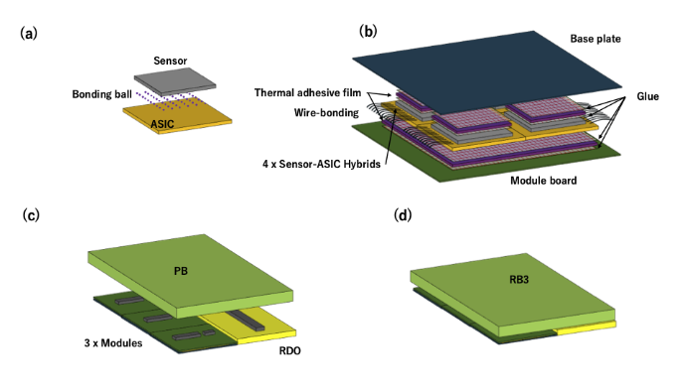
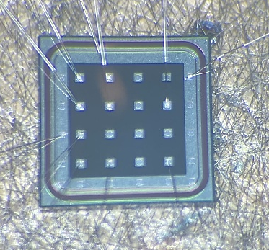
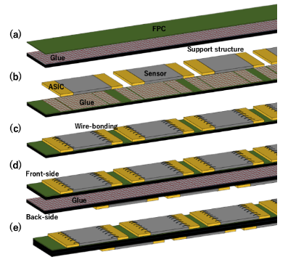
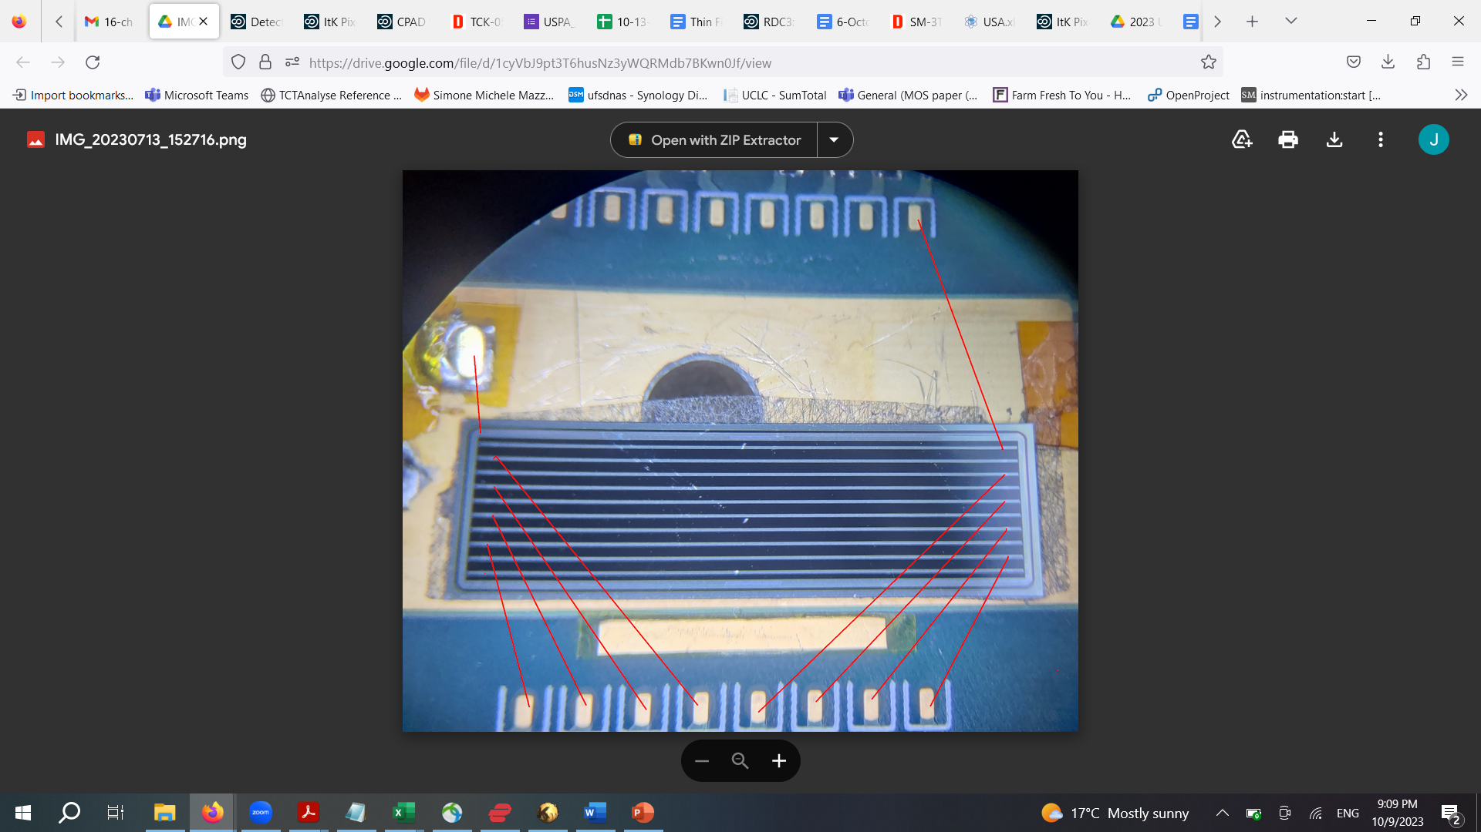
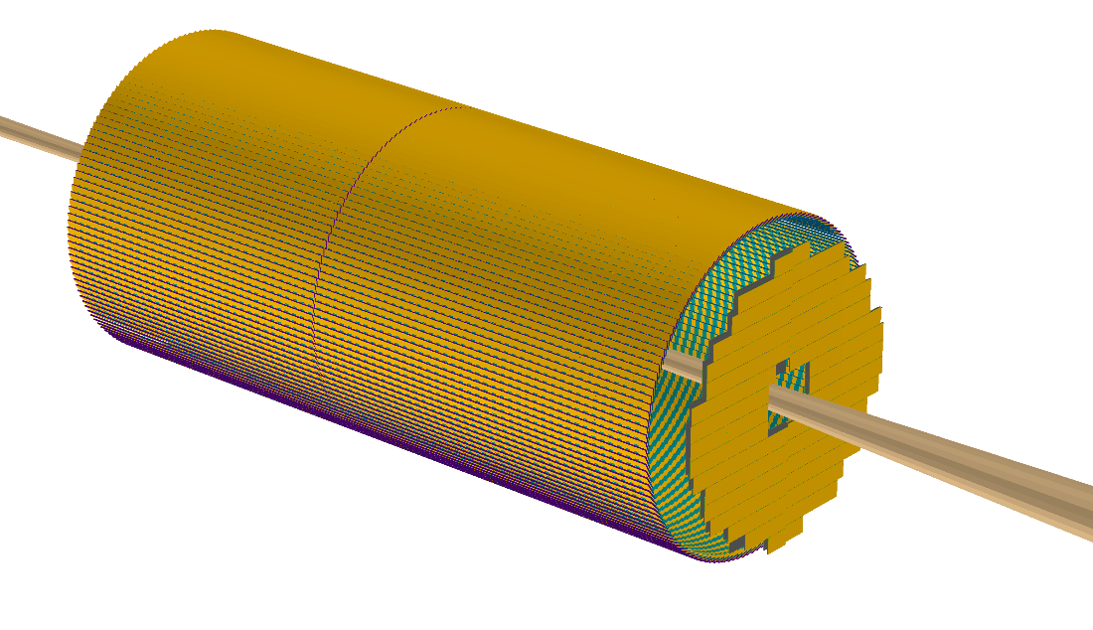
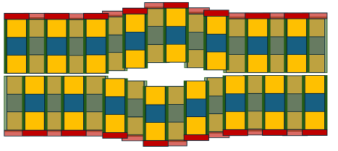
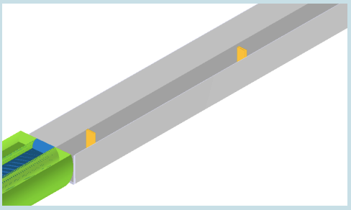
TOF layout in ePIC
Sensors: pixels
Readout: EICROC
Divided in two halves
Sensors: strips
Readout: FCFD
(outdated figures)
Sensors: pixels
Readout: EICROC
Off-Momentum Detectors (OMD)
(mostly outdated schematics)

Slide 9
Stave Assembling Steps (Opt1)
Sensor + ASIC
Module Assembly Site
Glue dispenser
Wire bonding
Interposer
FPC
Support structure (Carbon fiber)
FPC
Module-to-Module bonding machine
Cooling pipe and return (10-20C)
Stave Front/Back
Final Construction Site
Glue dispenser

Slide 10
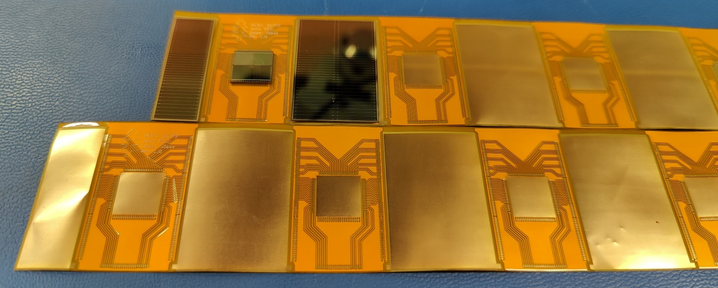
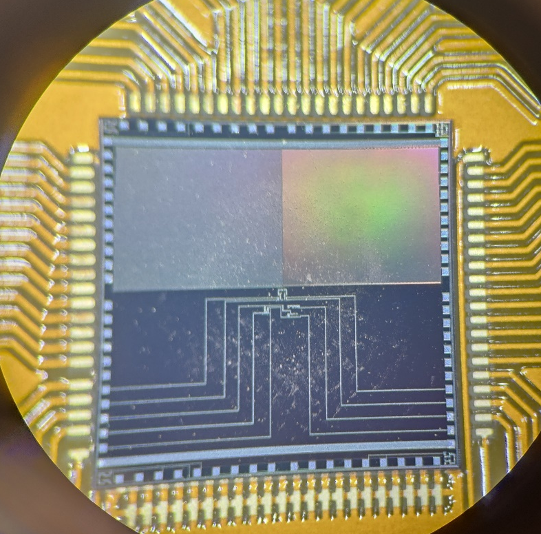
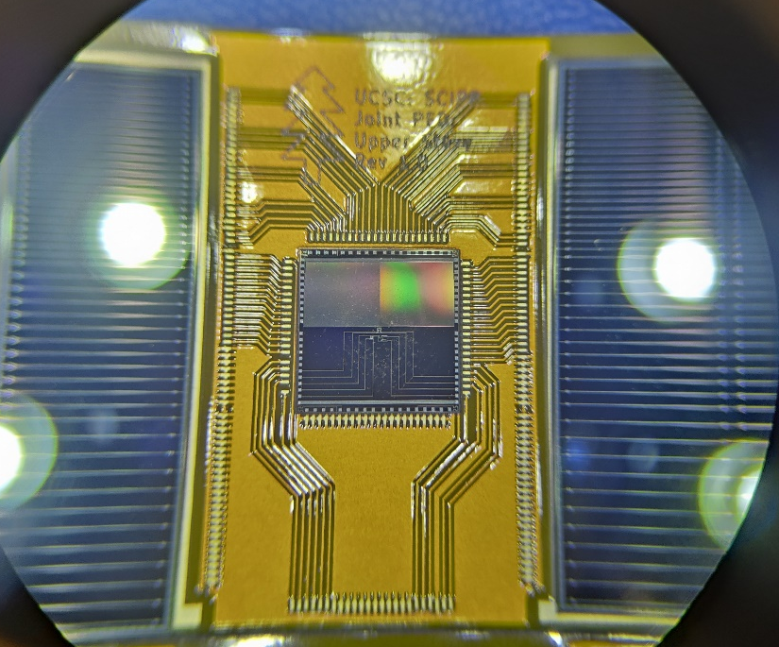
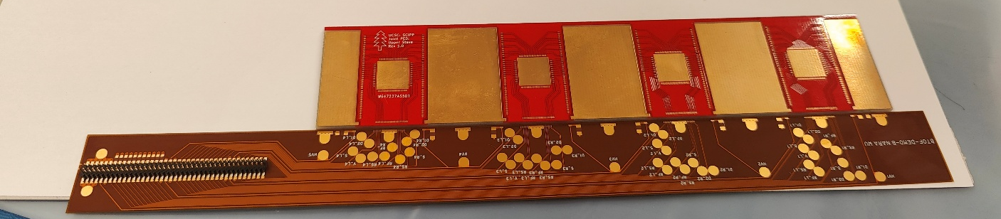
Stavelet demonstrator - 2025
Plan to demonstrate the assembly procedure and study the thermal characteristic of a stavelet
First prototype of interposer board produced
Using non-working detectors from the HPK production
Si heaters to simulate ASIC
Fully load a double-sided stavelet with active pipe cooling and check thermal dissipation in prototype

Slide 11
Data Transmission
Half-Stave = 8 x Modules = ~ 1320 [mm]
Front-side
Back-side
Module (Stavelet) ~ 160 [mm]
3 x 8 x 2 x 288
=13824
8 x 2 x 288 =4608
2 x 8 x 2 x 288
=4608

