Slide 1
Stave Assembling Steps (current design)
Sensor + ASIC
Module Assembly Site
Glue dispenser
Wire bonding
Interposer
FPC
Support structure (Carbon fiber)
FPC
Module-to-Module bonding machine
Cooling pipe and return (10-20C)
Stave Front/Back
Final Construction Site
Glue dispenser

Slide 2
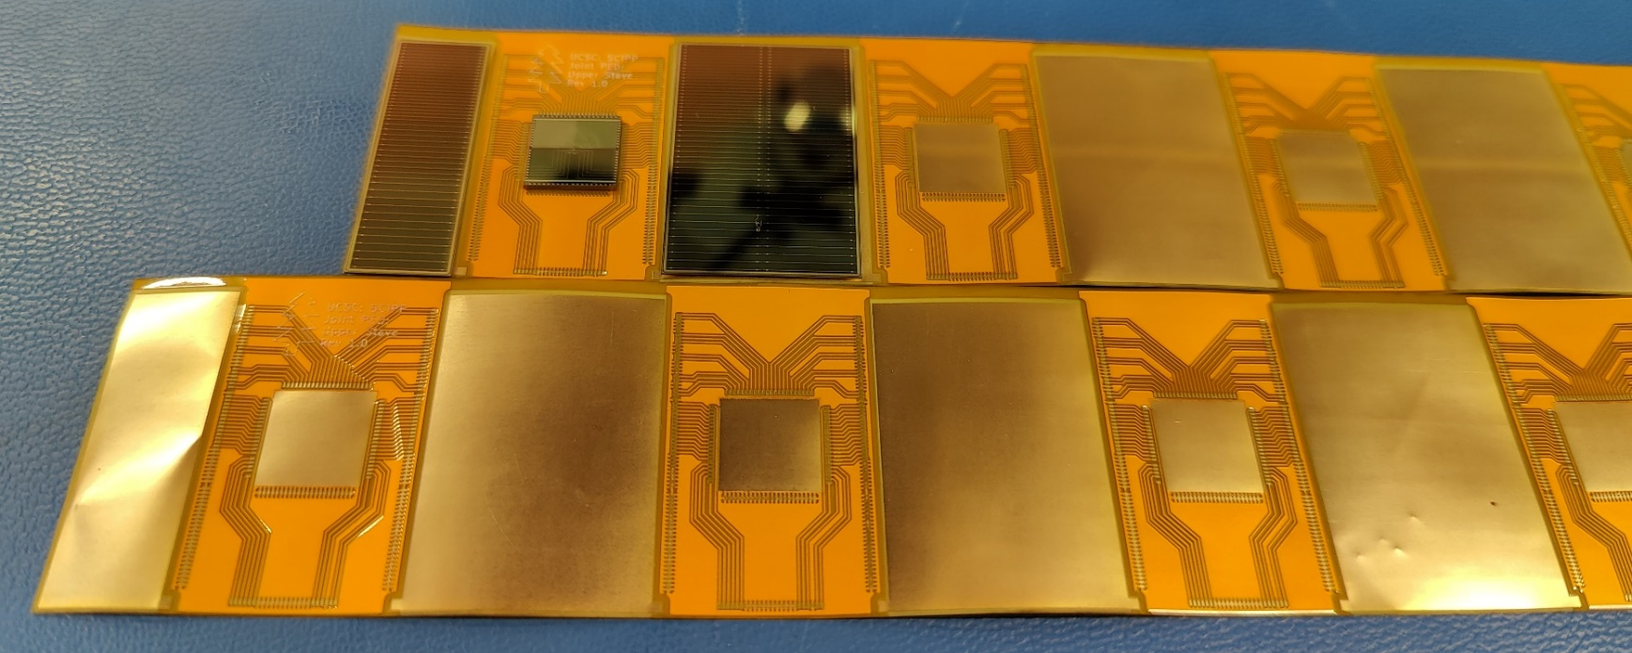
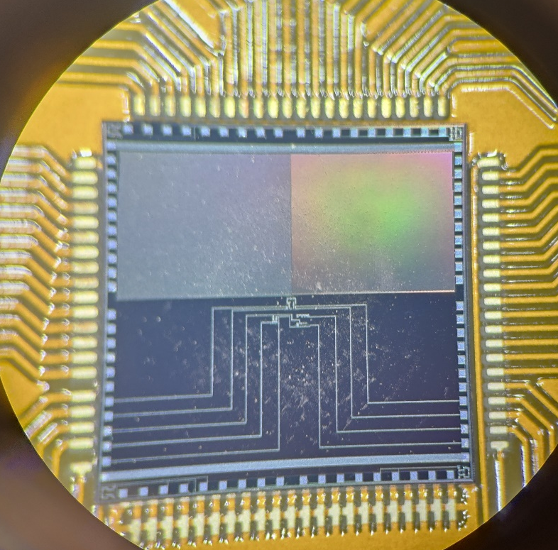
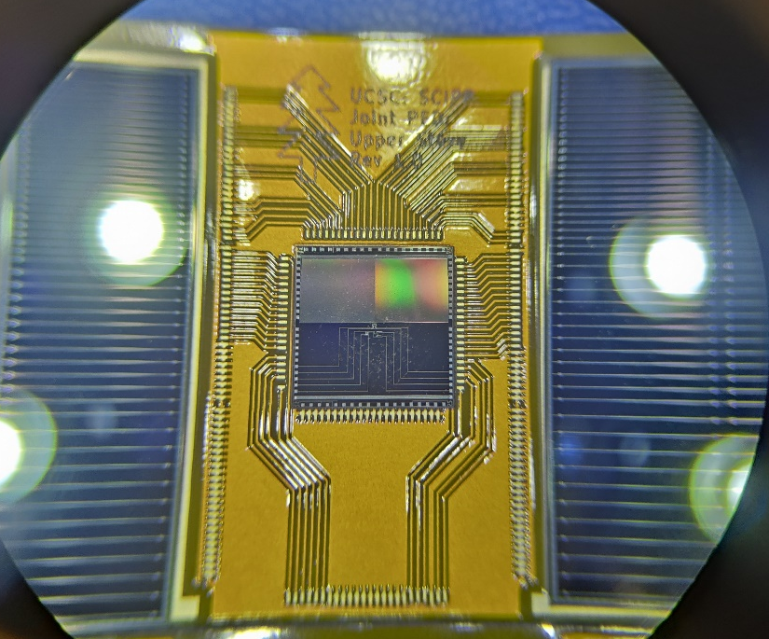
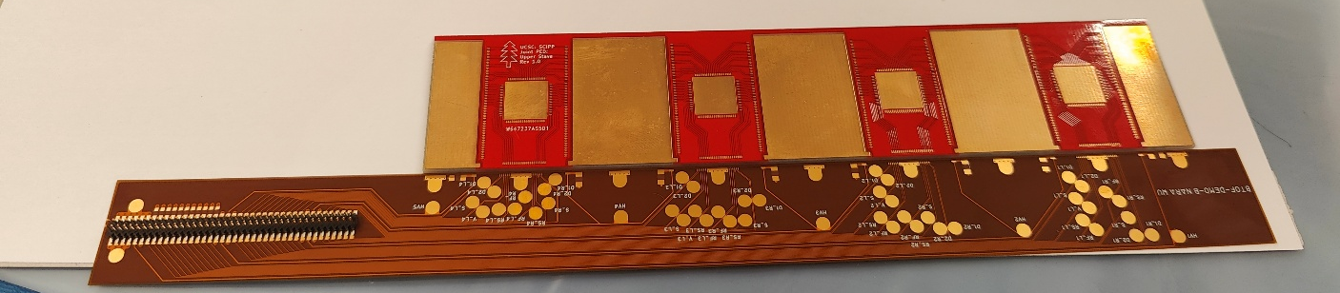
Stavelet demonstrator - 2025
Plan to demonstrate the assembly procedure and study the thermal characteristic of a stavelet
First prototype of interposer board produced
Using non-working detectors from the HPK production
Si heaters to simulate ASIC
Fully load a double-sided stavelet with active pipe cooling and check thermal dissipation in prototype

Slide 3
Changes to discuss
Change 1:
  4 FCFD daisy-chained instead of a single one with traces on the interposer board
  Pro: avoid traces between sensor and chip
  Cons: daisy chaining

Slide 4
Discussion with FCFD developers
Fan-in lines can be an issue for the chip readout, degrade the signal and introduce extra capacitance
Solution: use 4 chips per 2 half-sensors, long and narrow with same pitch as sensor
  Direct connection to sensor
4 chips will be condensed in only one set of lines, no increase in connections
Stavelet design remains the same, we can’t split in the middle the interposer (need lines between chips)
FCFD
To FPC

Slide 5
Changes to discuss
Change 2:
  Using concentrator chip to group together ASICs in each interposer board
  Pro: less traces on FPC, better communication. Less wire-bonding at stave level
  Cons: concentrator chip has to be designed!

Slide 6
Current data Transmission
Half-Stave = 8 x Modules = ~ 1320 [mm]
Front-side
Back-side
Module (Stavelet) ~ 160 [mm]
3 x 8 x 2 x 288
=13824
8 x 2 x 288 =4608
2 x 8 x 2 x 288
=4608

Slide 7
Data Transmission – using concentrator
Half-Stave = 8 x Modules = ~ 1320 [mm]
Front-side
Back-side
Module (Stavelet) ~ 160 [mm]

Slide 8
Changes to discuss
Change 3:
  Change interposer board material and design
  Pro: more rigid object, easier to glue. Better thermal connection for chips
  Cons: more material, need to check effect

Slide 9
Module (Stavelet) ~ 160 [mm]
Interposer material: FPC (1 metal layer)
600 [mm]
Hole under chip with ‘frame’
Sensor is glued to frame during assembly
When loaded on stave fill hole with thermal paste
→ Better thermal connection with stave
Sensor
(ASIC)
Interposer
FPC
Module (Stavelet) ~ 160 [mm]
Interposer material: Ceramic/Alumina
(1 metal layer)
Thickness 250um
(might go down to 150um)
8 x 2 x 288 =4608
600 [mm]
Sensor
FCFD
(ASIC)
Interposer
FPC
Add holes in the interposer/FPC for alignment pins (could use screws)

Slide 10
Changes to discuss
Change 4:
  Co-cure vs Co-bond FPC
  Issue with co-cure, might risk fracturing the FPC due to high temperature of curing
    Might be less of an issue with a different glue and curing process
  Co-bond (gluing after curing) can solve this, but need to understand thermal connection

Slide 11
Changes to discuss
Change 5:
  Flipped stave assembly with ladder structure of the tray
  Pro: sturdier and easier to assembly tray
  Cons: accommodate SH (might need spacers)

Slide 12
Side view
Current setup
The stave is 6cm divided in 2
  Half for sensor/chip and half for FPC lines
New idea:
Flip the components on the two sides during gluing
Get 100% coverage when assembled in ‘ladder’
Sensor/chip
FPC
Cooling pipes
Stave
Sensor/chip
FPC

Slide 13
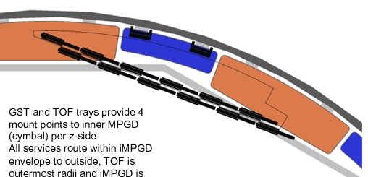
Ladder assembly
From Andreas with current design
  Might be hard to support and connect
New design
  Assemble in ‘ladders’ in each tray, much more solid
  Spacer/support on the FPC between different staves
  Same assembly procedure, change during stave final gluing

Slide 14
Support?
Example assembly

