Slide 1
Outer MPGD Detector Cooling
Girish Gowda
Mechanical Engineer
I^3 Engineering Meeting
March 23rd, 2026

Slide 2
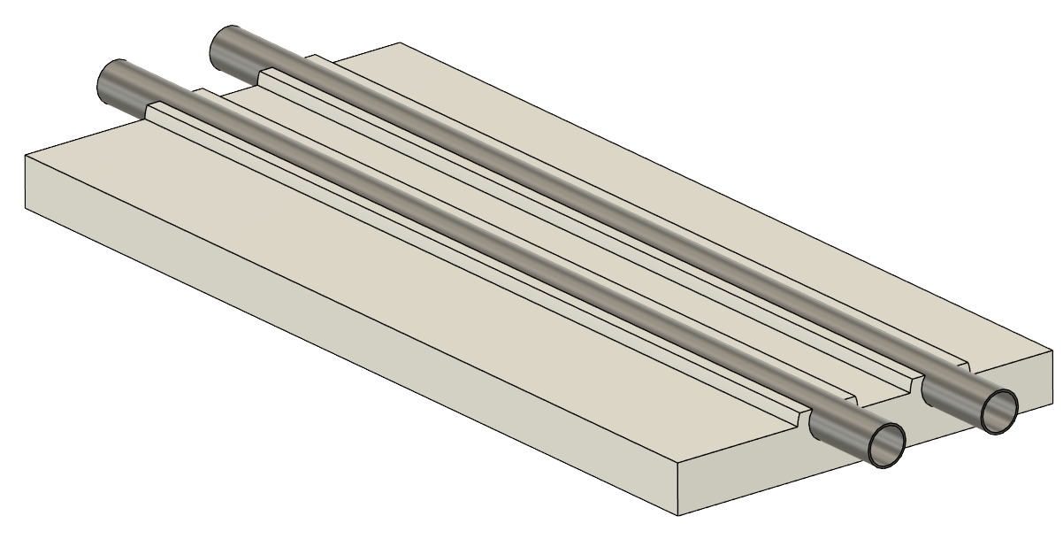
Heatsink
Hot Water Return
Cold Water Feed
SS (304) Pipe embedded Aluminum Heatsink.
304 Stainless steel (~16.5 W/mK)
6063 Aluminum (200 W/mk)

Slide 3
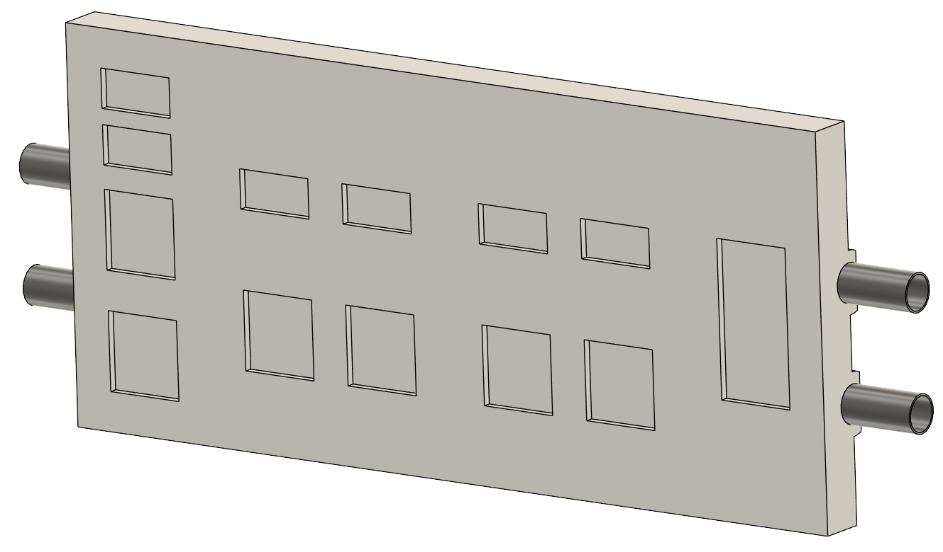
Components
Number | Name | Power (mW)
1 | DC/DC | 4400
2 | SALSA1 | 1800
3 | SALSA2 | 1800
4 | SALSA3 | 1800
5 | SALSA4 | 1800
6 | LDO_S1 | 450
7 | LDO_S2 | 450
8 | LDO_S3 | 450
9 | LDO_S4 | 450
10 | LDO_lpgbt | 156
11 | LDO_VTRX | 875
12 | lpGBT | 600
13 | VTRX | 175
 | TOTAL | 15,206
10
11
9
8
12
7
6
13
5
4
1
3
2

Slide 4
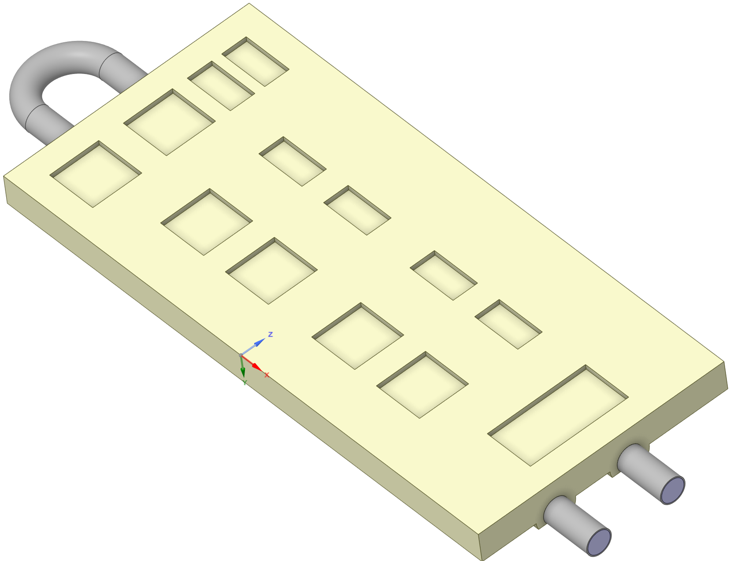
Outer MPGD Detector – Heat Load
Component | Power | Power | Area | Area | Heat Flux
 | mW | W | mm^2 | m^2 | W/m^2
DC/DC | 4,400 | 4.4 | 200 | 0.0002 | 22,000
SALSA | 1,800 | 1.8 | 100 | 0.0001 | 18,000
SALSA | 1,800 | 1.8 | 100 | 0.0001 | 18,000
SALSA | 1,800 | 1.8 | 100 | 0.0001 | 18,000
SALSA | 1,800 | 1.8 | 100 | 0.0001 | 18,000
LDO | 450 | 0.45 | 50 | 0.00005 | 9,000
LDO | 450 | 0.45 | 50 | 0.00005 | 9,000
LDO | 450 | 0.45 | 50 | 0.00005 | 9,000
LDO | 450 | 0.45 | 50 | 0.00005 | 9,000
LDO lpGBT | 156 | 0.156 | 50 | 0.00005 | 3,120
LDO VTRX | 875 | 0.875 | 50 | 0.00005 | 17,500
lpGBT | 600 | 0.6 | 100 | 0.0001 | 6,000
VTRX | 175 | 0.175 | 100 | 0.0001 | 1,750
 | 15206 | 15.206
Outlet
Inlet
Components Heat load data
Single FEB model

Slide 5
Outer MPGD Detector – Single FEB Heat Load
Temperature rise 0.5 C
Temperature rise 2 C
FEB | 15.2 | W
with margin | 16 | W
dT | 0.5 | C
Cp | 4181 | J/kg C
m | 0.00741 | kg/s
m | 0.00741 | l/s
m | 7.41 | ml/s
FEB | 15.2 | W
with margin | 16 | W
dT | 2 | C
Cp | 4181 | J/kg C
m | 0.00185 | kg/s
m | 0.00185 | l/s
m | 1.853 | ml/s
Velocity | 0.467 | m/s
Velocity | 0.1168 | m/s
Re | 2198 | Laminar
Re | 549.53 | Laminar
Inlet water Temperature | 22 | C
Ambient Temperature | 23.3 | C

Slide 6
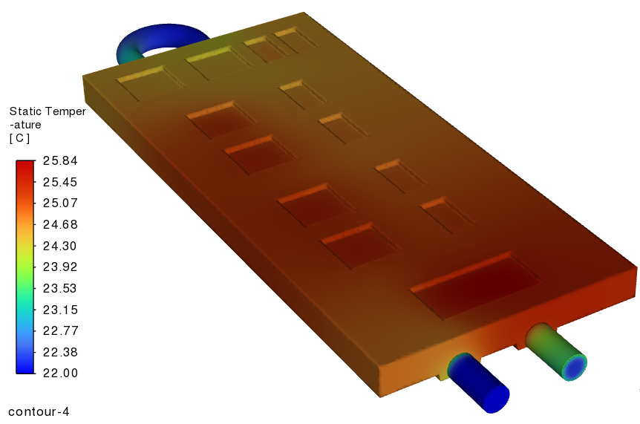
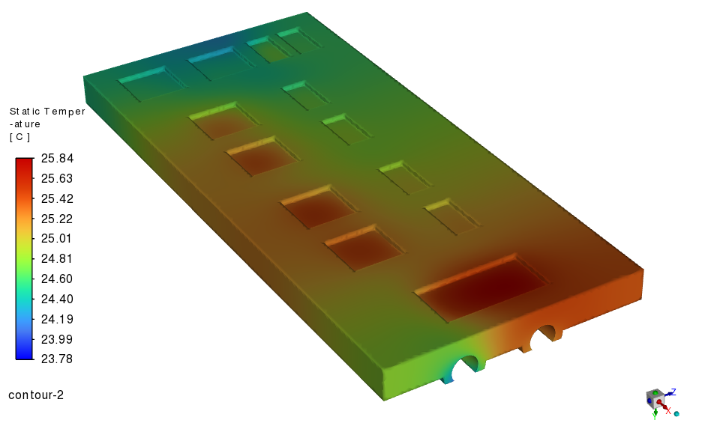
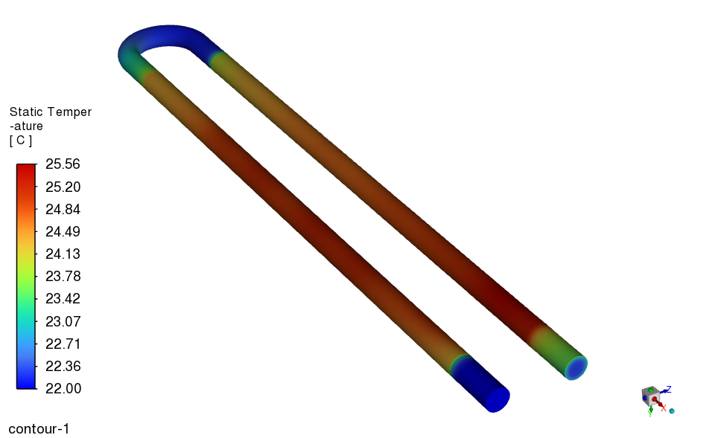
Results – 0.5C temperature rise, inlet temperature 22C
Temperature distribution

Slide 7
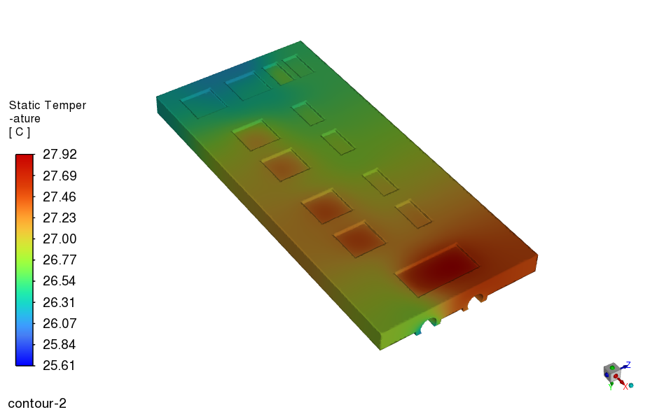
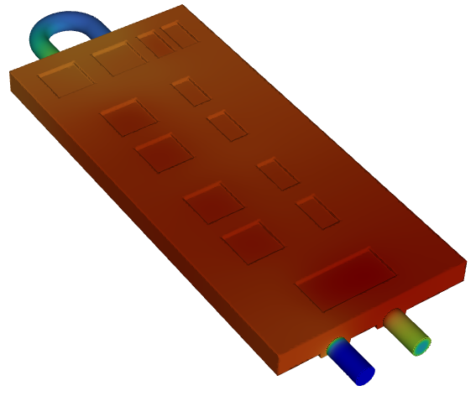
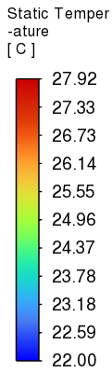
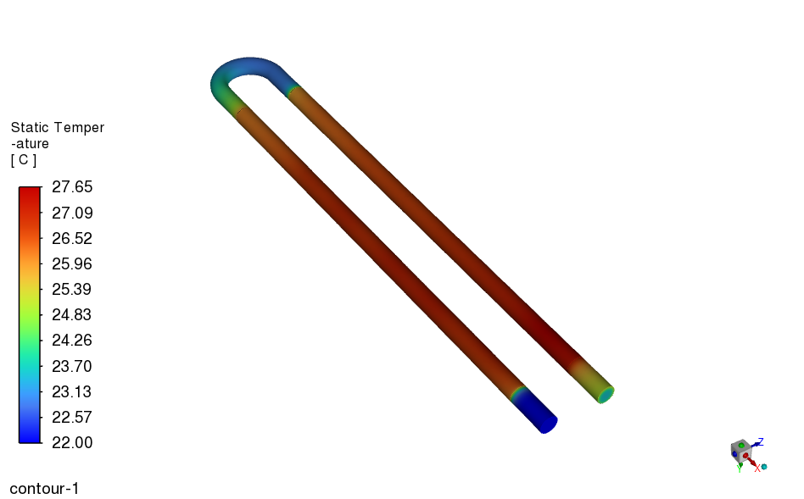
Results – 2C temperature rise, inlet temperature 22C
Temperature distribution

Slide 8
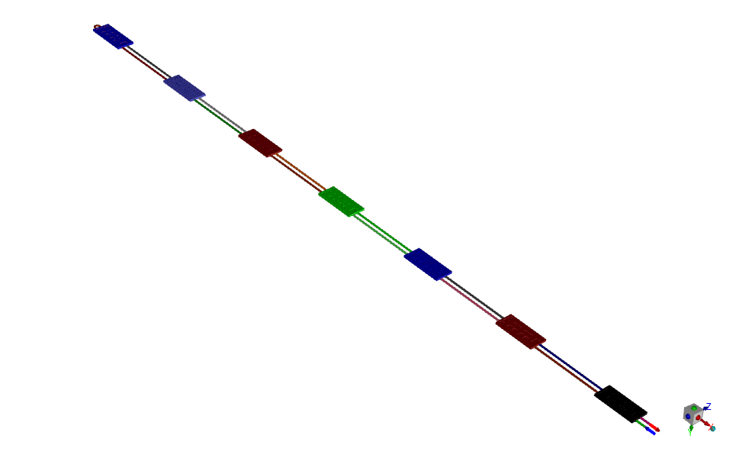
7FEB Model
Outlet
Inlet

Slide 9
Outer MPGD Detector – 7 FEB Heat Load
Temperature rise 0.5 C
Temperature rise 2 C
Number of FEB | 7
Single FEB | 15.5 | W
with margin | 16 | W
Total FEB | 112 | W
dT | 0.5 | C
Cp | 4181 | J/kg C
m | 0.05358 | kg/s
m | 0.05358 | l/s
m | 53.58 | ml/s
Number of FEB | 7
Single FEB | 15.5 | W
with margin | 16 | W
Total FEB | 112 | W
dT | 2 | C
Cp | 4181 | J/kg C
m | 0.01339 | kg/s
m | 0.01339 | l/s
m | 13.39 | ml/s
Velocity | 3.3761 | m/s
Velocity | 0.844 | m/s
Re | 15883 | Turbulent
Re | 3971 | Transition
Inlet water Temperature | 22 | C
Ambient Temperature | 23.3 | C

Slide 10
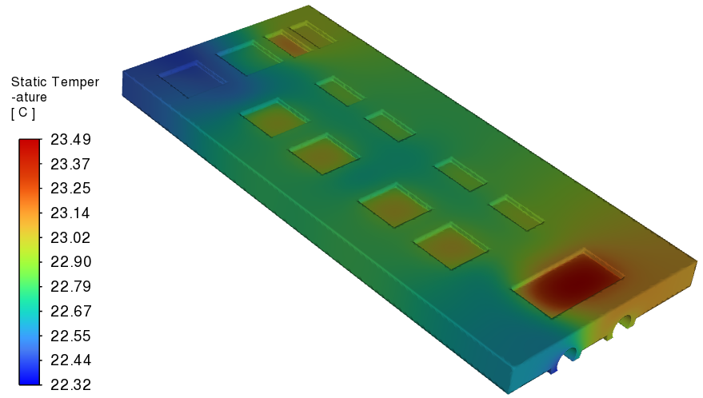
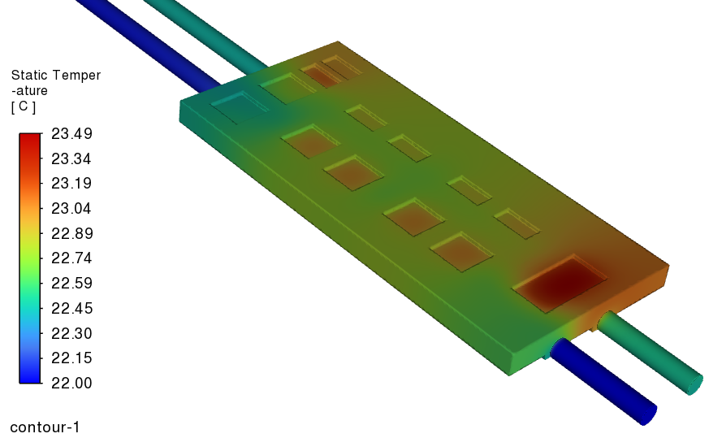
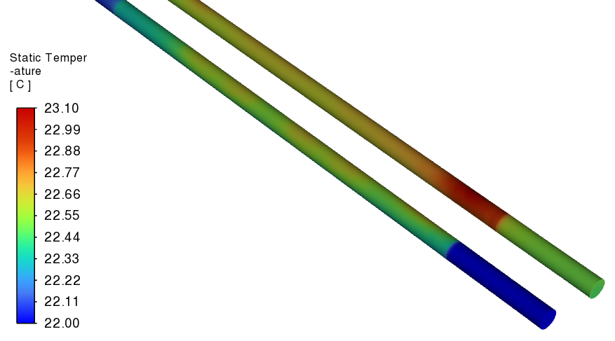
Results – 0.5C temperature rise, inlet temperature 22C
Temperature distribution

Slide 11
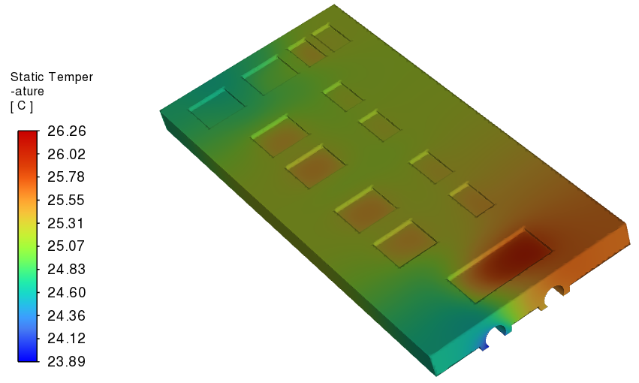
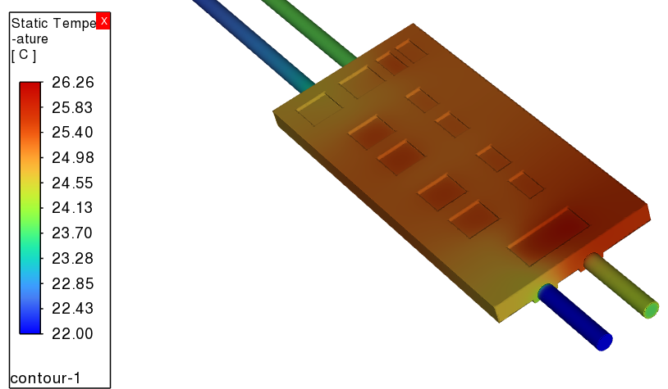
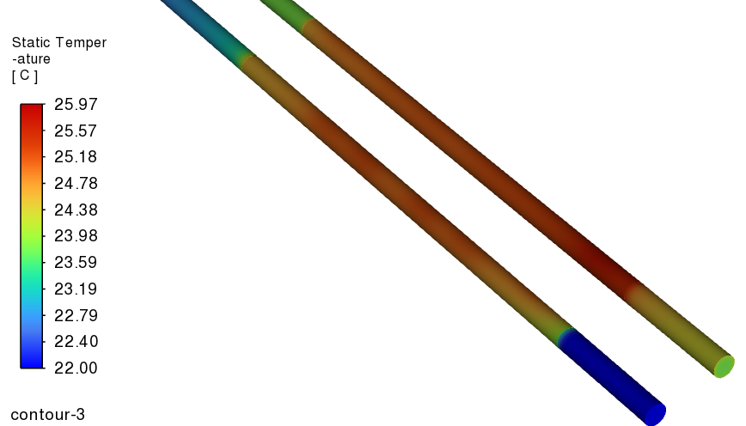
Results – 2C temperature rise, inlet temperature 22C
Temperature distribution

Slide 12
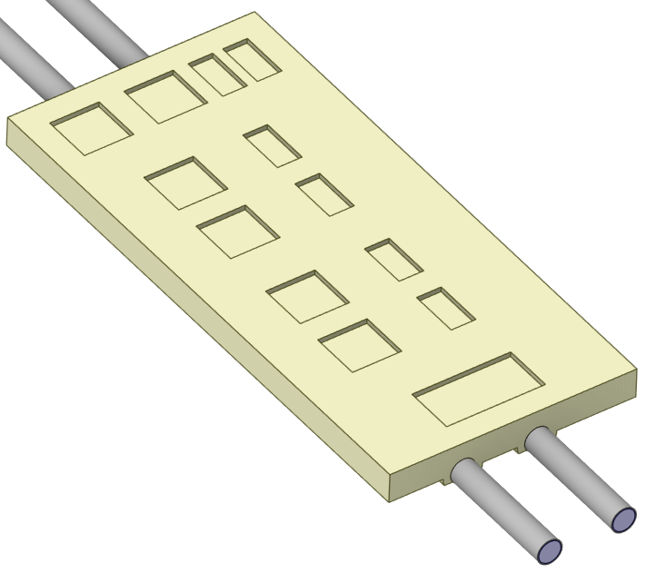
7 FEB Heat Load – baseline design
Temperature rise 2 C
Analytical calculation
CFD calculation
Number of FEB | 7
Single FEB | 15.5 | W
with margin | 16 | W
Total FEB | 112 | W
dT | 2 | C
Cp | 4181 | J/kg C
m | 0.01339 | kg/s
m | 0.01339 | l/s
m | 13.39 | ml/s
m | 0.013328 | kg/s
Cp | 4181 | J/kg C
in | 22 | C
out | 23.8906 | C
dT | 1.8906 | C
Total FEB heat load | 105.35 | W
Heat Load
Analytical calculation | 112 | W
CFD calculation | 105.35 | W
Difference | 6.65 | W
Baseline design
Velocity | 0.844 | m/s
Re | 3971 | Transition
Tube ID 4.5 mm, OD 5 mm
Inlet water Temperature | 22 | C
Ambient Temperature | 23.3 | C

Slide 13
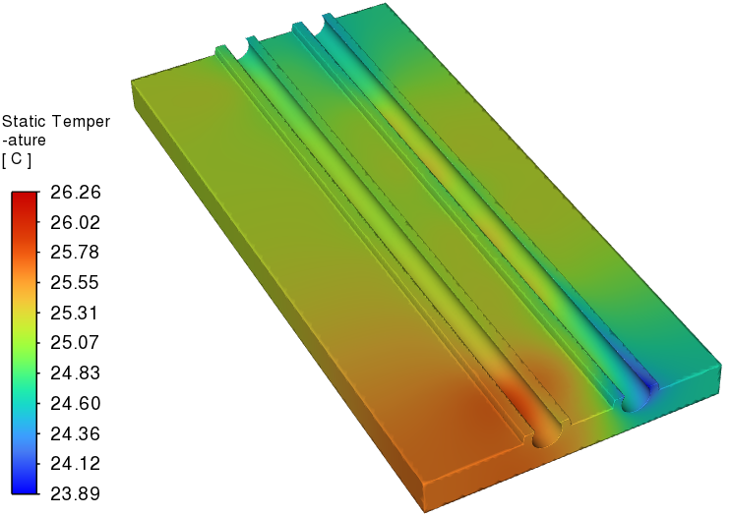
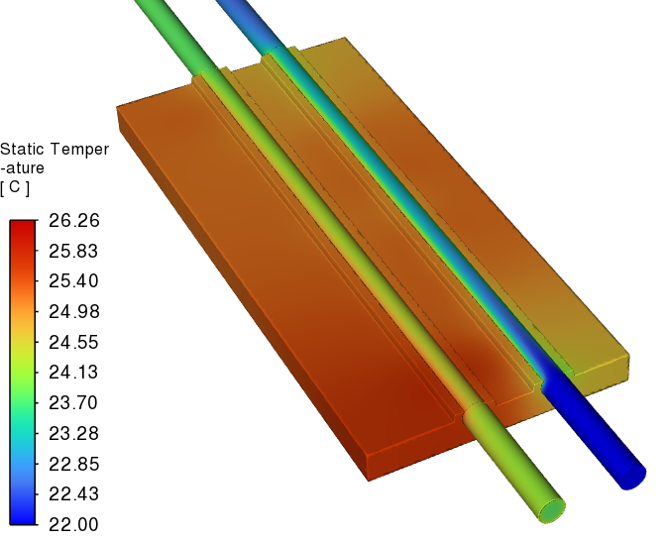
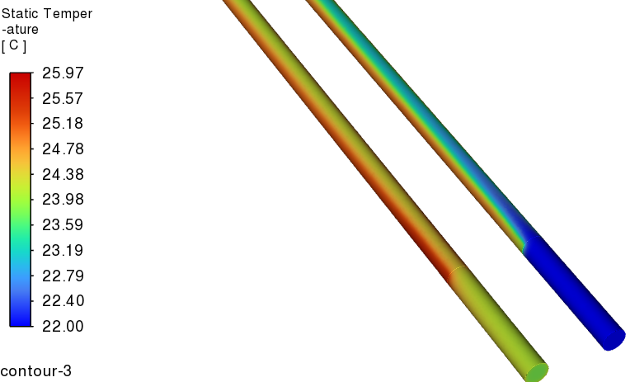
Results – baseline design
Temperature distribution

Slide 14
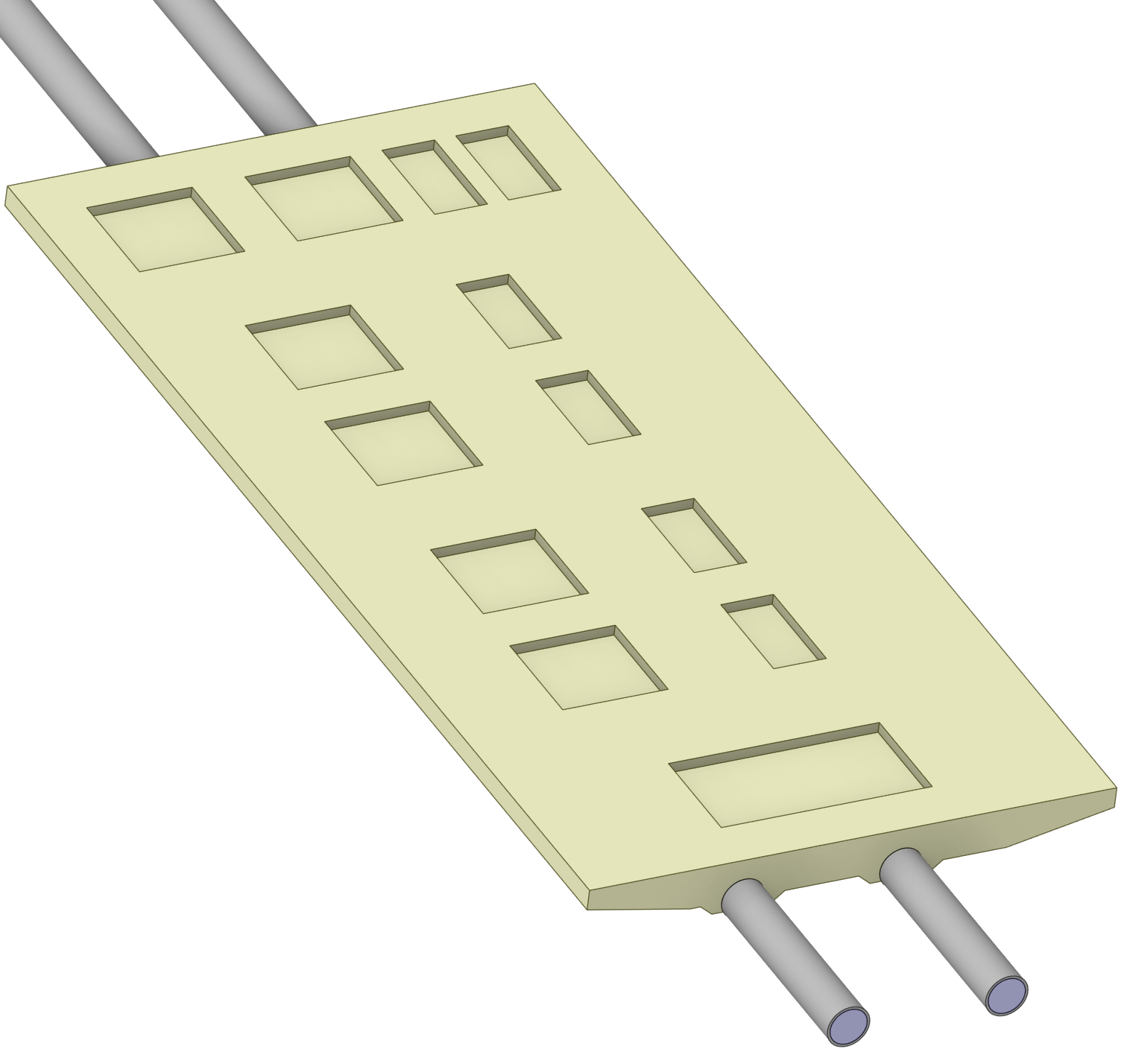
7 FEB Heat Load – modified design – without insulation
Temperature rise 2 C
Analytical calculation
CFD calculation
Number of FEB | 7
Single FEB | 15.5 | W
with margin | 16 | W
Total FEB | 112 | W
dT | 2 | C
Cp | 4181 | J/kg C
m | 0.01339 | kg/s
m | 0.01339 | l/s
m | 13.39 | ml/s
m | 0.013285 | kg/s
Cp | 4181 | J/kg C
inlet | 22 | C
outlet | 23.903 | C
dT | 1.903 | C
Total FEB heat load | 105.7 | W
Heat Load
Analytical calculation | 112 | W
CFD calculation | 105.7 | W
Difference | 6.3 | W
Tapered design
Velocity | 1.392 | m/s
Re | 5145 | Turbulent
Tube ID changed from 4.5 mm to 3.5 mm
OD changed from 5 mm to 4 mm
Inlet water Temperature | 22 | C
Ambient Temperature | 23.3 | C

Slide 15
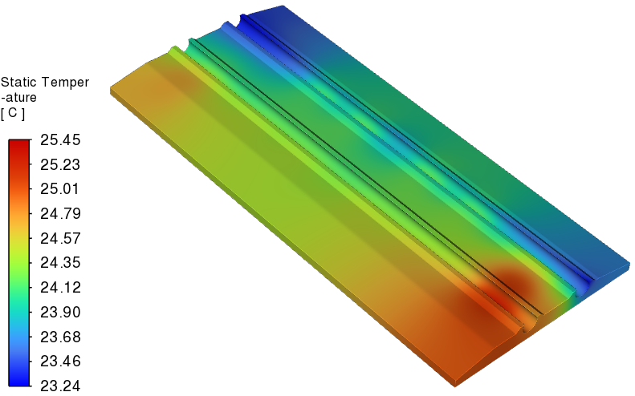
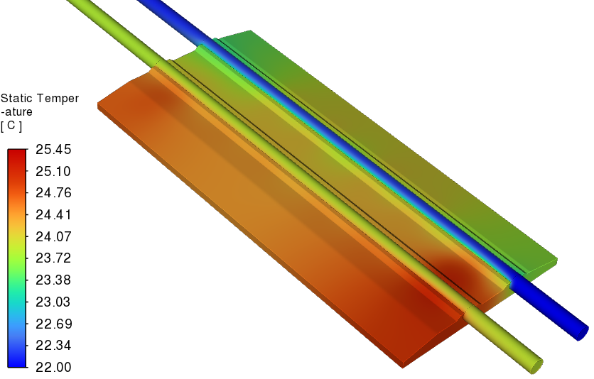
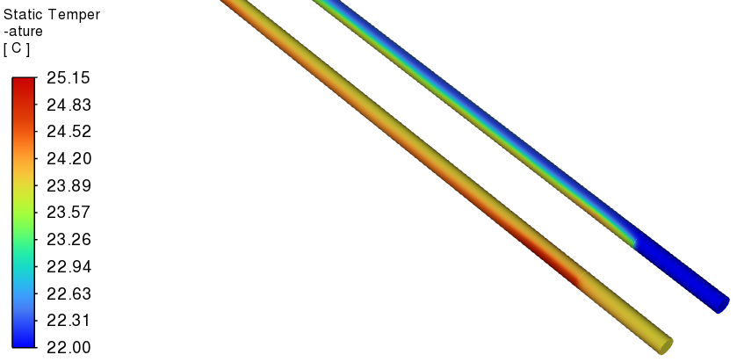
Results – modified design without insulation
Temperature distribution

Slide 16
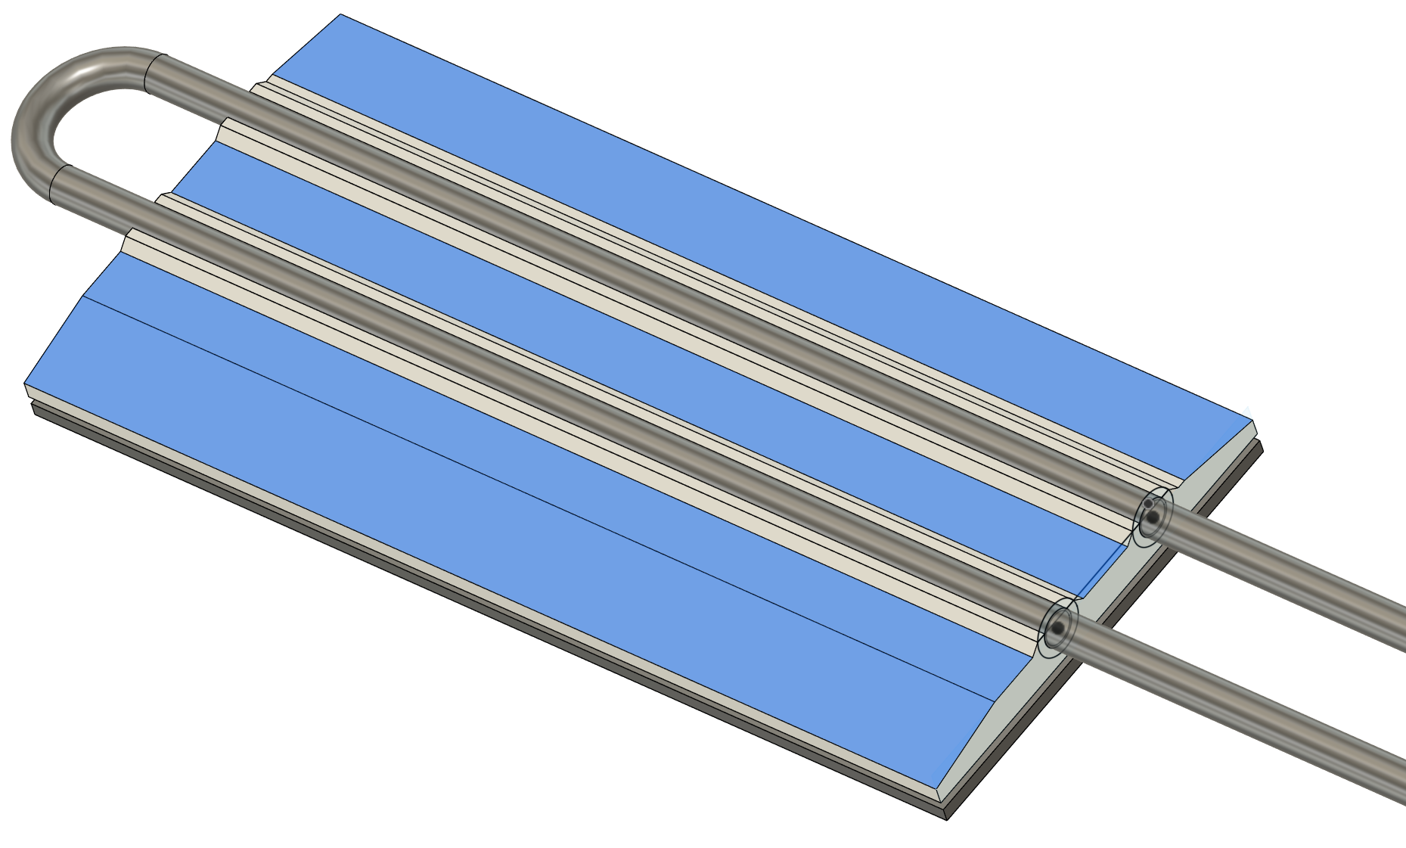
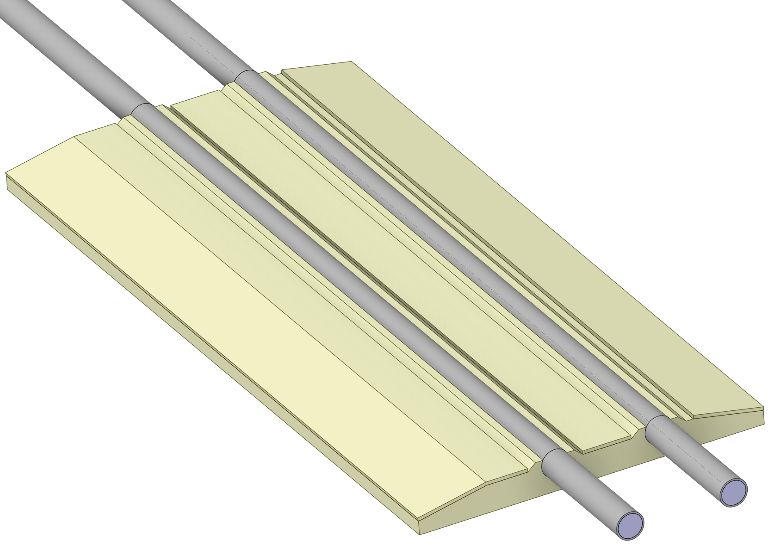
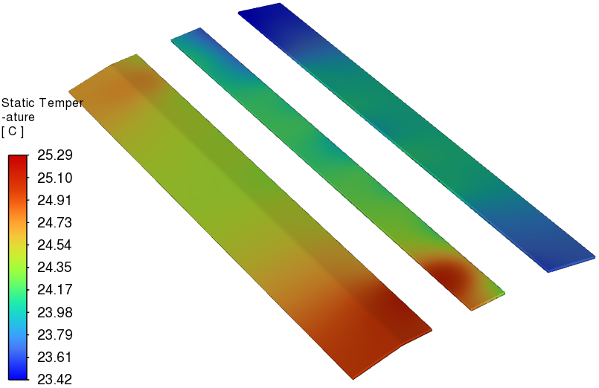
7 FEB Heat Load – modified design – with insulation
Temperature rise 2 C
Analytical calculation
CFD calculation
Number of FEB | 7
Single FEB | 15.5 | W
with margin | 16 | W
Total FEB | 112 | W
dT | 2 | C
Cp | 4181 | J/kg C
m | 0.01339 | kg/s
m | 0.01339 | l/s
m | 13.39 | ml/s
m | 0.013285 | kg/s
Cp | 4181 | J/kg C
inlet | 22 | C
outlet | 23.907 | C
dT | 1.907 | C
Total FEB heat load | 105.93 | W
Aerogel insulation of 0.5 mm thickness
Heat Load
Analytical calculation | 112 | W
CFD calculation | 105.93 | W
Difference | 6.06 | W
Velocity | 1.392 | m/s
Re | 5145 | Turbulent
Inlet water Temperature | 22 | C
Ambient Temperature | 23.3 | C

