Slide 1
Far-Forward / Far-Backward
Detector Integration
Jonathan Smith (JLAB), Ron Lassiter (JLAB),
and India Krehbiel (JLab)
March 23rd, 2026

Slide 2
Primary Updates Outline
B0 Israeli Group Detector Concept
ZDC HCal Updates
ZDC EMCal Concept

Slide 3
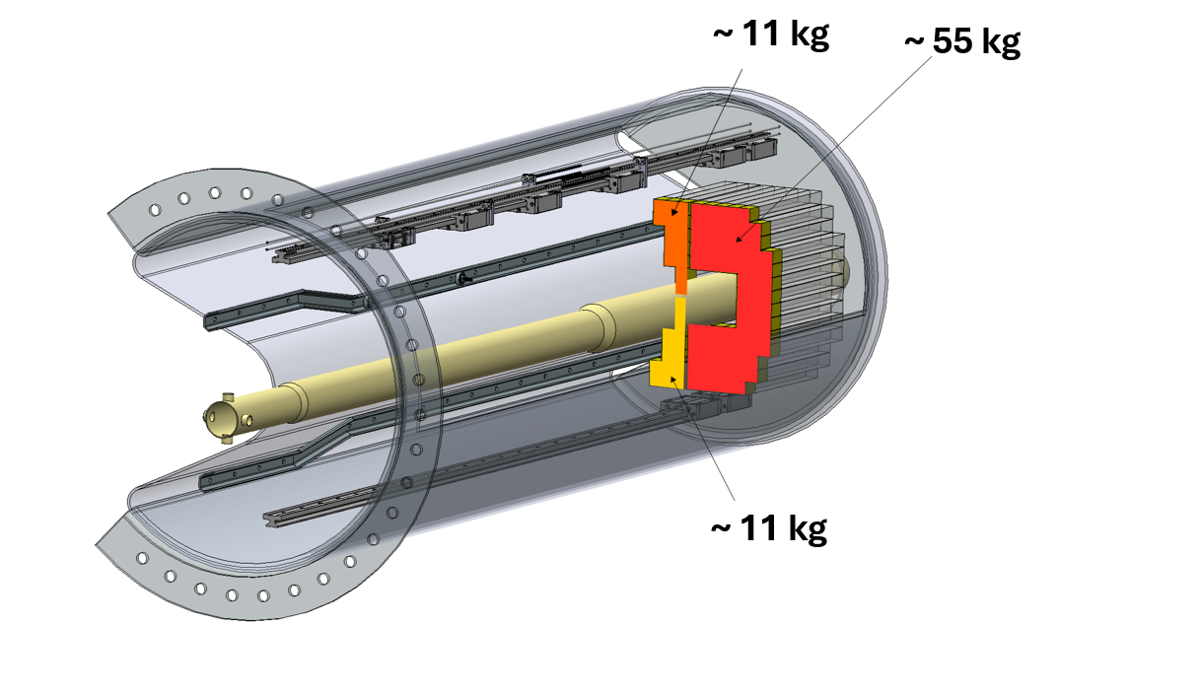
Israeli Group B0 Detector Concept
Igor, Avishay, and Zvi shared an update (3/16/26) to our existing B0 Railing and expanded the model to include lead screws and proposal for moving the calorimeter to the front face.
Latest concept splits the calorimeter in 3 sections, with the smaller 11kg sections running along the guide rail
Slide courtesy of Igor Korover (Tel Aviv)

Slide 4
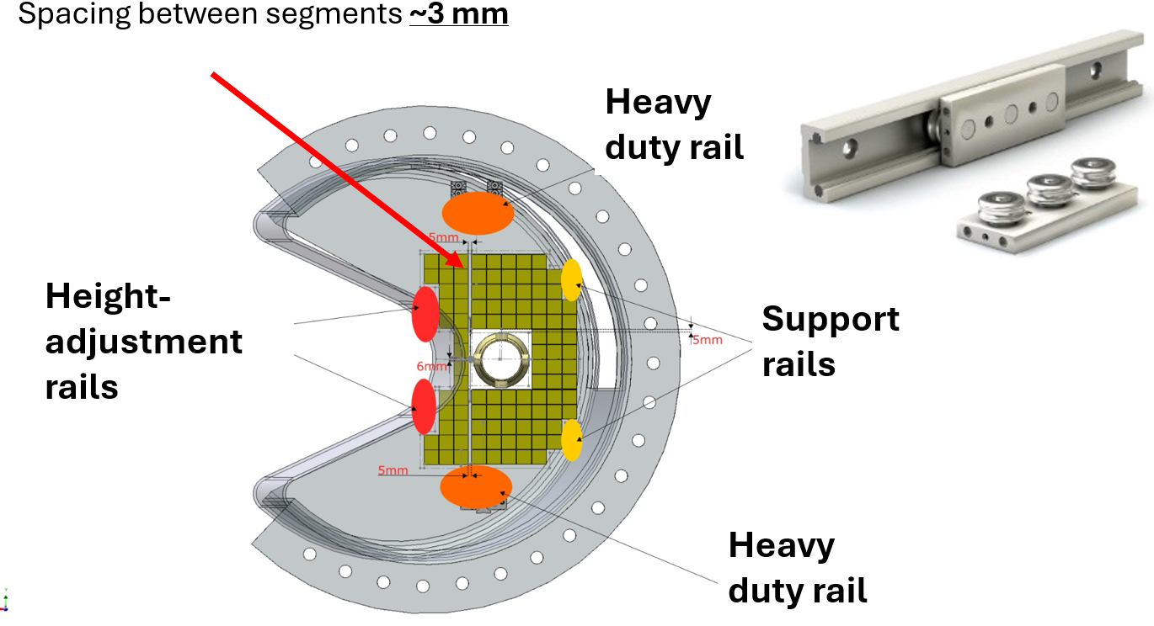
Israeli Group B0 Detector Concept
Slide courtesy of Igor Korover (Tel Aviv)

Slide 5
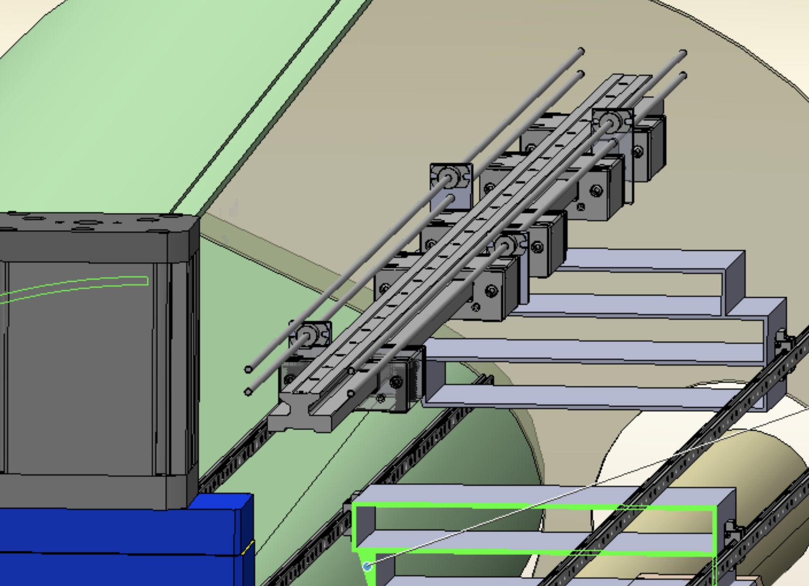
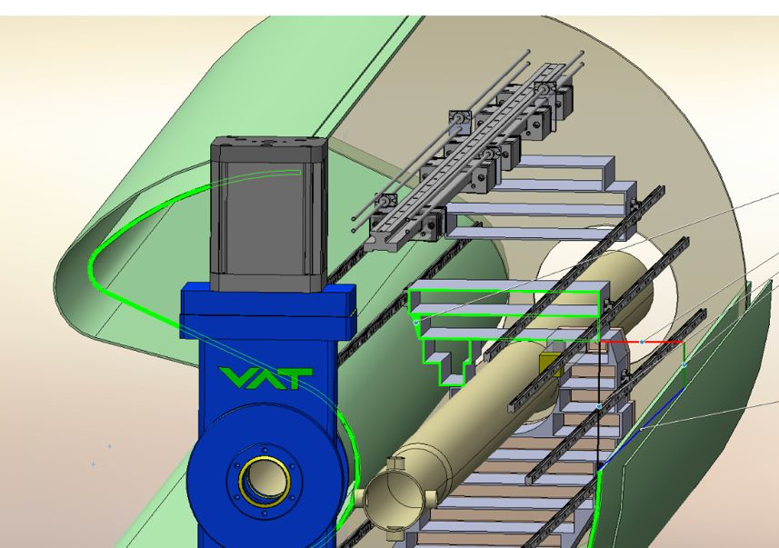
Israeli Group B0 Detector Concept
Driving motor for each plan is detachable and removed
after positioning each tracker plane
Slide courtesy of Igor Korover (Tel Aviv)

Slide 6
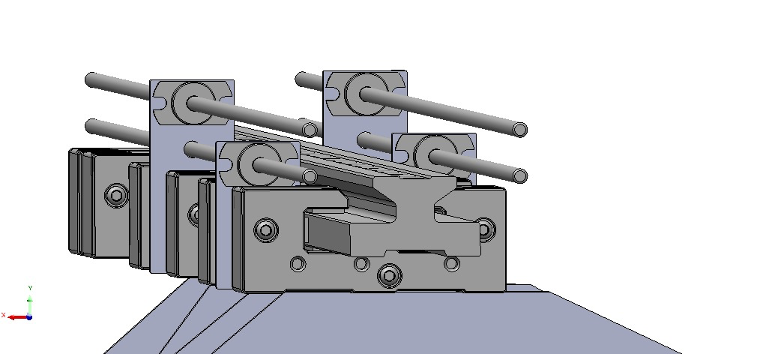
Israeli Group B0 Detector Concept
Each tracker plane moved by different driver
Slide courtesy of Igor Korover (Tel Aviv)

Slide 7
Israeli Group B0 Detector Concept
JLab has requested a standing recurring bi-weekly meeting with the Israeli Group to establish a better communication. We are coordinating a day/time that works with both teams given time zone challenges.

Slide 8
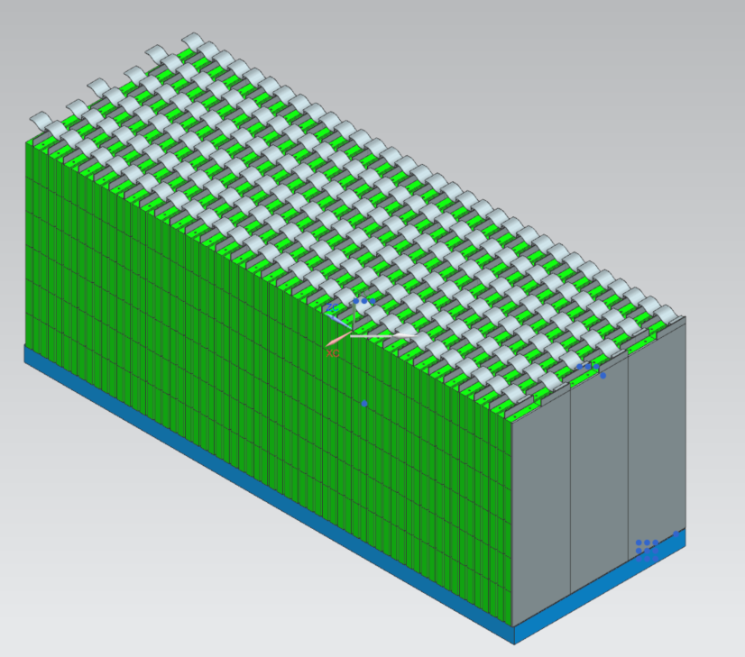
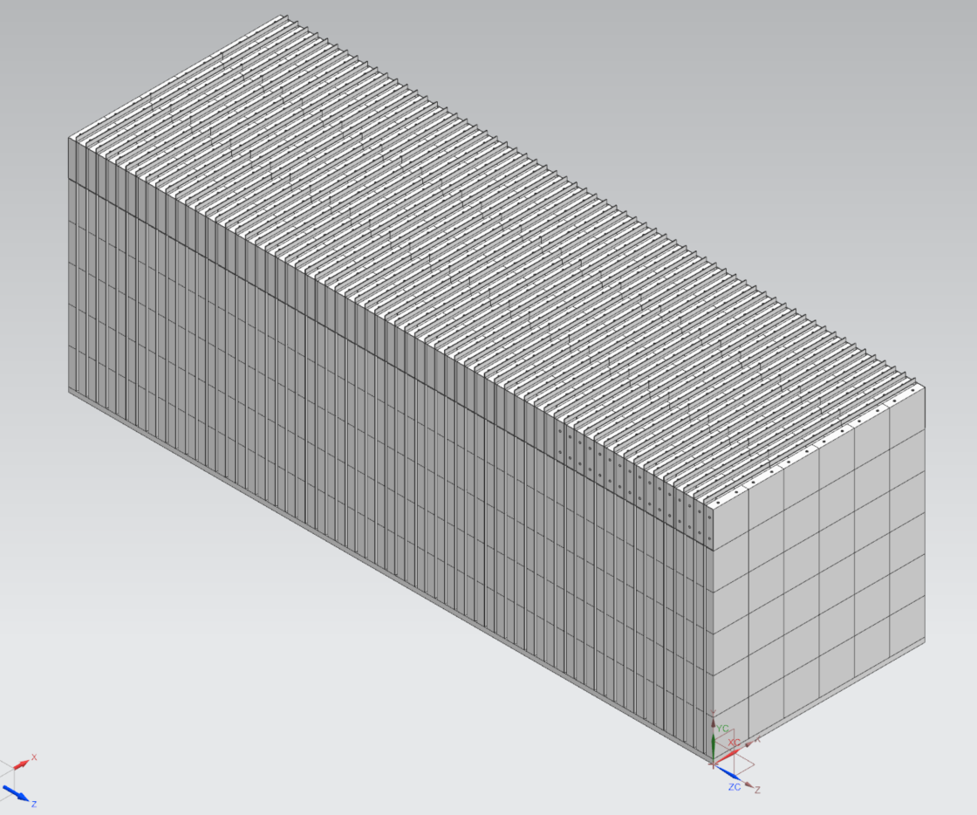
ZDC HCal Update
Existing JLab Model
Model Latest
(Courtesy Sean Preins, University of California, Riverside)

Slide 9
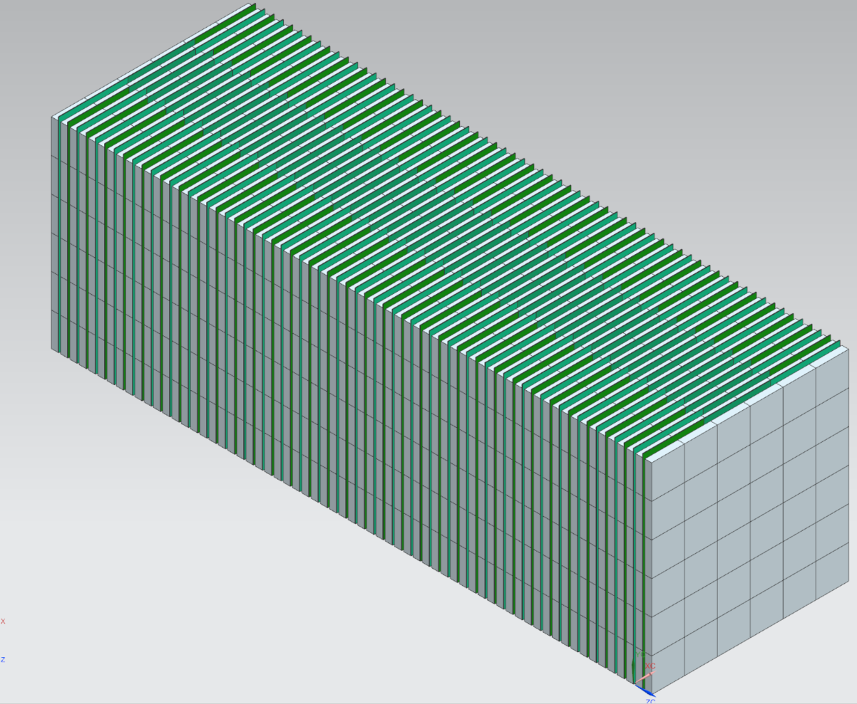
ZDC HCal Update
Due to the difference software between UCR (Sketchup) and JLab (NX), we had to recreate the model in NX.
Updated model includes a change to the PCB boards using (3) different sizes, sensor locations, and an increased size in the Z-axis
We will be repurposing existing iron blocks and modifying accordingly for future support frame design.
Upcoming model updates for support frame and cable routing
Continued discussions with UCR are ongoing.
Updated JLab Model

Slide 10
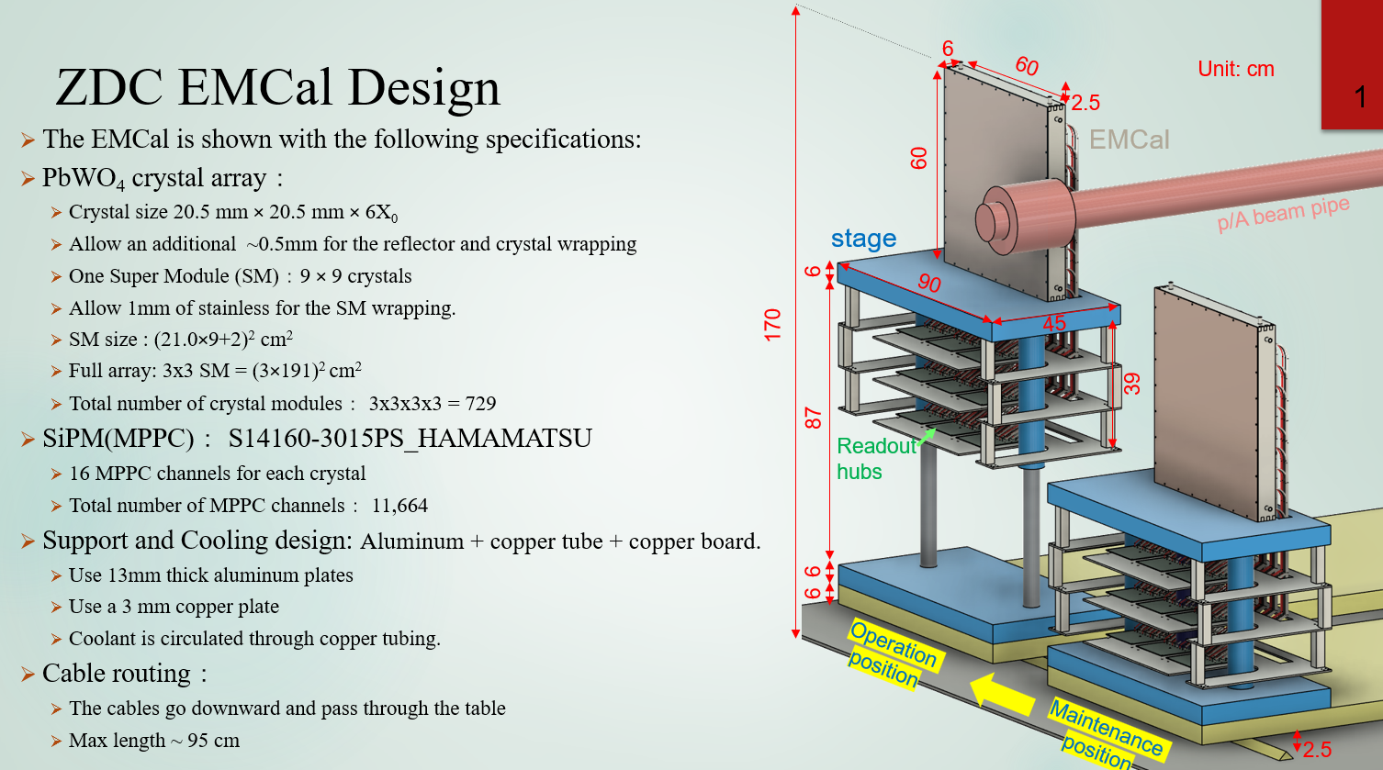
ZDC EMCal Update
Received an updated EMCal Design from Chia Ming Kuo (NCU, Taiwan). Latest concept received 3/23/26.
Slide courtesy of Yu-Siang Xiao, NCU, Taiwan

Slide 11
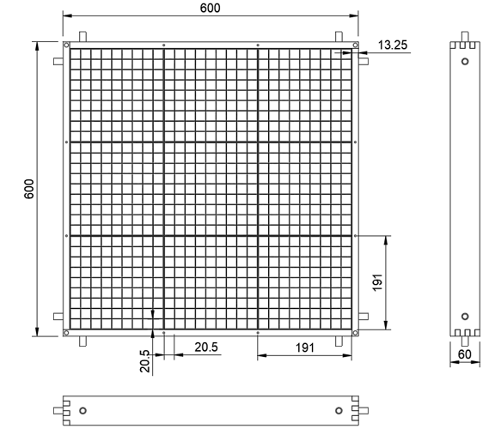
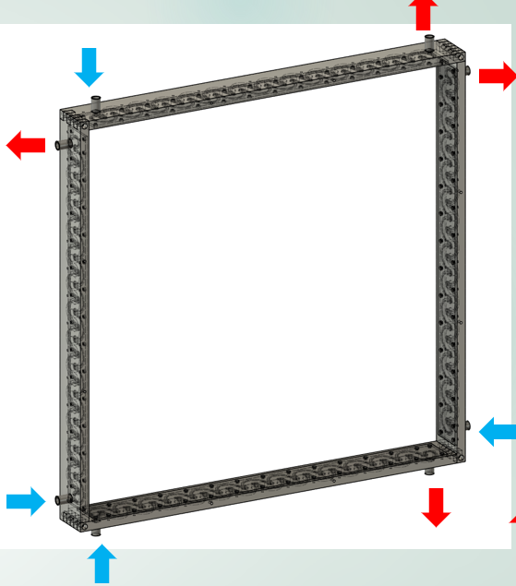
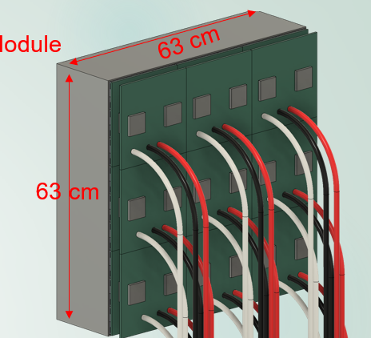
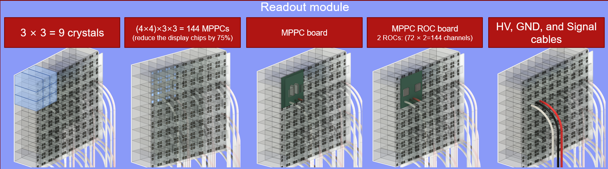
ZDC EMCal Update
JLab Model will need to update to suit latest high detail provided by NCU Group. Updates include EMCal Crystal sizes, Cooling Frames, SiPMs, and cable routing

Slide 12
Other Updates
Preparing Infrastructure/Integration Portion for PDR for the Lumi, ZDC, and Low Q^2 Tagger Stations
  Dry Run Scheduled for Tuesday, March 31st.
  PDR Scheduled for April 20th
Need to update Lumi Dipole Stands.
Relocating the Lumi Collimator further from IP.

