Slide 1
bTOF + Cymbal global mechanics status
Cymbal ONLY drawer mechanics
13 April 2026

Slide 2
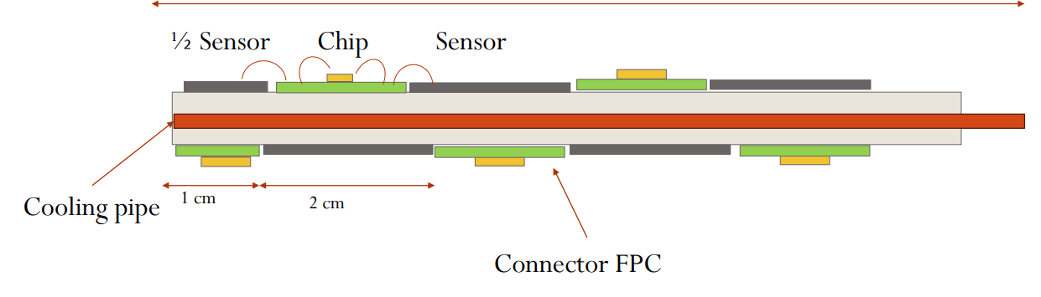
Summary of status on BTOF Mechanics
The staves assembly does not fit in the given envelope of R625 to R700 mm for barrel TOF with the services with the current layout of the trays.
New proposed layout shown in the next slide
The concept is to combine the cooling manifold services on bTOF and Cymbal to save on space.
Details for bTOF shown in next slide – the ATLAS mounting mechanism will be incorporated for the staves
1300 mm
6mm
6mm

Slide 3
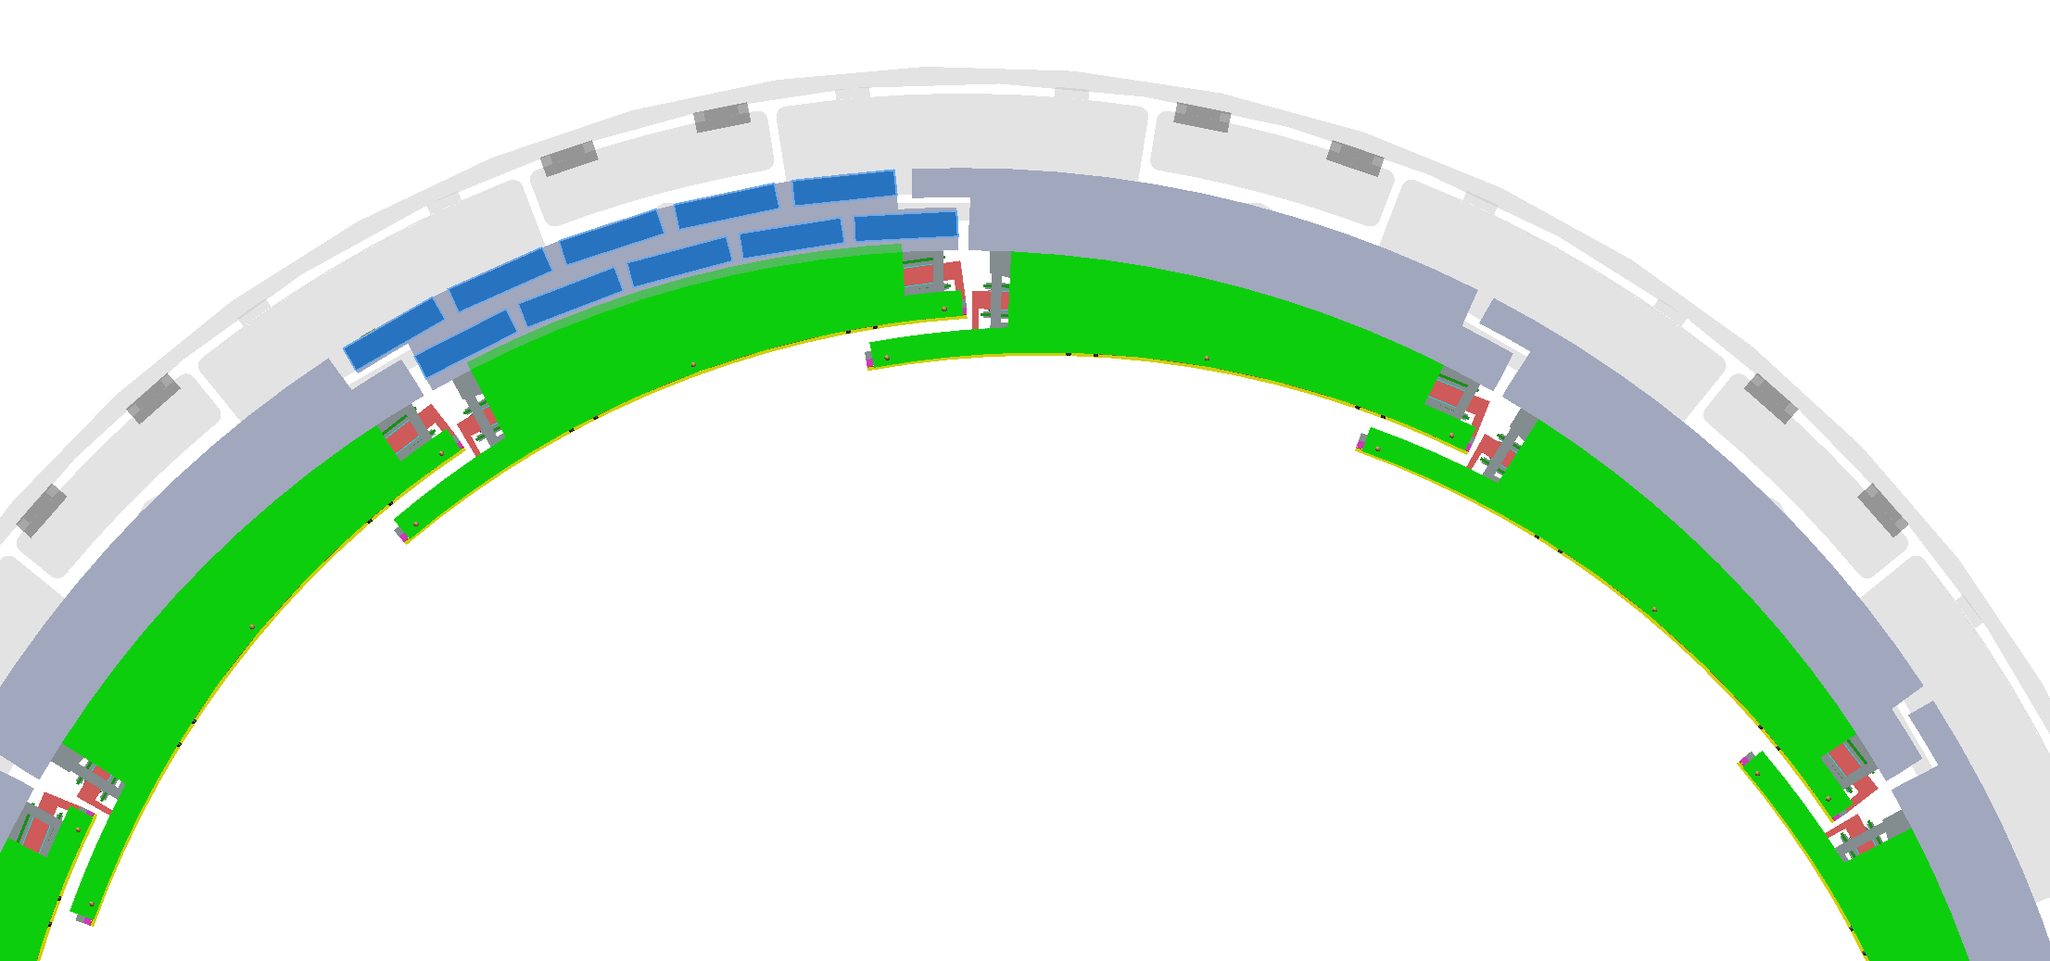
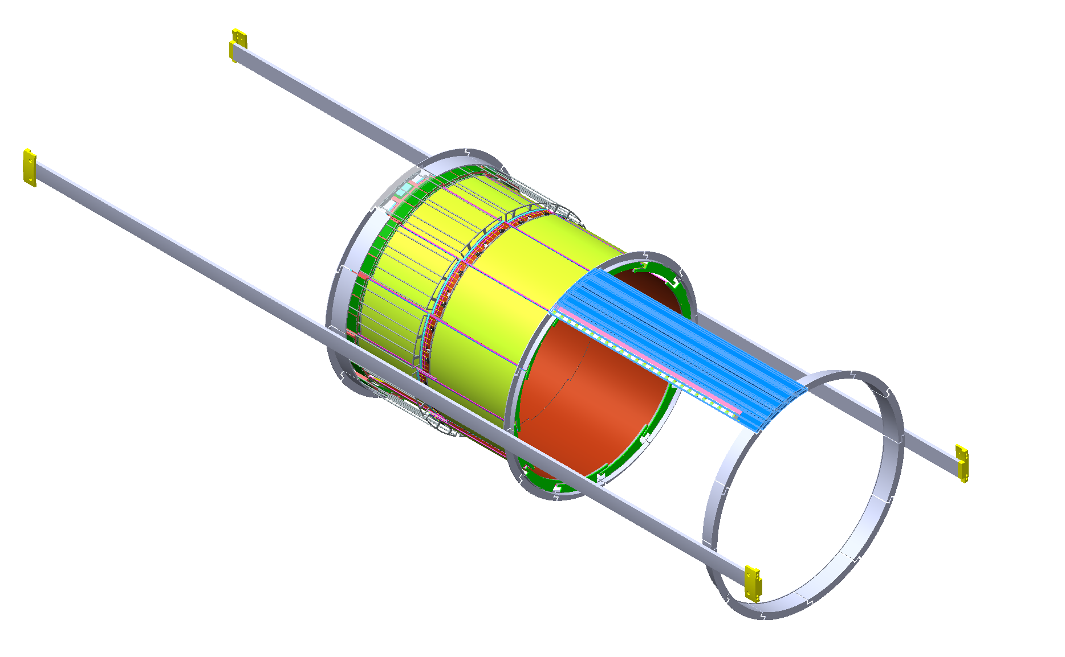
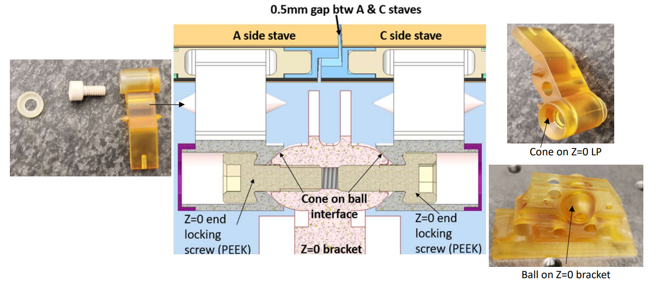

The cymbal was rotated 17.5° to match the service rails on the GST for TOF+Cymbal
Latest iteration of the bTOF tessellation in a tray
Cymbal and bTOF will form a tray as shown here and will be inserted into the GST as a single unit
COPIED FROM ATLAS - https://cds.cern.ch/record/2899769/files/ATL-ITK-SLIDE-2024-127.pdf

Slide 4
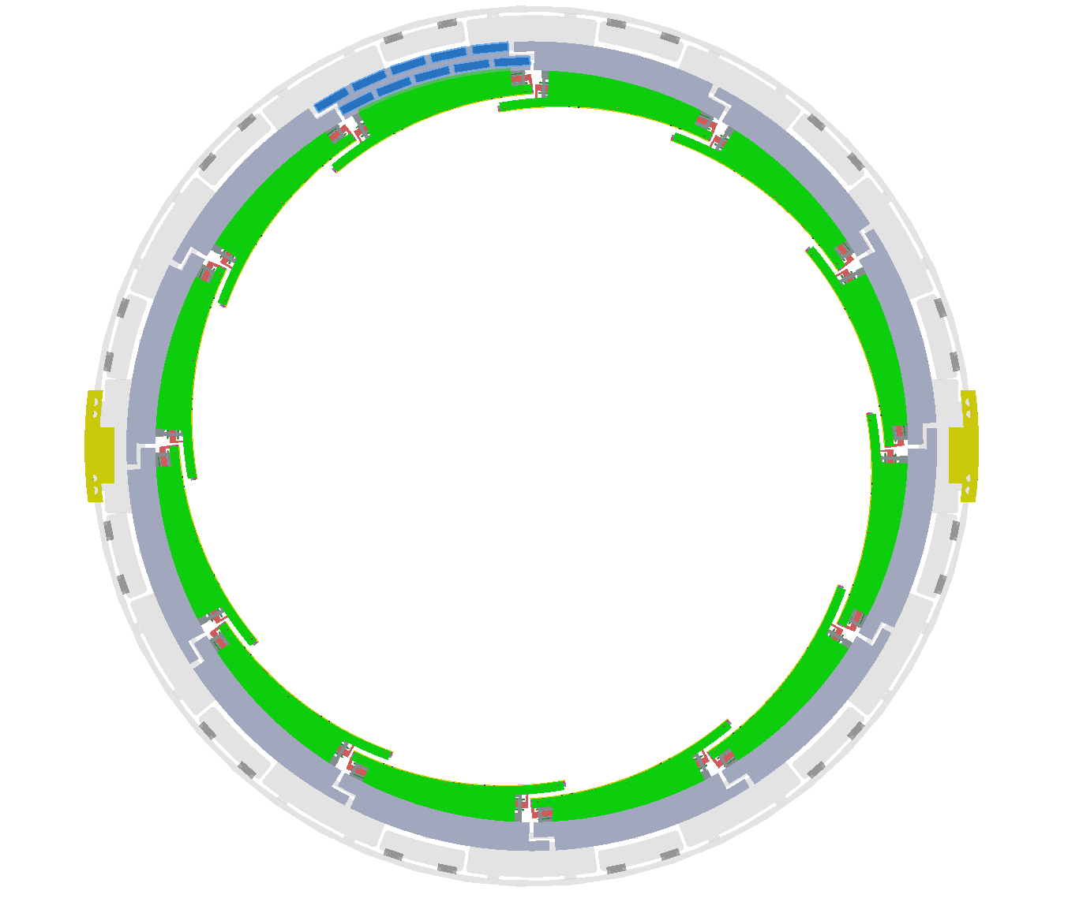
Summary
The new TOF+Cymbal tray design takes into account the access / space needed at the 3 & 9 o’clock rails and clearances there of to be able to be slid in after the PST+beam pipe mounting
Current on-going steps –
FEA of the deformation of the designed drawers for the TOF+Cymal – target is less than 1 mm radial deformation to be able to be inserted in the given space.
Designing the assembly sequence needed for the drawer insertion along with the tooling.

