Slide 1
Far-Forward / Far-Backward
Detector Integration
Jonathan Smith (JLAB), Ron Lassiter (JLAB),
and India Krehbiel (JLab)
June 22, 2026

Slide 2
Primary Updates Outline
B0 Updates
Lumi Dipole Update
ZDC Lift Table Quote
Ongoing Updates

Slide 3
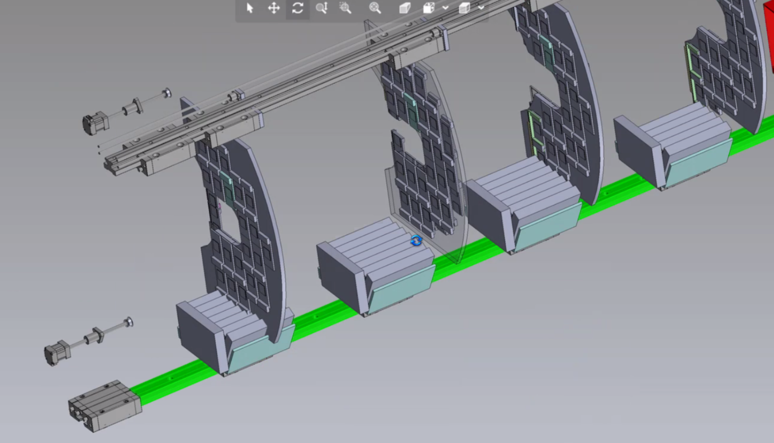
Israeli Group B0 Detector Concept
JLab, Igor, and Avishay hold a bi-weekly meeting to discuss ongoing B0 detector mechanic design. Igor and Avishay are actively working on the inner B0 detector railing system and JLab are working on the external railing and inner-barrel support structure.
Latest design has detector Read-Outs on the individual detector in a support. Intent is to carry the detectors with the readouts as one piece.
Detector Plane
Readout Support
Image courtesy of Avishay Mizrahi (Tel Aviv)

Slide 4
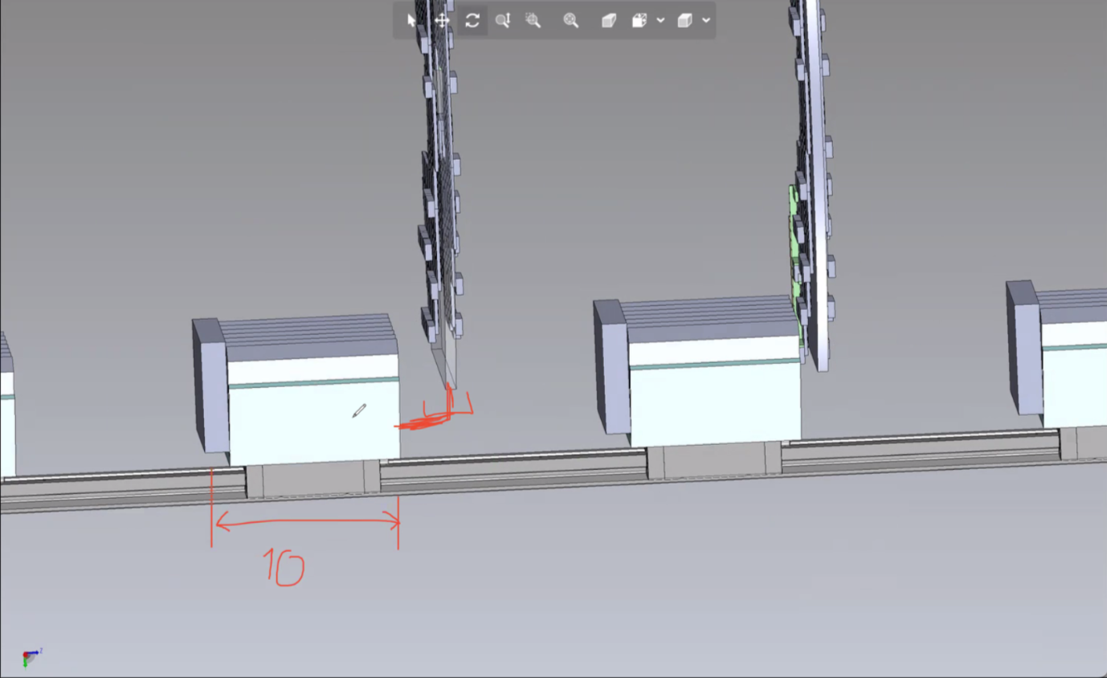
Israeli Group B0 Detector Concept
Having the readouts local to the detector planes resolves 2 issues:
2 meters limitation for Read-Out cabling
Reduced stationary cabling from the front opening of the B0 Magnet

Slide 5
Israeli Group B0 Detector Concept
Air Cooling
Igor has proposed we use a 2-PCB B0 detector solution. The detector staves will remain in location, however there will be a gap between PCBs to allow for air cooling for electronics.
Unsure if there will be impacts to the detector readings if using moving air for cooling. We have scheduled a meeting (7/2) with Alex Jentsch to provide input.
Rear-PCB for a single plane
Front-PCB for a single plane
Air Cooling

Slide 6
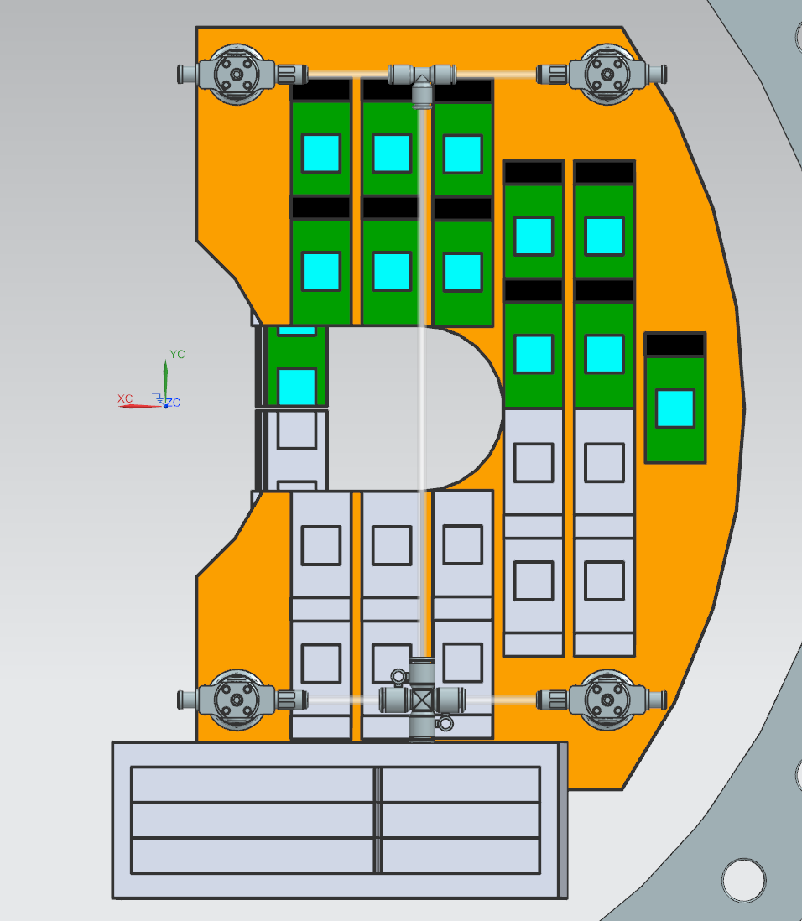
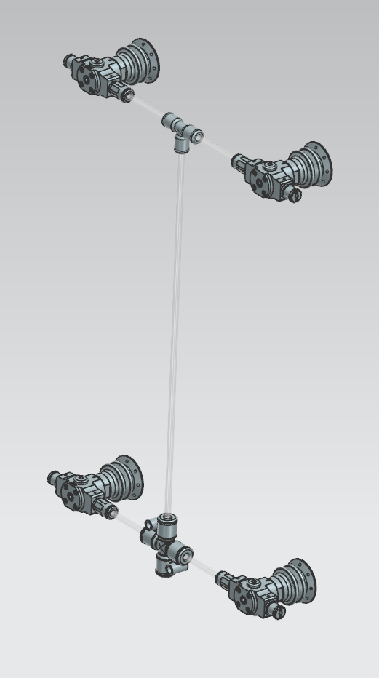
B0 External Detector “Carriage”
We’re working on a solution to push/pull the B0 detector layers from the front-face of the B0 to the maintenance area of the platform.
Uses pneumatic suction cups to grip onto the detector planes. The carriage will also include a tray for the local readouts.
Unknown question – Can pneumatics be used outside of the B0 magnet?
Active design in progress.

Slide 7
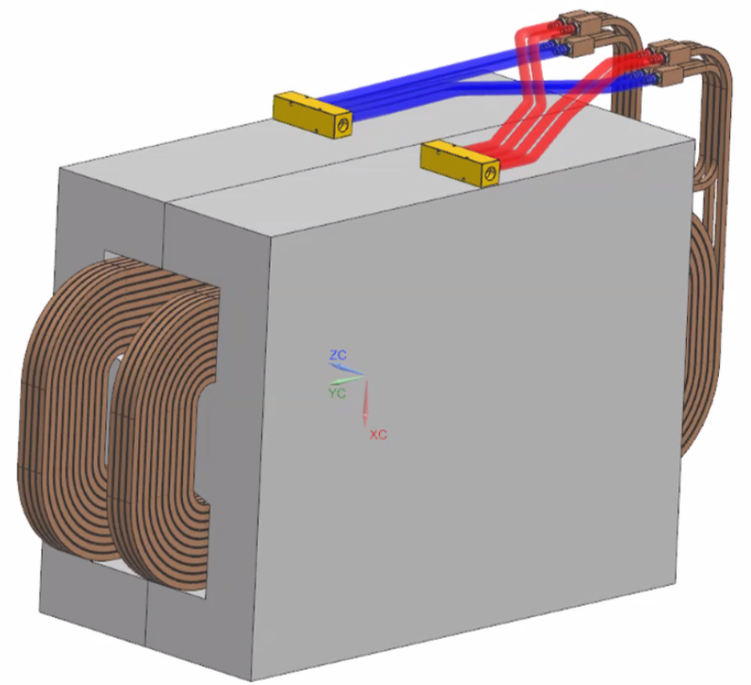
Lumi Dipole Model Update
There’s been an update to the Lumi Dipoles to include a cooling solution. Minimal impacts on infrastructure, and our models will be updating soon to reflect.
Slide courtesy of Ian Gildea, JLAB

Slide 8
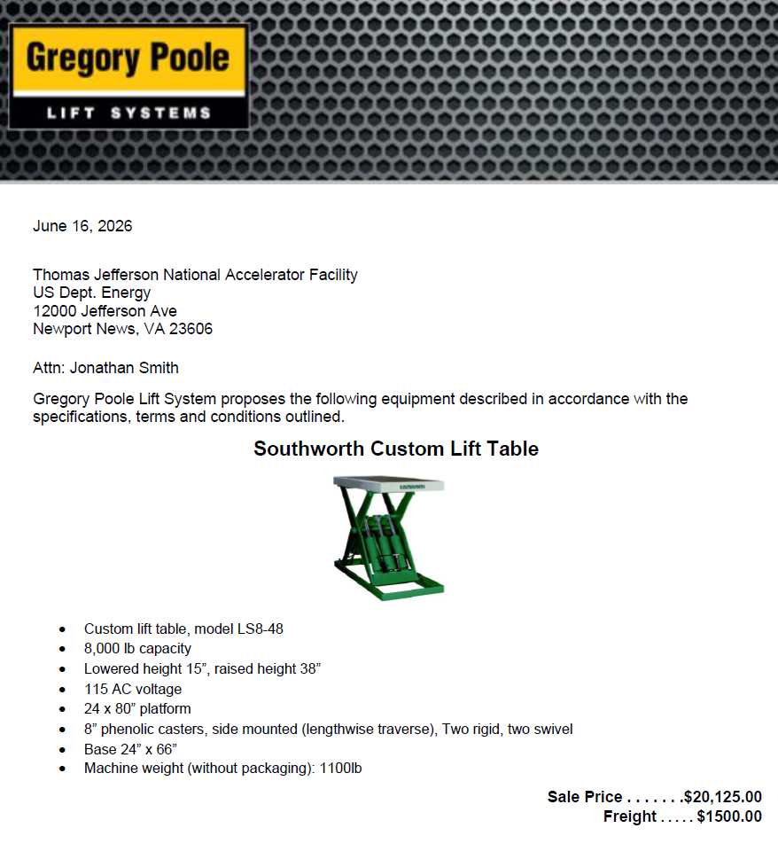
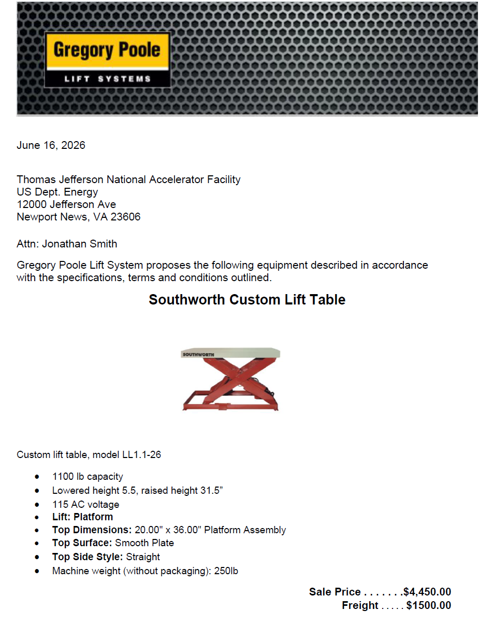
ZDC – Lift Table Quotes
Received quote from Gregory Poole (Southworth supplier) for the ZDC Lifting Tables
Company policy does not allow for CAD file sharing until a purchase has been placed.
ZDC HCAL
ZDC EMCAL

Slide 9
Ongoing/Upcoming Workload
Continuing B0 design
  Support Carriage
  Inner mechanics
Integrate latest Lumi in vacuum pipe
Off-Momentum Detector Support – Per Charlie Hetzel, OMD are permitted to be supported off beampipe supports.
Update ‘strawman stave’ detector design for off-moment/roman pot detectors, possibly B0
Roman Pot Support – ongoing discussions on Roman Pot design (kick-off meeting hosted by Karim, 6/16

