Slide 1
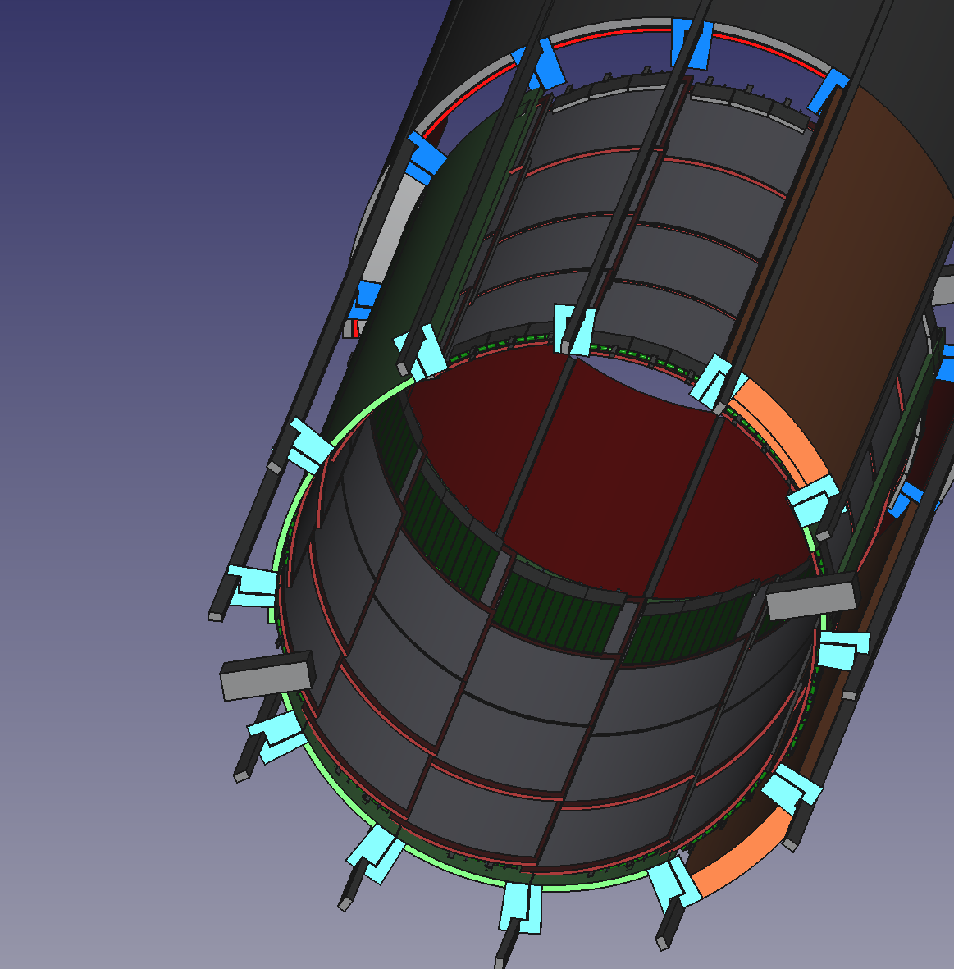

Inner MPGD CyMBaL Status
Seraphin Vetter , Alain Delbart, for the CEA/Saclay IRFU team
EIC/EPIC 3I meeting, 22 June 2026

Slide 2
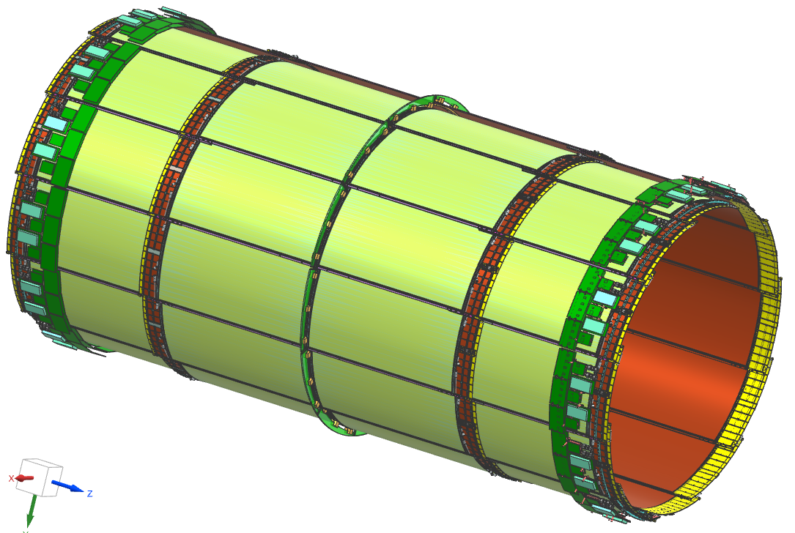
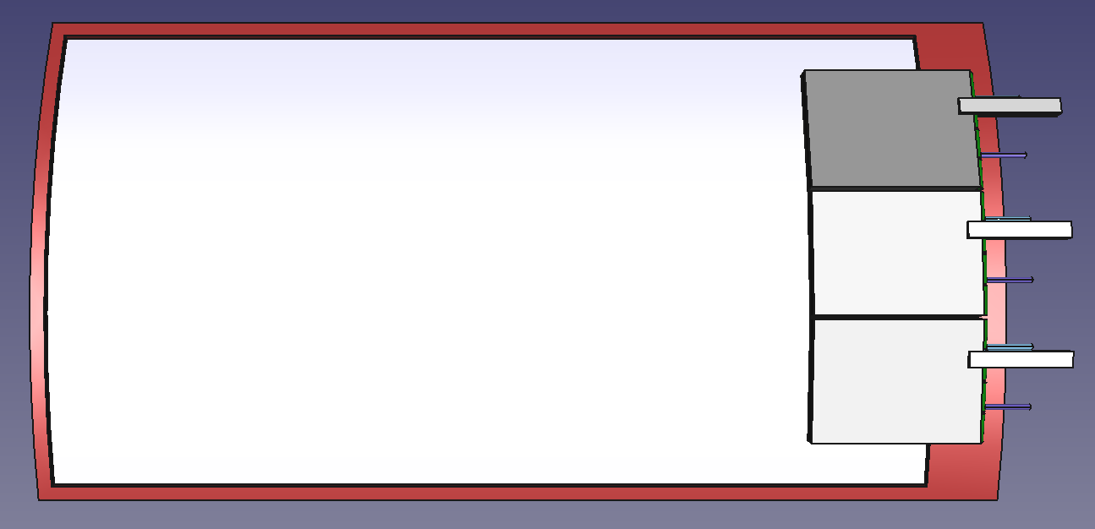
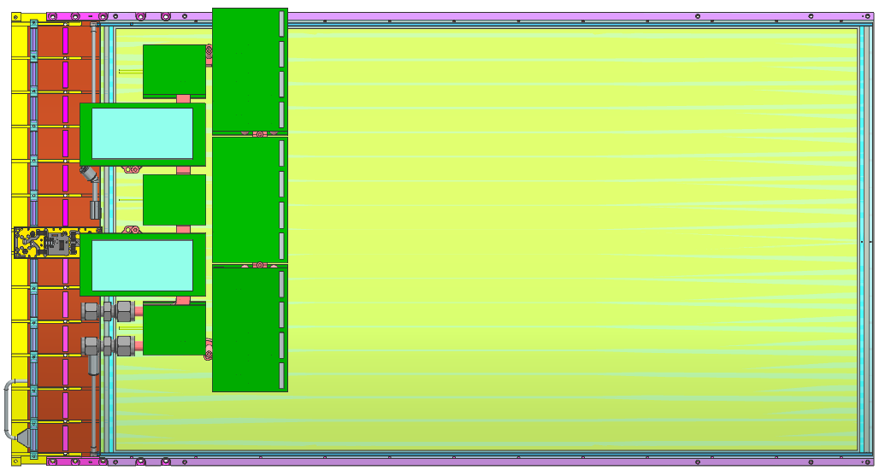
CyMBaL tiles integration : test article design
Services
via patch panel(s)
CyMBaL: Current design
Design of a tile / test article (Cylindrical)
3 OF (to DAM)
5 HV cables
3 LV cables (1 tile)
Gas I/O (2 tiles)
FEB cooling I/O
2 tiles – 6 FEBs+DC/DC
few l/min of 18°C water
192 strips (~1.7 mm pitch)
LV
R=56.5 cm
36.6 cm
(module)
576 strips (~1 mm pitch)
59 cm
67.3 cm
48 tiles: 12 in ϕ × 4 in z (integration in GST in “fish scale”)
R_{min} = 55.5 cm; R_{max} = 61.5 cm
Overlaps in ϕ and in z for hermeticity (~2-4 cm)
768 readout channels/module
36K readout channels in 3 FEBs/tile
Module dimensions
Z = 673 mm / R*phi = 366 mm
Active zone dimensions
Z = 590 mm / R*phi = 340 mm
Weigh estimates
~1 kg / tile + ~0,6 kg / FEB
Expected performances
Spatial resolution: < 300 (500) µm in Z (r*phi)
Time resolution ~20ns
Efficiency ≥ 98%
Material budget ~0.5% X0
18-22°C water cooling for FEBs (16 W with 25% margin) for a 2800 W total power (last estimate incl. DC/DC)
2

Slide 3
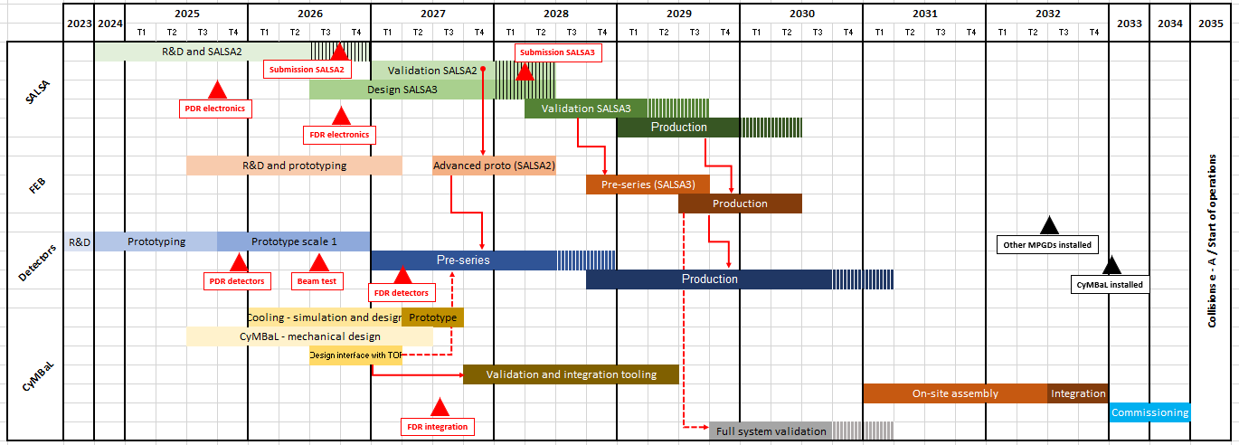
CyMBaL Timeline

Slide 4
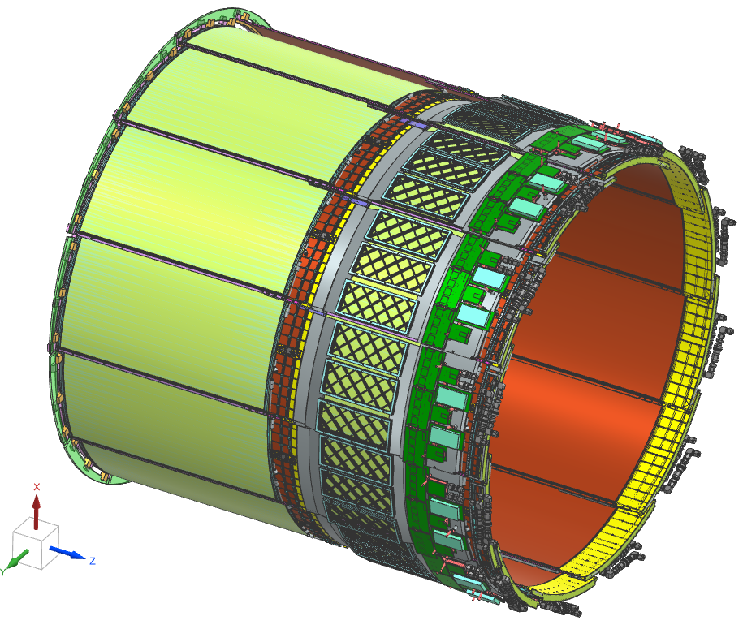
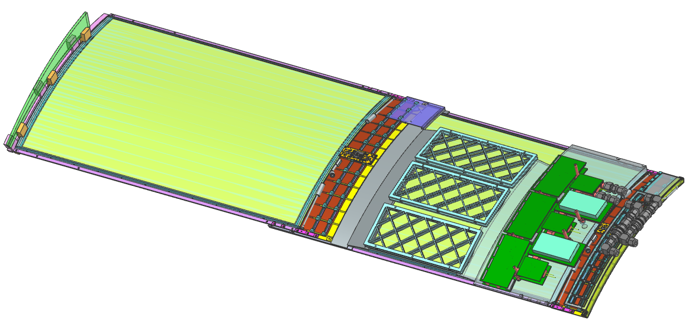
CyMBaL Half Detector / Section
Half Detector Half Section
The Detector is not actively cooled
Only the Readout Electronics

Slide 5
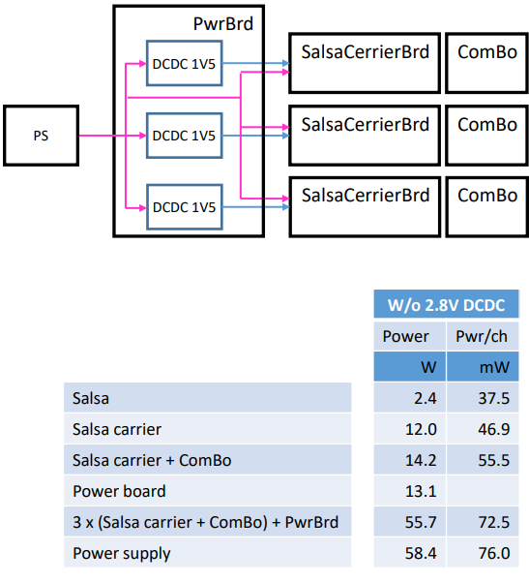
CyMBaL Readout Electronics
For more details: Look here
Readout Electronics for one Tile
2 Tiles per half section → 110W in total
Outside the detector
In the Barrel
ca. 2800W for the full detector
A change in the SALSA Power consumption will have a big impact.
SALSA values (2.4W) are our current best pessimistic estiamte.

Slide 6
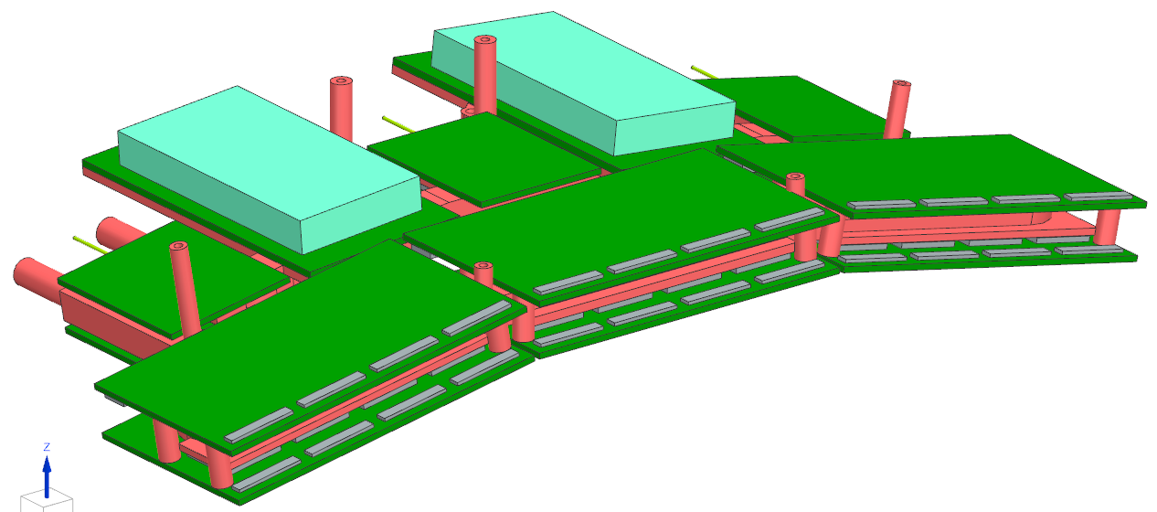
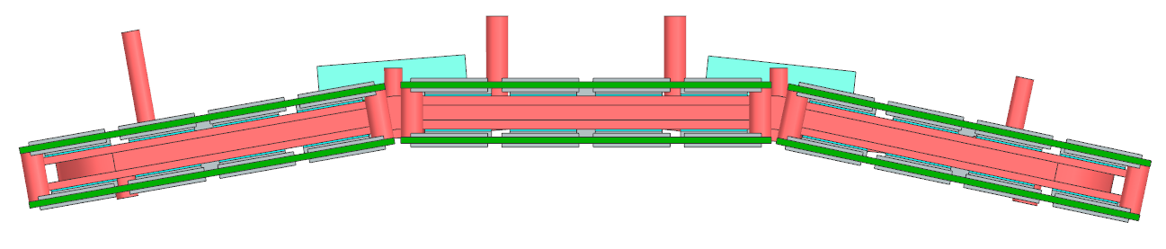
Cooling Block
110W to dissipate
Water Inlet/Outlet
Odd curved shape
Readout Boards on top and bottom
Minimal height to work with
Mounting Points for the rest of the Detector
Attachment Points to TOF
Design of all of the Boards should start soon!

Slide 7
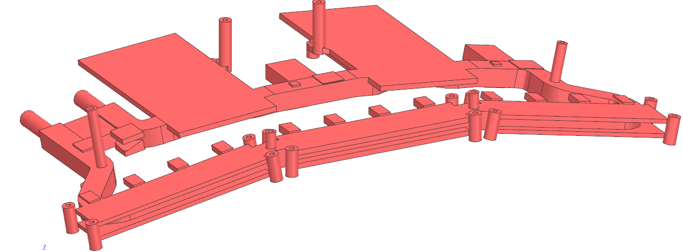
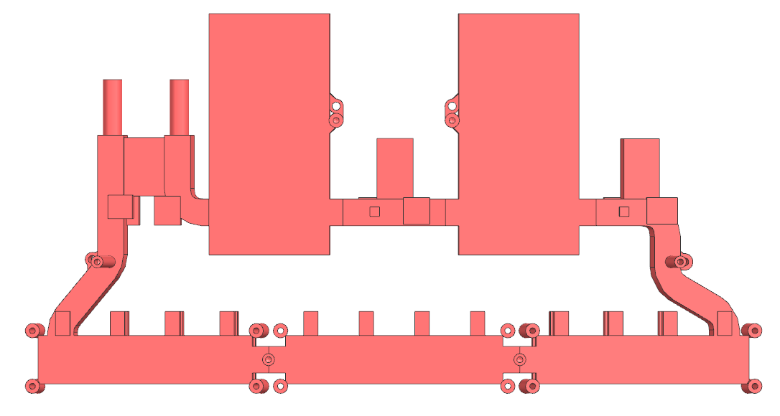
Cooling Block
3D printed Copper Block
Integrated cooling channels
Minimal Material usage
Integrate all possible features
Not easy to advance without any Board Design

Slide 8
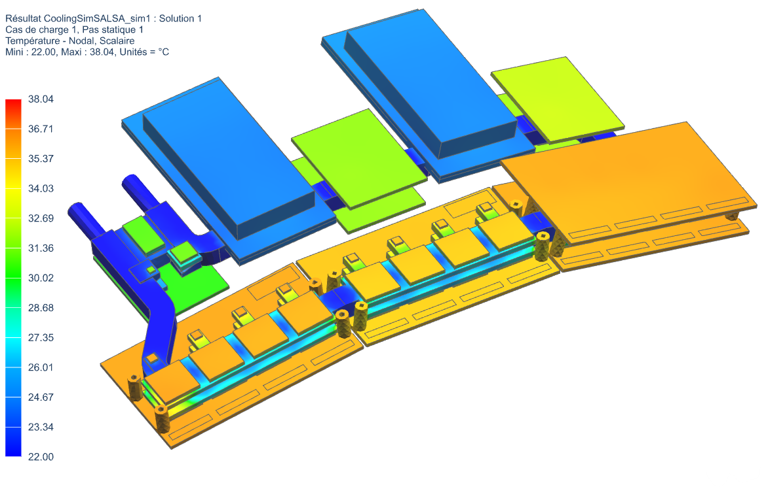
Cooling Simulation
22degC Water
3 l/min
PSalsa = 2.4W
Max TSalsa = 30 degC
Including:
Gap Pads 2W/mK
Chip encapsulation 1W/mK
FR4 Boards 0.3W/mK
deltaT = ca. 0.5 degC
deltaP = 0.04 bar (without any connectors)
Good first results
TSalsa almost in range
Hotspot on VTRx LDO:
really small piece
Decent wattage with 2,8W Salsa

Slide 9
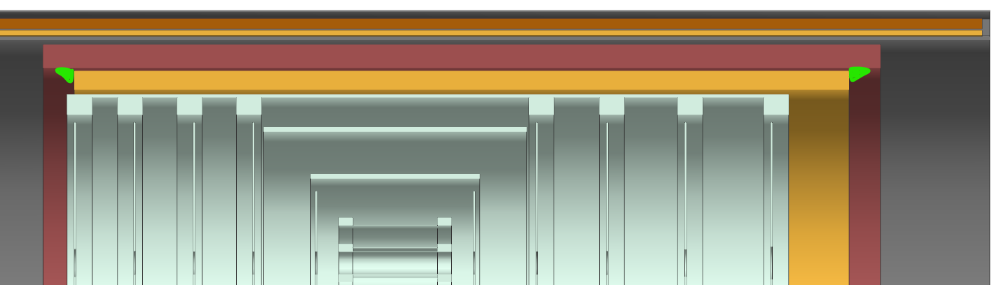
Water Connection
Parker Push-in fittings
In&Outlet Quick Connectors per section and side
Maybe water circuit of CyMBaL & TOF can be connected for a section
Potential to squeeze the Quick Connectors in the green triangle in-between the envelopes
TOF
Cymbal

Slide 10
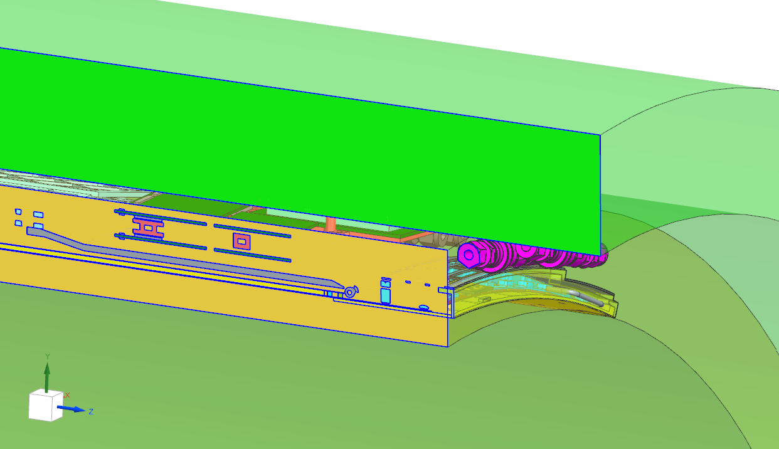
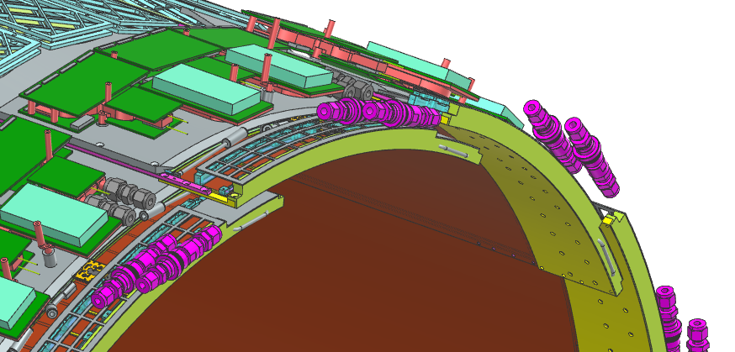
Water Connection
Water (and everything else) needs to be able to connect/disconnect right at the section (on both ends).
Inserting and extracting the supertrays (TOF + CyMBaL) would be super tricky otherwise.
Maybe there is a possibility to daisy chain CyMBaL and TOF for each half section.
That could reduce water lines and connectors.
But it has to be further investigated.

