Slide 1
Mechanical installation of B0 calorimeter and railining for trackers
Weekly update
March 16, 2026
Igor, Avishay
Tel Aviv University
Zvi
Ben Gurion University

Slide 2
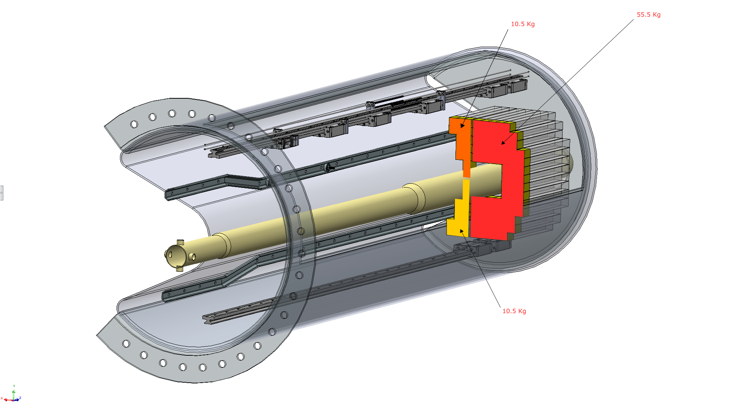
Mechanical installation of B0 calorimeter
~ 11 kg
~ 55 kg
~ 11 kg

Slide 3
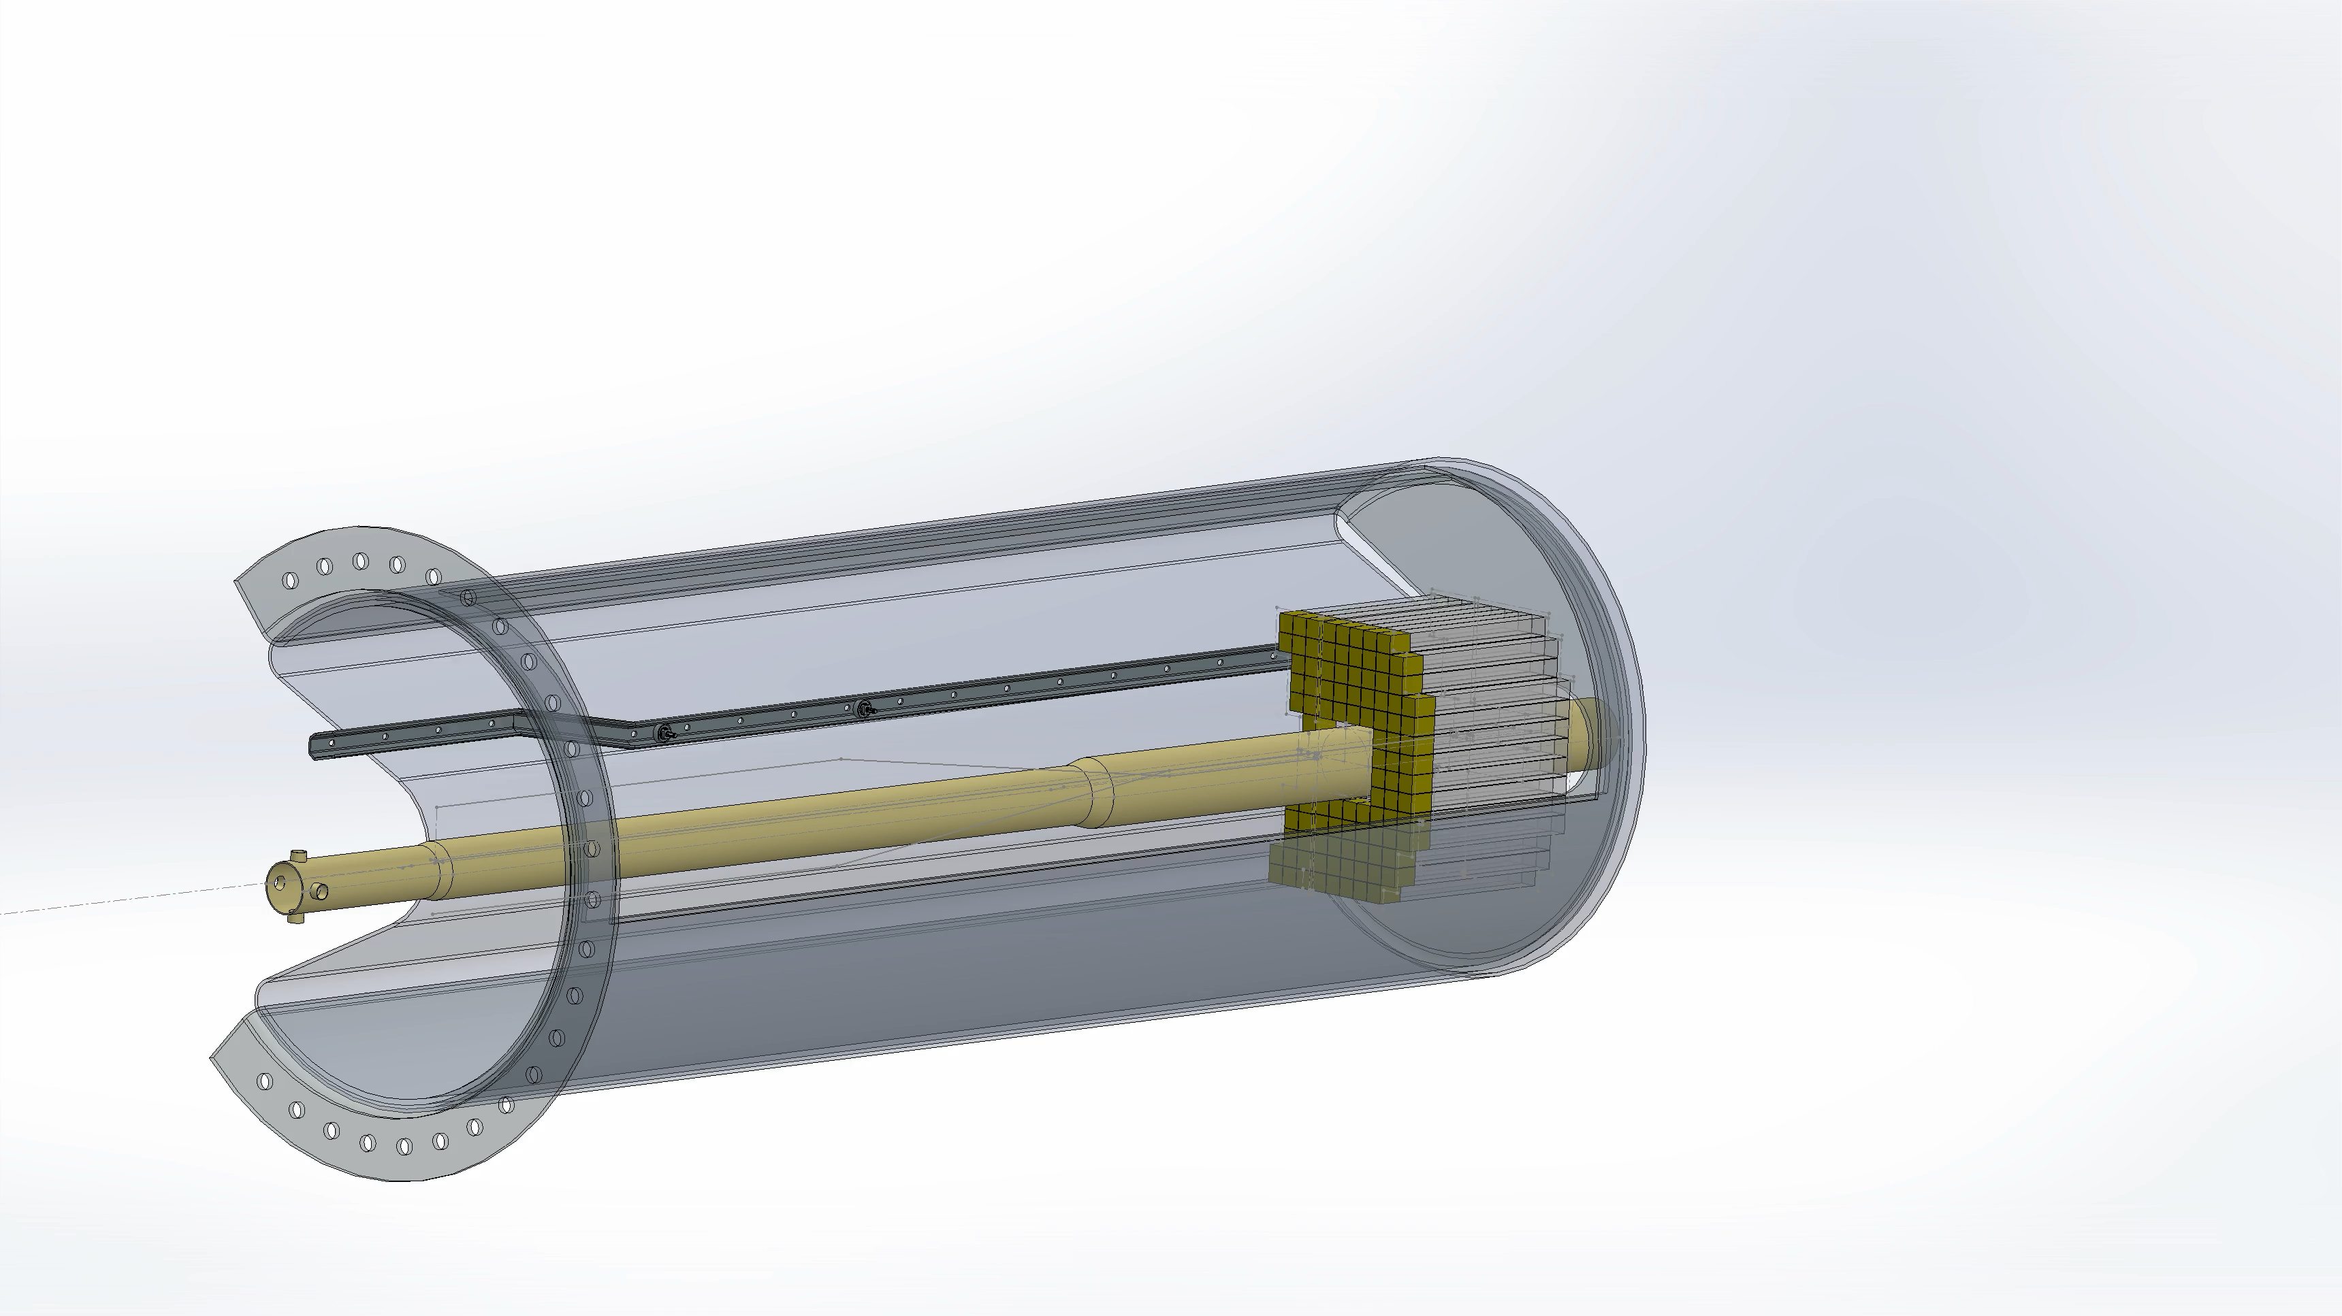
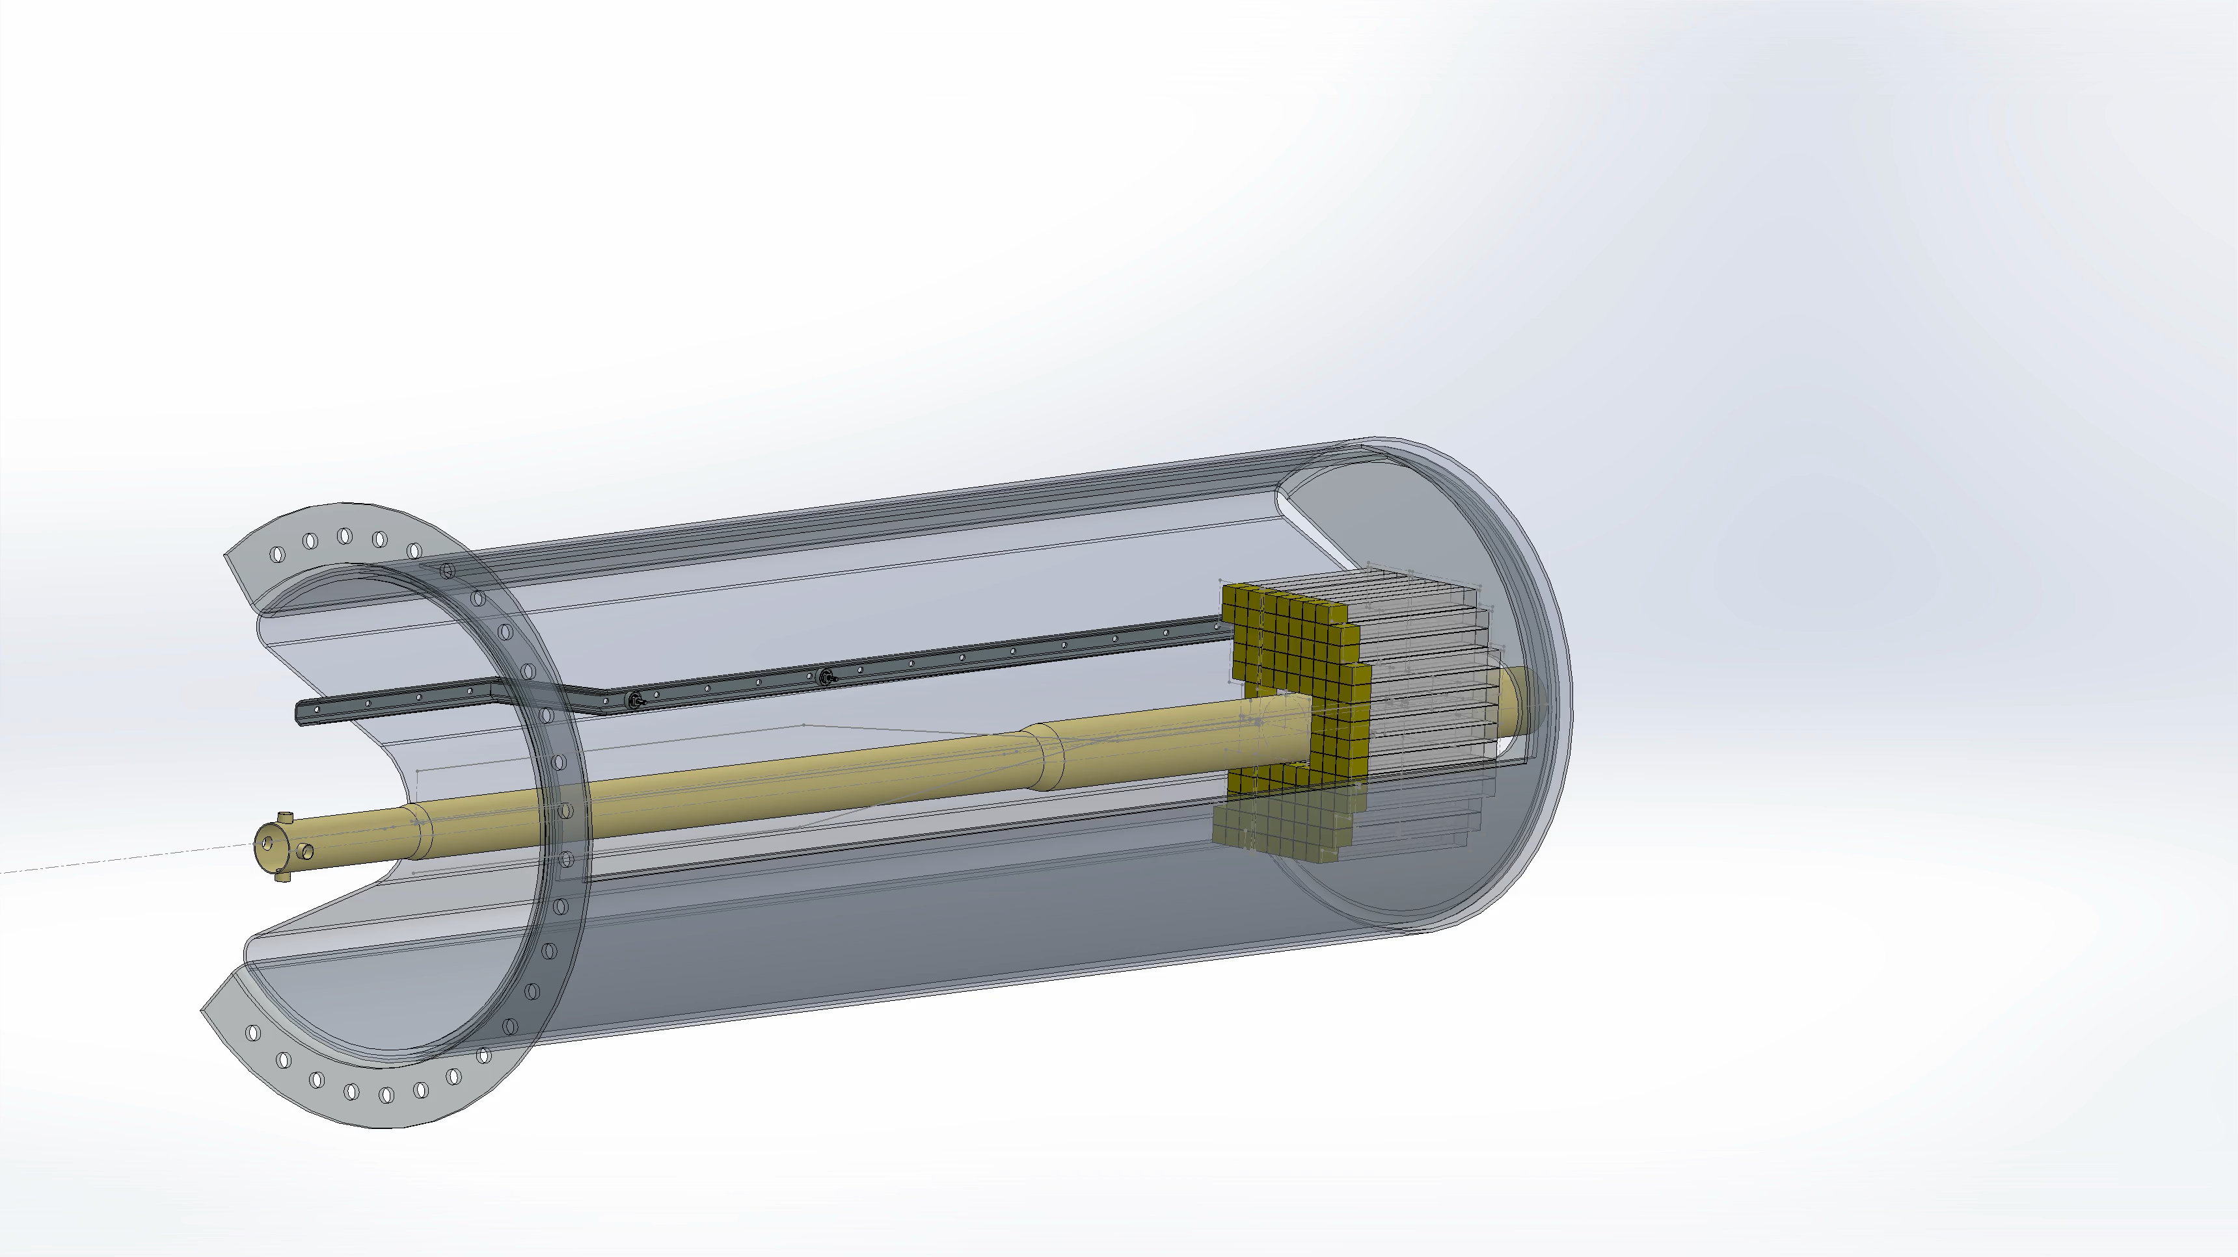


Slide 4
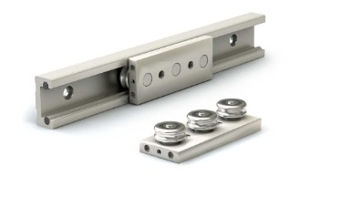
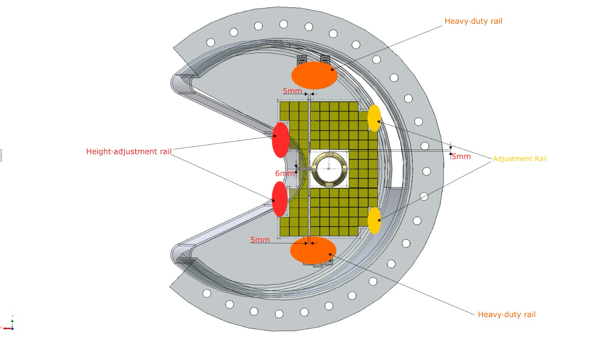
Spacing between segments ~3 mm
Heavy duty rail
Height-adjustment rails
Support rails
Heavy duty rail

Slide 5
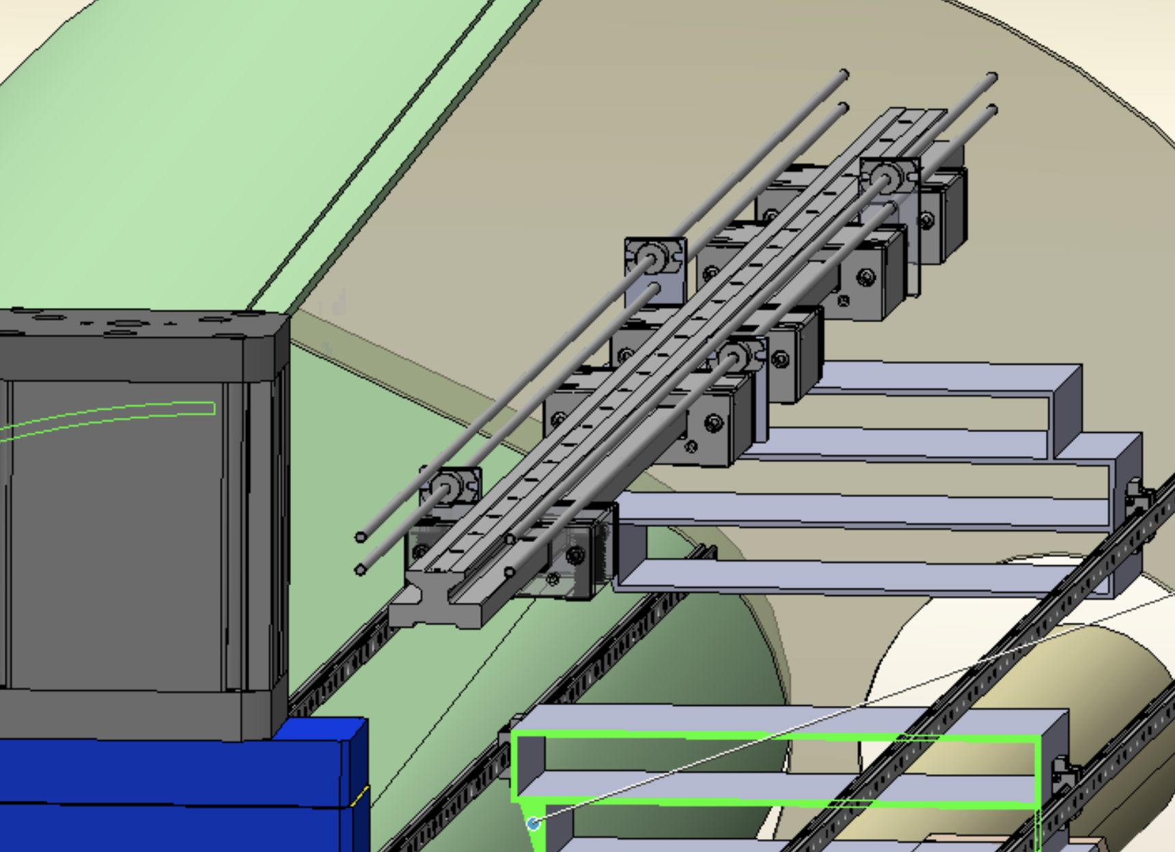
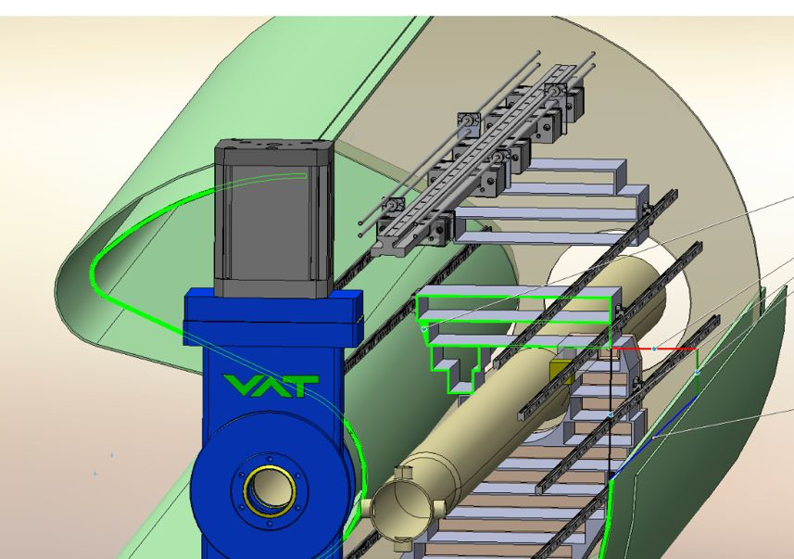
Driving motor for each plan is detachable and removed
after positioning each tracker plane

Slide 6
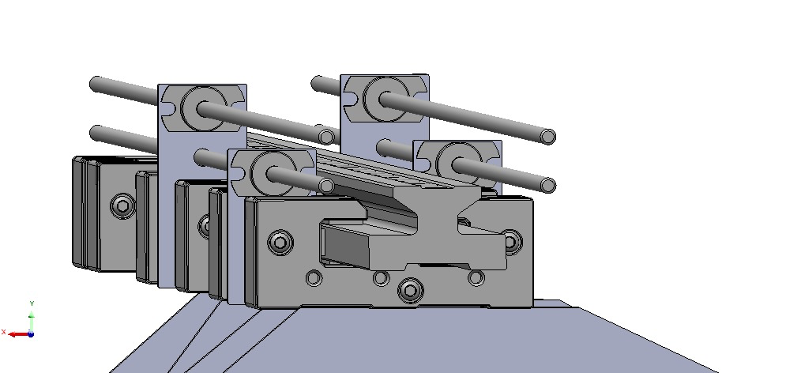
Each tracker plane moved by different driver

