Slide 1
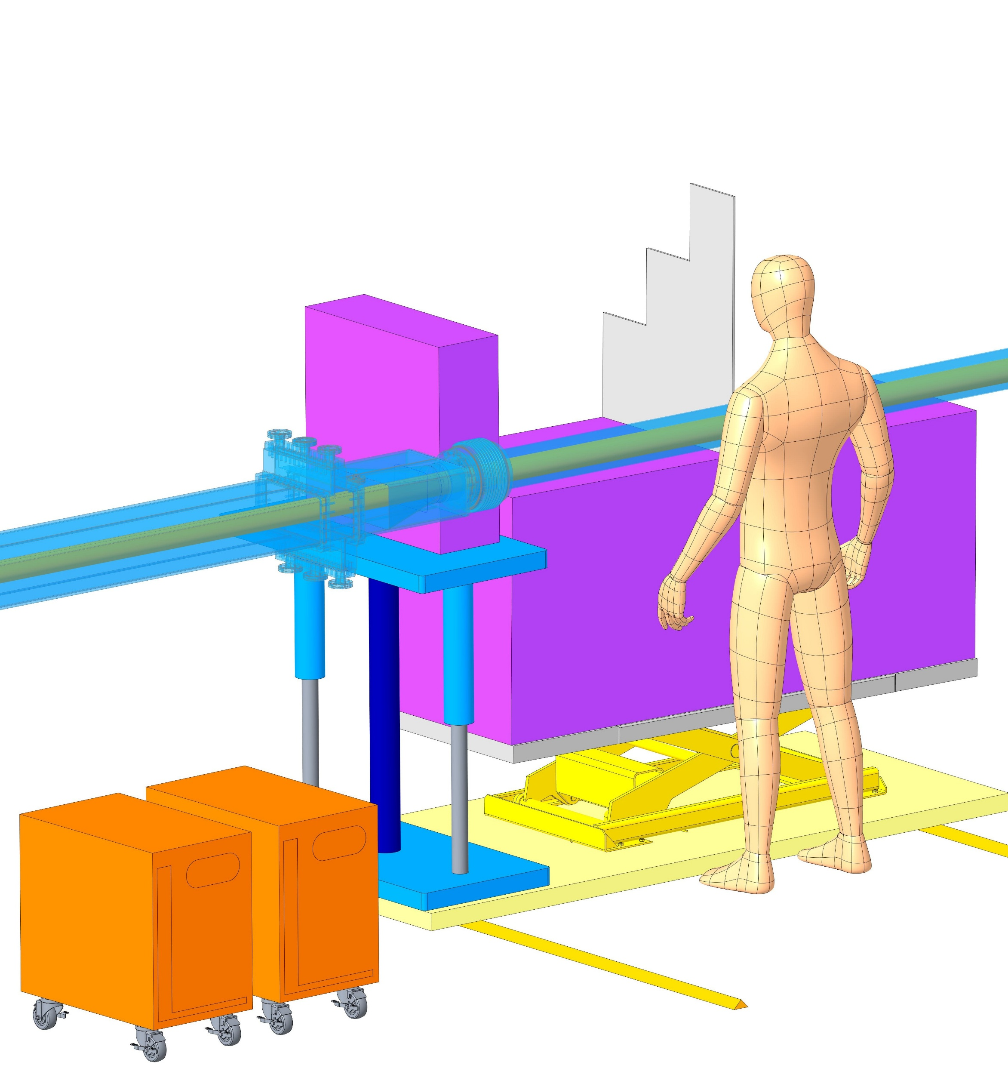
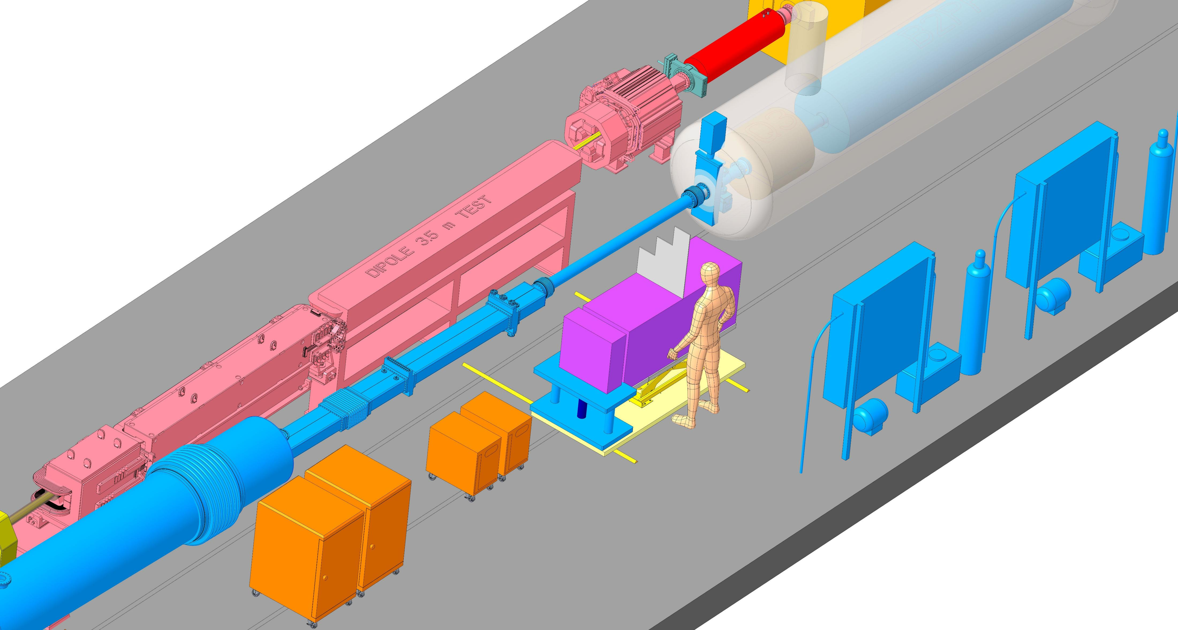
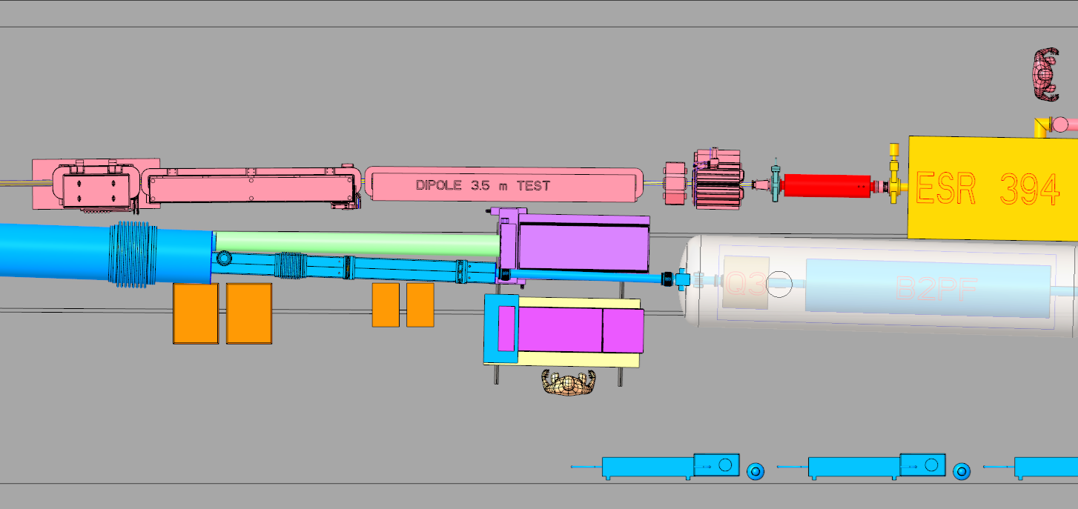
PCB/SiPMs boards
vertical insertion
Independent lift tables
EMCAL
HCAL
EGRESS
ZDC position in operation
~1.1m
Maintenance position
Cart slides on rails

Slide 2
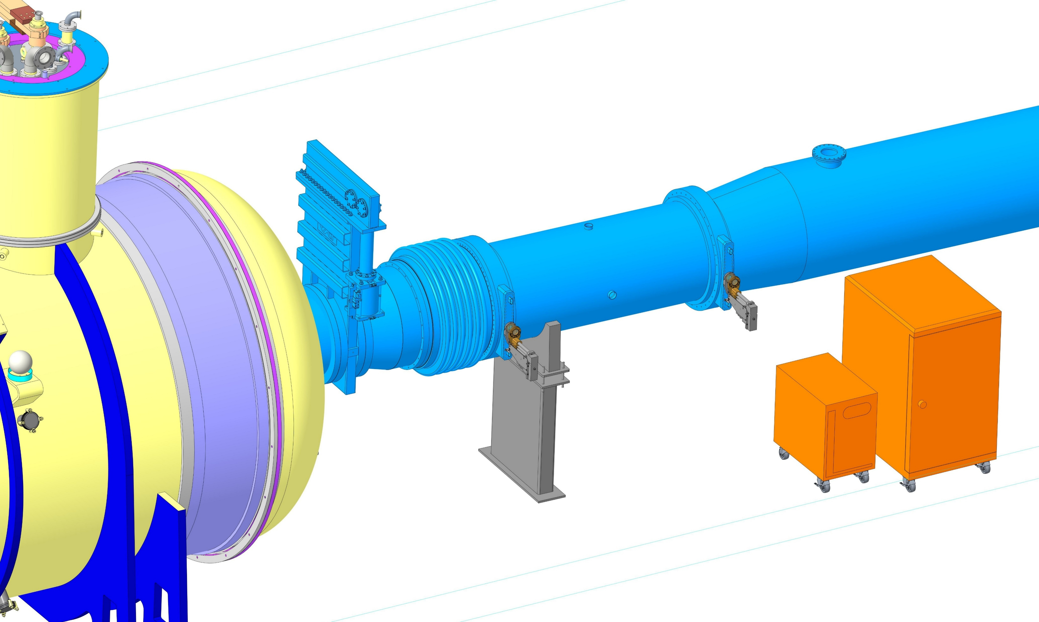
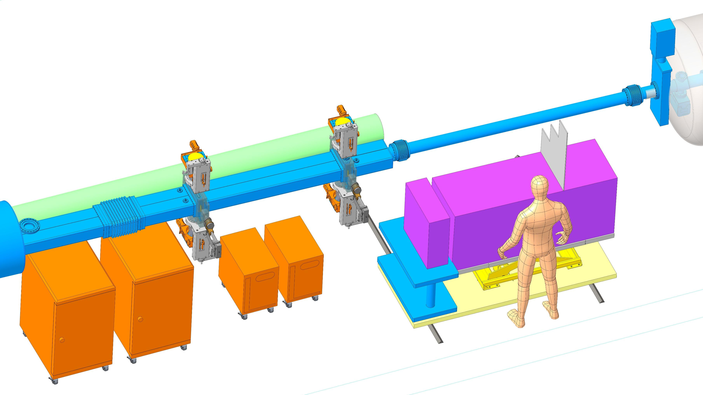
Off momentum detectors
Roman Pot (baseline)

Slide 3
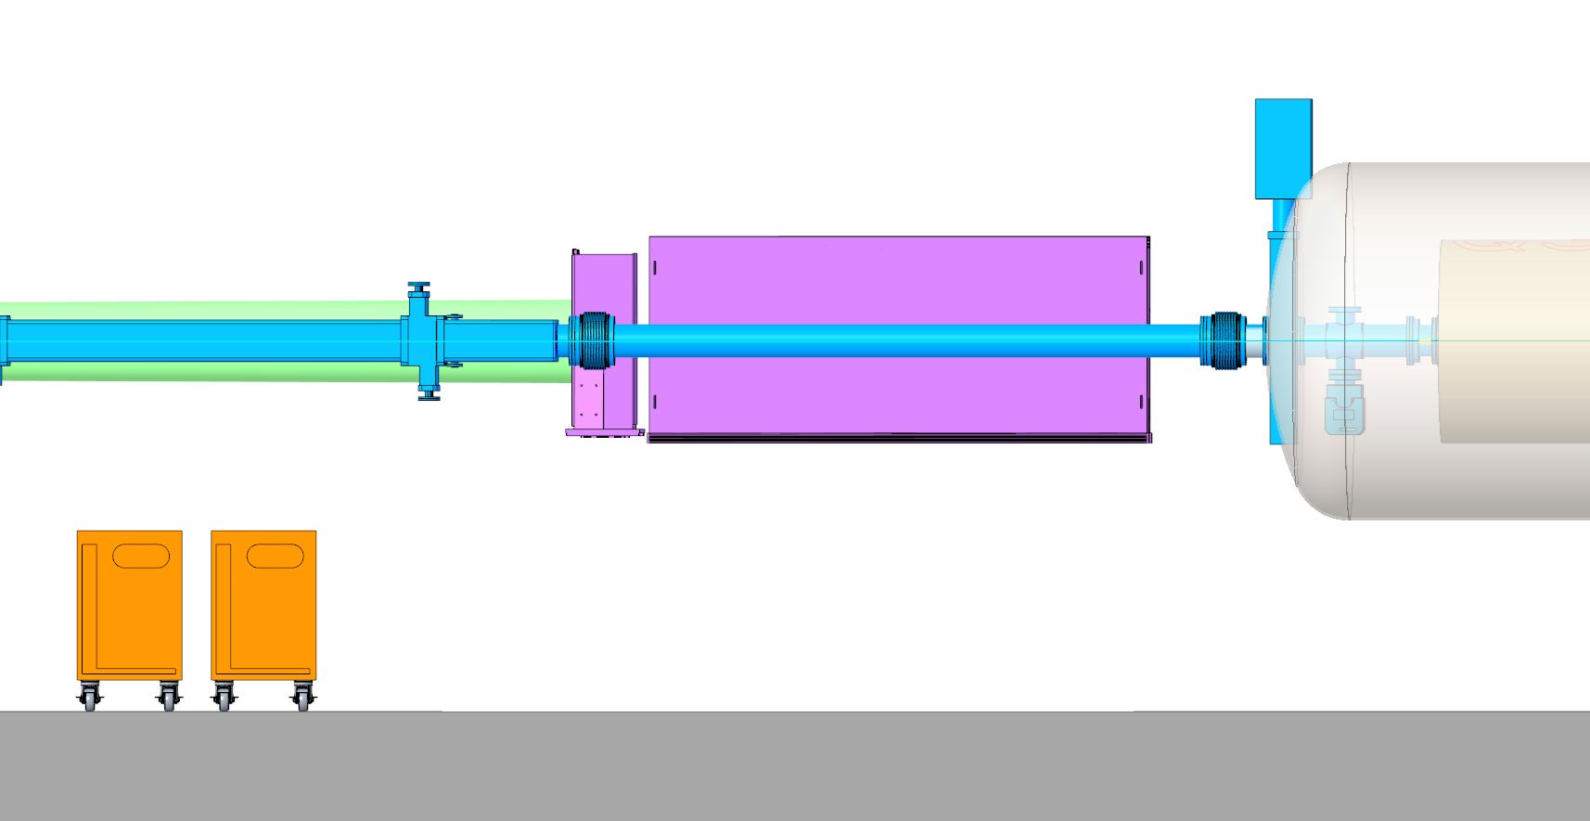
ZDC
(cables not shown)
Ø4.5” PIPE
18”
18”
Must clear the neutron beam
44.5”
47.8”
TUNNEL FLOOR

Slide 4
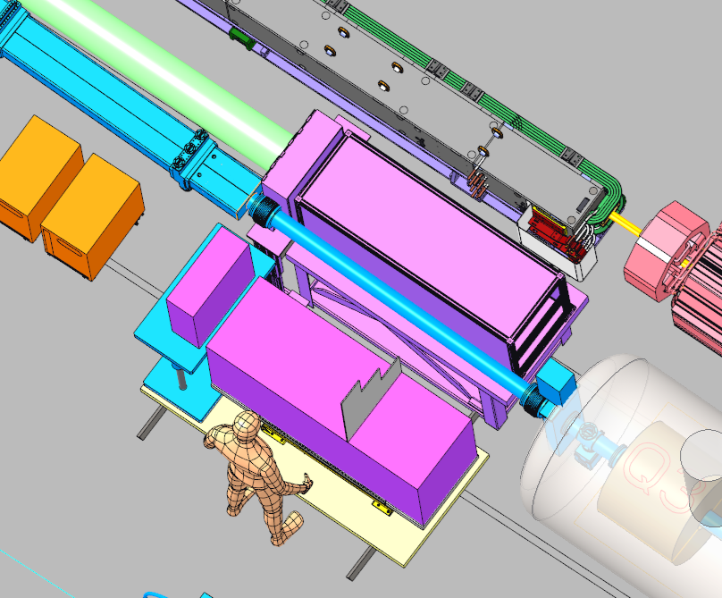
3.5m Dipole
Relocate upstream
22.8”
~4” clearance

Slide 5
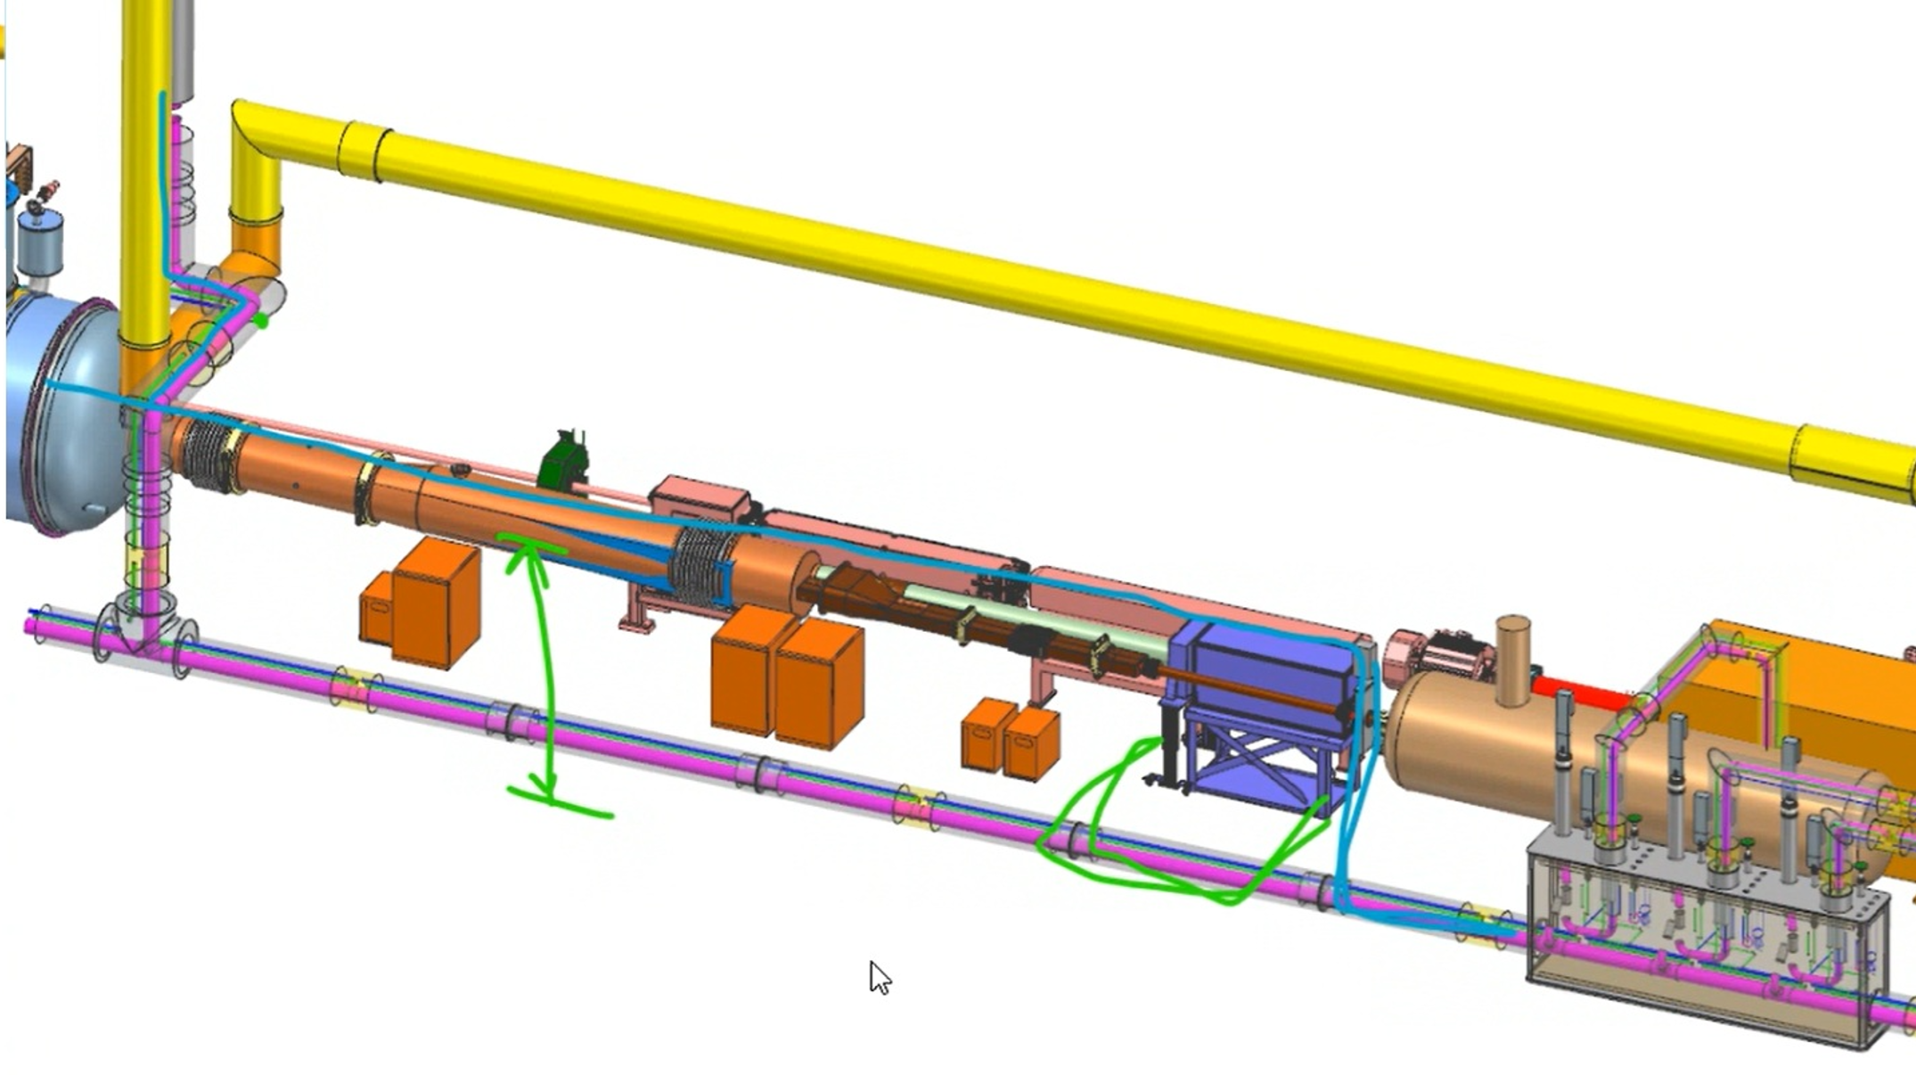
Cryo valve box
Note:
the cryo distribution line will be moved 8 ft above ground

Slide 6
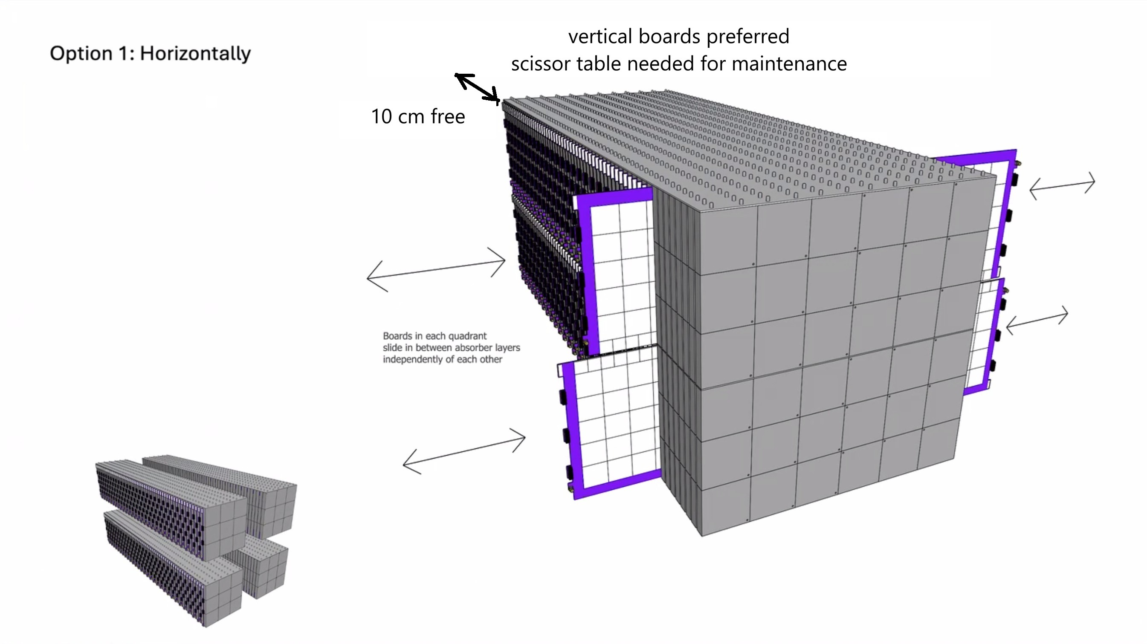
Shean Preins

