Slide 1
Electronics & DAQ WG
Fernando Barbosa (JLab)
19 March 2026

Slide 2
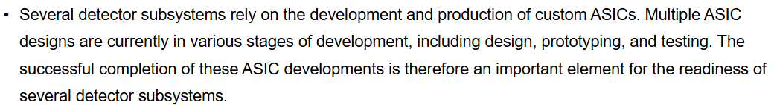
Agenda
  Today: ASIC & Electronics Status Updates
  Director’s Review – 9-12 March 2026
    Well received, with Cost and Schedule drilldown
    Findings
        Need better coordination with sub-detector schedules.

Slide 3
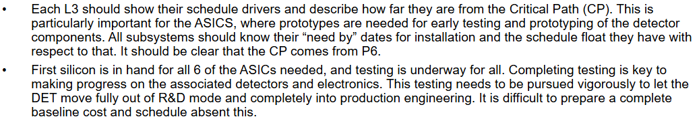
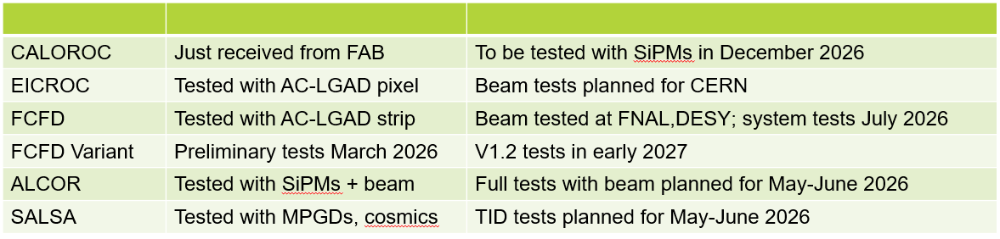
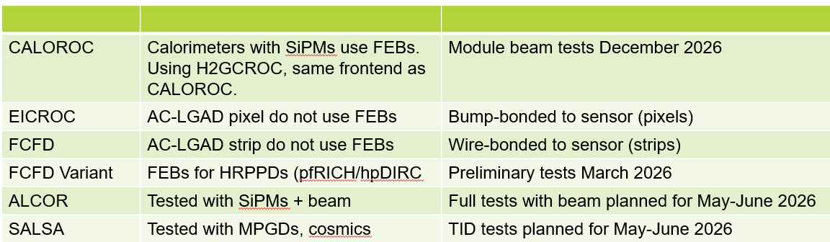
    Comments
    Recommendations
        Need better coordination with sub-detector schedules
          In progress: linking & dependencies
        Tests
          Summary of testing results – documentation.
ASICs
FEBs

Slide 4
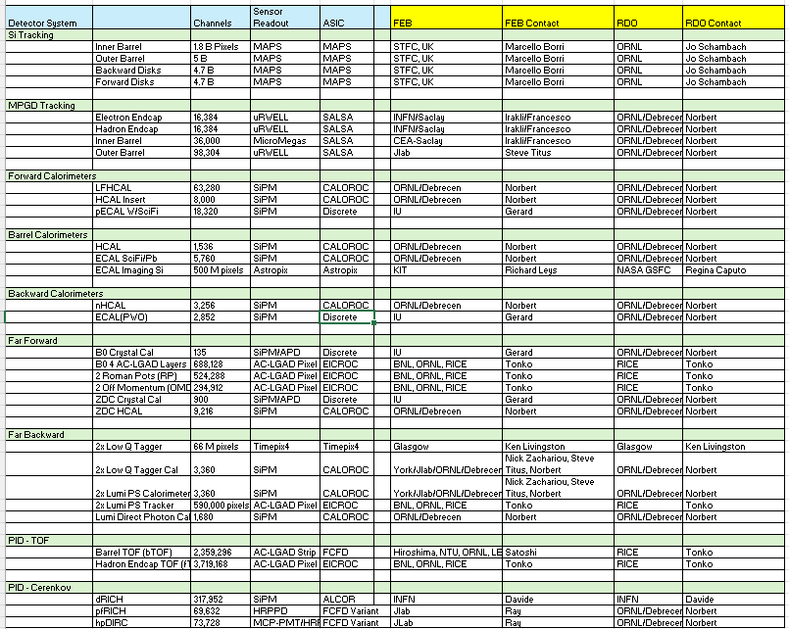
  Upcoming internal assessment reviews of each ASIC/Discrete:
      EICROC - 1 April 2026
      ALCOR - 22 April 2026
      SALSA - 6 May 2026
      CALOROC - 13 May 2026
      FCFD - 20 May 2026
      Discrete - 27 May 2026
  FEBs/RDOs Responsibilities:
    In agreement, no changes.

Slide 5
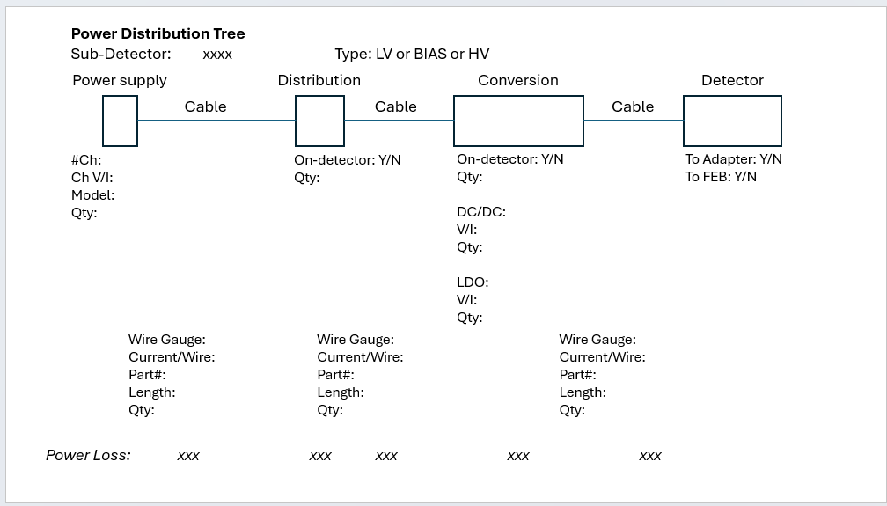
  Power Distribution Tree
Please submit Power Distribution Tree for each sub-detector by the end of March 2026.

