Slide 1
ePIC Collaboration Meeting
HRPPD Electronics Design Overview
Raymond Dawson
Electronics Engineer
January 20 – 23, 2026

Slide 2
Outline
HRPPD Electrical Design Overview
FCFD Front-End Board Overview
HRPPD Electronics Design Overview
Raymond Dawson

Slide 3
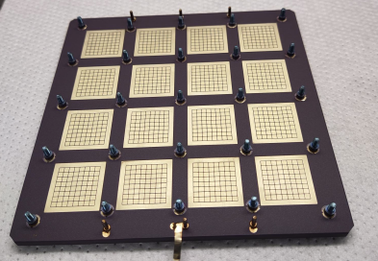
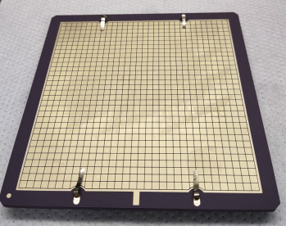
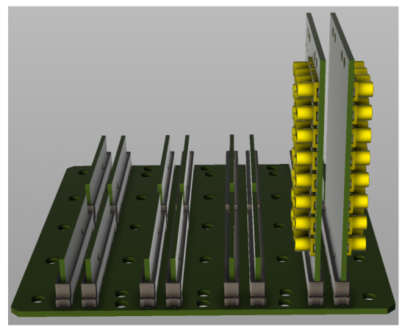
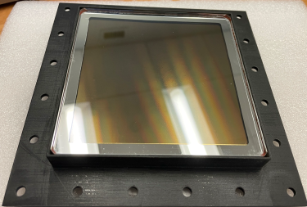
JLab Electrical Design of the HRPPD/pfRICH
JLab is contributing to the electrical design of the HRPPDs including the ceramic sensor and the readout electronics/PCBAs
Initial HRPPDs had issues with crosstalk (10%)
  Led to analysis and simulation to improve overall signal integrity of the signal chain from sensor to readout
Improvements to mechanical aspects
  Connectorization
  Board-board interfaces
  High voltage routing
HRPPD
(Air/Readout side)
HRPPD
(Vacuum/Detection Side)
Readout PCBAs
HRPPD
(Window)
HRPPD Electronics Design Overview
Raymond Dawson

Slide 4
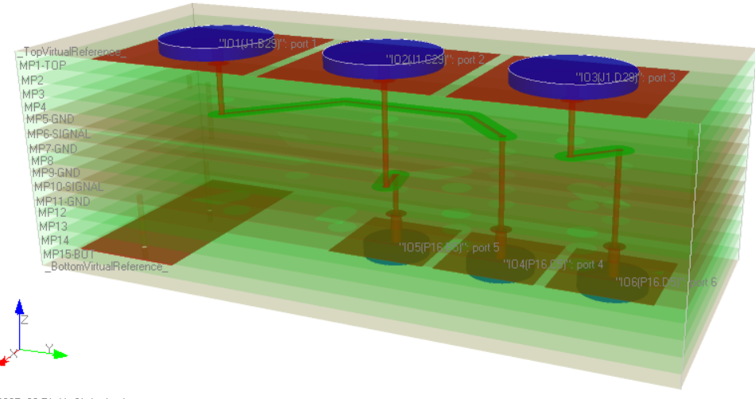
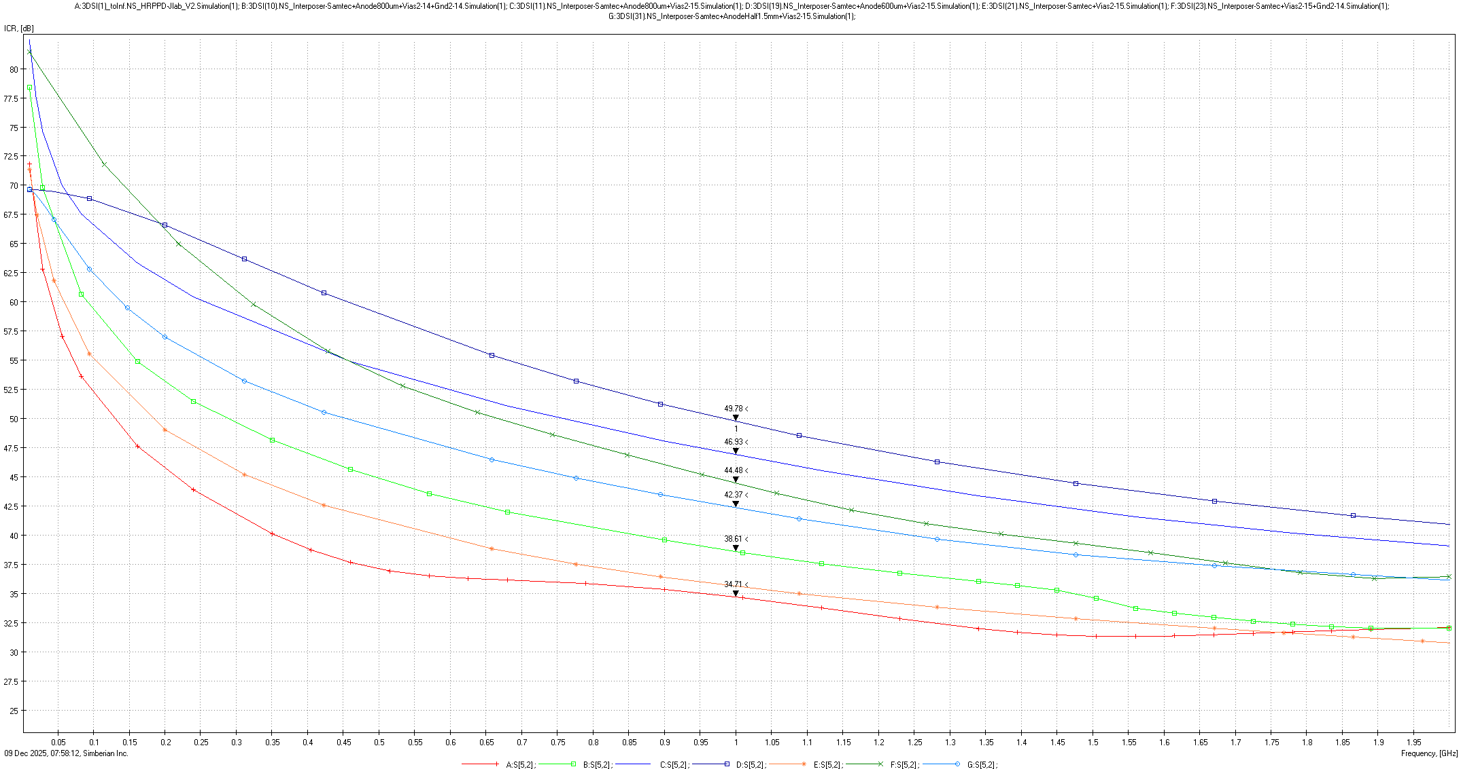
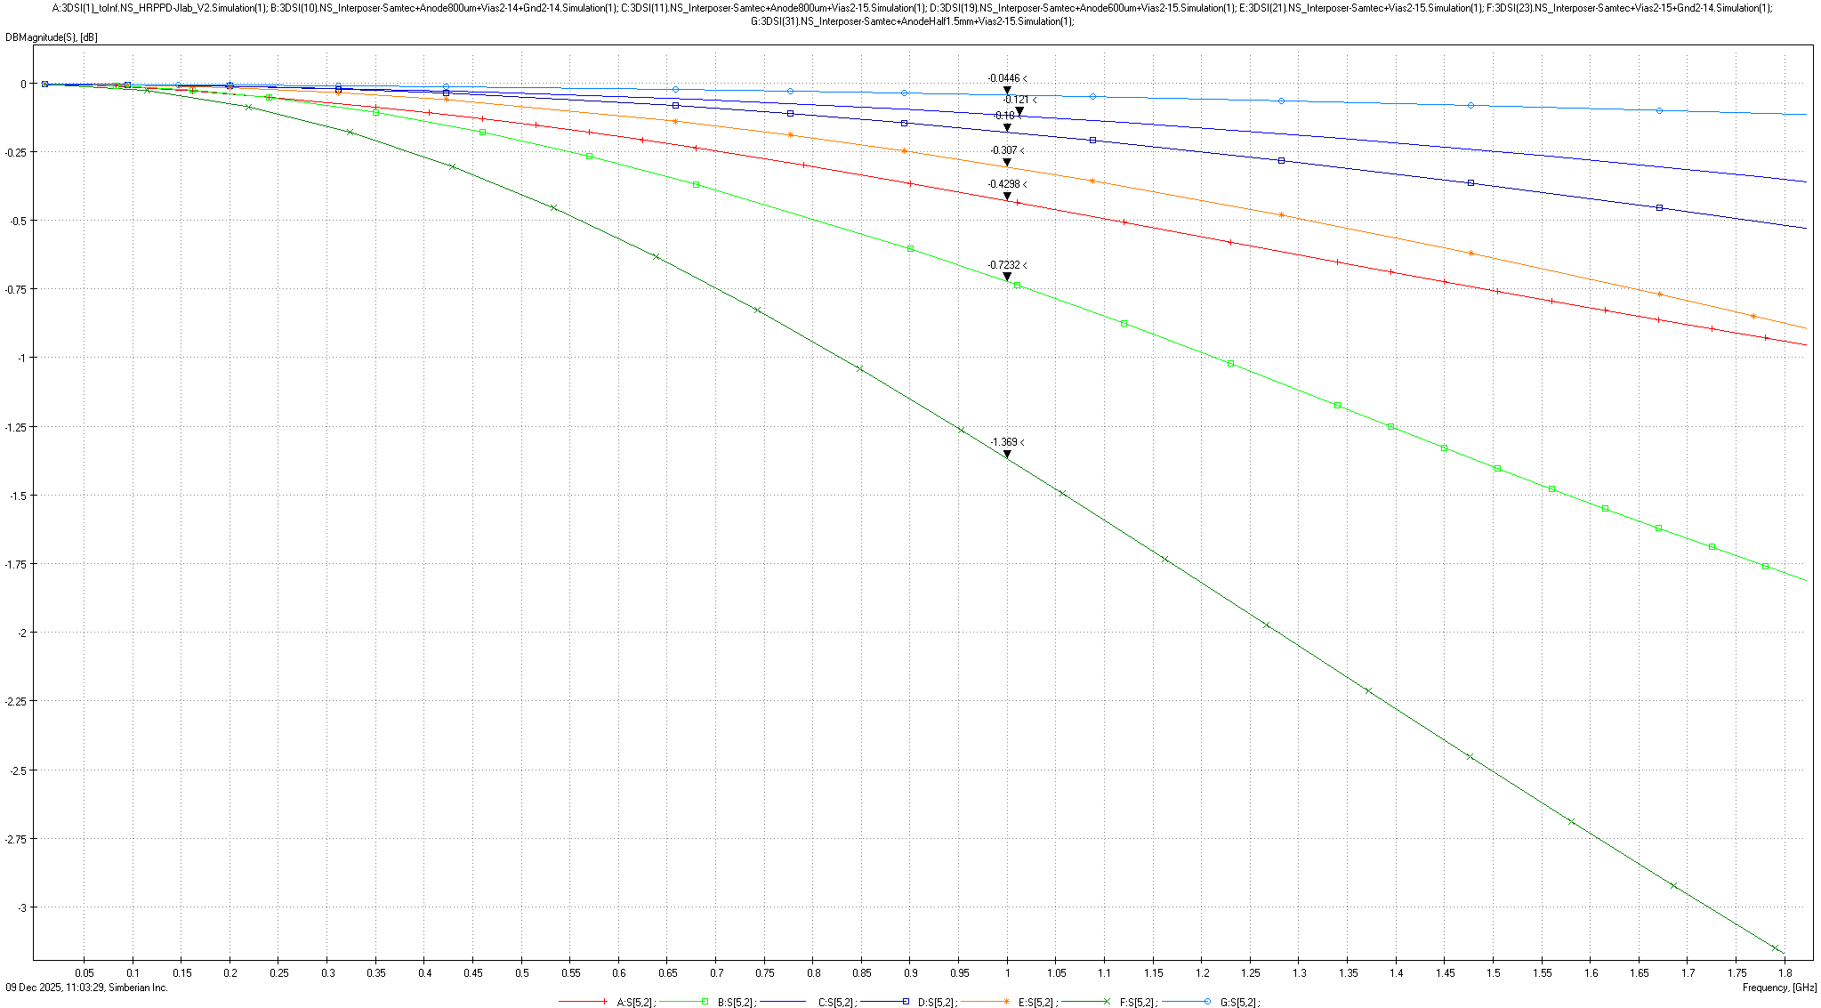
HRPPD Electrical Simulations
Signal integrity metrics
  Crosstalk, insertion loss, return loss
Simulated signal quality with variations to the following key tenets of SI
  Copper-copper spacing / pad size
  Increased ground stitching via density near signal vias
    Within ceramic and connectors
  Ground planes adjacent to signal layers and smaller dielectric thickness
    Results not as expected due to dielectric material
Combined ceramic simulations with connectors and PCBAs to evaluate entire signal chain
Simulations drive changes to improve design
Simulation Model
0.32%: Optimized design
1.75%: Original design
S-parameter Graph of Insertion Loss-Crosstalk Ratio
S-parameter Graph of Insertion Loss

Slide 5
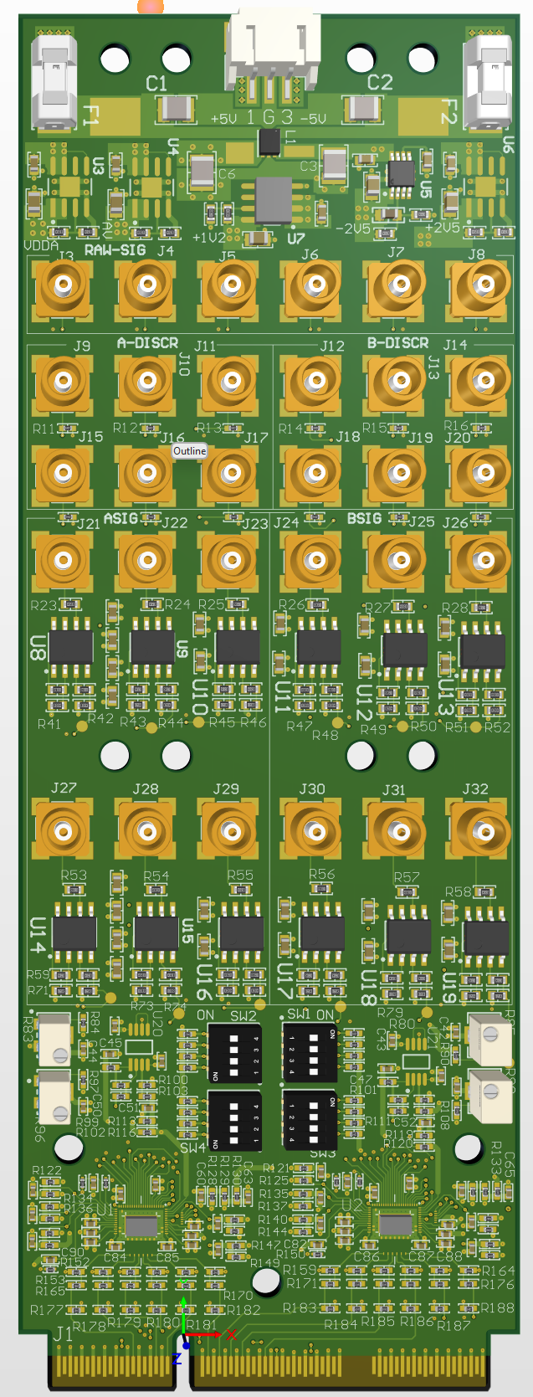
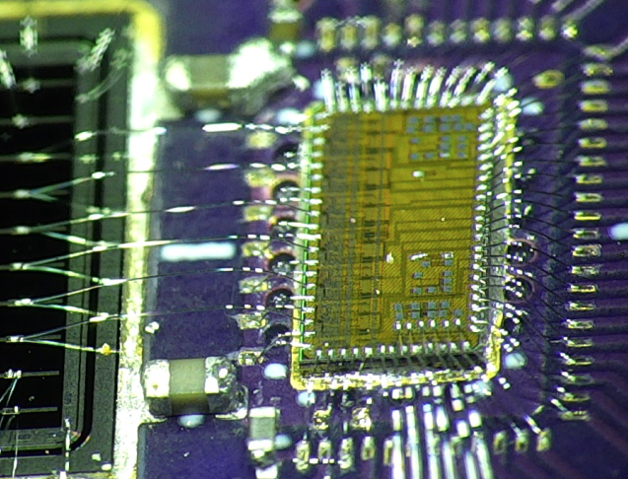
Preliminary Front-End-Board (FEB)
FCFDv1.1
  Originally designed to read AC-LGAD strips
    Directly wirebonded to sensor
  Analog front-end only
  6 input channels with 2x outputs per channel (analog + digital CFD)
  Maximum dynamic range of 100fC
FEB
  Represents final front-end board design
  6x boards expected late Febuary
    Feedback to FNAL in Spring
    Prototype variant in 2026
      If changes are simple
Challenges
  Feasibility
    Routed to sensor rather than wirebonded
  Limited inputs
    Using 2x ASICS on FEB to test 12 channels
  Dynamic range
    HRPPD max charge of 160fC
  Impedance matching / attenuation
    Impacts dynamic range
HRPPD
(Vacuum/Detection Side)
FCFDv1.1
FEB
HRPPD Electronics Design Overview
Raymond Dawson

Slide 6
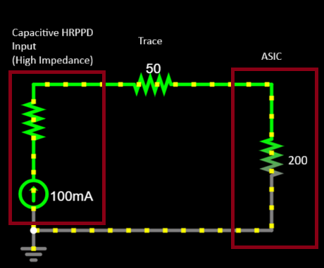
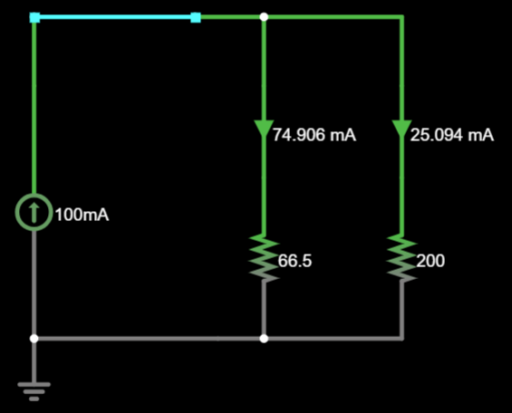
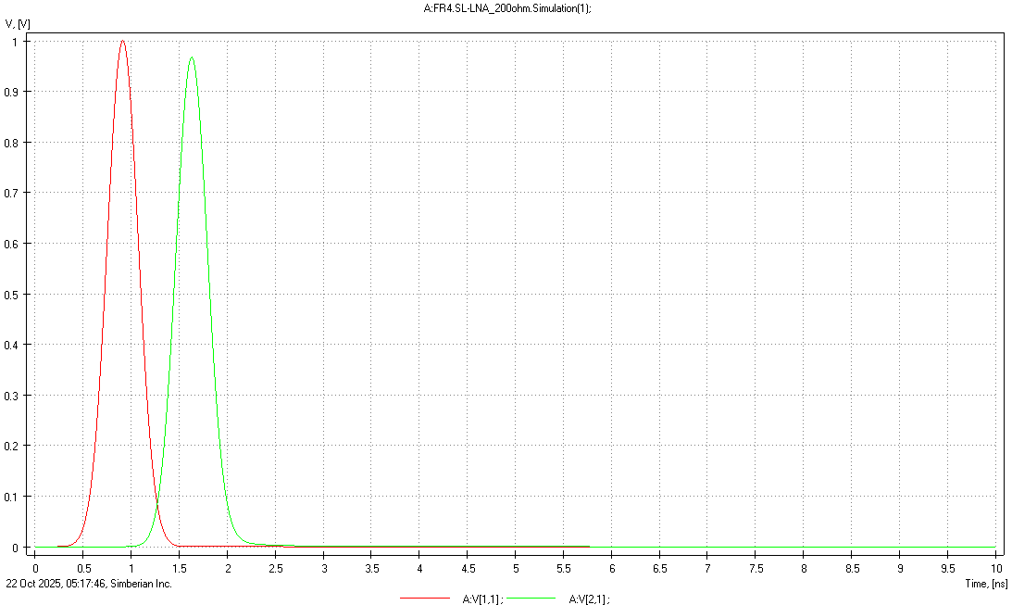
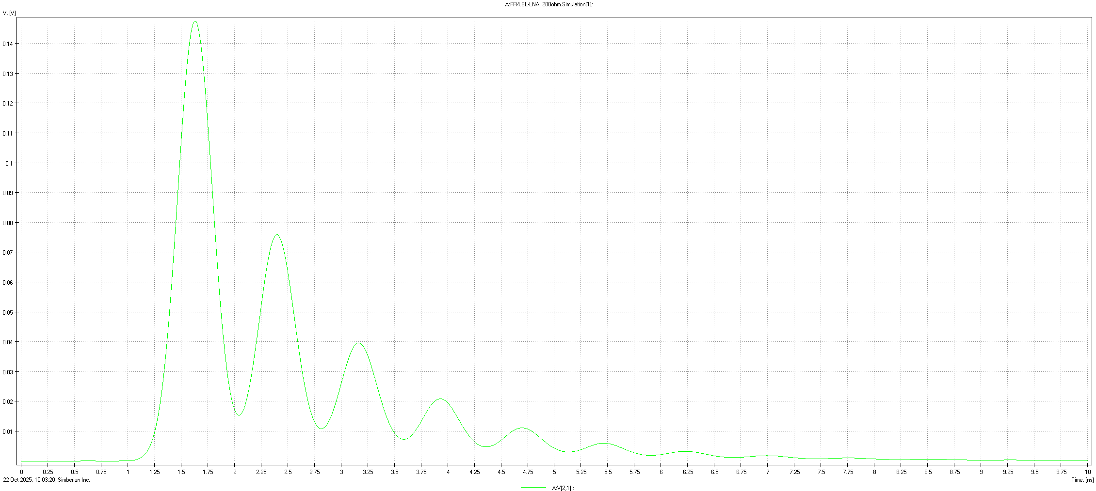
Impedance Matching Simulation
Perfectly matched system
50Ω Tx
50Ω Rx
50Ω transmission line
550
Unmatched system in reality
High impedance Tx
200Ω Rx
50Ω transmission line
To fix, adjust impedance of Rx
This reduces amount of charge to ASIC and impacts dynamic range
50
50
Red = Signal from Tx
Green = Signal at Rx
Green = Signal at Rx
HRPPD Electronics Design Overview
Raymond Dawson

