Slide 1
ePIC Collaboration Meeting
Development of the FCFD Variant ASIC - Overview
Fernando Barbosa
Chief Electrical Engineer, L3 Manager
Control Account Manger WBS 6.03.01.07
January 20 – 23, 2026

Slide 2
Outline
ePIC Channels, Scale & Technology
Requirements/Specifications
FCFD Variant Development

Slide 3
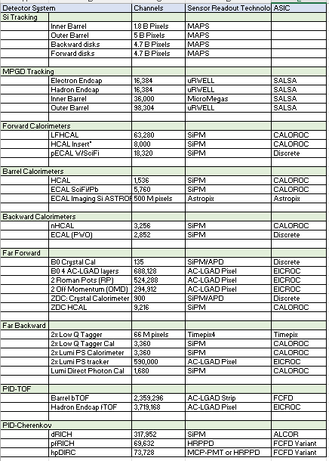
ePIC Channels, Scale & Techology
CERN
eRD109/PED Initiatives:
Discrete COTS – SiPM, 14-bit
CALOROC – SiPM, 10-bit
ALCOR – SiPM, 1 pe
EICROC – AC-LGAD, pixel
FCFD – AC-LGAD, strip
FCFD Variant – HRPPD/MCP-PMT
SALSA - MPGD
eRD109/PED
KIT, NASA (GSFC), ANL
eRD109/PED
Electronics Readout:
  One (1) Discrete COTS
  Six (6) ASICs
U. Glasgow
eRD109/PED

Slide 4
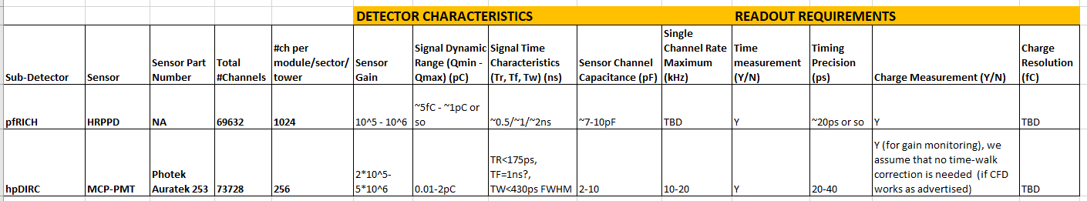
Requirements/Specifications
HRPPD/MCP-PMT - FCFD Variant (FNAL, JLab)
We had a few meetings with pfRICH, hpDIRC, FNAL, JLab.
Need to re-assess specifications and requirements with pfRICH, hpDIRC and FNAL groups, within range of interest/physics reach:
  Detector Gain Operation & Lifetime
  Dynamic Range (DR)
  Timing Precision
ASIC backend will be the same as the FCFD, following on previous development of the ETROC.

Slide 5
FCFD Variant Development
Dynamic range requirements for pfRICH possibly narrower and agreeable with FCFD design for the bTOF AC-LGADs and wrt timing precision and signal charge envelope
  Current FCFD design has a design margin of ~10 in DR – revision to frontend design is feasible, if within this range
  However, a considerable re-design is necessary if a factor of 100 is needed.
In progress:
  Evaluate performance of FCFD v1.1 (AC-LGAD strip version) w/ prototype PCB Plug-in
  Evaluate performance w/ HRPPD – terminations, attenuators/scaling for dynamic range matching on PCB – Considerable signal attenuation (see Ray’s talk).
  These activities will provide good feedback to ASIC and FEB design.
FCFD Variant is now in P6 and contract has been issued to FNAL.
FCFD1.2 Variant design & MPW in 2026.
Will likely be renamed in 2026.

