Slide 1
pfRICH Sensor Plane
Simon Snydersmith, Sushrut Karmarkar, Andreas Jung
23 March, 2026

Slide 2
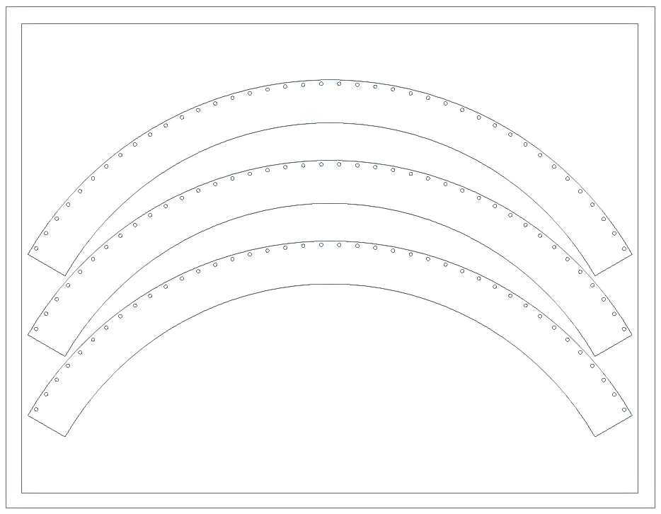
End Ring Hole Check
Hole pattern based on probe points from end ring 3
3-part waterjet-cut ring to check end ring hole alignment before cutting final sensor plate
Price from Xometry:
1/8 in aluminum $94
¼ in aluminum $167
¼ in HDPE $136
Sourcing properly sized stock likely more expensive

Slide 3
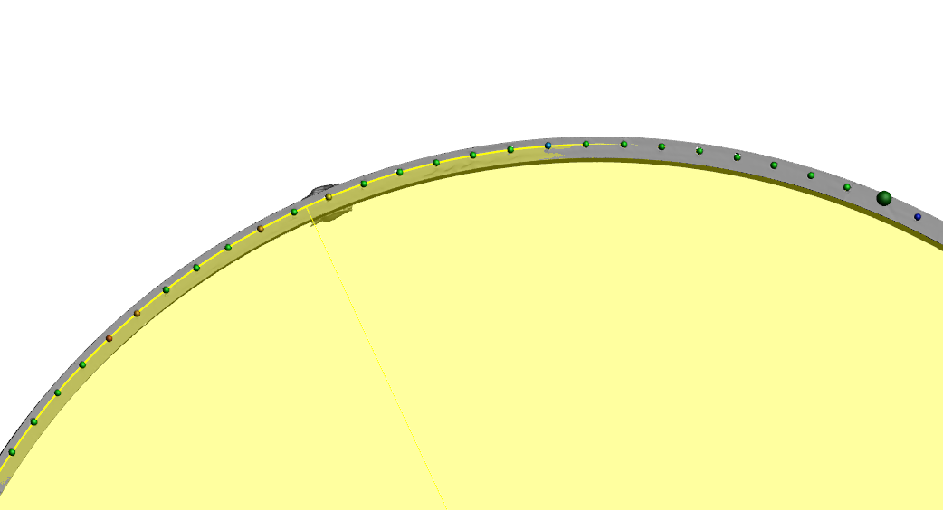
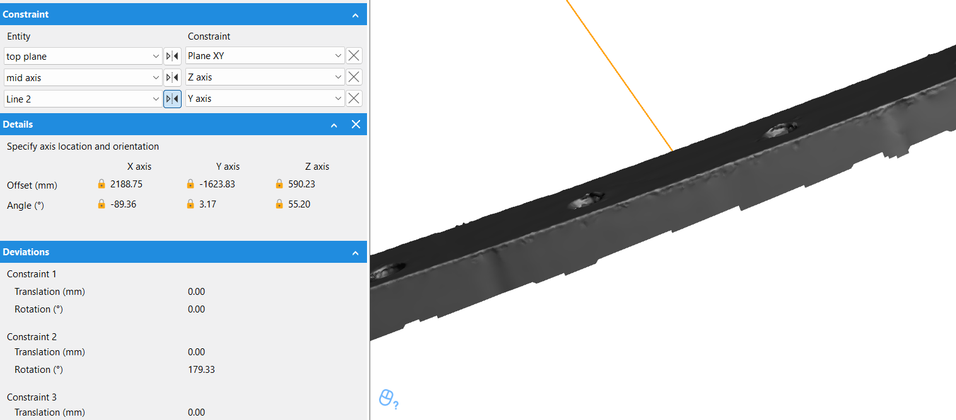
References to hole location, marks on test parts

Slide 4
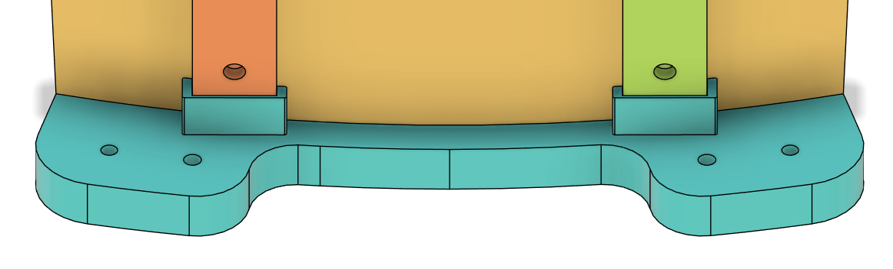
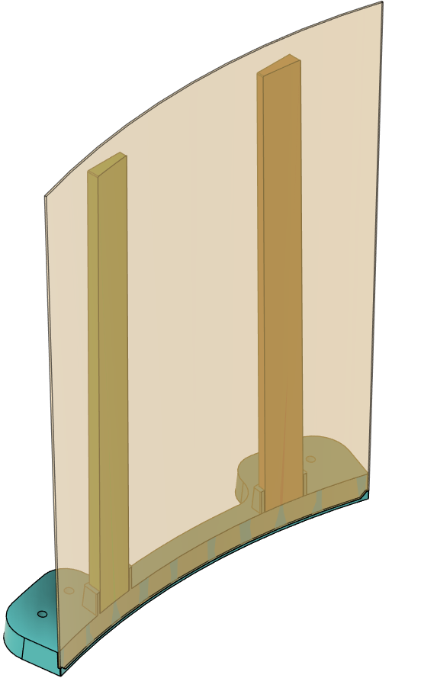
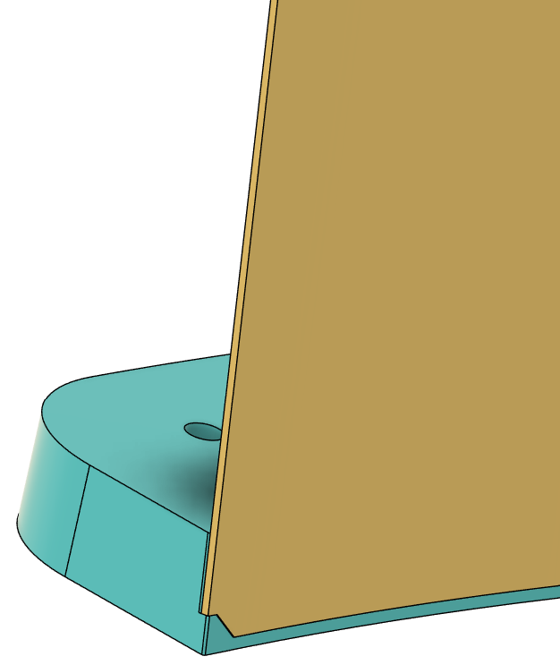
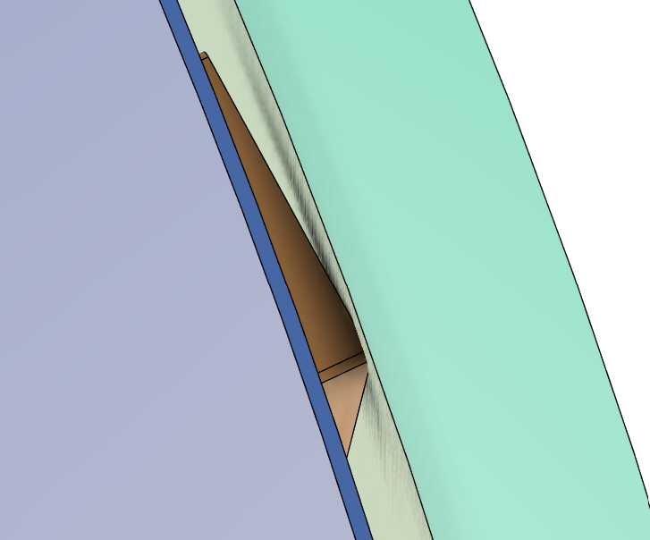
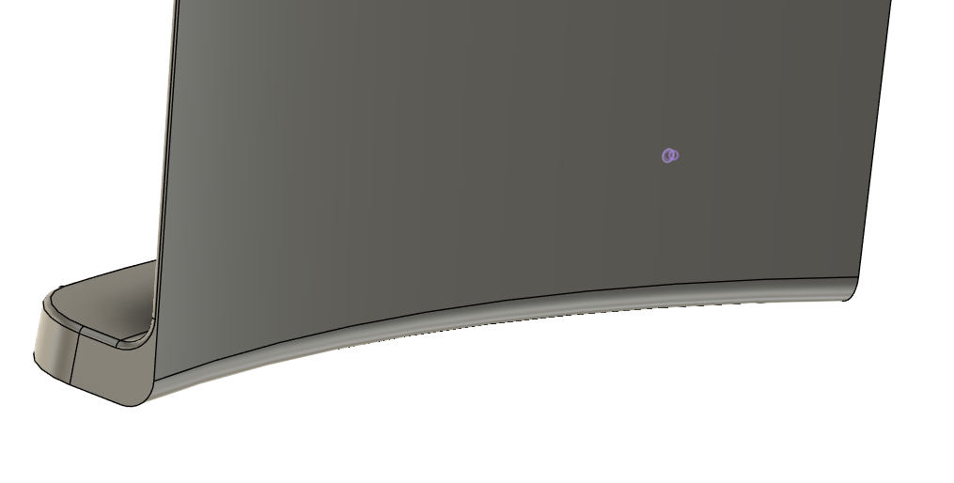
Outer Mirror Backer
Thickened uprights to allow for 0.225 inch 10-32 inserts
Flattened back of uprights for mounting
Problem of mirror backer interference with cylinder
Requires top mounting hole to move or removable section of backing

Slide 5
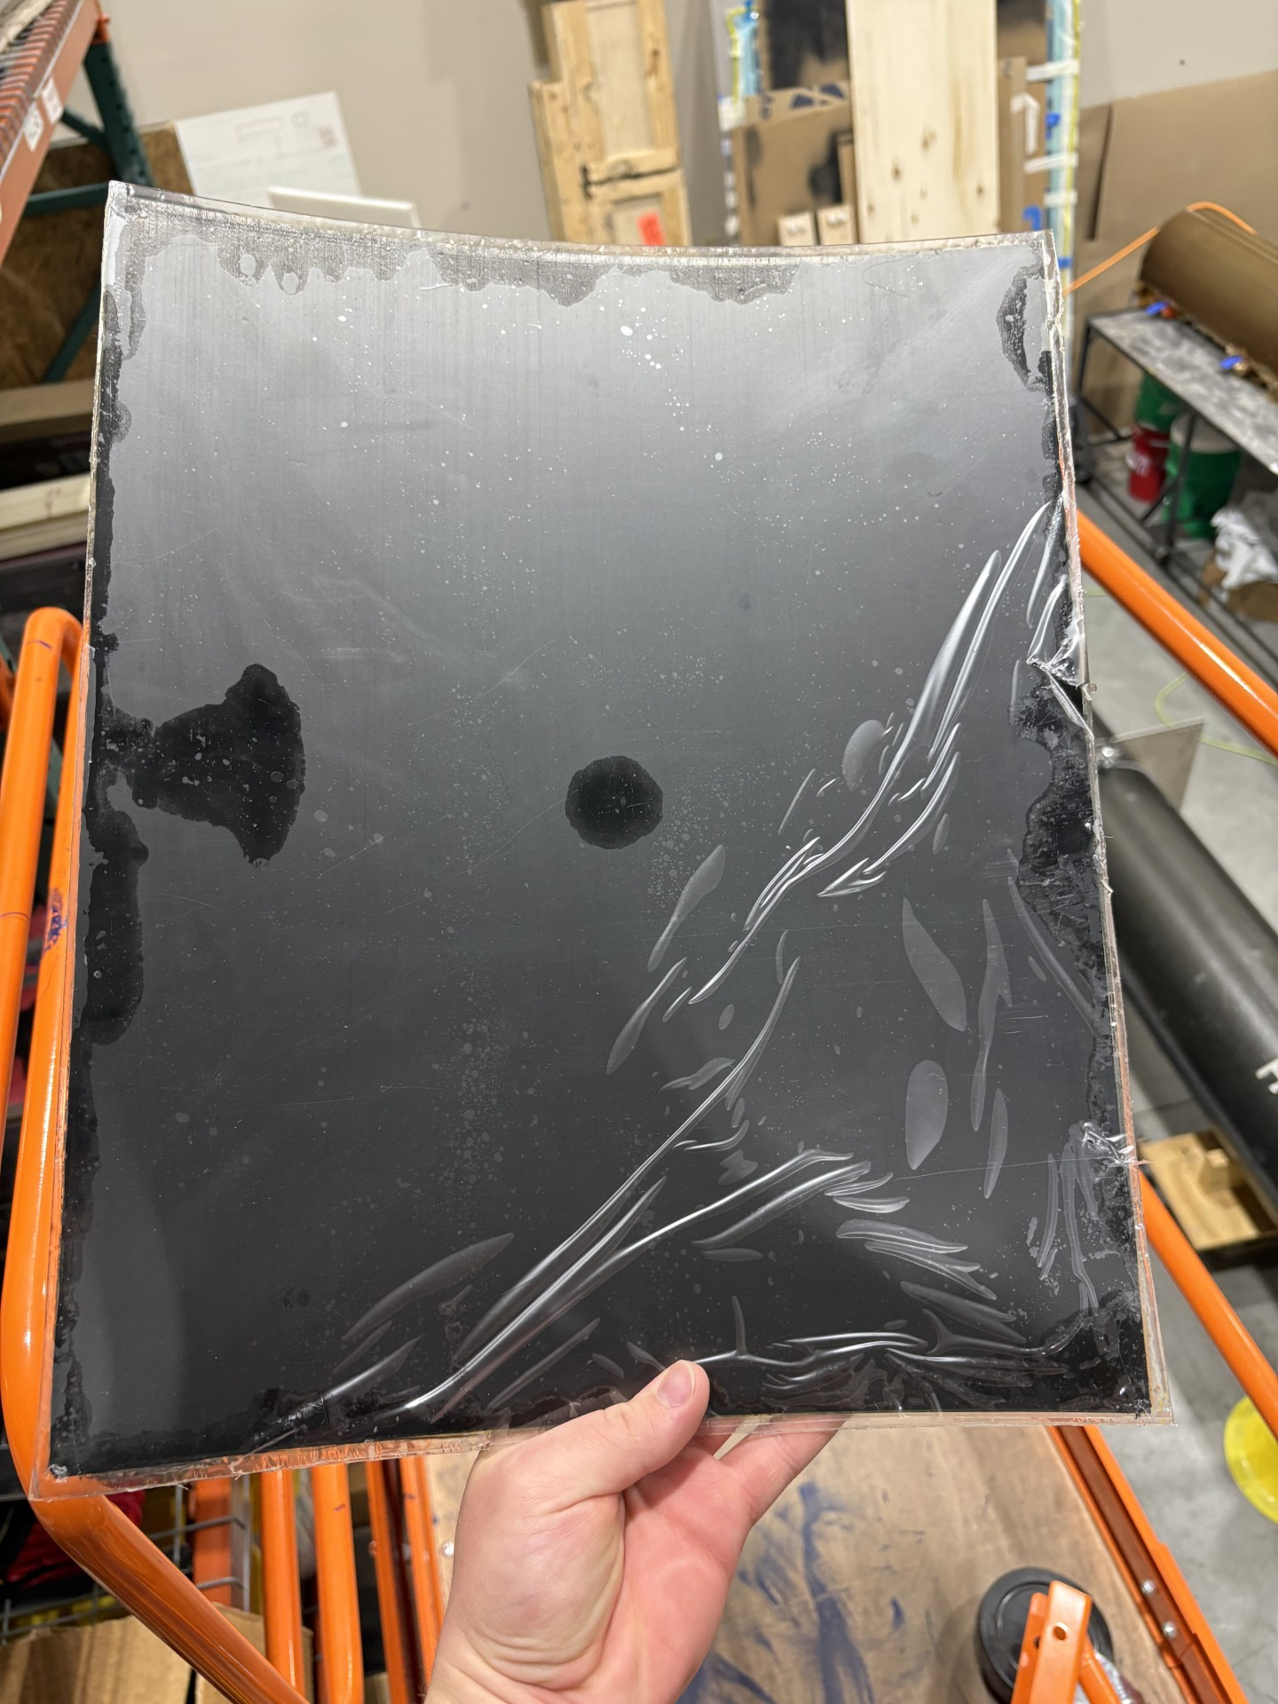
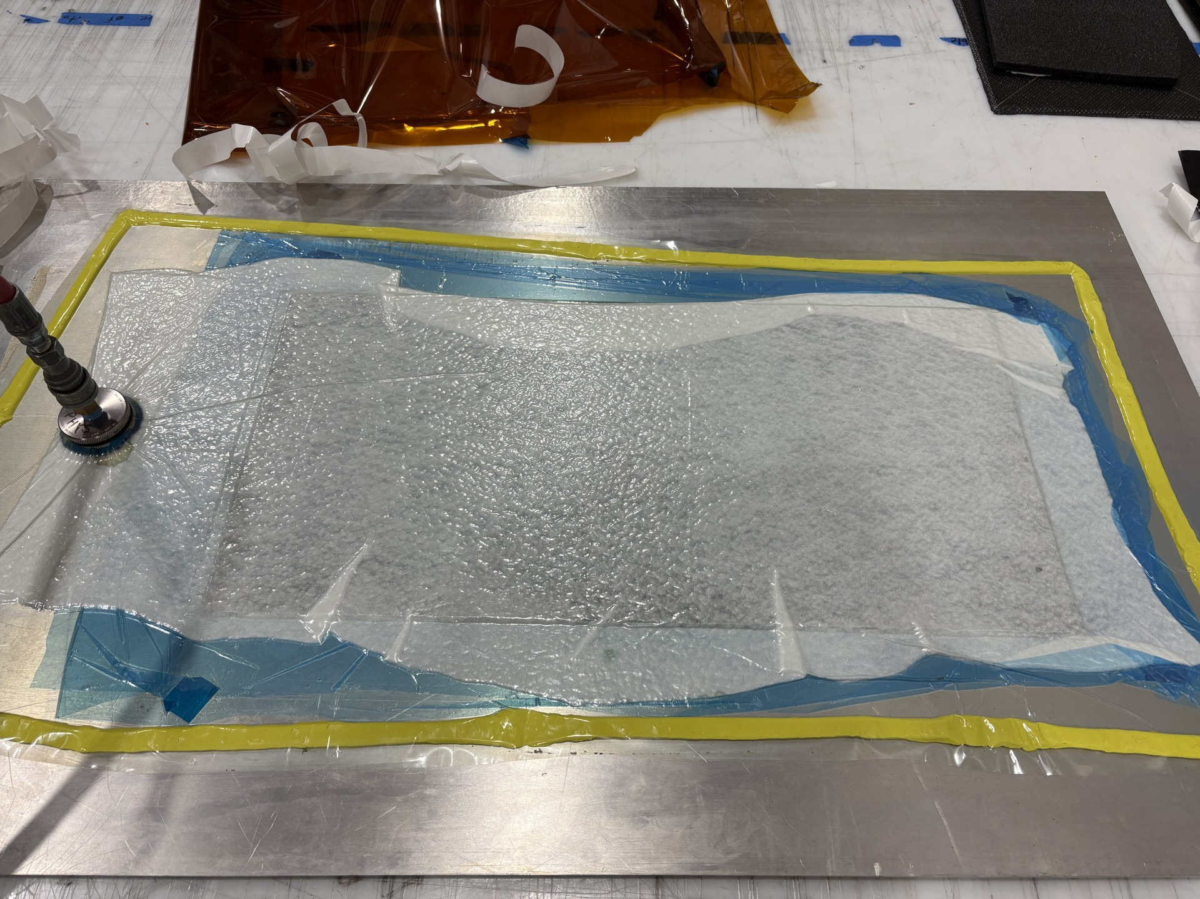
Mirror Manufacturing updates
One outer mirror with Lexan bonded
One 24x12 in flat plate ready to cut to sample size
Ordered more 0.03 in thick lexan for 2nd outer mirror and inner mirrors

Slide 6
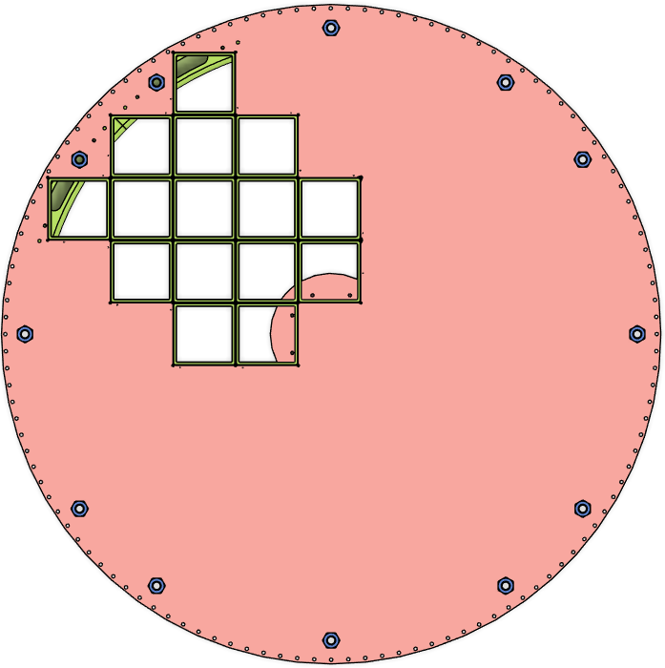
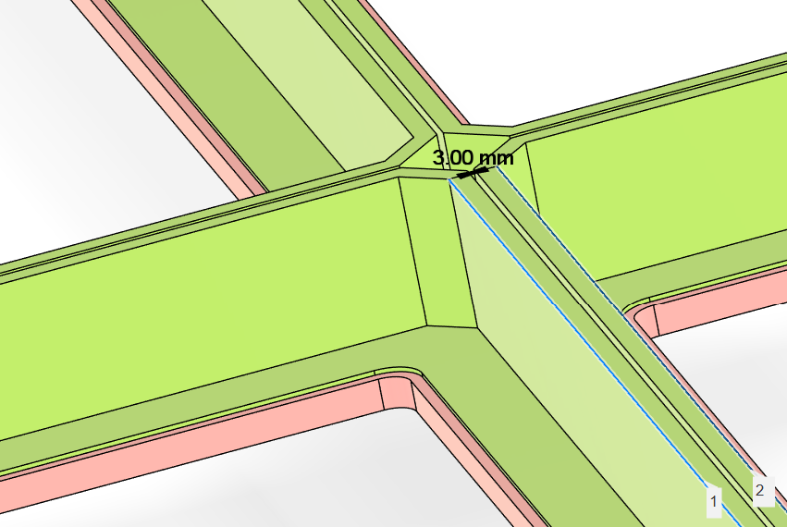
Current Dimensions and Features
Outer radius: 1300 mm
Bolt hole placement derived from End Ring 3 scan
15, 120.5 mm sensor frames
Center circle and air ports derived from Alex CAD
3 mm combined wall thickness
1/8 in radius on square holes

Slide 7
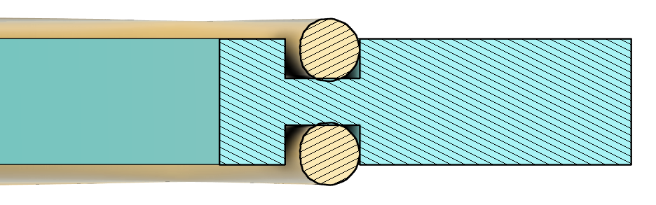
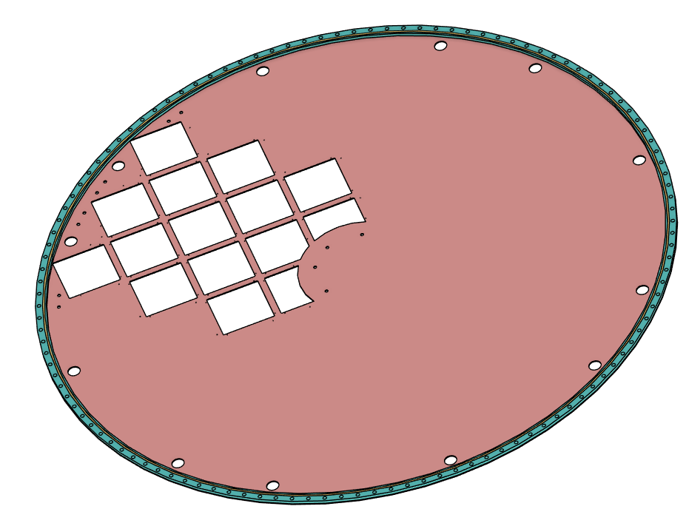
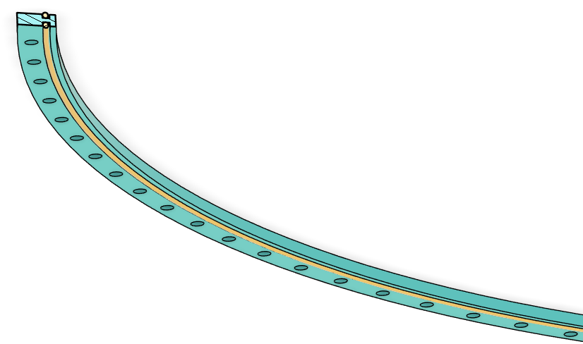
Sealing Thickener
H-design, 2 o-rings
Unglued spacer allows for:
Independence of sealing from bonding precision
Simpler machining and assembly
1/8 in O-rings require 7 mm thick spacer

Slide 8
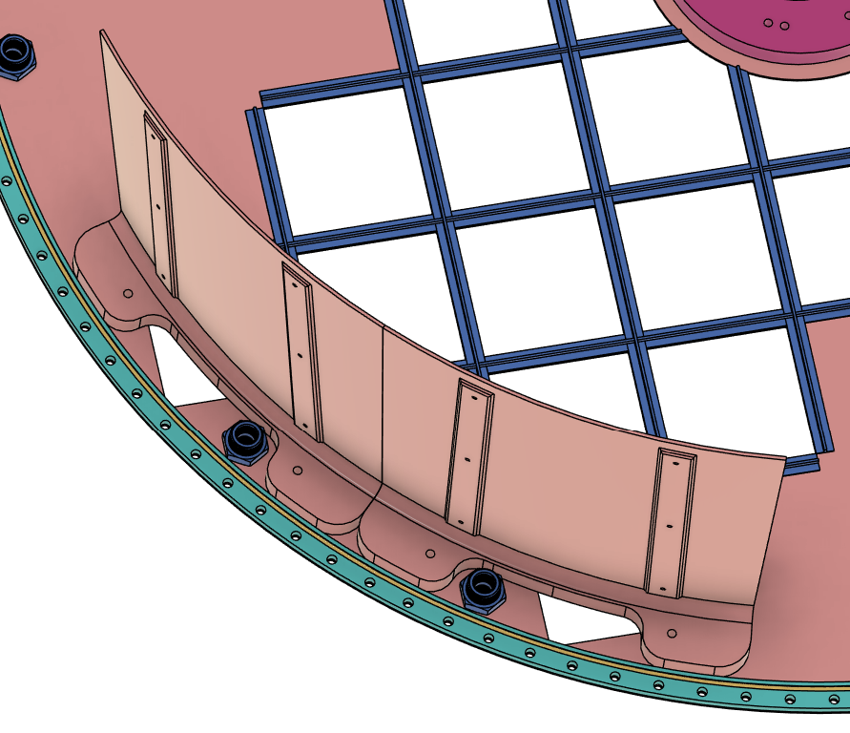
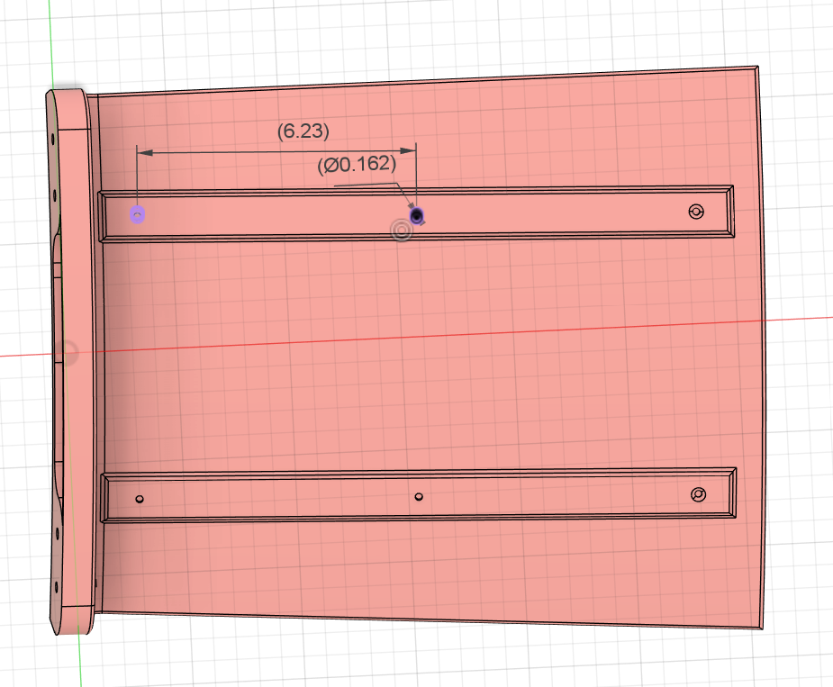
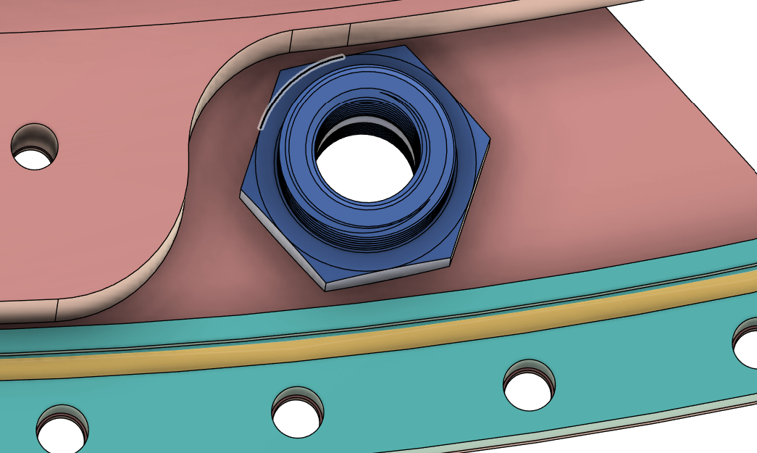
Outer Mirror
NPT ports moved outward radially by 5 mm
Slot Modified to fit bulkhead fittings
Easy to change 3D printed part
6 Mounting holes added to mirror backer, 6.23 in spacing
Inserts for 10-32 screws?

