Slide 1
ePIC SRO WG Meeting
Agenda:
  Echelon 0-1 Network Updates (Updates Jeff / Discussion)
  Echelon 2 Resource Allocations (Marcus)
Google Docs:
  Meeting Notes: ePIC Streaming Computing WG Meetings - Google Docs
  Network Notes: ePIC/EIC networking - Google Docs
  E0-E1 interface notes: E0-E1 interface notes - Google Slides

Slide 2
There were a series of 4 recent meetings:
Feb 10 – SRO meeting discussed E0-E1 interface (E0-E1 interface notes - Google Slides)
Many issues discussed, but network related items listed here:
  Latency Requirements
    Rucio Delivery of 2GB STF files at E1: “Several Minutes”
    10-30 seconds “TF-scale statistics”
    10-30 seconds AI information via streaming processing at E1
    Very low (<1 sec) local Echelon 0
  DAQ proto-enclave end of calendar 2026
    Prototype message flows for orchestration (replacing ownership of DAQ emulator)
    Data challenges (limited hardware)
  Calibrations with potential network implications
    Separate DAQs (ie polarimetry)
    Dataflow back to echelon 0 for calibration results
    Calibration runs may need analysis of workflow (e.g. SVT scans taking O(days))
  MCP for AI
    Depending upon infrastructer could have network implications

Slide 3
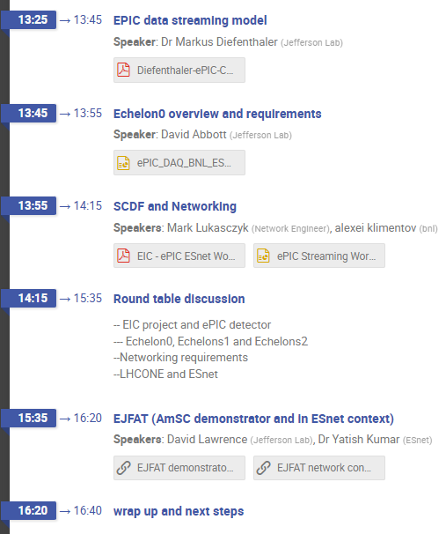
PreMeetings for ESNET
- Feb 10 – Kickoff Meeting with SCDF: built list of questions
- Feb 23 – Discussed agend for Feb 26-27 meeting with ESNET
  DAQ SCDF Computing to be installed by end of 2026
    Connectivity and throughput needs in coming years (2026-2032)
    Final Connectivity and throughput needs
    What is DNS configuration, firewall setup, subnet configuration, etc…
    Secondary path between IP and Bldg. 725
  Echelon 0 - JLAB’s Echelon 1 connectivity
    Currently 40 Gbit/s to BNL. Upgrade soon to 400 Gbit/s
    Plan to add dark fiber, what timeline?
    How to guarantee BNL – JLAB data transfer resilience
    Access to echelon 0 from outside BNL
    Large Language Model access (in particular for non-BNL ePIC users)
  LHC-ONE and EIC computing
  EJFAT / AmSC
  AmSC / ePIC EIC computing prototype/collaboration?
  AI/ML Role
https://indico.bnl.gov/event/31851/

Slide 4
ESNET Meeting Feb 26-27
Markus
  Overview of computing model
  10^5 MB/s requirement (1000 Gb/s) quoted
  Data rate 100 Gb/s
  350 PB data stored per year
Dave
  Overview of streaming DAQ
  400 Gb/s ESNET requirement – with guaranteed throughput
Mark
  Curent transfers saturate around 800 Gb/s (All SCDF users)
  Single fiber path exists from IP6 (and rest of ring) to BLDG 725. Re-iterated plea for redundant paths
ESNET
  Re-iterated that latency was fixed by distance but small compared to second time scales
  Schedule regarding dark fiber was discussed – ?fiber soon but instrumentation as needed later?
  Seemed to be flexible with respect to dedicated ePIC BNL-JLAB fibers or world-shared fiber. Said it would be no problem to guarantee throughput with shared fiber, but no specific mechanism given?
https://indico.bnl.gov/event/31851/

Slide 5
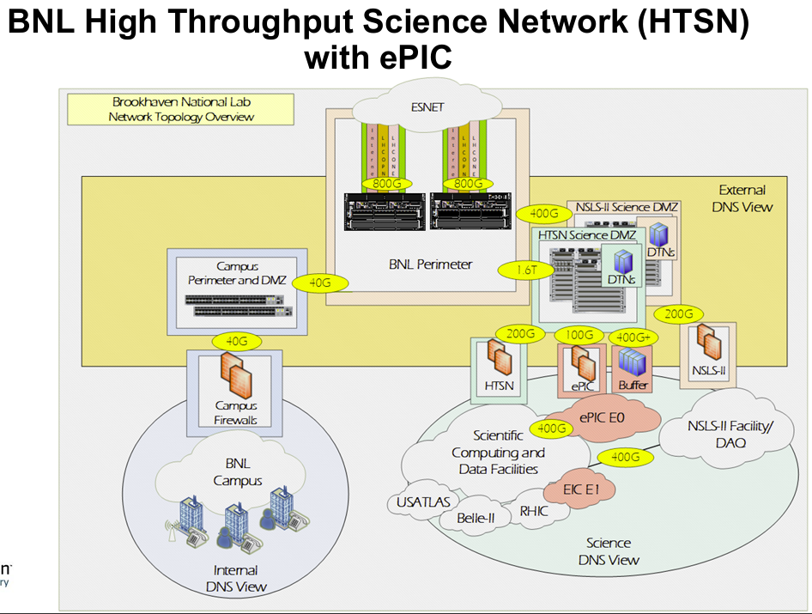
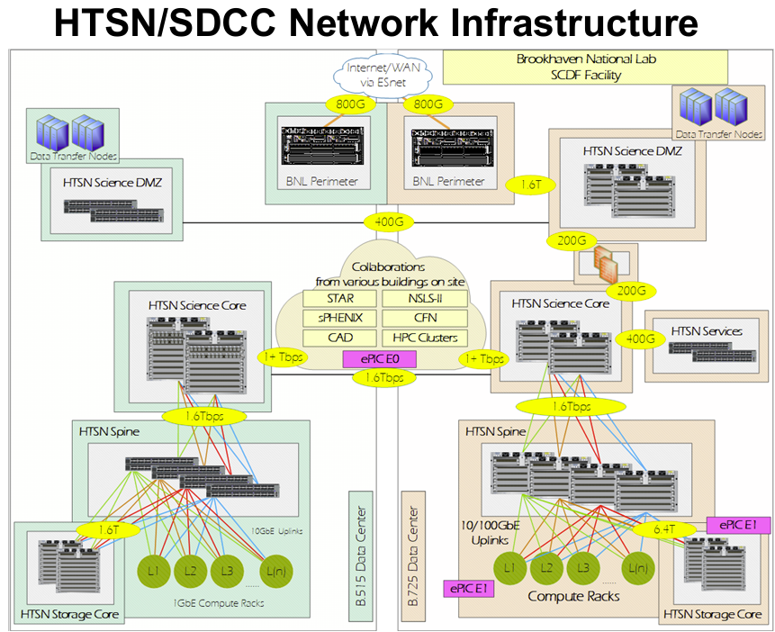
Mark’s Descriptions of BNL Networks…

Slide 6
Discussion…
→ Markus’ Echelon 2 requirement discussion

