Slide 1
B-field Test Analysis – Run QA
Cheuk-Ping Wong
03-06-2026

Slide 2
Last Update via Email Exchanges
Outliner?
Observe residues of pedestal after pedestal cut leads to underestimated mean integrated charge (<q>) → Improve fit function especially for 0T runs → Fit signal with Gaussians to extract <q>
Run-by-run QA: gains, magnetic fields, inclination angles

Slide 3
Pedestal (0T, Laser tune 40%, 200-675-200-675-200)
Fit= |Gaus1| + |Gaus2| + |Gaus3| + |Gaus4|

Slide 4
Pedestal (0T, Laser tune 40%, 200-675-200-675-200)

Slide 5
Pedestal (0T, Laser tune 40%, 200-675-200-675-200)

Slide 6
Pedestal (0T, Laser tune 40%, 200-675-200-675-200)

Slide 7
Full Spectrum Integrated Charge (0T, Laser tune 40%, 200-675-200-675-200)
Black markers: pedestal + signal
Red markers: after pedestal subtraction
There’s residual of pedestal still
Fit the signal instead (Red line)
Range 3,000 – 15,000
Excluded 200572 – 200578 (calibration runs)
Excluded 201549 – 201572 (0T runs) (excessive negative integrated charge)

Slide 8
Full Spectrum Integrated Charge (0T, Laser tune 40%, 200-675-200-675-200)

Slide 9
Full Spectrum Integrated Charge (0T, Laser tune 40%, 200-675-200-675-200)

Slide 10
Full Spectrum Integrated Charge (0T, Laser tune 40%, 200-675-200-675-200)

Slide 11
Full Spectrum Integrated Charge (0T, Laser tune 40%, 200-675-200-675-200)

Slide 12
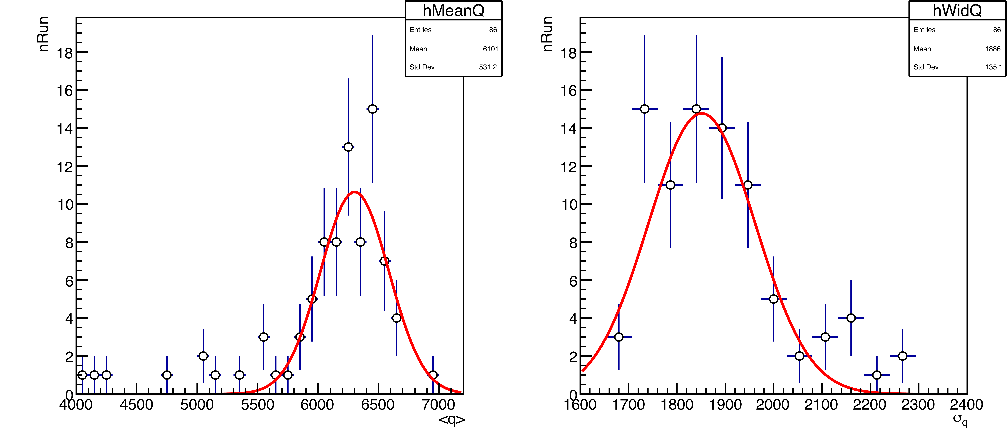
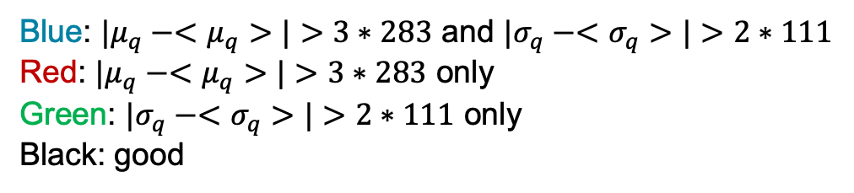
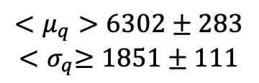
Integrated Charge Distributions Overlayed, 0T, Pedestal Subtracted
Residual of pedestal
q>1500
Scaled to match the max.
$$<μ_{q}>6302±283$$
$${<σ}_{q}≥1851±111$$
Blue: $|μ_{q}−<μ_{q}>|>3∗283$ and $|σ_{q}−<σ_{q}>|>2∗111$
Red: $|μ_{q}−<μ_{q}>|>3∗283$ only
Green: $|σ_{q}−<σ_{q}>|>2∗111$ only
Black: good

Slide 13
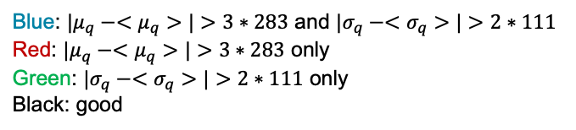
Integrated Charge Distributions Overlayed, 0T, q>1500
RunNum, date, nEvt, good, axis, Curr, deg, rep, ch
200188, 11/19/2025, 100000, 1, x, 0, 10, 2000, 5
200197, 11/19/2025, 100000, 1, x, 0, 0, 2000, 5
200221, 11/19/2025, 100000, 1, x, 0, -20, 2000, 5
200230, 11/19/2025, 100000, 1, x, 0, -27.5, 2000, 5
200248, 11/19/2025, 100000, 1, x, 0, -5, 2000, 5
200273, 11/24/2025, 100000, 1, x, 0, 15, 2000, 5
200274, 11/24/2025, 100000, 1, x, 0, 25, 2000, 5
200292, 11/24/2025, 100000, 1, x, 0, -25, 2000, 5
200320, 11/24/2025, 100000, 1, x, 0, 0, 11000, 5
200934, 11/26/2025, 100000, 1, x, 0, -12.5, 1600, 5
200964, 11/26/2025, 100000, 1, x, 0, -12.5, 1600, 5
201089, 11/26/2025, 100000, 1, x, 0, 0, 10000, 5
201528, 12/12/2025, 100000, 1, x, 0, 17.5, 1600, 5
Blue: $|μ_{q}−<μ_{q}>|>3∗283$ and $|σ_{q}−<σ_{q}>|>2∗111$
Red: $|μ_{q}−<μ_{q}>|>3∗283$ only
Green: $|σ_{q}−<σ_{q}>|>2∗111$ only
Black: good
q>1500
Scaled to match the heights

Slide 14
Elog Entries
date | time
11/18/25 | 15:38 | Changing to single digitizer with 6x6 channels, excluding 4 corners.
11/19/25 | 11:07 | run 200188
11/19/25 | 11:39 | run 200197
11/19/25 | 14:21 | run 200221
11/19/25 | 14:55 | run 200230
11/19/25 | 15:59 | run 200248
11/24/25 | 9:04 | run 200273
11/24/25 | 9:08 | run 200274
11/24/25 | 11:19 | run 200320
11/24/25 | noon | Changed to a different pair of outputs on the logic fan-out, which are in sync with the other pair with a jitter of ~10ps. Changed to a different slot on the NIM->TTL converter and switched to a negative TTL signal (also on the PiLas). Timing remains the same, but jitter presumably went down from ~25ps to ~12ps.
11/24/25 | noon | IMPORTANT: we changed DRS4 trigger cables output on the NIM fan-out, and switched to using negative TTL pulse slope on the PiLas laser. Using the scope, we seemingly verified that jitter between DRS4 trigger and PiLas trigger went down from ~25ps to ~12ps (RMS, as measured by the scope).
11/25/25 | 8:34 | leading edge (sample number) around 650 run 200583 - cable of laser shorten down to move signal peak to the left leading edage around 600 run 200584 DRS4 delay in start up script from 23 to 27 leading edage 550
11/25/25 | 9:34 | Laser cable shorten down to move peak to the left to see afterpulse (it was became from 650 to 600 bin) Delay with DRS4 from 23 to 27 (changed from 600 to 550 bin) As a result, leading edge around 550 sample number and started data-taking
11/26/25 | 9:15 | run 200934
11/26/25 | 10:07 | run 200964
11/26/25 | 15:28 | run 201089
12/12/25 | 13:45 | run 201528

Slide 15
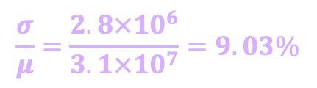
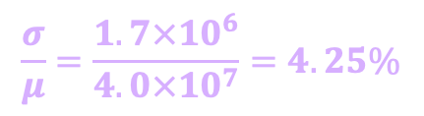
Gain Distribution at 0T, Laser tune 40%
Before
After (fitted mean q extraction, removed calibration runs)
$$\frac{σ}{μ}=\frac{2.8×{10}^{6}}{3.1×{10}^{7}}=9.03\%$$
$$\frac{σ}{μ}=\frac{1.7×{10}^{6}}{4.0×{10}^{7}}=4.25\%$$

Slide 16

Non-0T Runs
Pedestal
Signal (4$σ$ pedestal cut)
Full spectrum
ChatGPT’s guesses
normal gain fluctuations
Inefficiency
Bad integration window
Threshold bias

Slide 17
Total Magnetic Field Distributions

Slide 18
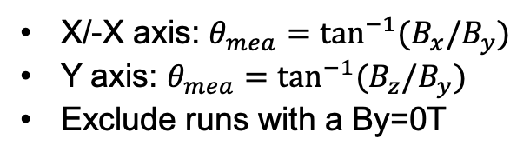
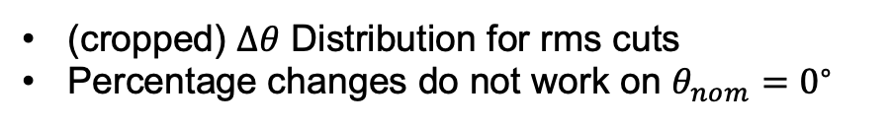
Inclination Angles from Hall Probe
X/-X axis: $θ_{mea}=\tan^{−1}{(B_{x}/B_{y})}$
Y axis: $θ_{mea}=\tan^{−1}{(B_{z}/B_{y})}$
Exclude runs with a By=0T
(cropped) $Δθ$ Distribution for rms cuts
Percentage changes do not work on $θ_{nom}=0^{∘}$

Slide 19
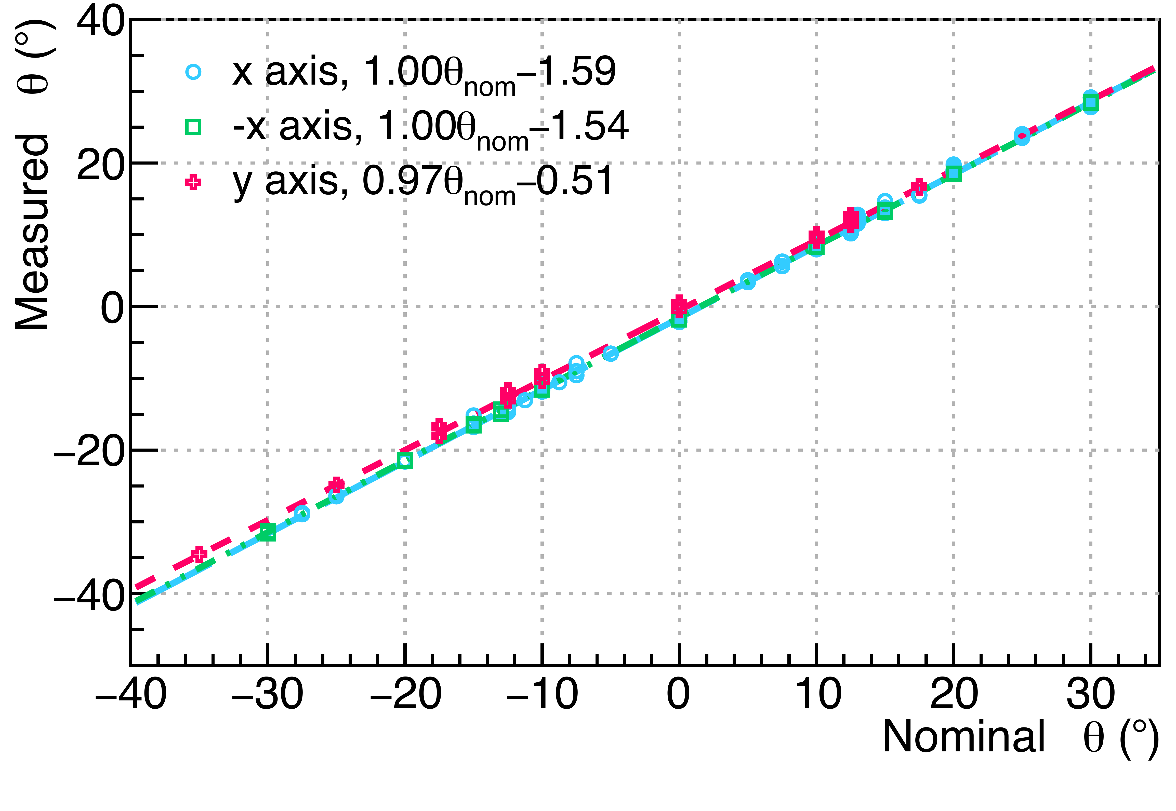
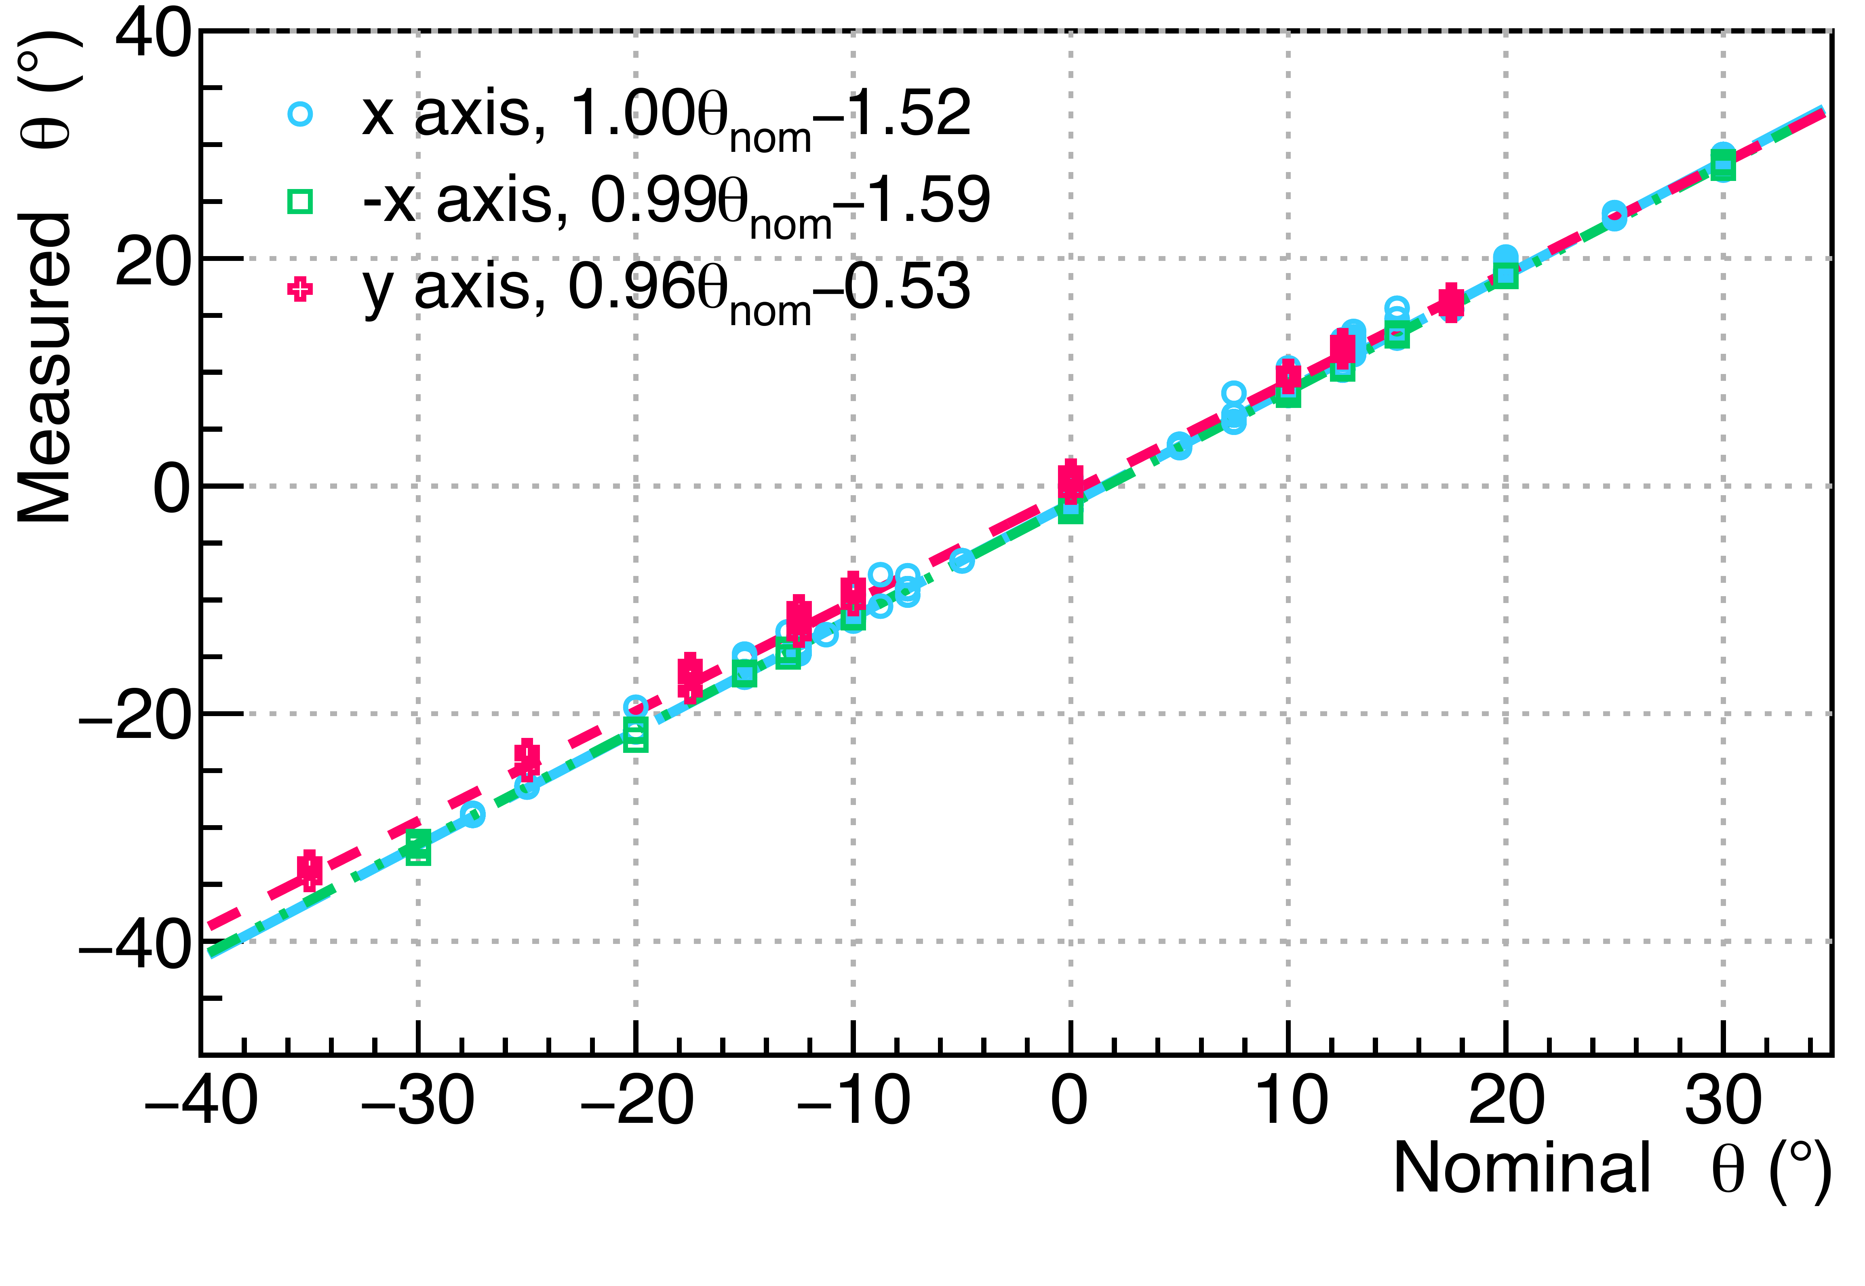
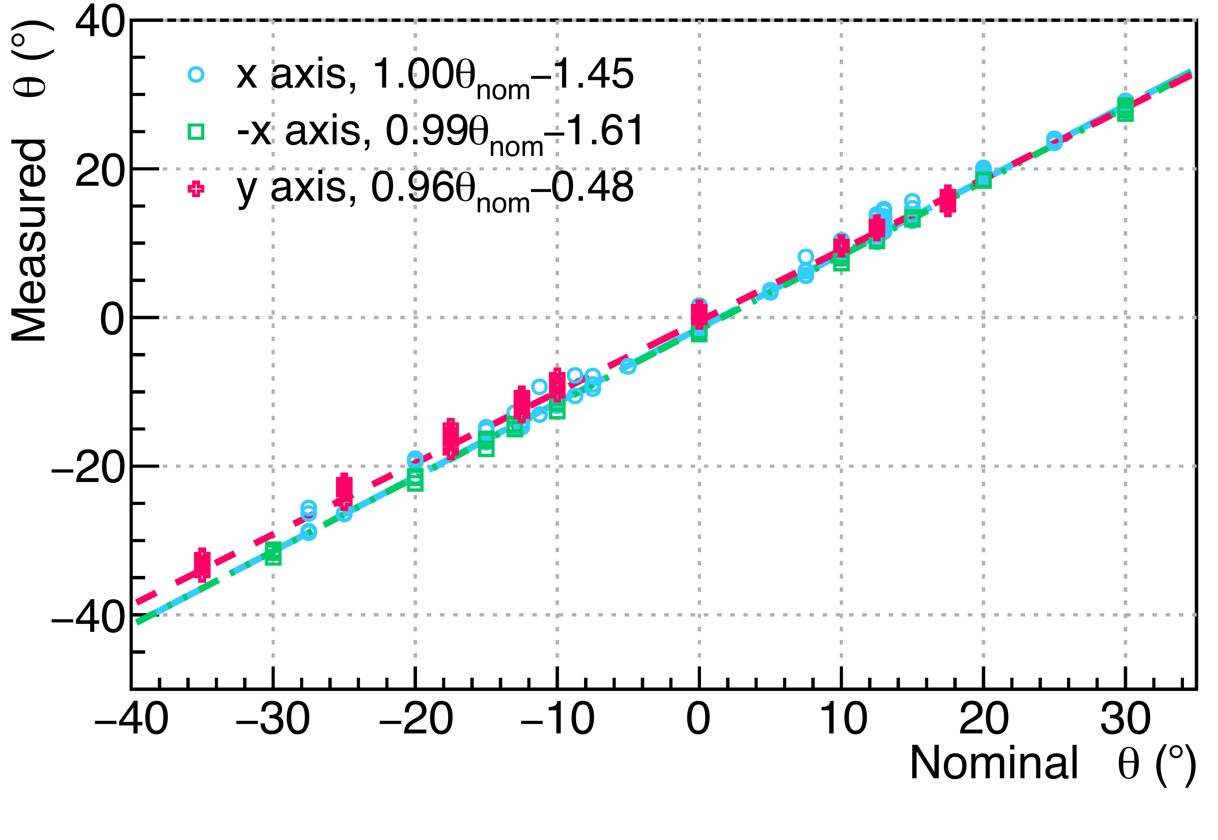
Inclination Angles from Hall Probe
1 rms cut
2 rms cut
3 rms cut

Slide 20
Gain vs Inclination Angle (No Normalization)
Old

Slide 21


Gain vs Inclination Angle (No Normalization)
7.5° points are gone not because of $Δθ$ or |B| cut, but they are from the excluded runs (with excessive neg int. charge)
1rms $Δθ$ cut, 3rms |B| cut
These were hiding before
A bunch of after pulse tests

Slide 22

Gain vs Inclination Angle (No Normalization)
3rms $Δθ$ cut, 3rms |B| cut
Systematic shift?

Slide 23
Gain vs Inclination Angle (No Normalization)
3rms $Δθ$ cut, 3rms |B| cut, 4.25x3~13% error for no normalization

Slide 24
Summary
Run-by-run QA
Gain of 0T runs
Btotal
Angle
To-do
build a bad run list
Angle shift between the beginning and the end 0T runs?

