Slide 1
How to access our DAQ (carbon) from the outside
At long last…
This is how we go:
The World
hallgw
bnl-daq
carbon
Network where we keep our stuff, like scopes, cameras, …

Slide 2
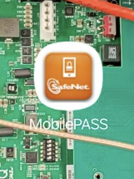
What do you need?
People that work at BNL are used to logging in via ssh keys. Super-convenient and safe.
We will need to use Jlab’s authentication method for the “way in”
After that’s it’s still ssh-keys (my preference)
You need to email the helpdesk@jlab.org and tell them that you need “MobilePASS” access
You will get an email with instructions, chiefly the link to the proper App (there are similar-sounding ones, get the right one)
You set a numeric pin. You may have used DUO, same deal – your password is the pin + the one-time-code that the app gives you
Like you set 123456 as pin, and the code is 999333, the pw is 123456999333

Slide 3
The path to carbon
You will need to go through
a gateway that klets you “inside” Jlab;
my gateway that is currently to the right of the setup
And from there, finally to carbon (or any other node that may reside there)
mlpmacM2-4:~ purschke$ ssh -l purschke hallgw.jlab.org
(purschke@hallgw.jlab.org) Password: 123456999333
[purschke@login1]~% ssh -l mep bnl-daq
X11 forwarding request failed on channel 0
Last login: Wed Mar 25 11:55:15 2026 from 129.57.52.50
[mep@bicgw ~]$
[mep@bicgw ~]$ ssh carbon
Welcome to Ubuntu 22.04.4 LTS (GNU/Linux 6.8.0-106-generic x86_64)
< stuff deleted>
Last login: Wed Mar 25 12:49:46 2026 from 192.168.60.1
(base) mep@carbon:~$

Slide 4
And now please set it up right.
The step-by-step I showed before is good for an initial test that it all works.
And then forget all that. Set up your .ssh/config right and do
How? A few lines in your ~/.ssh/config
mlpmacM2-4:~ purschke$ ssh carbon
< some chatter deleted >
Last login: Wed Mar 25 12:50:08 2026 from 192.168.60.1
(base) mep@carbon:~$

Slide 5
.ssh/config
Start with the most-wanted stuff. Don’t do ssh –A –X ….
That is valid for all connections. Convenience.
Important: Make sure you have this block in your .ssh/config on your account on hallgw!
ForwardAgent yes
ForwardX11 yes
ForwardX11Trusted yes
NoHostAuthenticationForLocalhost yes
PubkeyAcceptedKeyTypes +ssh-rsa
HostKeyAlgorithms +ssh-rsa

Slide 6
Getting to the bnl-daq “gateway machine”
1) Getting to bnl-daq
That says “in order to get to bnl-daq, please jump via hallgw”
From this point on, “bnl-daq” can act as a Proxy Jump host in its own right
Host bnl-daq
ServerAliveInterval 60
HostName bnl-daq
User mep
LocalForward 9922 localhost:22
ProxyJump purschke@hallgw.jlab.org

Slide 7
Getting to the carbon
2) Getting to carbon
That says “in order to get to carbon, please jump via bnl-daq”
Host carbon
ServerAliveInterval 60
HostName carbon
User mep
LocalForward 5910 localhost:5902
LocalForward 9923 localhost:22
ProxyJump mep@bnl-daq

Slide 8
All together
The relevant lines from my config, together
That says “in order to get to carbon, please jump via bnl-daq”
Host bicdaq bnl-daq
ServerAliveInterval 60
HostName bnl-daq
User mep
LocalForward 9922 localhost:22
ProxyJump purschke@hallgw.jlab.org
Host carbon
ServerAliveInterval 60
HostName carbon
User mep
LocalForward 5910 localhost:5902
LocalForward 9923 localhost:22
ProxyJump mep@bnl-daq

Slide 9
You must use the ssh-agent
The ssh-agent is able to hand out the unlocked ssh key to proper entities asking for it. It does really act like an agent on your behalf.
All it takes is to grant it the power to do that by “unlocking” the key.
And no, it will not ever give away an unlocked version of your key so it can be used in some other way or session.
You can also take keys away from it again.
On non-Windows systems (Mac, Linux) you already have such an agent running. Check by typing ssh-add –L
Ok, you have an agent, you just haven’t given it anything to do yet.
$ ssh-add -L
The agent has no identities.

Slide 10
You must use the ssh-agent
The ssh-agent is able to hand out the unlocked ssh key to proper entities asking for it. It does really act like an agent on your behalf.
All it takes is to grant it the power to do that by “unlocking” the key.
And no, it will not ever give away an unlocked version of your key so it can be used in some other way or session.
You can also take keys away from it again.
On non-Windows systems (Mac, Linux) you already have such an agent running. Check by typing ssh-add –L
Ok, you have an agent, you just haven’t given it anything to do yet.
$ ssh-add -L
The agent has no identities.

Slide 11
Unlocking a key for the ssh-agent
Now type
And type your key’s passphrase (not your password) and unlock it.
The filename defaults to $HOME/.ssh/id_rsa, but you can specify any (secret) key file name. This is how I unlock other keys as needed.
After that (this is all on your laptop still), ssh-add –L shows
$ ssh-add
Enter passphrase for /Users/purschke/.ssh/id_rsa
$ ssh-add -L
ssh-rsa AAAAB3NzaC1yc2EAxxxxxxxxxx…….= /Users/purschke/.ssh/id_rsa

Slide 12
What I need you to do
Get set up with mobilepass. If you can already log in to hallgw, you are good.
get me your ssh public key. Don’t use passwords…
It’s usually $HOME/.ssh/id_rsa.pub
If you want to make a dedicated ssh key for this, it’s good practice – if one gets away from you for some reason, you don’t have to change them all.

Slide 13
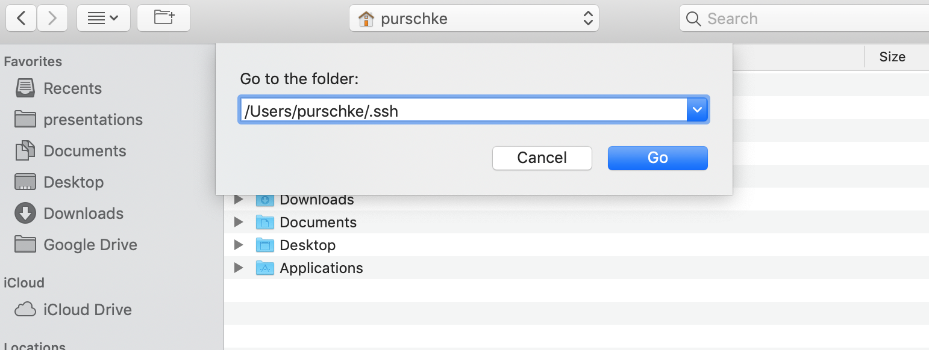
A tip for Mac users
Typically your public key is in a hidden directory .ssh/id_rsa.pub as shown before.
To access such a hidden directory in the file dialog, enter Command-Shift-g
and type the directory name
Then you can pick the otherwise hidden file.

