Slide 1


Stave Prototype Testing Update
08/04/26

Slide 2
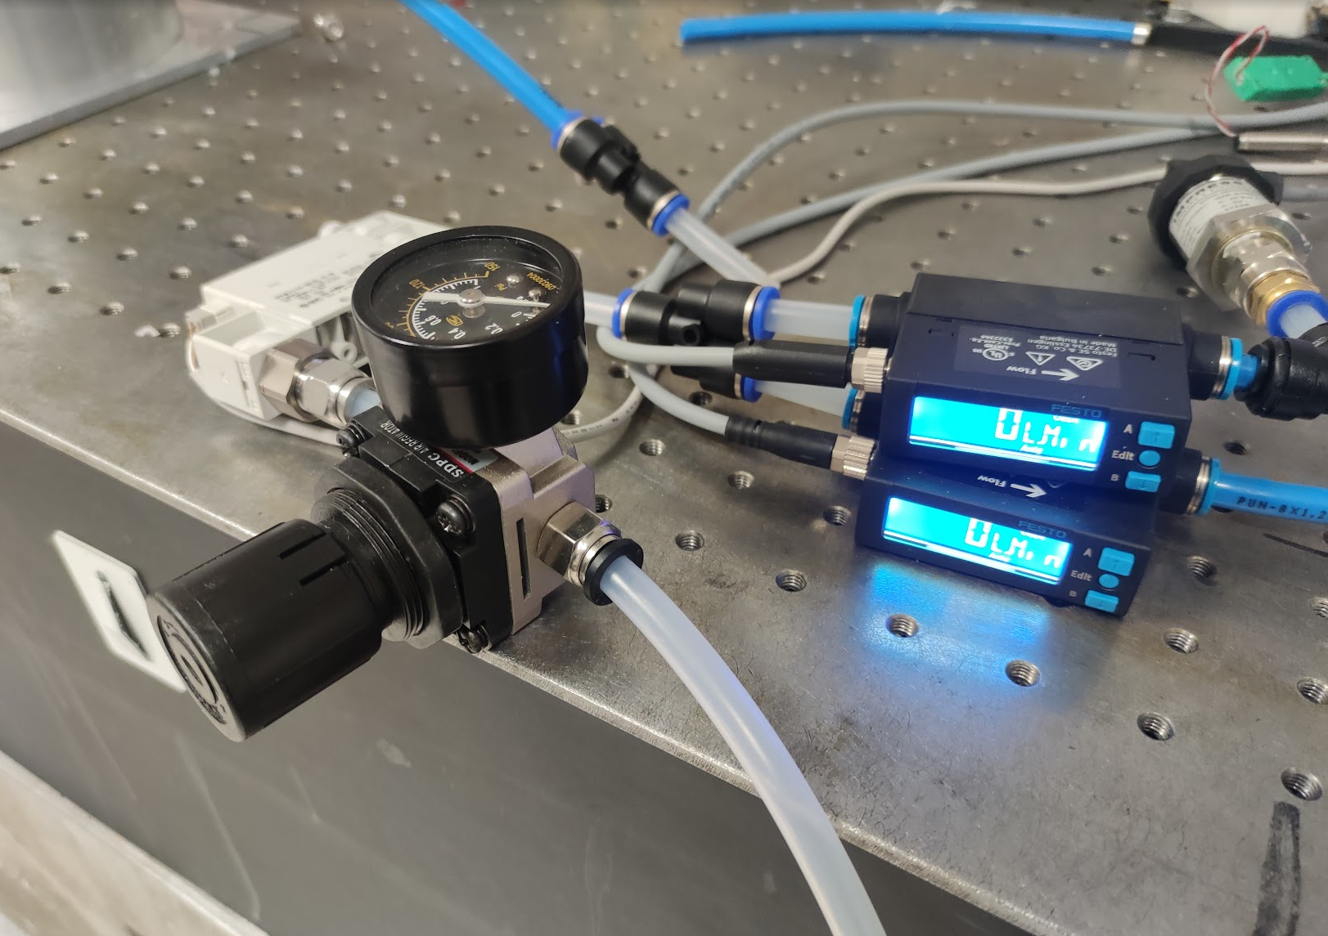
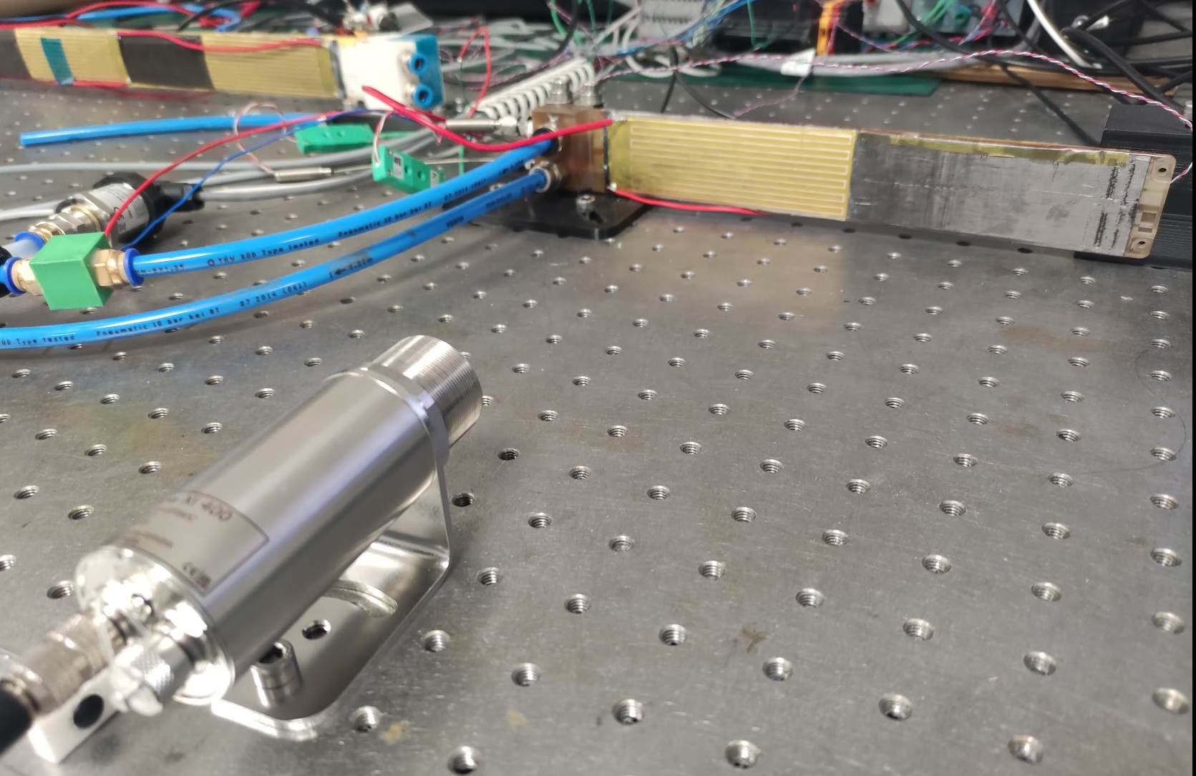
Updates
Volumetric Flow meters
QSP3 has been fitted with the revised Kapton heating elements
Flow on both halves of the stave with separate flow monitors on each side (but no control)
Closed loop flow controller replaced with a regulator
4 thermocouples
  Exhaust
  Ambient
  ½ way through Module 1
  ½ way through Module 2
Regulator
TC
TC
TC
TC
TC = Thermocouple

Slide 3
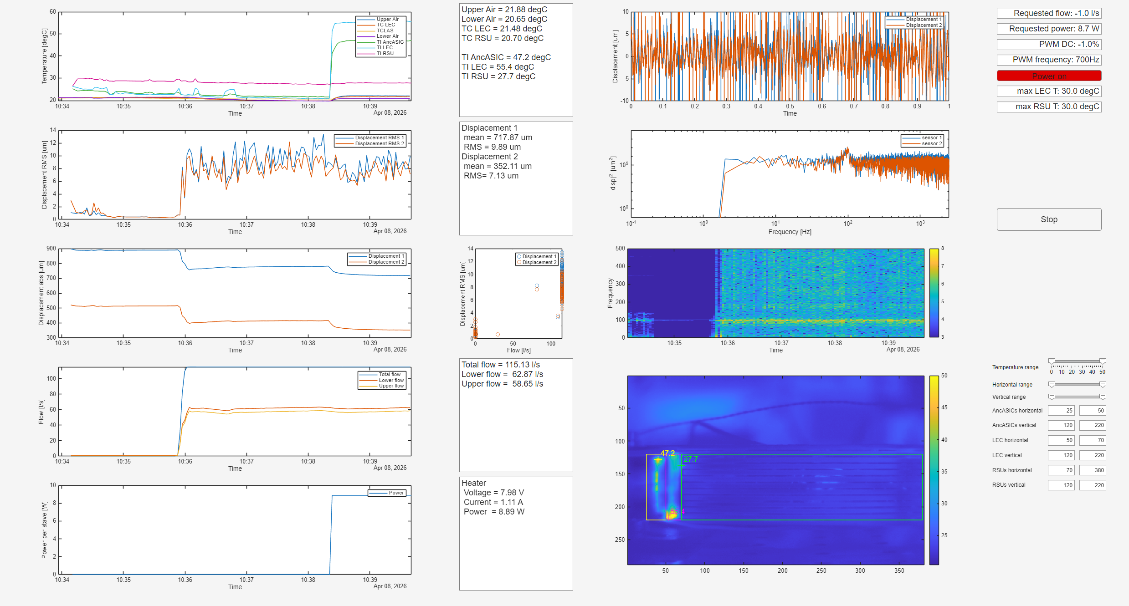
Thermal Flow Testing GUI

Slide 4
Test States
Kapton heaters don’t have temperature dependant power, so we test in states representative of nominal and max power conditions
Nominal Power Case (21.9 W L4 stave equivalent)
  Flow rate per channel of 37 lpm
    Based on hand calculation thermal model this should give delta T of 10C along an L4 stave (based on ASIC to ASIC, but also true of RSU to RSU & LEC to LEC)
  Actual applied power = 5.60 W
Max Power Case (34.9 W L4 Stave equivalent)
  Flow rate per channel of 58 lpm
  Actual applied power = 8.89 W

Slide 5
Heat Removal - Nominal Power (5.60W)
What proportion of thermal power is removed through internal flow?
Exhaust ΔT (between power on and power off) = 1.4°C
  Thermal power based on exhaust = 2.04 W
    This is a very rough estimate
Internal thermocouples increased by 0.37°C between first and second module
  Expected temperature rise based on applied power is 2°C
  This difference may just be due to the two thermocouples being closer/further from the RSU

Slide 6
Heat Removal - Max Power (8.89W)
What proportion of thermal power is removed through internal flow?
Exhaust ΔT (between power on and power off) = 1.23°C
  Thermal power based on exhaust = 2.88 W
    This is a very rough estimate
Internal thermocouples increased by 0.34°C between first and second module
  Expected temperature rise based on applied power is 1.9°C
  This difference may just be due to the two thermocouples being closer/further from the RSU

Slide 7
Temperatures - Nominal Power (5.60W)
Surface temperature monitored with thermal imaging camera
Maximum RSU Temperature to coolant temperature delta of approx. 8.2°C
Peak ASIC and LEC temperatures do not show a fair representation of cooling performance

Slide 8
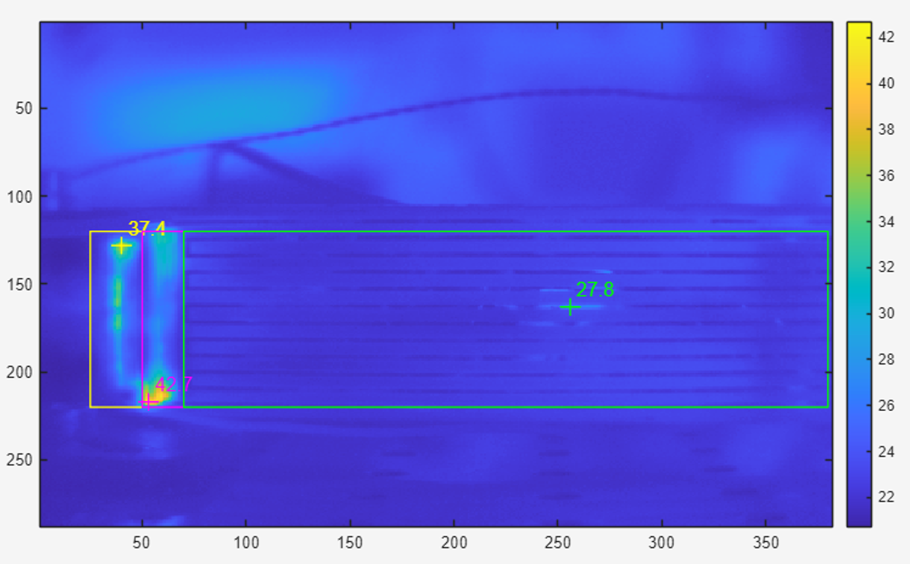
Temperatures - Nominal Power (5.60W)
90% central internal is more like:
RSU Temperature: 22°C – 24°C
  (ΔT of 2.5°C – 4.5°C)
LEC: 24°C - 32°C
  (ΔT of 4.5°C – 12.5°C)
ASIC: 24°C - 32°C
  (ΔT of 4.5°C – 12.5°C)

Slide 9
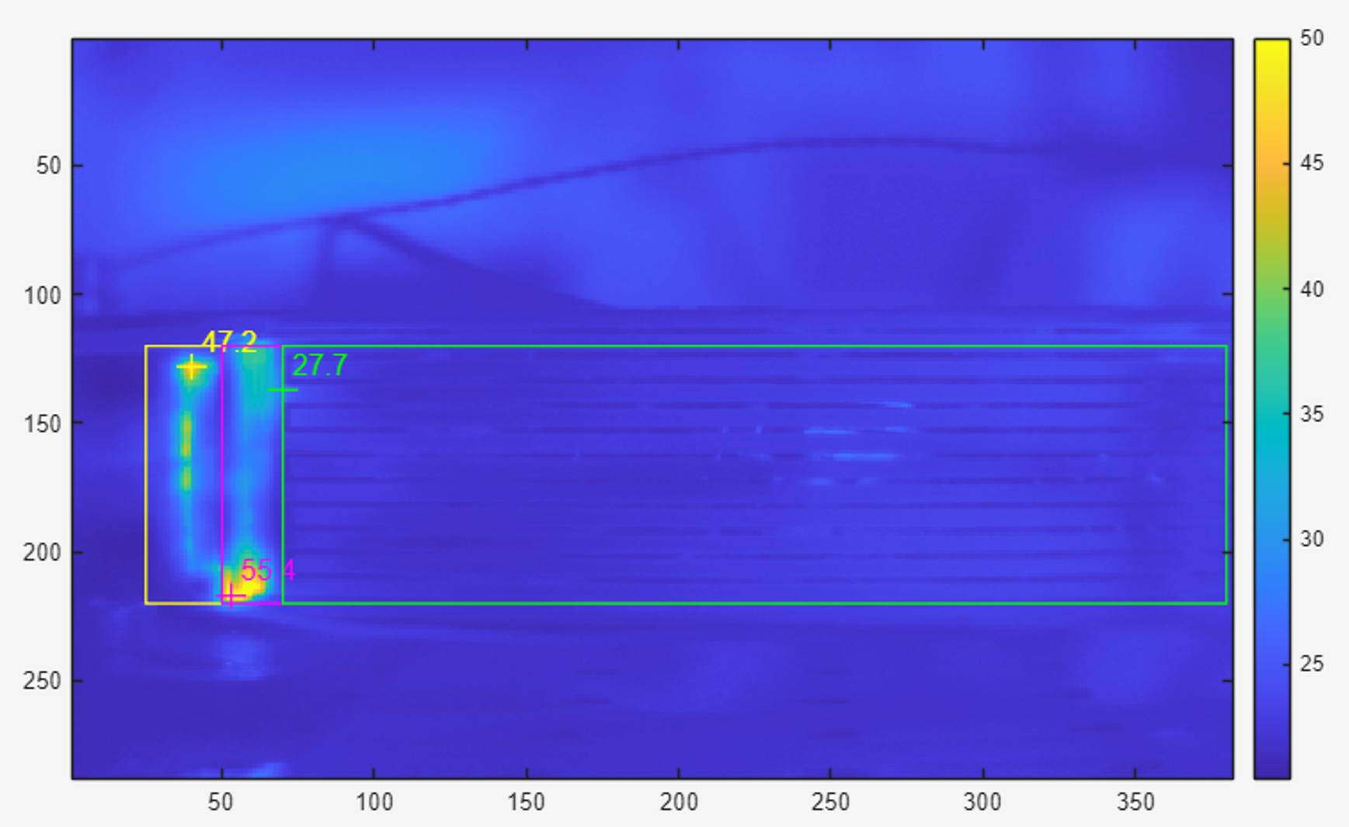
Temperatures - Max Power (8.89W)
90% central internal is more like:
RSU Temperature: 22°C – 25°C
  (ΔT of 2.5°C – 5.5°C)
LEC: 24°C - 37°C
  (ΔT of 4.5°C – 17.5°C)
ASIC: 24°C - 40°C
  (ΔT of 4.5°C – 20.5°C)

Slide 10
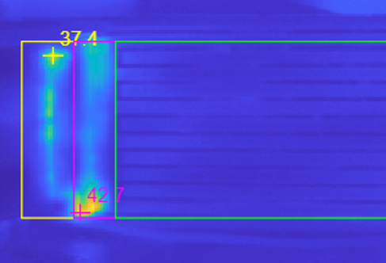
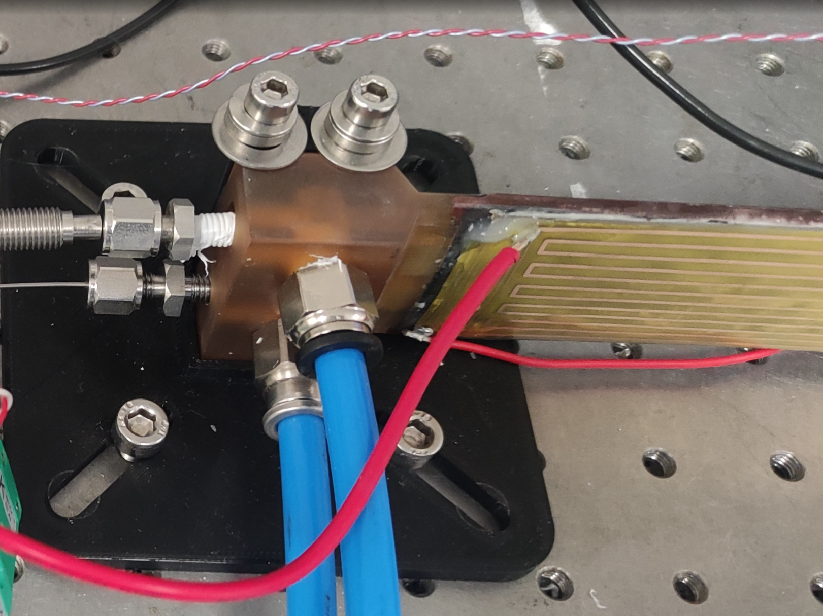
Temperatures
Should we be ignoring these hot spots?
  We may just be seeing the wire temperature or soldering impacts the thermal conductivity of the interface
  One of the solder tabs was damaged

Slide 11
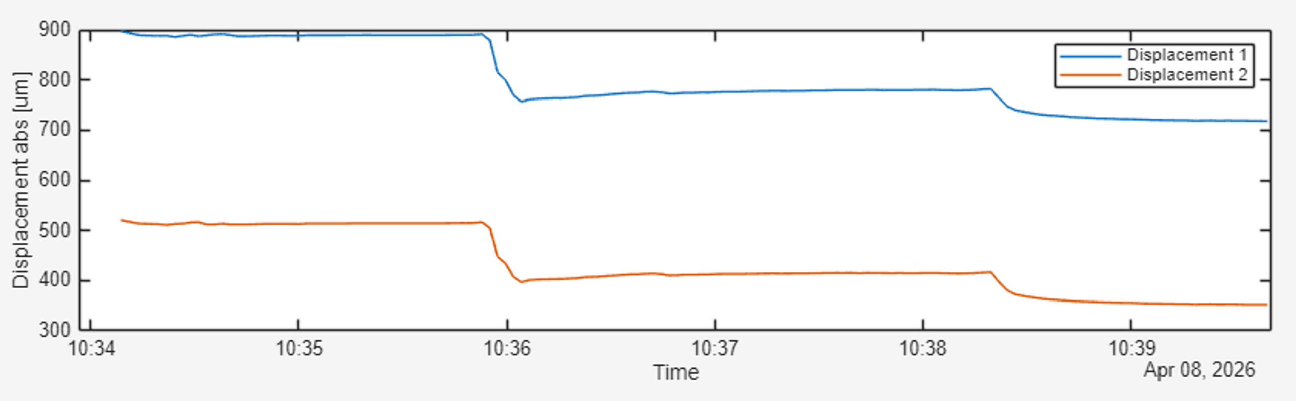
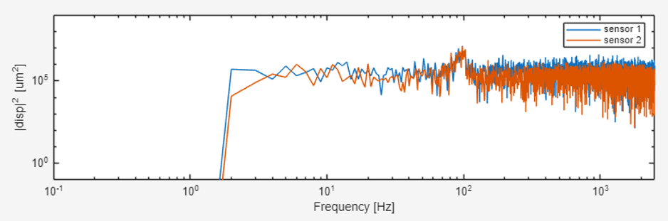
Displacement / Vibration
Unexpected displacement during application/ removal of power
As expected, stave deflects when power is applied (one face of the stave heats and expands
Stave does not return to its original position when heat is removed
First mode matches values seen on the vibration table.
RMS displacements of 8-10 µm at 58 lpm per channel, not obvious how this translates to full L4 stave
RMS of 1.7 µm at 37 lpm

Slide 12
Early Thoughts on Feasibility
We are looking at the first module of 8, inlet temperature of 8th module will be approx. 9°C hotter than the first
Target ASIC/LEC temp of 25°C
8th ASIC Temp 25°C → 8th Coolant Temp of 13°C → Inlet Temp of 4°C
Inlet temperature of 4°C may be hard to achieve
  If inlet temperature was 10°C we could expect ASIC/LEC operating temperature ranging from 22°C – 31°C
Δ12°C
Δ9°C

Slide 13
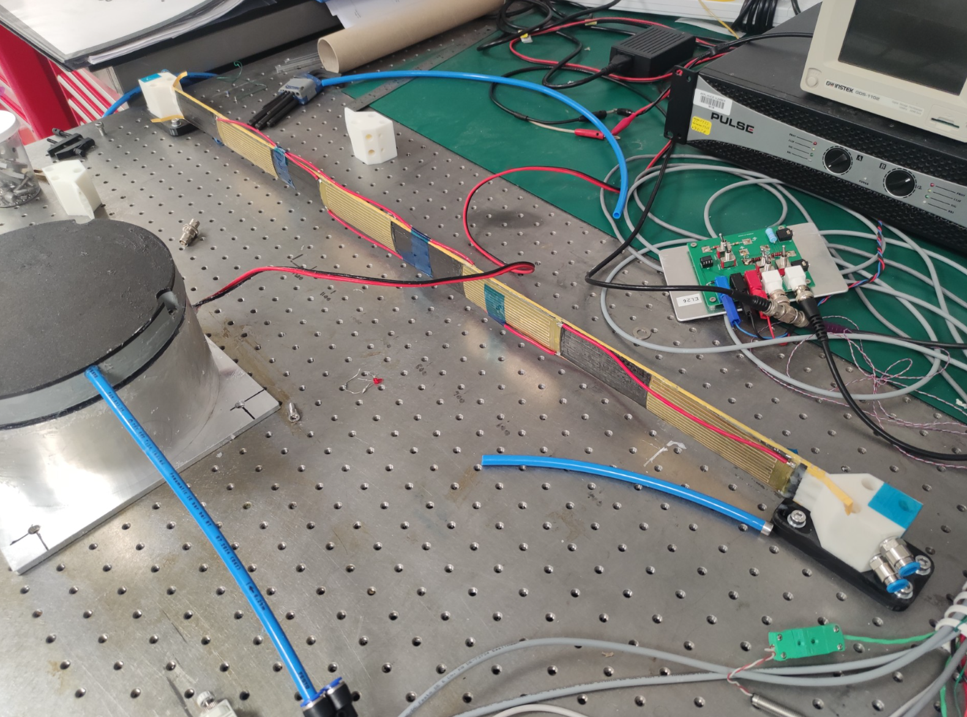
Full L4 Stave
Full L4 Stave is ready to test
Many leaks have been patched
This L4 stave uses low thermal conductive foam under 1 of the LEC/ASIC, we can see how effective the K9 foam is.
We will test with the thermal imaging camera facing multiple modules.

Slide 14
Conclusions
No showstoppers seen so far, temperatures are in the right ballpark
Nominal temperatures targets may be achievable if powers stay similar.
  It should be noted the ASIC geometry is further from reality than the LEC/RSU heater
More work needs to be done to identify thermal pathway
  How much thermal power is lost externally
We should try to identify causes of hot-spots

Slide 15
