Slide 1
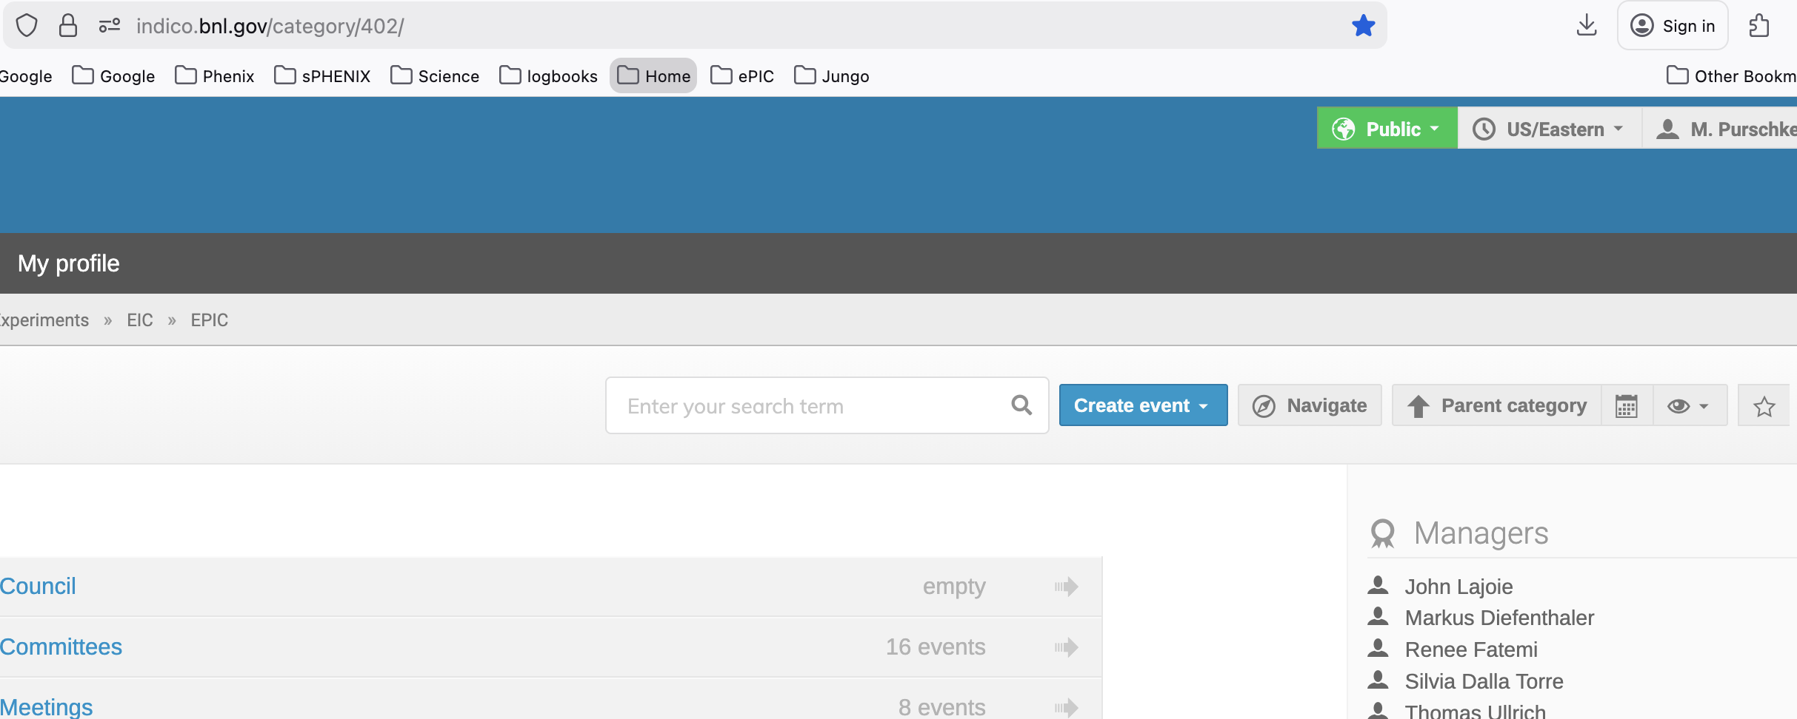
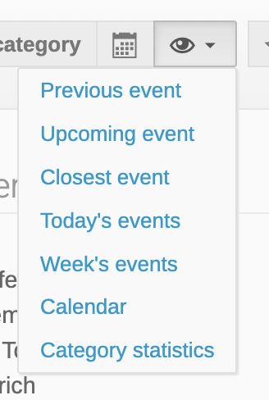
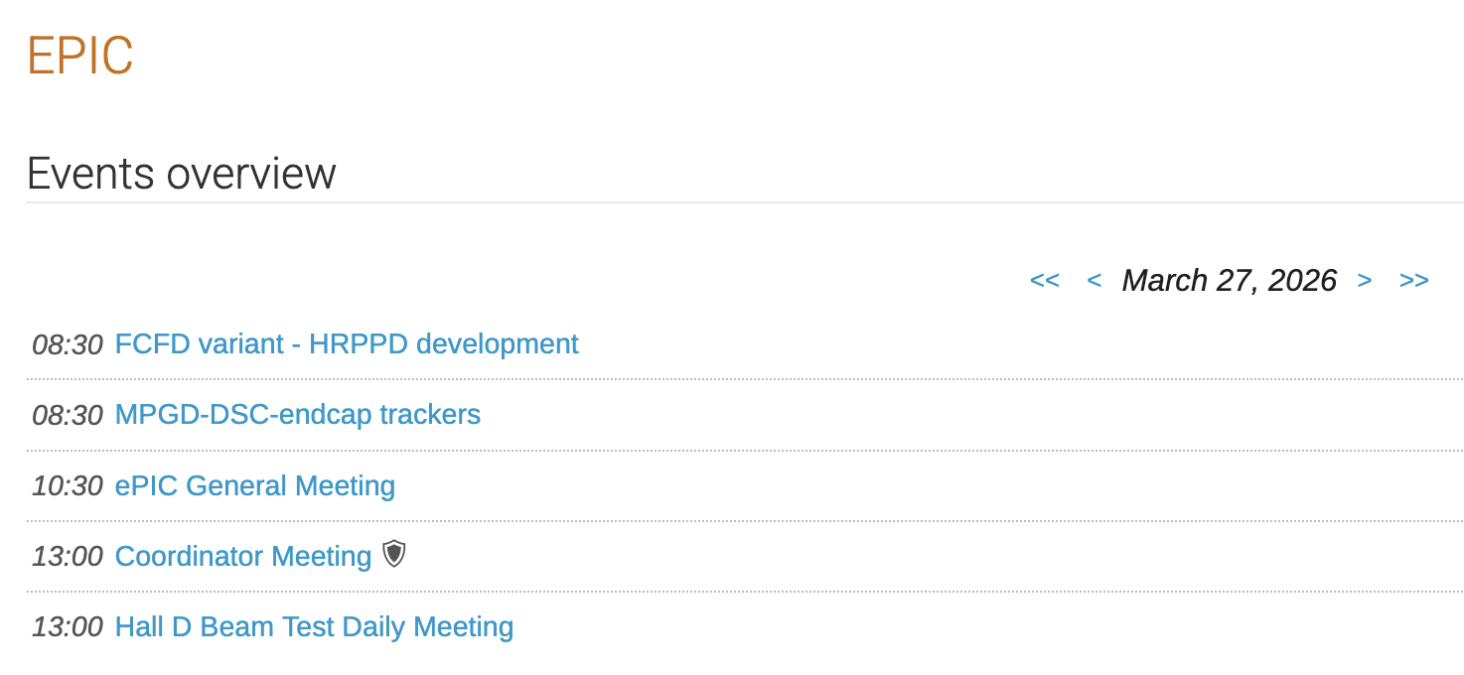
First, a service announcement w.r.t. indico
Most may know this, but I have explained this now several times…
Go to https://indico.bnl.gov/category/402/ (the ePIC top level), and find “the eye”
Then pick “Today’s Events”, and bookmark this
That shows all meetings in ePIC-land of the day, and you can go back to another day, too

Slide 2
Friday
Our gateway is up, and carbon is up
192.168.60.0/24
The World
hallgw
bnl-daq
129.57.26.172 / 192.168.60.1
Carbon
192.168.60.10
MPOD
(not yet..)
Network where we keep our stuff, like scopes, cameras, …

Slide 3
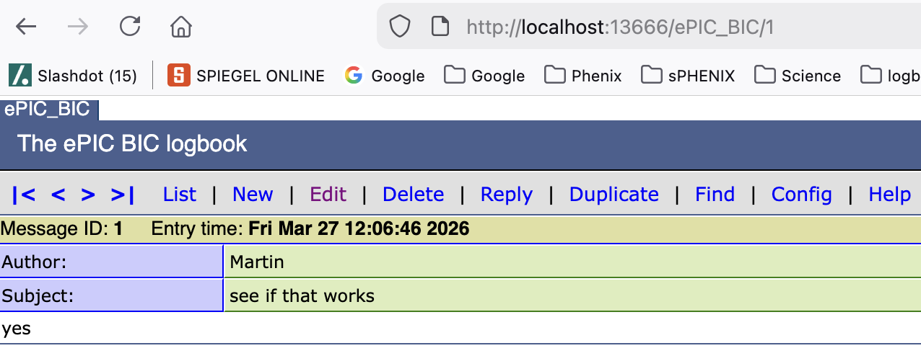
ELOG
I set up an elog on carbon
I lives on port 666
Modify the ”carbon” block in your ~/.ssh/config with one more line -
Host carbon
ServerAliveInterval 60
HostName carbon
User mep
LocalForward 13666 localhost:666
LocalForward 5910 localhost:5902
LocalForward 9923 localhost:22
ProxyJump mep@bnl-daq
Why 13666? Just a number > 1000
I have the various elogs I access as 10666,11666,12666,13666

Slide 4
Next up
I’ll set up the vnc, will take maybe an hour
That’s what the 5910 –> 5902 tunnel is for already
You later say vncviewer localhost:5910
(I use 5910 b/c my local 5902 is taken for sPHENIX elogs)
Host carbon
ServerAliveInterval 60
HostName carbon
User mep
LocalForward 13666 localhost:666
LocalForward 5910 localhost:5902
LocalForward 9923 localhost:22
ProxyJump mep@bnl-daq

Slide 5
DAQ status
As we said yesterday, the KCU/ROC reads out nicely,
viable “barebones” online monitoring in place, to be evolved
I implemented the support of the CAEN readout via the A4818 module (first time I had access to one)
I’ll pull over the online monitoring from the pfRICH that uses the CAENs extensively, as a start
AstroPix final touches are next then. Here I don’t think we have online monitoring, Bobae and I will sit together.

Slide 6
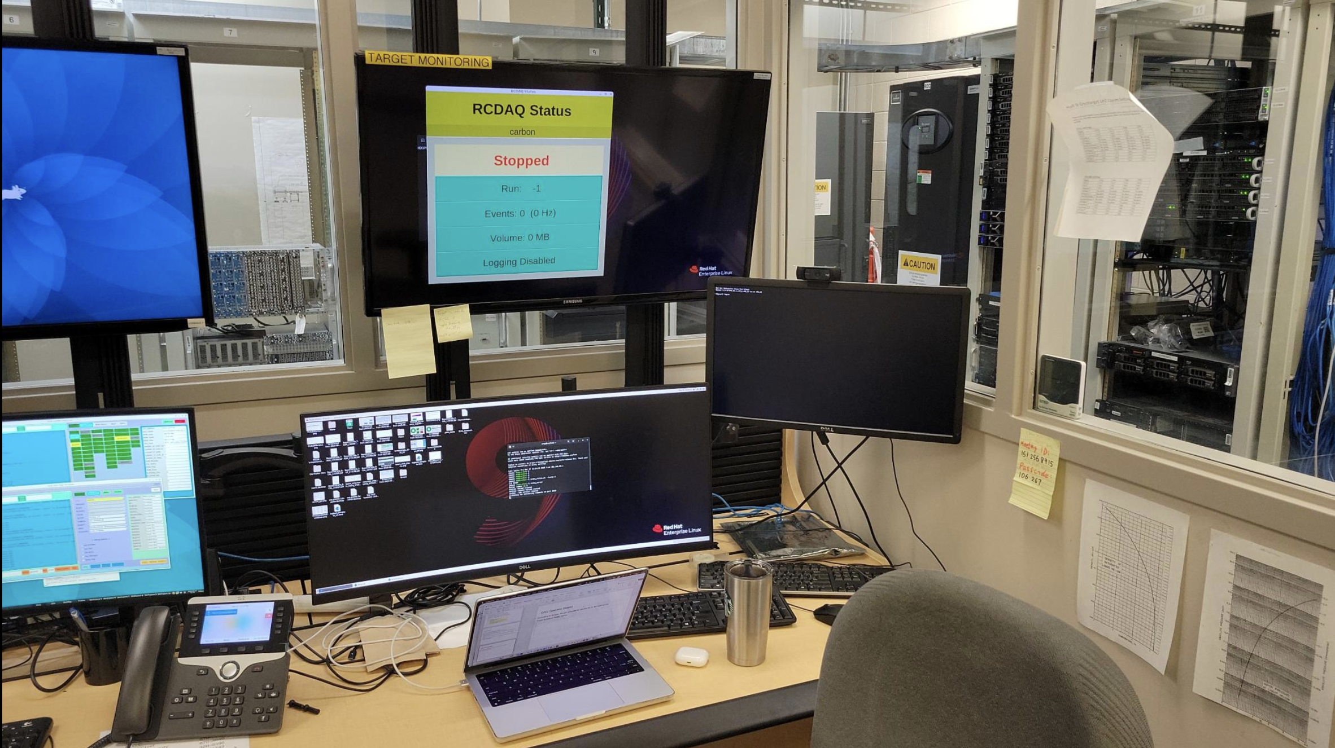
DAQ Operator Station
According to Sergey, we are welcome to use the PC in the right corner
It has access to carbon, will make it more convenient when I’m back
You can see that we made our home there already.

