Slide 1
RCDAQ organization
We will be running O(4) RCDAQs, 2 for the 2 KCUs (0/1), one Astropix (2), one for the 2 CAENs (3)
Independent RCDAQ servers are started with (I already made the scripts in ~/rcdaq_scripts ) rcdaq_server n, like “rcdaqserver 3”
The rcdaq_client commands by default talk to server 0.
In order to talk to another server (just for one command), do
If in your session you will continue to work on a particular server (like Henry did this morning), set the session up with
While we are running as individual RCDAQs (not as one cohort with Run Control), be very careful not to mess with the wrong one
$ RCDAQHOST=localhost:3 daq_status
$ export RCDAQHOST=localhost:3
… commands …

Slide 2
Quick CAEN Data Analysis
Henry and I took some data with the CAEN unit last night
Using 2 (?) channels of the calo for a cosmic coincidence (not 100% sure)
This was mostly to test that the fresh-of-the-press CAEN with A4818 readout works
First off, how does one access the RCDAQ data?
( Please review my tutorial at https://indico.bnl.gov/event/31661/ )
By and large, the data of a given device end up in a Packet with a given packet id
I have (arbitrarily) assigned the two CAEN units the IDs 2000 and 2001.
We read out only the one with ID 2001 (16 channels, 2 connected… true?)
$ dlist /scratch/data/CAEN/junk/junk_CAEN-00000004-0000.evt
Packet 1011 14 -1 (ePIC Packet) 9 (IDRTCLOCK)
Packet 2001 6924 -1 (ePIC Packet) 85 (IDCAENV1742)

Slide 3
Asking the packet questions…
The point of the Packet object is that you can ask it generic questions without having to know the inner representation of the data.
You still need to know a little bit what kind of device this is, such as a waveform sampler here, that is, many channels that each give you a waveform (as opposed to, say, a pixel device such as a MAPS)
The Packet gives you well-defined APIs to ask questions, such as
“how many channels do you have?”
“how many samples does channel c have?”
“please give me sample value s of channel c”
The whole point is that you don’t need to know, and your code must not know, how the real raw data are structured. Then it won’t break if the raw format changes.

Slide 4
This most important API
This is a generic code snippet that works for many waveform samplers.
Here you see the questions answered from the previous slide.
“p” is a pointer to Packet 2001.
The ”business end” of a waveform sampler is this API:
For example, for a “Single Event Display” (SED):
Sample_value = p->iValue(s,c)
for ( int c = 0; c < p->iValue(0,"CHANNELS"); c++) // the channels
{
for ( int s = 0; s < p->iValue(c,"SAMPLES"); s++) // the samples
{
h2->Fill(s, c, p->iValue(s,c) );
}
}

Slide 5
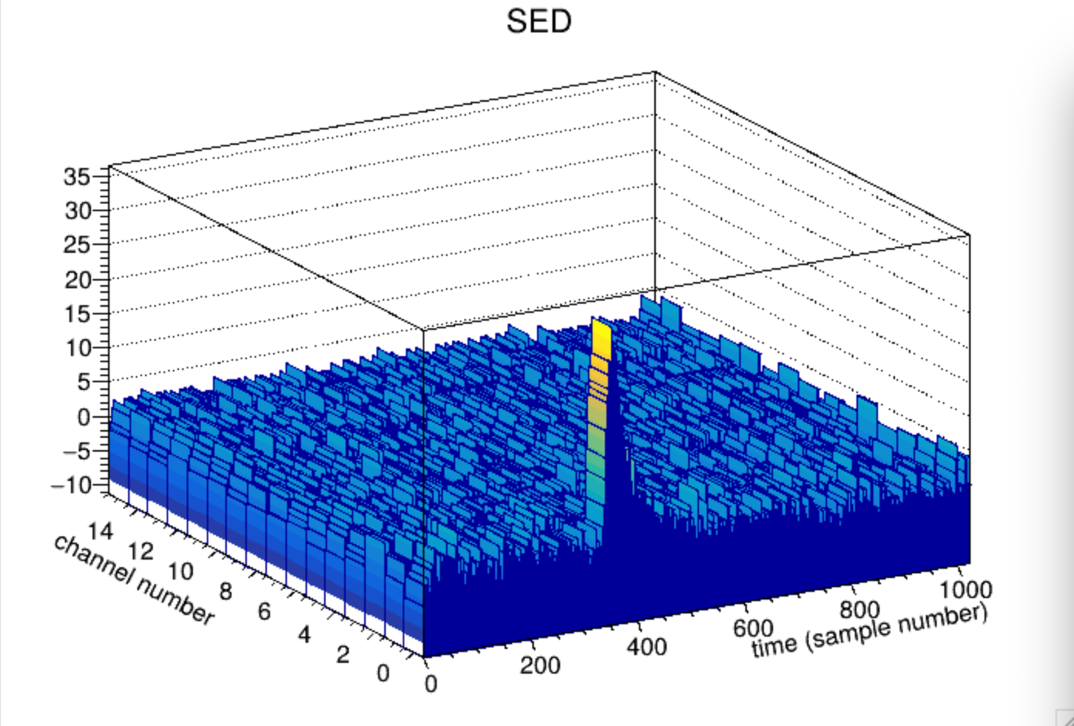
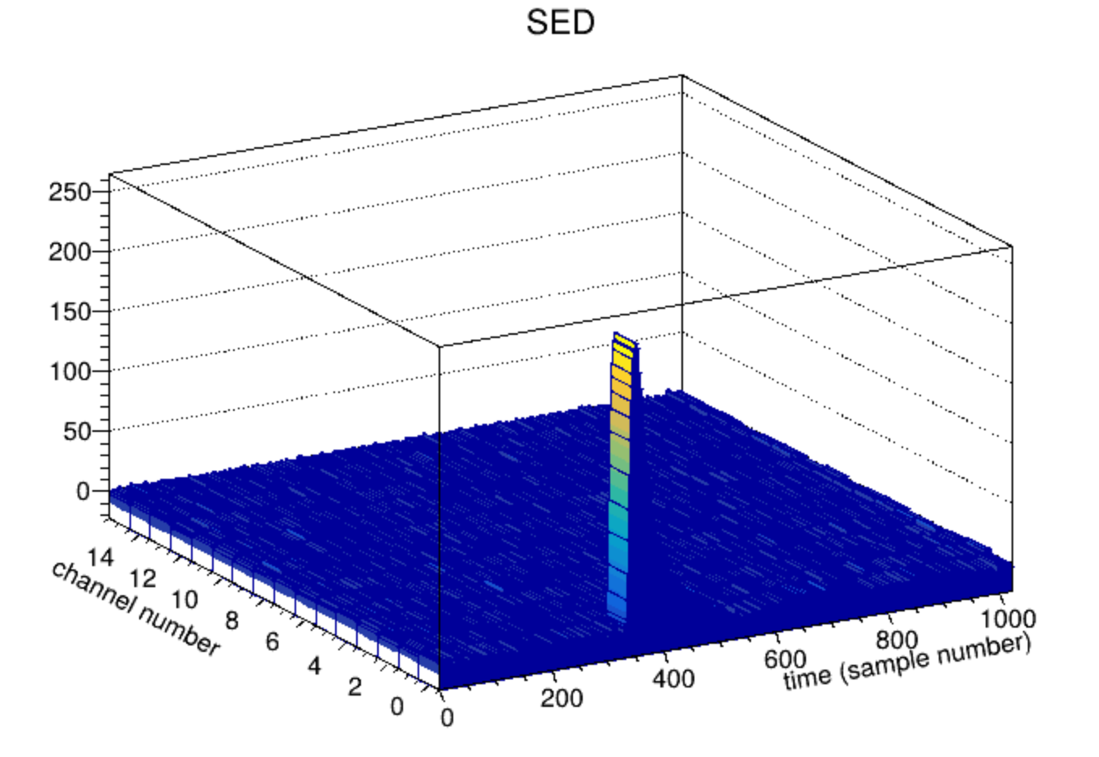
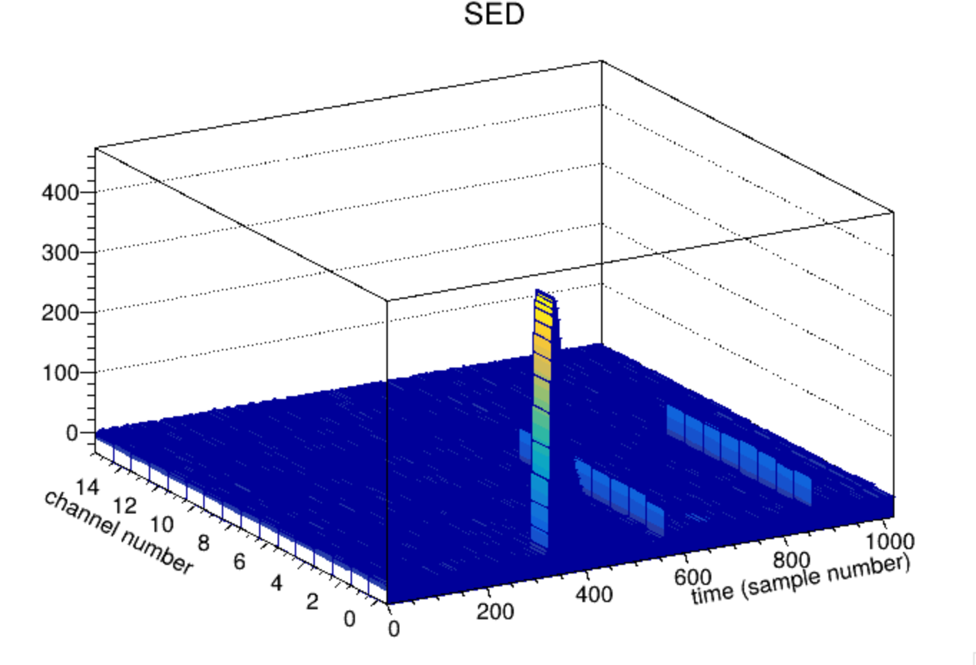
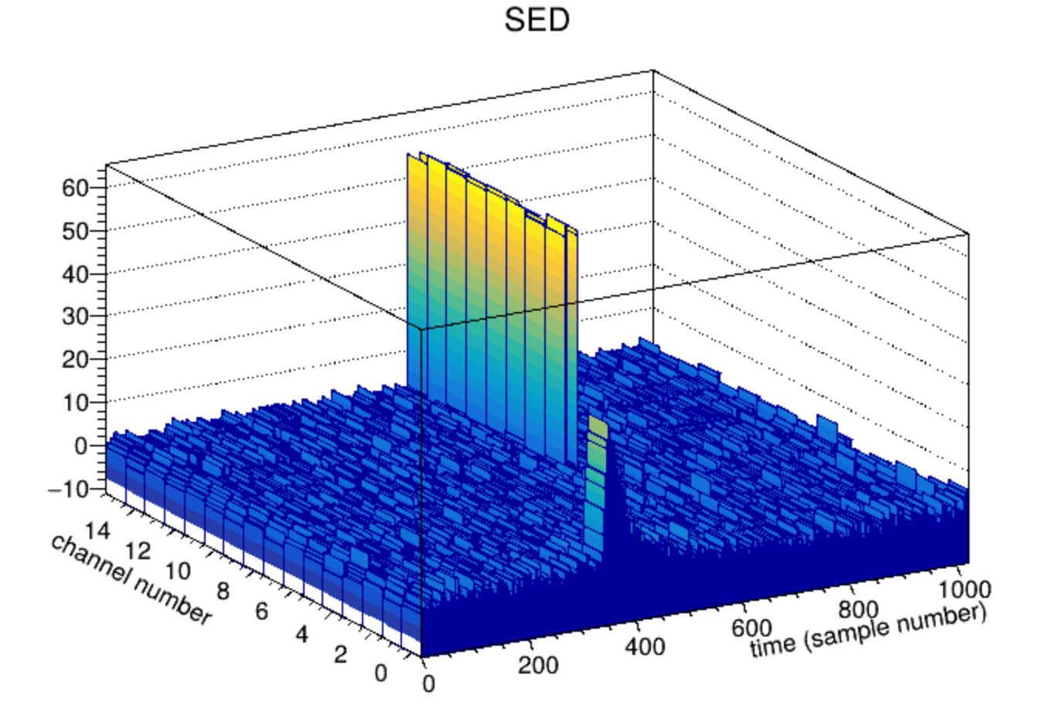
SEDs
Here are a few SEDs.
I usually look at many of those to get a feel for the data
Since the pulses are negative-going, I plot -1*value for the z-Axis

Slide 6
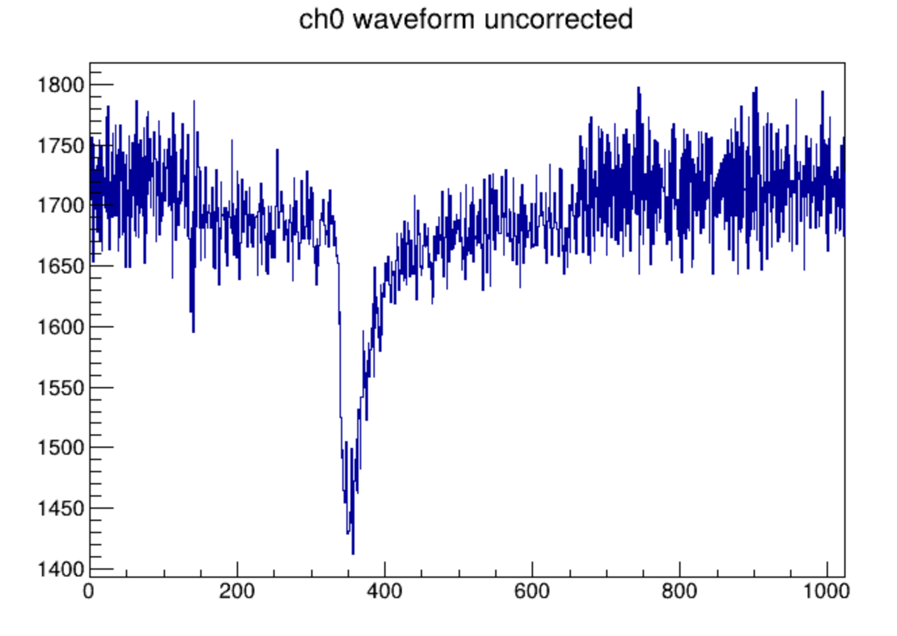
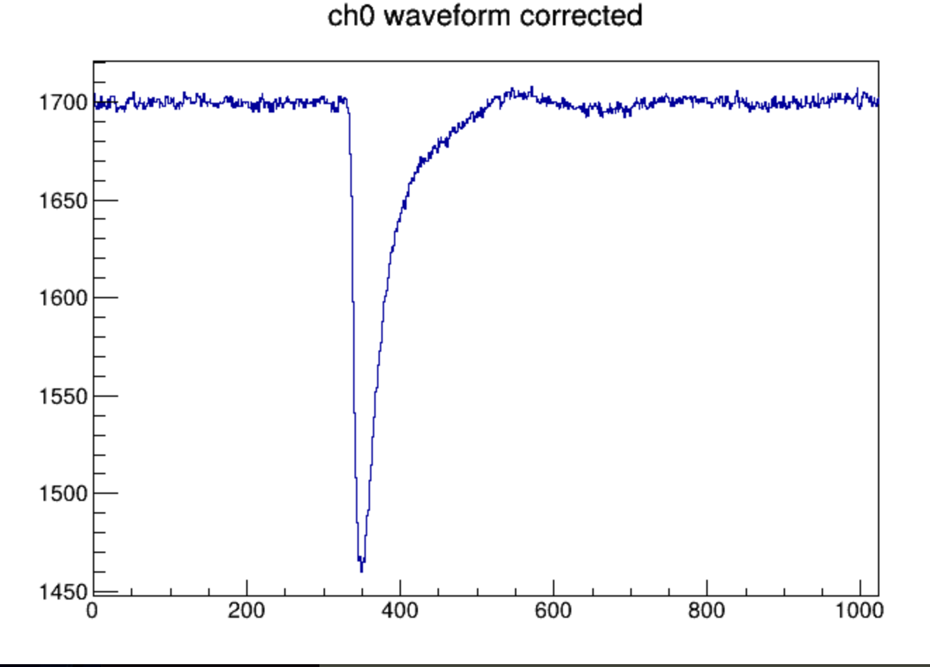
DRS4 Corrections
Each CAEN unit with a DRS4 has what amounts to a “factory calibration” to correct for the cell-by-cell differences of each individual chip. The correction values are burned into the Eprom of a given unit.
The correction is applied offline. My CAEN plugin comes with a utility to extract these factory correction. But this also allows us to generate our own corrections if we are so inclined

Slide 7
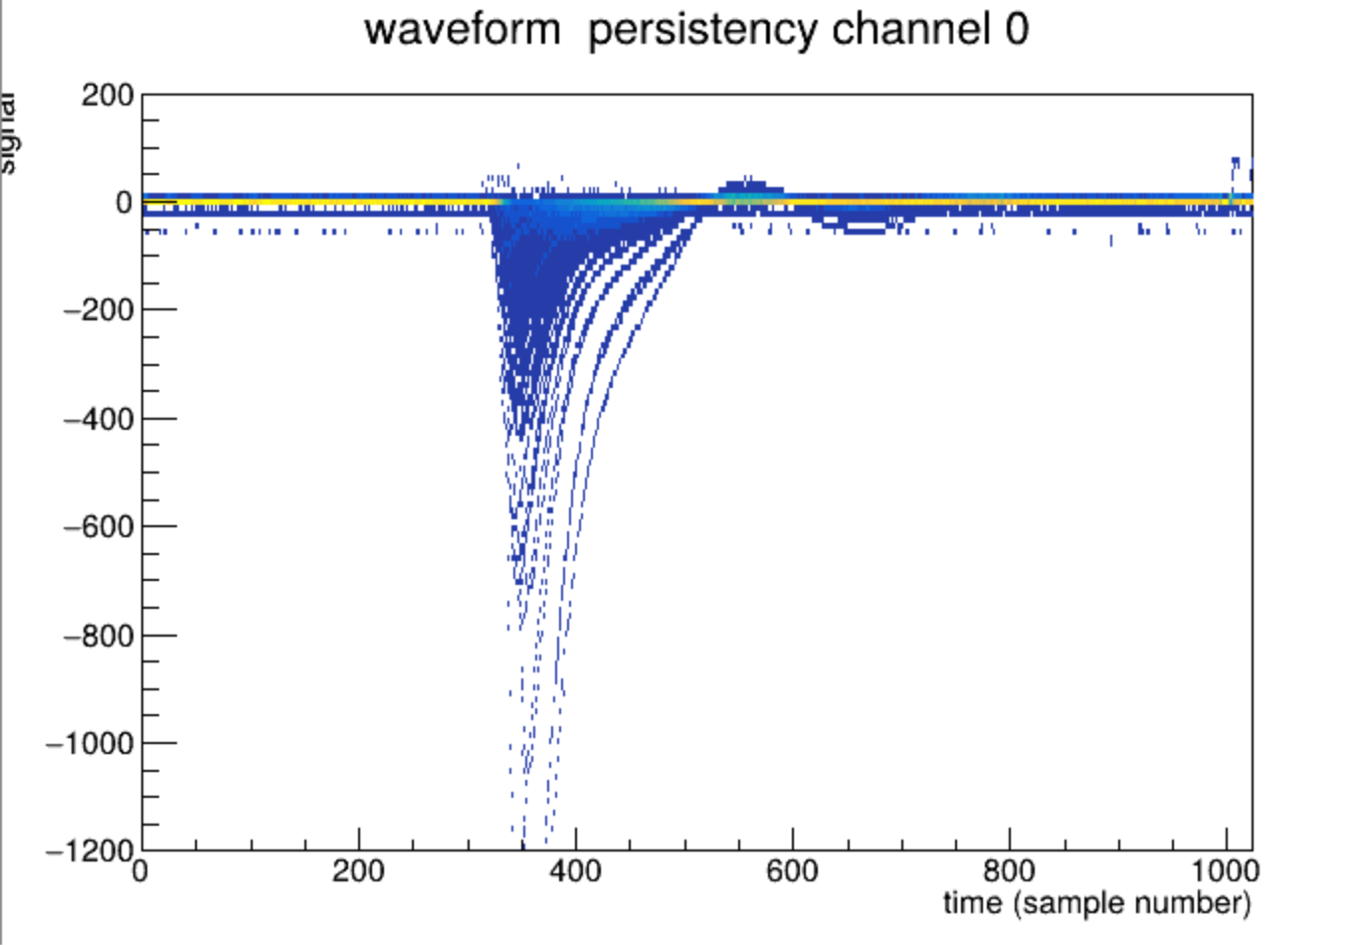
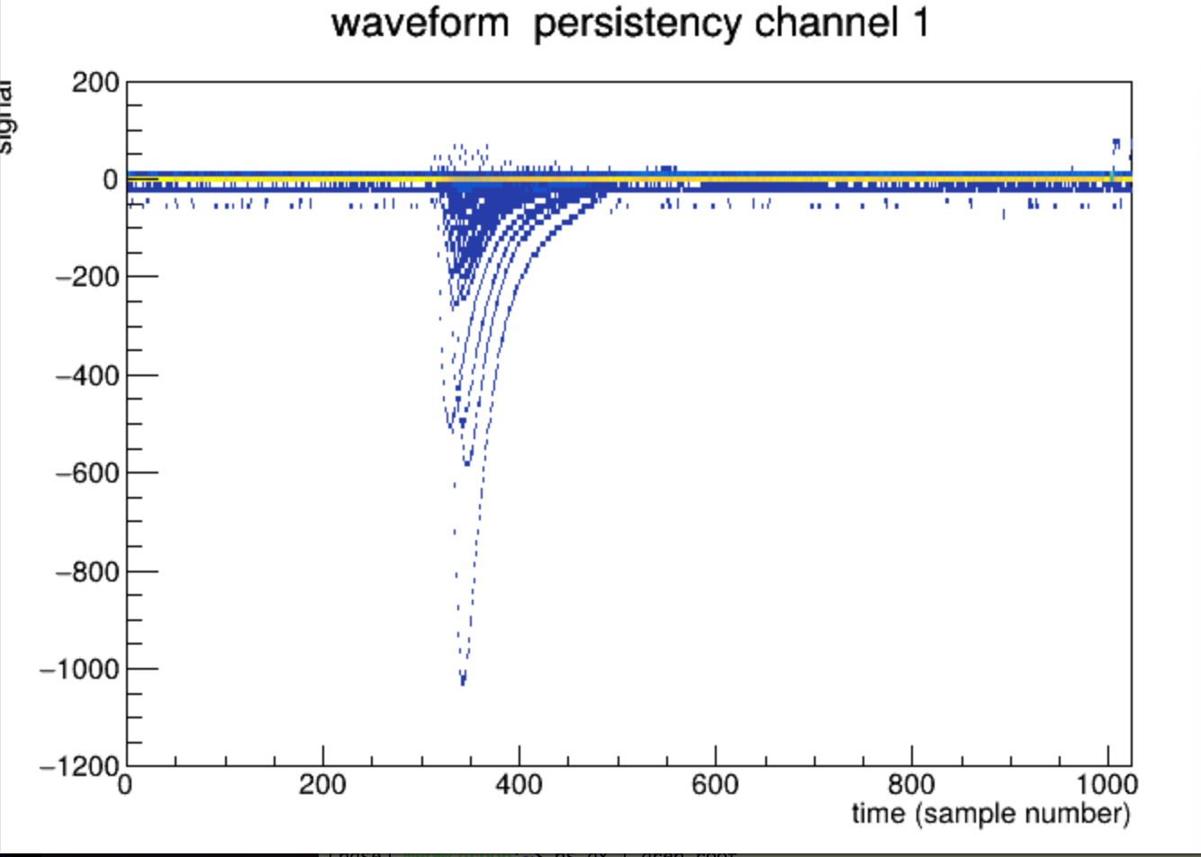
Persistency Plots
My standard approach to an initial view of waveform data is a “persistency plot”, gleaned from a digital scope’s persistency mode, where many pulses are plotted on top of each other. This allows you to see an “envelope” of the pulse shapes
The online monitoring plots we looked at for the ROC the other night are also persistency plots.
Before I leave, we should have another quick tutorial on all that.

Slide 8
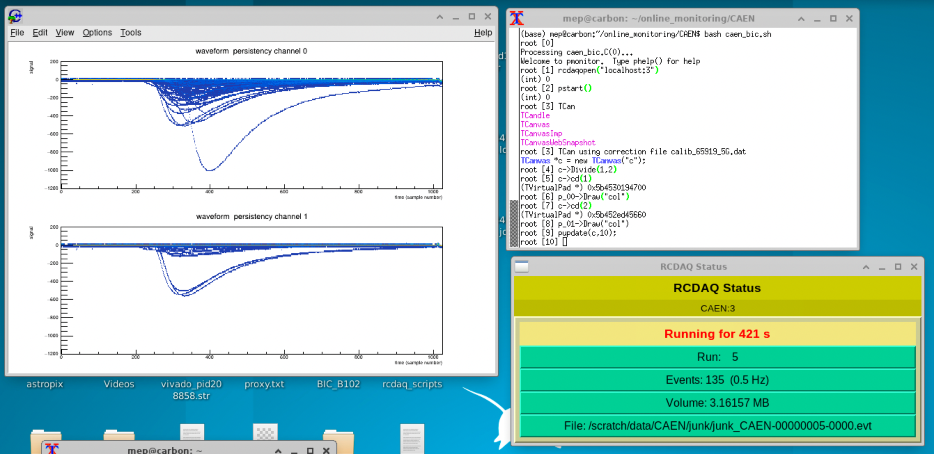
Online monitoring running on the VNC
I started a new run and let the onl. monitoring run overnight. Have a look!

