Slide 1
EIC Cost Management Strategy
Jim Yeck
Project Director & Associate Laboratory Director
Brookhaven National Laboratory
EIC Resource Review Board (RRB) Meeting
June 9-10, 2026

Slide 2
Cost Reduction Strategy
The EIC Total Project Cost (TPC) objective is ~$3B; current preliminary cost estimates exceed this target.
To close this gap, the project team developed a comprehensive cost-reduction strategy and identified approximately ~$920M in potential TPC savings.
The cost-reduction opportunities were developed with stakeholder input and were presented at the Director's Review in March 2026.
Immediately following the Director’s Review the project team met with the BNL and JLAB Directors, DOE, and the ePIC spokesperson to confirm plans to implement the TPC cost reduction options.
Achieving the project’s TPC funding target requires deferring certain performance capabilities; however, DOE – approved mission need requirements will be achieved.

Slide 3
DOE Approved Mission Need Parameters
A high degree of beam polarization* (~ 70%) for electrons and light ions
Availability of ion beams from deuterons to the heaviest stable nuclei
Variable center of mass energies ~20-100 GeV, upgradable to ~140 GeV (e-p)
High collision luminosity* ~10³³⁻³⁴ cm⁻²s⁻¹
Possibility for more than one interaction region in the future
Luminosity and polarization are interpreted as average polarization and luminosity over a fill.

Slide 4
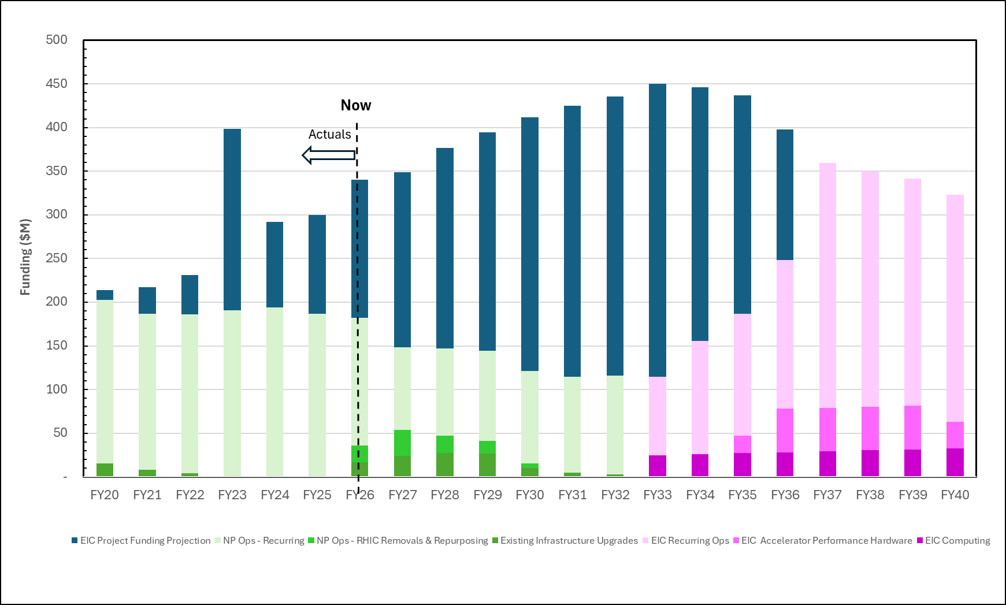
EIC Notional Funding Profile
Project
NP-Ops & Computing
R&R
Infrastructure improvement projects
EIC Ops
EIC AIPs
EIC Computing
4

Slide 5
Cost Reduction Categories
Class 1 – Cost reduction actions that do not impact expected performance
Items implemented through normal change control process.
  Value Engineering
  Cost Scrubbing
  Scope Realignment
  Procurement Optimization to maximize best value opportunities
Class 2 – Cost reduction actions that defer scope into the initial operations phase
Scope deferred until initial operations will be reviewed with stakeholders and DOE.
Deferred capabilities supported by operations funding, additional in-kind opportunities, future upgrades.

Slide 6
Cost Reduction Actions Identified
Class | Cost Reduction Action | Savings ($M) | Examples
Class 1 | Design Optimization & Value Engineering | ~102 | SFR relocation IR10→IR8; SC magnet and power supply optimization
Class 1 | Cost-to-Go Estimate Scrubbing | ~200 | Infrastructure task force reviews; bottom-up estimate reconciliation
Class 1 | Scope Realignment to Off-Project Funding | ~262 | HSR magnet modifications; pre-operations workforce; controls scope
Class 2 | Scope Deferred to Initial Operations | ~346 | ESR SRF systems; RCS magnet girder scope
Total |  | ~920

Slide 7
Summary
The project team is proactively identifying and evaluating a comprehensive set of cost-reduction opportunities to achieve the $3B Total Project Cost (TPC) target.
Cost optimization actions are expected to reduce the TPC project cost while preserving DOE-approved Mission Need capabilities with some capabilities deferred to initial operations and upgrades.
The project team will continue to engage with DOE, the scientific community, and other key stakeholders to assess impacts, to ensure informed decision-making and to maintain the capabilities needed to achieve the scientific program.

