Slide 1
EIC Project Detector Overview
E.C. Aschenauer (BNL)
R. Ent (JLab)
Co-Associate Directors for the Experimental Program
7th EIC RRB Meeting, Tokyo, Japan
June 9th – 10th, 2026

Slide 2
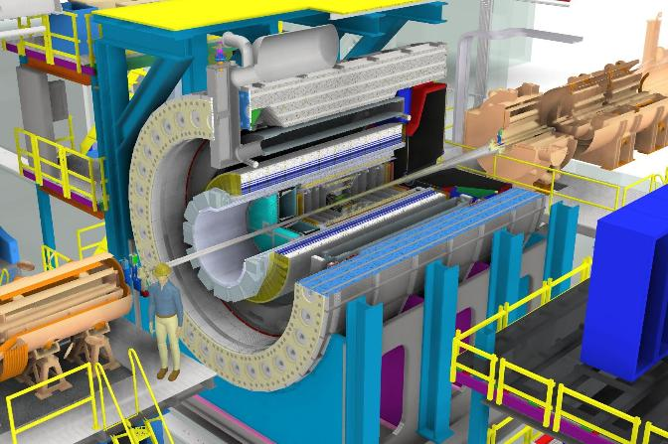
Outline
Subproject Scope
Technical Progress
Cost
Schedule
In-kind Contributions
Path to Baseline
Risks
Summary

Slide 3
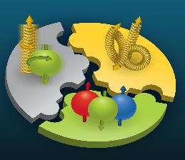

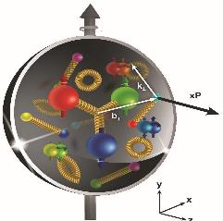
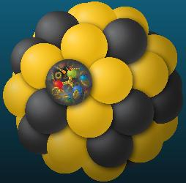
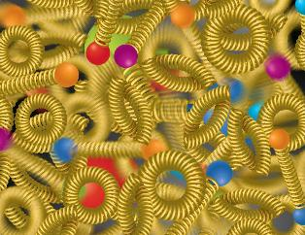
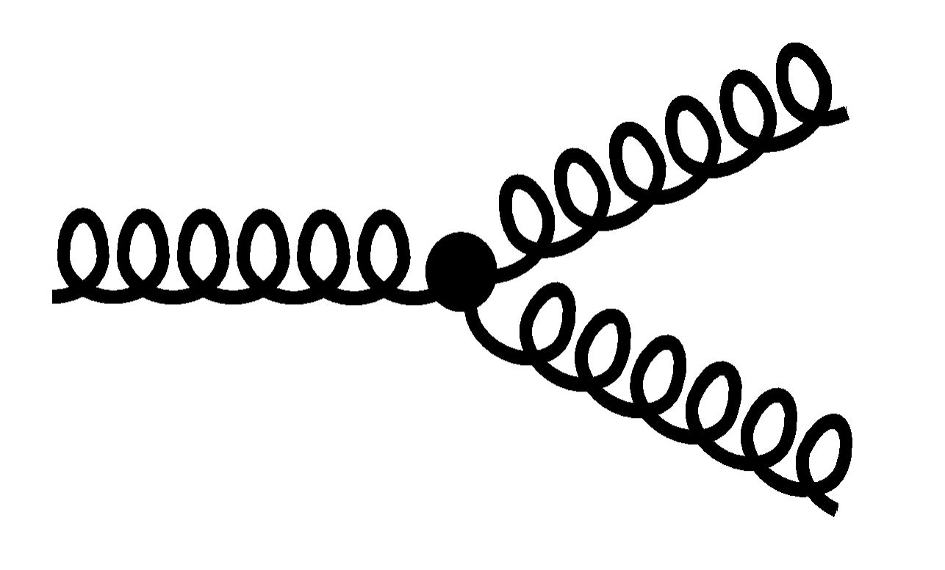

EIC Science Pillars
How do quarks, gluons, and orbital angular momentum contribute to proton spin?
Spin is a fundamental property of matter. All elementary particles but Higgs carry spin.
Spin of composite particles such as the proton cannot be explained by a static picture but are caused by the interplay of properties and interactions of quarks and gluons inside.
Does the mass of visible matter emerge from quark-gluon interactions?
Atom:
Binding/Mass = 0.00000001
Nucleus:
Binding/Mass = 0.01
Proton:
Binding/Mass = 100
The EIC will determine an important term contributing to the proton mass, the so-called QCD trace anomaly.
How are quarks and gluons distributed in space and momentum inside the nucleon & nuclei?
How do the nucleon properties emerge from them and their interactions?
How can we understand their dynamical origin in QCD?
What is the relation to Confinement?
How do the confined hadronic states emerge from quarks and gluons?
Is the structure of a free and bound nucleon the same?
How do quarks and gluons interact with a nuclear medium?
How do the quark-gluon interactions create nuclear binding?
Does gluon density in nuclei saturate at high energy?
How many gluons can fit in a proton?
How does a dense nuclear environment affect the quarks and gluons, their correlations and interactions?
=
gluon
splitting
?
gluon
recombination
SPIN
MASS
3D-Imaging
QCD in Nuclei
Dense Gluon Systems
(National Academies of Sciences, Medicine, and Engineering, 2018 Consensus Study Report)

Slide 4
What is required of an EIC Detector
Asymmetric beam energies
  41GeV 100 to 275 GeV polarized p/A polarized electrons 5 GeV, 10 GeV, 18 GeV
requires an asymmetric detector with an electron and a hadron endcap
  tracking, particle identification, EM and hadronic calorimetry functionality in all directions, covering equal rapidity area: (-4 < η < 4)
  low mass detectors critical for precise scattered electron reconstruction
Highly polarized proton and electron beams: 70%
→ requires high precision electron
and hadron polarimetry
Dedicated detector to
measure very low
Q² at 35 m
Detectors integrated
along the beam line
up to 40 m
SPIN
QCD in
Nuclei
Dense Gluon
Systems
MASS
3D-Imaging
require detection of scattered electron and produced hadrons
require detection detection of all produced particles,
especially the ones scattered under very small
angles into the detectors along the beam line

Slide 5
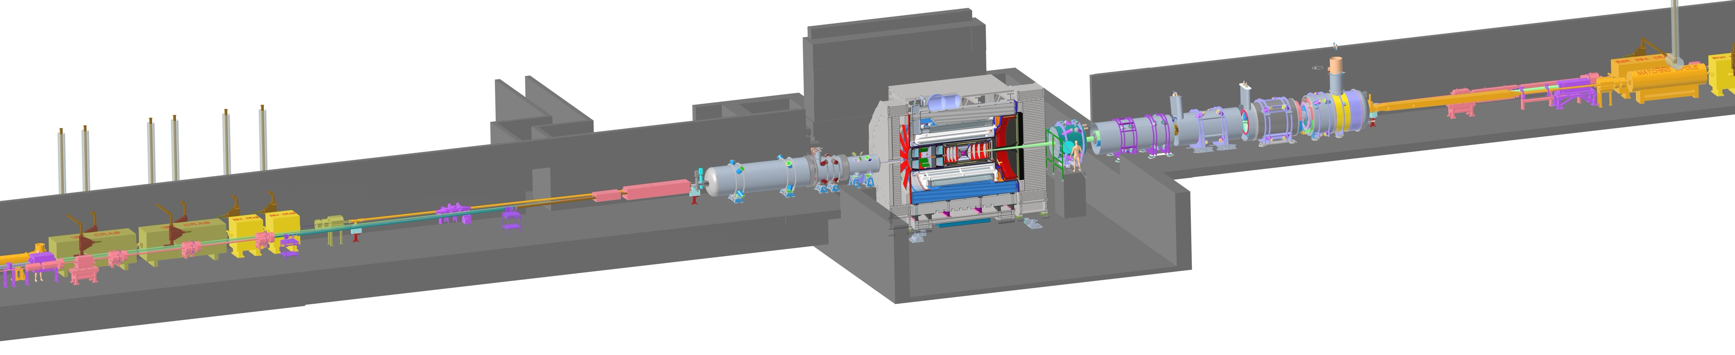

6.03 DET – EIC Detector = ePIC
26 subsystems over ± 40 m to measure particle momenta, energy and type
2T Solenoid (⌀ 2.84 m)
3 hadronic calorimeters
3 electromagnetic calorimeters
5 particle Identification detectors
Various Silicon and Micro-pattern gas tracking detectors
7 detectors integrated into the
accelerator lattice
fully streaming readout electronics and DAQ → integrating AI/ML capabilities
electron and hadron polarimetry to measure the spin of the beam particles
Backward
p/A beam
electron beam
Forward
Barrel HCal
Backward HCal
Magnet
forward HCal
8 world-first technologies:
4 in Micro-Electronics
4 in detector technologies
DIRC
Barrel ECal
forward ECal
Barrel ToF
dRICH
backward
ECal
pfRICH
forward ToF
Zero Degree Calorimeter
electron beam
p/A beam
Luminosity System
Low-Q2 Taggers
Roman Pots (RPs) and
Off-Momentum Detectors (OMDs)
B0 Magnet
Spectrometer

Slide 6
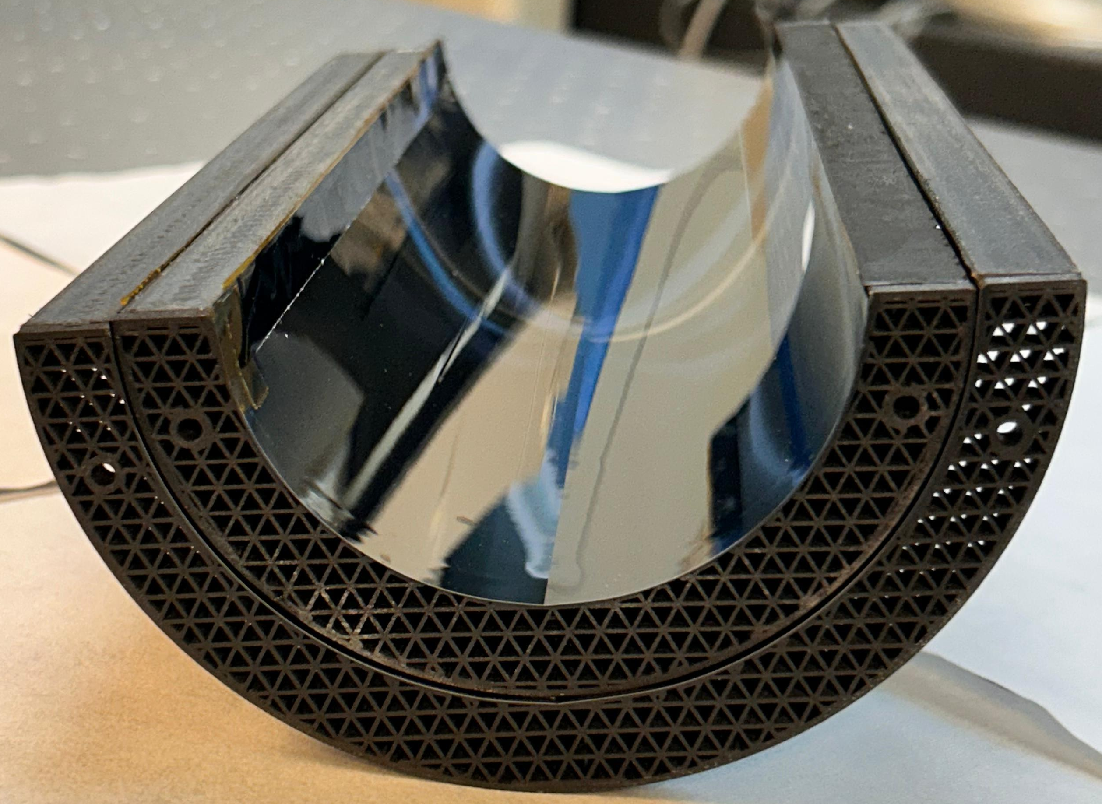
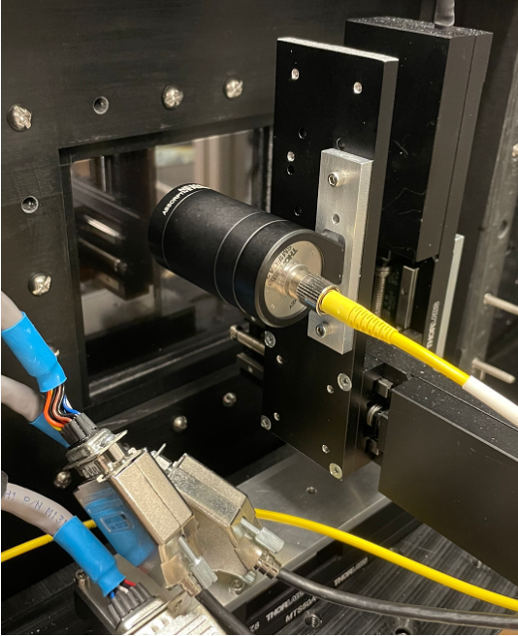
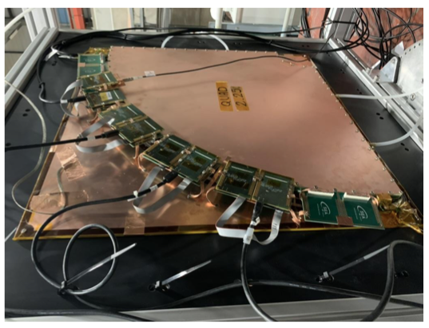
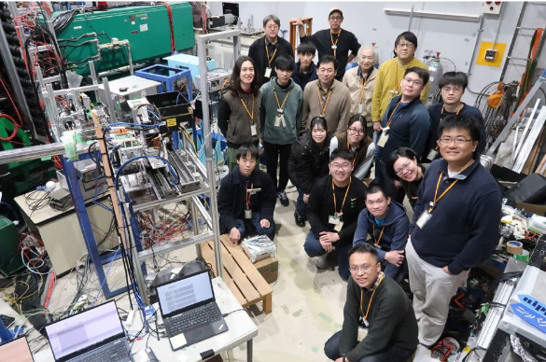
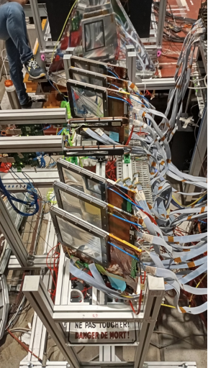
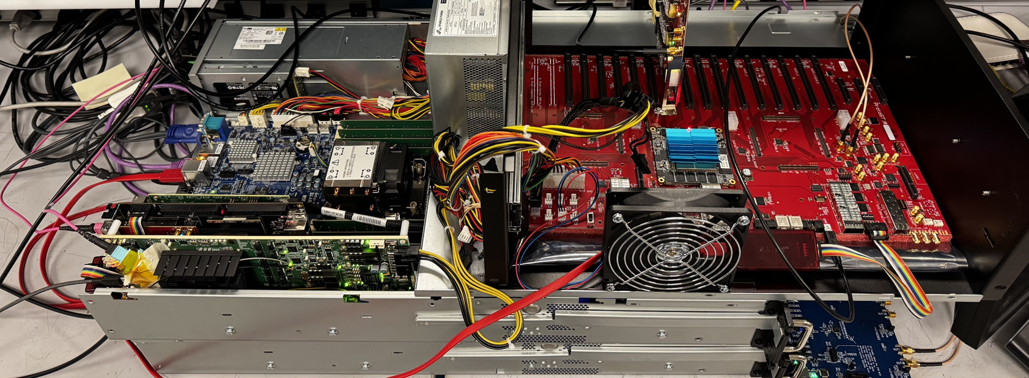
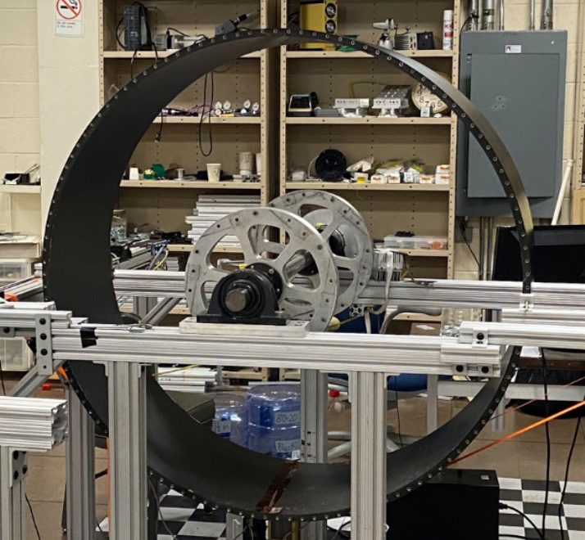
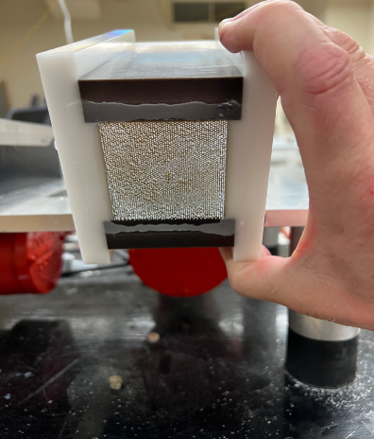
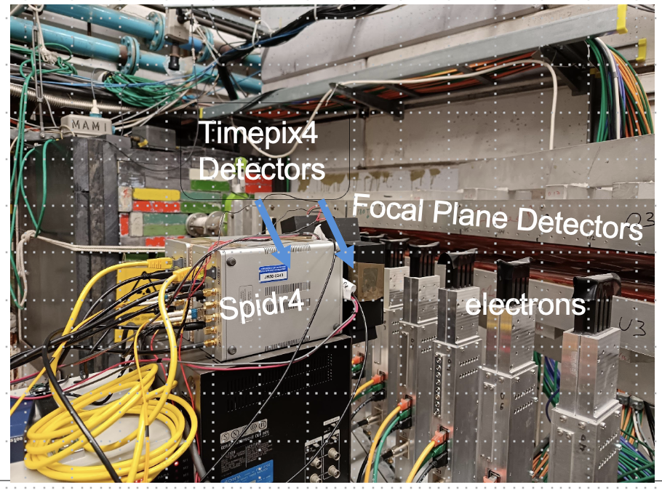
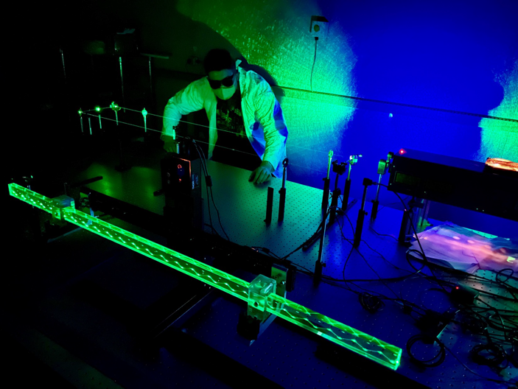
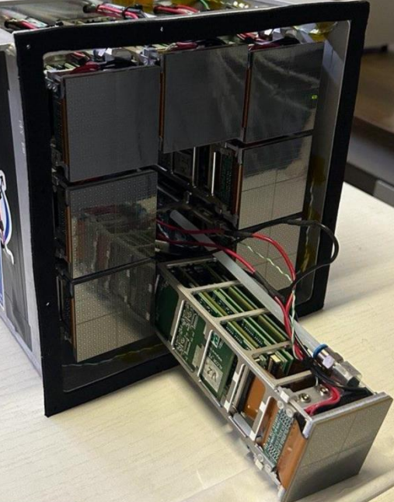
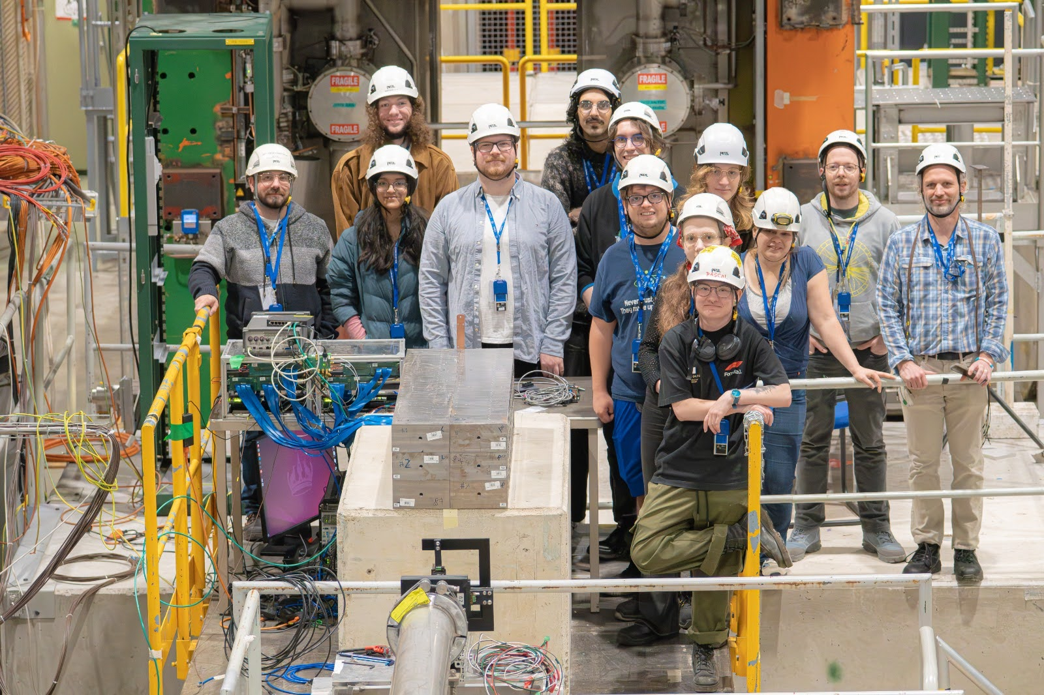
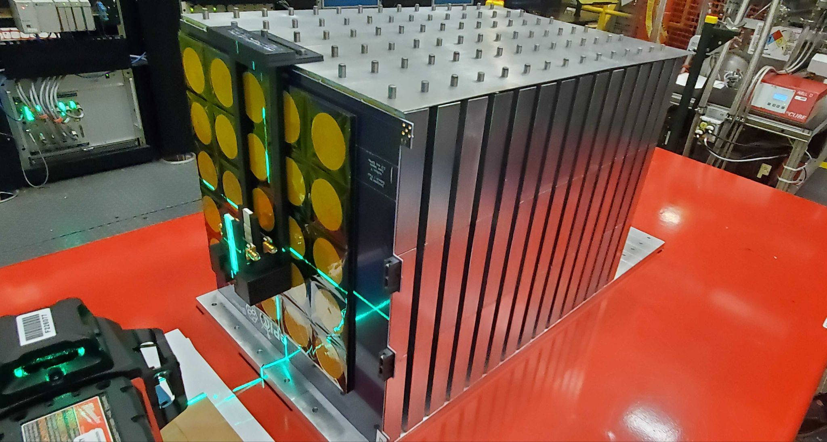
EIC Detector – Around the World Progress
L0 & L1 MAPS at INFN
engineering test article (ETA)
HRPPD
MicroMega ETAs (CEA) at CERN
Test Beam Nov 2025
DIRC and pfRICH
Photonsensor at BNL & JLab
μRWELL-ECT ETAs (INFN) at CERN Test Beam 11/25
Team of Japan, Taiwan and Korea at Tohoku U test beam
ePIC DAQ Setup at BNL (similar at JLab)
Low-Q² Tagger ETA (Glasgow) at test beam
dRICH readout unit at INFN
proximity focusing RICH
Carbon fiber vessel at SBU
ZDC engineering
test article at UCR
forward HCal engineering test
article at CERN test beam
Optical test of refurbished DIRC at JLab

Slide 7
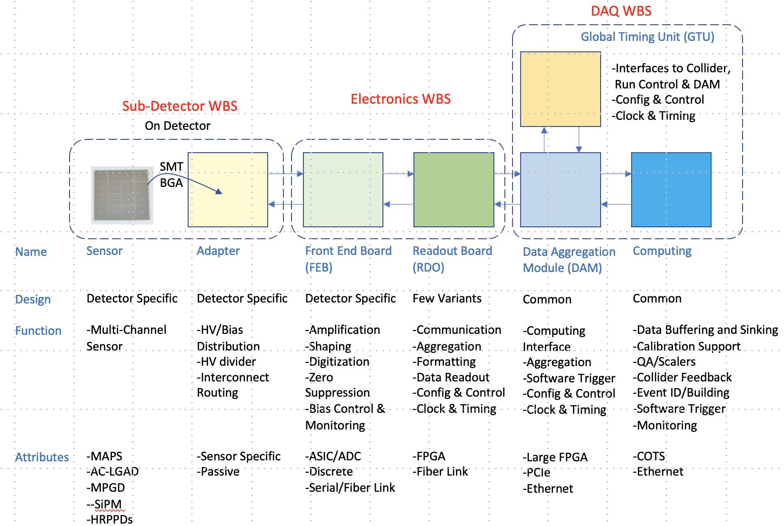



ePIC/EIC Detector - Electronics
All electronics (ASICs and Discrete) conform to streaming readout implementation
Considerable progress:
Development of ASICs nearing final designs.
Peer reviews of all ASICs completed in May 2026 → towards production readiness.
CD-3B LLP scope: lpGBT and VTRX+ (in production by CERN).
FEB Design synergies, particularly within the same technology reach, all sub-detectors.
A generic RDO design is nearing completion, all sub-detectors.
Three PDRs (8/2022, 6/2024, 9/2025) have been successfully completed establishing a 60% design readiness and a clear path to CD-2.
 | #Ch | #Ch/ Unit | #ASICs/Wafer | #Wafers | Node (nm) | Packaging | Cost/ch (US$) | Next Steps | Production Ready
Discrete/COTS (SiPM) | 27.6k | 32 | NA | 863 Digitizers | COTS | NA | 66 | Engineering article FY27 | May 2028
CALOROC (SiPM) | 144 k | 36 | 800 | 5 | 130 | BGA | 2.2 | CALOROC2 (36 ch) – FY27-FY28 Select version 1A/1B. Tests - FY26-FY27 | March 2027
EICROC (AC-LGAD Pixel) | 7.5 M | 1,024 | 160 | 46 | 130 | Wafer Bump | 0.1 | EICROC2 (32x32) FY27-FY28 Add De-randomizer and ZS. Digital on Top design for lower power (~1 mW/ch). Tests. | April 2027
FCFD (AC-LGAD strip) FCFD Variant (HRPPD) | 3.1 M 207 k | 32 32 | 1,250 1,250 | 100 6 | 65 | Bump/Wire BGA | 0.4 3.7 | FCFD2.0 (32 ch) FY27-FY28 Add ADC, TDC, interfaces from ETROC, ECON CERN. FCFD3.0 (32 ch) FY28-FY29 | May 2028 May 2028
ALCOR (SiPM) | 461 k | 64 | 800 | 9 | 110 | BGA | 0.7 | ALCOR-64 MPW – FY26-FY27 Final iteration for production & Testing FY28-FY29 | March 2028
SALSA (MPGD) | 256 k | 64 | 500 | 8 | 65 | BGA | 3.2 | SALSA3 (64 ch) FY27-FY29, full DSP, 64 ch | July 2029

Slide 8
ePIC/EIC Detector - DAQ
High-level Scope:
Custom hardware providing timing synchronization (1 Global Timing Unit - GTU).
Hardware providing an interface between the custom front-end electronics and the online computing (~120 Data Aggregation and Management boards - DAM).
COTS-based computing and networking to support online readout, filtering, beam and detector Q/A and intermediate data storage (Echelon 0 - consisting of ~120 computing nodes interconnected with 100/400Gb ethernet network).
Software and firmware to implement a streaming DAQ system using all computing and hardware.
Roughly 8000 data path fibers connecting DAM boards to detector readout electronics (connecting to external RDOs or to on-detector patch panels for detectors without external aggregation).
Electronics racks for mounting all components in the experimental areas and for Echelon 0 computing (roughly 25-30 total racks).
Integration of EPICS-based slow controls system.
Technical Progress:
DAM engineering articles
FLX-155 Designed for CERN ATLAS Experiment.
Development at BNL. Engineering articles are currently being tested there.
We will purchase engineering articles through them at BNL in 2026.
FLX-155 operating in test stand at BNL with GTU article.
GTU engineering article
An internal peer review of the design was completed in November 2025.
GTU engineering articles operational in tests stands at BNL and JLAB.
Evaluation of engineering articles to complete final design underway
Status:
Three PDRs (8/2022, 6/2024, 9/2025) have been successfully completed establishing a 60% design readiness.
No CD-3A and CD-3B LLP.
A functional DAQ will be necessary for small-scale detector testing and for commissioning and pre-ops.
Detector Install: FY30Q2 - FY33Q2
Cosmics: FY33Q2
CD4: FY34Q3
DAQ Releases:
PicoDAQ: FY26Q4
  Simple readout of test setups
MicroDAQ: FY27Q2
  Readout detector data in test stand using engineering articles
MiniDAQ: FY28Q4
  Readout detector data using full hardware and timing chain
Full DAQ-v1: FY30Q3
  Full functionality DAQ ready for full system integration & testing
Production DAQ: FY32Q4
Ready for cosmics

Slide 9
CD-3A Status and CD-3B Scope
CD | Scope | Status
CD-3A | Lead Tungstate Crystals for the Detector Backward Electro-Magnetic (EM) Calorimeter (1069 of 2899 crystals) | Contract awarded 3/5/2025 (CRYTUR) – 1069 (!) crystals delivered – quality tests completed, all passed specifications → completed
 | Scintillating Fibers for the Detector Barrel (1125 km of 4900 km) and Forward EM Calorimeters (750 km of 3000 km) | Barrel SciFi: Contract awarded 12/19/2025 (Kuraray) → 357km of 1125km delivered Forward SciFi: Contract awarded 3/12/2025 (Luxium) → iterated with Luxium to fulfill requirements, 386km of 1000km delivered and accepted
 | Silicon Photomultipliers for the Detector Forward Hadronic Calorimeter (341k of 540k) | Contract awarded 11/25/2024 (Hamamatsu) → All 341k SiPMs delivered to BNL → testing done at Yale → no quality issues. → completed
 | Steel towers for the Detector Forward Hadronic Calorimeter (650 towers of 1138) | The Acquisition Plan and RFP have been approved by BHSO. RFPs have been received. Need a different procurement strategy cost was 2.2 higher.
 | Detector Solenoid Magnet Design and Fabrication and Conductor | Solenoid: becomes In-Kind. Tender process starting in Spring 2026 led by Italy Conductor: contract awarded 09/23/2025 (Luvata), Vendor has acquired all materials.
CD-3B | Lead Tungstate Crystals for the Detector Backward Electro-Magnetic (EM) Calorimeter (1000 pieces cont. CD-3A) | Contract option for CD-3B triggered. First 100 crystals have arrived 06/04/2025
 | Scintillating Fibers for the Detector Barrel (1264 km cont. CD-3A ) and Forward EM Calorimeters (1065 km cont. CD-3A ) | Contract options for CD-3B triggered – delivery will start after CD-3A scope is completed
 | Steel towers for the Detector Forward Hadronic Calorimeter (200 towers cont. CD-3A ) | Need first resolution for cost increase in CD-3A scope; will award CD-3A and B scope in one contract.
 | Detector Solenoid Magnet Power Supply | 3 quotes received, vendor selected on the technical basis, procurement team is working with the technical team to finalize the vendor and send the documents to DOE.
 | Flux Return Steel for the Electron and Hadron Endcap Structures (50% of needed steel → first phase hadron endcap) | SOW, technical specifications and drawings are signed, APP close to final, PRR planned after floor loading assessment has been finalized.
 | VTRx+: Versatile Link Plus Transceivers (5500 pieces ) and lpGBT: Low Power GigaBit Transceivers (1500 pieces) | Planning with CERN, procurement going through DOE for approval → CERN bought components; assembly will happen after HL-LHC components are done.
 | DIRC Bar Refurbishment – work-to-go related to reuse of components | 2 (of 8) ex-BABAR DIRC bar boxes opened and disassembled in short bars, 6 bar boxes are CD-3B: 3rd DIRC bar box opened in February after CD-3B authorization.
DET: $33M DOE scope (38%)
DET: $12M DOE scope (25%)

Slide 10
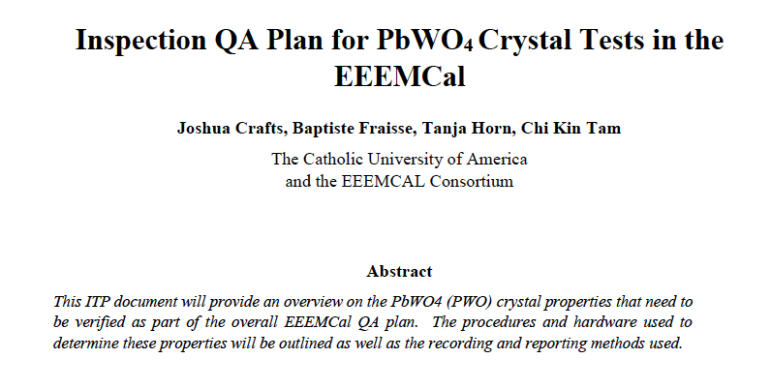
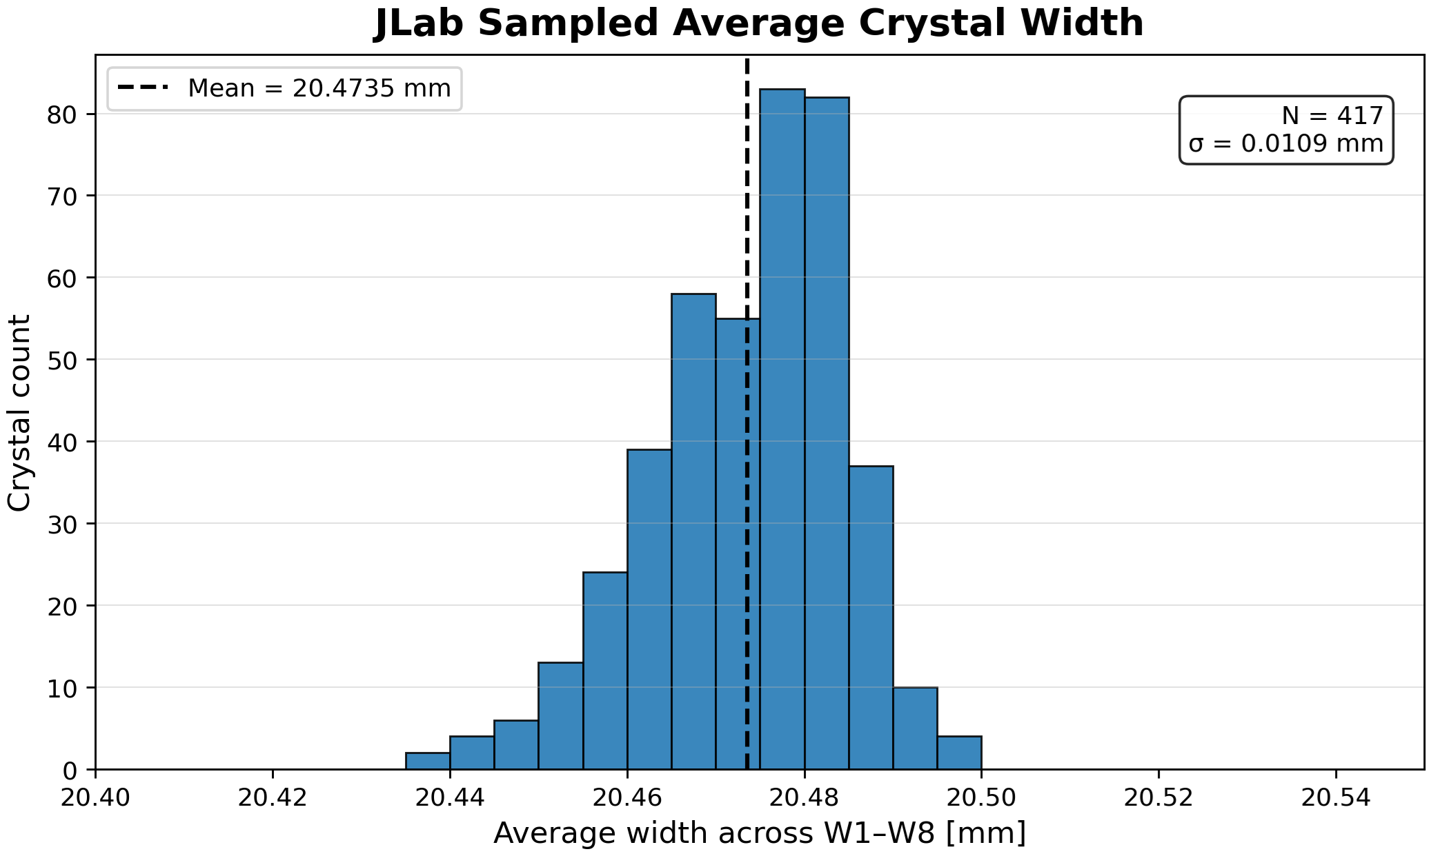
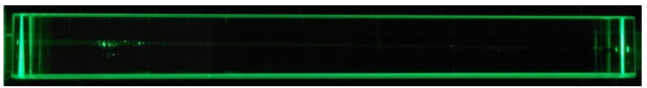
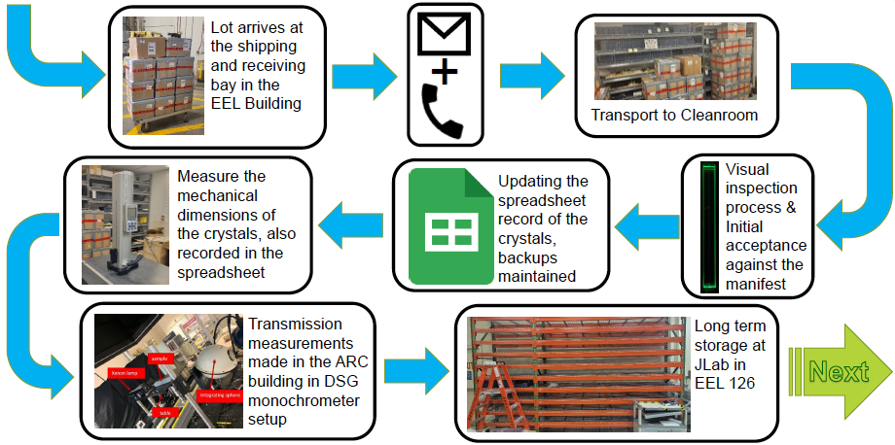
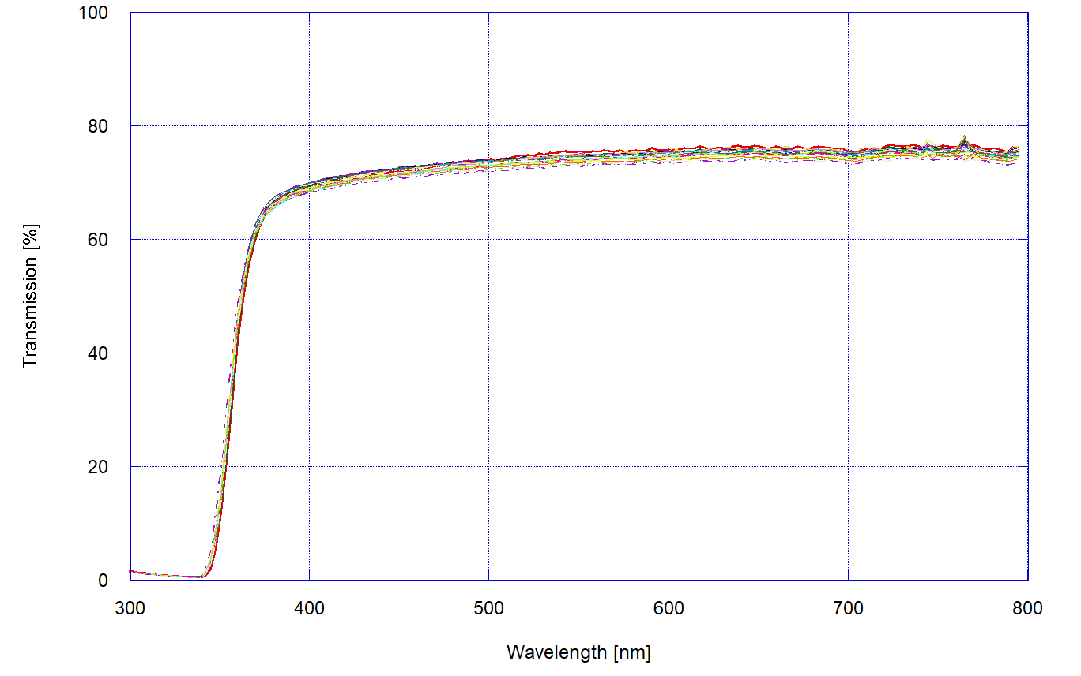
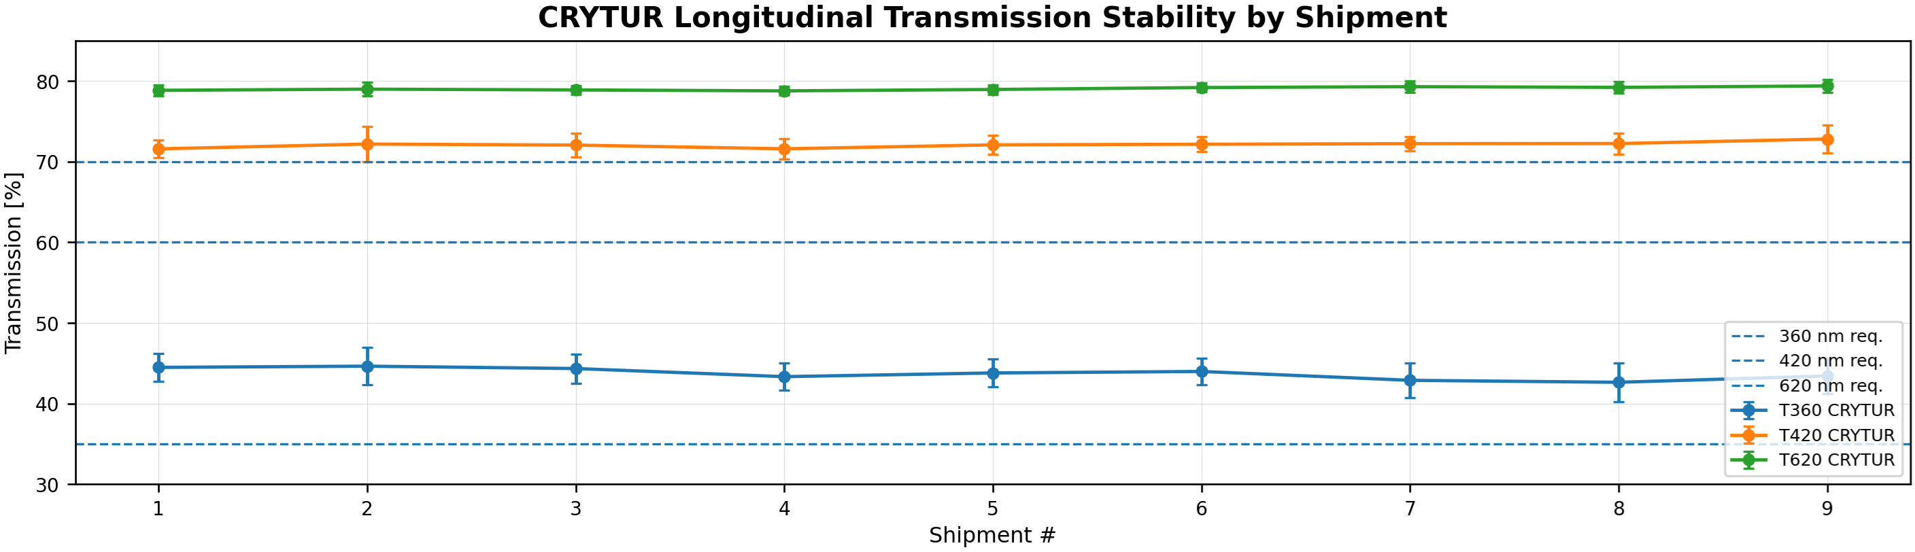
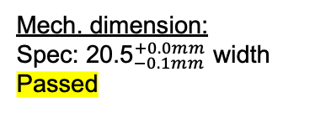
Quality Assurance: PbWO4 crystals for EEEMCAL
Mech. dimension:
${\text{Spec}\text{: 20.5}}_{−0.1mm}^{+0.0mm}$ width
Passed
Visual test (also with laser):
No Scratches, no surface pitting, no internal bubbles
Passed
360 nm
420 nm
620 nm
vs 𝝀
vs shipment #
Optical transmission:
Spec: >35% at 360nm, >60% at 420nm and >70% at 620nm
Passed

Slide 11
Path to Baseline and Beyond

Slide 12
Detector Technical Readiness for Baselining
Detector has been technically baselined since Spring 2024
Project Detector R&D has been fully completed
June 11-13, 2025: Comprehensive Design Review by DAC
Detector Baseline Readiness Review Feb 3 – 5, 2026
BNL Director’s Review – Comprehensive, Mar. 9-12, 2026
DOE OPA Status Review September 15-18, 2026
Subsystem | PDR Completed | PDR Scheduled | CD-3A,B FDR Completed | Subsystem FDR Completed
Tracking | 40% & 60% Si, 40% & 60% MPGD
PID | 40% & 60% hpDIRC, pfRICH, dRICH ToF 40% & 60%, TOF Peer review |  | DIRC Bar refurbishment
ECals | 60% bECal, BECal, fECal |  | SiPM & SciFi fECal, BEcal SiPM & PbW04 bECal | backward ECal
HCals | 40% & 60% BHCal & fHCal 40% & 50% bHCal |  | SiPM bHcal & fHcal Lead blocks fHCal
Solenoid | 60% PDR Cryogenics |  | Magnet, Conductor and Power Supply
Electronics | 40%, 50% & 60% |  | VTRX+ & lpGBT
DAQ | 40%, 50% & 60%
Integration- Installation - infrastructure | 60% Inner and outer Barrel support-structures |  | electron and hadron endcap support structures
Auxiliary Detectors | 40% & 50% RP, B0, ZDC, Low Q2-Tagger, Lumi, 60% ZDC, Low Q2-Tagger, Lumi | 60% B0, RP/OMD: aim for July 2026
Polarimetry | 40% & 60% RCS & ESR Compton Polarimeter & HSR Polarimeters

Slide 13
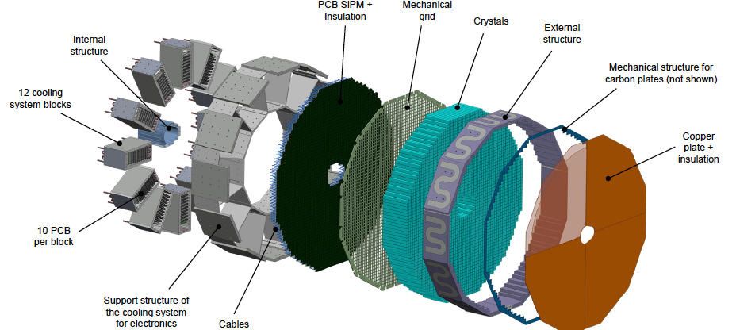
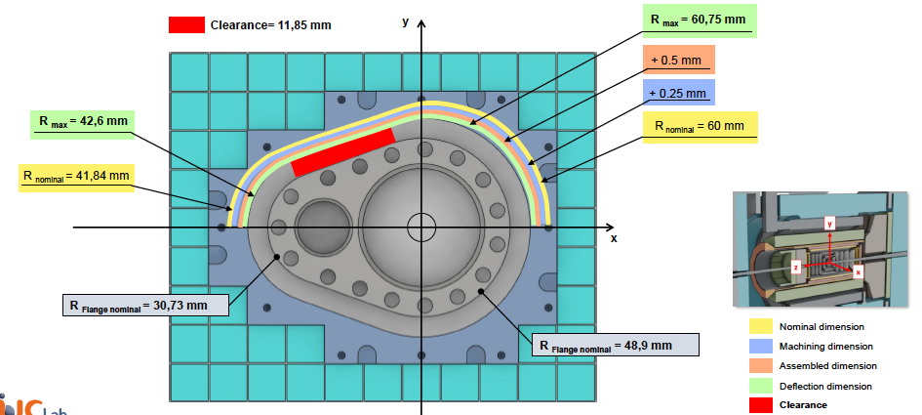
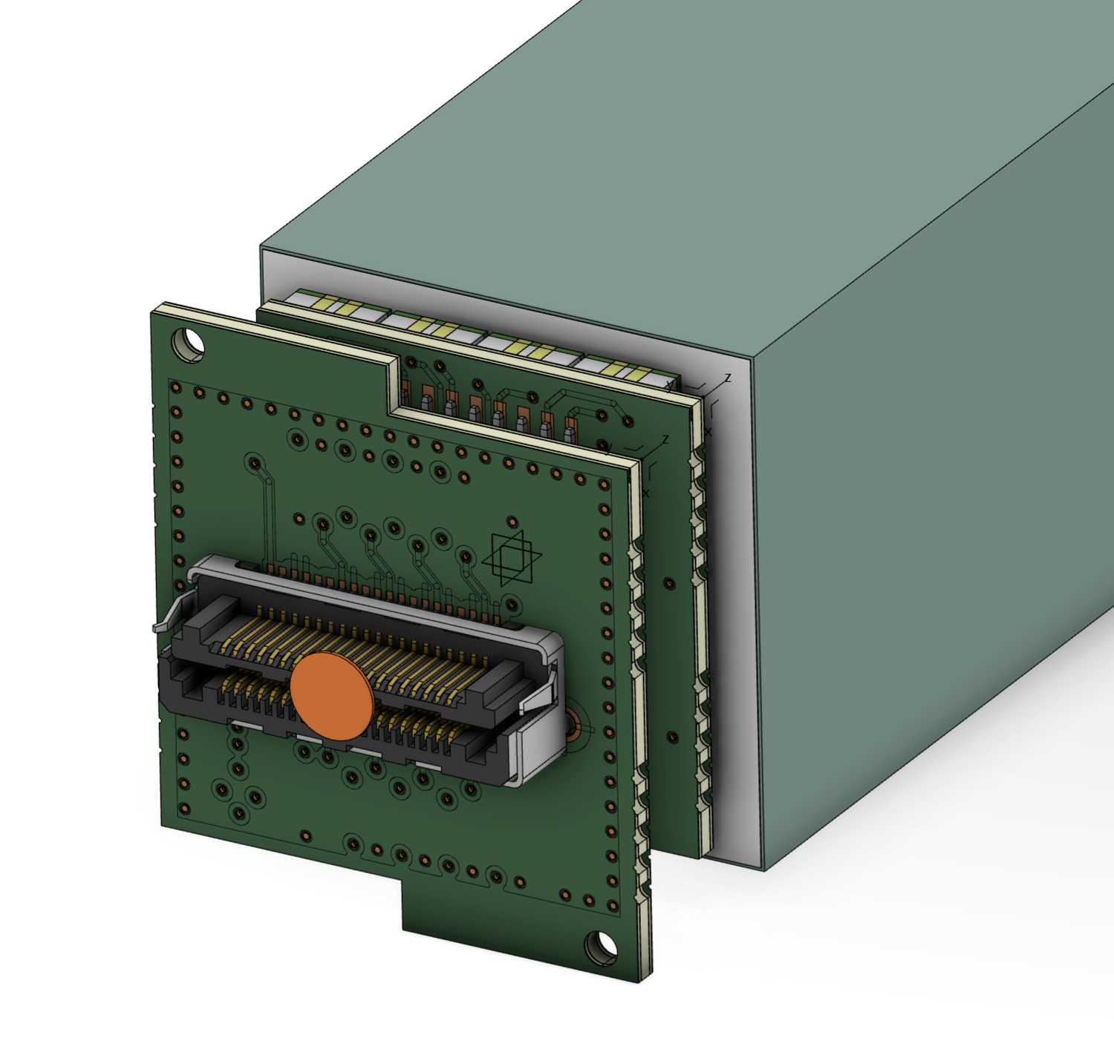
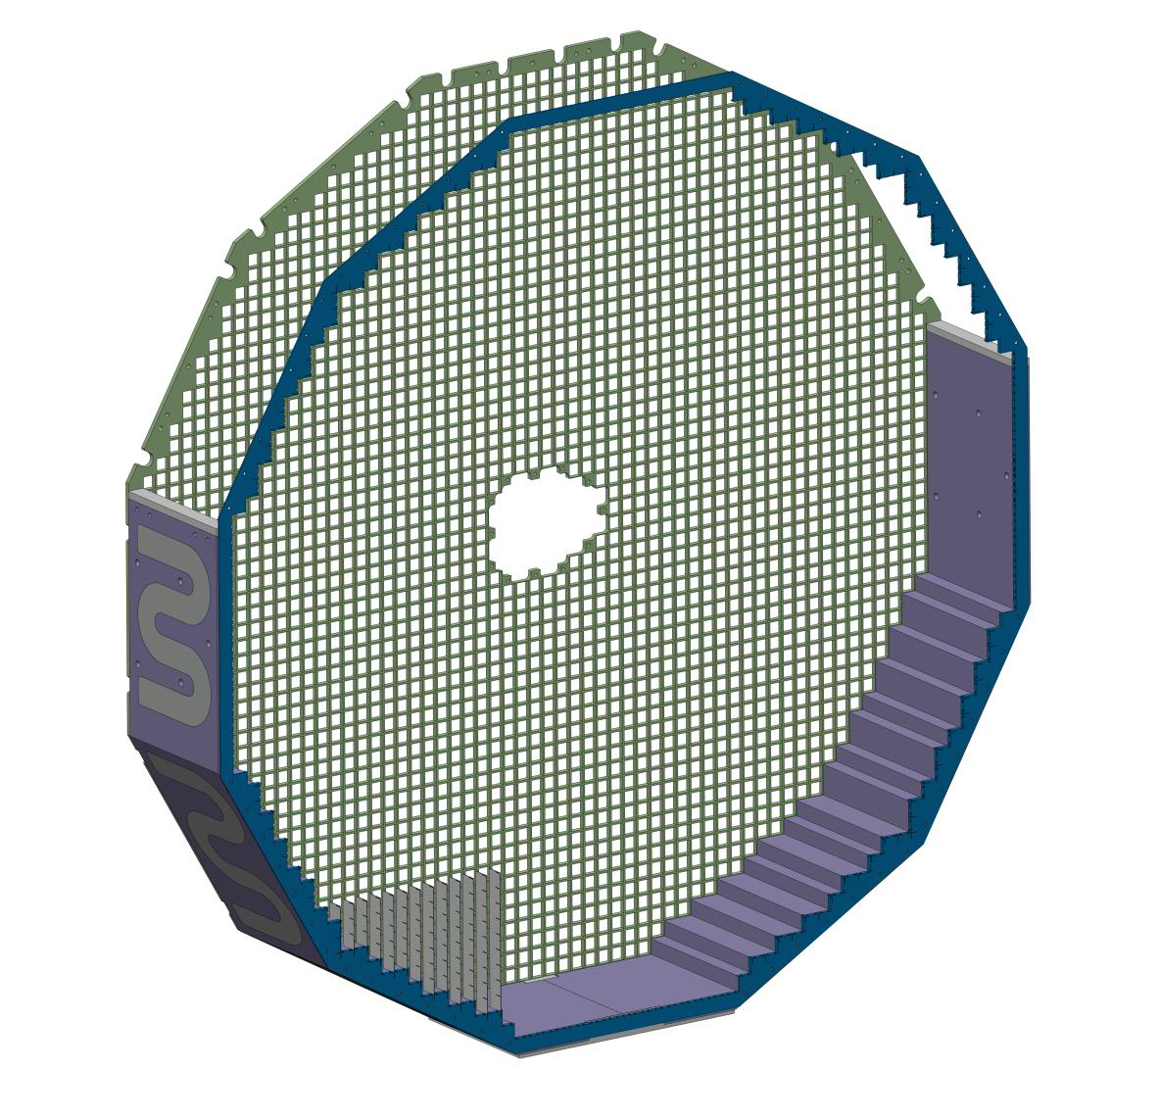
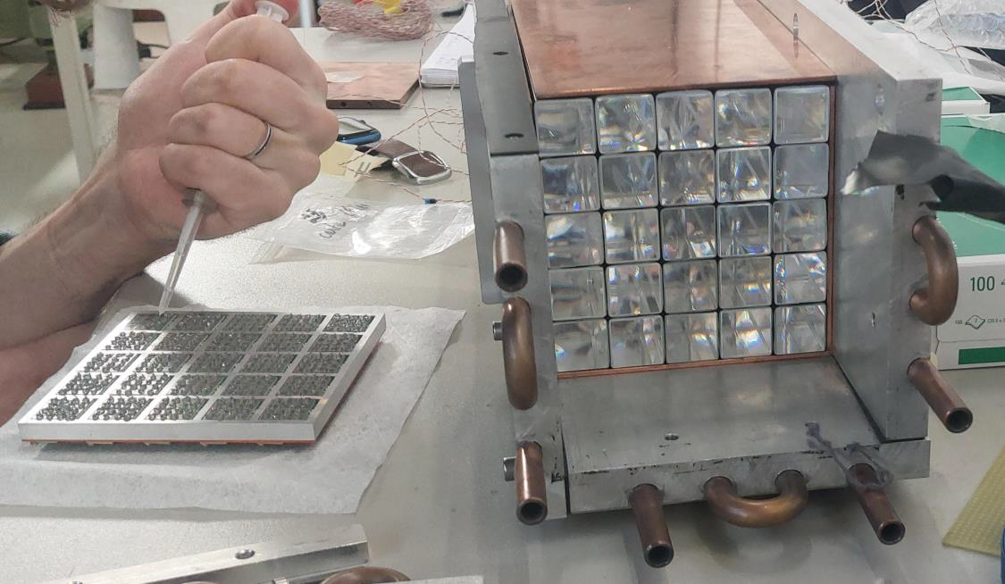
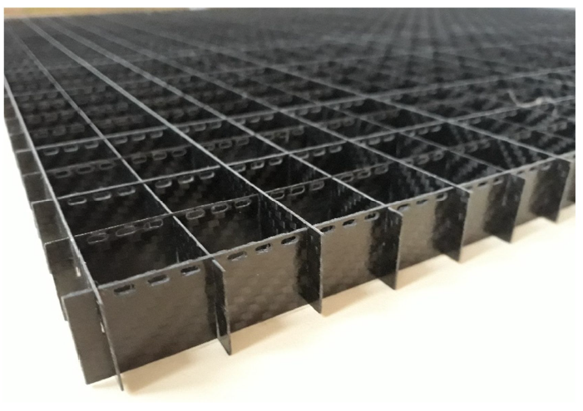
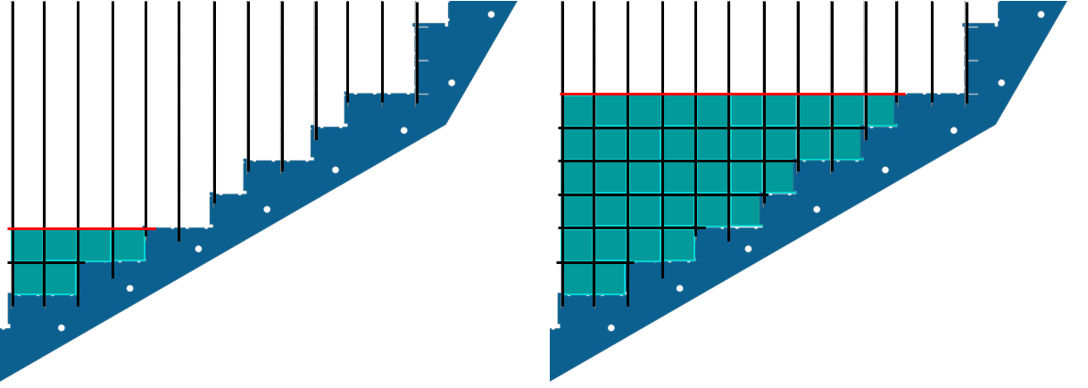
EEEMCAL FDR, May 26, 2026
Review Committee:
Liping Gan (UNC Wilmington)
Lars Schmitt (GSI Darmstadt)
Timothy Whitlatch (Jefferson Lab)
PWO crystal FDR: July 21, 2023
Photosensor FDR: Sep 14, 2023
Mech. Structure FDR: This Review
Overall mechanical Design
Electronics Integration
Integration with beam pipe
PCB SiPM
PCB adapter
Cooling Prototyping
Assembly
Conclusion:
We congratulate the Backward EEEMCal team for the remarkable achievements.
We thank the team for the excellent quality of the presentations and the constructive discussions in the Q&A.
We are looking forward to further progress towards CD2 and the realization of the project.
Carbon Structure

Slide 14
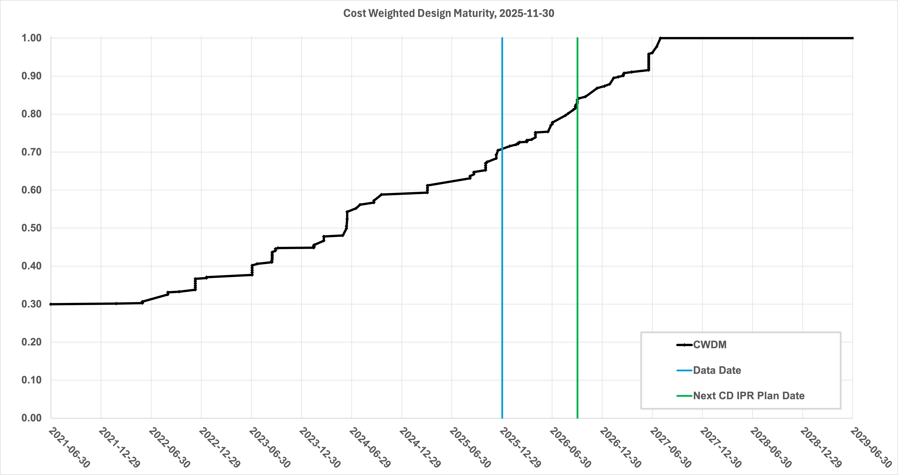
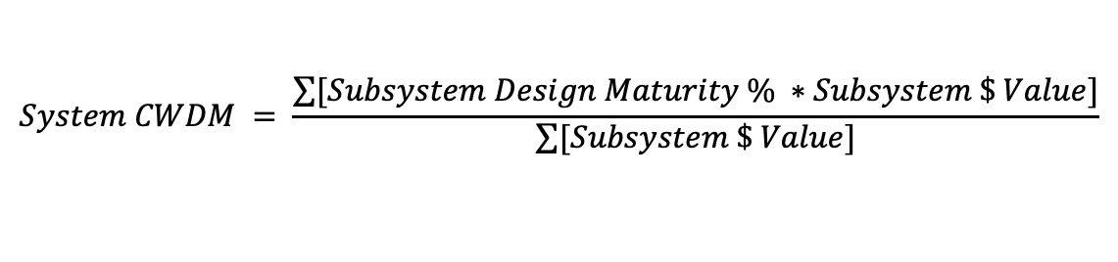
Path to Baseline – Design Maturity
$$System CWDM = \frac{\sum{[Subsystem Design Maturity \% ∗Subsystem \$ Value]}}{\sum{[Subsystem \$ Value]}}$$
Cost-weighted design maturity:
Present design maturity >75%
Projected >80% in September 2026
All 26 subsystems have already received at least one PDR
June 2026: only 1 subsystem needs a final PDR, planned for 07/26 but relies on mature IR design.
10 FDRs completed for CD-3A and 3B items
1 FDR completed for entire sub-system (05/26/26)
Until CD-2/3 (Q1FY28): +16 FDR

Slide 15
Detector Advisory Committee
DAC founded in 2020; Per the charter, 1/3 of the committee replaced every year
  2024: transition from Ed Kinney to Andy White as Chair
2024
2025
2026
Andrew White | U. Texas Arlington
Edward Kinney | Boulder CO
Ken Wyllie | CERN
Petra Merkel | FNAL
Antonis Papanestis | Rutherford Appleton Laboratory
Peter Krizan | U Ljubljana
Ana Amelia Machado | Campinas State U, Brazil
Cecilia Gerber | UIC
Brigitte Vachon | McGill
Stefano Miscetti | INFN Frascati
Roman Poeschl | IJCLab
Eraldo Oliveri | CERN
Andrew White | U. Texas Arlington
Edward Kinney | Boulder CO
Ken Wyllie | CERN
Petra Merkel | FNAL
Antonis Papanestis | Rutherford Appleton Laboratory
Peter Krizan | U Ljubljana
Ana Amelia Machado | Campinas State U, Brazil
Brigitte Vachon | McGill
Stefano Miscetti | INFN Frascati
Roman Poeschl | IJCLab
Eraldo Oliveri | CERN
Andy White | U. Texas Arlington
Filippo Costa | CERN
Szymon Kulis | CERN
Petra Merkel | FNAL
Antonis Papanestis | Rutherford Appleton Laboratory
Peter Krizan | U Ljubljana
Floris Keizer | CERN
Anna Macchiolo | TU Zurich
Lorenzo Rota | SLAC
Stefano Miscetti | INFN Frascati
Roman Poeschl | IJCLab
Eraldo Oliveri | CERN
DAC-Meetings 2024-2026:
June 21, 2024: 8th DAC meeting - strategic advice on the planning for the construction phase of the ePIC detector
  “Congratulations on enormous progress on developing realistic designs and starting active design review cycles on different systems”
August 28-29, 2024: 9th DAC meeting - Annual advice on detector R&D status and FY25 completion needs
June 11-13, 2025: 10th DAC meeting - Comprehensive look of DAC to design status and readiness for CD-2.
  “Overall, the DAC found that the ePIC detector design is well established and prepared to address the broad range of the EIC physics program. The R&D phase is converging well to a conclusion and the transition to a PED phase is occurring.”
Fall 2026 (planned): 11th DAC meeting - act as next comprehensive review of the ePIC detector status: has progress since the June 2025 comprehensive design review of the DAC been satisfactory, have all recommendations that are relevant for detector CD-2 baselining been addressed, and to give advice for the ePIC detector CD-3 production phase.

Slide 16
CD-3C Preliminary Package - DET
Subproject | WBS | Long Lead Procurement Description | $M | FDR
DET | 6.03 | Lead tungstate crystals (cont. CD-3A/B) – 830 remaining | 2.3 | Done
DET | 6.03 | fECal Scintillating Fibers (cont. CD-3A/B) – 1185 km remaining; Barrel SciFi → Korea In-Kind | 1.0 | Done
DET | 6.03 | SiPMs (cont. CD-3A/B) – 220 k remaining | 2.1 | Done
DET | 6.03 | Steel towers for forward HCal (cont. CD-3A/B) – 288 towers remaining | 1.7 | Done
DET | 6.03 | Flux return steal rear endcap | 3.4 | Done
DET | 6.03 | High-Rate Picosecond PhotoDetectors (HRPPDs) | 6.8 | 08/2026
DET | 6.03 | SiPMs for all the other subsystems and mounting on the SiPMs on boards | 3.4 | Done
DET | 6.03 | Aerogel for pfRICH and dRICH (Ring Imaging Cherenkov (RICH) | 0.6 | 09/2026
DET | 6.03 | Mirrors for dRICH | 1.8 | 09/2026
DET | 6.03 | Forward HCal towers due to large assembly time (incl. SiPMs and Steel towers) | 8.2 | 09/2026
DET | 6.03 | Forward ECal due to large assembly time (excl. SciFi) | 7.0 | 09/2026
DET | 6.03 | Barrel Imaging Calorimeter to assemble sampling calorimeter modules (excl. SciFi) | 4.3 | 09/2026
 |  | Total | 42.6
$21M for the high priority items (without contingency)

Slide 17
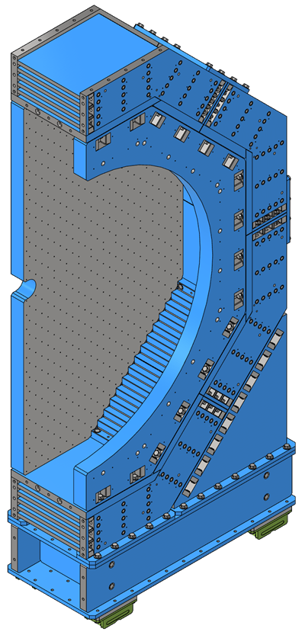
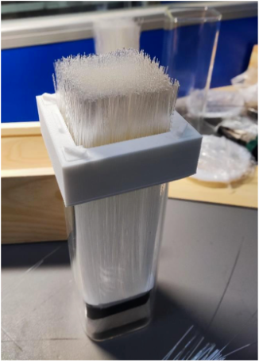
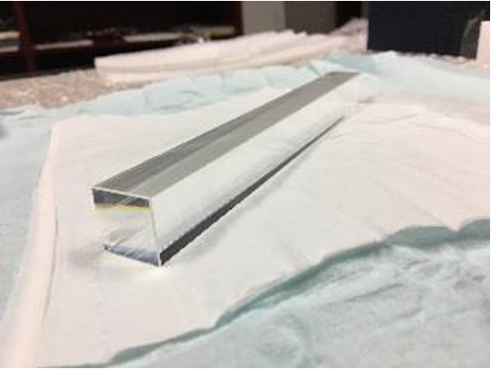
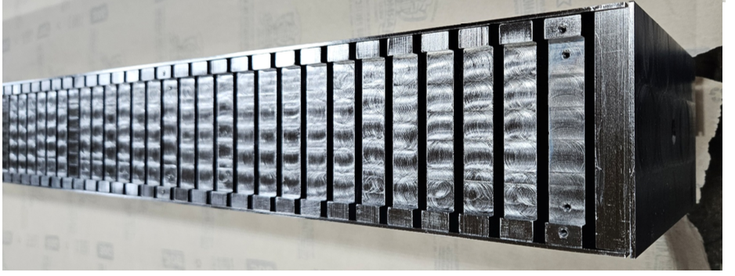
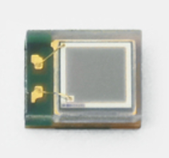
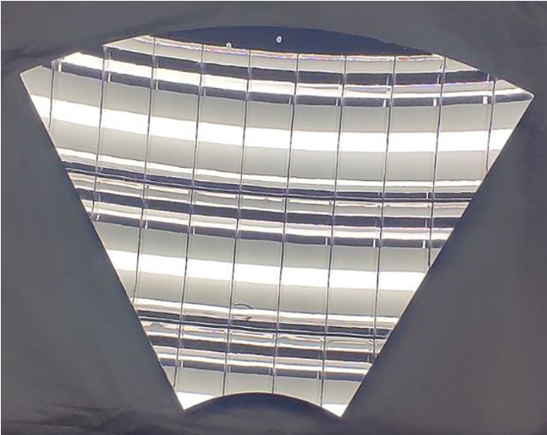
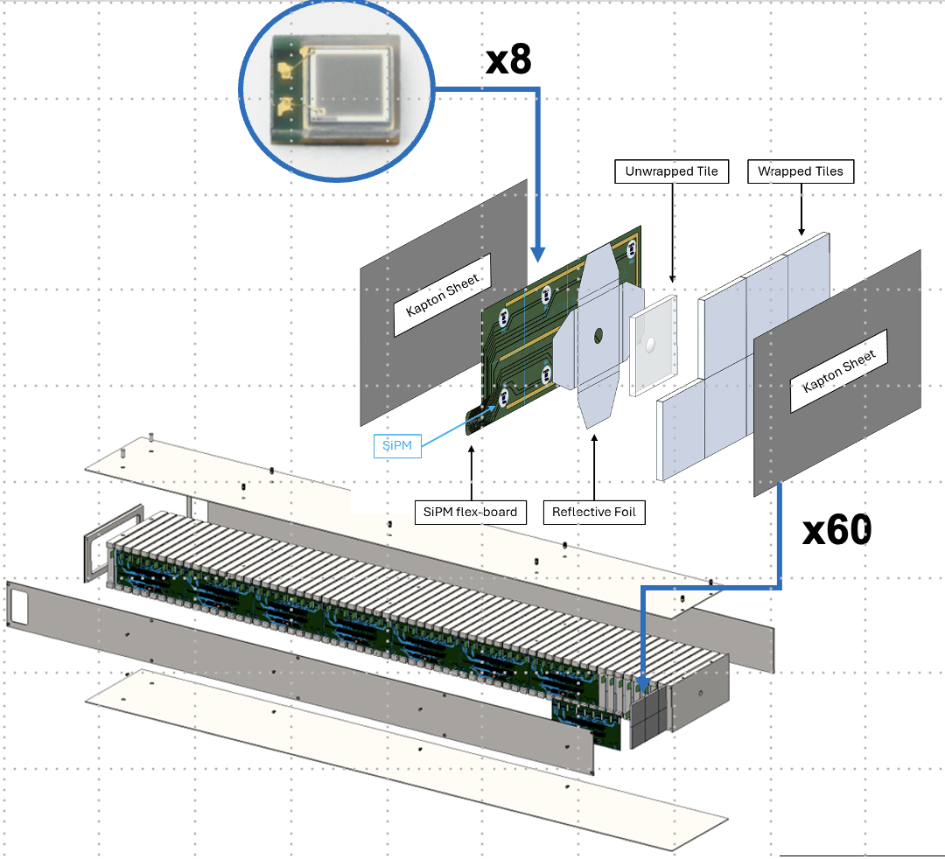
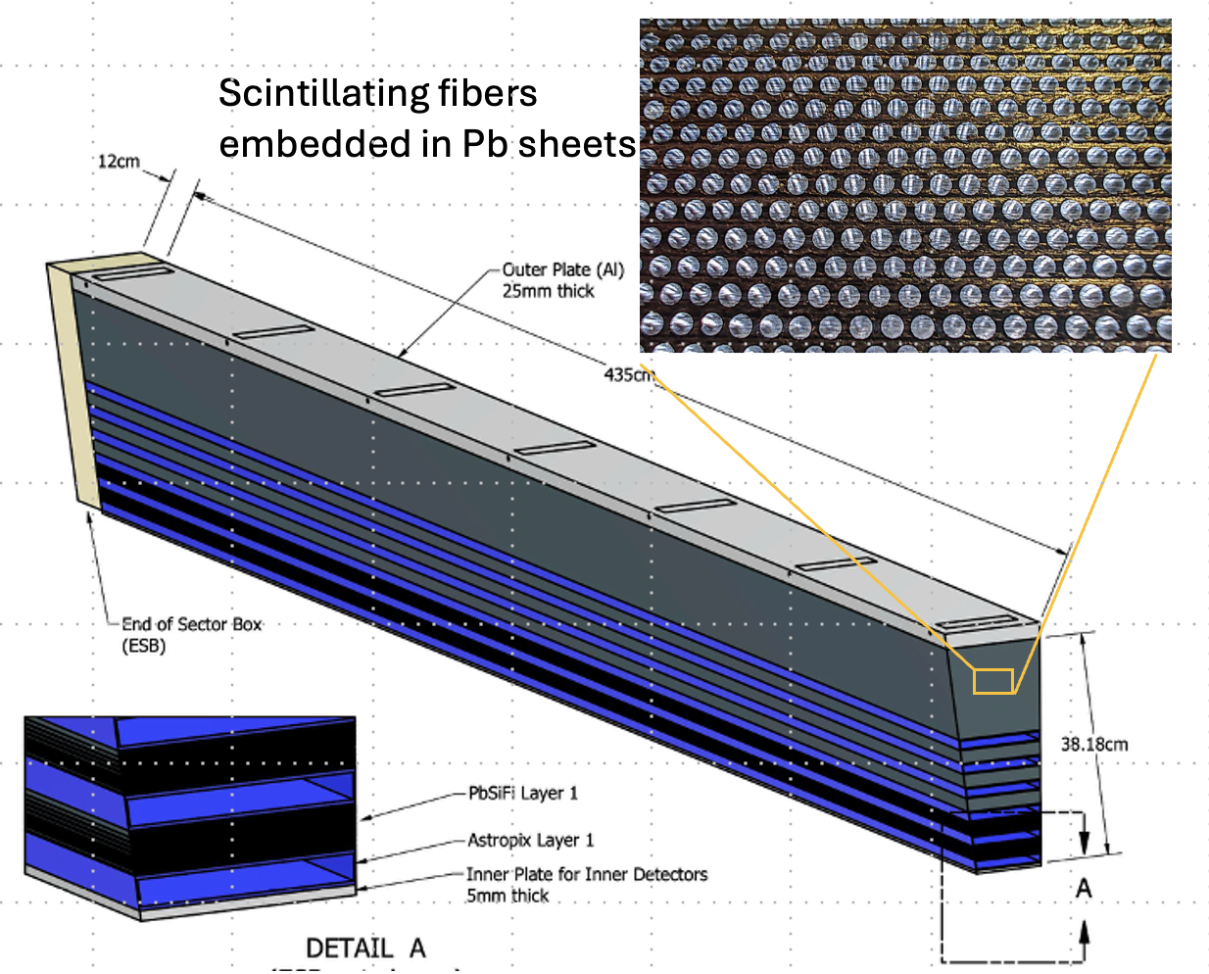


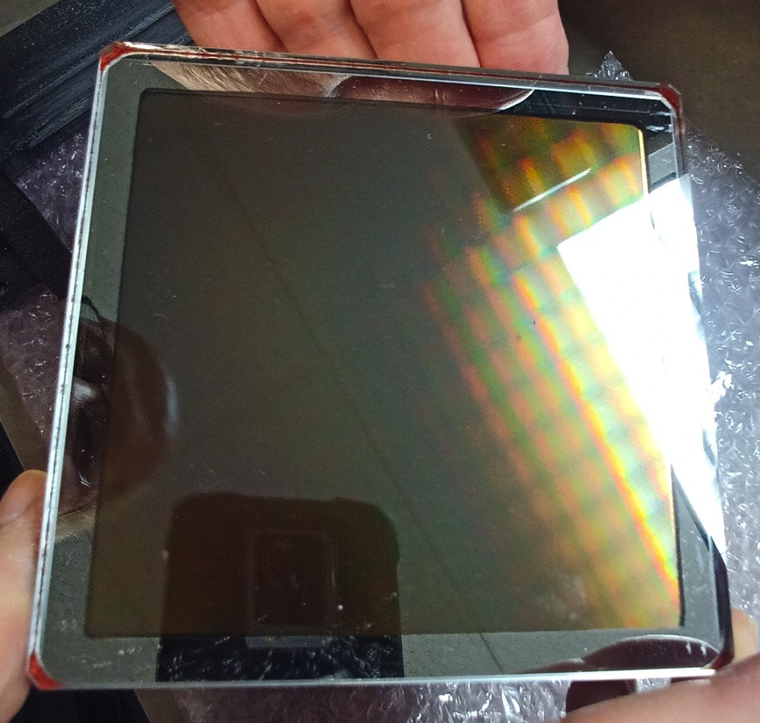
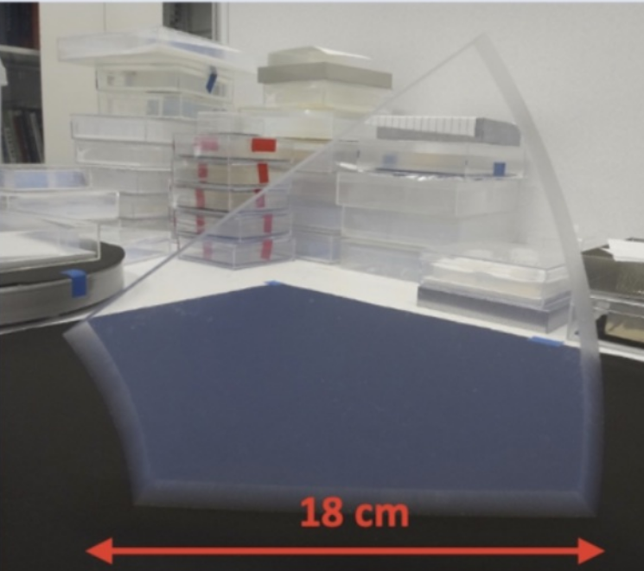
CD-3C Preliminary Package - DET
Items to be continued from CD-3A & CD-3B:
SiPMs
Flux return steal rear endcap
& forward and backward
endcap moving cradle
PbWO4 - Crystals
Steel towers for forward Hcal
Scintillating
fibers
Forward HCal towers
Barrel Imaging Calorimeter modules
New Items for CD-3C:
High-rate Picosecond
PhotoDetectors
forward Ecal
towers
dRICH Mirrors
& pfRICH and
dRICH
Aerogel

Slide 18
Cost and Schedule

Slide 19
DET Cost Status
Present Cost Summary:
LLP Actuals thru April. 2025: $6.8 M
LLP (CD-3A/CD-3B): $ 34.5 M
Actuals thru April. 2025: $ 52.8 M
Cost to DOE to go in present P6:
$191.6 M (without contingency)
  This is for a technically driven schedule → will increase with a more realistic budget profile
Contingency: $68 M (36 %)
  From Monte Carlo at 90% confidence level. This includes Risk-based contingency and Estimate Uncertainty.
In-Kind Goal Met:
Re-Use: $ 20 M
In-Kind: $ 97 M
Detector Subproject WBS 6.03 | Point Estimate (Burd/Esc) | Estimate Class
6.03 – Detector Systems | $338.1M
6.03.01 – DS Management incl. R&D | $25.0M
6.03.02 – DS Tracking | $66.6M (*) | 3
6.03.03 – DS Particle Identification (PID) | $51.8M (*,**) | 3
6.03.04 – DS Electromagnetic Calorimetry | $37.6M (*,**) | 2
6.03.05 – DS Hadronic Calorimetry | $26.6M (**) | 2
6.03.06 – DS Detector Solenoid Magnet | $5.5M (*,**) | 2
6.03.07 – DS Electronics | $43.4M (*,**) | 3
6.03.08 – DS DAQ / Computing | $13.1M | 3
6.03.09 – DS Integration, Installation and Infrastructure | $38.2M (*,**) | 3
6.03.10 – DS Auxiliary Detectors | $12.5M (*) | 3
6.03.11 – DS Polarimetry | $9.9M | 2-3
6.03.12 – DS Non-Beam Commissioning | $8.0M
Cost Drivers:
The different subsystems have all more or less the same cost
  With Tracking, PID Electronics having the highest costs
  The different subsystems have relatively equal costs
  total cost driven by amount of critical subsystems required for EIC science
(*) these subsystems have large IKC
(**) these subsystems have scope in CD-3A/CD-3B or reuse equipment

Slide 20
Mitigations for UKRI In-Kind Issues
As of Today: P6 as been updated to account for the change in UK in-kind contribution.
Assumption: It is critical that all ePIC Detector Sub-Systems can continue beyond PDR-level to full E&D completion (90% design-maturity FDR-level) to allow the UK situation to further evolve and seek further in-kind.
The UK In-Kind scope change has been accounted for as follows:
  Lumi detector $1.5M: Is required for any EIC science → Absorb as DOE Cost
  Low-Q2 Detector $3.5M: This detector was assumed as fully UK in-kind → Defer
  Silicon Vertex Tracker $15.6M: Critical towards ITS3/LAS design and L3/L4 of SVT barrel → Keep moving while the situation evolves (this requires UK critical specialized labor to be allowed to continue to work on EIC)
  → Move all non-labor UK In-Kind of SVT to DOE → $5.3 M
  → Labor remains In-Kind as currently a proposal is in to STFC to support this
Mitigation to ensure we can baseline the detector and stay “DOE cost-neutral” (<200M$ DOE cost-to-go):
  Delay forward TOF construction → $2.86M
  Delay backward HCal construction → $3.8M
  Delay Low-Q2 Detector → $0.223M
  Delay electronics (HV, LV, FEB) that accompanies these systems → $1.3M
Summary: we defer the construction of the forward AC-LGAD/TOF detector, the backward Hadron Calorimeter, and the low-Q2 detector but will complete the final engineering design to “park” these until the funding paths are known. For the forward TOF, sensors and perhaps ASICs may be in-kind. We do rely on the UK proponents to have success in their proposal.

Slide 21
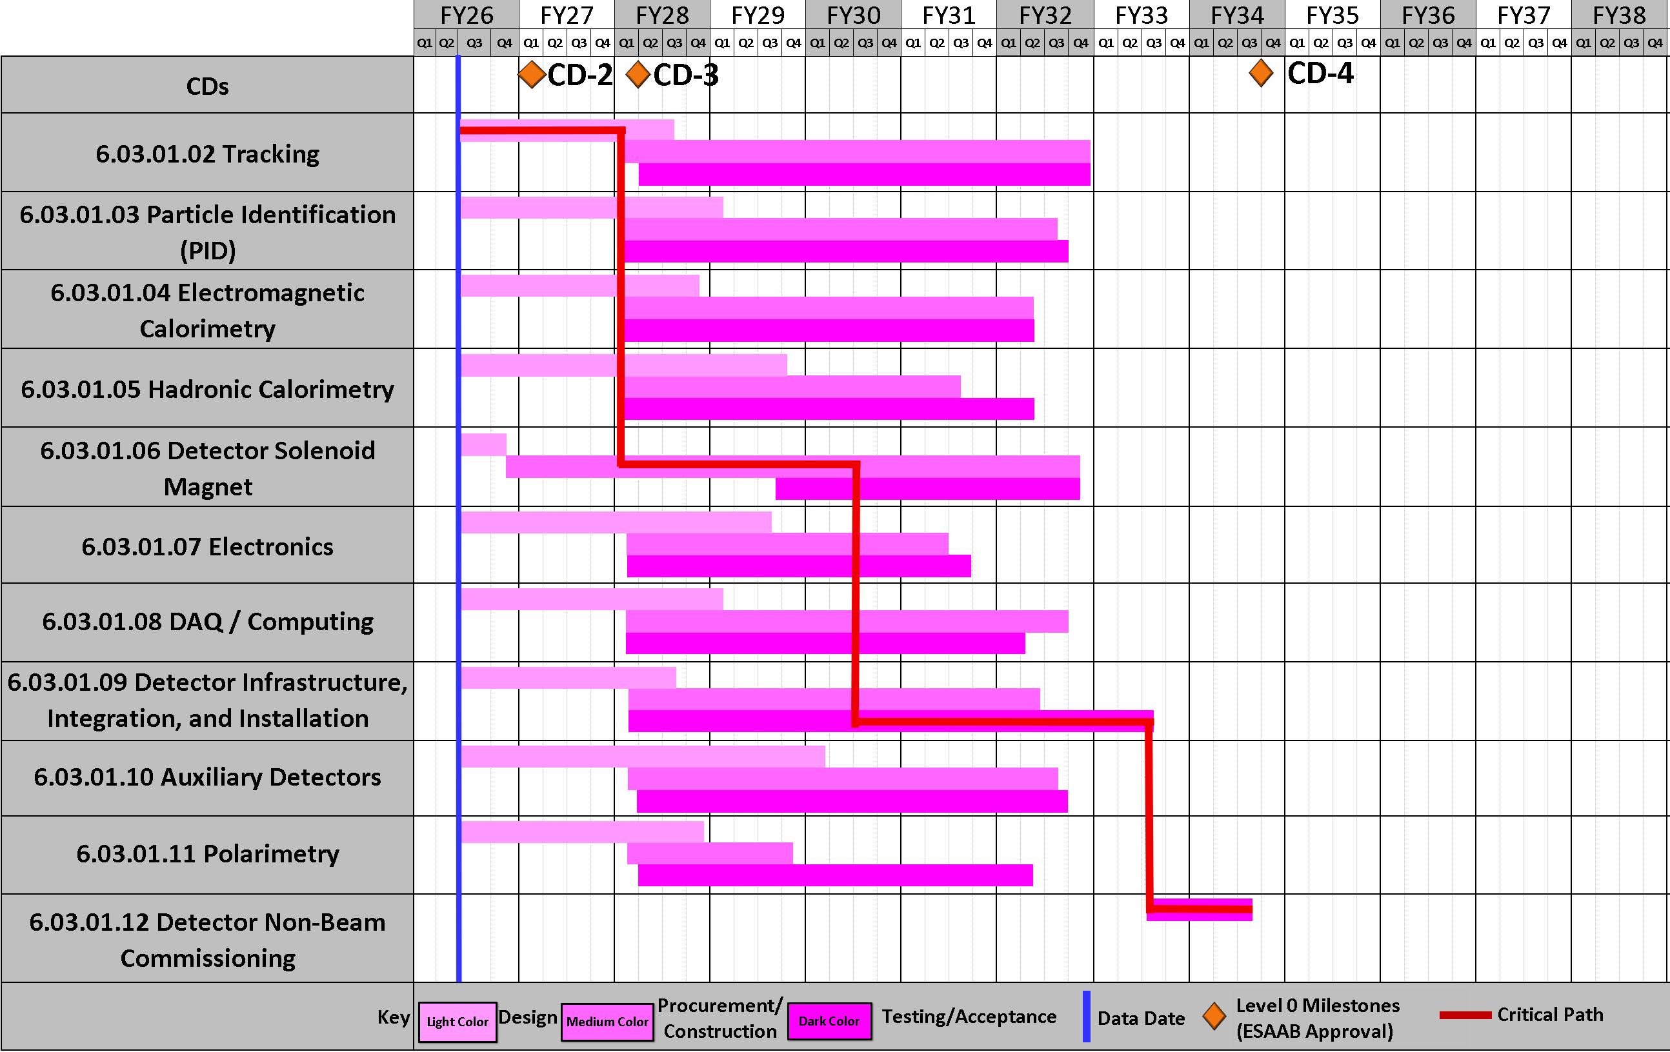
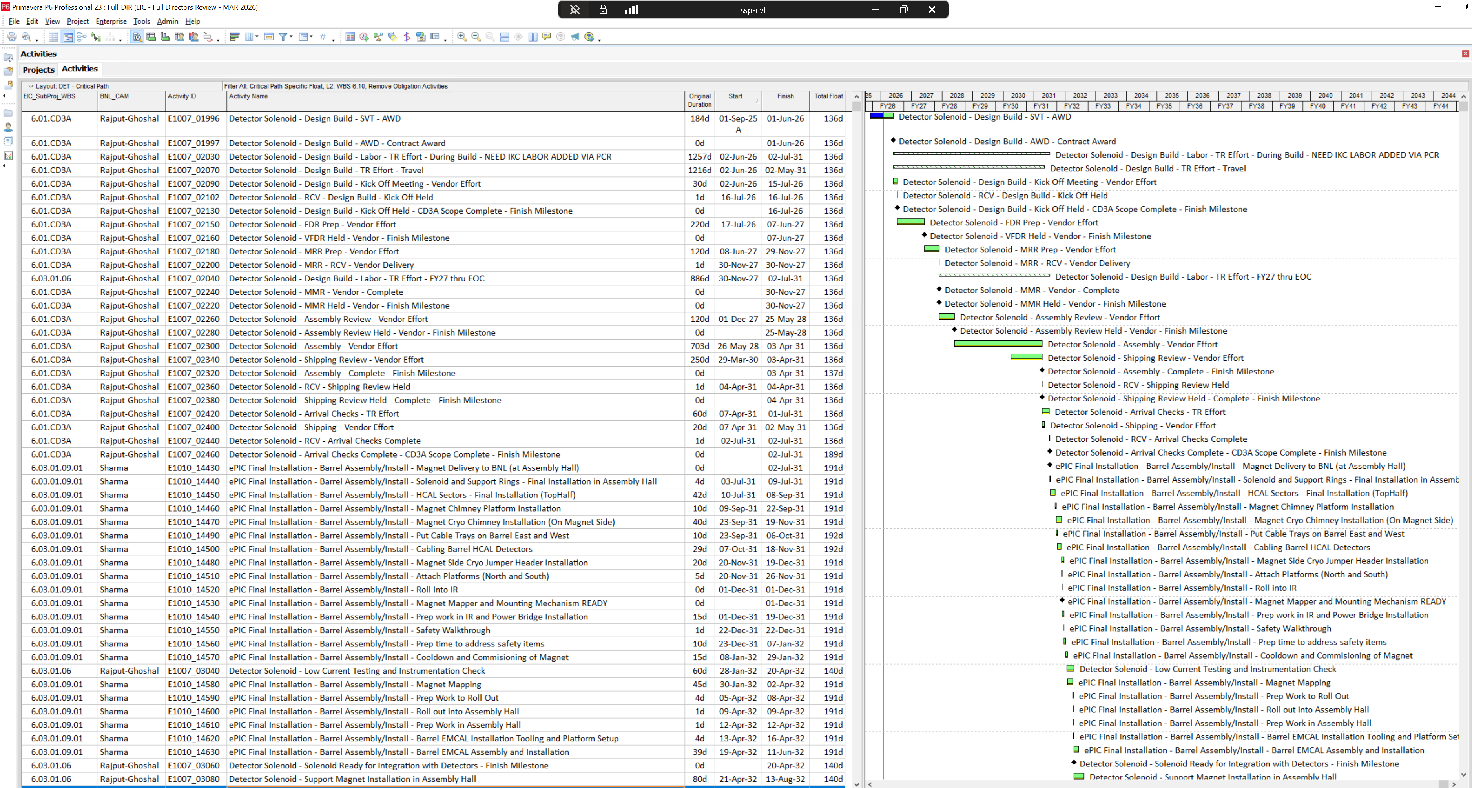
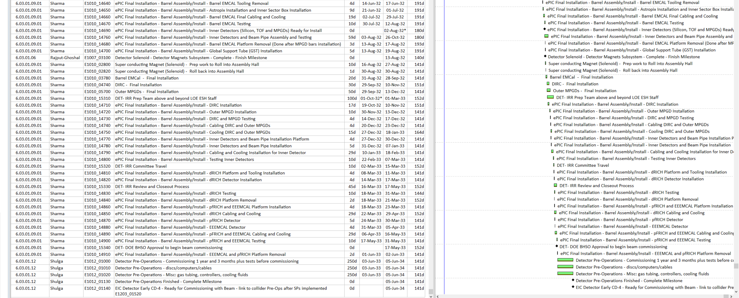
DET (Subproject) Schedule
start of non-beam
commissioning
Key Schedule Drivers/Assumptions: Magnet (CD-3A) and ASICs Production; all sub-detectors ready and at BNL at near-equal times for assembly process
Key Take Away: Critical Path goes through SVT/MAPS design, magnet construction and acceptance, detector assembly and final non-beam commissioning

Slide 22













High Level Installation Schedule
10/2029
02/2030
04/2030
09/2031
02/2032
06/2032
11/2032
02/2033
02/2033
06/2033
06/2033
In Assembly Hall:
Pre-OPS
Install Cradle and
moving mechanisms
Lower Hcal
installed
ePIC Solenoid
installed
Upper Hcal
installed
Magnet ready
for mapping
south and north platforms attached
Barrel ECal installed
Outer MPGD
and DIRC
installed
IR-6 ready for
installation
Magnet Mapping
in IR complete
→ roll back to
Assembly hall
backward ECal
pfRICH and
dRICH installed
Prep. Work for
Magnet, e.g. Cryo.
by 07/2030
01/2032
06/2033
In parallel we can assemble PST with Silicon Detectors, MPGD Disks and TOF Disk
Start
Commissioning
with Cosmic
Parallel in Experimental Hall:
SVT, TOF, MPGD-disks and Cymbal
installed
fHCal and backward
flux-return endcaps
assembled
fECal and backward
HCal assembled

Slide 23
In-Kind Contributions

Slide 24







In-Kind Contributions
In-Kind contribution goal:
30% of Detector TPC → ~100M
Reused equipment is not listed (~$20.1M); R&D and PED In-Kind is not listed (~$10M)
Up-To Cost are DOE construction costs; they will differ greatly from the country proposals that include engineering and design and research activities → current $97 M ($86.5M in M&O)
Labor and Non-Labor In-Kind contributions
Labor In-Kind Contributions
UK:
design contribution L3, L4,
ANCASIC, LAS-Sensor, Lumi
& Low Q²⁻Tagger
Czech Republic:
contribution to construction of
backward ECal, Low-Q2 tagger, MAPS sensor testing
Germany
contribution to construction of
DIRC and design of Barrel
ECal AstroPix - Sensors
Poland
Far-forward detector systems
and luminosity detector
* still tentative
Note: This excludes In-Kind contributions to Computing and Off-project activities

Slide 25
Commissioning and Early Operations

Slide 26



EIC - ePIC Commissioning
Q2/2033
~ CY 2034
exact dates under development
ePIC no-beam commissioning
ePIC commissioning with beam
ePIC fully assembled and Ready for Cosmic Data Taking
EIC first beam commissioning
central ePIC in assembly hall
endcap calorimeters
and beam pipe with instrumentation to have a first look on backgrounds
Luminosity detector and hadron & electron polarimeters fully installed
Move central
ePIC into wide-angle hall
Commission
ePIC with beam
All auxiliary detectors, but RPs and OMDs are installed
Start of Science
program
RPs and OMDs will be installed in year-2

Slide 27

EIC Science Reach for ep vs. Deferred Scope
5 GeV x 100 GeV
+
EIC Full Capability
+
EIC
RF for 7nC/bunch
MASS
3D-Imaging
+
EIC
RF for 7nC/bunch
no 394 MHz crab cavities
+
+
+
+
Average Luminosity (cm⁻² s⁻¹)
+
EIC
Start of Operations
RF for 7nC/bunch
no 394 MHz crab cavities
no low energy cooling
no 41 GeV bypass
SPIN
+
+
+
+
+
+
QCD in
Nuclei
Dense Gluon
Systems
+
+
+
e-p Center-of-Mass Energy [GeV]

Slide 28
EIC Science Program in First Years of Operations
Year - 1 |  | Year - 2 |  | Year - 3 |  | Year - 4 |  | Year - 5
Start with Phase 1 EIC
New Capability:
Commission electron polarization in parallel
Run:
9 GeV electrons on 115 GeV/u heavy ion beams (Ag, Nb, Cu, Ru)
Physics:
Dense Gluon Systems QCD in Nuclei
Phase 1 EIC + long. electron polarization
New Capability:
Commission proton polarization in parallel
Run:
9 GeV long. polarized electrons on 130 GeV/u Deuterium
Physics:
QCD in Nuclei Flavor structure of nucleons and nuclei
Run:
Last weeks: 9 GeV long. polarized electrons and 130 GeV polarized protons
Physics:
Flavor structure of nucleons and nuclei
Phase 1 EIC + long. electron polarization + proton polarization
New Capability:
Commission running with hadron spin rotators
Run:
9 GeV long. polarized electrons on 130 GeV transverse polarized protons
Physics:
Flavor structure of nucleons and nuclei
Run:
Last weeks switch to longitudinal proton polarization
Physics:
Spin
Phase 1 EIC + long. electron polarization + proton polarization + spin rotators
New Capability:
Commission hadron accelerator to operate with not centered orbits
Run:
9 GeV long. polarized electrons on 110 GeV Au
Physics:
Dense Gluon Systems QCD in Nuclei
Run:
9 GeV long. polarized electrons on 275 GeV transverse and longitudinal polarized protons
Physics:
Spin
Phase 1 EIC + long. electron polarization + proton polarization + operation of hadron spin rotators
Run:
9 GeV long. polarized electrons on 110 GeV Au
Physics:
Dense Gluon Systems QCD in Nuclei
Run:
9 GeV long. polarized electrons on 166 GeV transverse and longitudinal polarized He-3
Physics:
Spin
Unique science questions addressed as EIC performance ramps up to ultimate performance

Slide 29
EIC Ultimate Performance
Installation priority during initial operations determined by science (FY25$)
Construct/Install 4 additional SRF systems for ESR full bunch current @9GeV $79M
Construct/Install Low-Energy Cooler $90M
Construct/Install 394 MHz Crab Cavities $54M
→ This supports the mission-need luminosities of 10³³ ⁻³⁴cm⁻²s⁻¹
Construct/Install 41 GeV Bypass $11M
→ This extends the center-of-mass energy down to 29 GeV
  → mission need: E_{cm} = ~20 – 100 GeV (upgradeable to 140 GeV)
Refurbish/Install remaining 2 snakes to achieve full polarization for He-3 beams $3M
→ This supports mission need of 70% of polarization of light ions (p, He-3)
Upgrade to 18 GeV $193M
  → RCS and the corresponding RCD 2K Construct/Install 2 additional SRF systems in the ESR, 6 additional SRF systems and cryoplant in the RCS, and remaining arc magnet girders
→ This extends the center-of-mass energy up to 140 GeV

Slide 30
Summary
ePIC Detector is stable and has been technically baselined since Spring 2024.
Detector scope has been complete in the P6 resource-loaded schedule since Fall 2025.
  This allows us to use it as a tool, for example to find cost mitigations to work with our UK colleagues
  The risk register is regularly updated for the Detector
  This allowed us since February 2026 to also project Monte-Carlo based contingencies
Two of the Detector-related CD-3A procurements have completed (PbWO4 crystals, Silicon Photomultipliers).
All but one of the 60% Preliminary Design Reviews have been completed, and the first 90% Final Design Review for non-CD-3A/CD-3B scope has been completed.
EIC Detector Cost-Weighted Design Maturity grew from ~65% at last RRB to ~75% now.
The EIC Detector documentation is well advanced – see https://eic.jlab.org/Detector, the ePIC draft pre-TDR, and the extensive prebrief documentation for the Detector at various reviews.
There is strong and broad support to keep the momentum of ePIC and its international character.
  Large component of Detector in planned CD-3C package (~33% of the scope).
  Project support to continue non-CD-3C scope Detector FY26 momentum into FY27.
CERN and DOE are in their final stage to prepare the collaboration agreement and eventually sign; such an agreement will formally initiate cooperation on the EIC between DOE and CERN, with signatures aimed for early this summer

Slide 31


Slide 32


