Slide 1
Finalizing iCRADAs
- Status of international collaboration -
Luisella Lari
EIC Associate Director for Strategic Partnership & Sr. Scientist
Paolo Berrutti
EIC IKC Engineer
EIC Resource Review Board Meeting
June 9-10, 2026

Slide 2
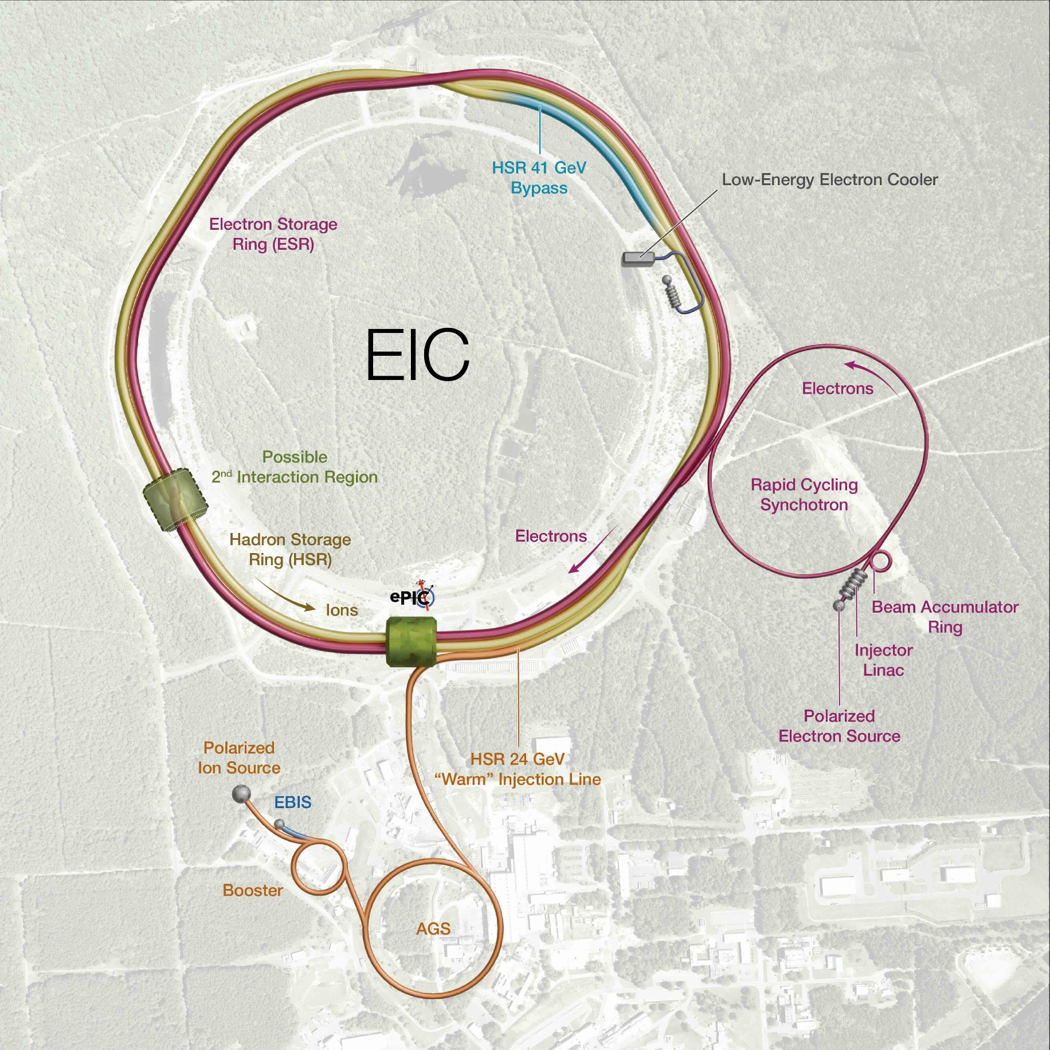
Outline
Current Electron Ion Collider (EIC) In-Kind Contribution (IKC) identified scope
  iCRADAs status
EIC International Collaboration Overview
Summary
2

Slide 3
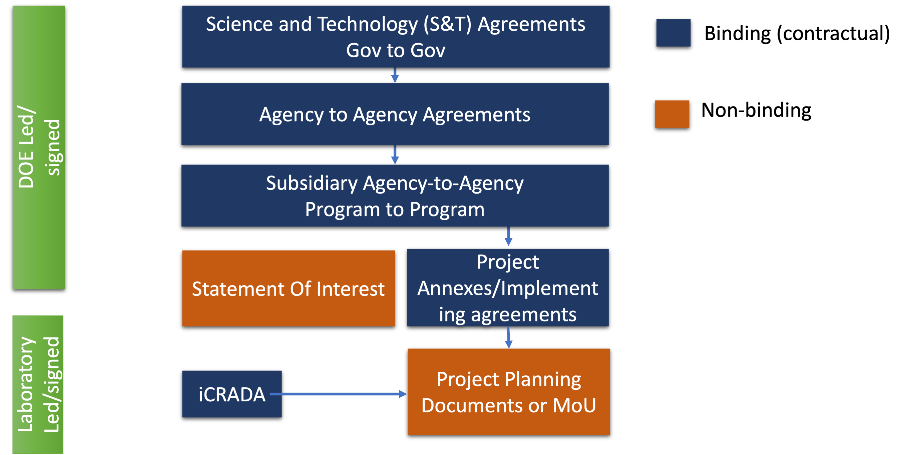
IKC Docs @ Lab-Level: iCRADAs and PPDs
DOE level agreements do not contain details on EIC IKC scope. For this reason, it is suggested to pursue an iCRADA (laboratory-level) binding agreement for all the EIC IKC items for which the development of Project Planning Documents (PPDs) are necessary.
3

Slide 4
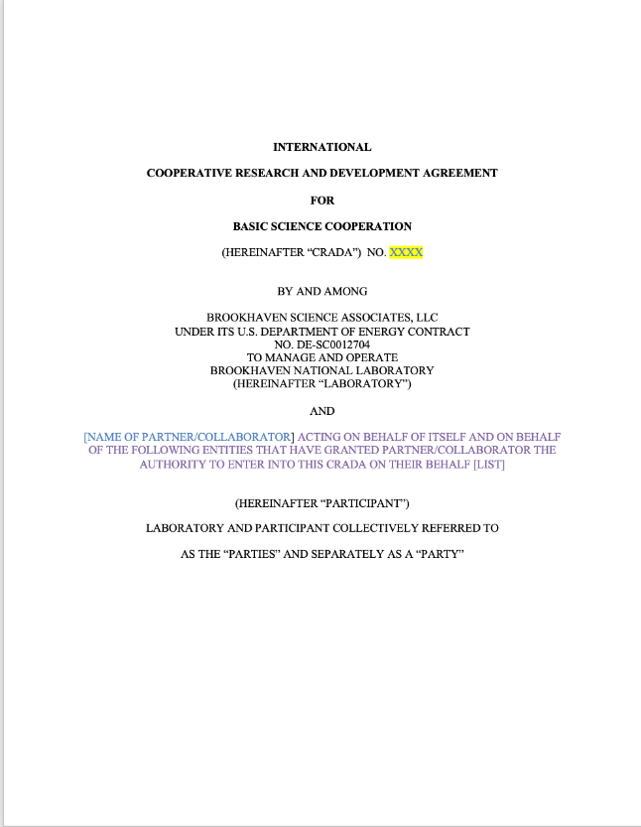
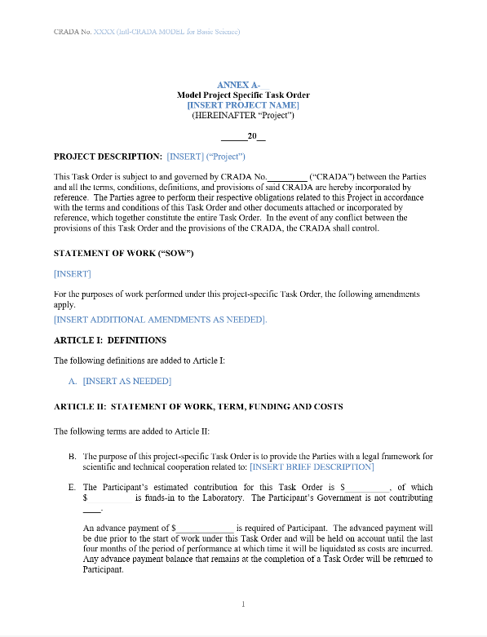
EIC IKC iCRADA Overview
As a reminder, the first 8 pages of the iCRADAs can not be changed,
while the iCRADA Annex A must be tailored for each specific IKC Partners.
Dec. 2023 – The first template for the EIC iCRADA was shared with EIC Partners.
Nov. 2024 - A multi-signature/3 parties EIC iCRADA template was shared with EIC Partners.
June 2025 - DOE approved the EIC non-negotiable iCRADA - final - model agreement with a tailorable Annex A for use.
4

Slide 5
EIC US iCRADA Process
The BNL Research Partnerships and Technology Transfer (RPTT) Office is supporting the development and approval coordination of each iCRADA in collaboration with
EIC Partners, JLab and DOE site offices.
Collaborator for EIC is identified
BNL drafts Annex A, Statement of Work & iCRADA & provides to JLAB
Each Lab routes Joint Work Statement (JWS)
and Annex A internally for approvals
Each Site Office reviews & sends to DOE HQ** for concurrence
Each Lab sends their JWS & Annex A to their respective DOE Site Office*
Upon concurrence, each DOE Site Office provides Lab with authorization to proceed with the signature
iCRADA & Annex A fully executed by all parties
* Both Lab’s must submit their package to their DOE Site Office at or close to the same time.
** the BNL & JLAB package will route together through the DOE HQ concurrence process; the Site Offices will coordinate with each other. Note: there are appx 7 offices within DOE HQ that must concur.

Slide 6
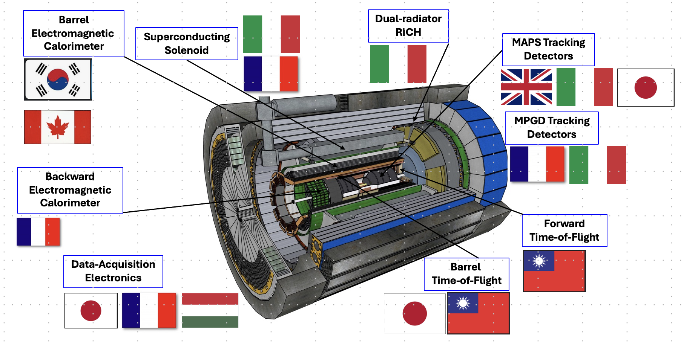
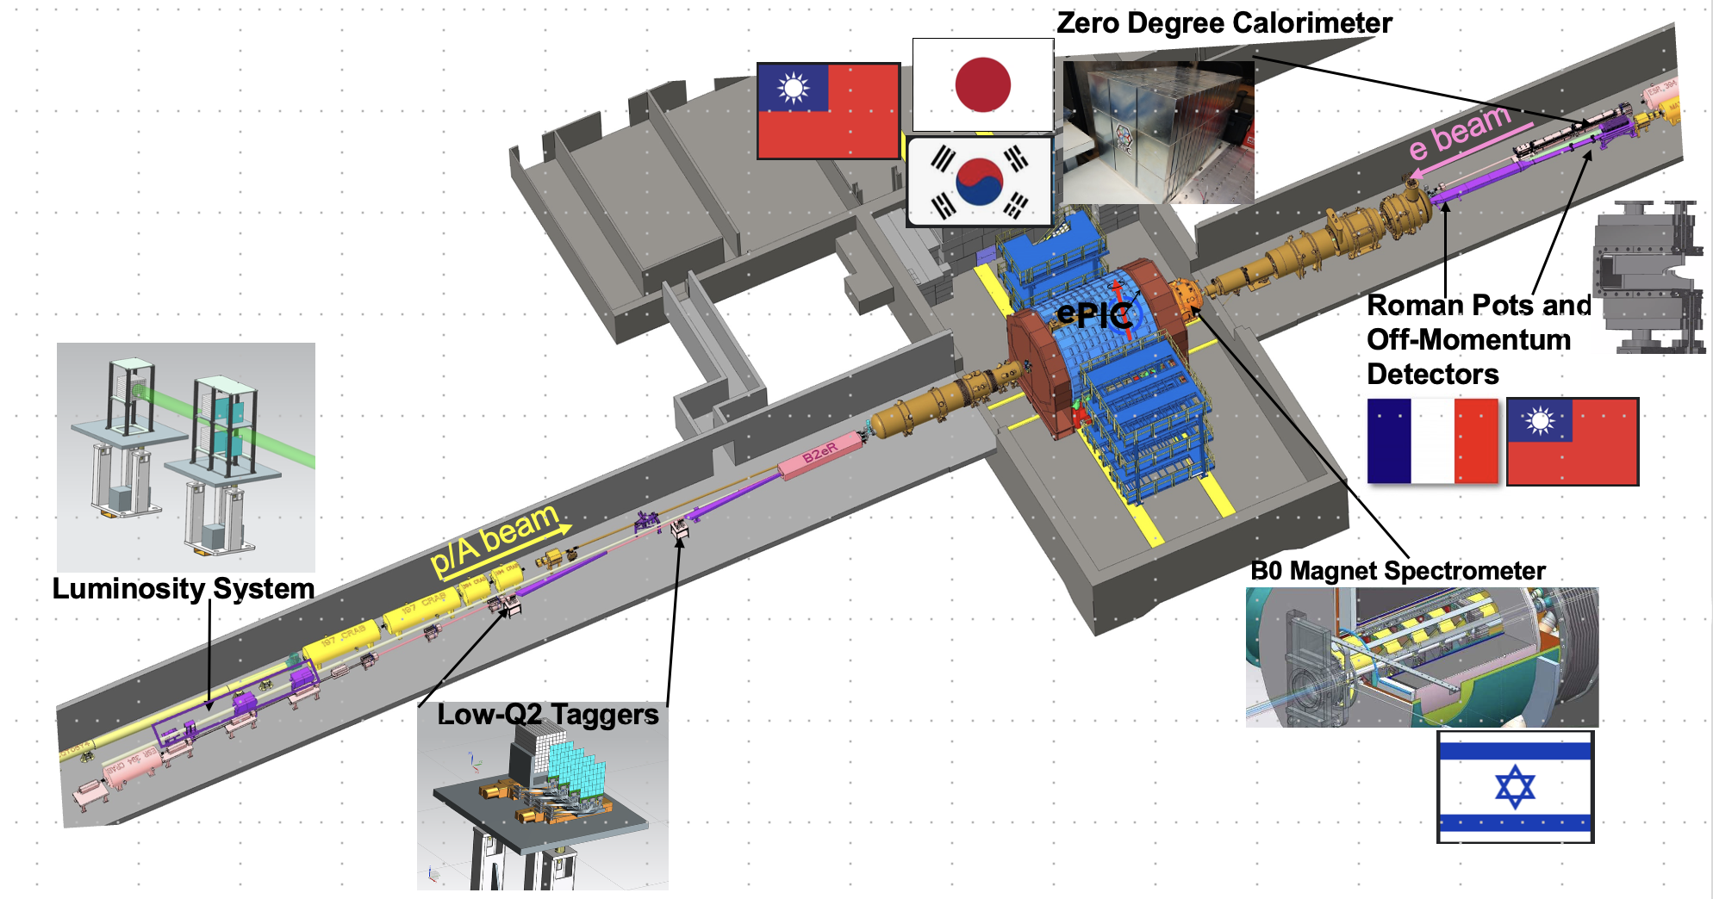
Overview of IKC for Detector (IKC Goal 30%)
Detector Solenoid Magnet (MARCO) procurement IKC from Italy is advancing.
  iCRADA started the approval process before signature in U.S.
Japan and S. Korea are finalizing/checking the iCRADA Annex A.
6

Slide 7
iCRADAs – Annex A – Detector
Country/Agency | Scope | Status
Italy - INFN | Detector Solenoid magnet (MARCO) | Started US approval process before signature Received 2 of 7 DOE HQ approvals.
Japan | MAPS forward Disks (still tentative) Barrel Tof; ZDC – Hcal; | Finalizing Annex A Close to start the US approval process.
S. Korea | Barrel mRWell; Half of Barrel ECal Barrel & Forward ToF Contribution to ZDC | Finalizing Annex A
France - IRFU | Barrel MicroMegas; Salsa ASIC | Drafted
France - IN2P3 | Rear Ecal: Cooling, Readout, Mechanics; RP & Off-momentum Det.:Cooling, Readout; CaloRoc & EICROC ASIC | Drafted
Canada | Barrel ECal readout | Drafted
Italy - INFN | MAPS L0-L2, mRWell Disks; dRICH (but not mirrors); Alcor ASIC | Drafted
Israel | B0 Tracker & ECal | On-going discussion
Taiwan | Barrel & Forward ToF; ZDC - ECal | On-going discussion

Slide 8

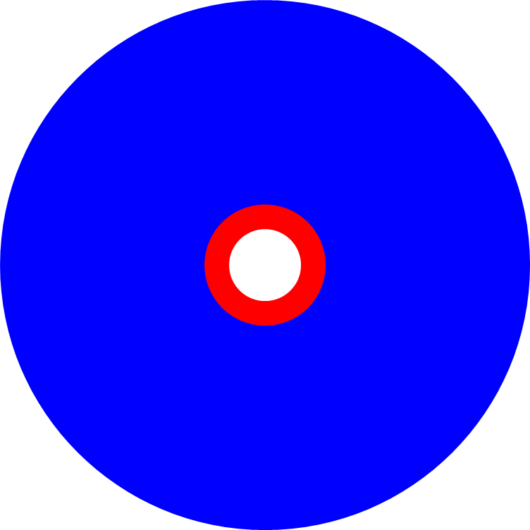
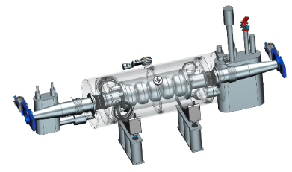

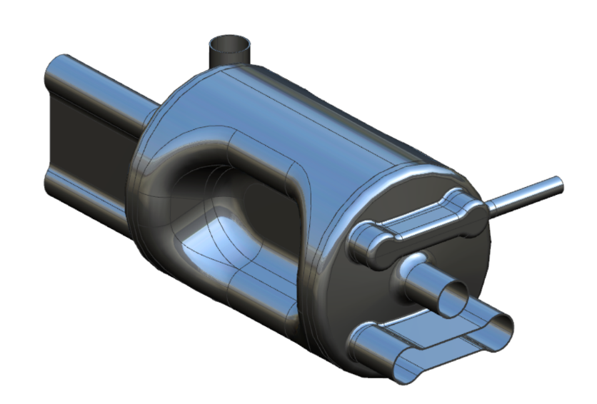

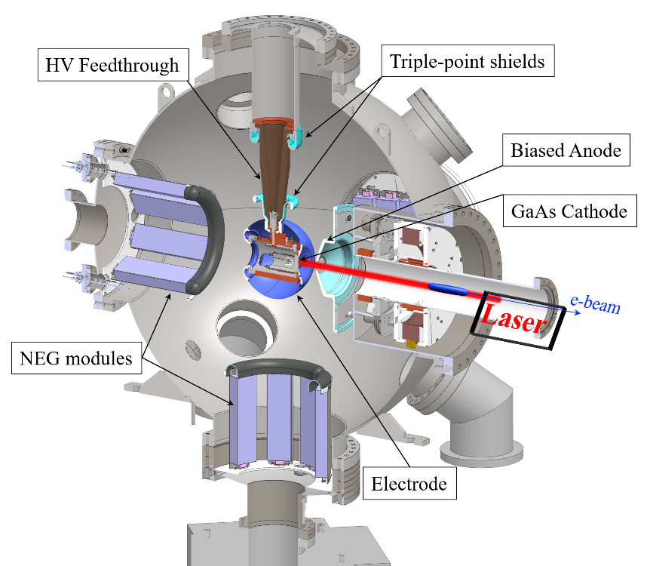

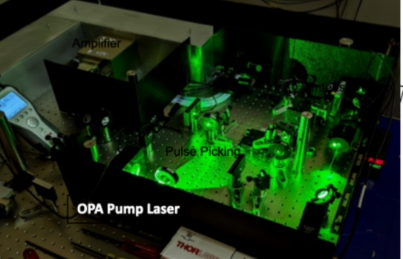

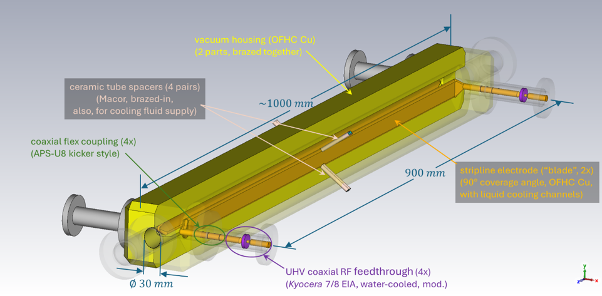
Overview of IKC for Accelerator (IKC Goal 5%)
591 MHz 5-cell CM for RCS
Spin rotators for the IR
394 MHz Crab CMs
Kickers
Laser for the Electron Source
8

Slide 9
iCRADAs – Annex A – Accelerator
Country/Agency | Scope | Status
Czech Republic - ČVUT | Electron Source Laser | Draft Shared with CVUT
France - IN2P3 | 591 MHz 5-Cell CMs | Draft started
France - CEA | Spin Rotators | Scope Discussion
Canada - TRIUMF | Crab 394 MHz CMs | Drafted
Taiwan | Kickers | Scope Discussion
Discussions ongoing with other potential Partners on increasing the 5% IKC goal for the Accelerator.

Slide 10
EIC International Collaborations Overview
10

Slide 11
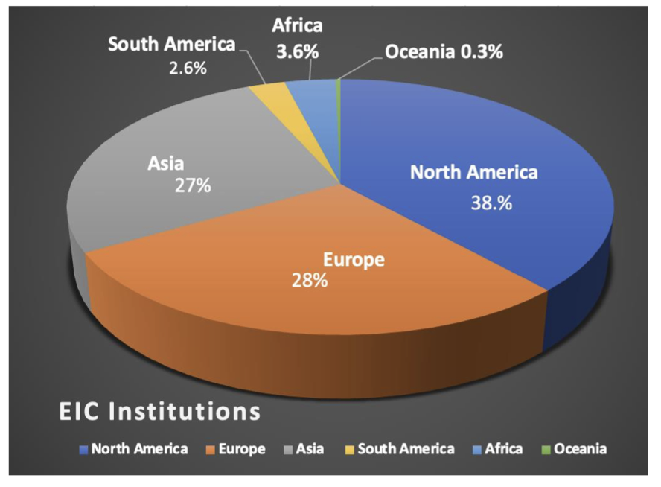
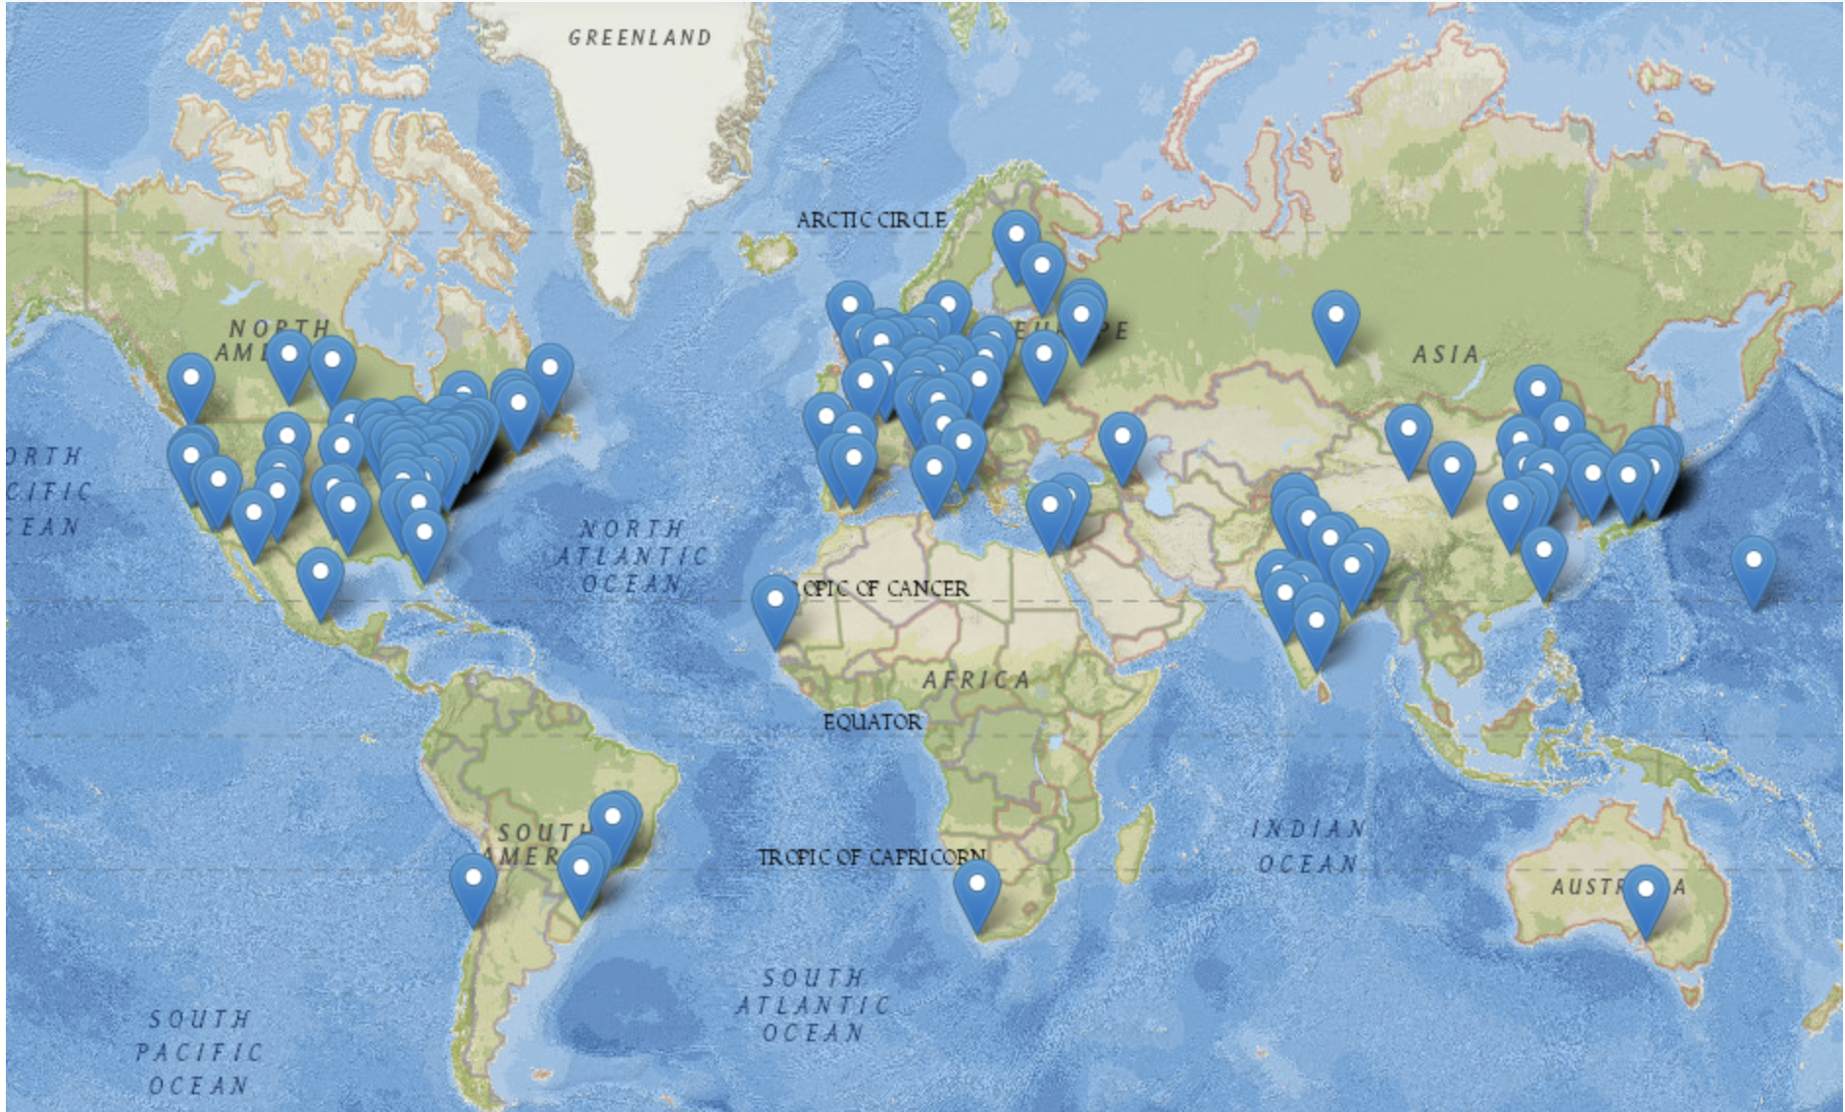
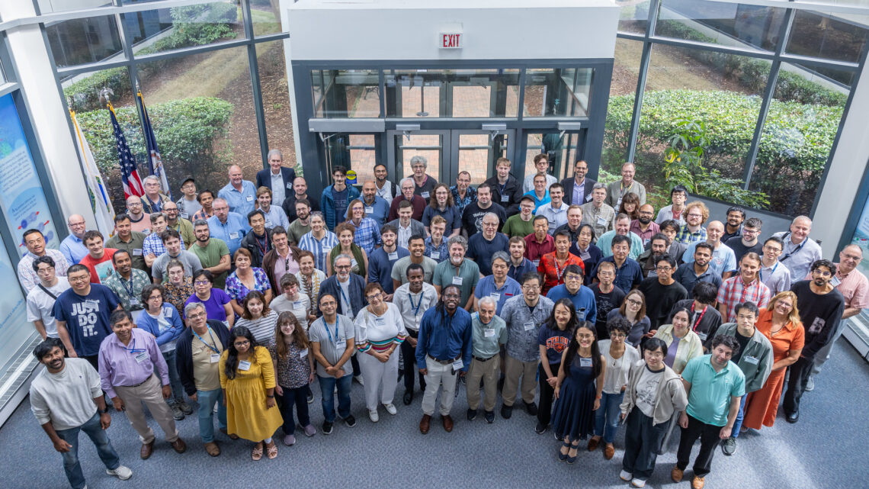
  EIC Users Group
The Electron-Ion Collider User Group (EICUG) is an international affiliation of scientists dedicated to developing and promoting the scientific, technological, and educational goals and motivations for a new high energy EIC.
Established in 2016, currently:
~1550 collaborators
~41 Countries; ~305 Institutions
July 2025 @ JLab
11

Slide 12
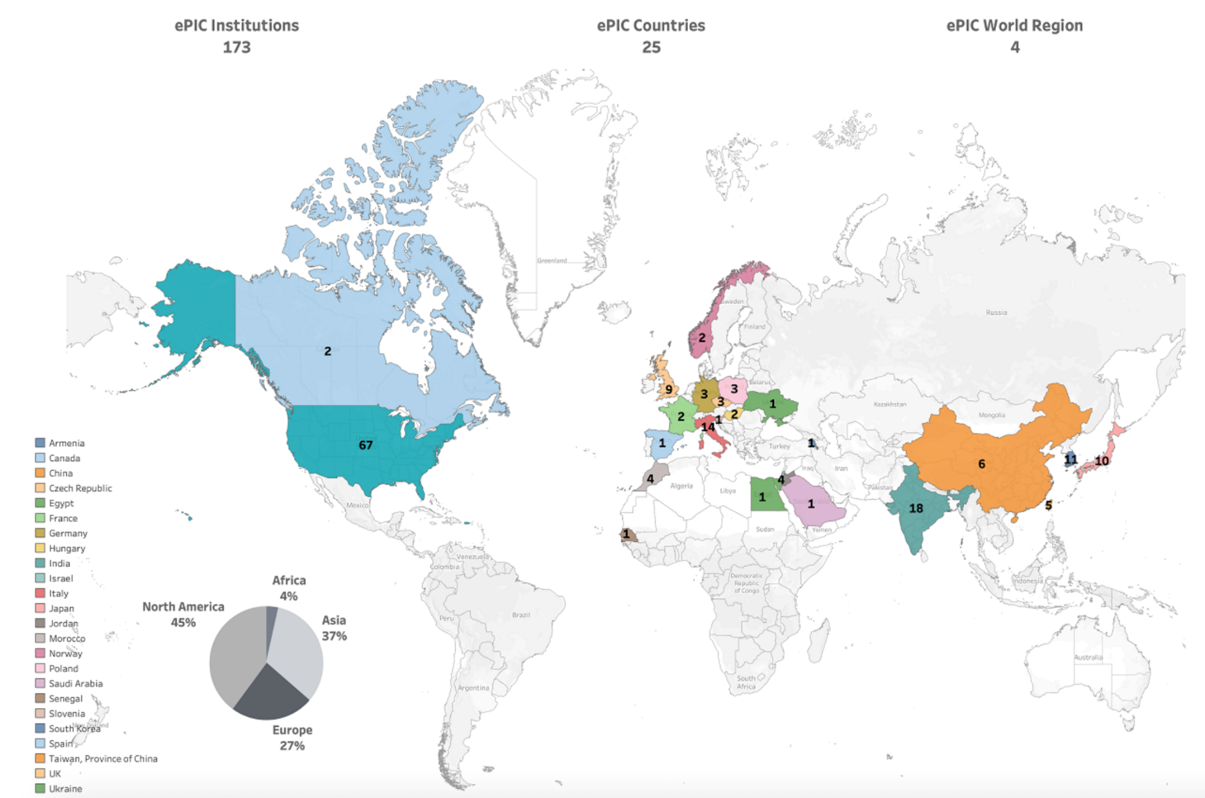
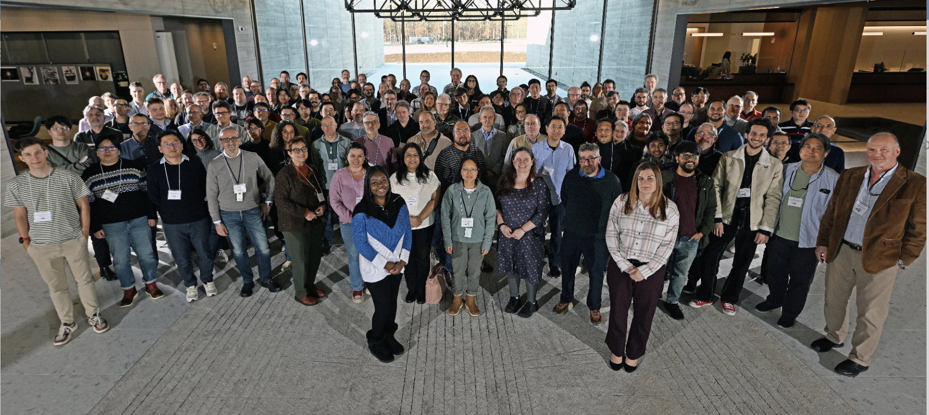

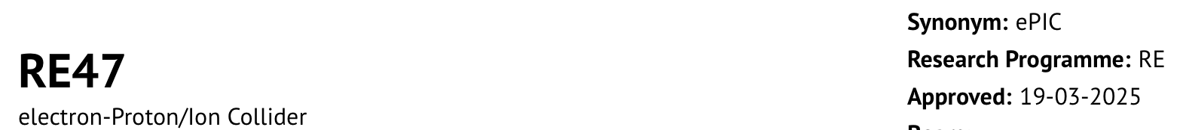
  EIC ePIC Collaboration
ePIC: a wide, strong, motivated Collaboration. It is dedicated to the EIC physics via the realization of ePIC Detector fully complement with physics studies, dedicated computer and simulation effort.
Established in 2022, currently:
~25 Countries; ~173 Institutions
January 2026 @ BNL
12

Slide 13

EIC Advisory Board (EAB)
The purpose of the Electron Ion Collider Advisory Board (EAB) is to provide guidance and advice to the BNL Director on the design and construction of the EIC accelerator facility and on the efforts to establish partnerships, international and domestic, with institutions collaborating on the facility.
Membership includes Laboratory Directors (or senior leadership) of institutions participating in the design and construction of the EIC accelerator facility. Board members may also include leaders of institutions with common accelerator Science and Technology interests.
The EAB provides a forum for high-level planning, communication, coordination, and resolution of issues affecting the EIC facility, appropriate at the level of the Laboratory Directors.
Current EAB Chair:
Jens Dilling (JLab Director)
~2 hours virtual meeting every 3 m.

Slide 14






Contribution for Accelerator by Labs
US National Laboratories & CERN
SC magnets
NC magnets
SC magnets
SC magnets
NC magnets
SRF
SRF
SRF
Beam Dynamics
Vacuum
Beam Dynamics
SRF
Beam Dynamics
Beam Dynamics
Examples in Advanced Stage of Discussion or on-going collaborations
14

Slide 15
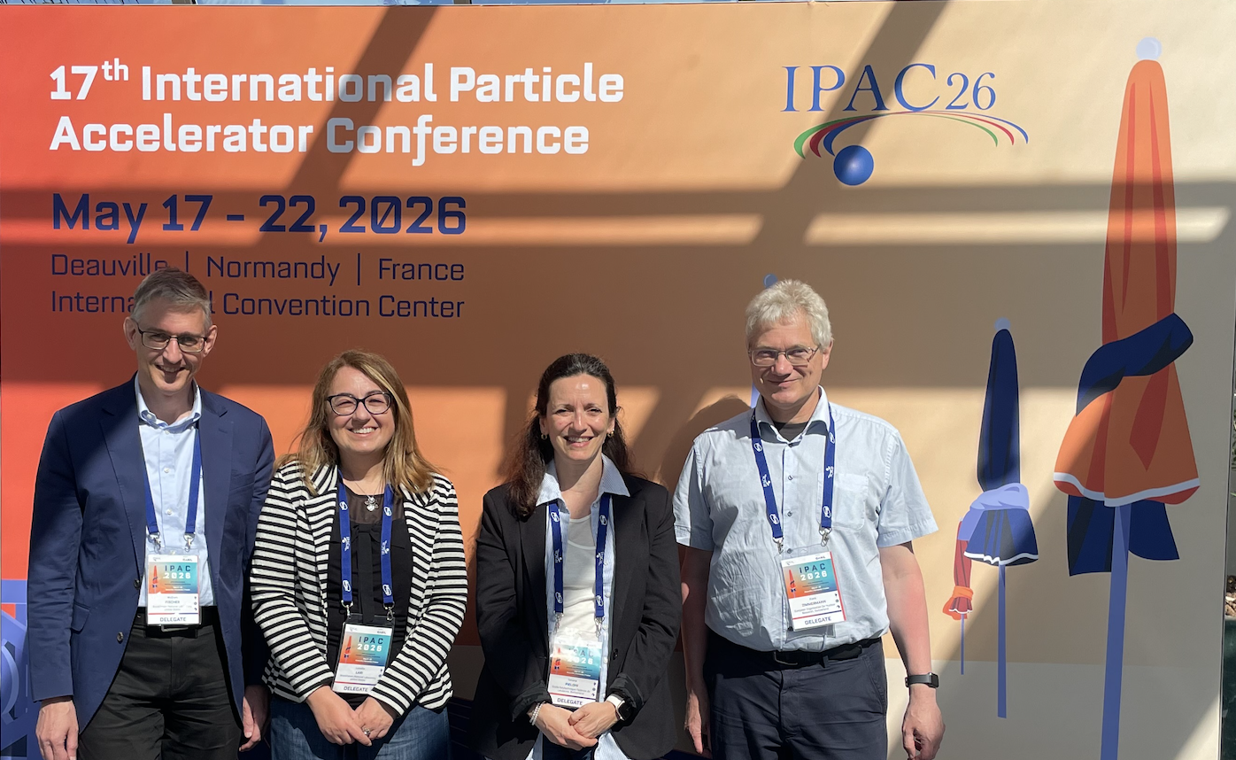
EIC Accelerator Collaboration
Since Dec 2023, the EIC Accelerator Collaboration (EICAC) has taken flight, with growing international engagement and ongoing contributions to key areas of EIC design, R&D beyond EIC Project, and long-term performance planning.
Current EIC Accelerator Collaboration Co-Chairs:
Tatiana Pieloni (EPFL)
Wolfram Fisher (BNL)
Working groups
Beam-beam - Christoph Montag & Xavier Buffat
Polarized Beams & Polarimetry - Frank Rathmann & Georg Hoffstaetter
Commissioning Tools - Yue Hao and Jean-Luc Vay
Possible additional working group
Second Interaction Region
Electron injectors
High Energy Beam Cooling
FCC-EIC Forum
….
15

Slide 16
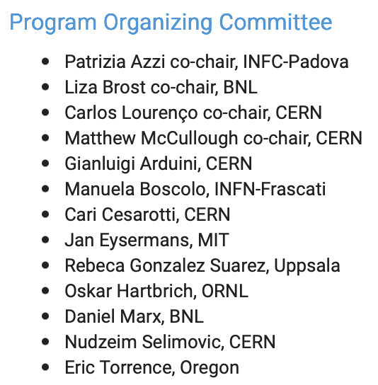


EIC – CERN School Aug-Sept 2026
https://indico.cern.ch/event/1661010/
Aug 27 - Sept 4, 2026 @ CERN
This school focuses on the future of particle colliders, exploring the core scientific motivations and the ways in which evolving accelerator and detector technologies can be exploited to address fundamental science questions.
16

Slide 17
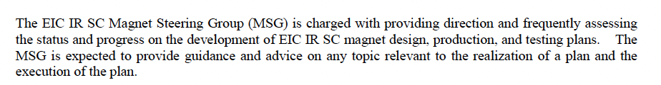
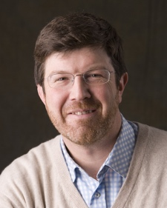
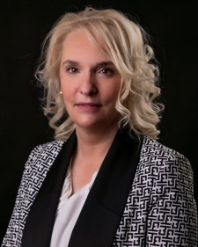
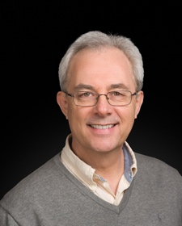
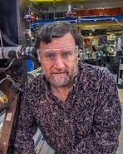
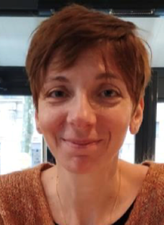
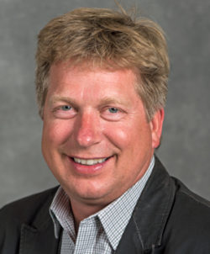
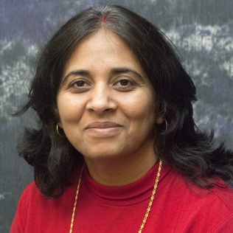
IR Superconducting Magnet Steering Group (MSG)
Support Execution
Name | Relevant Experience
Giorgio Apollinari (FNAL) | Technical Facilities, HL-LHC Magnet Design and Construction, LARP & AUP Project
Amalia Ballarino (CERN) | LHC/HL-LHC Superconductor & Superconducting Systems
Ruben Carcagno (FNAL ret.) | Technical Facilities, HL-LHC Magnets Design and Construction, AUP Project
Helene Felice (CEA) | Technical Facilities, LHC & MRI Magnets
Steven Peggs (BNL) | Technical Facilities, LARP, RHIC Project
Soren Prestemon (LBNL) | Tevatron, Technical Facilities, RHIC Project
Renuka Rajput-Ghoshal (Jlab) | LHC/HL-LHC Magnets Design and Construction, LARP & AUP Project
Magnets Requirements
Acceptance Criteria
Interfaces Control Documents
Prototypes/Conceptual Design
  (if/where necessary)
Design Specs/Design Report
  Preliminary
  Final
  Material Approvals
  Production Readiness Review
Test Plans
Test/Assembly Facilities
…..
What
How (technically)
Who
Current MSG Chair:
Giorgio Apollinari (Fermilab)
17

Slide 18
Summary
The EIC iCRADA for the ePIC solenoid magnet (MARCO) with Italy is started the US approval process.
  In the meantime, the team is preparing the PPDs in collaboration with INFN.
The EIC iCRADAs with Japan, S. Korea and Czech Republic US approval process will be initiate soon.
In the meantime, we are investigating new opportunities of IKC collaboration specifically for the accelerator areas.
CERN and DOE are in their final stage to prepare the collaboration agreement and eventually sign it, which will formally initiate cooperation between the EIC and CERN in approximately one month to support both Detector and Accelerator scope.
EIC will be a facility “fully international in character”.
The User, ePIC and Accelerator communities are showing a strong interest in participation to the construction and future operation of the EIC facility.
18

Slide 19
Extra Slides
19

Slide 20
The EIC iCRADA Templates highlights
The EIC iCRADA Multi-signature template allows to both BNL and JLab to sign with an EIC Partner.
An EIC iCRADA is considered valid for 5-years after the final signature date.
  In case of longer collaboration, the iCRADA needs to be re-signed.
Annex A contains a high-level description of the EIC specific IKC scope from a EIC Partner.
  The Annex A contains an estimation in USD of the IKC work “up to/do not exceed” calculated as the IKC work would be performed by DOE $.
20

Slide 21

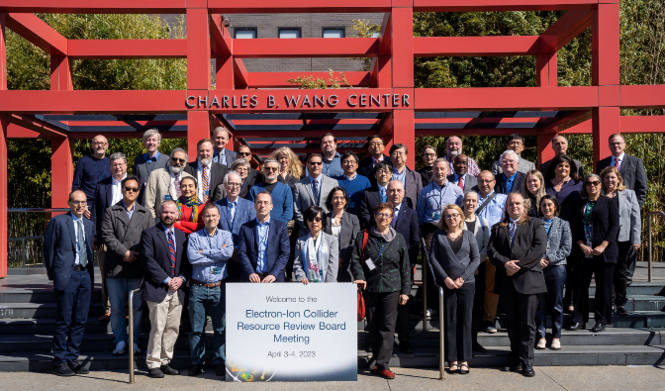
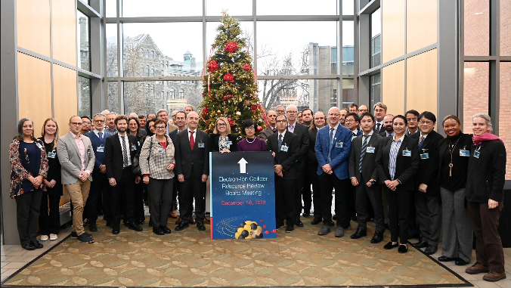
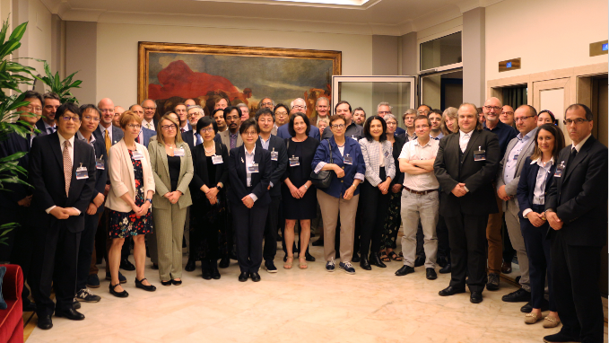
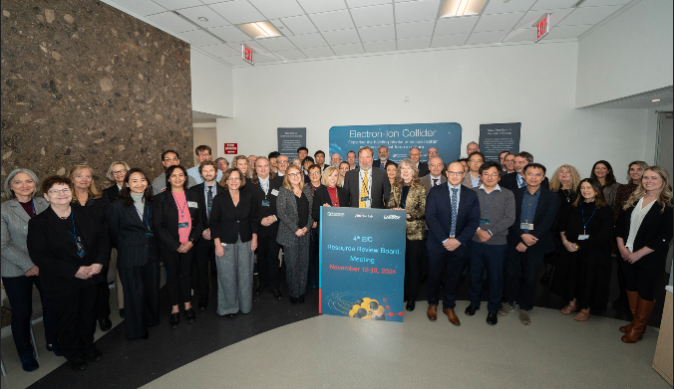
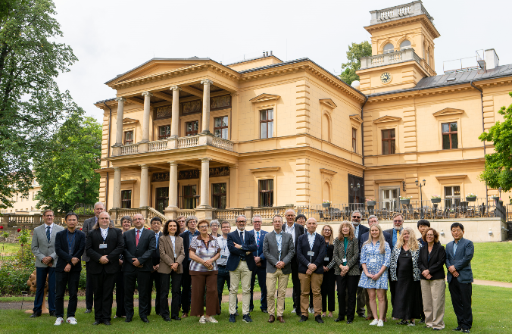
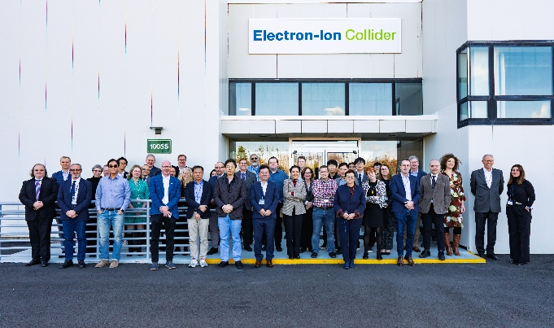
Resource Review Board (RRB)
DOE and the host labs promote the EIC as a facility “fully international in character.”
The EIC-RRB provides coordination among the different funding partners during both the detector development and construction phase of the project and during the future operations of the experiments.
Current RRB Co-Chairs:
Abhay Deshpande (BNL)
Franck Sabatie (CEA, Saclay)
David Dean (Jlab)
https://www.bnl.gov/eic-rrbmeeting/
1st RRB meeting on April 3-4, 2023 at Stony Brook University.
2nd RRB meeting on December 7 + 8 at Catholic University of America.
3rd RRB meeting on May 6 + 7 hosted by INFN/Italy in Rome
4th RRB meeting on November 7+8 2024 at BNL
5th RRB meeting on June 5+6 2025 in Prague
6th RRB meeting on November 4+5 2025 at BNL
Future: 7th RRB meeting June 9th-10th 2026 – MEXT, Tokyo, Japan
8th RRB meeting November 2026 – U.S.A.
9th RRB meeting June 2027 - Interest from Taiwan & France
The EIC-RRB provides coordination among the different funding partners during both the detector development and construction phase of the project and during the future operations of the experiments

