Slide 1

Report from the
Collaboration Spokesperson
John Lajoie
Oak Ridge National Laboratory

Slide 2

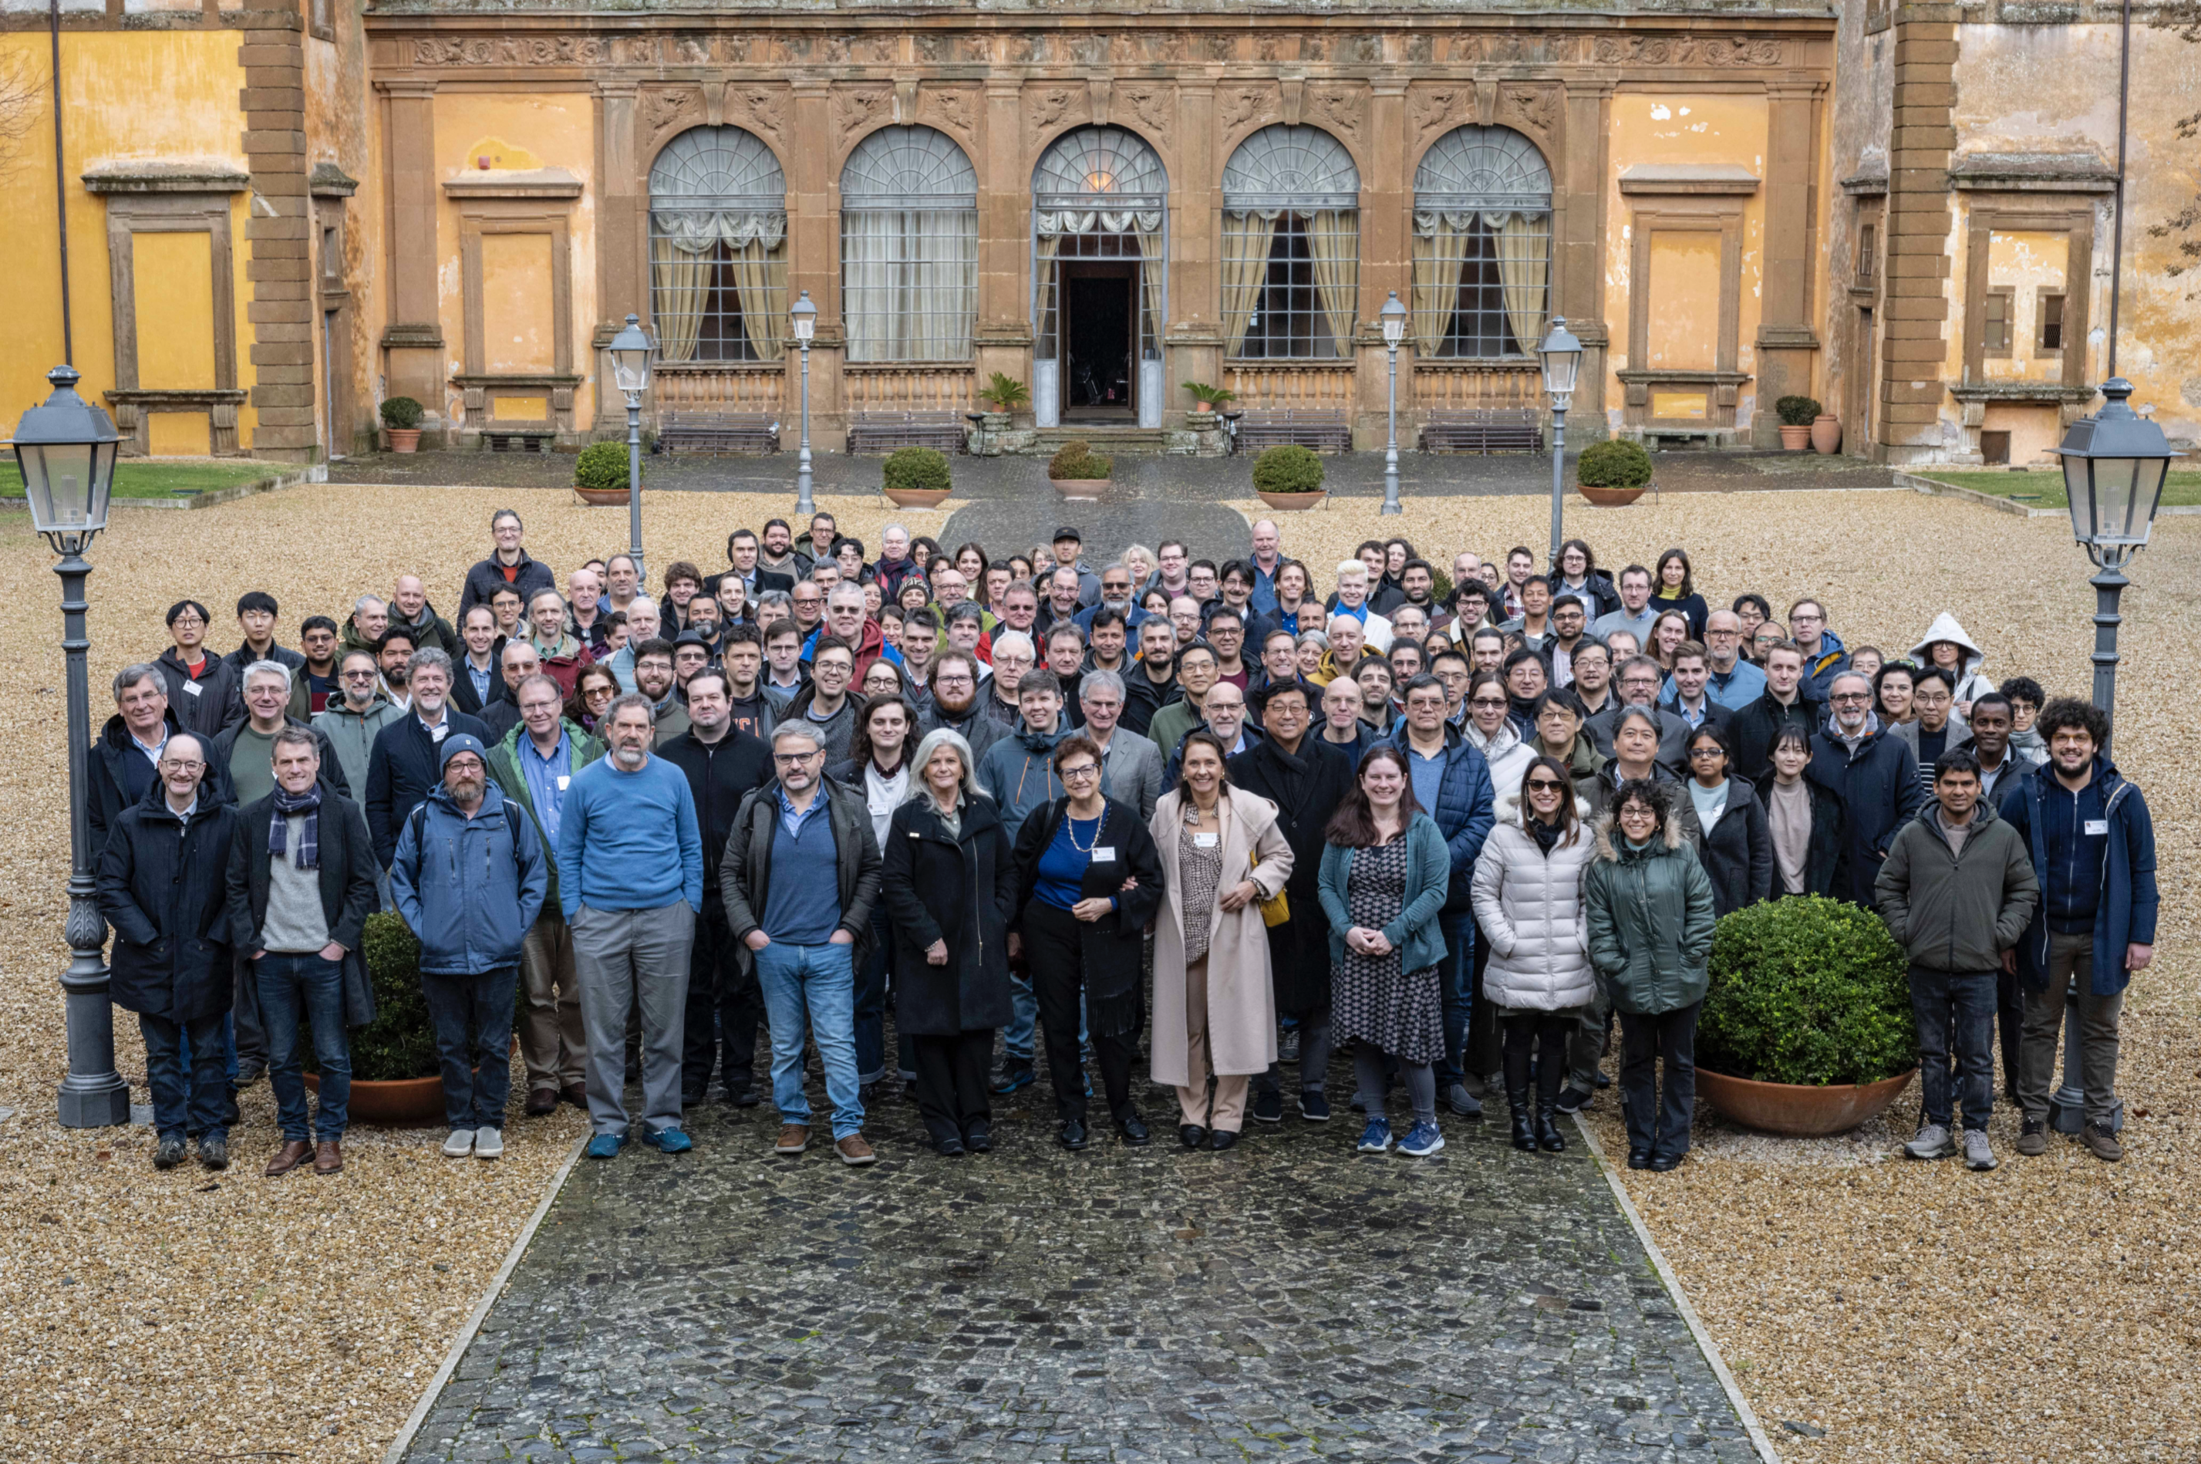
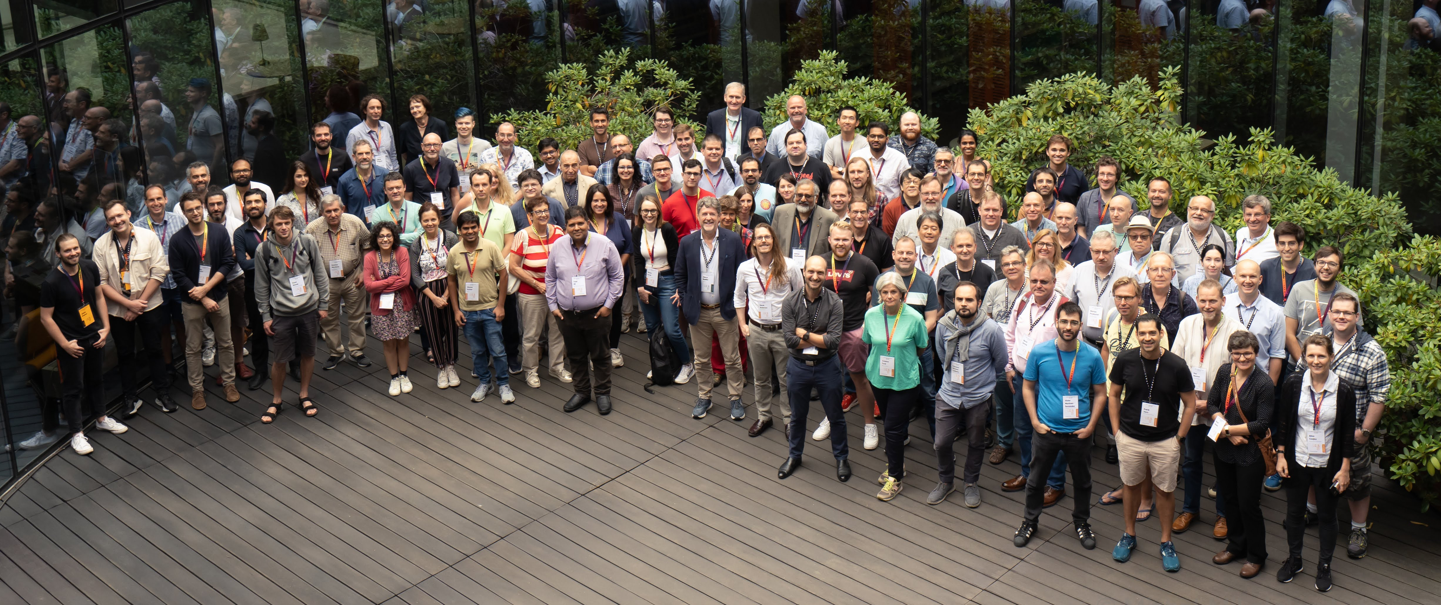
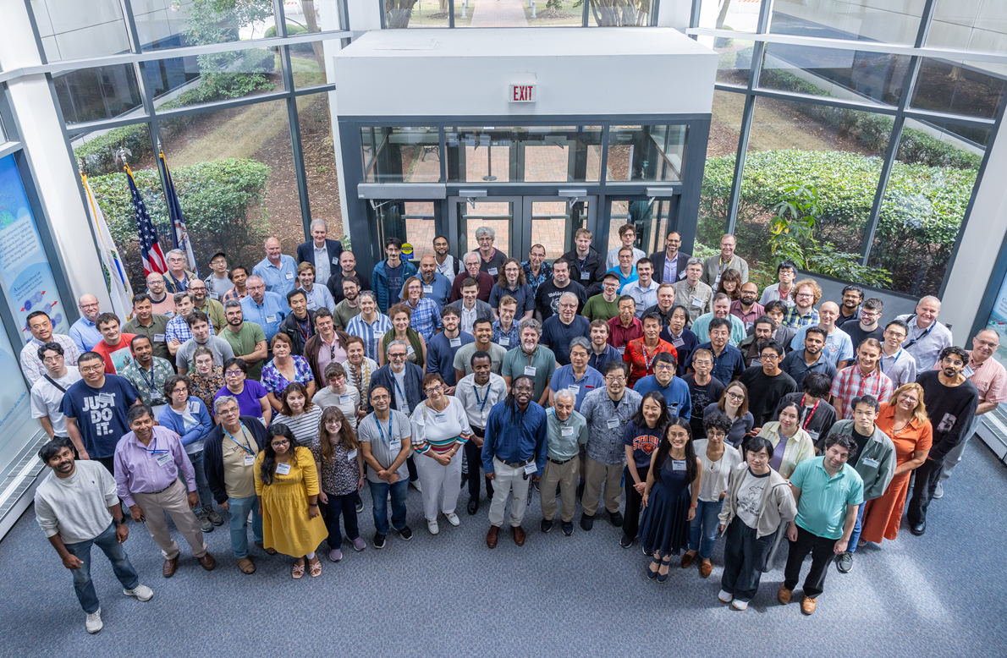
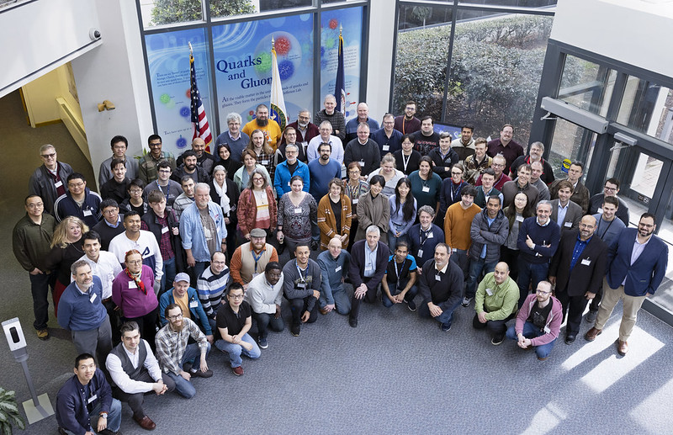
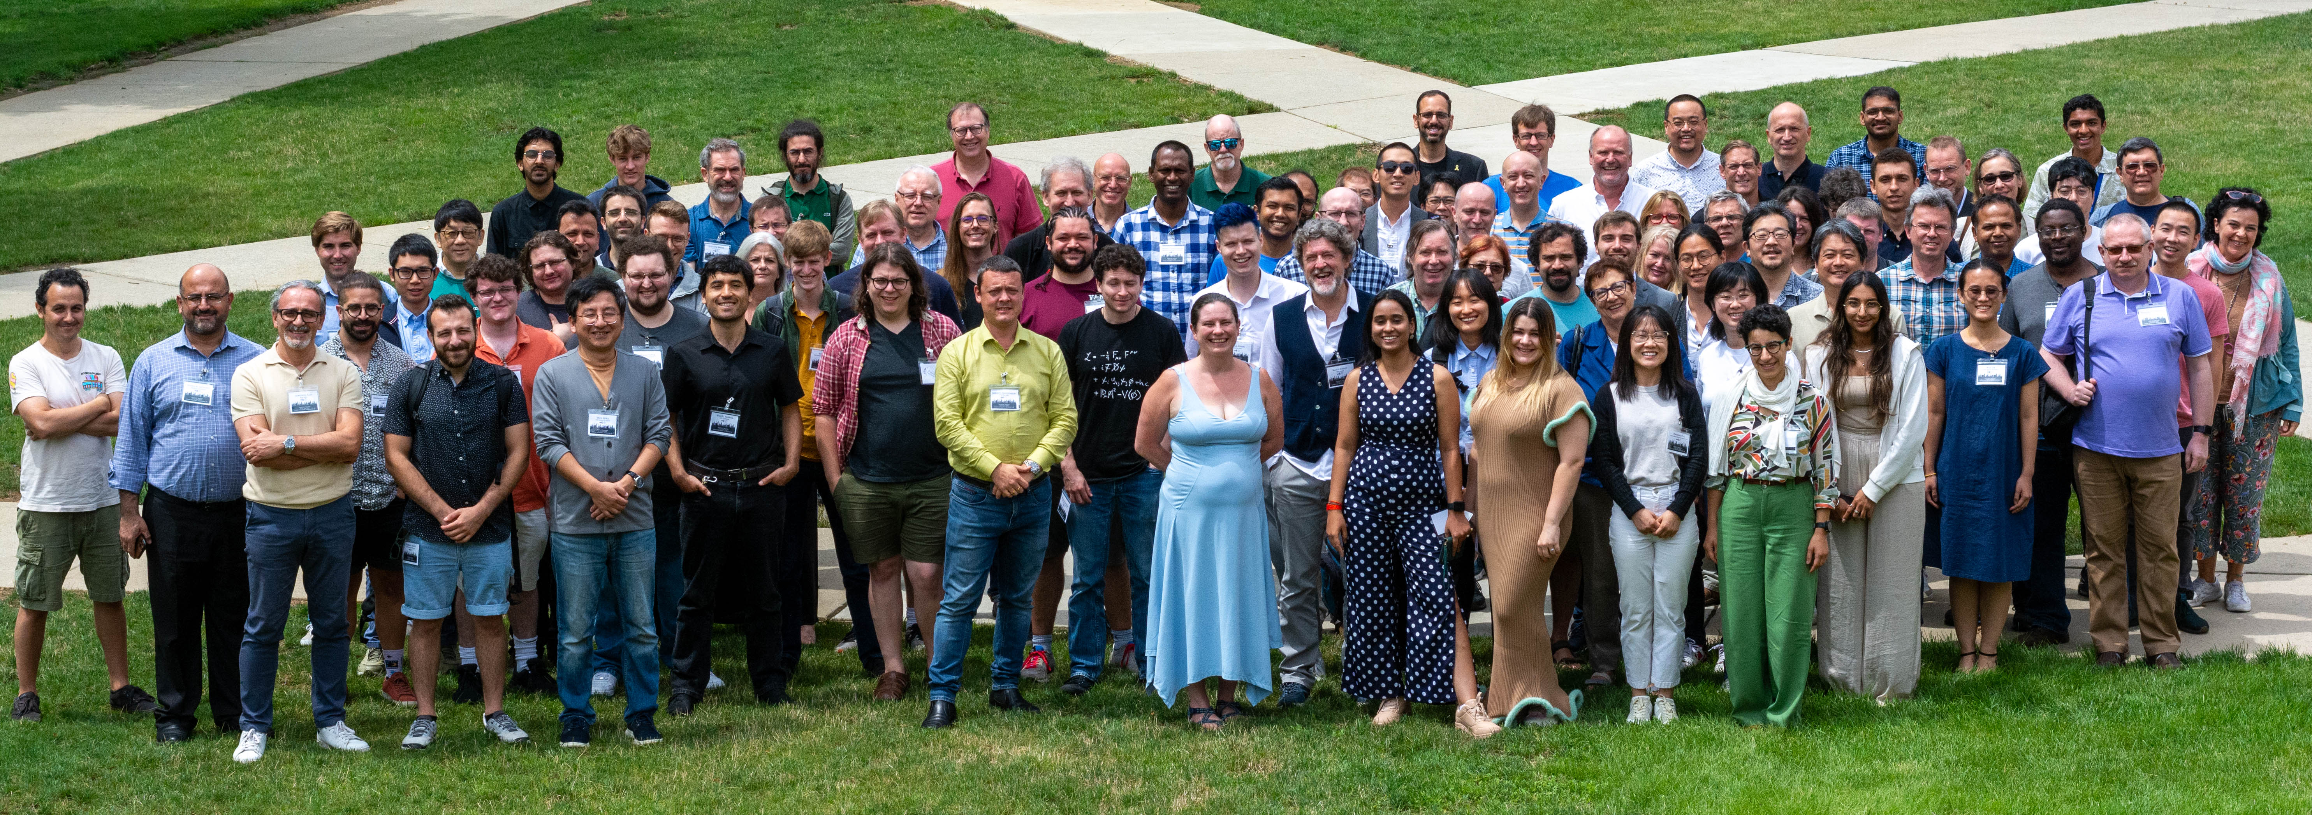
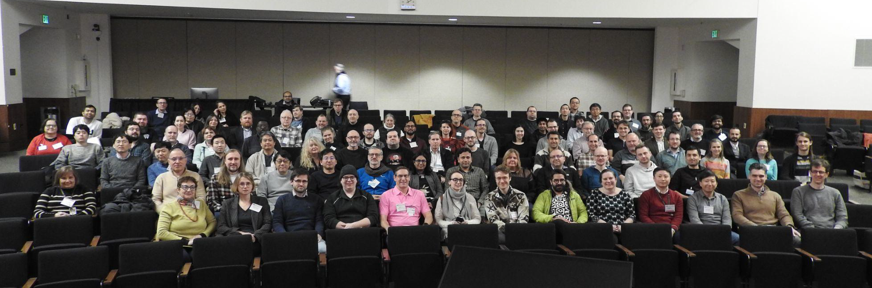
The Collaboration
JLab, Jan. 2023
Warsaw, July 2023
ePIC is a community of scientists dedicated to realizing the EIC science mission.
The ePIC Collaboration is as unique as the ePIC detector.
Frascati, January 2025
EICUG/ePIC Meeting – Lehigh, July 2024
Brookhaven National Lab, January 2026
Jefferson Lab, July 2025
ANL, Jan 2024

Slide 3
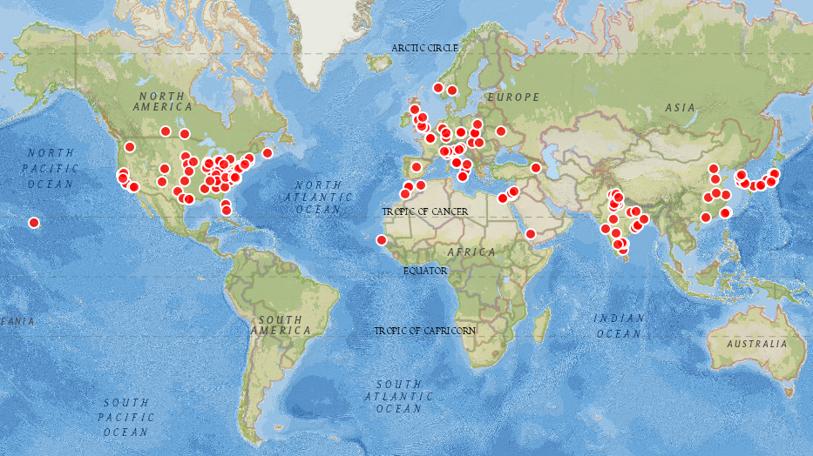
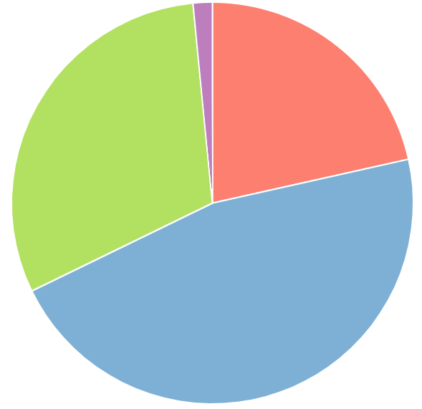
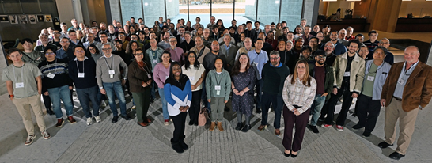
Africa 1.6%
Asia
21.5%
Europe
30.7%
North America
46.3%
>1150 collaborators
183 institutions, 26 countries
ePIC Collaboration – January 2025

Slide 4


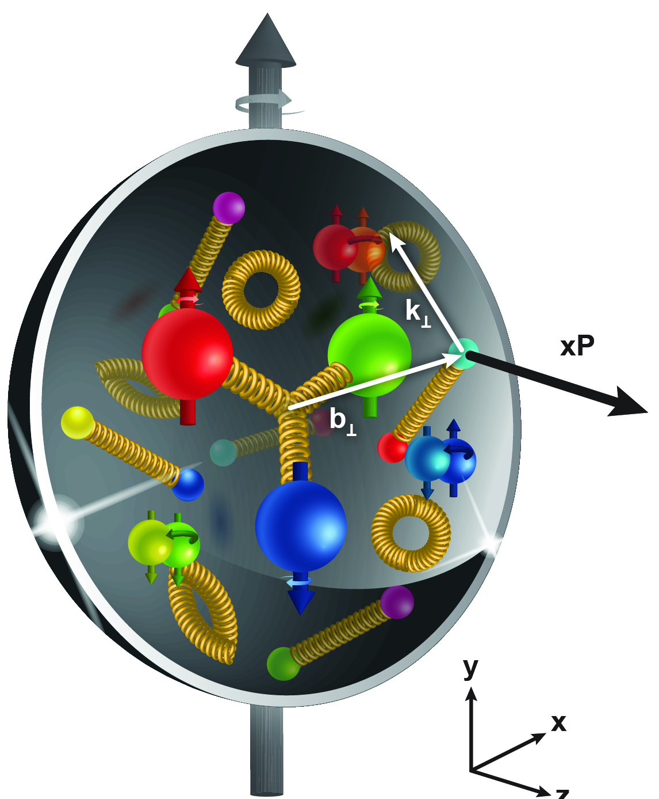
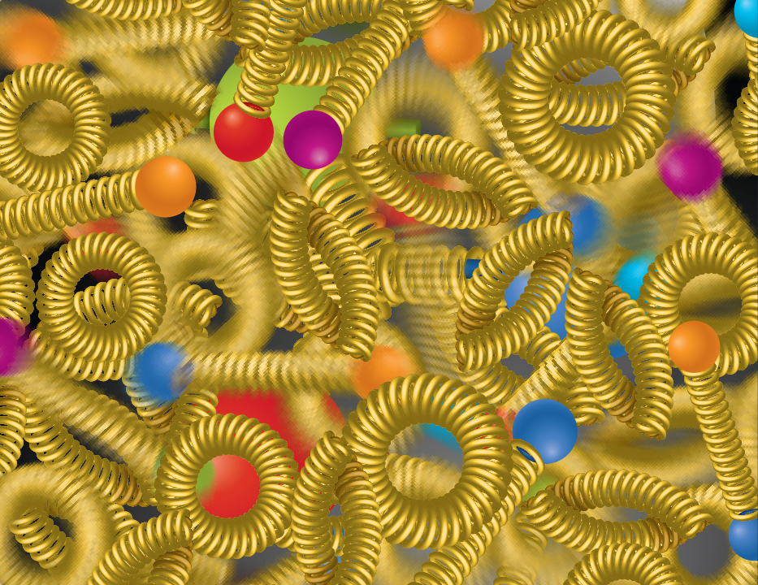
The ePIC Collaboration Pursues EIC Science
SPIN
MASS
IMAGING
NUCLEI
GLUONS
The EIC will unravel the different contribution from the quarks, gluons and orbital angular momentum
SPIN is one of the fundamental properties of matter.
Spin cannot be explained by a static picture of the proton
It is the interplay between the intrinsic properties and interactions of quarks and gluons
Does the mass of visible matter emerge from quark-gluon interactions?
Atom: Binding/Mass =
0.00000001
Nucleus: Binding/Mass =
0.01
Proton: Binding/Mass =
100
For the proton the EIC will determine an important term contributing to the proton mass, the so-called “QCD trace anomaly
How can we understand their dynamical origin in QCD?
What is the relation to Confinement
How are the quarks and gluon distributed in space and momentum inside the nucleon & nuclei?
How do the nucleon properties emerge from them and their interactions?
How do the confined hadronic states emerge from quarks and gluons?
Is the structure of a free and bound nucleon the same?
How do quarks and gluons, interact with a nuclear medium?
How do the quark-gluon interactions create nuclear binding?
What happens to the gluon density in nuclei? Does it saturate at high energy?
How does a dense nuclear environment affect the quarks and gluons, their correlations, and their interactions?
?
=
gluon
splitting
gluon
recombination
4

Slide 5
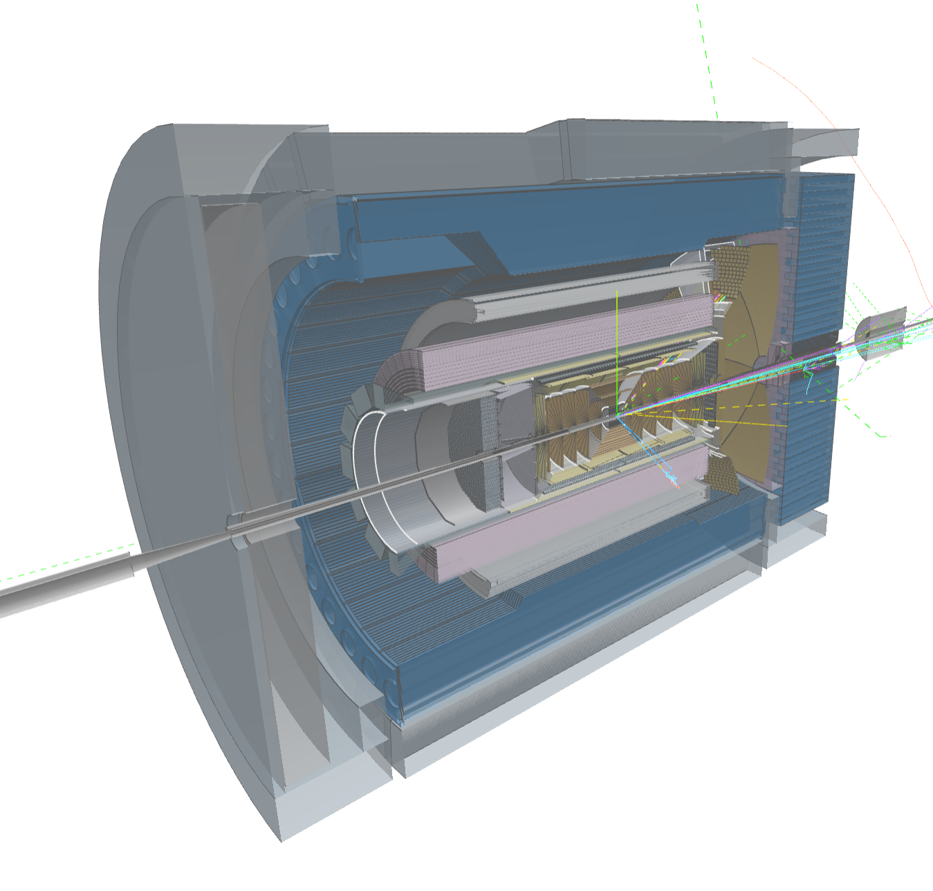
The Collaboration is:
Building a State-of-the-Art Detector:
New and Different: Asymmetric design with multiple “first of it’s kind” technologies deployed for unprecedented performance.
Integrated: 26 subsystems over ± 40 m highly integrated internally as well as with the EIC collider
Defining a Streaming Computing Model:
Scientific Flexibility: Fully streaming data acquisition and readout
Continuous calibration and alignment: Enables rapid delivery of scientific results, AI integrated.
Echelon Model: Organizes resources across the computing hierarchy and enables international contributions.
Evolving the EIC Science Program:
Simulations: Developing the analysis tools to reject backgrounds and reconstruct events in ePIC.
Physics Impact: Working with the community to continuously update the impact the EIC will have on our understanding of QCD.
ePIC event display by Dmitry Romanov

Slide 6

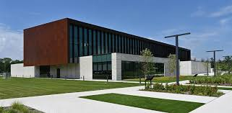

Jan 2026 Collaboration Meeting
BNL Science and User Support Center
143+ in-person
200+ online
Jan 20-23rd, 2026:
Three plenary sessions
  Round-table sessions with EIC and ePIC Leadership
8 parallel/workfest sessions
Collaboration Council Meeting
https://indico.bnl.gov/event/30532/

Slide 7
Collaboration Goals for the first half of 2026
Support the EIC project and ePIC Technical Design:
  Close the design loop with ePIC simulations
  Advance the pTDR in preparation for CD-2
    Respond to review recommendations
Complete the Early Science whitepaper
Progress in developing a multi-year plan for ePIC Software and Computing
Begin submissions to the NIMA Special Issue
More in Silvia’s presentation
More in Markus’ presentation

Slide 8

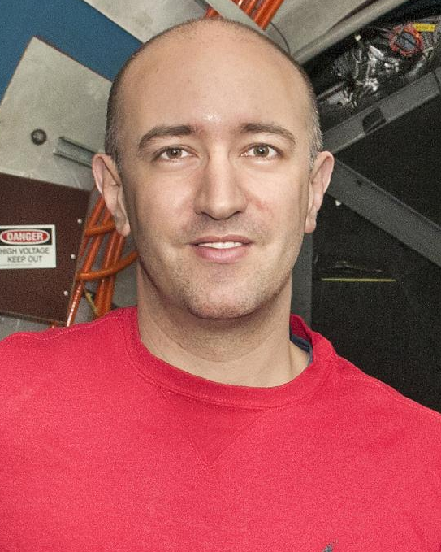
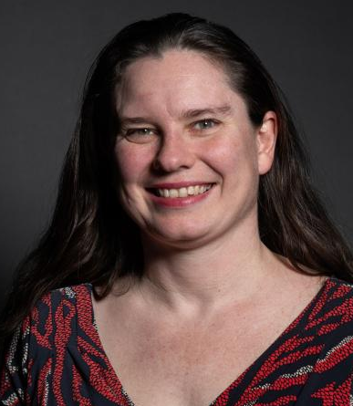
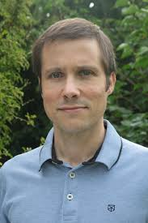
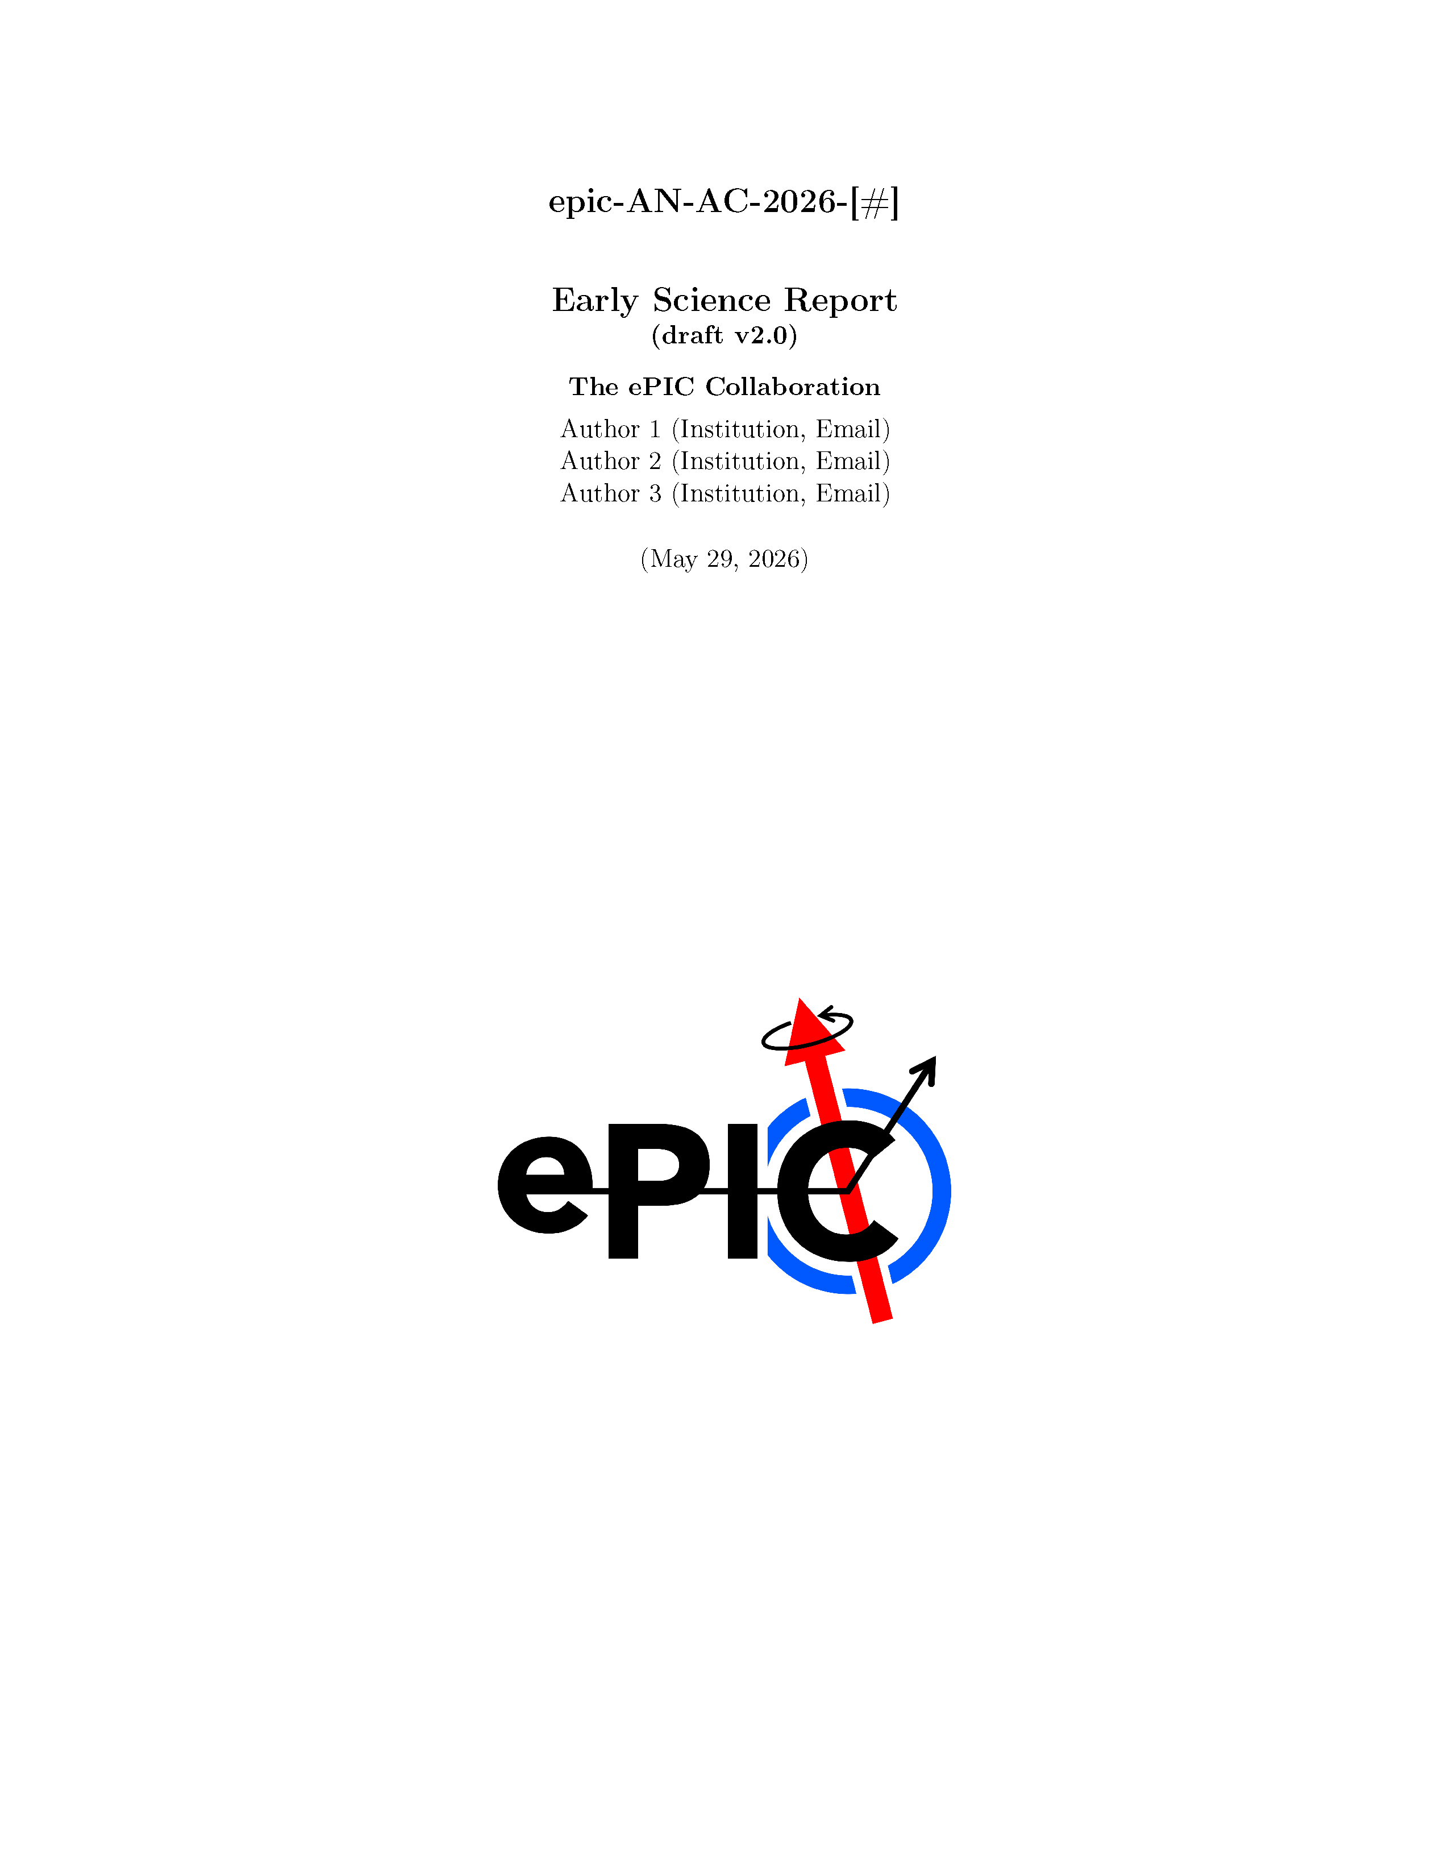
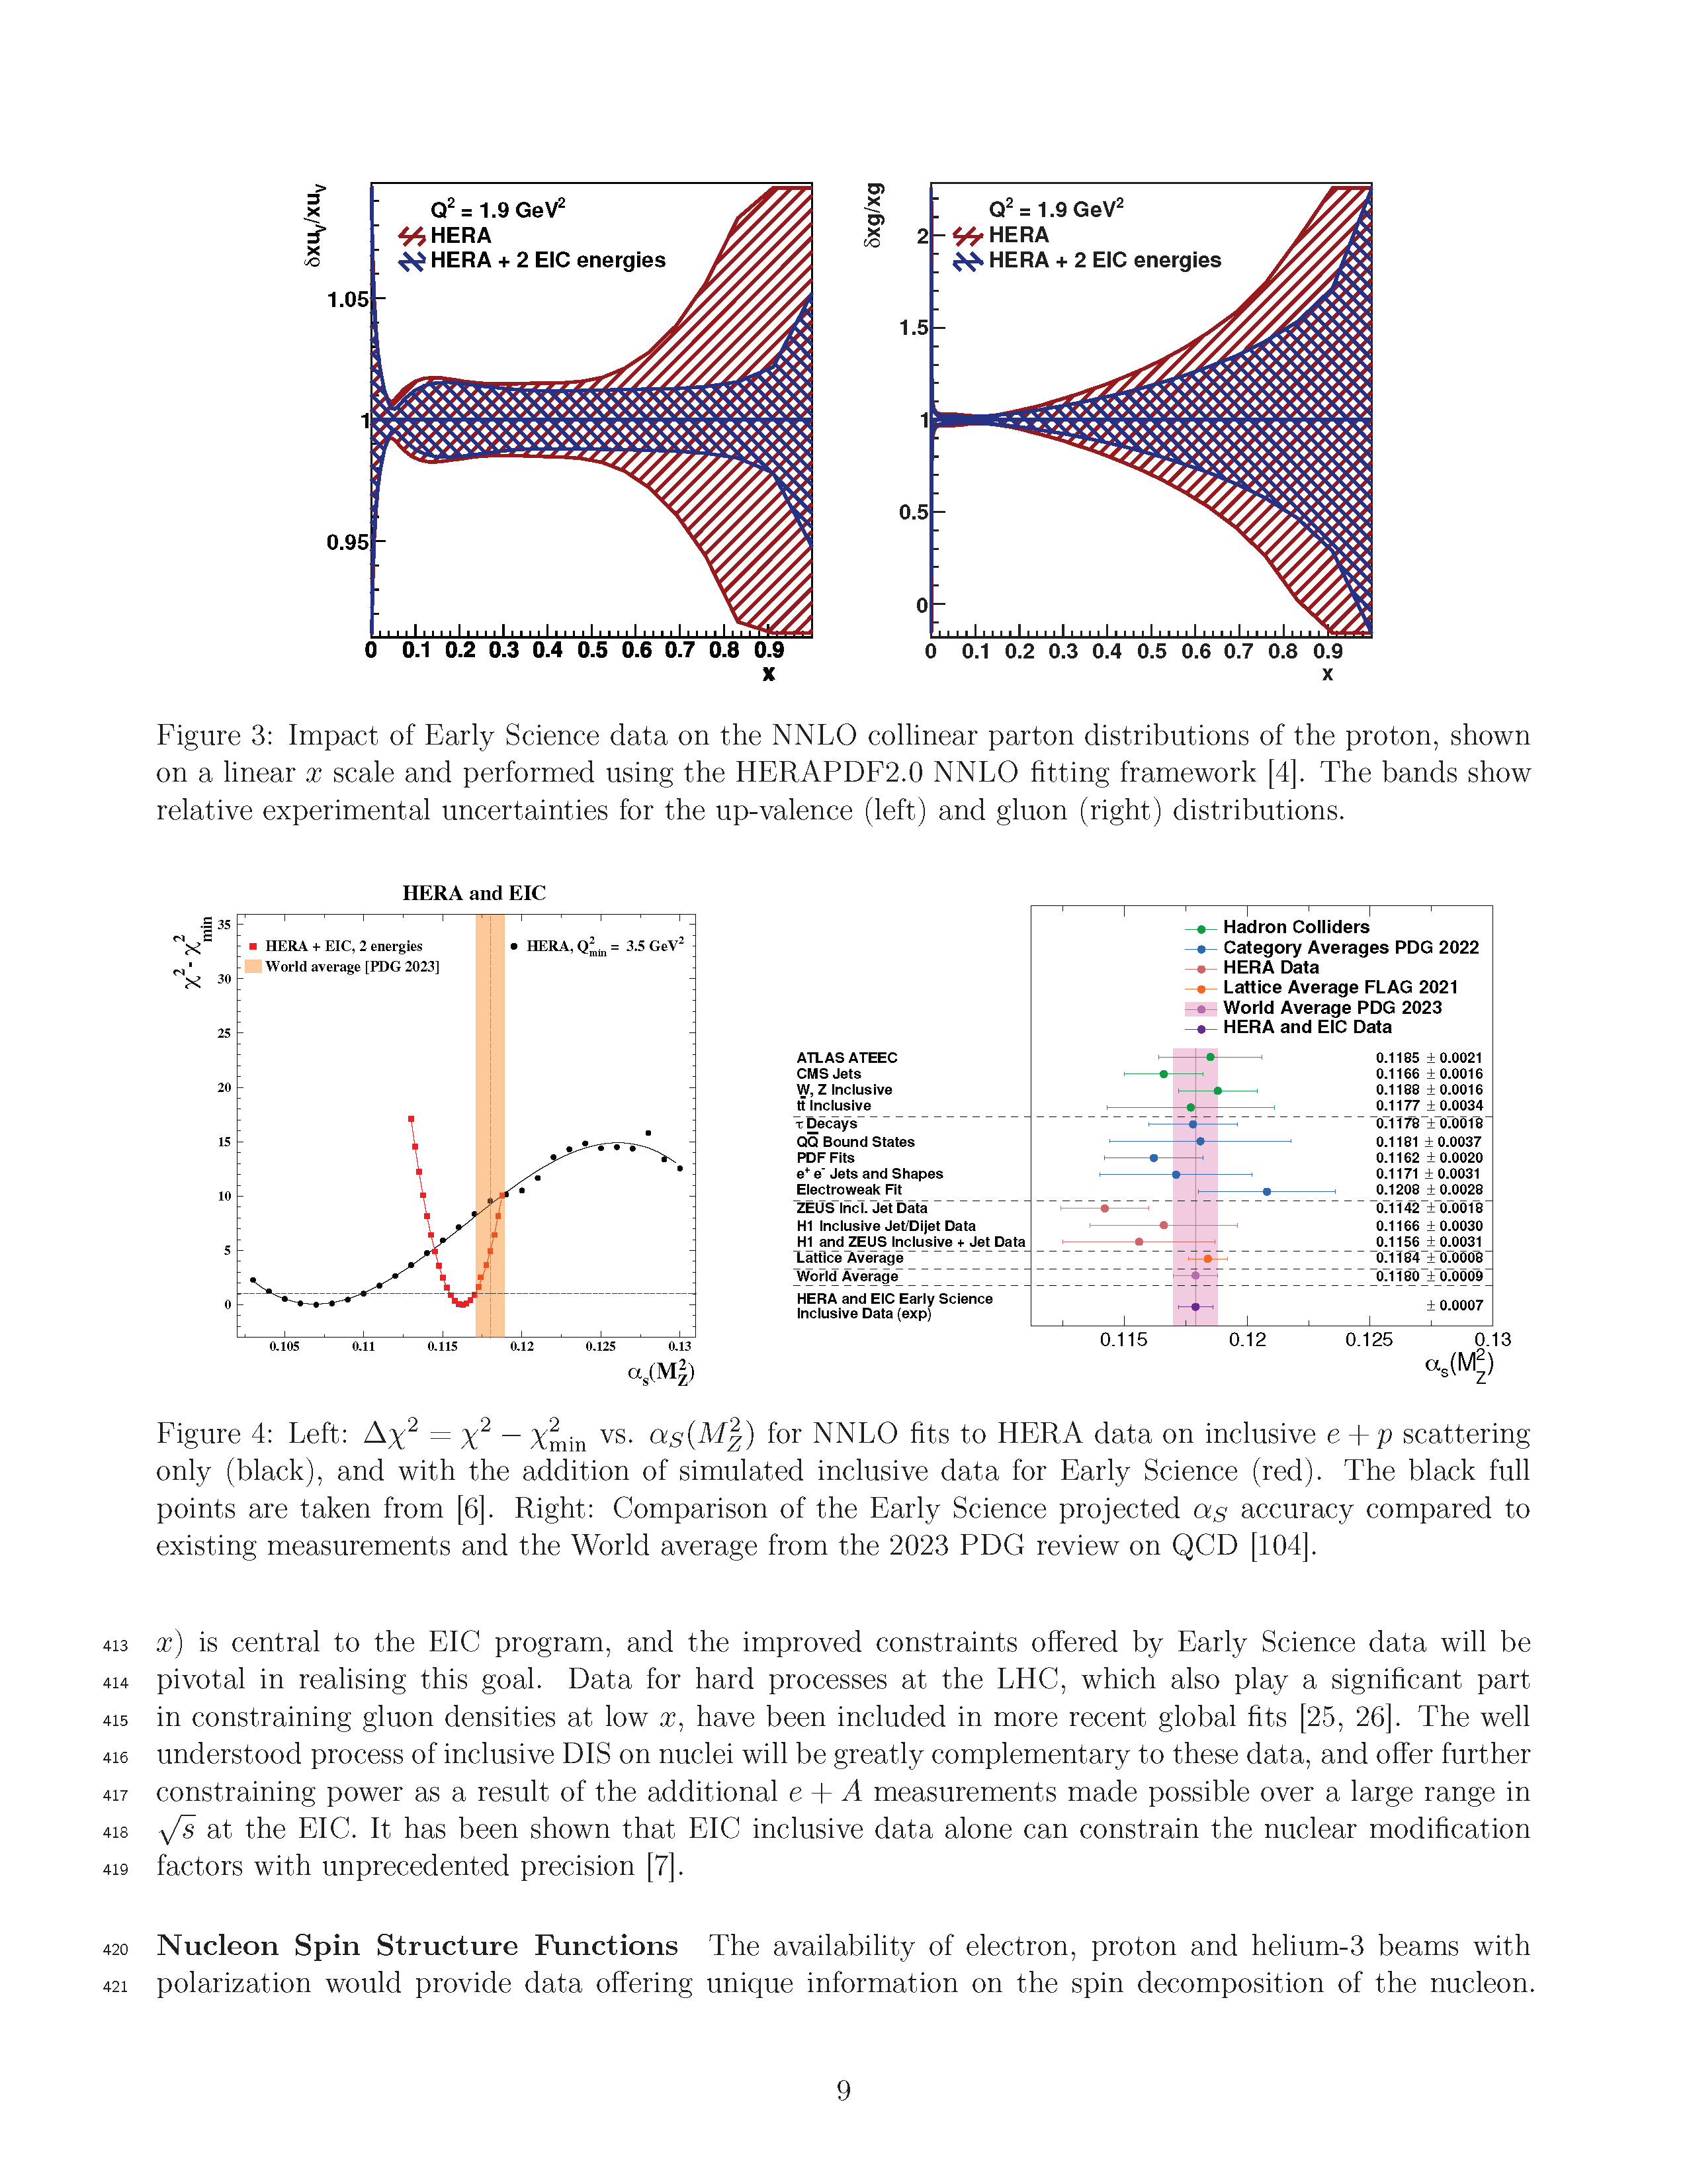
The Early Science Whitepaper
The collaboration was charged by Abhay Deshpande and David Dean to develop a document that summarizes EIC Early Science.
  Dedicated simulation campaigns March/April 2026
  Second workshop held in Calabria March 17-19th - first draft discussed
  Second draft to reviewers May 29th
  Collaboration release late June
A substantial effort by ePIC collaborators
The report will be submitted in early July

Slide 9
ePIC NIMA Special Issue
Plan to publish a super-set of the material prepared for the pTDR
  ePIC Overview Paper
  Subsystem technical papers (derived from pTDR)
  Physics performance paper (derived from pTDR)
  Early Science Whitepaper
  Early Science Physics Appendices
  BSM/EW Physics Performance Paper
  Streaming Computing Model Paper
Overall 30+ publications
This Special Issue will be an important tool to communicate to the NP community the depth, breadth and excitement for EIC science.
Planning developed in multiple PAC and TIC meetings.

Slide 10


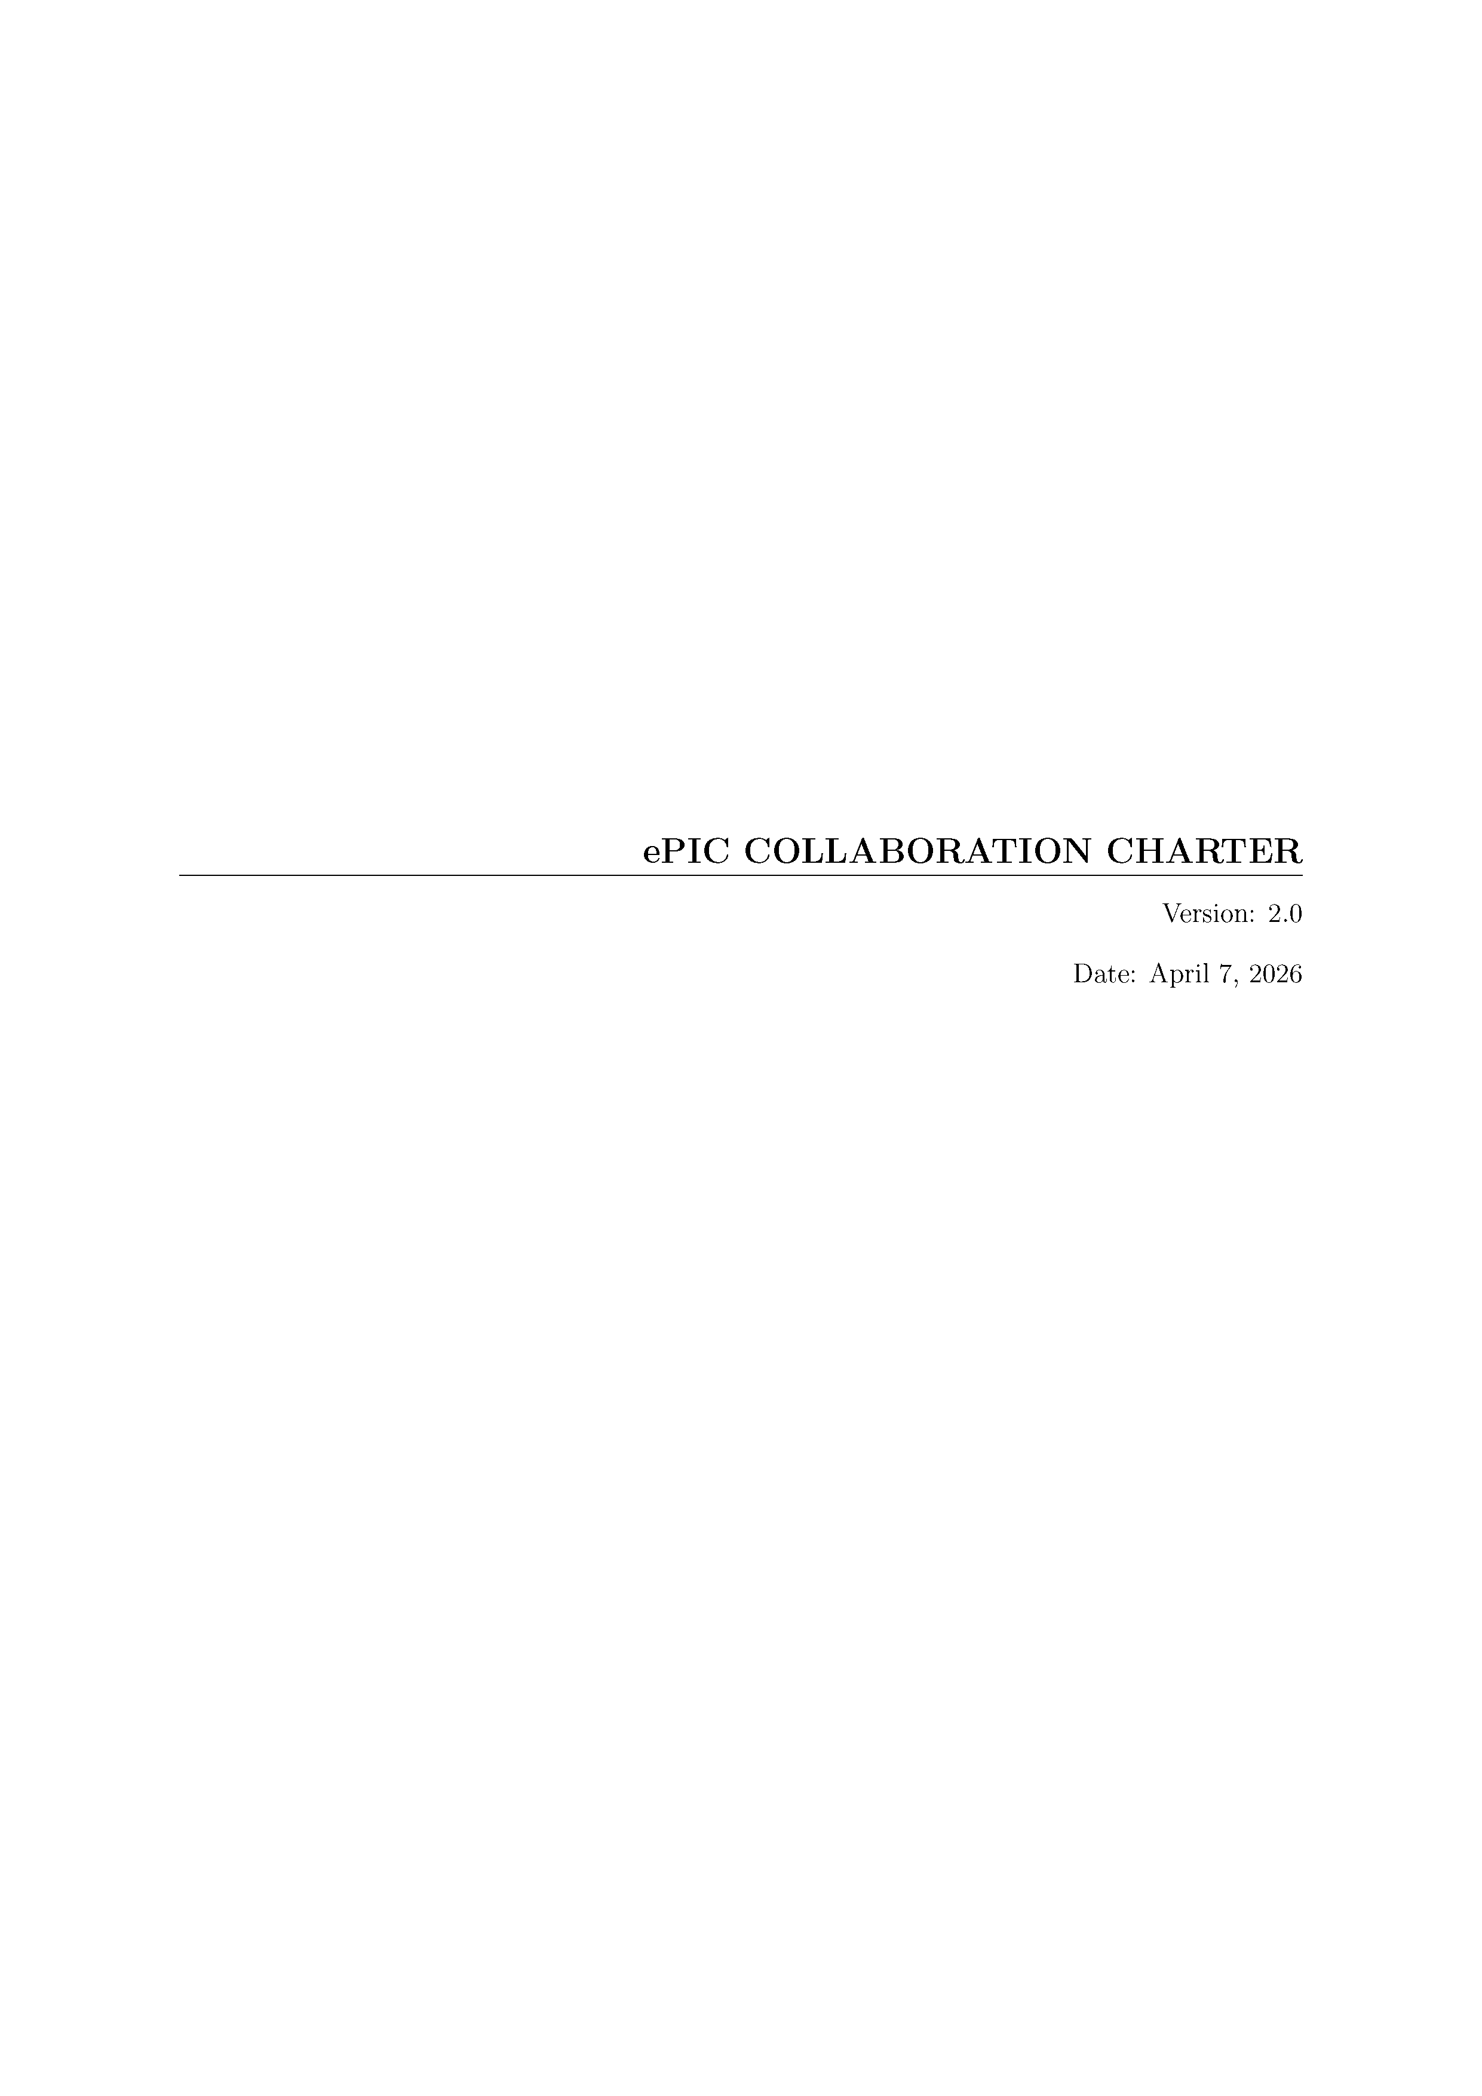


Revised Collaboration Charter
Charter Update Committee:
Jana Bielcikova (Prague)
Annalisa D'Angelo (Rome)
Olga Evdokimov (UIC)
Sylvester Joosten (ANL)
Rongrong Ma (BNL)
Paul Newman (Birmingham)
Gary Penman (Glasgow)
Ernst Sichtermann (LBNL)
Satoshi Yano (Hiroshima)
Revised ePIC Collaboration Charter passed by Collaboration Council vote April 7, 2026
  Original charter from late 2022
Revisions include:
  Collaboration Culture Committee with revised scope
  Clearer separation between charter and policies (especially Membership, Publication policies)
  Added Affiliate membership
  Added Emeritus Collaborators
  Shorten voting timeline
  Cleanups and clarifying language
Policy revisions underway to synchronize with revised charter

Slide 11
Collaboration Survey
The goal of the survey was multifold:
  To better understand collaboration engagement
  To get feedback from the collaboration to inform collaboration meeting planning
  To see how the collaboration is responding to the developing EIC project baseline
Survey opened May 11th, closed May 25th
184 responses in total
  Substantial variation in the number of responses for each question, between ~30 to ~160
Questions ask for a ranking, then free-form comments

Slide 12
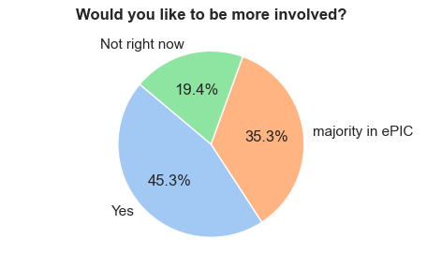
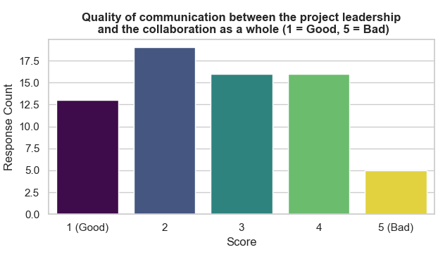
Collaboration Survey Summary (I)
Strong overall commitment to ePIC and high willingness for deeper involvement
Major constraints: limited time, overlapping commitments, funding/travel limitations
Communication with project viewed as mixed: many positive comments, but requests for greater transparency
Most requested improvements: more accelerator/project updates, realistic schedules, better discussion formats
Collaboration values regular meetings, tutorials, and technical exchanges

Slide 13
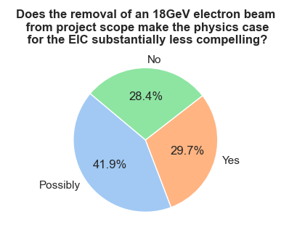
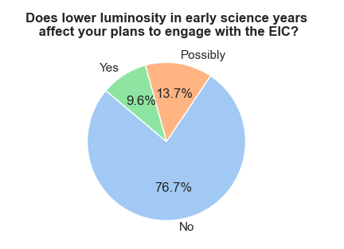
Collaboration Survey Summary (II)
Mixed response on 18 GeV electron beam
  Main worries: reduced kinematic reach, weaker saturation physics potential, reduced discovery reach
Most respondents said lower Early Science luminosity would not immediately reduce engagement
  However, respondents emphasized that long-term scientific competitiveness is critical
Suggested actions: improve transparency and communicate mitigation strategies clearly

Slide 14
Overall Survey Assessment
The survey indicates a collaboration that is:
  Scientifically committed,
  Operationally active,
  Increasingly concerned about transparency, realism in planning, and preservation of the full physics potential of the EIC.
The strongest positive signal is continued enthusiasm and willingness to engage.
The strongest concern is that repeated reductions in machine capability or uncertainty in planning could gradually erode scientific momentum.

Slide 15
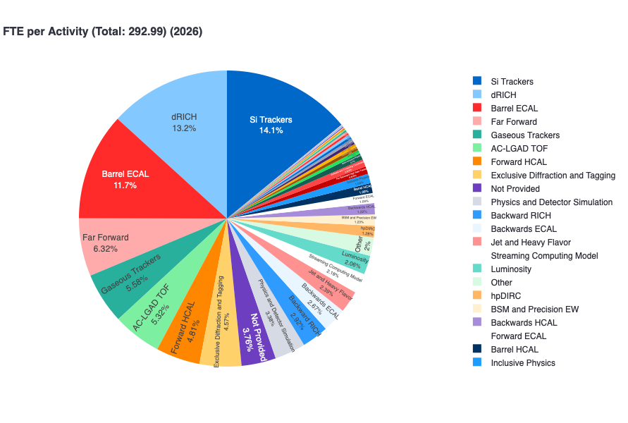
2025/26 Statements of Service
Statements of Service (SoS) are required by the ePIC membership policy.
2025: Certify commitments for past year
199.5 FTE Pledged, 238.7 Certified
2026: Pledged commitments for coming year
293 FTE Pledged
Collaboration effort and engagement continues to grow.
New collaboration tools deployed to manage membership and SoS. Comprehensive update of Membership Policy underway.

Slide 16






New Institutions in 2026
4 new institutions petitioned for membership on June 1st
20 new institutions added since the start of 2024!
New Institutions:
  Chung-Ang University
  Tokyo City University
Institutions Petitioning to Join ePIC:
  Trento Institute for Fundamental Physics and Applications
  Justus-Liebig-Universität Gießen
  Vrije Universiteit Brussel (VUB)
  Ahram Canadian University

Slide 17
Conference and Talks Committee (CTC) Report
The CTC is responsible for equitably distributing ePIC speaking opportunities
  Manages nominations, speakers and approval workflow.
  The CTC was asked for a report at the Jan 2026 Collaboration Meeting.
  The report was presented at the May 29th CC meeting.

Slide 18
Distributions
NOTE: ID by self-reporting and inference.

Slide 19

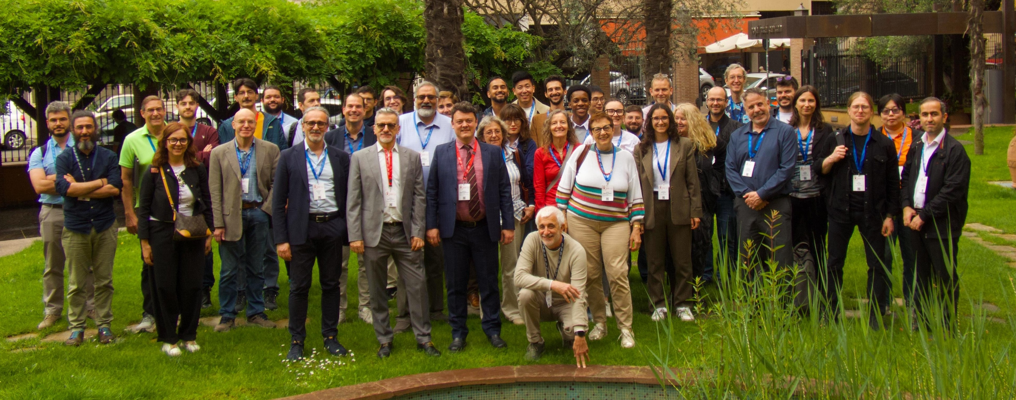
@
May 4-8th, 2026
Bologna, Italy
Ongoing Development in a Proximity-Focusing RICH Detector for ePIC at the Electron-Ion Collider | Jihee Kim
Preliminary cooling tests for the ePIC Silicon Vertex Tracker Inner Barrel | Sabrina Ciarlantini
Design and development status of Silicon Vertex Tracker for ePIC experiment | Domenico Colella
ePIC PID Performance in SIDIS Processes | Lorenzo Polizzi
The G-RWELL Endcap Tracker of the ePIC Experiment | Stefano Gramigna
Forward Particle Identification at the EIC with the ePIC dRICH Detector | Simone Vallarino
The ePIC dRICH Streaming Readout System | Sandro Geminiani
Simulation based performance of the ePIC-dRICH for Forward PID at the Electron Ion Collider | Ramandeep Kumar
Particle physics at the BNL electron-ion collider | Allesandro Tricoli
Inclusive electron-proton measurement prospects in the Electron-Ion Collider early science stage | Stephen Maple
Heavy-Flavor Studies with the ePIC Experiment at the Electron–Ion Collider | Domenico Elia
Projected High Precision Measurements on the Spin Structure g1 for the Proton and the Neutron at EIC | Win Lin
The EIC: Physics, Status and Perspectives | John Lajoie
Thirteen contributions from ePIC collaborators!

Slide 20
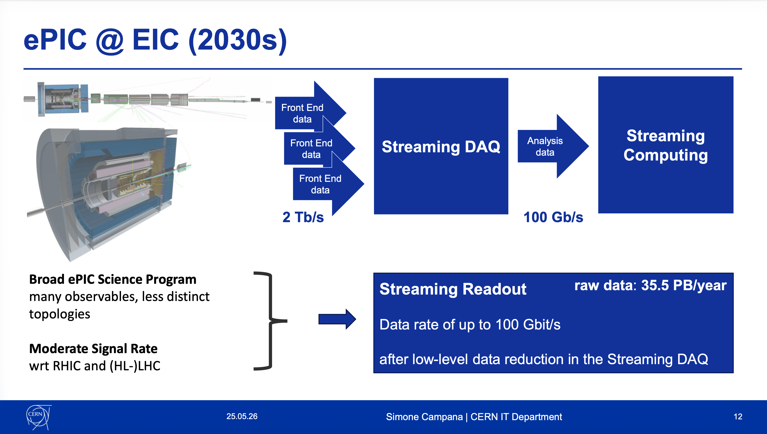
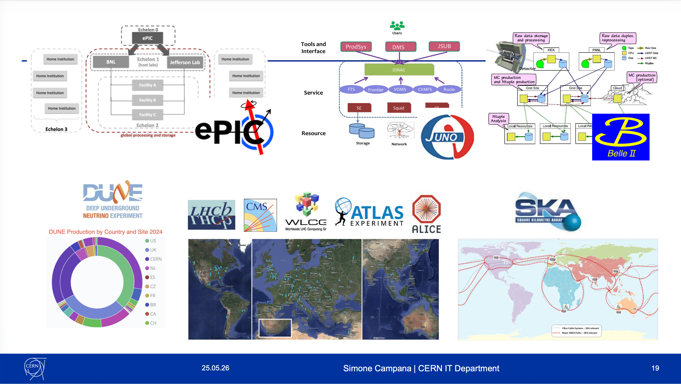
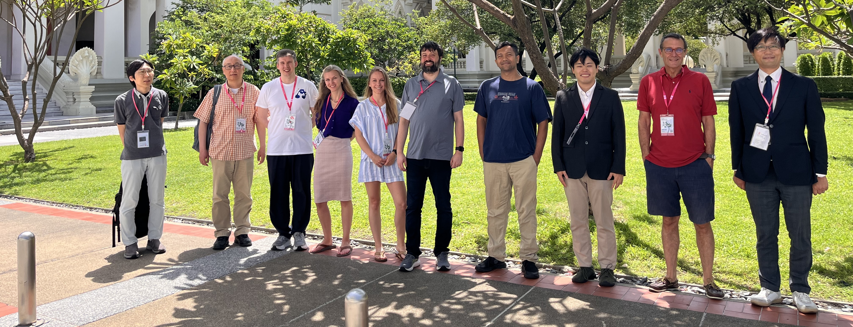

ePIC Representation at CHEP 2026 (May 25–29, Bangkok, Thailand)
ePIC was well-represented, including in Simone Campana’s keynote
ePIC Contributions
Takuya Kumaoka – Development of Streaming Data Reconstruction for ePIC Experiment at EIC
Sakib Rahman – Scaling ePIC Simulation Production: Distributed Workflow and Data Management
Holly Szumila – The ePIC Streaming Computing Model
Sakib Rahman – Exploring Potential Pathways to Accelerated ePIC Detector Simulations
Sasha Prozorov – ePIC User Learning Training and Documentation Strategies

Slide 21
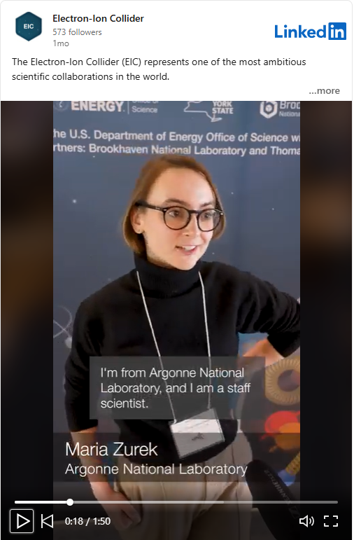
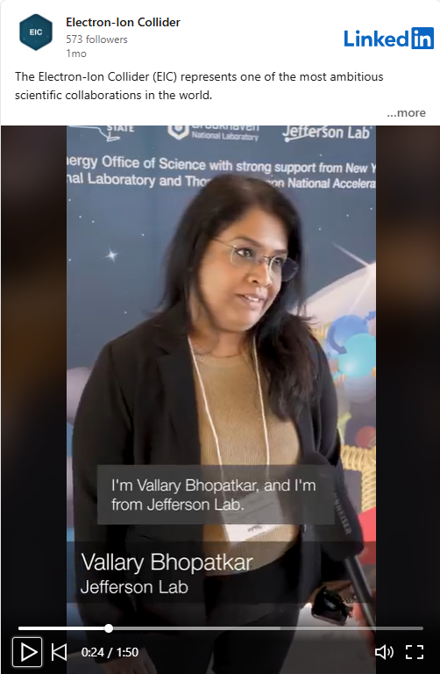
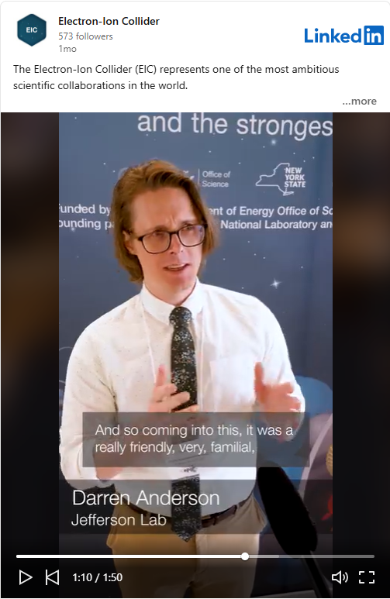
LinkedIn @ the Collaboration Meeting
At the January 2026 Collaboration Meeting, Amber Aponte with BNL’s Media & Communications Office arranged a videographer team to interact with - and profile - ePIC collaborators. The goal was to highlight the interesting people and the work being done at ePIC. The video is available here.

Slide 22
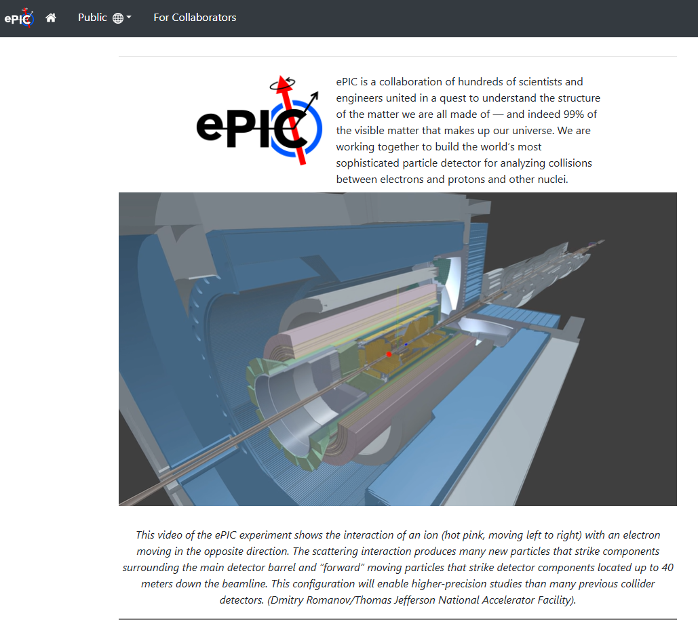
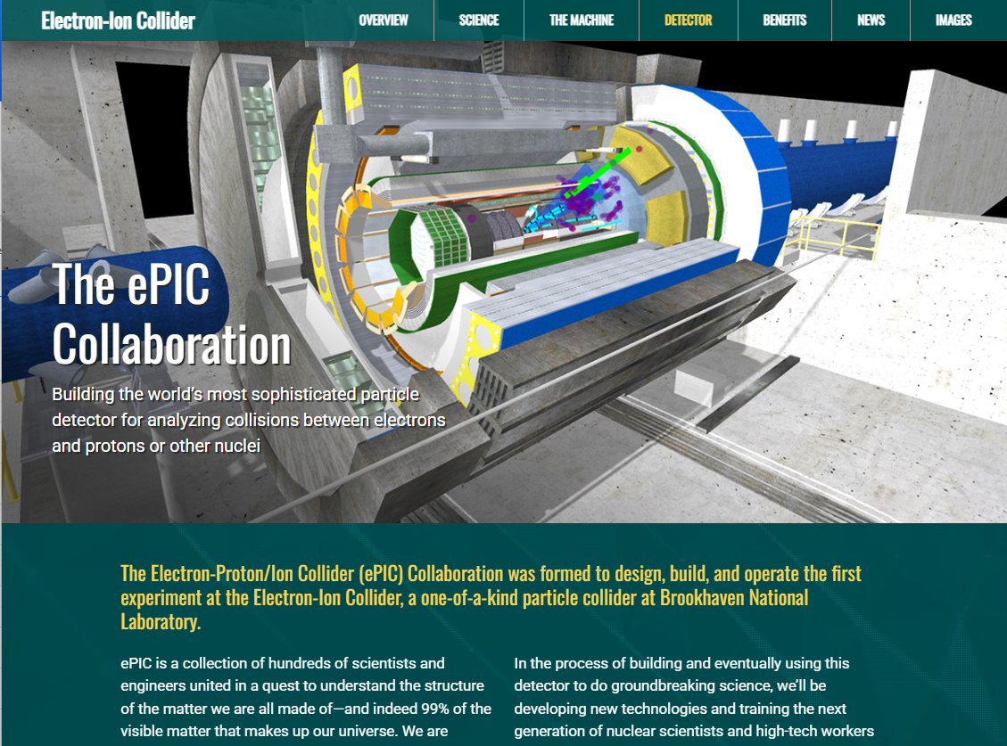
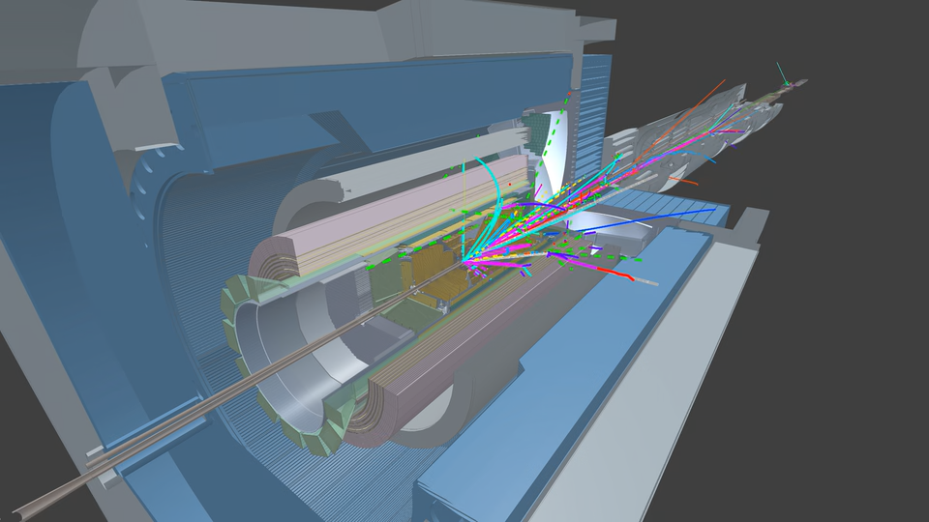
New Firebird Event Videos!
https://www.epic-eic.org/
https://www.bnl.gov/eic/epic.php
Awesome new Firebird event display videos from Dmitry Romanov (JLab) – integrated into ePIC and BNL web pages.
Firebird is the ePIC event display used for both outreach and reconstruction and analysis development:
https://eic.github.io/firebird/
Planning a variety of videos of different physics process to be incorporated into public portion of website.

Slide 23

(Following the 7th RRB June 9-10th at MEXT)
https://indico2.riken.jp/event/5568/
Registration now open!

Slide 24
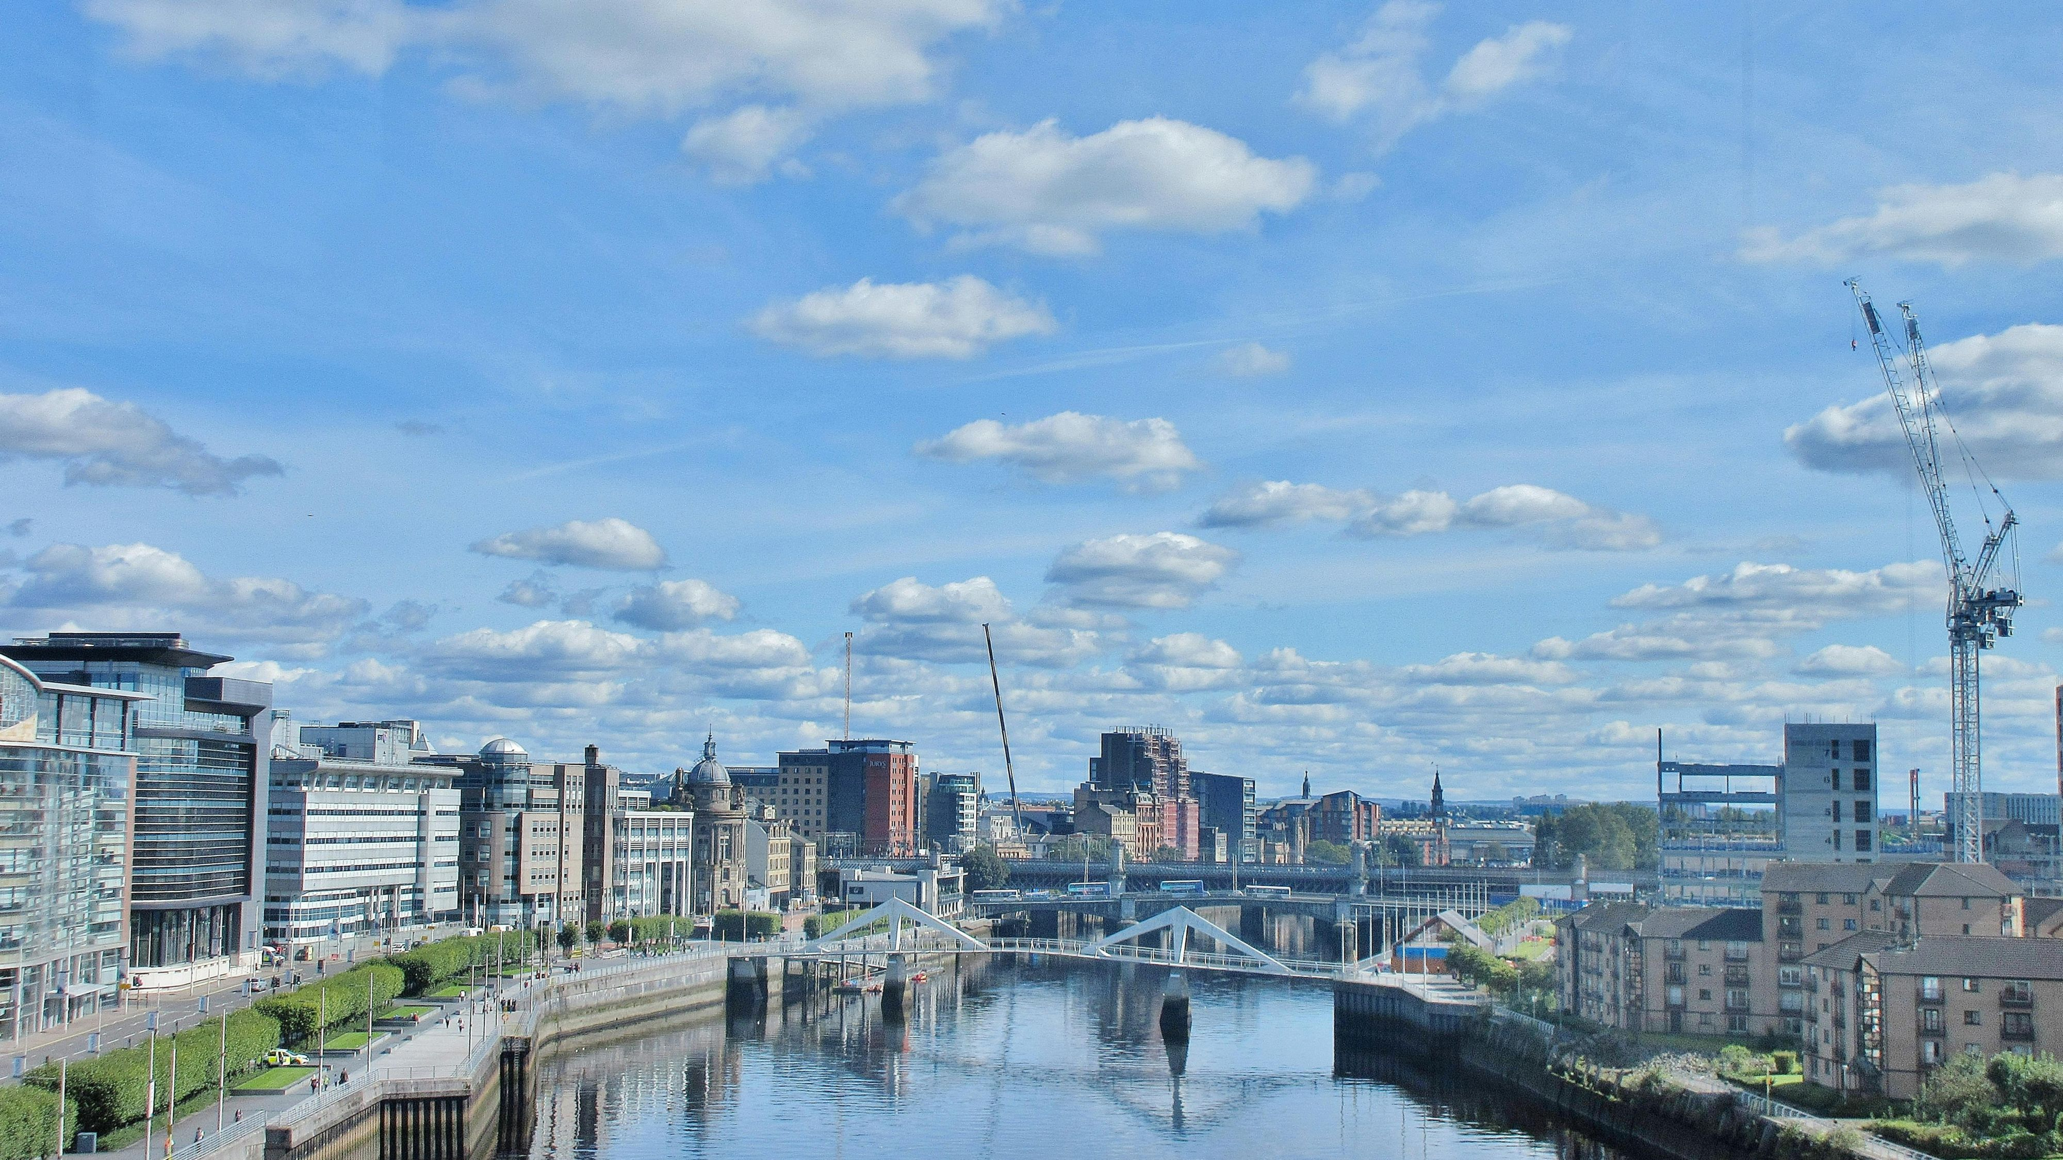
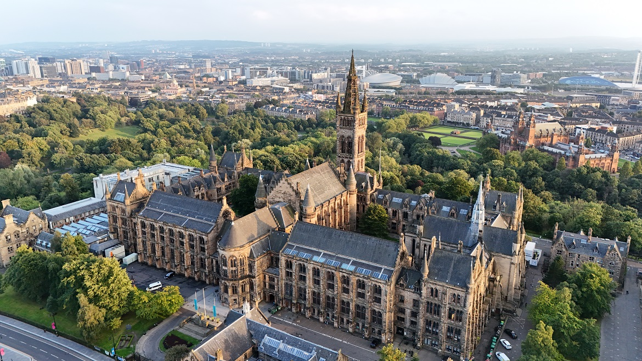
Summer 2026 Joint EICUG/ePIC Meeting
The Summer 2026 joint EICUG/ePIC meeting will be held at the University of Glasgow July 13-17th , 2026.
ECR event July 11-12th (organized by EICUG) – looking for contributions!
Indico w/information and Registration:
https://indico.bnl.gov/event/31808/
Registration Now Open!

Slide 25
The Status of the ePIC Collaboration
The ePIC Collaboration is strong, active and growing!
The collaboration is making progress on identified priorities
  The Early Science Report will be completed and submitted in July.
  See talks from Silvia and Markus for more details.
Engagement remains strong and is growing, but significant headwinds have been identified. This is a challenge for collaboration leadership.
Collaboration presence at major international conferences is strong and collaboration-specific outreach efforts continue.
Looking forward to the EIC-Asia meeting this week, the EICUG/ePIC Collaboration meeting and release of the Early Science Report in July.

Slide 26


Slide 27

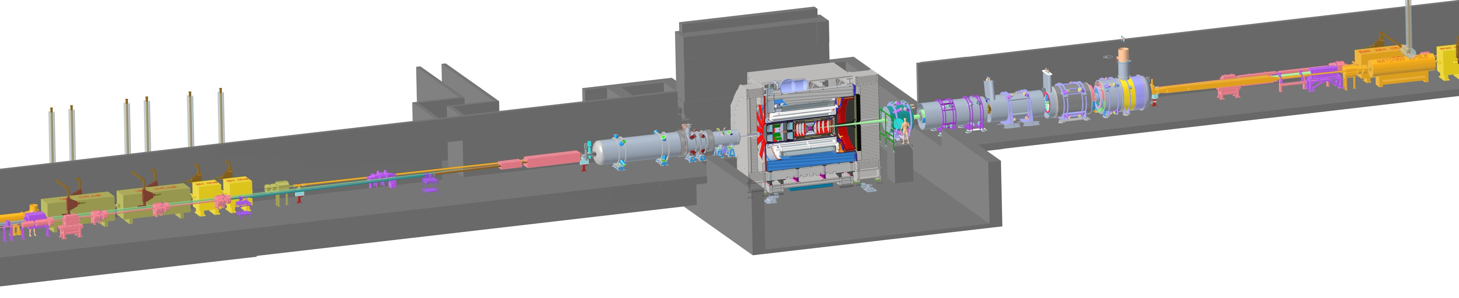
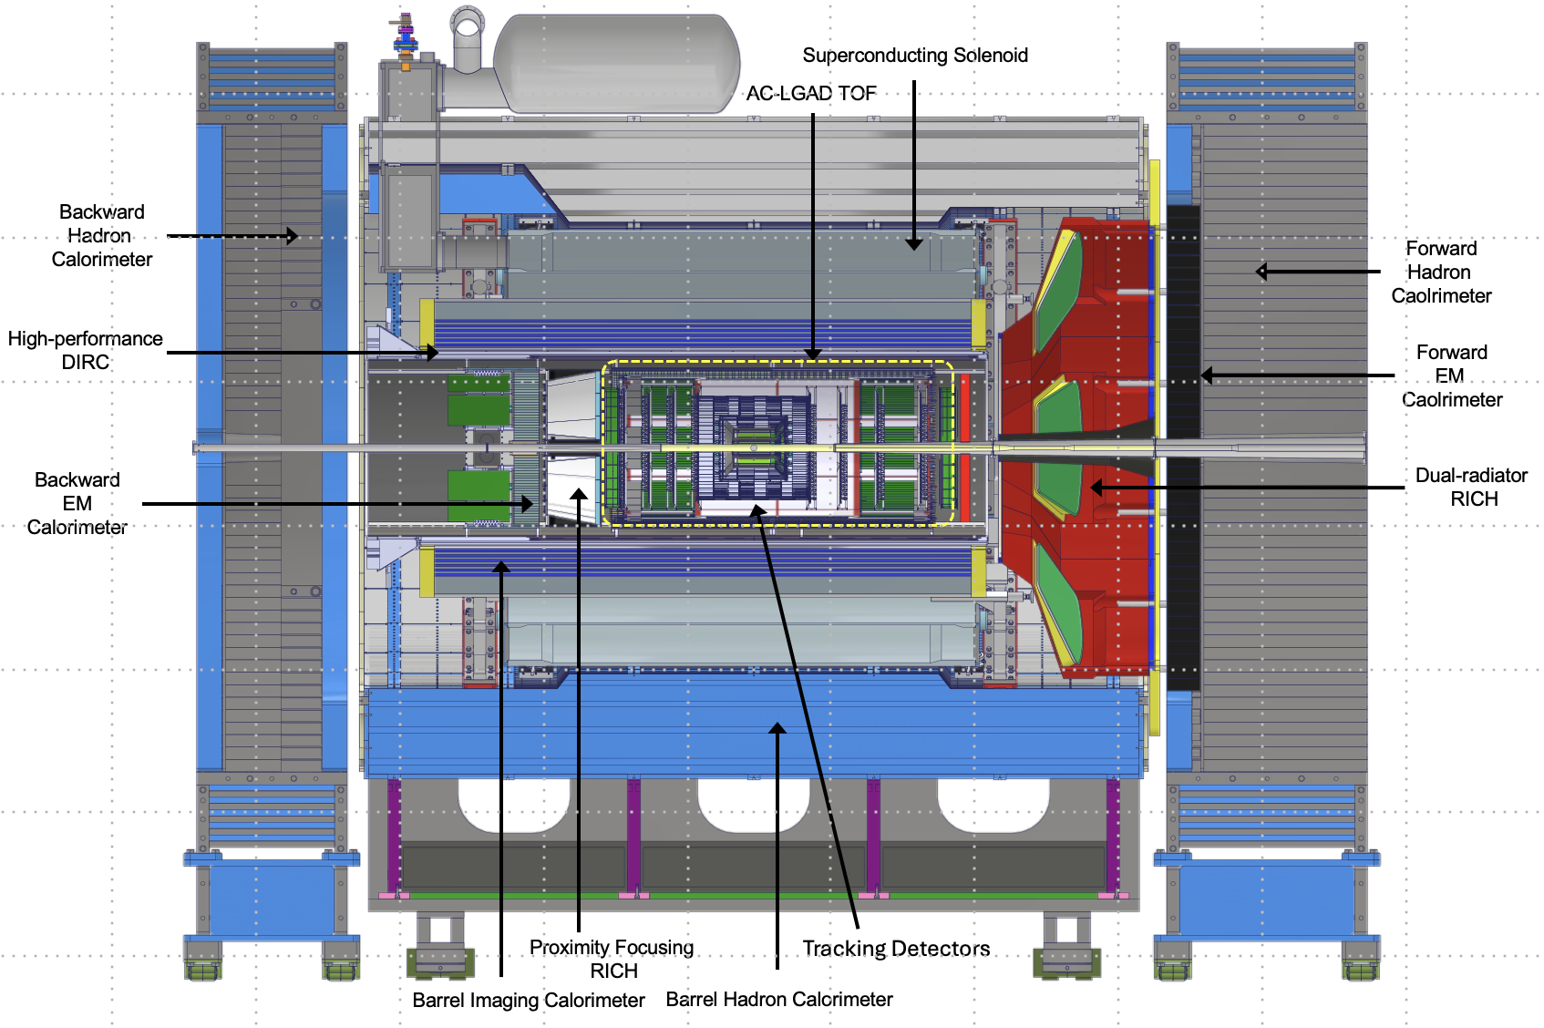
ePIC – The EIC State-of-the-Art General-Purpose Detector
electron beam
Zero Degree Calorimeter
p/A beam
Luminosity
System
Low-Q2 Taggers
B0 Magnet
Spectrometer
Roman Pots (RPs) and
Off-Momentum Detectors (OMDs)
26 subsystems over ± 40 m
to measure particle momenta, energy and particle type
3 electromagnetic calorimeters
3 hadronic calorimeters
Silicon and Multi-pattern gas detectors
3 RICH detector + time-of-flight
7 Auxiliary detectors (Si + HCal + ECals)
electron and hadron polarimetry
Integration, Installation and Infrastructure
Non-Beam Commissioning
Highest scientific flexibility
→ fully streaming readout electronics and data acquisition
→ integration AI/ML capabilities from the start
27

Slide 28
Computing-Detector Integration
Streaming Readout and DAQ:
High-speed data flow: The front-end electronics are designed to support a total bandwidth of up to 50 Tbps, with over 3,000 fiber streams feeding data from the detector to the computing system.
Zero dead time: By avoiding a traditional hardware trigger, the system eliminates dead time and allows for unbiased data collection.
AI and ML in the Data Pipeline:
Intelligent data filtering: AI/ML algorithms can select the most relevant collision events to study.
Real-time feedback: AI can enable rapid detector diagnostics and optimization, with systems capable of automatically calibrating detectors and validating data.
Streaming Computing Model:
Continuous calibration and alignment: Enables rapid delivery of scientific results.
Echelon Model: Organizes resources across the computing hierarchy and enables international contributions.
ePIC event display by Dmitry Romanov

Slide 29
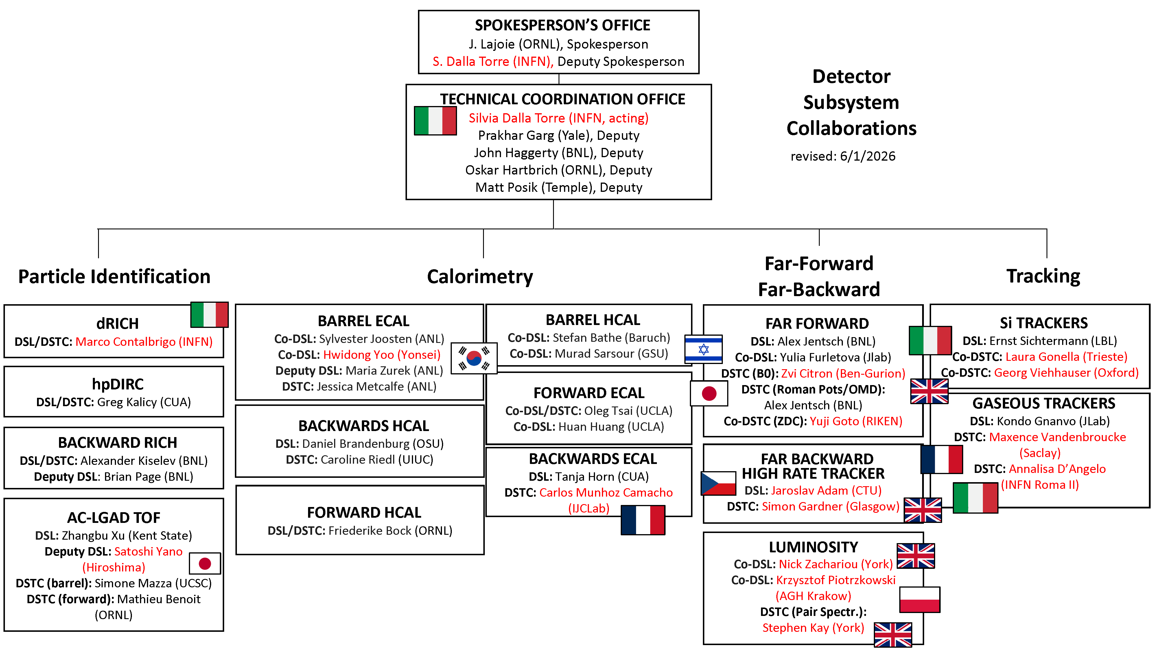
Reminder: ePIC DSC Structure

Slide 30
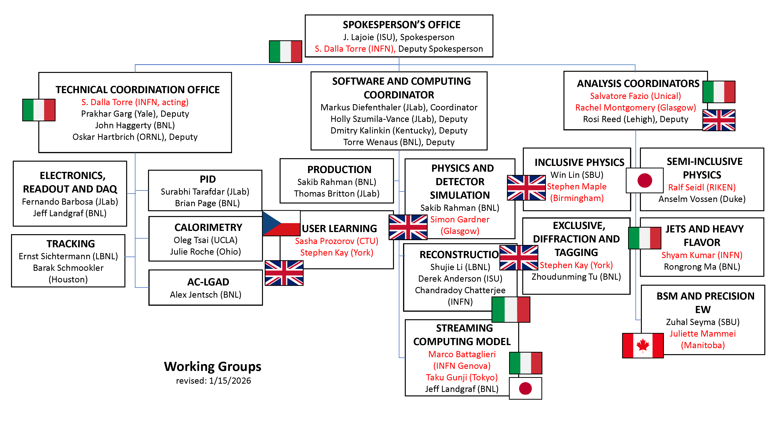
Reminder: ePIC Working Group Structure

Slide 31
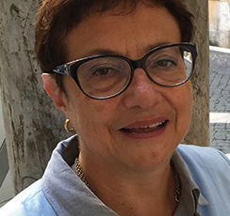


Reminder: ePIC Collaboration Structure
Collaboration Council
Institutional Representatives
Spokesperson’s Office
Spokesperson (SP)
Deputies
EIC Project
Executive Board
Standing Committees
Professional Conduct
Conferences and Talks
Membership
Elections
Publications
Ad-Hoc Committees
Technical Coordination (TC)
Software and Computing Coordination (SCC)
Physics Analysis Coordination
(AC)
Technical Coordinator (Acting)
• Silvia Dalla Torre (INFN)
Deputy TC’s:
Prakhar Garg (Yale)
John Haggerty (BNL)
Oskar Hartbrich (ORNL)
Matt Posik (Temple)
SCC Coordinator
• Markus Diefenthaler (JLab)
Dmitry Kalinkin
(Kentucky, Deputy SCC for Development)
Torre Wenaus
(BNL, Deputy SCC for Infrastructure)
Wouter Deconinck
(U. Manitoba, Deputy SCC for Operations)
Physics Analysis Co-Coordinators
• Rachel Montgomery
(Glasgow)
• Salvatore Fazio
(Univ. Calabria)
Rosi Reed (Deputy, Lehigh)

Slide 32


ePIC Committees
Membership Committee:
Chair: Peter Steinberg (BNL)
Vice-Chair: Pietro Antonioli (INFN-Bologna)
Friederike Bock (ORNL), Helen Caines (Yale), Doug Higinbotham (JLab), Bedhanga Moharty (NISER), Silvia Niccolai (IJCLAB), Marzia Rosati (ISU)
Collaboration Council
Institutional Representatives
Professional Conduct Committee:
Chair: Megan Connors (GSU)
Vice-Chair: Christine Nattrass (UTK)
Francesco Bossù (CEA-Saclay), Wouter Deconinck (University of Manitoba), Narbe Kalantarians (Virginia Union University) , Iris Ponce Pinto (Yale University) , Maya Shimomura (Nara Women’s University) , Allison Zec (University of New Hampshire)
Standing Committees
Professional Conduct
Conferences and Talks
Membership
Elections
Publications
Ad-Hoc Committees
Conferences and Talks:
Chair: Maria Zurek (ANL)
Vice-Chair: Brian Page (BNL)
Barbara Jacak (Berkeley), Daniel Brandenburg (OSU), Dmitry Kalinkin (Kentucky), Nick Zachariou (York), Xuan Li (LANL), Nicola Rubini (Bologna), Wouter Deconinck (Manitoba)
Publications Committee:
Chair: Rene Bellwied (U. Houston)
Vice –Chair: Annalisa Mastroserio (INFN Bari)
Lokesh Kumar (Panjab U.), Michela Chiosso (Torino), Prithwish Tribedy (BNL), Markus Diefenthaler (JLab), Sevil Salur (Rutgers),
ex-officio w. Conferences and Talks Committee:
Daniel Brandenburg (OSU)
Elections Committee:
Chair: Helen Caines (Yale)
Vice-Chair: Ken Barish (UCR)
Past-Chair: John Arrington (LBNL)
Maria Stefaniak (OSU), Domenico Elia (INFN)

Slide 33
Why a NIMA Special Issue?
At the January 2025 collaboration meeting we discussed how to better engage early career scientists in ePIC:
  Need recognition for their efforts
  The recognition that matters is publications …
  However, we are not an experiment with data (yet)
Started discussions with NIM Editors in Feb 2025
  Elsevier expressed an interest in publishing performance studies for the EIC.
  Broadened the discussion to a comprehensive issue on the ePIC detector and its capabilities for EIC science.
  Subsequently added S&C (Streaming Data Model) to the conversation
  Model for this is the NIM Special Issue for RHIC
  Submissions will be peer-reviewed
  Elsevier editors very encouraging

Slide 34
Special Issue Discussions
The contents and format of the special issue are beginning to take shape!
Physics Analysis Coordination Meeting:
  Discussion within the April 14th PAC Meeting:
  https://indico.bnl.gov/event/32328/
  Expecting:
    Early Science Whitepaper, 4 ES papers from the WG’s, BSM+ EW paper
Technical and Integration Council Meeting:
  Discussion within the April 20th TIC Meeting
  https://indico.bnl.gov/event/31905/
  Thoughtful discussion around creating a combined set of subsystem, technology and test beam performance papers.
    e.g. separate EMCal papers, but a common HCAL paper
    Separate ASIC contributions?
Software and Computing:
  Will publish the Streaming Computing Model paper in the NIMA Special Issue
  Dedicated software and simulation paper
SP Office has also invited “outside” contributions:
  EIC polarimetry groups invited to contribute
  In discussions with EPIOS consortium

Slide 35
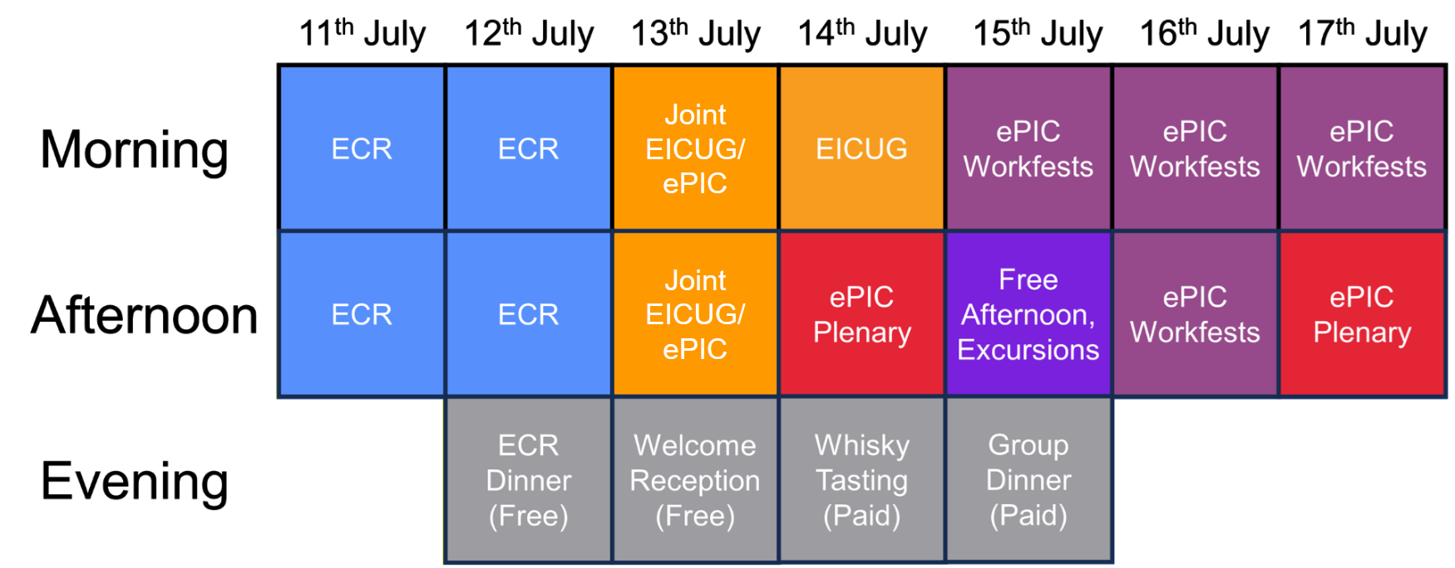
July Collaboration Meeting Block Structure
Working on ePIC plenary and workfest agendas

Slide 36
ePIC Resources
Public Website - https://www.bnl.gov/eic/epic.php
Mailing Lists – https://lists.bnl.gov/mailman/listinfo
Indico Agenda - https://indico.bnl.gov/category/402/
  ePIC Software and Computing: https://indico.bnl.gov/category/435/
Wiki - https://wiki.bnl.gov/EPIC
ePIC Software Training:
  Landing Page: https://eic.github.io/documentation/landingpage.html
  Tutorials: https://eic.github.io/documentation/tutorials.html
Mattermost: https://chat.epic-eic.org
ePIC Zenodo Community: https://zenodo.org/communities/epic

Slide 37
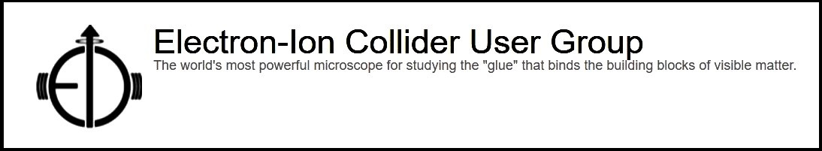

EICUG Membership
The EICUG is a vital organization to promote the interests of the EIC community!
  Without the EICUG we would never have gotten far enough to form ePIC!
Please register your institution!
Check with your EICUG IB representative to get registered as a member
https://www.eicug.org/content/join.html

Slide 38
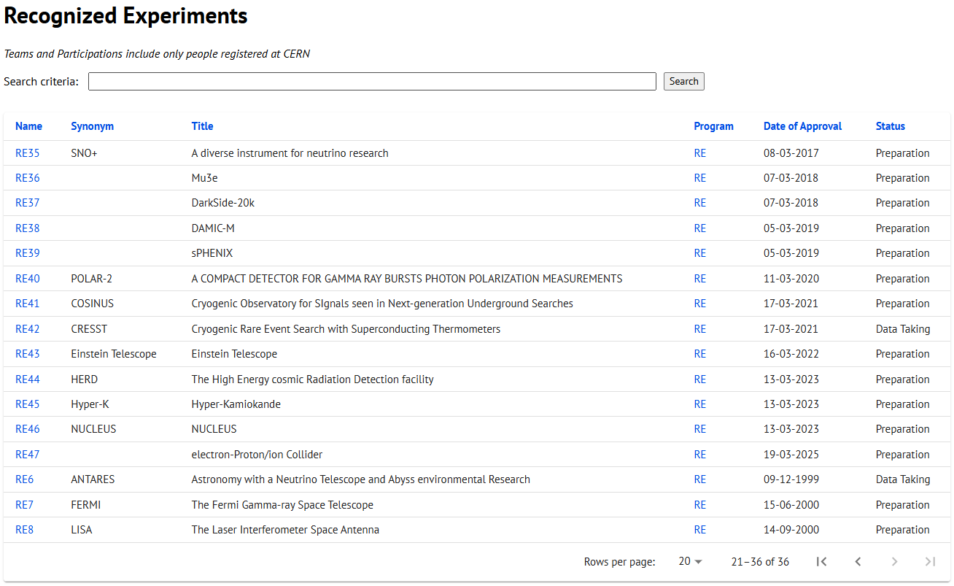
CERN Recognized Experiment Status: RE47
ePIC now appears in the CERN Grey Book database as RE47:
https://greybook.cern.ch/experiment/recognized
Two steps to get ePIC Collaborators registered at CERN:
CC Representative needs to register as team leader with
CERN Users Office:
  https://usersoffice.web.cern.ch/
  https://usersoffice.web.cern.ch/team-leaders-corner
  Users.Office@cern.ch
CC member can then certify registrations of team members
Several ePIC groups successfully registered

