Slide 1


The EIC Computing and Software Joint Institute
Status Report
Alexei Klimentov
aak@bnl.gov
David Lawrence
davidl@jlab.org

Slide 2
The EIC Computing and Software Joint Institute.
Brookhaven National Laboratory and Thomas Jefferson National Accelerator Facility, as Electron-Ion Collider host labs, have established a collaborative entity, the EIC Computing and Software Joint Institute (ECSJI*). The Institute reports to the host Labs and the host Labs delegate functions to ECSJI (for instance, organize SW&Computing reviews)
  This joint institute is designed to support the computing and software needs and activities of the EIC.
  The Institute was created about two and half years ago (fall 2023)
ECSJI leverages complementary expertise at the two labs and provides needed visibility to the respective lab management and stakeholders.
  BNL and JLab’s expertise in computing and software stems from our long-standing involvement in high-energy physics and nuclear physics experiments, as well as our support for other scientific fields such as light sources, materials science and astro-particle physics, both nationally and internationally.
  The advantages of such a structure also include increased reliability and availability of resources for the ePIC collaboration and other future collaborations.
*List of abbreviations and glossary

Slide 3
The EIC Computing and Software Joint Institute. Cont’d
EIC Computing and Software Joint Institute provides for EIC computing and software matters:
1) A single entity to interface with the EIC program and the ePIC collaboration,
2) Maintains Service Level Agreements and statements of work outlining the host labs’ contribution to the ePIC collaboration concerning computing resources, services, and personnel assigned to work on ePIC computing and software deliverables,
3) A coordinating body for interacting with international partners providing computing resources as in-kind contributions. This includes assessing resources, managing the agreements of cooperation with the sites delivering resources (including service level agreements), and facilitating and assessing the delivery against the agreements,
4) Execution of host laboratories responsibilities*
  Assessing resources.
  Managing the agreements with the sites delivering resources (including service level).
  Facilitating and assessing the delivery against the agreements.
The ECSJI scope may evolve over time and the organization of the institute as well
*The Primary Computing Technical Responsibilities of Host Labs

Slide 4
ECSJI Progress and Priorities. Main Tracks Since the Last RRB
  The EIC International Computing Organization (EICO) - together with EICO Working Group
    EICO Boards and Forums
    EIC Computing in Global Context
    ECSJI charter update
  Echelon1 and Echelon2 computing needs
    BNL and JLab Requirements for ePIC/EIC Computing in 2027–2032
  Echelon0 prototype at BNL, planned data challenges and Echelon0-Echelon1 joint tests

Slide 5
ECSJI Progress and Priorities. Planning Dates
Planning Dates (since the last RRB) | 2026
ECSJI talk at ePIC collaboration meeting | January 20
Regular meetings with LHCONE* and ESnet (EIC network infrastructure) | Feb, Apr, May
EIC International Computing Organization annual meeting | May 18-19
Host Labs Responsibilities for collaborative services and tools (technical discussion) | June 17
Data streaming and workflow orchestration Technical Meeting (ESnet, BNL and JLab) | July 30 - 31
Echelon-0 (DAQ) first racks will be installed at the BNL Data Center | End of August
LHCONE-LHCOPN meeting | October 1-2
ECSAC review : ePIC and ECSJI software and computing review at BNL | October 13-14
EIC Computing (Echelon0 and Echelon1) workshop at BNL | October 15
L
*The LHCONE is a dedicated network architecture inter-connecting participating Resource Centre sites and allowing those sites to pool their computing resources for a more efficient distribution, storage, processing and analysis of physics data. Acceptable Use Policy ensures an appropriate secure scientific use of the overlay network and to protect the connected sites. Many EIC sites are LHCONE sites

Slide 6
EIC Computing, DOE Context
DOE OFFICE OF HIGH-ENERGY &
NUCLEAR PHYSICS
Communication
Reporting
EIC Project
ECSJI
ePIC Collaboration
EIC Project
[& EIC Committees]
EIC Computing Council [ECC]
ePIC Spokesperson
BNL NPP ALD, JLab DDST
EIC Computing & Software
Joint Institute [ECSJI]
Computing & Software Advisory Committee
[ECSAC]
Two ECSJI co-directors [nominated by ECC]
Alexei Klimentov (BNL)
David Lawrence* (JLab)
ePIC SW & Computing
Coordination
*)Amber Boehnlein (JLab) stepped down as co-director of ECSJI. David Lawrence (JLab) took over this role on 1 April 2026.
ECSAC charter and members.
v0.3 May 27, 2026

Slide 7





Progress and Priorities. Track 1 : EIC International Computing Organization I
The RRB meetings in 2024/25 discussed international contributions for the EIC's extraordinary computing needs. The EICO charter was approved by the RRB at the November 2025 meeting.
EICO (together with ePIC SW&C and ECSJI) is working on a mechanism for managing contributions at a technical level is the EIC International Computing Organization to include representatives of the organizations that contributing resources
Regular EICO/ECSJI meetings in 2024/26. These meetings are held every two weeks
  The following topics have been discussed :
    Organization of funding for Nuclear and Particle Physics computing at the national level. Funding opportunities
    International partners view and prospects on ePIC/EIC computing. Structure of computing for the EIC and for ePIC within each respective country. Existing support and commitment for EIC computing.
    Echelon1 and Echelon2 roles
    ePIC Streaming Computing Model
    EIC Computing in global context (WLCG, OSG, LHCONE,…)
    EICO boards and forums
    EICO and RRB communication
    Intellectual property
EICO Working Group
W.Deconick
C.Munoz Camacho
F.Bossu, A.Bressan, D.Elia, F.Noferini
T.Gunji
E.Yen
R.W.L.Jones, D.Sokhan
Host Labs and ePIC Reps
A.Boehnlein
M.Diefenthaler, A.Klimentov, D.Lawrence

Slide 8
EIC Computing, International Context
Communication
EIC Resources Review Board
v0.3 May 27, 2026
Reporting
[US National and International Funding Agencies]
EIC Project
ECSJI
Computing Scrutiny Group
ePIC Collaboration
EIC Project
[& EIC Committees]
DOE OFFICE OF HIGH-ENERGY & NUCLEAR PHYSICS
ePIC Spokesperson
EIC Computing Council [ECC]
BNL NPP ALD, JLab DDST
ePIC SW & Computing
Coordination
EIC Computing & Software
Joint Institute [ECSJI]
Computing & Software Advisory Committee
[ECSAC]
Two ECSJI co-directors [nominated by ECC]
Alexei Klimentov (BNL)
David Lawrence* (JLab)
EIC International Computing Organization
[EICO]
*) Amber Boehnlein (JLab) stepped down as co-director of ECSJI.
David Lawrence (JLab) took over this role on 1 April 2026.
ECSAC charter and members

Slide 9
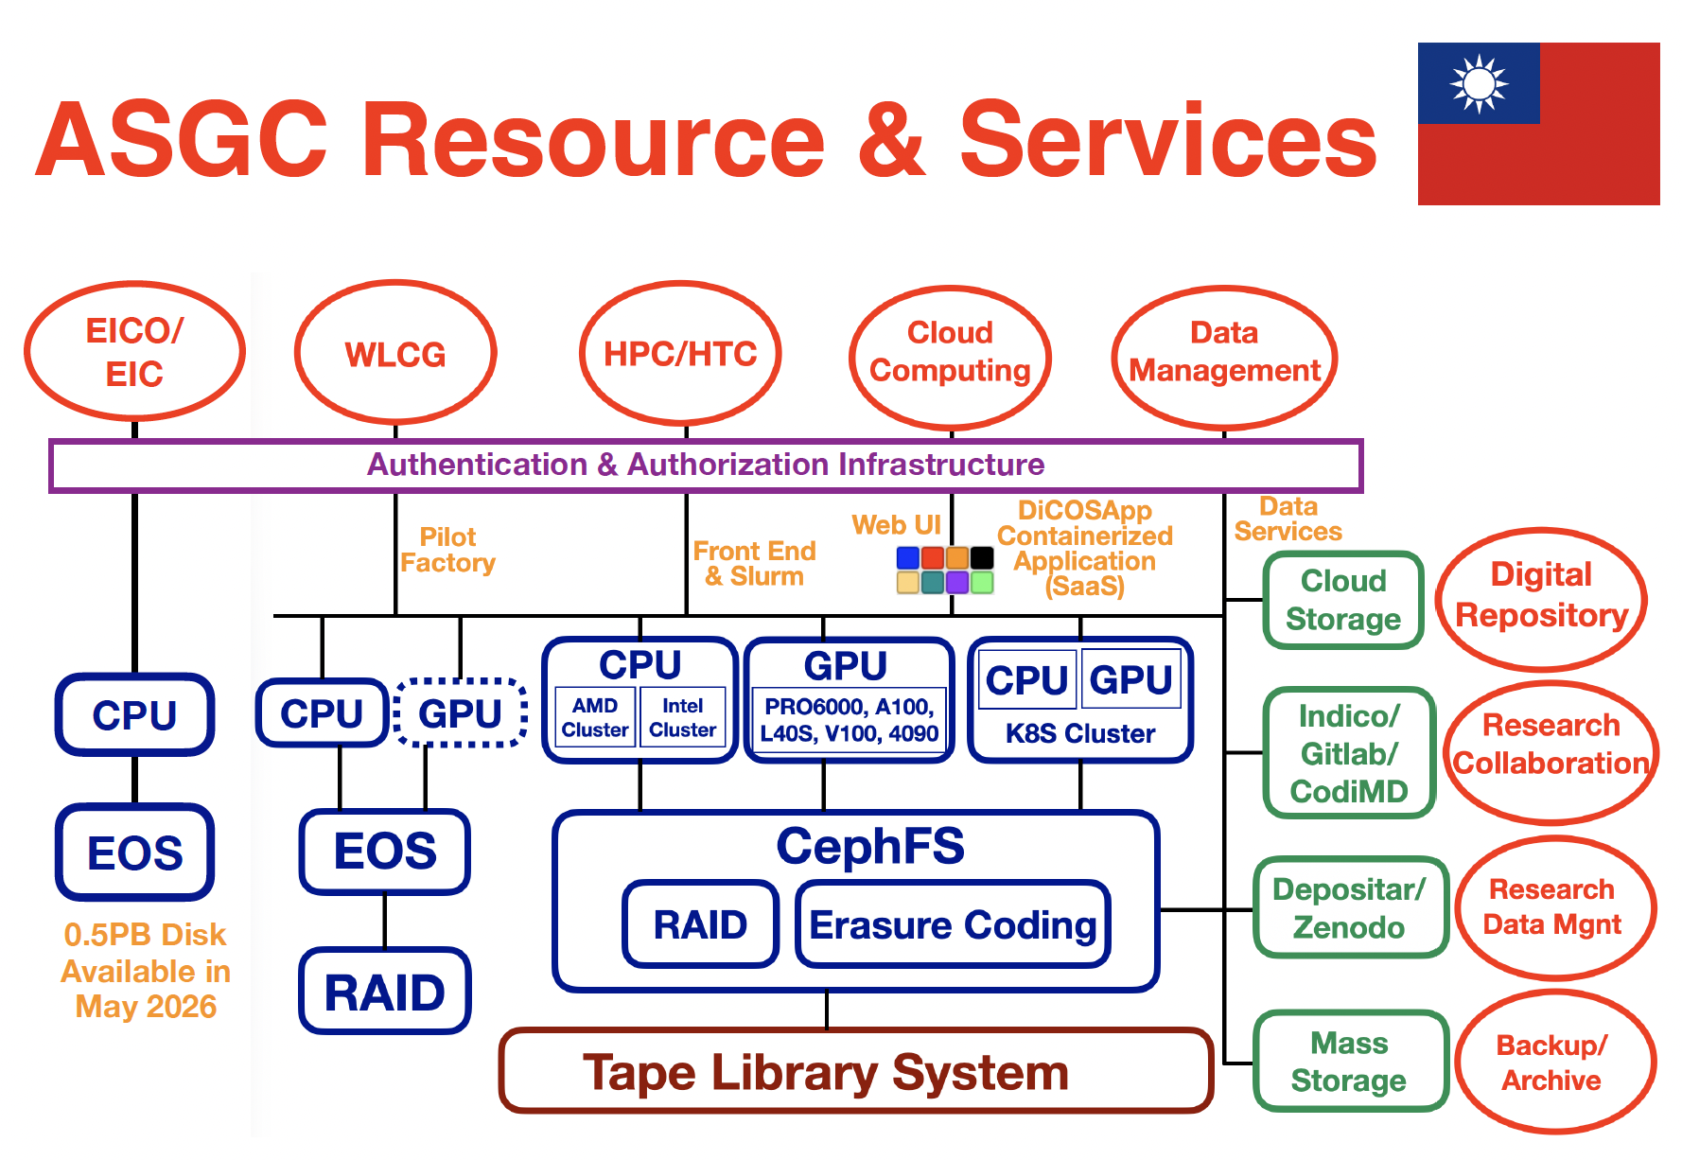
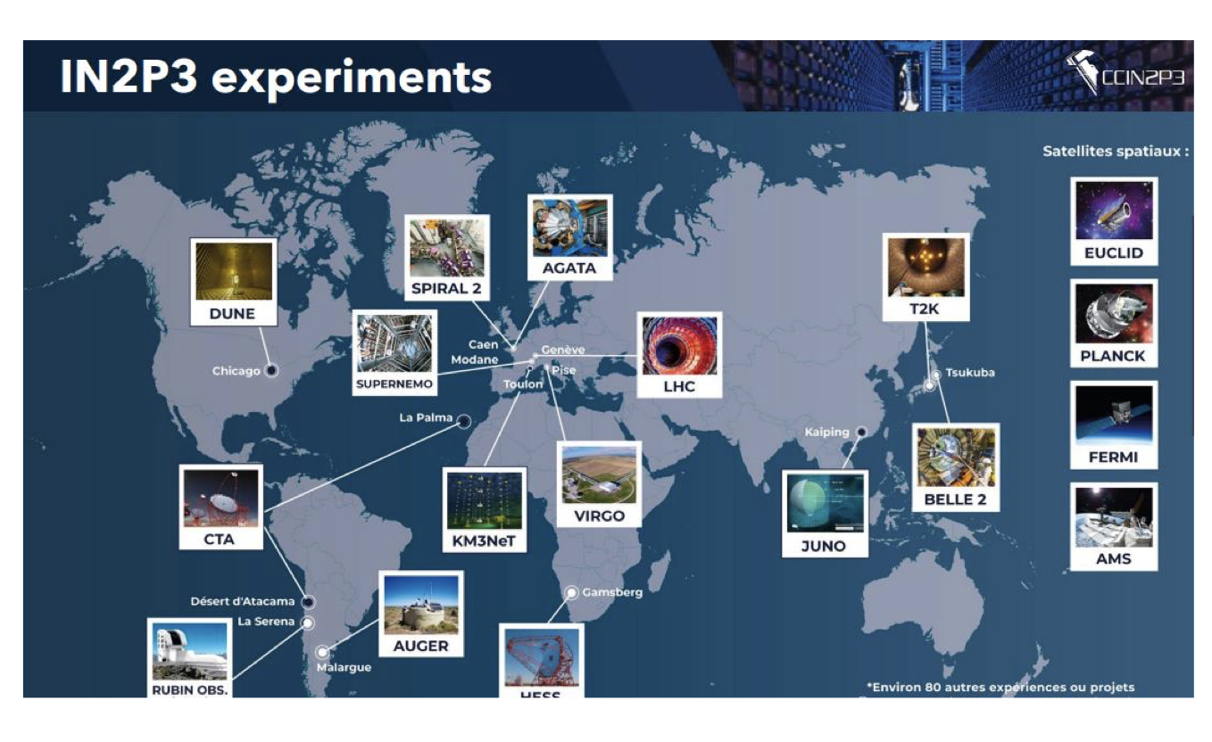
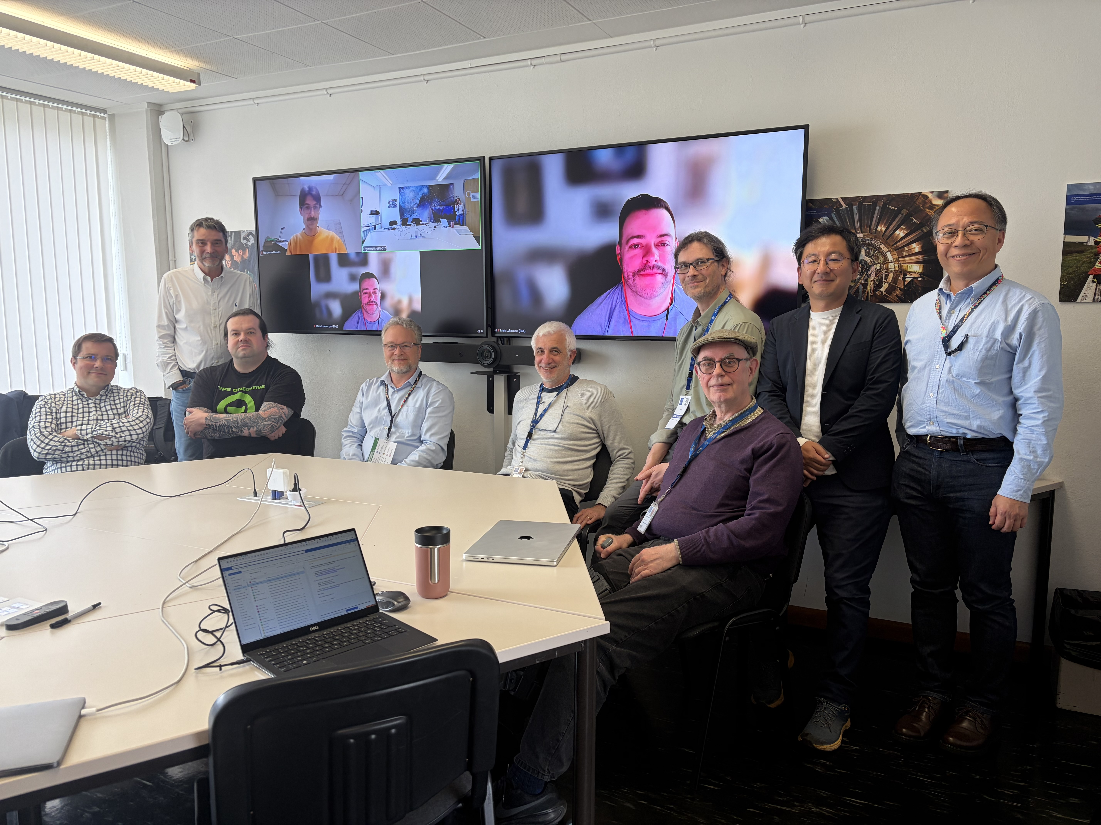

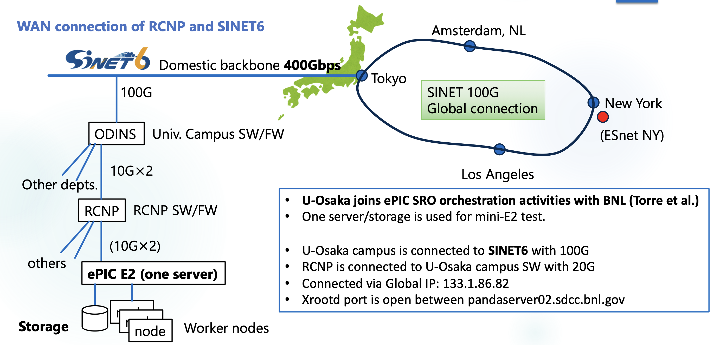
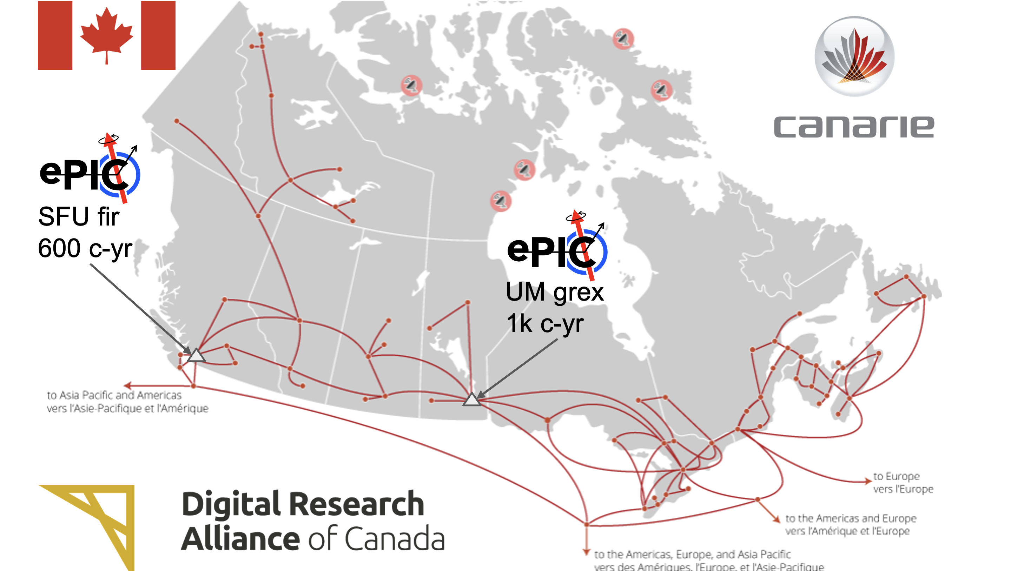
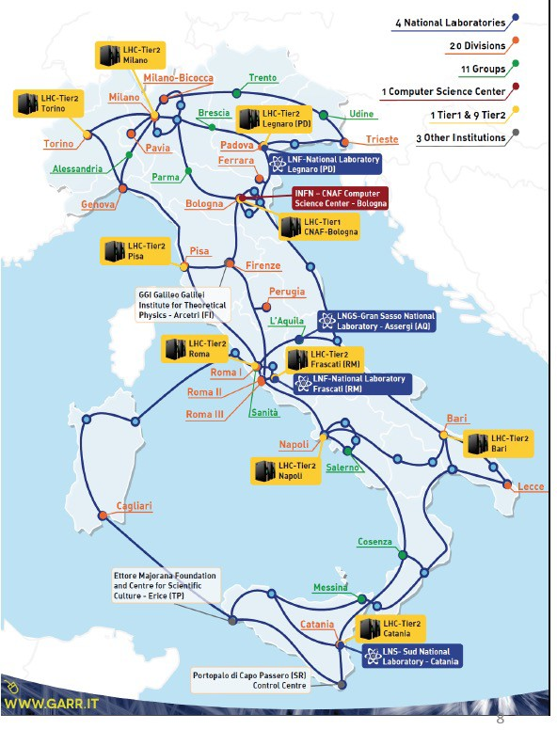
ECSJI & EICO Annual Meeting
May 18-19, 2026

Slide 10

Progress and Priorities. Track 1 : EIC International Computing Organization II
EICO and ECSJI 2026 Annual Meeting at CERN May 18-19, 2026 (agenda, access code EICO@CERN2026)
Meeting highlights and action items
EIC Computing Technical Forum is established. Co-Chairs : F.Noferini (U & INFN Bologna) and A.Panta (JLab)
WLCG Leader (T.Boccali) invited EICO and ePIC to be WLCG associated members
JLab will begin the formal process of transitioning to LHCONE
EICO Overview Board. We will begin forming the EICO OB with the aim of completing it by January 2027. EICO members will hold discussions within EIC national groups and with funding agencies, and will propose one OB member per country.
Six national teams (CA, FR, IT, JP, TW and UK) started (will start) a formal process to request Echelon2 resources funding
  Potential Echelon2 centers are defined, and sites are already in production
  Discussion about Cooperative Agreement (iCRADA)
  Discussion about computing facilities recognition
Joint data challenges will be planned by ECSJI, EICO and ePIC
  EICO members are already participating in many E1 activities
Present Echelon1s computing needs at the June RRB and Echelon2s computing needs at the November RRB
Agenda
ePIC Computing Model
EIC Computing : Echelon1 and Echelon2 needs
International partners view and prospects on ePIC/EIC computing
Meeting with WLCG Leadership Team
EIC Networking (LHCONE and ESnet infrastructure)
EICO evolution : Overview Board composition and EIC Computing Technical Forum
Preparation to EIC RRB in June

Slide 11
Progress and Priorities. Track 2 : Echelon1s computing needs
EIC Computing
Echelon0 computing facilities – funded by the EIC Project
Echelon1 computing facilities – will be funded by EIC Operations
Echelon2 extraordinary computing resources – will be funded by EIC International Computing Organization members
The white paper, 'Estimate of BNL and JLab requirements for the ePIC/EIC computing in 2027-2032’ (A.Boehnlein, M.Diefenthaler, and A.Klimentov), was written in response to the DOE Office of Nuclear Physics' request at the June 2025 EIC RRB meeting.

Slide 12

Progress and Priorities. Track 2 : Echelon1s computing needs. Motivation
The computing request covers the period between 01/01/2027 until 12/31/2032. Computing procurement and deployment are aligned with the overall EIC Project schedule and the associated timelines for the development and deployment of the ePIC DAQ, Echelon1 computing, and AI components (and to have computing and SW compatible with Genesis mission [and AmSC]).
There are needs for ePIC/EIC computing in 2026-2029
  ePIC detector and physics performance studies for pre-TDR and Early Science report.
  Accelerator and beam-induced background studies
  EIC machine protection simulation (FLUKA)
  Simulations related to radiation studies
  DAQ data challenges and data streaming prototyping
  Data management and workload management services deployment and operations
  Development of the Echelon 0-1 Interface and related prototyping
Jun-2025 | Oct-2025 | 10/28/2025 | Nov-Dec 2025 | 01/20/2026 | May-2026
Request for paper (EIC RRB) | The first draft was ready | The draft was sent to Paul Mantica and his comments were addressed | The draft was discussed in detail at various meetings: ECSAC SW&Computing review EIC collider team ePIC/EIC workshop R.Ent & E.Aschenauer BNL ALD & JLab DDST. | The draft was presented at the ePIC collaboration plenary session and discussed with Echelon0 Leaders | The draft was shared with the EICO Working Group and Discussed at EICO Annual Meeting

Slide 13
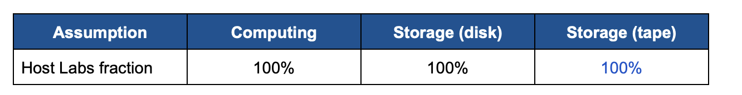
Estimate of BNL and JLab requirements for the ePIC/EIC computing in 2027-2032.
Inputs and Assumptions
The estimates are based on the most recent version of the ePIC Streaming Computing Model Report, it is assumed that in 2034 the EIC will operate at 10% of its expected maximum luminosity of approximately 10³⁴ cm⁻²s⁻¹
To estimate host labs contributions, we assume their share is based on the following allocation fractions for the first year of running
It is further assumed that Echelon 1 computing facilities will be sufficient to perform prompt and full processing of ePIC data at the EIC startup. This aligns with the expectation that two data replicas will be archived at BNL and JLab and Echelon 2 sites will not be fully operational by 2034.
We assume a typical 99% of uptime for the Echelon1 computing resources.
A common 5-year replacement cycle is assumed for computing and storage servers. Equipment can be purchased with longer warranty (at a cost) and can also be operated out-of-warrant (at a risk).
Final assumption: The final assumption concerns the EIC schedule. The execution of the current request will cover the period between 01/01/2027 until 12/31/2032. Computing procurement and deployment are aligned with the overall EIC Project schedule and the associated timelines for the development and deployment of the ePIC DAQ, computing, and AI components.

Slide 14
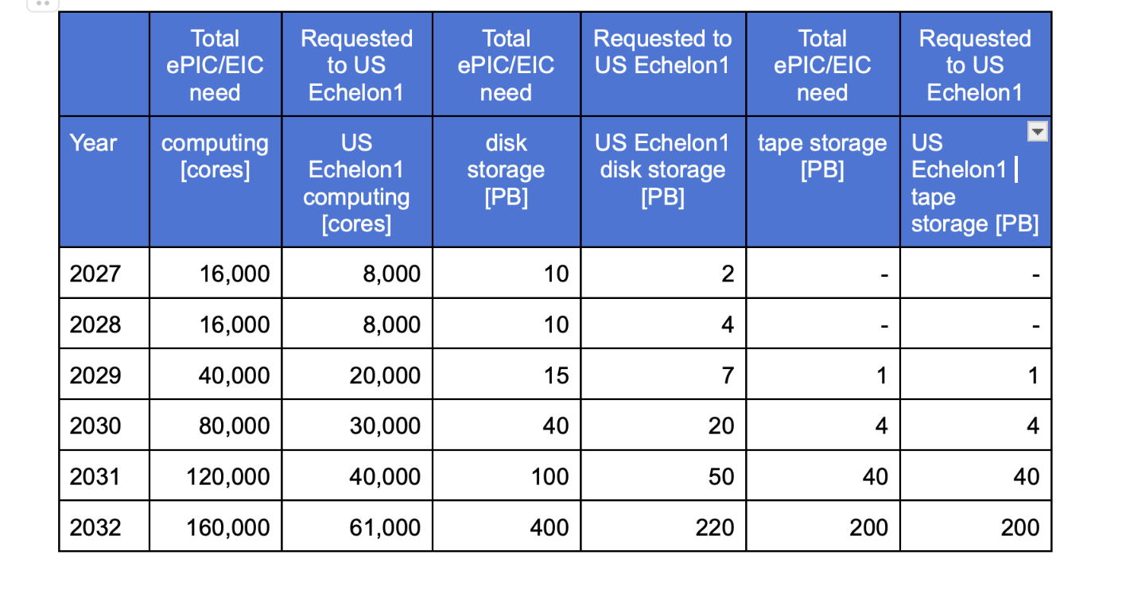
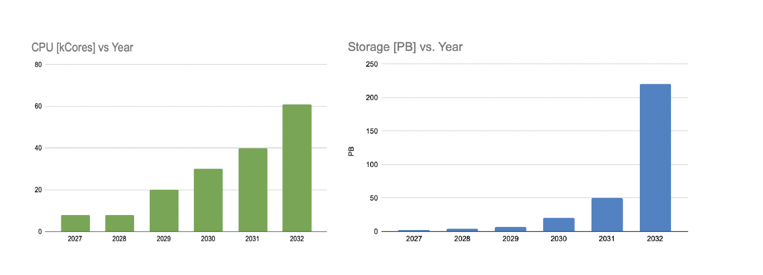
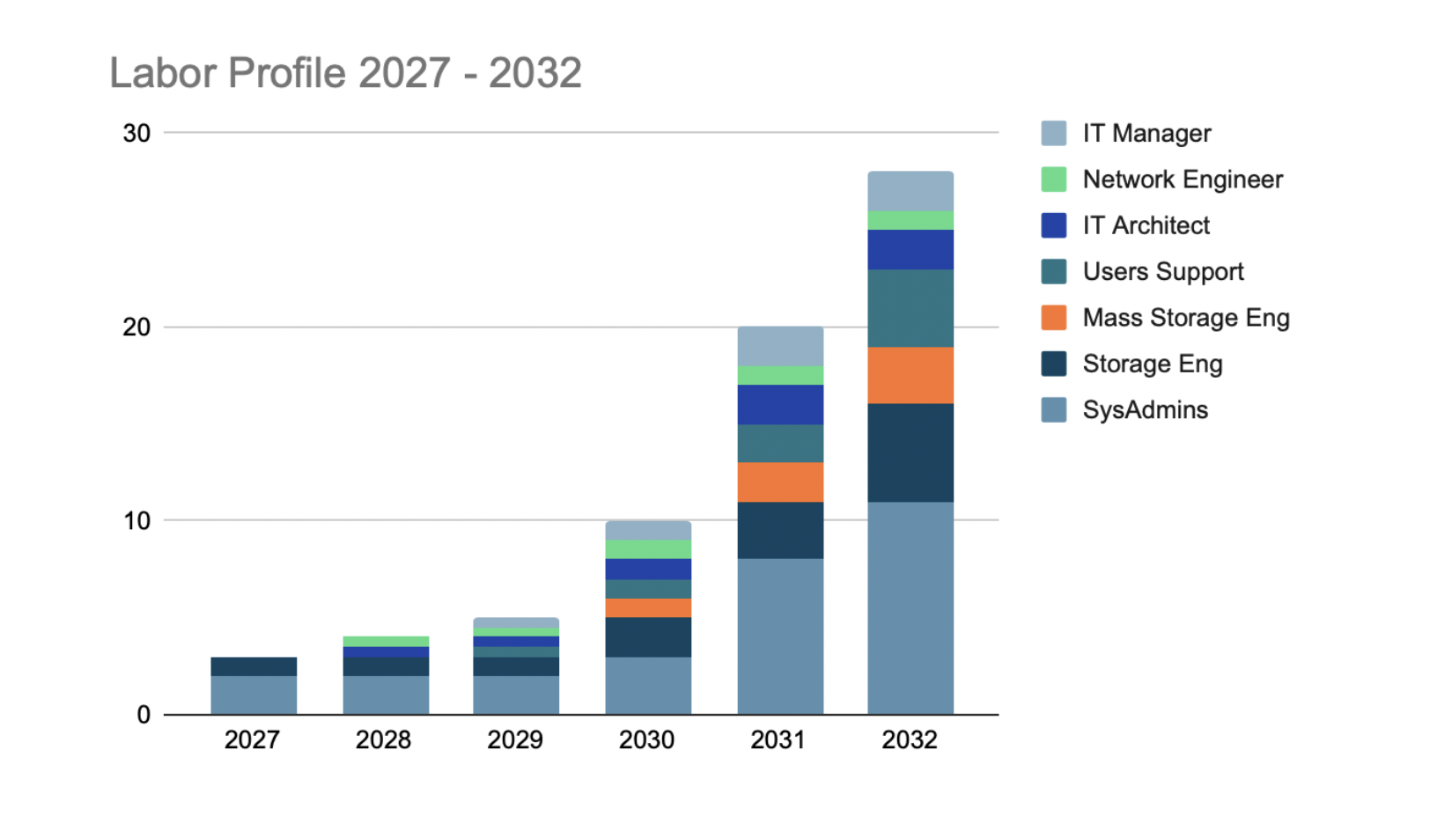
ePIC/EIC growth of computing needs at BNL and JLab [2027-2029]
CPU and Storage Estimates 2027-2032
There is a gap in the funding of IT resources between the EIC project and EIC operations, and the DOE’s OHENP is aware of this. According to DOE OHENP it is necessary that the laboratories prioritize their allocation of facility operations funds to address this gap
The computing requirements of the host laboratories appear reasonable, and the DOE (in collaboration with BNL and JLab) is working on how IT costs for the period 2027–2029 could be incorporated into the EIC portfolio.
The DOE does not foresee any fundamental issues regarding Echelon 1 funding from the CY2027 onwards. However, EIC compute needs will have to be addressed within the constraints that the program has shared with the laboratory leadership
CPU and Storage profiles 2027-2032
4 FTE
5 FTE
3 FTE

Slide 15
Progress and Priorities. Track 2 : Echelon1s computing needs. Summary
There is a request for dedicated ePIC and EIC project (collider) computing resources (compute, storage, tape, operational support) at both labs today.
  EIC project storage needs are small for the next 2-3 years, but CPU needs are a few-1000 CPU x86 (cores), as compared to core needs for EIC/ePIC streaming and data challenges and stress tests (8000, 8000 and 20000 cores, for US Echelon-1 in 2027, 2028 and 2029, resp.)
  The ePIC simulation requires significant CPU resources and growing storage capacity, some of which could be opportunistic or EICO resources. However, there is no opportunistic storage, This requires dedicated storage resources from host laboratories and international partners.
There are DAQ (Echelon0) plans for early prototyping starting from summer 2026.
BNL and JLab work on the plan to bridge the gap in computing in 2027-2029
We believe that we should start the early deployment of computing facilities at both labs in CY27, ramping up slowly (depending on the EIC schedule). The slower ramp-up of computing needs in the period of 2027-2029 may need to be bridged while DOE support for computing needs to ensure later Echelon-1 readiness for outyears is secured and while the team strives to be ready to run the host labs' facilities (including the new generation of leaders).

Slide 16
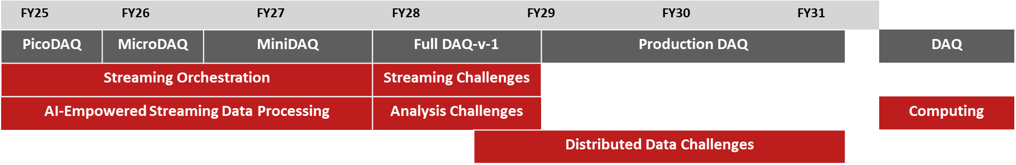
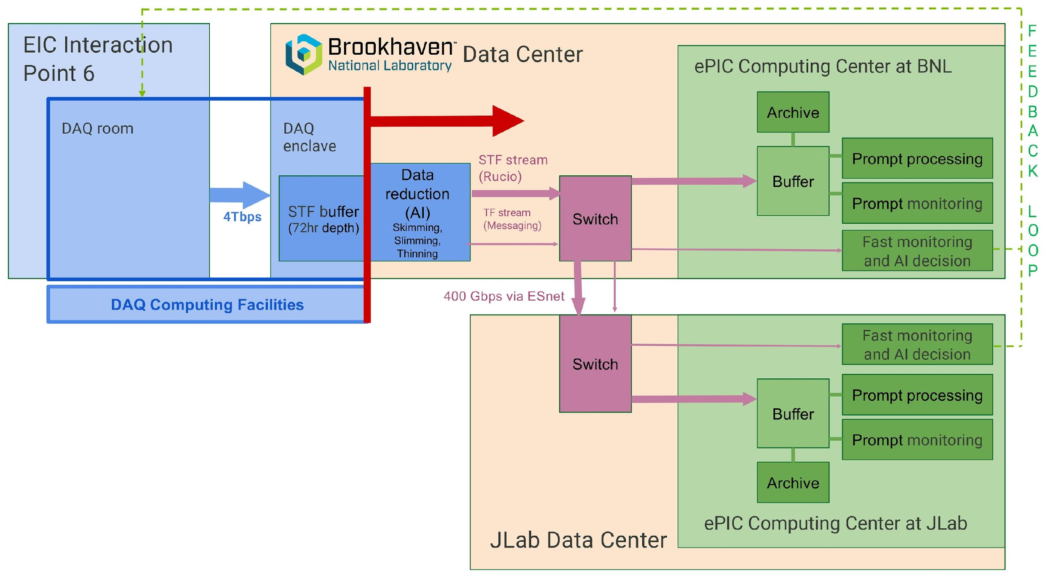
Progress and Priorities. Track 3 : Echelon0 planned data challenges and Echelon0-Echelon1 joint tests
Compute-Detector Integration:
  Joint deliverables between DAQ (Echelon-0) and computing (Echelons-1) to develop integrated systems for detector readout, data processing, and ultimately physics analysis.
DAQ is planning to install the first DAQ Enclave prototype at BNL Data Center in Aug-Sep 2026
ePIC streaming orchestration testbed prototype at BNL should be available for Echelon0-Echelon1 tests by September 2026
Mini-Data Challenges between BNL and JLab will begin in the fall of 2026 (together with ESnet)
MiniDAQ available in FY27, work ongoing on streaming orchestrations
First version Full DAQ available in FY28/FY29, Streaming and Analysis Challenges required
Production DAQ available in FY29/FY30, Initiate Distributed Data Challenges
Data transfer (STF, Rucio Data Management)
Data streaming (TF)
Messaging (anomaly detection and Health&Status)
Data Orchestration and Data streaming
testbeds/demos scope is right of the red line.
Also part of AmSC demos (BNL and JLab lead them)

Slide 17
Summary
The EIC Computing and Software Joint (BNL and JLab) Institute is working in close collaboration with the EIC, ePIC SW&Computing and International Computing groups. The importance of the Joint Institute for EIC computing was acknowledged by the EIC Computing and Software Advisory Committee, EIC project and ePIC.
The EIC International Computing Organization is progressing rapidly. The next step will be to establish closer collaboration with the WLCG and the LHCONE (ESnet)
  An EICO Overview Board and an EIC Computing Technical Forum will be formed this year
  Draft version of Cooperation Agreement will be developed by EICO working group
The main priority for 2026/27 is to set up the Echelon 1 prototype in the host laboratories, in order to support the EIC Project and ePIC activities, including first data challenges with Echelon 0.

Slide 18
Acknowledgments
This talk drew on materials, discussions, comments, input from many. Thanks to all, including those we’ve missed…
  EICO working group : F.Bossu, A.Bressan, W.Deconick, D.Elia, T.Gunji, R.W.L.Jones, C.Munoz Camacho, F.Noferini, D.Sokhan, E.Yen
  ePIC collaboration : S. Dalla Torre, M.Diefenthaler, J.Lajoie, T.Wenaus
  BNL and JLab colleagues : E.Aschenauer, A.Boehnlein, D.Dean, A.Deshpande, J.Dunlop, J.Elmsheuser, R.Ent, B.Sawatsky
  DOE OHENP : P.Mantica

Slide 19
Glossary and Abbreviations
AHM – All Hands Meeting
ALD – Associated Laboratory Director
AmSC – American Science Cloud DOE project
CM – Computing Model
CRADA - A Cooperative Research and Development Agreement
DDST – Deputy Director for Science and Technology
E0, E1, E2 – Echelon0, 1, 2 sites according to ePIC computing model
ECC - EIC Computing Council
ECSAC – EIC Computing and Software Advisory Committee
EICO – EIC International Computing Organization
ECSJI – EIC Software and Computing Joint Institute
IKC – in-kind contribution
LHCONE – LHC centers dedicated network
MB – Management Board
NPP – Nuclear and Particle Physics
OB – Overview Board
OHENP – DOE Office of High-Energy & Nuclear Physics
OSG - Open Science Grid (NSF supported computing consortium)
RRB – Resource Review Board
SLA – Service Level Agreement
SW&C – Software and Computing
TF – Technical Forum
TIM – Technical Interchange Meeting
WLCG – World LHC Computing Grid

Slide 20
Supplementary slides

Slide 21
The Primary Computing Technical Responsibilities of Host Labs
Oversight for ePIC distributed software and computing designs and execution to provide assurance functions for the host labs and DOE.
Provisioning and operating standard infrastructure solutions consistent with supported lab infrastructures and community best practices.
Support for the EIC International Computing Organization.
Interface for local resources and policies at the respective labs.
On-going computing operations in support of the accelerator and detector design and construction.
Operational support functions for:
Experimental data curation.
First-pass processing.
Data analysis.
Support of collaboration(s) and users.
Accelerator and detector simulations .
ECSJI charter, May 2026

Slide 22
EIC Computing and Software Advisory Committee
Computing and Software Advisory Committee (ECSAC)
  The ECSAC is chartered to propose advice, guidance, and counsel on the strategy and objectives of the Institute and of the EIC International Computing Organization.
  ECSAC has members from US Laboratories, US Universities and International Laboratories (CERN, GSI, PIC)
2026 ECSAC members
  Mohammad Al-Turany (GSI)
  Ilya Baldin (JLab)
  Simone Campana (CERN, chair)
  Mario Cromaz (LBNL)
  Nicholas D'Imperio (BNL)
  Verena Martinez Outschoorn (UMass Amherst)
  Pere Mato (PIC)
  Wei Yang (SLAC)
  Ex-Officio
  Alexei Klimentov (BNL)
  David Lawrence (JLab)

Slide 23
Major Elements from the EICO Charter
EIC International Computing Organization is led by the Institute's co-directors and administered by the ECSJI. This organization exists to provide computing resources, infrastructure, and services related to the EIC. The current focus is on the ePIC experiment. This will be extended to other foci as endorsed by the EIC RRB. Funding agencies will indicate the activities and services they will provide, and this will be approved by RRB. The EICO structure is formally documented in this charter.
EICO Overview Board. The Overview Board (OB) oversees the functioning of the EICO. It is composed of a representative of each Institution that is a member of the EICO, the ECSJI directors and the Spokesperson(s) of each EIC Experiment with voting rights. The OB is co-chaired by EIC Computing Council Members (or one of ECSJI directors), which include a member of the OB appointed as a co-chair.
  OB approves the report that details the accomplishments of the EICO, and the individual site metrics outlined in the cooperation agreement.
  The OB has the responsibility to manage external relationships with partner organizations, such as WLCG
  The OB also provides a resolution path for institutional issues relative to the cooperation agreement .

Slide 24
Major Elements from the EICO Charter. EICO Technical Forum
EICO Technical Forum : The Technical Forum (TF) is part of the EICO and represents in particular the computing centers (including Echelon 1 centers). The TF has several roles, including:
  to exchange information;
  to act as a forum for technical discussions and planning, including schedules, resources utilization and technical solutions, challenges and requirements;
  to organize technical discussions related to production system and middleware, etc and make proposals to the MB;
  discuss technical roadmap for the evolution of EIC facilities and services;
The TF meetings are open to all interested members of the EIC computing.
Other parties may be invited for topical discussions.
The TF chairperson is appointed by MB for a two-year period.
Extension is possible with full concurrence of OB. The TF reports to the MB.
The chair of the TF is an ex officio member of the EICO Management Board.
The TF may start and stop working groups when needed to address technical issues.
TF shall provide regular (bi-monthly) updates on its activity to MB.

Slide 25
Estimate of BNL and JLab requirements for the ePIC/EIC computing in 2027-2032.
Risks
Risk 1: Given the large increase in computing and storage needs just prior to the start of the
EIC Operations, additional schedule delays may modify the amount of funds needed in this 6-year
request.
Risk 2: We assume a 10% and 5% reduction per year in the computing cost per kHS and in the disk storage per PB. External factors like supply-chain interruptions, exchange rates, and additional costs due to importing tariffs (or high demand on storage and compute) may have a large impact on the assumption of cost reduction per year. Changes in architecture (eg, GPU and FPGA computing, or NVMe storage) can also have an impact on the cost.

