Slide 1
Update on ePIC & EIC-UG Outreach WG
E.C. Aschenauer for the EIC-UG/ePIC Outreach WG
^{7th} EIC RRB Meeting, MEXT, Tokyo
June 9th – 10th, 2026

Slide 2
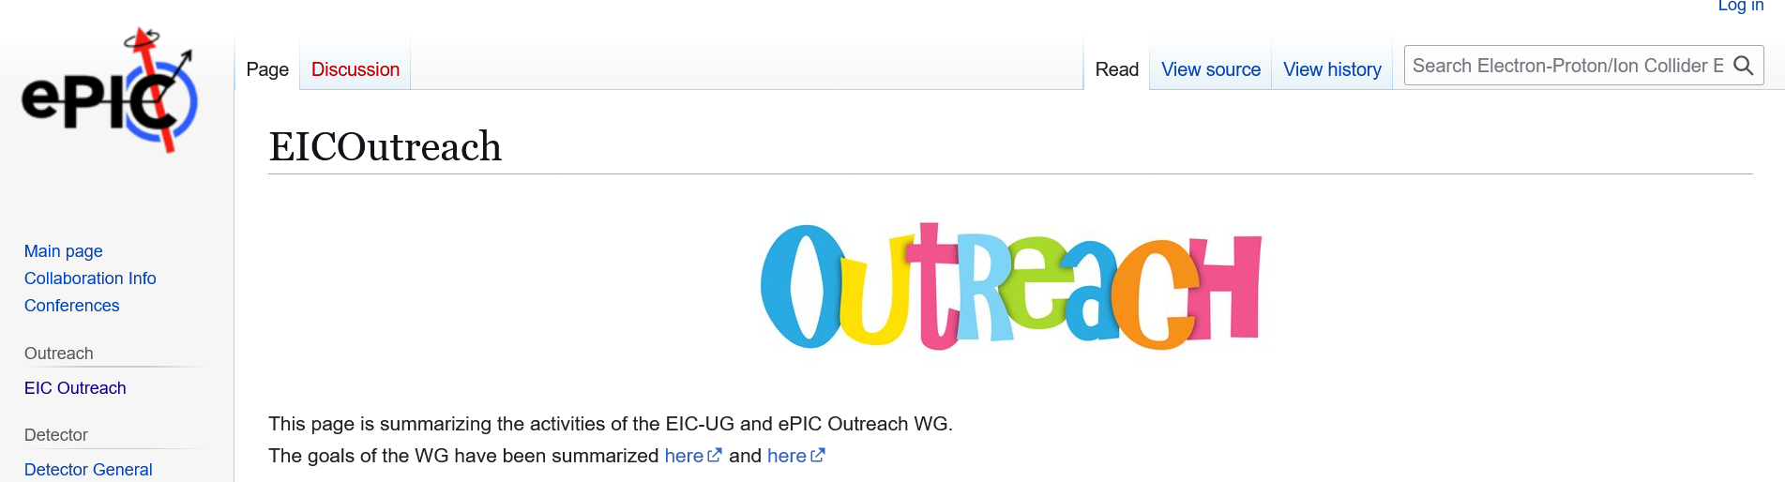
General Info
WG Members:
  Armenia: Dr. Hrachya Marukyan
  Czech Republic: Prof. Jana Bielcikova
  France: Dr. Silvia Niccolai
  India: Prof. Md Nasim
  Israel: Prof. Zvi Citron
  Italy: Prof. Marta Ruspa
  Dr. Anna Maragno
  Japan: Dr. Masashai Kaneta
  Senegal Dr. Sokhna Bineta Amar
  Taiwan: Prof. Yi Yang
  UK: Prof. Rachel Montgomery
  USA: Elke-Caroline Aschenauer\
  Amber Aponte
  and several early career members
Email-list: eic-outreach-wg@lists.bnl.gov
Regular Meeting: Biweekly Wednesdays
8:15 am NY-Time
Wiki-Page: https://wiki.bnl.gov/EPIC/index.php?title=EICOutreach
Everybody is welcome to the meetings, helping with activities

Slide 3
The Global Goals of the WG
Expand EIC experimental community
Built up a STEM pipeline
Provide opportunities for early career scientist especially from developing countries
Develop a truly diverse workforce
Make the EIC a real international facility
Spread EIC science to general public

Slide 4
Examples of Activities in different Countries

Slide 5
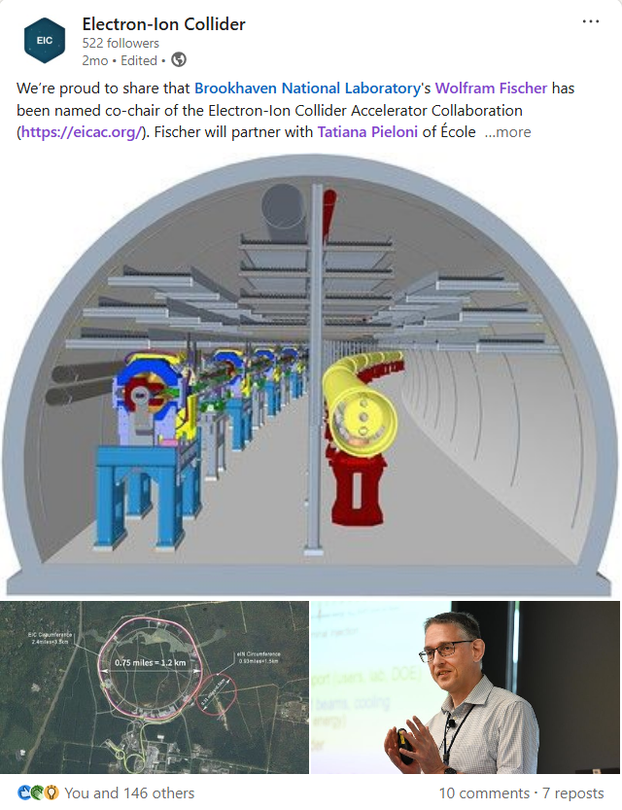
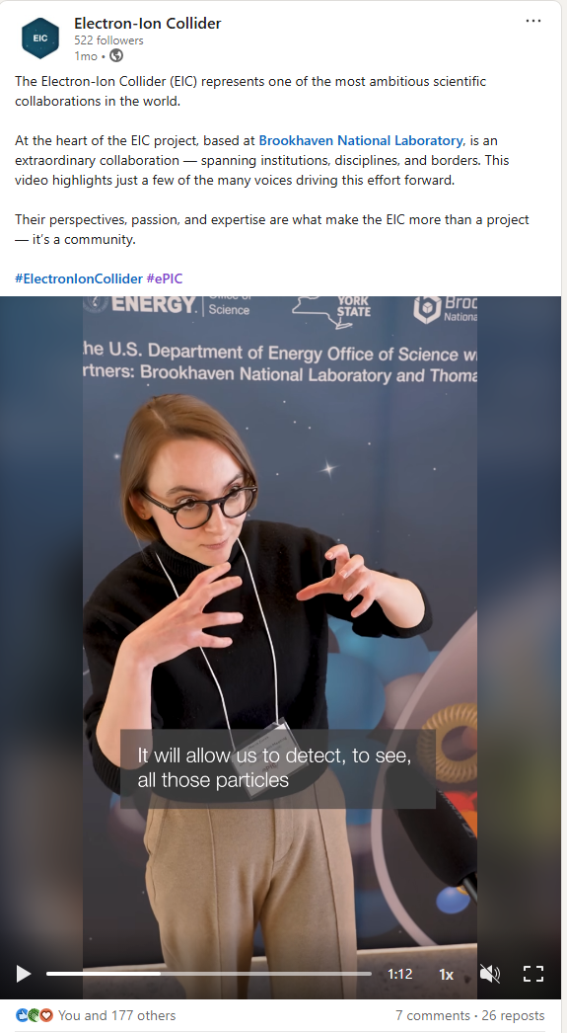
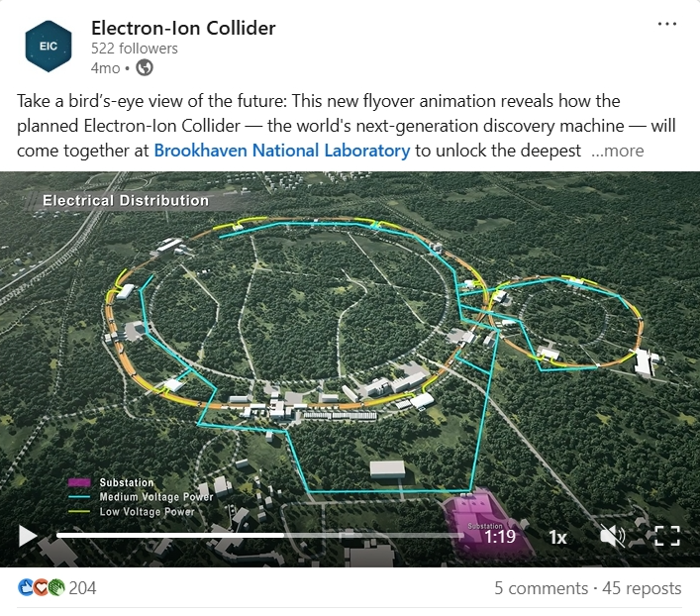
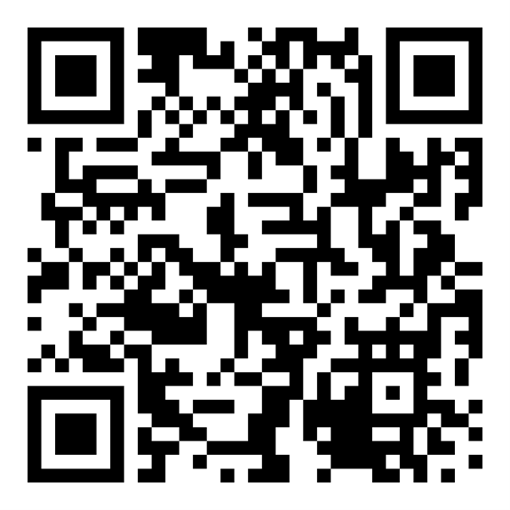
BNL EIC LinkedIn
Official page for the project, launched January 2026
Latest developments
Project milestones
Staff profiles
Leadership spotlight
Technological advancements
Partnerships and collaborations
Multi-media
Authentic

Slide 6
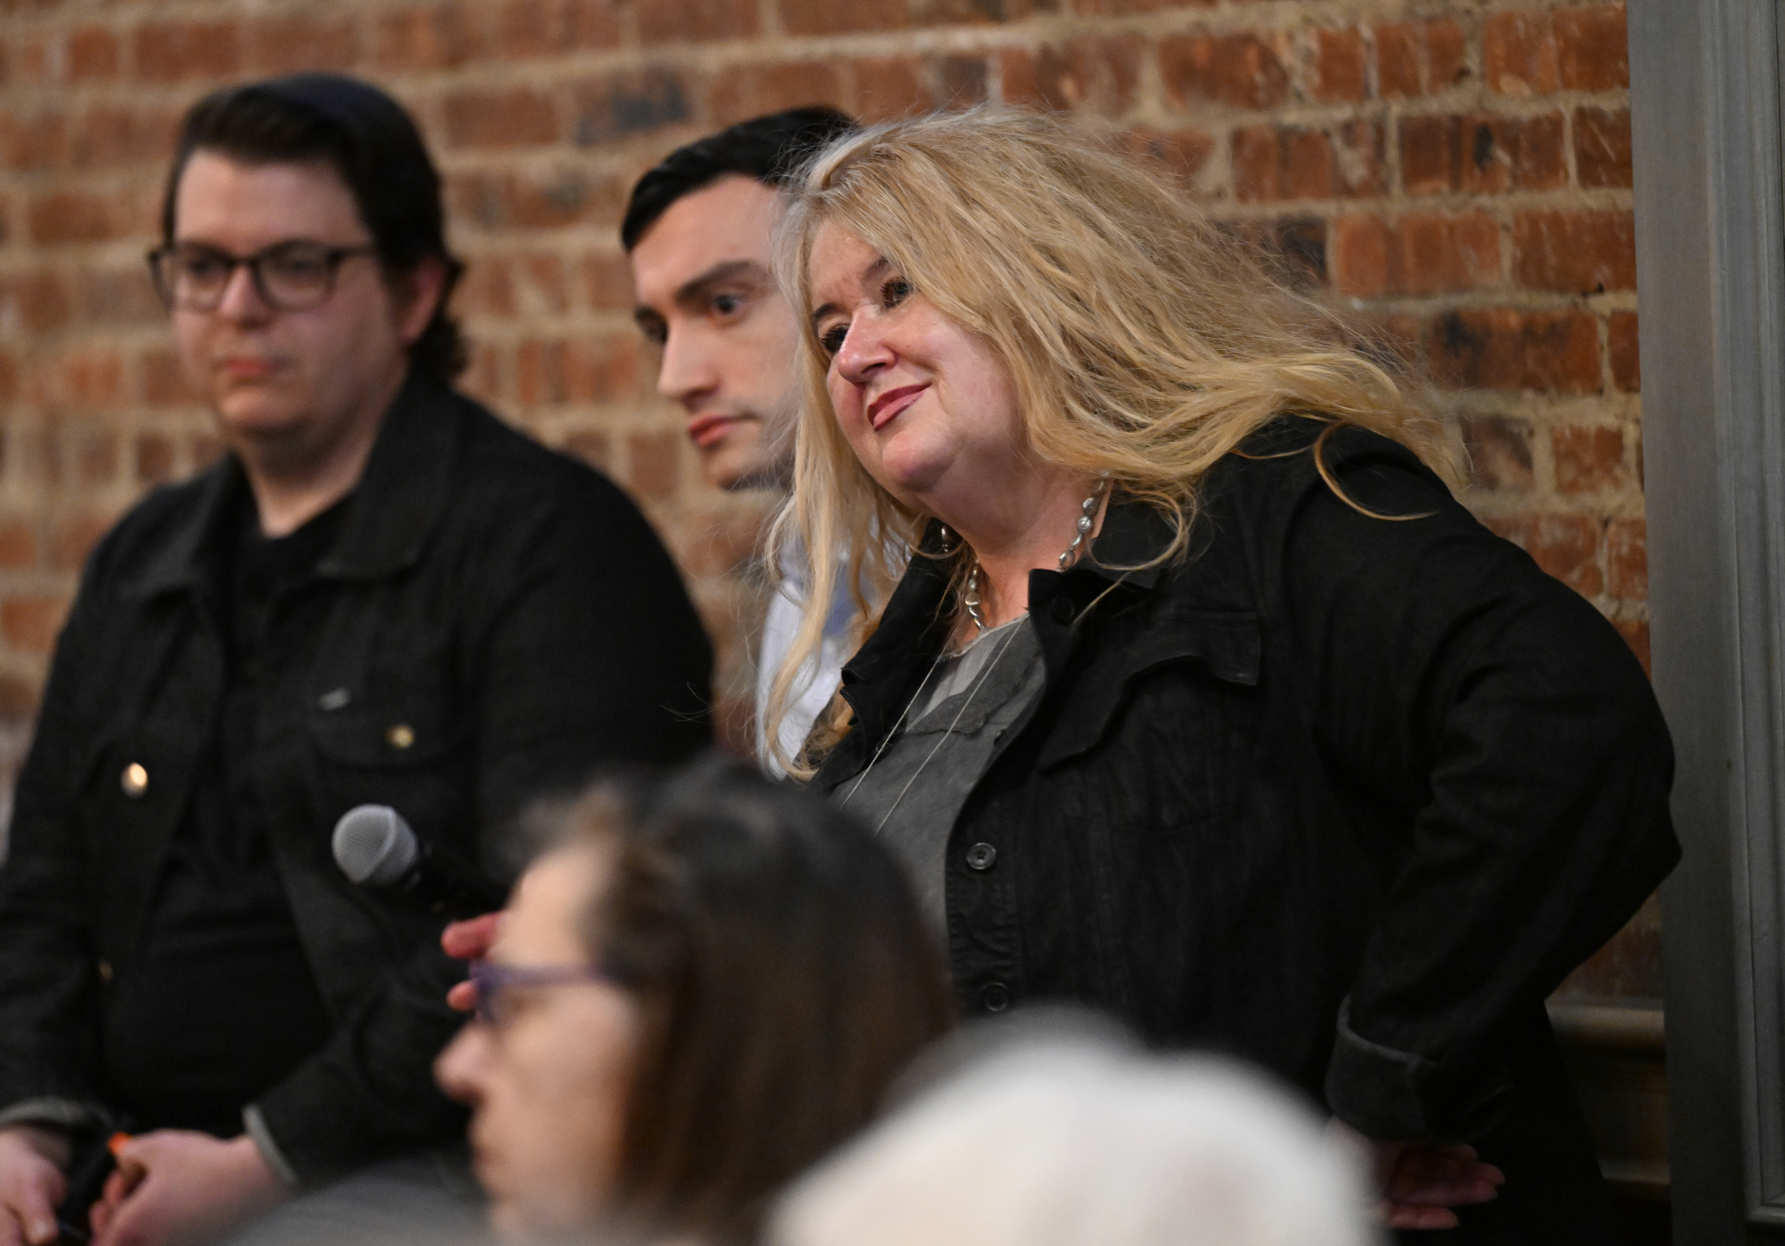
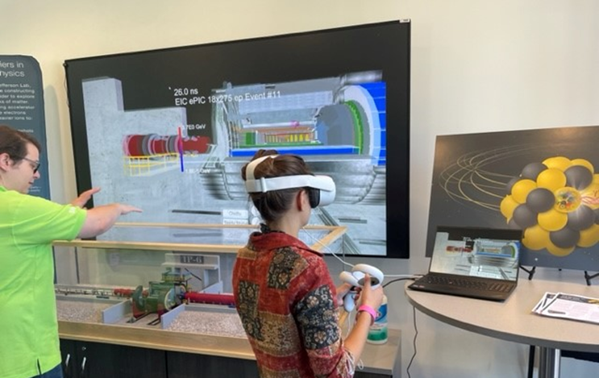
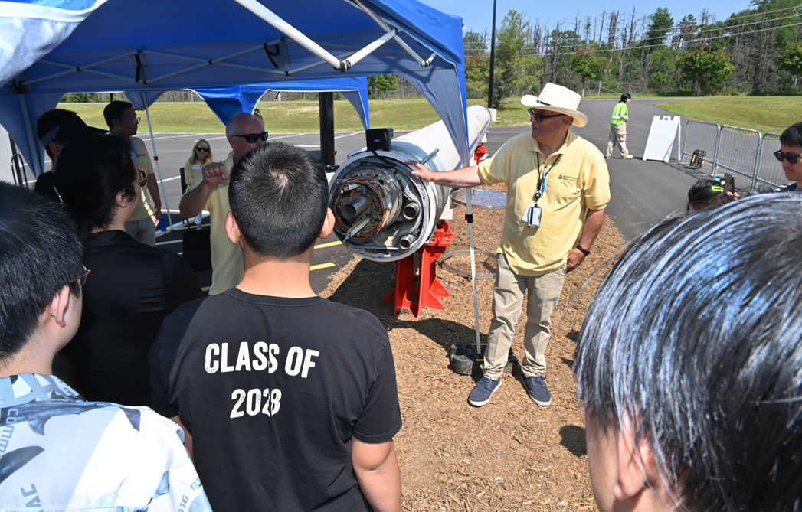
EIC Outreach Activities
BNL Summer Sundays “Fascinating Physics”: EIC Open House - August 2026
“Let’s Smash the Proton” session for high schoolers – July 2026
  “Escape the Control Room” activity (based on Yale Pathways Summer Scholars Program)
BNL PubSci event: “The Secrets of Matter: Journey to the Electron-Ion Collider”

Slide 7

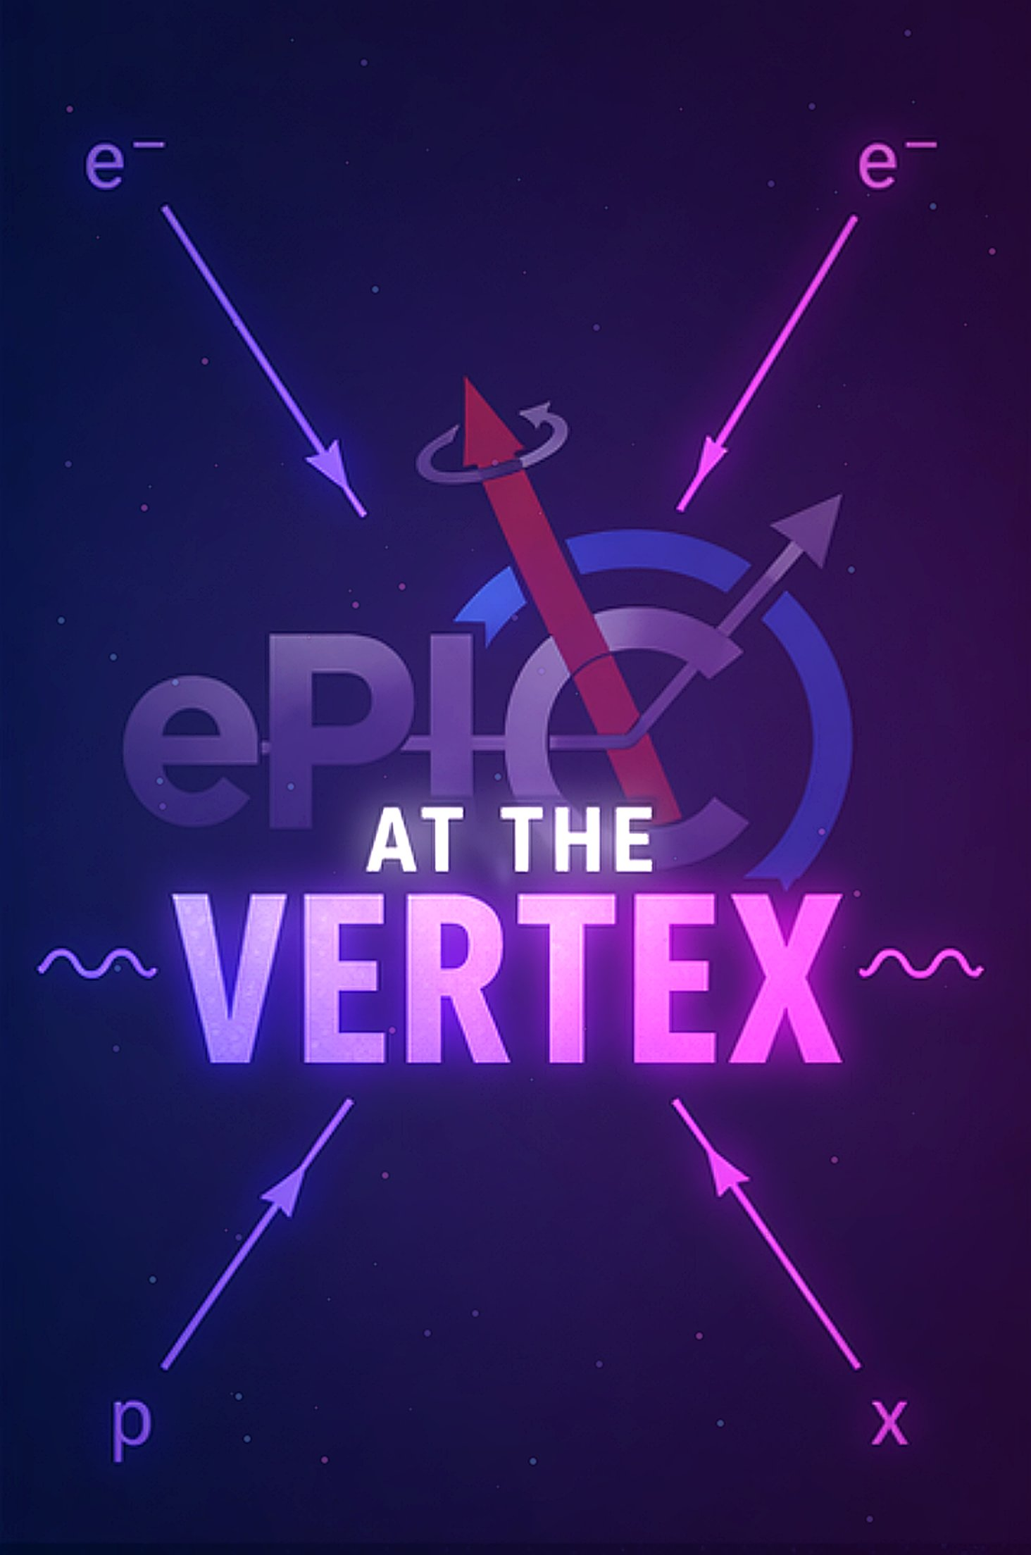
ePIC Outreach Initiative – early Career Group
Our Goals • Our Plan • How We Reach the World
🎯
🎙
📱
Our Goal
Podcast — ePIC Radio
Social Media
Make EIC science accessible to the general public
Monthly episodes, 45–60 min, on YouTube
Short explainer reels — 30 sec to 1 min
Engage physics students, PhDs & researchers globally
Live broadcasts & interview-style recordings
Detector series & physics topic series
Highlight early-career researchers & diversity
Topics: EIC history, detectors, physics & beyond
"Who We Are" videos + weekly Q&A
Build a lasting public narrative for the ePIC collaboration
Early-career spotlight & community discussions
Instagram, TikTok, YouTube & LinkedIn
How we reach everyone: YouTube • Instagram • TikTok • LinkedIn • Live Q&A • Country pages • Conference clips & interviews
How we reach everyone: YouTube • Instagram • TikTok • LinkedIn • Live Q&A • Country pages • Conference clips & interviews
June 2026
July 2026
Branding & team confirmation
Launch channels + Episode 1
Episode 2 + weekly posts
Monthly podcast & ongoing content

Slide 8
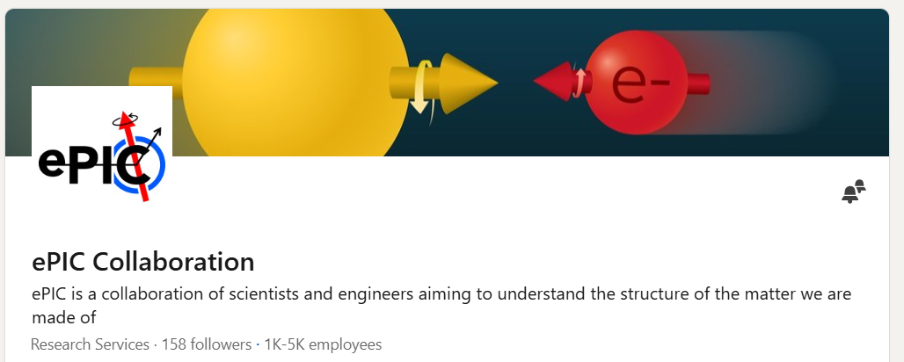
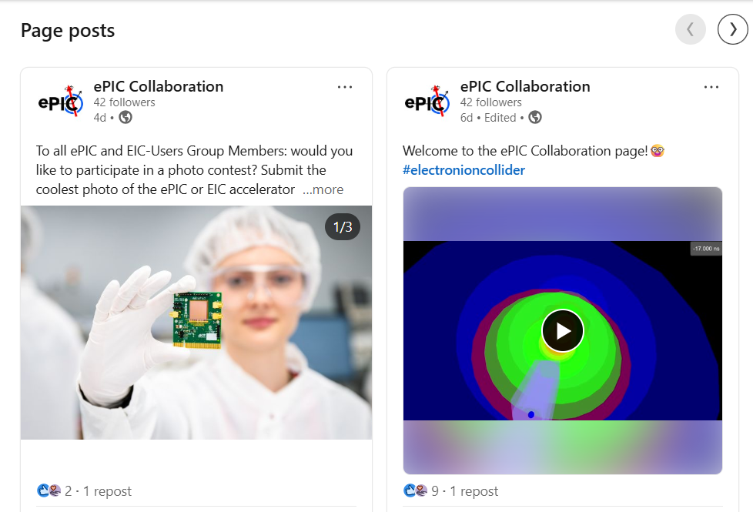
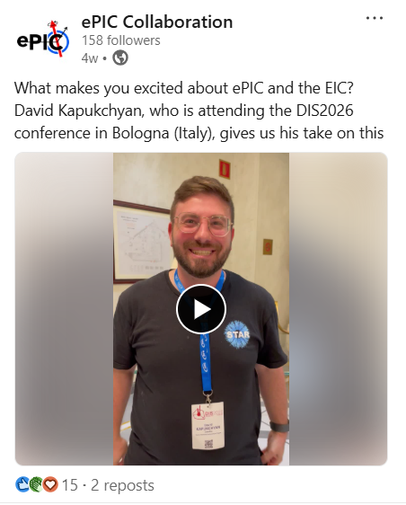
Linkedin ePIC Collaboration page
A Linkedin page for the ePIC Collaboration was created in December Follow us! Ideas/material for new posts are very welcome!
https://www.linkedin.com/company/epic-collaboration/

Slide 9

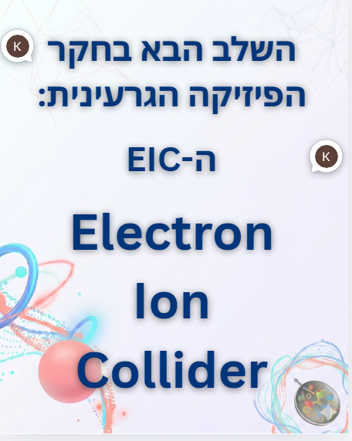
ePIC – Israel Outreach
In our outreach goals we target two distinct audiences
  General population w/some interest in science
    Raise awareness of the science’s very existence
    Share progress and even one day results with broad audience
    Aim to build support for long-term participation (and nuclear physics in general)
  Young people ages ~12-25
    Raise interest in science generally w/nuclear & EIC interest as best case
    Aim to inspire people to study science/physics/nuclear
Activities
  Instagram – building up media “bank” scheduled to go live mid-June (!)
  High school direct outreach – starting discussions/coordination for talks to high school students (summer vacation probably pushes schedule to Fall)
Group
  So far, we are 1 PI, Zvi, and 2 UG students, Kfir and Guy, at BGU working on this
Screenshot from Instagram ‘carousel’

Slide 10
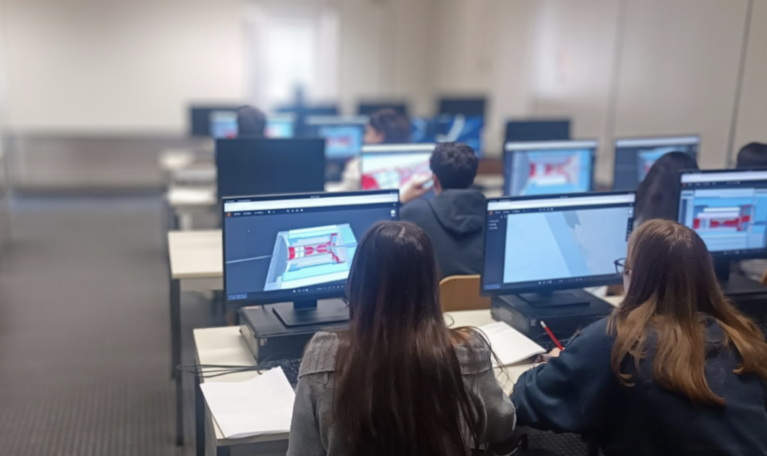
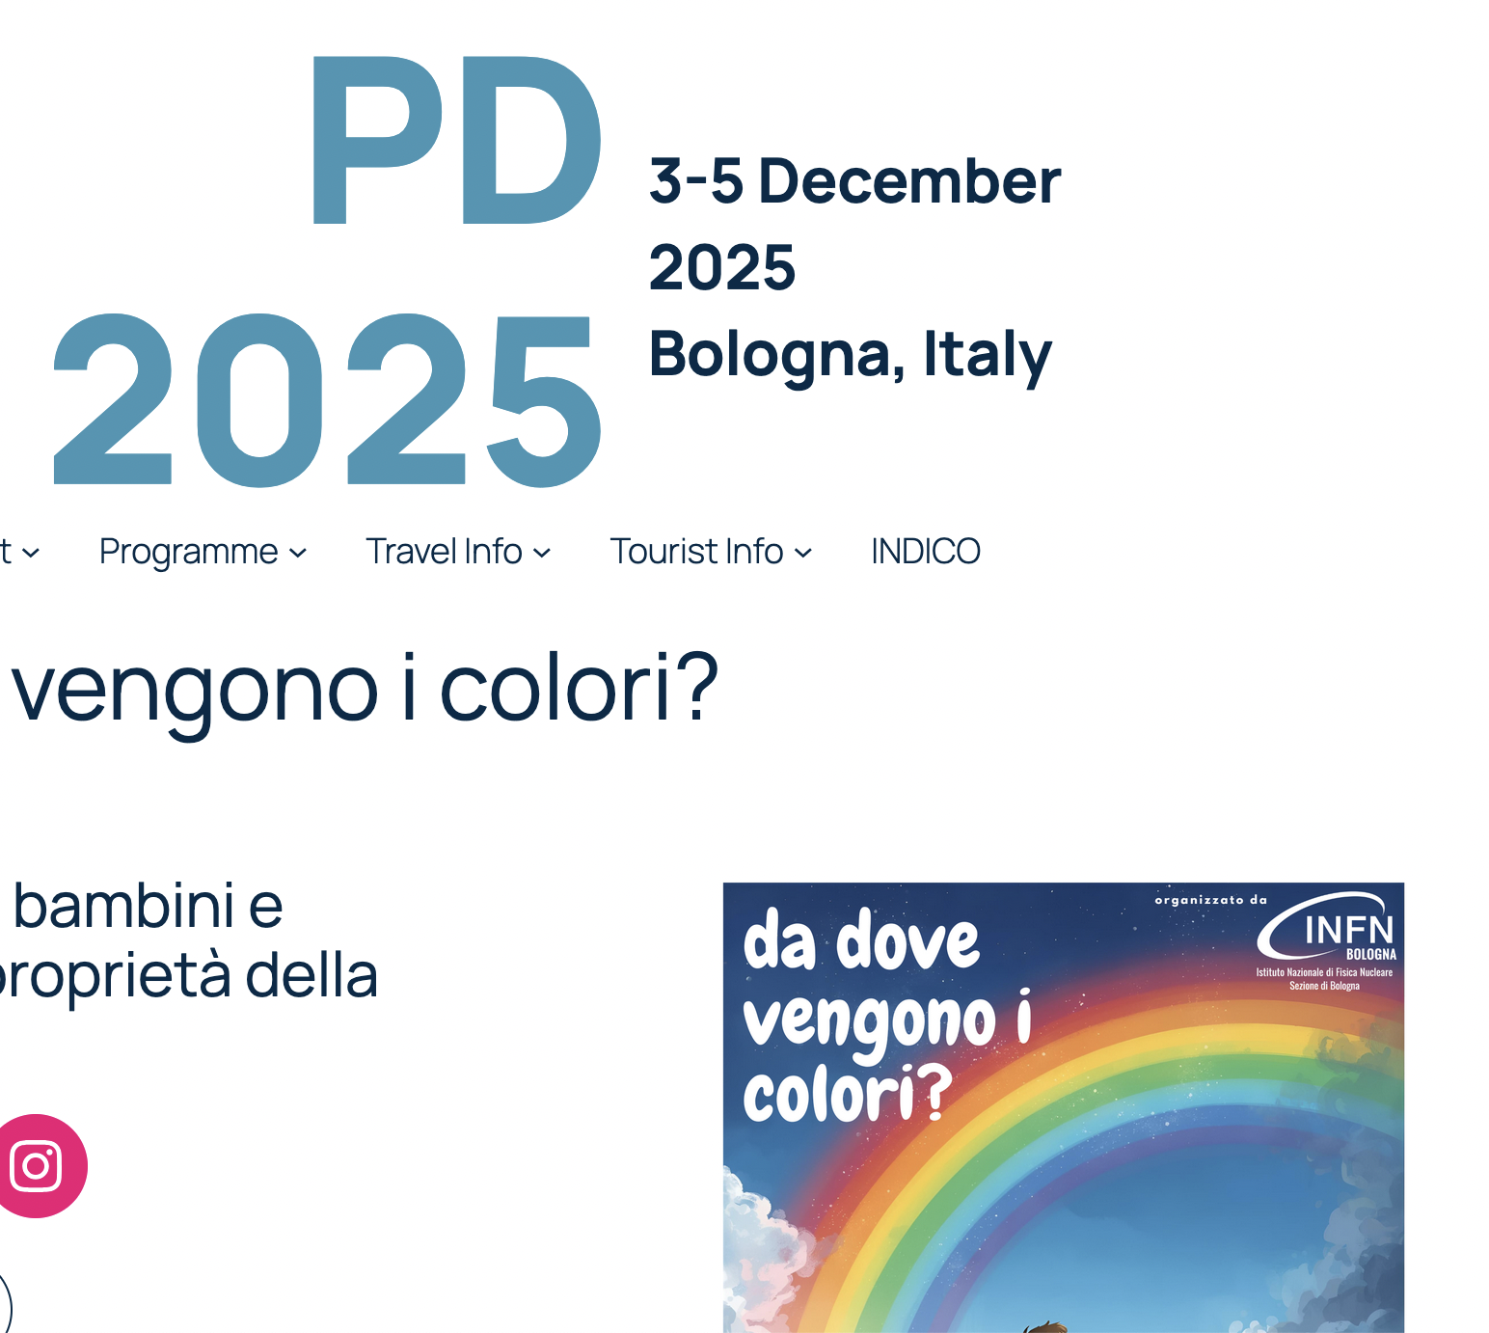
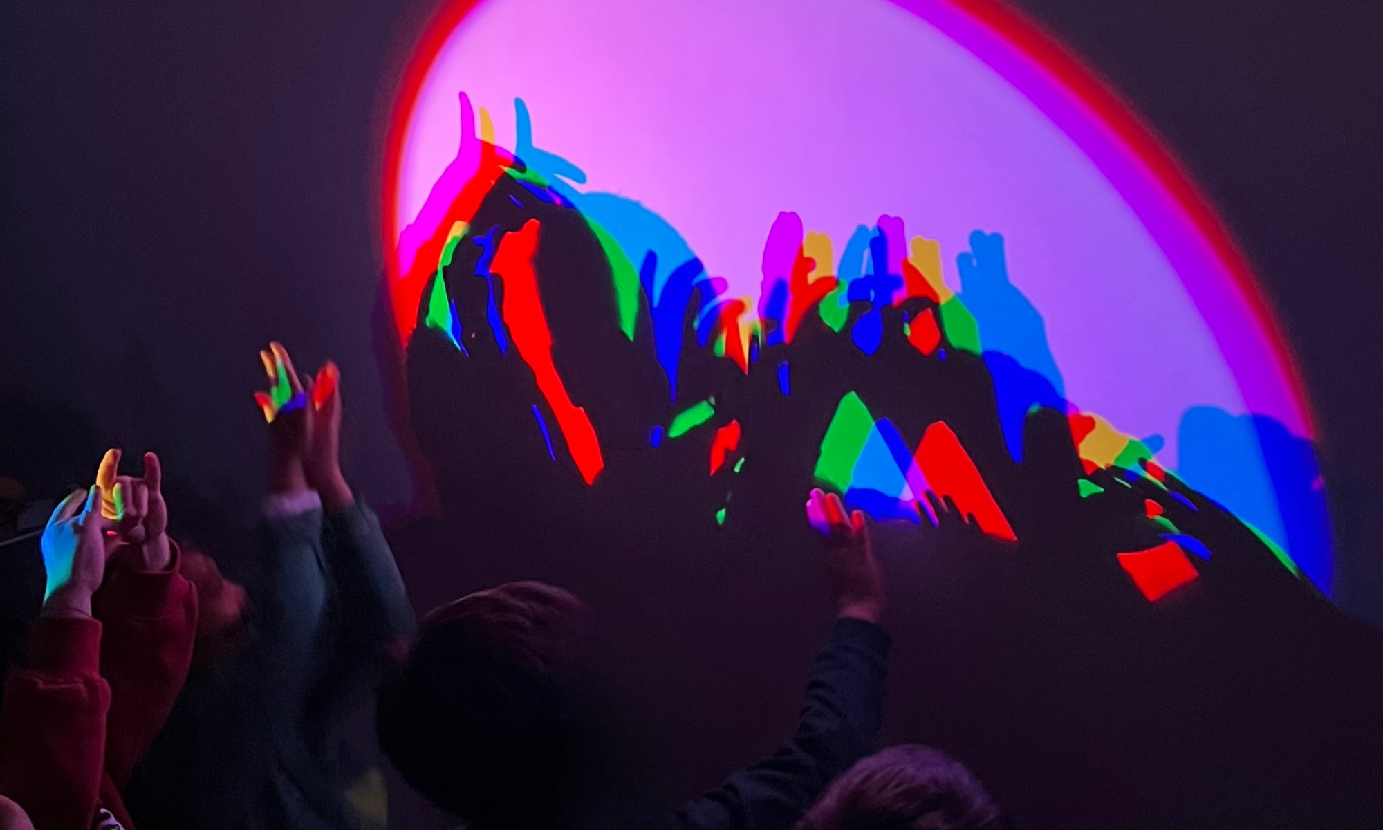
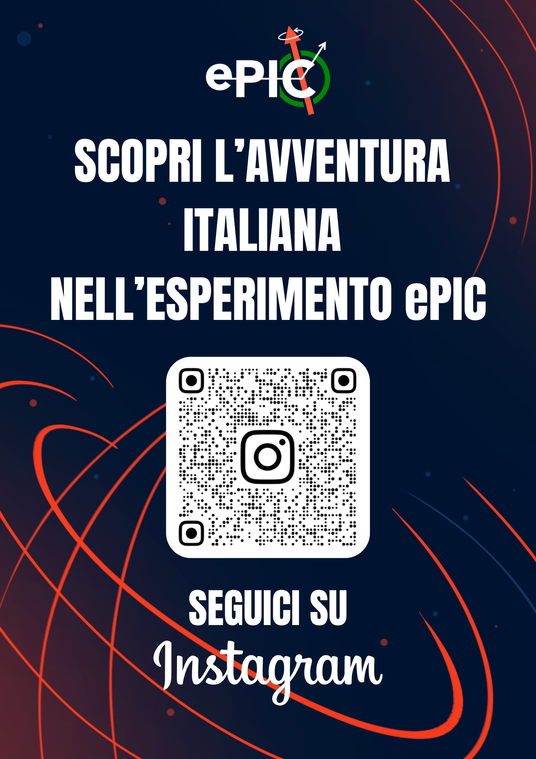
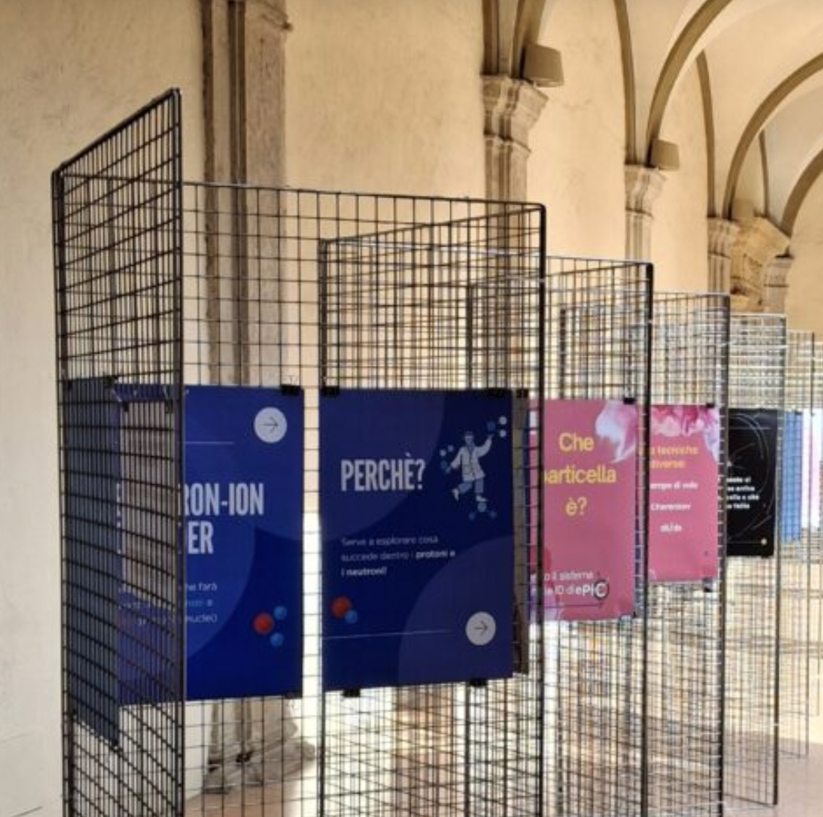
Italy EIC Outreach
  Instagram: https://www.instagram.com/epic_italia?igsh=MWoyYzR1OG9tMWNwNw%3D%3D&utm_source=qr
  Web site https://eic-it.infn.it/ , Mailing list epic-italia-outreach@lists.infn.it
  Events for schools
  - «Ti presento ePIC» (high schools),
  Introduction to the ePIC physics and experiment, held in several
  INFN sites https://agenda.infn.it/category/2222/
  - Hands-on «pilot» event (high schools) in preparation of a
  future Masterclass https://agenda.infn.it/event/51776/
  - Event for 10-13 aged students
  2 satellite events (to PD2025 and DIS26)
  for kids and families
  Exhibition of ePIC «cards»
  (collection of Instagram carousels)
Notes:
First of all to whom?

Slide 11
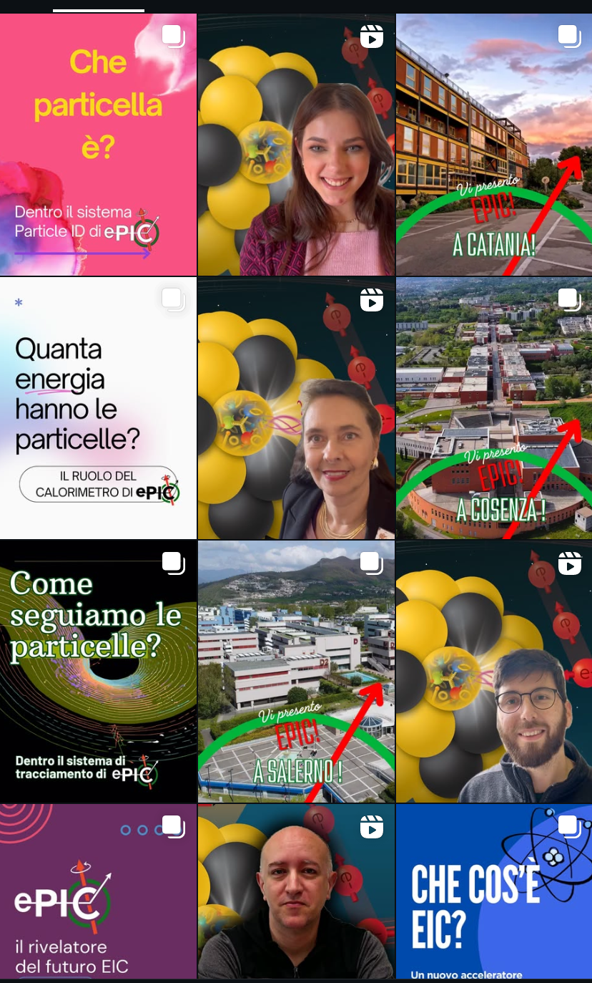
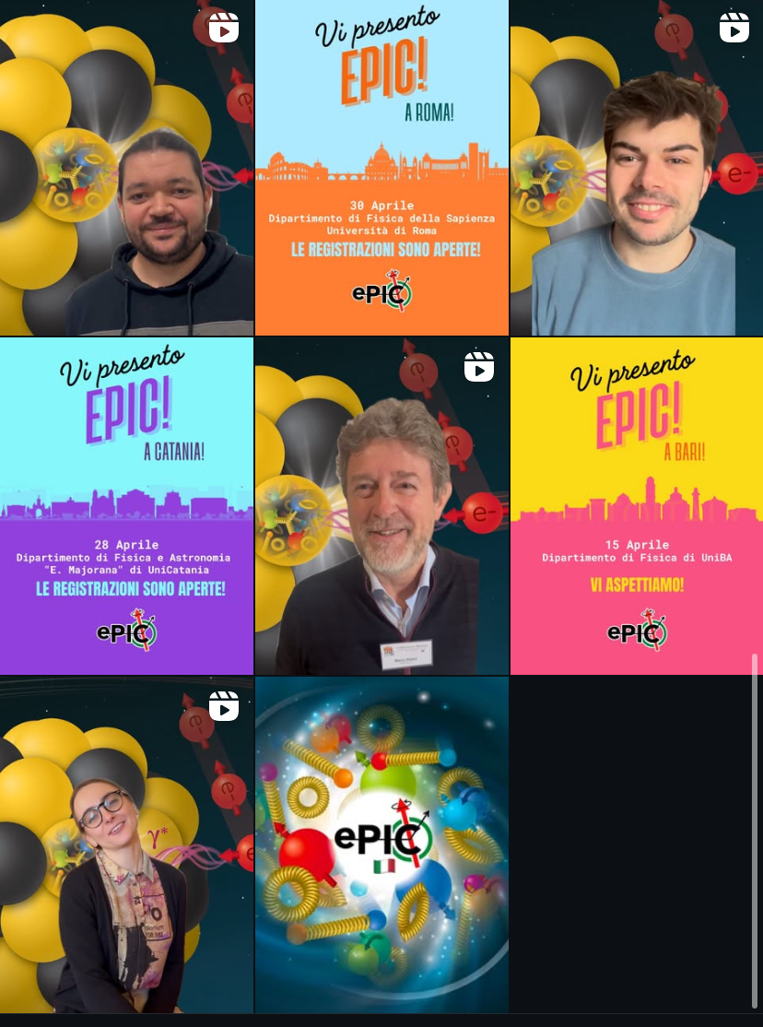

Slide 12
UK Outreach Topics
Binding Blocks in UK
Nuclear physics outreach collaboration in UK led and coordinated by University of York
Run yearly online nuclear physics masterclasses for high school students
In addition to curriculum related material, masterclasses are research-led, they involve researchers and research topics
  e.g. webinars, research-led modules (eg “particle physics meets nuclear physics” module)
Would be great to get EIC embedded in these masterclasses
Binding Blocks have STFC funding. Can help support people getting involved (eg materials production, travel)
In the past (from University of Glasgow personal experience) we partook in masterclasses via development of “particle physics meets nuclear physics” module, live webinars about our research, and creating pre-recorded videos with PhD students discussing their research in Mainz and JLab or on strong force topics
e.g. PhD student videos (https://www.youtube.com/watch?v=KfB-eU9HUjg and https://www.youtube.com/watch?v=nf_sZVCnugI)
Other UK institutions have also joined with similar activities

Slide 13
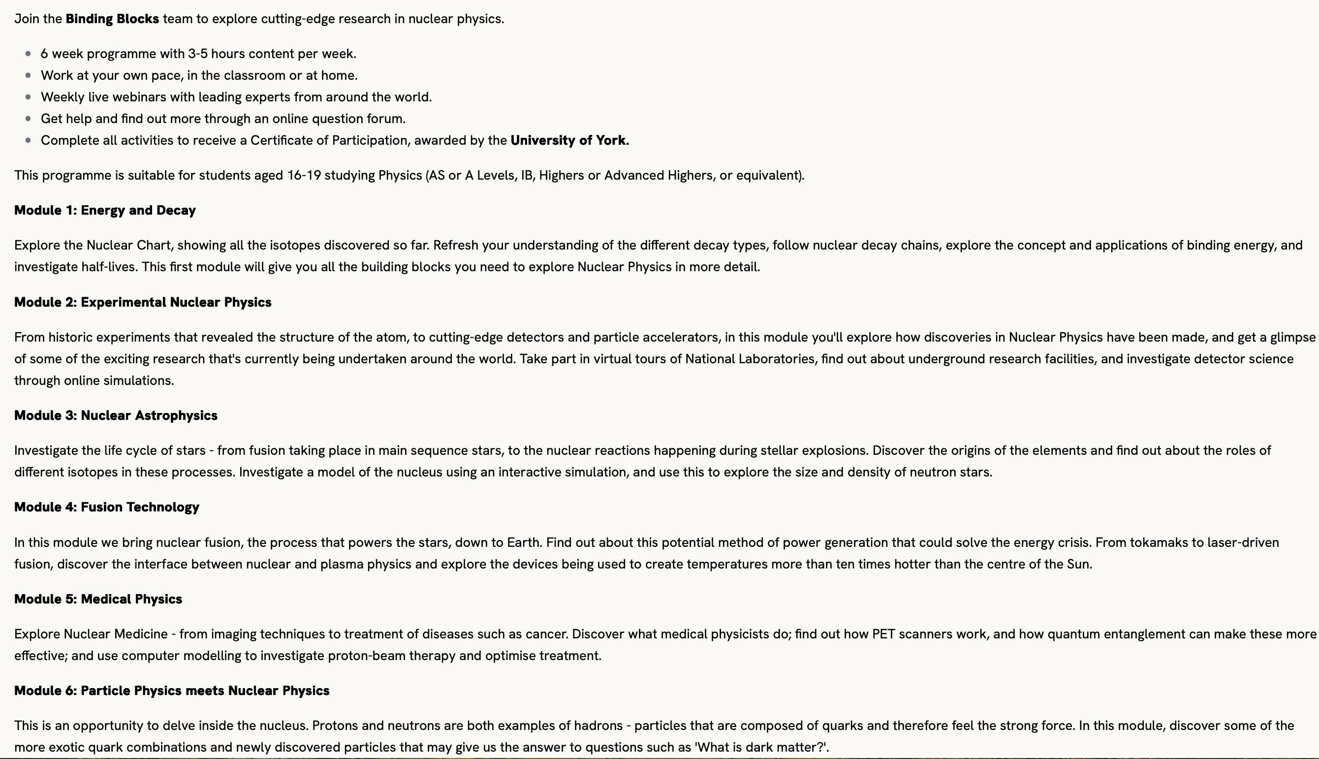
UK Outreach Topics – II
Online masterclasses:
Pre-16 masterclass https://isaacscience.org/events/2503_pre16_bindingblocks
Post-16 masterclass https://isaacscience.org/events/2503_post16_bindingblocks
Students get certificate from University of York after completion
It would be great to get EIC embedded within this module

Slide 14
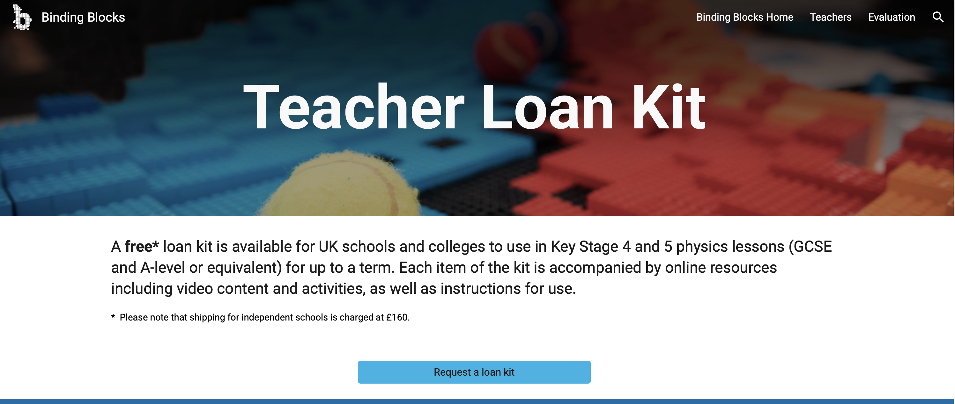
UK Outreach Topics – III
Teacher loan kits: https://sites.google.com/york.ac.uk/bindingblocks/teachers/loan-kit
We developed a couple of these kits in Glasgow (particle scattering kit and cloud chamber) and there are others available too
Schools can request kits to be sent to them, teachers can also attend teacher training events if they want to - but kits are all self explanatory with accompanying video content explaining how to use them
Only in England currently - would be nice to expand to other countries/remote places far form Universities (eg highlands and islands)

Slide 15
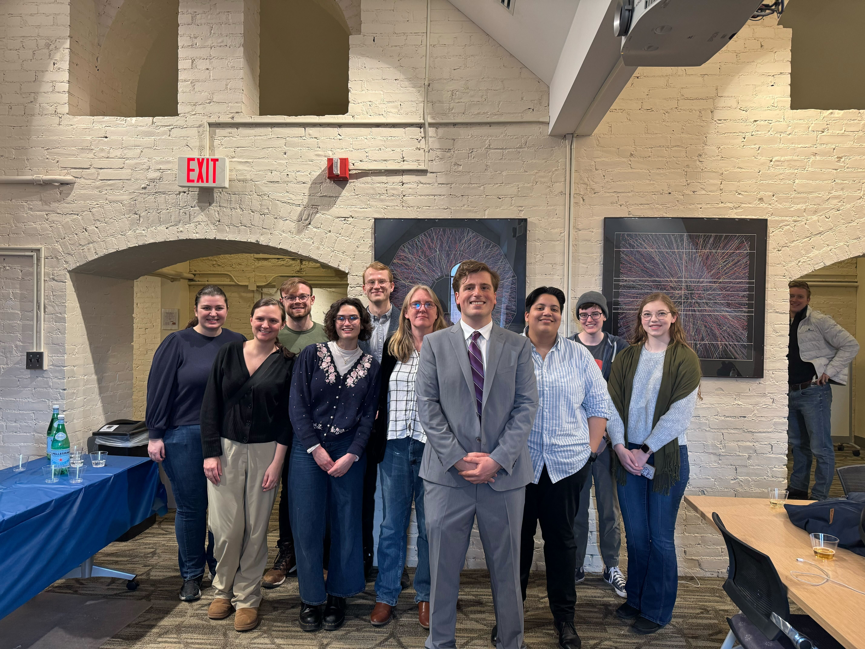
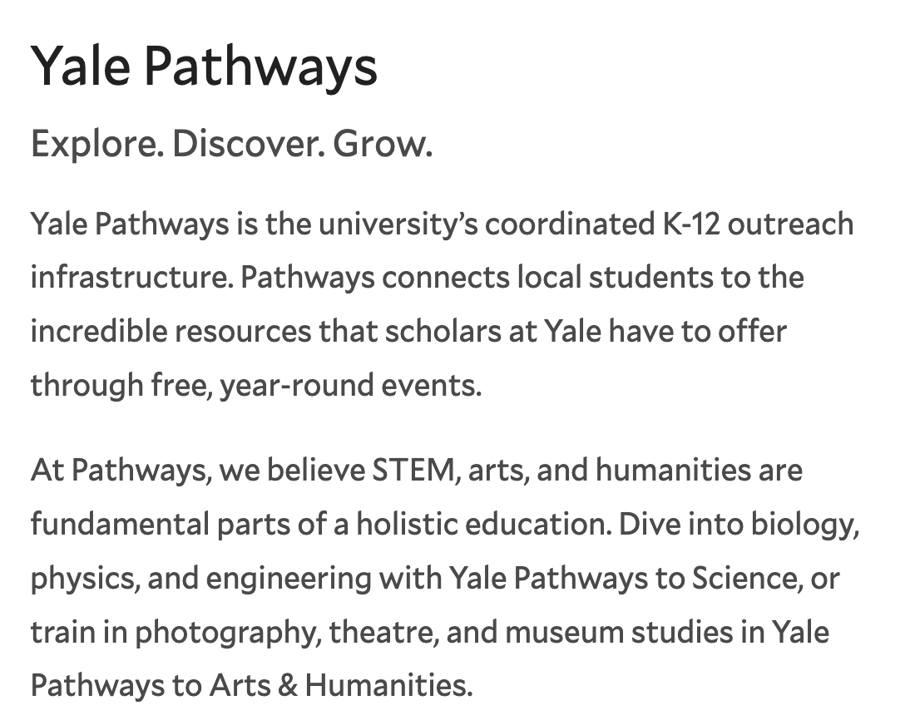
Yale Pathways to Science
Yale Pathways to Science is a free enrichment program connecting New Haven public school students (grades 6–12) with STEM opportunities at Yale.
The program partners with New Haven, West Haven, and Amity schools to provide hands-on workshops, lab tours, mentoring, and selective summer research opportunities.
Our RHIG group contributes through three outreach efforts:
1. Escape the Control Room
1-hour enrichment activity
2. Let’s Smash Some Protons!
1-week high school course
3. Summer Research Internship
7-week research experience in Wright Lab
pathways.yale.edu

