Slide 1
Electronics & DAQ WG
Fernando Barbosa (JLab)
9 April 2026

Slide 2
Agenda
Today:
ASIC/Discrete Internal Reviews
ASIC/Discrete Production Schedules
ASIC & Electronics Status Updates
Next week: 16 April 2026
Power Trees – Distribution and Regulation
Schedule Steps – Overview of sequence
Engineering & Design (PED)
Current Phase
Production (Construction)
QA/QC (Testing)
CD-3
Delivery to Sub-detectors

Slide 3
ASIC & Discrete Readout Internal Reviews
Goals of the reviews:
Provide a comprehensive assessment of the ASICs and Discrete Readout from design to production
Specifications & Requirements - frontend, processing, interfaces, power and packaging (including form factors where applicable).
Digital Interfaces - commands & controls
Status & Steps to Completion - with schedule and to include testing/validation with detectors
Production Outlook - to include final production review, production timeline and QA/QC testing
Documentation - Functionality (e.g. User’s Manual/Spec sheets) and QA/QC Plans, and with planned availability for FEB final designs and Engineering Articles, bump/wire bonding.
Review Schedule:
EICROC - 1 April 2026 – Good progress. Minutes & Summary @ https://indico.bnl.gov/event/32195/
ALCOR - 22 April 2026
SALSA - 6 May 2026
CALOROC - 13 May 2026
FCFD - 20 May 2026
Discrete - 27 May 2026

Slide 4
ASIC & Discrete Readout Internal Reviews
EICROC Internal/Peer Review, 1 April 2026 - Summary
Preliminary measurements of the EICROC1 are very encouraging; ~60 chips with fixed inverter issue (spare wafer) to be available for tests with sensors/detectors ~July 2026.
Specifications for readout and rates from all EICROC detectors to be provided to developers soon.
Availability of Test Boards to be coordinated with BNL and Tonko very soon.
QA/QC will need to be performed by collaborating institutions; OMEGA/IJCLab will provide documentation from ALTIROC, for guidance.
Schedules at OMEGA/IJCLab need to be revised to meet EIC needs. P6 has had EICROC production for all EIC detectors in FY28 for some time now.
In-Kind contribution is set in EIC project.

Slide 5




Technical Progress
Charge #3
Approximate quantities and costs shown with overages of 10% Discrete and 30% ASICs for production yields.
Costs include mask sets, fabrication, packaging & test NRE.
 | #Ch | #Ch/Unit | #ASICs/Wafer | #Wafers | Node (nm) | Packaging | Cost/ch (US$) | Institution
Discrete/COTS | 27.6k | 32 | NA | 863 Digitizers | COTS | NA | 66 (Includes FE Interface PCB) | Indiana University
CALOROC | 144 k | 36* | 800 | 5 | 130 | BGA | 2.2 | OMEGA/IN2P3/IJCL, ORNL, AGH
EICROC | 7.5 M | 1,024 | 160 | 46 | 130 | Wafer Bump | 0.1 | OMEGA/IN2P3/IJCL/CEA-Saclay, AGH
FCFD strip FCFD Variant | 3.1 M 207 k | 128 64 | 180 | 133 18 | 65 | Bump/Wire BGA | 0.4 4.1 | FNAL
ALCOR | 461 k | 64 | 800 | 9 | 110 | BGA | 0.7 | INFN
SALSA | 256 k | 64 | 500 | 8 | 65 | BGA | 3.2 | CEA-Saclay, U Sao Paulo
DOE
In-Kind
In-Kind
DOE
In-Kind
In-Kind
Production
65 nm: $750 k masks + $3.5 k per wafer
110 nm: $190 k masks + $4 k per wafer
130 nm: $250 k masks + $4 k per wafer
Packaging BGA: $3-$7.5 per chip; Wafer Bump: ~$25 k
ASIC Costs Total: ~$4 M
Masks: ~$3 M; Chips: ~$1 M
*Approved for 36 ch CALOROC, documented in record of decision EIC-ROD-051 (21 November 2025)

Slide 6
Technical Path Forward – Discrete & ASICs
Charge #3
 | Status & Development Summary | Next Steps | Production Ready | Institution
Discrete/COTS | Devices selected, PCB design practically completed. Beam tests FY24-FY25 | Engineering article FY26 | FY27 | Indiana University
CALOROC (36) | Interface design FY23- FY24, CALOROC1A/B designed FY24-FY25 CALOROC1A: ADC/TOT + TOA, full SRO interface CALOROC1B: Switched gain (4) + ADC + TDC, full SRO interface | CALOROC2 (36 ch) – FY25-FY26 Select version 1A/1B. Tests - FY26-FY27 | FY28 | OMEGA/IN2P3/IJCL/CEA-Saclay, AGH, ORNL
EICROC (32x32) | EICROC0A (4x4) designed FY24-FY25, EICROC1 (32x32) FY25 EICROC0A: ADC + TOA, improved testability EICROC0B: Replaced ADC with peak sensing, Wilkinson ADC, lower power. EICROC1: added full SRO interface | EICROC2 (32x32) FY26 Add Derandomizer and ZS. Digital on Top design for lower power (~1 mW/ch). Tests. | FY27 – FY28 | OMEGA/IN2P3/IJCL/CEA-Saclay, AGH
FCFD (128) | Front end characterized, FCFDv1 (6 ch) FY23-FY24 characterized, FCFDv1.1 FY25; FCFDv1.2 and FCFDv2 FY26; FCFDv3 FY26-FY27 | FCFDv2 (32 ch) FY25-FY26 Add ADC, TDC, interfaces from ETROC, ECON CERN. FCFDv3 (128 ch) FY26 | FY28 | FNAL
FCFD Variant (64) | FCFDv1.1 FY25 Preliminary tests with sensors; FCFD Variant v1 FY26; FCFD Variant v2 FY26-FY27; FCFD Variant v3 FY27 | Harmonize sensor/ASIC specifications, adapt FCFD for 64 ch. | FY28 | FNAL
ALCOR (64) | ALCORv2.1 (32 ch) beam tests FY24, ALCOR v3 (64 ch) FY24-FY26 Full specification, SRO interface, BGA | ALCOR-64 – FY26 Final iteration for production | FY27 | INFN
SALSA (64) | SALSA0/1 FY24, SALSA2 (32 ch) designed FY23-FY25 Full SRO interface, most DSP features, Submission October 2025 | SALSA3 (64 ch) FY25-FY27 full DSP, 64 ch | FY28 | CEA-Saclay, U Sao Paulo
ASIC production is ~1 Year: Fab, Packaging, Test. Additional information in the following slides. CD-3 in FY28.
- Complete
- Tests March 2026
- Next Steps

Slide 7
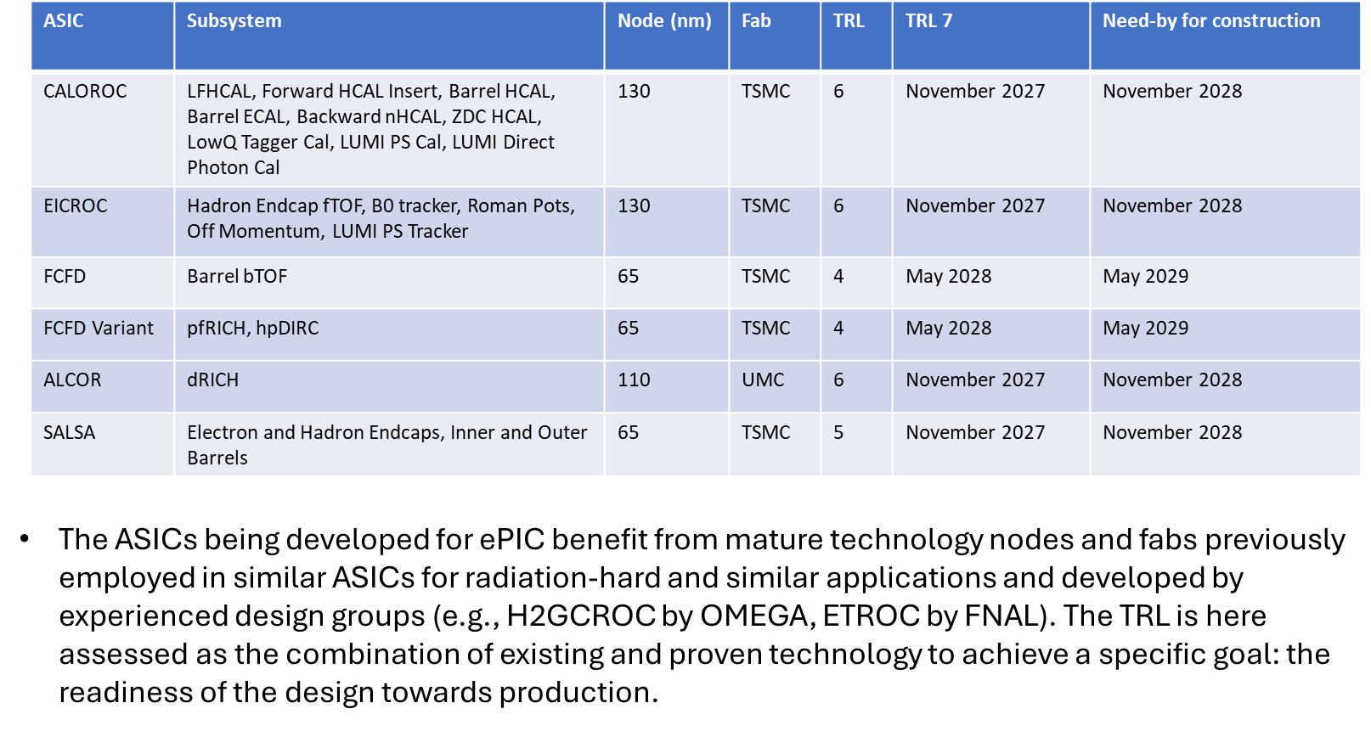
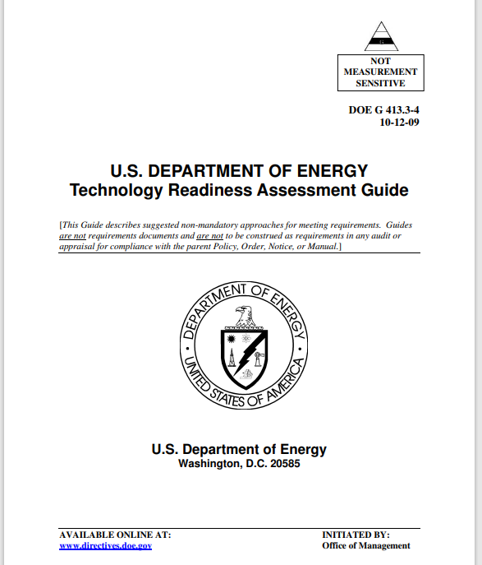
ASIC Readiness Assessment
Now
Production Start
The ASICs being developed for ePIC benefit from mature technology nodes and fabs previously employed in similar ASICs for radiation-hard and similar applications and developed by experienced design groups (e.g., H2GCROC by OMEGA, ETROC by FNAL). The TRL is here assessed as the combination of existing and proven technology to achieve a specific goal: the readiness of the design towards production.
TRL: DOE Technical Readiness Level

