Slide 1
Electronics and DAQ WG Meeting (4/30/2026) – Assorted Topics
ASIC Internal Reviews
Schedule / Status
Plan for documenting reviews
RDO Types and Counts
MPGD RDO baseline
Space Allocations in wide angle hall for RDO’s and electronics
Fiber Run Technicalities
“Curtain Rod” concept needs to be extended because there are now 5 movable installations (South Platform, West / East West Platforms (north and south)
East / West Platforms potentially offer additional difficulties because of overhead constraints
Wide angle hall shield wall offers new difficulties (relative to RHIC) because beam is planned while detector is in assembly hall
Request for Data Rates / Limits
Tic compiling rates / backgrounds / noise / limits

Slide 2
ASIC Internal Reviews
Peer Reviews - https://indico.bnl.gov/category/720/
4/1 – EICROC
4/22 – ALCOR
Design is advanced, including digital control interface, data formats, and operating modes
At the ASIC level, the synchronization of the clocks is handled via a digital reset line. This reset behavious depends upon the length of the asserted reset (between 8–31 394 MHz clock cycles), with an additional fixed latency before the reset occurs → implying detector specific latency between issuing reset and its synchronized effects
Fast Commands will need to be translated from a command structure to the ASIC requirements by the RDO.
Need a strategy for managing detectors with different latencies:
Ex. Define single delay for synchronous commands and control extra delay in DAM/RDO
(or) Define GTU to issue synchronous commands with varying delay for different detectors
Only snag is production issues with packaging leading to shorts. The communication between the manufacture and the ALCOR group seems effective and the problems are well characterized – but not yet solved. These could require some redesign efforts going forward
5/6 – SALSA
5/13 – CALOROC
4/20 – FCFD
4/27 - Discrete

Slide 3
ASIC Internal Reviews (p. 2)
It’s important to document the results of these reviews
The plan for doing this is in 3-parts
The presentations and recordings are on indico
The comments and questions are being placed in a document which will be distributed to the participants to ensure accuracy
After all of the reviews are finished a summary document will be put together by Fernando

Slide 4
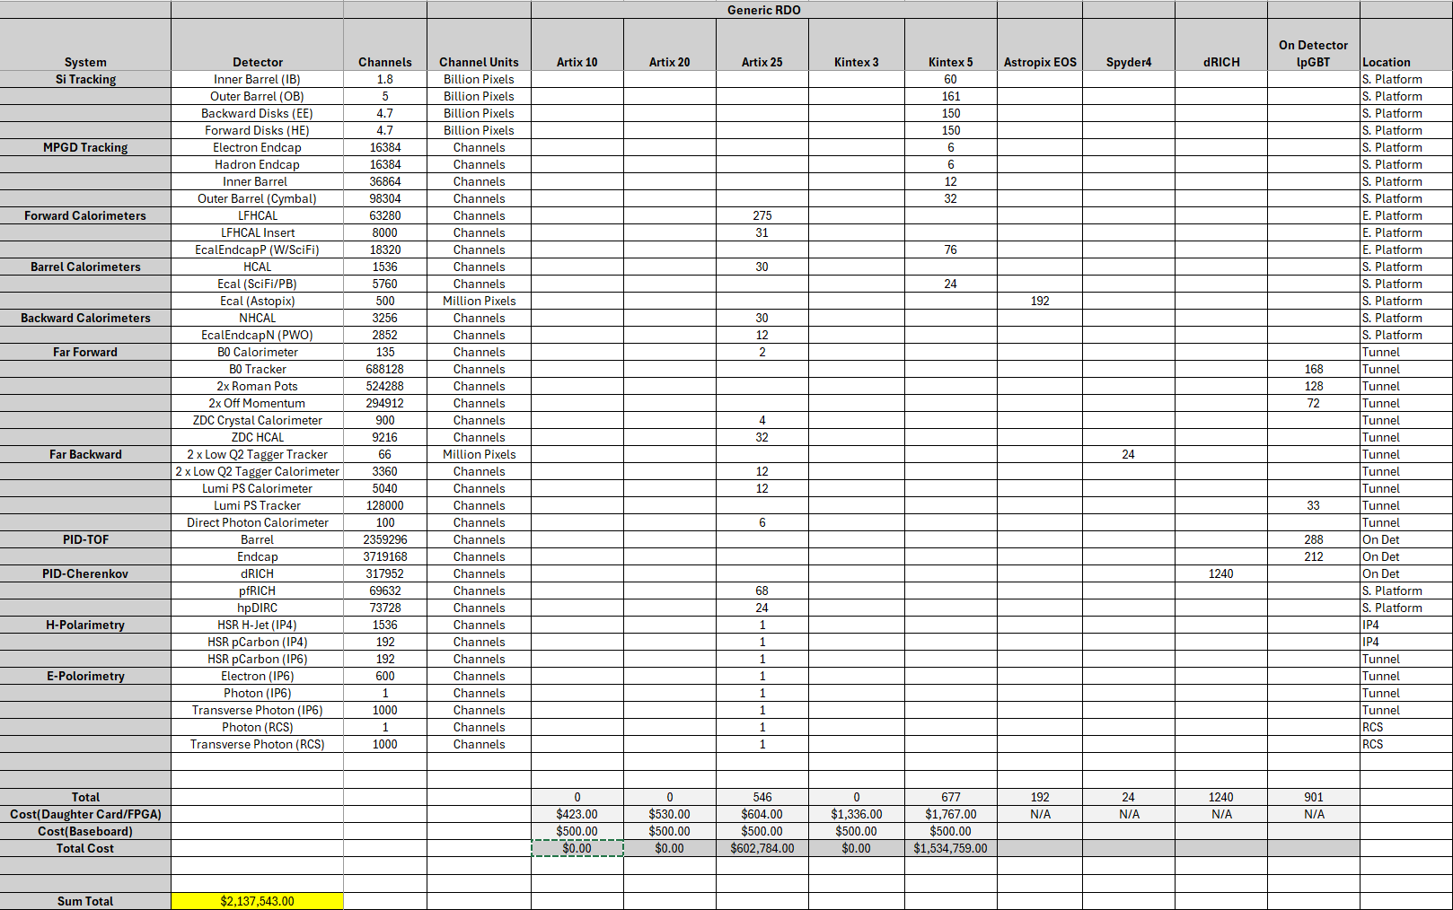
RDO types / counts
More expensive then previous estimates
Baseboard cost also added
Fewer boards than previous estimates
Verified that AC-LGAD components making up the service hyprid
ASIC Module
RDO
are costed separately from Generic RDO
Brought up issue of MPGD desire to remove RDO from chain

Slide 5
MPGD RDO / Direct Dam Connection
Current Situation is that the baseline is to use RDO’s
There are strong cost pressures – the CAM WBS costs are not allowed to grow
If the cost does not change the baseline can still change
Need to document decision
Need to fully document costs and other issues that might arise
Needs to be communicated to TIC, and may need record of decision
It isn’t clear (to me) that the change saves significant effort, as the lpGBT based aggregation board is required for the SVT and being developed. From the MPGD FEB using lpGBT hardware there is no difference whether the fibers are plugged in at the RDO or at a FLX board.
There are differences between the SVT and the MPGDs with regard controls – the integration time of the SVT may have some ramifications, as well as the controls interfaces, but in both cases these go through lpGBT. The issue the RDO must solve is the addressing of commands to specific FEBs, and this solution should be the same for either case.
Addressing integration issues related to structure of commands must be addressed in any case.
Development procedure can be:
Develop FEB/DAQ interfaces using DAM / DAM substitute directly
Separately develop lpGBT based aggregator board
Use aggregator board (The integration step will be to re-use the addressing scheme implemented by SVT, for controls rather than to address via fiber choice alone in the DAM board)
Obviously, there is additional complexity using the RDO, which does imply the risk of extra debugging or integration effort.
Dave / I have made some initial cost estimates and it appears that the cost is about $150-$200k higher bypassing RDOs. These need to be more carefully done though.

Slide 6
South Platform Space Allocation
Steve Titus is producing a map of the south platform space allocation for power supplies and RDOs
The basis of this are of the power supply surveys of all of the detectors done by Tim Camarda, and the RDO lists counts/locations shown earlier. The RDO form-factor assumption is that 20 RDOs will fit into a 6-u VME crate sized enclosure.
This map will be released soon
Currently there are about 5 unallocated racks on the 1st and 2nd floor. No racks are assigned to the 3rd floor.
This exercise has show two issues regarding the fiber runs:

Slide 7
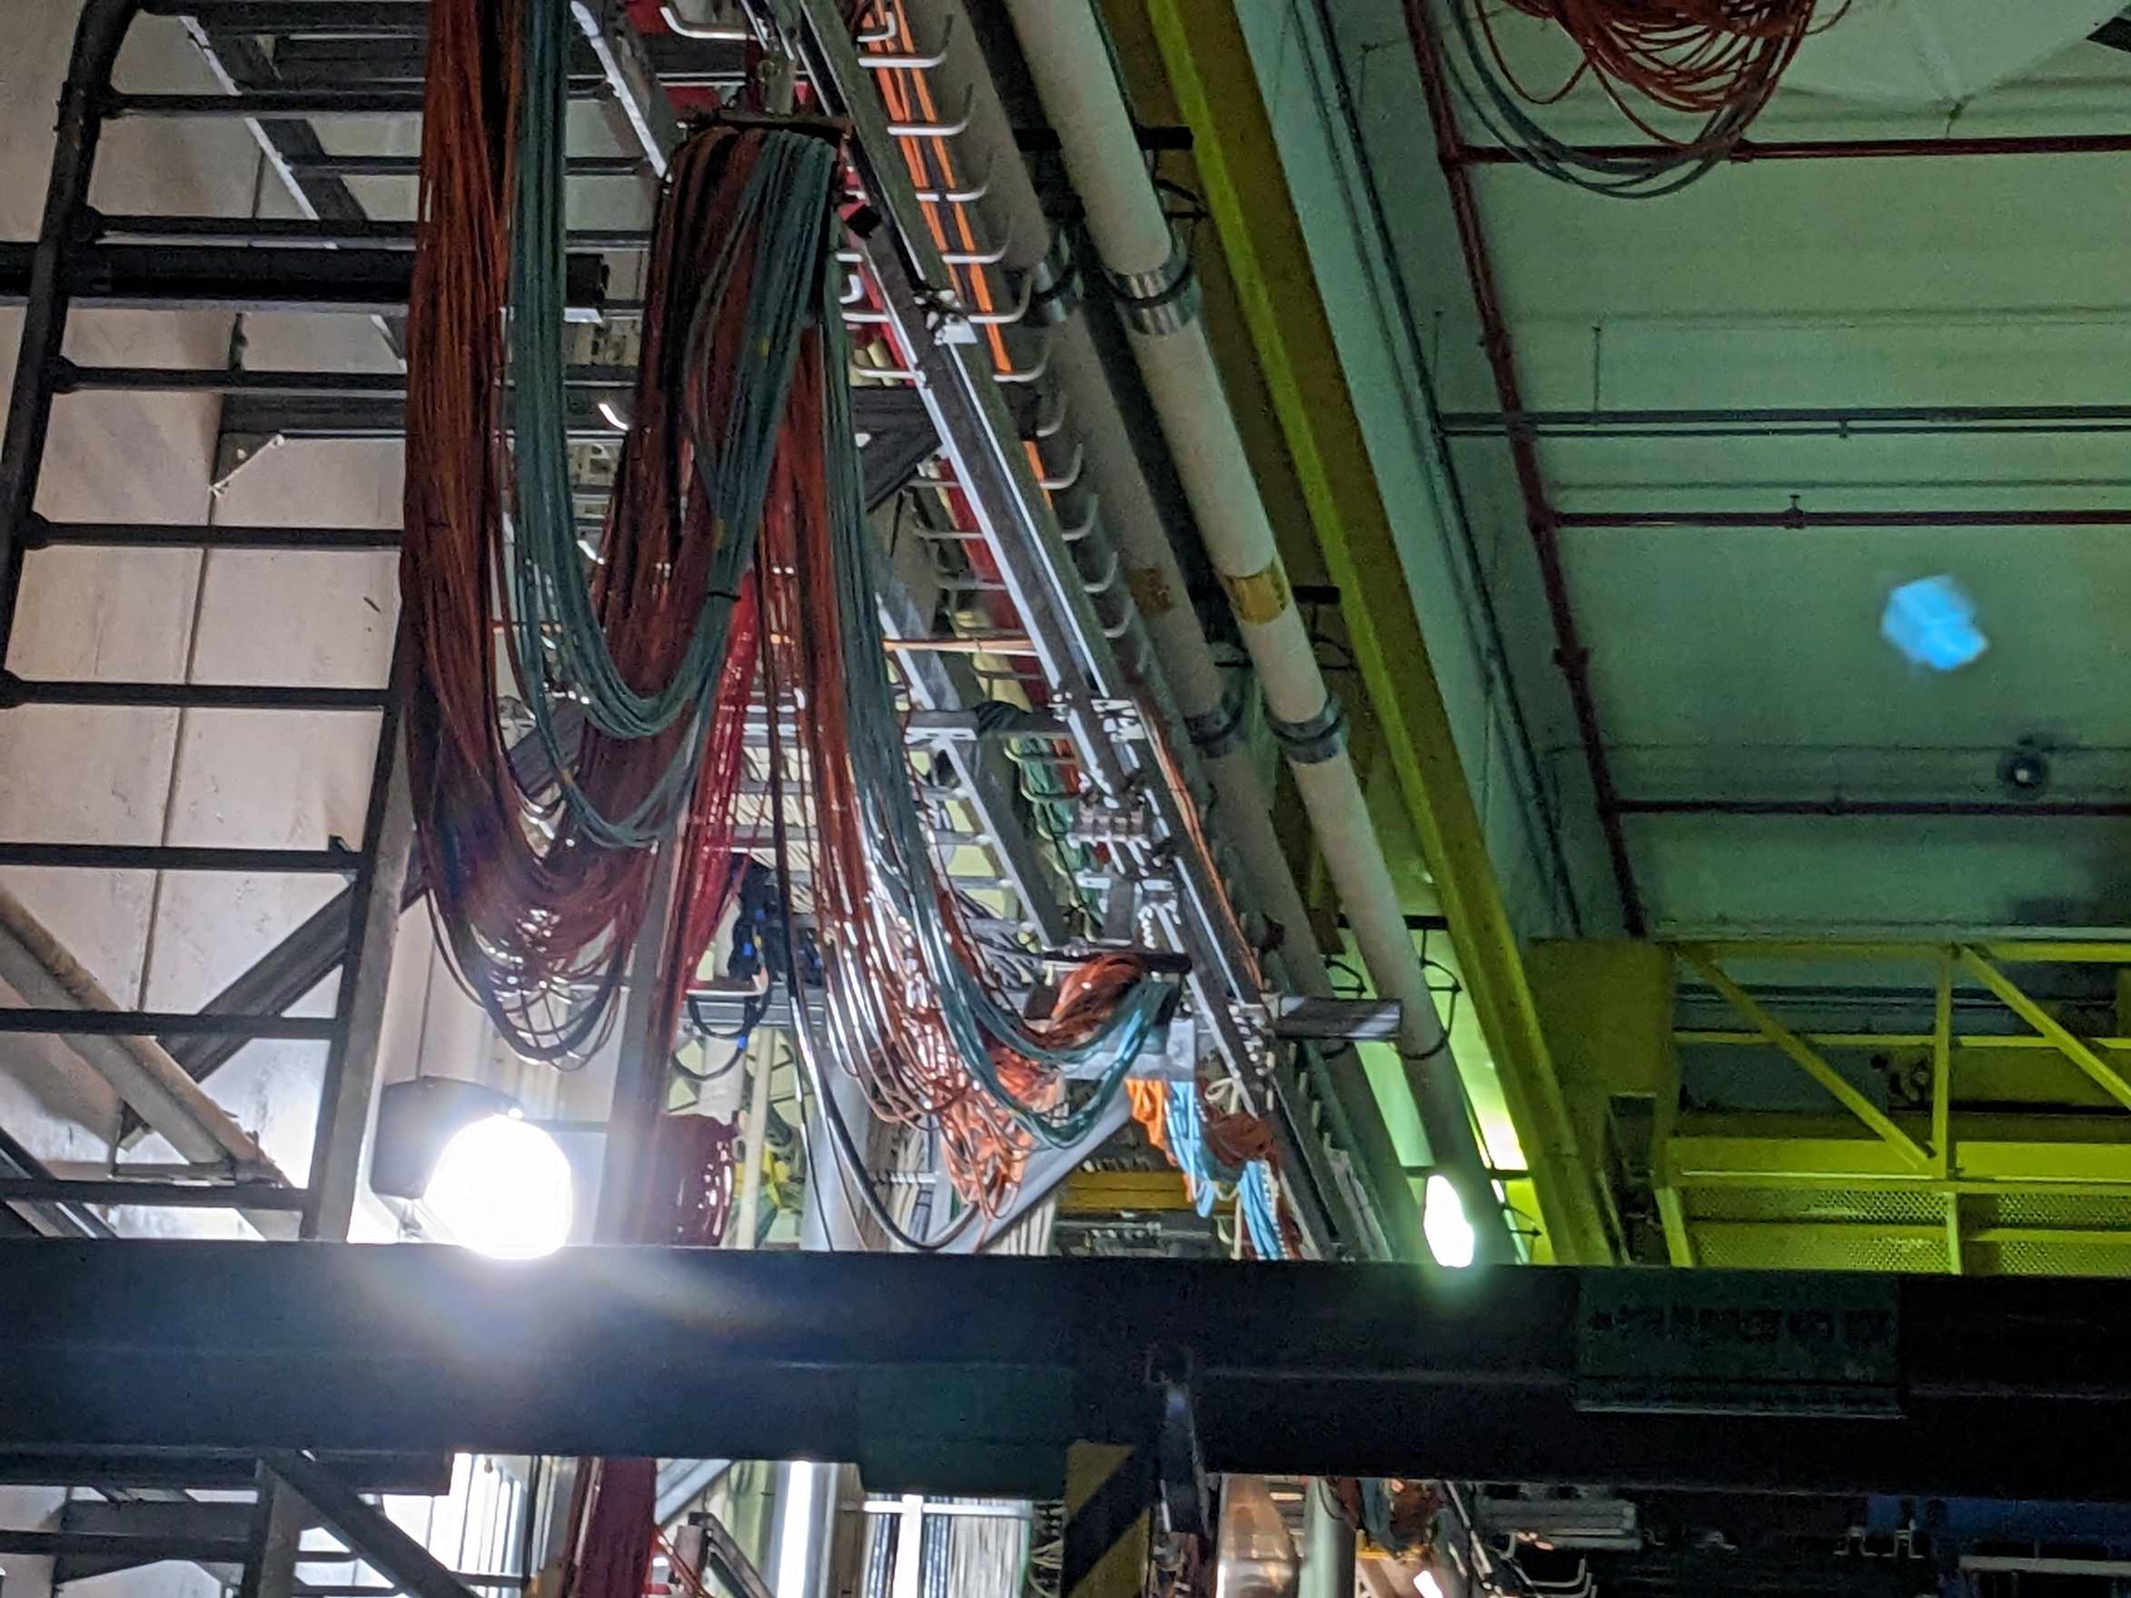
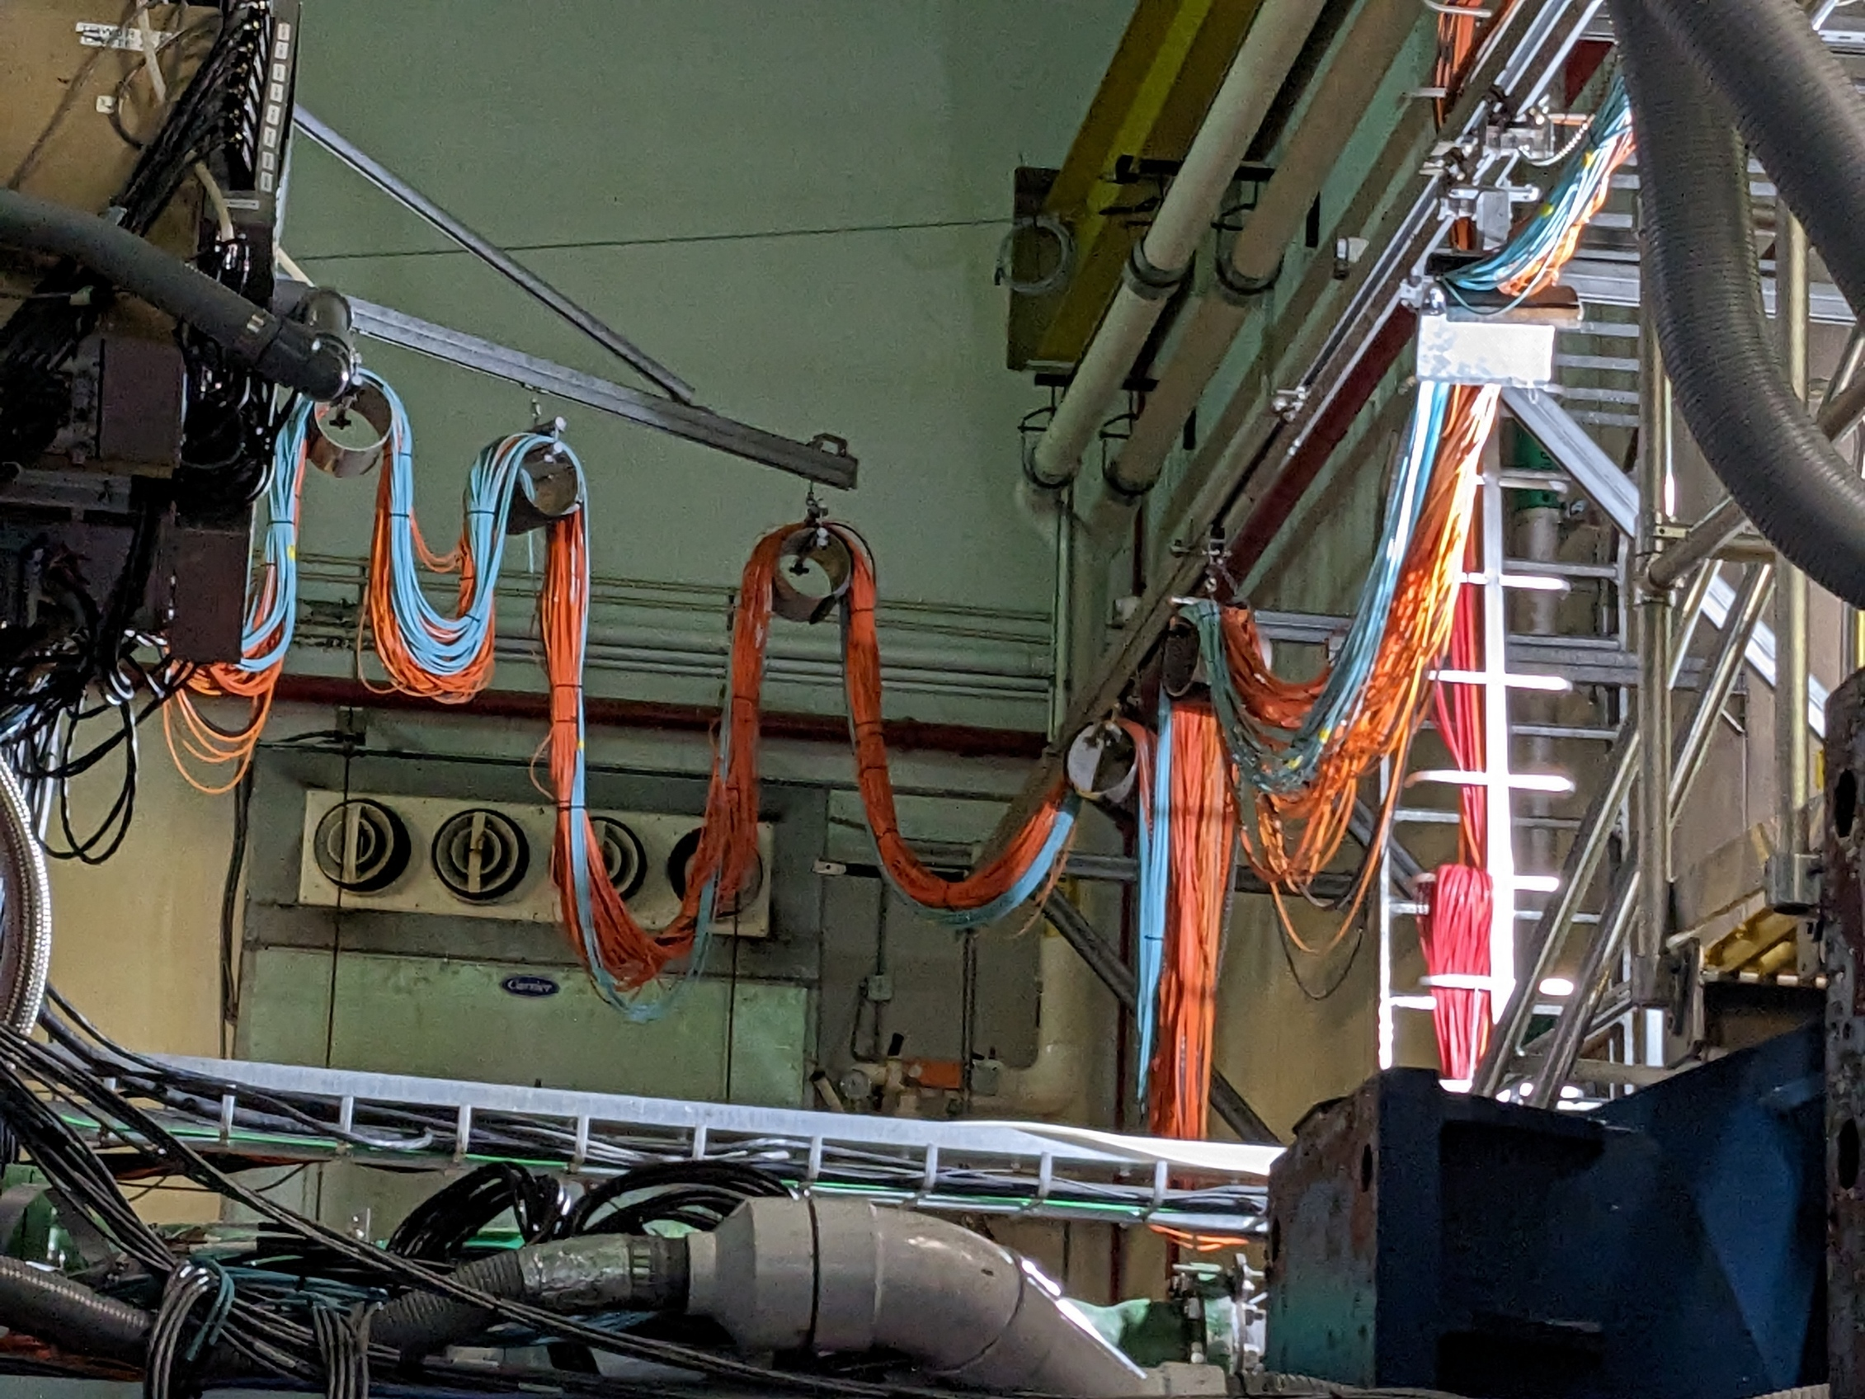
Fiber Runs
Unlike STAR, for which only the platform rolls in/out out of the wide-angle hall the East and West Platforms move significant distances (>30 feet). These platforms are split into a north and south section to move away from the beam-pipe
There will need to be a solution to allow keep the fibers straight throughout the motion. The original plan was to re-use the curtain rod like figures from the fiber runs at STAR
Now there will need to be 5 fiber runs requiring appropriate slack handling
Unlike STAR initial beam commissioning will be done while the detector remains in the assembly building. During this period the detector still needs to run
We need a mechanism that allows us to snake the fibers through the cement blocks making up the shield wall, preferably without having to disconnect any exiting fibers.
We will set up a meeting with the the mechanical engineering group to resolve these issues.

Slide 8
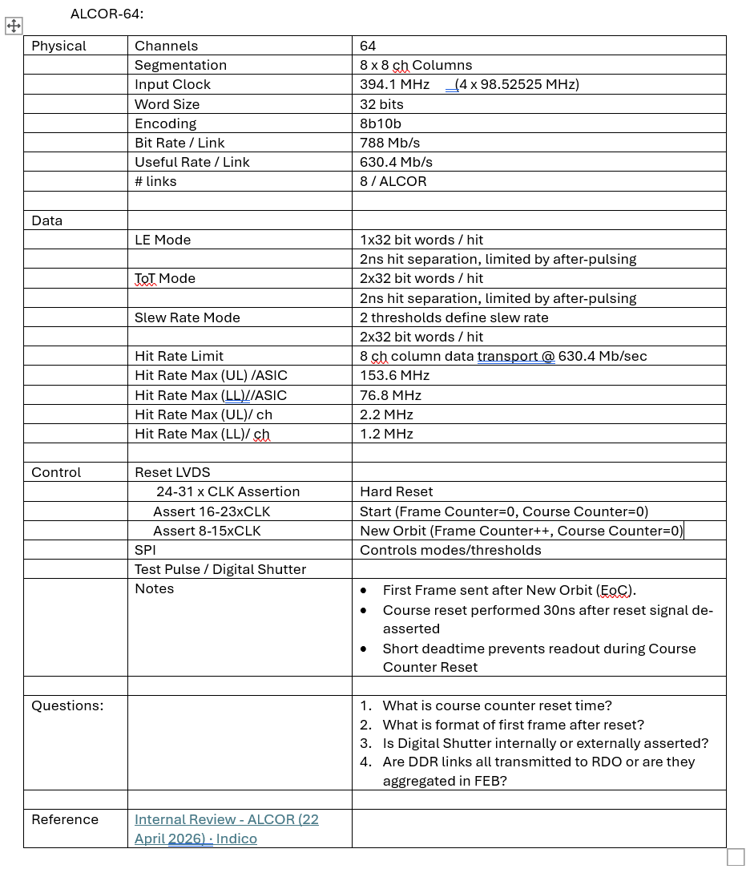
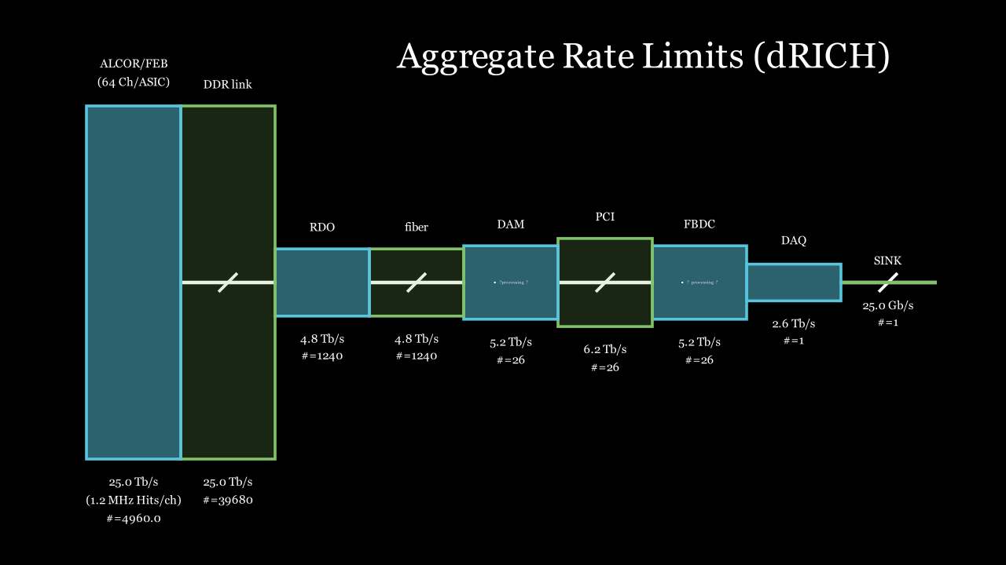
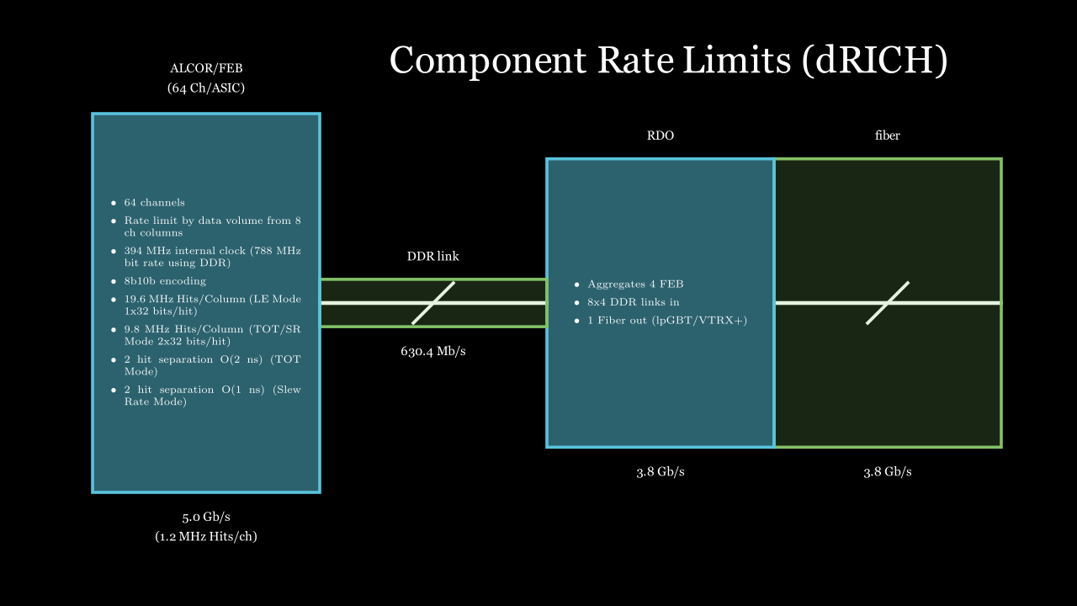
TIC effort to characterize data rates/noise rates/background rates and limitations
I’ve been struggling to provide a comprehensible overview of the data rate limitations
The current best idea is:
Aggregate Rate Diagram
Component Rate Diagram
Supplemental Summary
The next step would be histograms for each component’s expected hit rates by component to. However I think these histograms should come from the detector groups.
This information was verified by the ALCOR internal review.

