Slide 1

ePIC Collaboration News
J. Lajoie, S. Dalla Torre
April 9th, 2026

Slide 2
Hey John, start the recording….

Slide 3
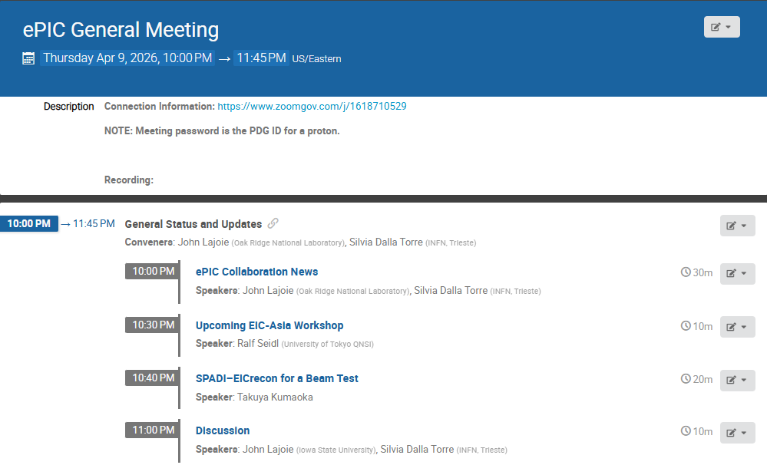
Agenda
Collaboration (and Project) News
Info for EIC-Asia Workshop
SPADI-EICrecon beam test

Slide 4
Collaboration Goals for the first half of 2026
Support the EIC project and ePIC Technical Design:
  Close the design loop with ePIC simulations
  Advance the pTDR in preparation for CD-2
    Respond to review recommendations
Complete the Early Science whitepaper
Progress in developing a multi-year plan for ePIC Software and Computing
Begin submissions to the NIMA Special Issue

Slide 5
News from the TC Office

Slide 6
Beam Background Challenges for the ePIC Subsystems
Motivations:
Background studies needed for pre TDR (subsystems and physics studies)
The project needs a feedback about the current scheme of collimation and shielding
Kick-off : TIC meeting on February 23Rd, 2026
Initial progress report based on the current simulation campaign: TIC meetings on March 30th and April 13th
Coordination of the test beam activities
Overview of the 2026 ePIC testbeams at CERN (TIC meeting February 23rd):
The coordination effort has made possible to accommodate all ePIC needs!
Status and plans for the coming testbeam efforts:
LHFCAL, TIC meeting March 9th
pfRICH, dRICH, TIC meeting April 20th^{th}
MPGDs, AC-LGAD, TIC meeting April 27th
Future perspective: collecting information for future needs of testbeams at FNAL

Slide 7
Workflow for managing simulation workflow
SCC/TC-Office cross-cutting efforts
Motivations:
The need for high fidelity in the geometry used in simulation studies
The need to establish a clear workflow for effectiveness and prompt implementation
Discussion at the TIC meeting on March 23rd
First step toward establishing an effective workflow
All DSCs are requested to provide, by the end of May, a comparison between the geometry currently implemented in the ePIC simulation and the input from the EIC Project engineering team. This comparison should be performed with respect to the September envelopes, which represent the latest version.
DSCs contributions to NIMA special issue
DSLs are requested to send a slide with their planning by April 10th
Discussion at TIC meeting on April 20th
Motivation:
    Having a high-level picture of the subsystem contributions to the special issue to understand/cure problematic aspects, if any

Slide 8
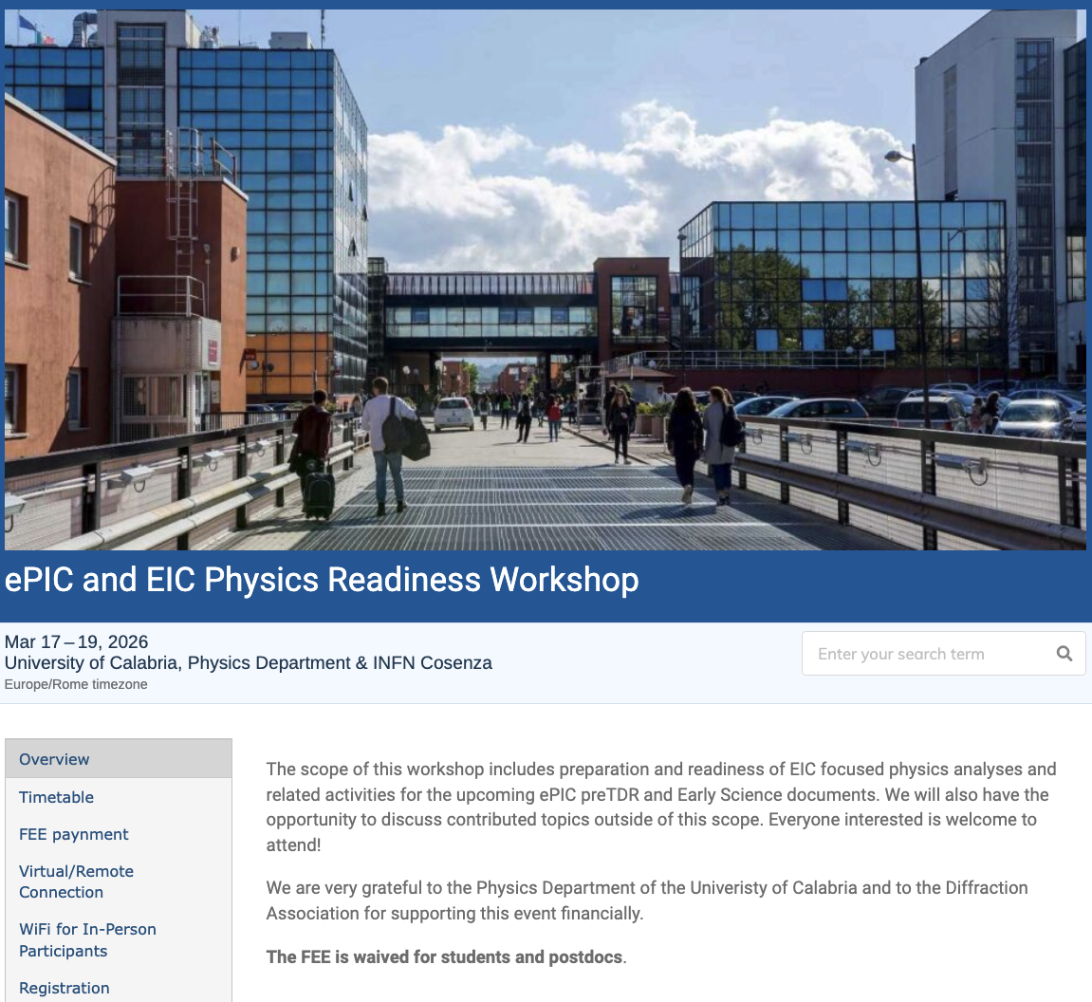

The discussion on performance continues!
Next Physics Readiness Workshop scheduled for March 17-19
  Hosted by the University of Calabria & INFN Cosenza
  Indico: https://indico.bnl.gov/event/30283/
  Hybrid format - Please register even if attending online (select proper option)
The workshop will focus on the finalization of studies and text for the TDR and early science documents
Joint sessions with Software & Computing to discuss reconstruction and simulation priorities
A very successful workshop with great participation held at the University of Calabria! Many thanks to the PACs for organizing, to all the participants, and especially to Sal for hosting!

Slide 9
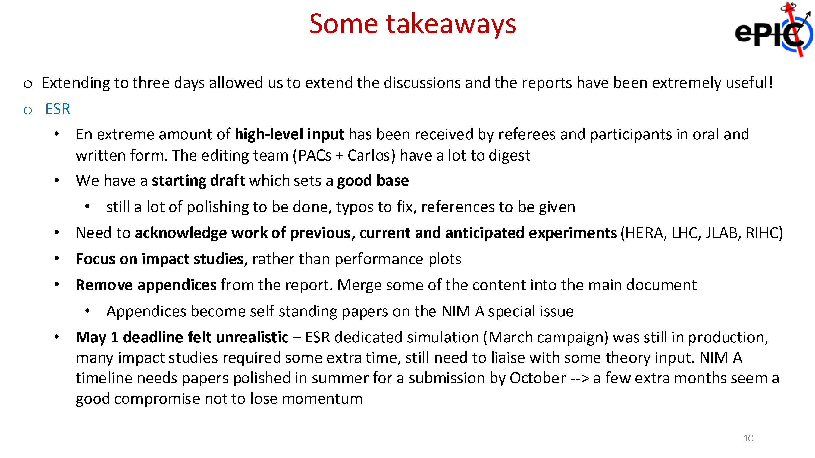
From Sal’s presentation at March 27th GM

Slide 10
Early Science Whitepaper
Excellent discussions on the status of the current draft of the whitepaper, led by comments from review teams.
Two important conclusions:
  It will be more flexible to present a list of expected colliding species and integrated luminosities rather than a year-by-year list of runs. The latter implies a degree of specificity that we don’t have.
    See following talk from EIC Project and PACs, as well as slides from Workshop:
    https://indico.bnl.gov/event/30283/timetable/#20260317.detailed
  Given the timing of the March simulation campaign and the EIC project’s work to develop a project baseline and implementation plan, we have requested a delay of the deadline for the whitepaper until July 2026.
    Do not expect further delays! Important to complete this so we can move on to other priorities.

Slide 11
Why a NIMA Special Issue?
At the January 2025 collaboration meeting we discussed how to better engage early career scientists in ePIC:
  Need recognition for their efforts
  The recognition that matters is publications …
  However, we are not an experiment with data (yet)
Started discussions with NIM Editors in Feb 2025
  Elsevier expressed an interest in publishing performance studies for the EIC.
  Broadened the discussion to a comprehensive issue on the ePIC detector and its capabilities for EIC science.
  Subsequently added S&C (Streaming Data Model) to the conversation
  Model for this is the NIM Special Issue for RHIC
  Submissions will be peer-reviewed
  Elsevier editors very encouraging

Slide 12
ePIC NIMA Special Issue
Plan to publish a super-set of the material prepared for the pTDR
  ePIC Overview Paper
  Subsystem technical papers (derived from pTDR)
  Physics performance paper (derived from pTDR)
  Early Science Whitepaper
  Early Science Physics Appendices
  BSM/EW Physics Performance Paper
  Streaming Computing Model Paper
Overall 30+ publications
This Special Issue will be an important tool to communicate to the NP community the depth, breadth and excitement for EIC science.
Discussions to follow in the PAC and TIC meetings.

Slide 13
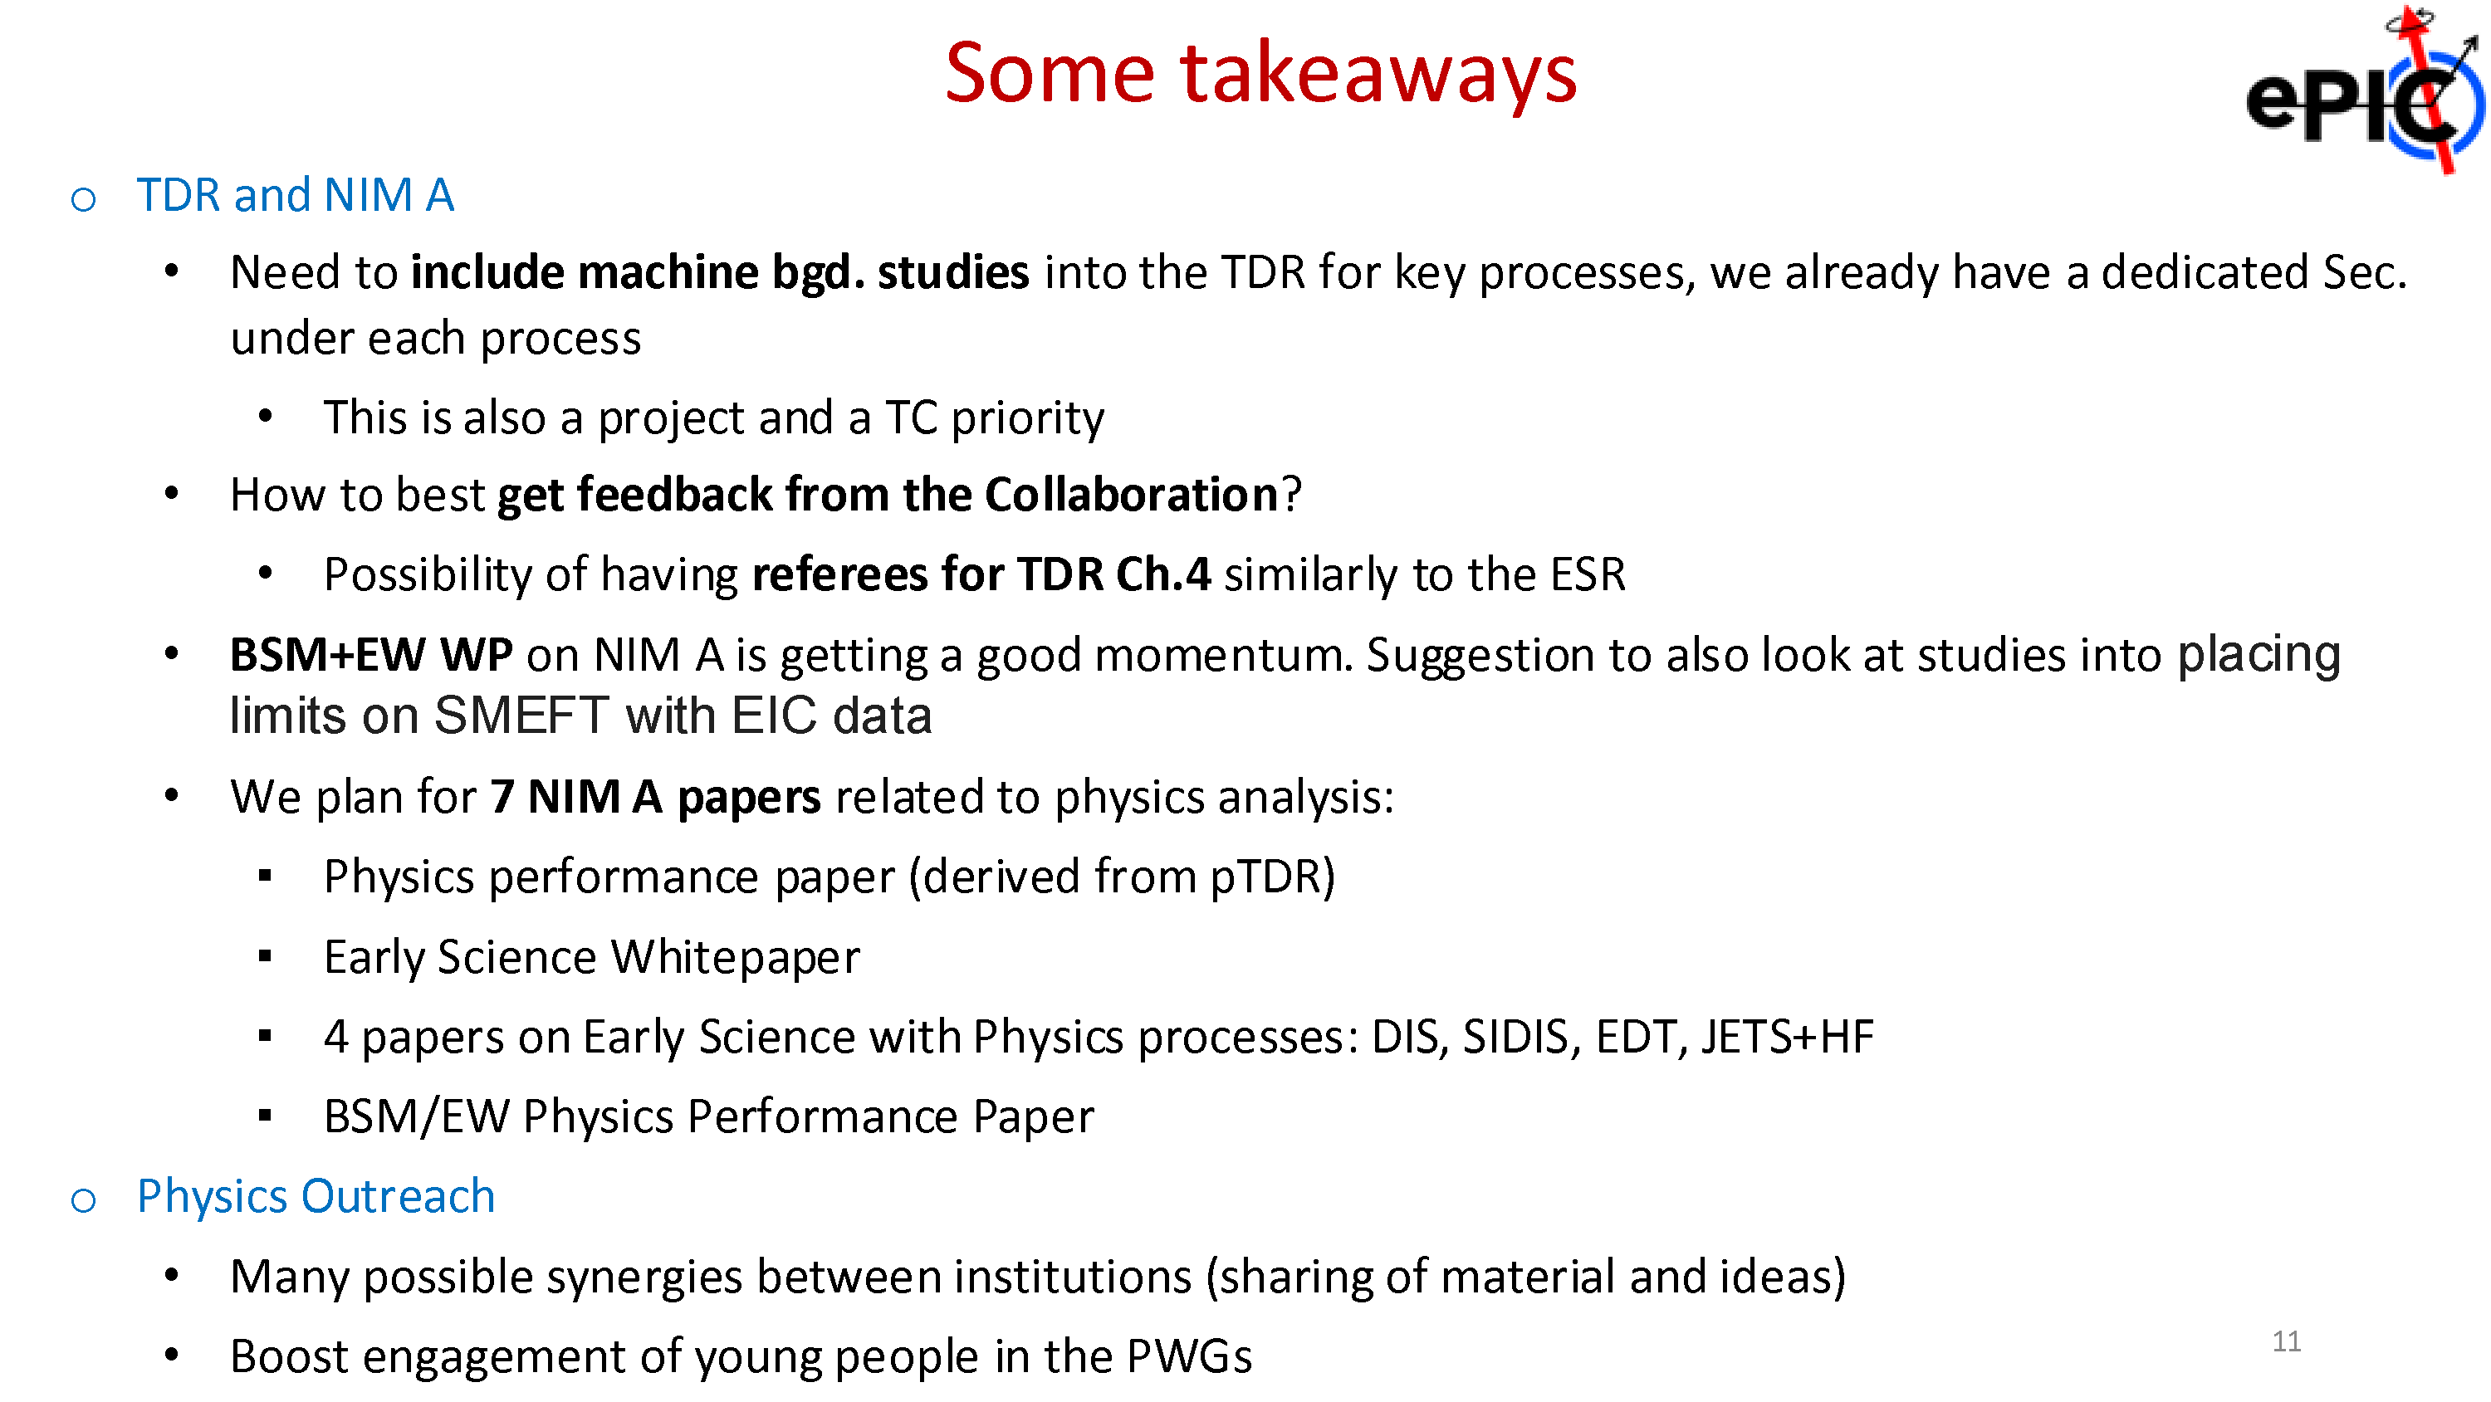

Slide 14
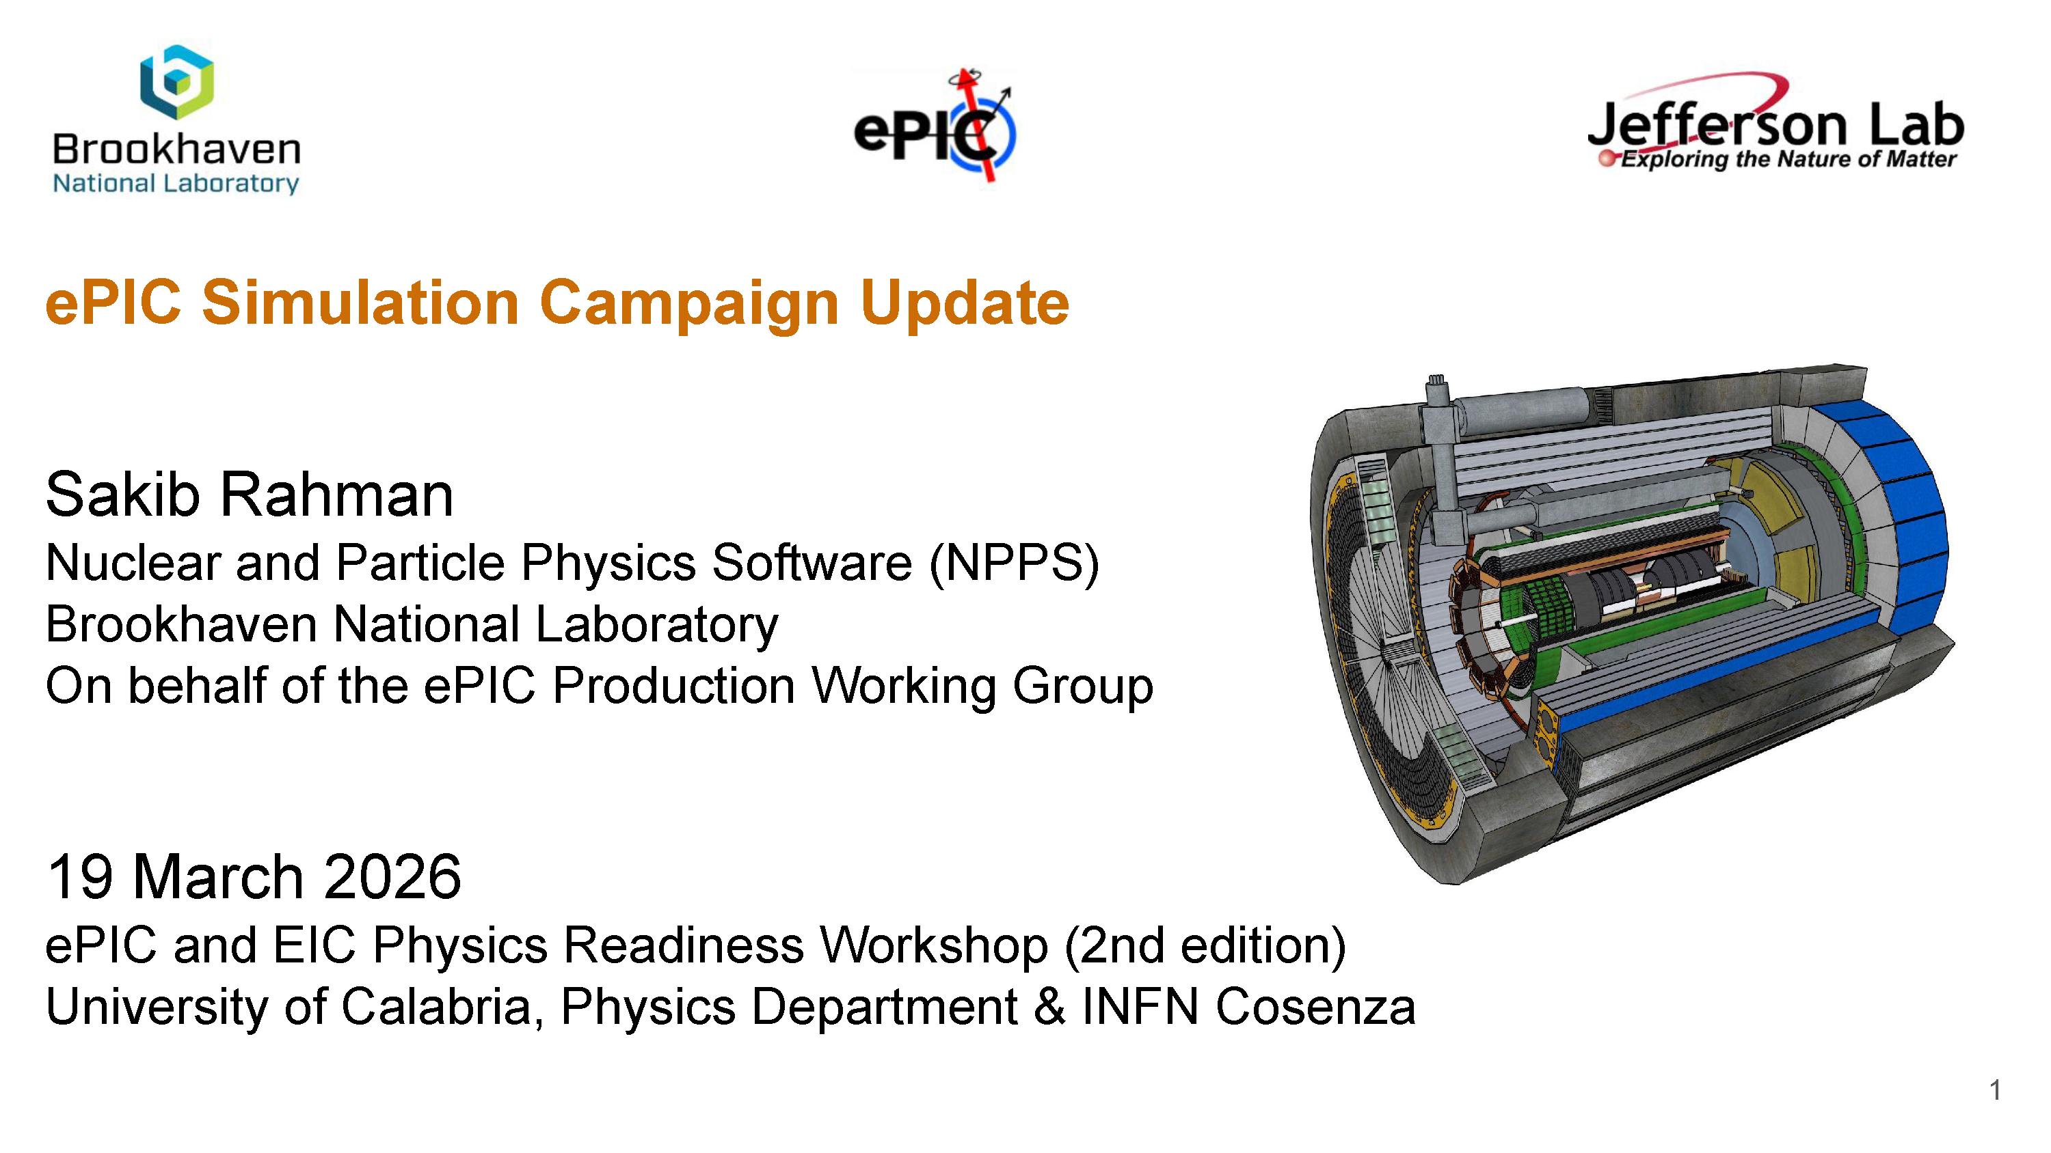
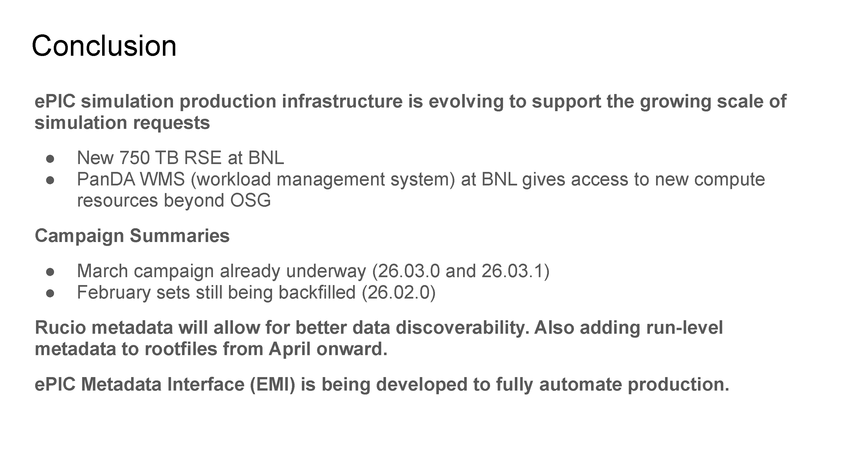
Software and Computing
Early Science Workshop had a joint session with Software and Computing – discussed simulation campaigns, reconstruction, Rucio tutorial, …
Efforts underway to scale our simulation productions and make datasets discoverable.
Software and Computing is extremely active both supporting the simulation effort and planning for the future of S&C in ePIC. Will have a report at the General Meeting on April 24th

Slide 15
Discoverability and Reusability for the preTDR and Beyond
Announced March 2nd
We are excited to announce the upcoming online only ePIC Software & Computing Workshop on “Discoverability and Reusability for the preTDR and Beyond”. This workshop will take place Wednesday, April 29th with presentations on the current strategies for software discoverability and will be an open discussion with the community to gather feedback and refine priorities. We invite all in the ePIC Collaboration and EIC Community to join to learn about the current efforts and contribute to the discussions. Please find the agenda and registration on indico: https://indico.bnl.gov/event/31760/
We look forward to your participation,
Holly Szumila-Vance, Stephen Kay, and Sasha Prozorov
on behalf of the ePIC User Learning WG

Slide 16
News Items

Slide 17

(Following the 7th RRB June 9-10th at MEXT)

Slide 18

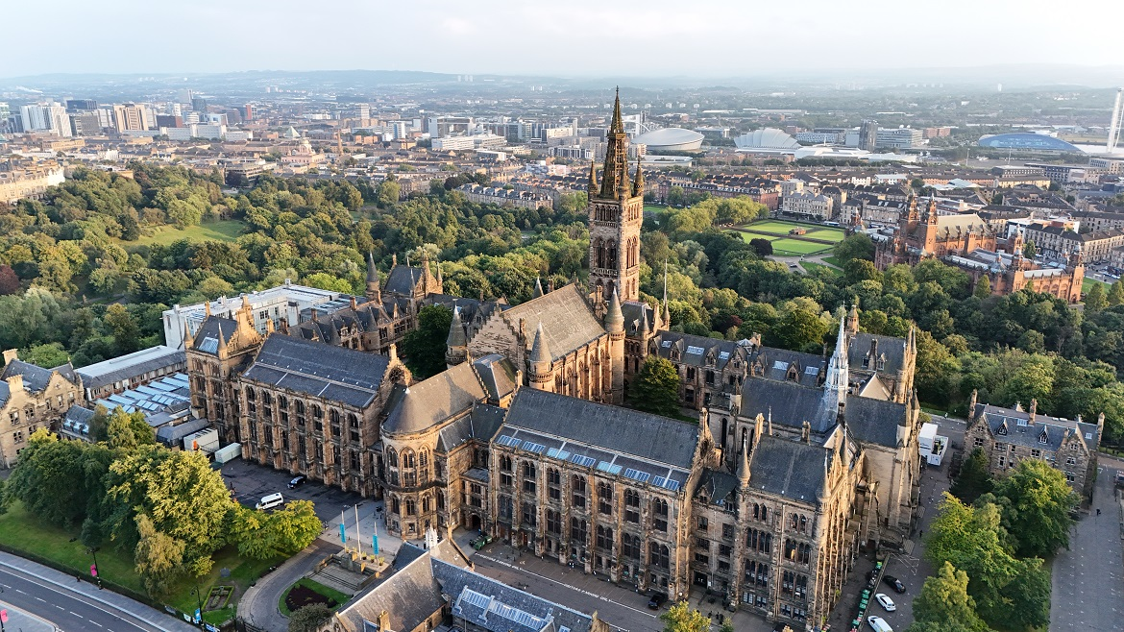
Summer 2026 Joint EICUG/ePIC Meeting
The Summer 2026 joint EICUG/ePIC meeting will be held at the University of Glasgow July 13-17th , 2026.
Indico w/information at:
https://indico.bnl.gov/event/31808/

Slide 19


Slide 20
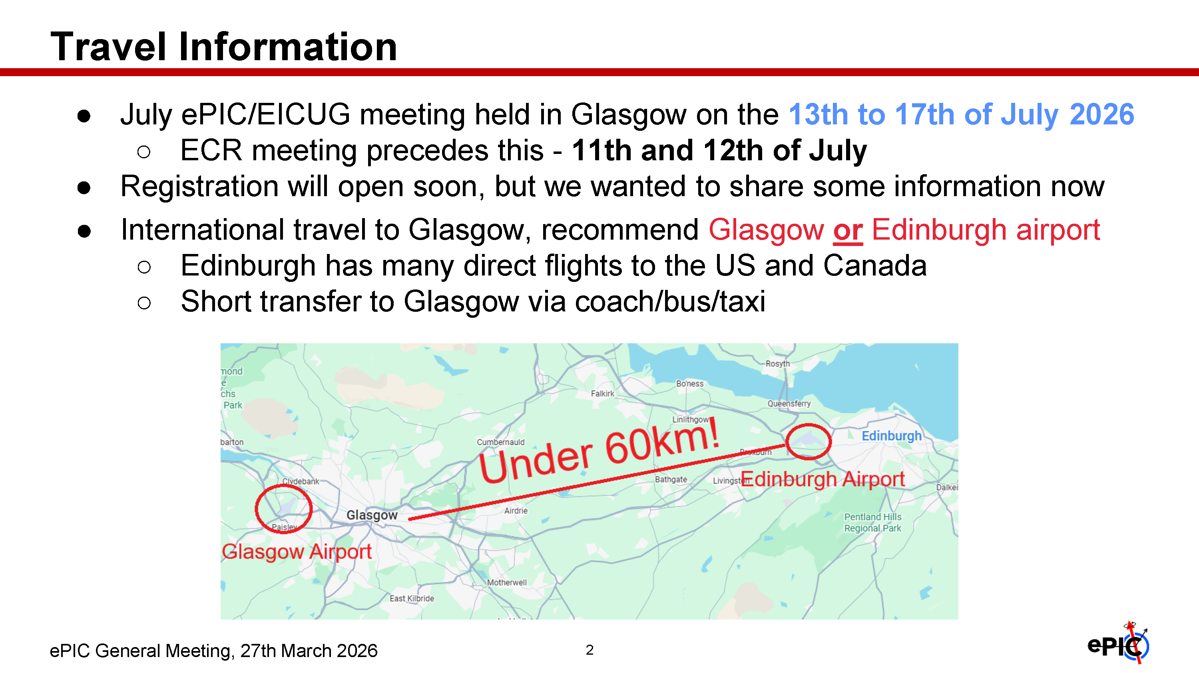
Indico:
https://indico.bnl.gov/event/31808/
For more information, see the GM presentation from March 27th:
https://indico.bnl.gov/event/31936/contributions/122246/attachments/69068/118555/27_03_26_GeneralMeetingUpdate.pdf

Slide 21
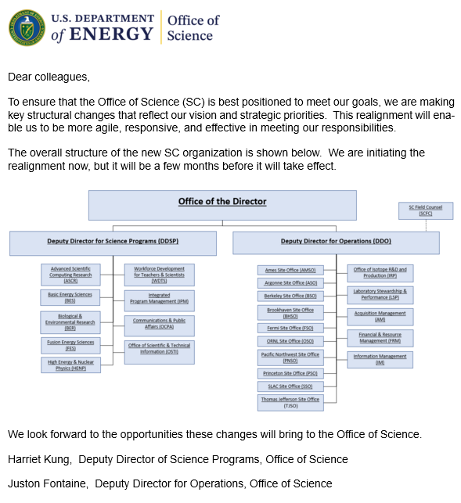

HEP-NP Merger in DOE SC
The long-anticipated merger of HEP and NP in DOE SC was announced March 17th.
Regina Rameika will lead
the combined office.
Sharon Stephenson discussed the change in the APS DNP business meeting on March 18th. The HEP and NP budget lines will remain separate through FY’27.
HEP and NP were originally together and were separated in 1990-91 under the Office of Energy Research (pre-Office of Science).

Slide 22
Upcoming CC Meetings
Closed Meeting (CC reps only): Friday, April 17th @ 10:30AM ET
  Agenda:
    Status of non-compliance with required Statements of Service
      We will present the current situation and the actions taken so far, and will solicit input from the Council.
    Policy updates
      Pending approval of the Charter update, we will ask the standing Council Committees to briefly summarize areas where they see a need for changes. This topic will also continue in the follow-up meeting.
    Targeted discussion of author lists / limited-author papers
      This will be an initial discussion, led by the publication committee, and will be revisited at the subsequent meeting (see below).
Open Meeting (All welcome): Friday, May 29th @ 10:30AM ET
  Preliminary agenda:
    Report from the CTC
    Presentation from institutions applying for membership
    Publication policies – author lists / limited-author papers
    Policy updates – first draft proposals

Slide 23
EIC Project News and ePIC

Slide 24
2026 Timeline Of Major Events (so far…)
EIC Project Strategy Meeting – Dec 4th, 2025
ePIC Collaboration Meeting – Jan 20-23rd
EIC DET Subproject Baseline Review – Feb 3-5th
  See Feb 13th GM Report: https://indico.bnl.gov/event/31494/
EIC Director’s Review – Mar 9-12th
  Report from the EIC Project in this meeting
Meeting with DOE in Washington D.C. – Mar 13th
  EIC Management Team, Lab Directors and ALD’s, ePIC SP
  Focus on achieving the EIC baseline and implementation plan
OPA Review moved to Sept. 13-15th
This review schedule has been a HUGE effort for both the DSC’s and especially the CAMs!

Slide 25
Director’s Review Conclusions (ChatGPT)
The EIC Project has made strong technical progress and demonstrates the capability to deliver the facility.
The primary challenge is no longer technical feasibility, but:
Establishing a credible, fully integrated baseline and aligning scope, cost, schedule, and risk management to meet the $3B cap while preserving mission need.
Focused effort on completing and defending the integrated baseline is now the single highest priority for project success.
Technical progress across all subprojects is strong and in many areas supports CD-2/3 technical readiness.
The project lacks a fully integrated, resource-loaded preliminary baseline, limiting cost and schedule credibility.
Current estimates exceed the $3B cap; systematic cost reductions tied to a defensible baseline are required.
Key leadership positions must be made permanent.
Completing the integrated baseline and quantifying risk-based contingency is the critical next step toward a successful DOE review.
From the March 27th GM:
https://indico.bnl.gov/event/31936/

Slide 26
Cost Reduction Boundary Conditions
Boundary conditions to guide cost reduction:
  “Upgrades” are not currently part of the discussion. The only upgrade currently envisioned beyond EIC project CD-4 is the 2nd Detector and experimental IR.
  Rather than “upgrade” – think about “adiabatic” evolution of the EIC facility capabilities achieved through construction and installation of deferred scope during the initial operations period.
  Assume conventional facilities scope (e.g. support buildings, penetrations, etc.) needed to support deferred scope must be delivered on project.
  In-Kind contributions of accelerator and detector equipment during the initial operations period are appropriate goals.
From the March 27th GM:
https://indico.bnl.gov/event/31936/

Slide 27
Cost Reduction Actions
We have developed a comprehensive list of potential cost reduction opportunities aimed at achieving a $3B cost estimate target for the project, organized into two main classes.
  Class 1
  Actions that reduce cost without impact to ultimate performance capabilities. For example:
    Design Optimization / Value Engineering
    Cost Scrubbing
    Realignment of the scope On-Project and Off-Project
    Procurement optimized to maximize best value opportunities
  Class 2
  Actions that reduce cost and scope by deferring ultimate performance capabilities.
    Scope Deferred to Initial Operations Period
    Example: Construction and installation of the full ESR RF system buildout during initial operations.
From the March 27th GM:
https://indico.bnl.gov/event/31936/

Slide 28
Plan to Achieve Total Project Cost Estimate Goal ($3B)
“Scenario 2”: Implement Class 1 and Class 2 Cost Reduction Actions
Class 1: (many items, full list in backup slides)
  Maximum electron beam energy reduced to 9 GeV.
    This requires that the respective PS in the HSR to support 275 GeV are upgraded to meet CM energy range.
  ESR Main SRF systems are relocated from the currently planned IR-10 location to IR-08.
    Potential 2nd detector location would move to IR-12​
    Would require a new Hall at IR-12 for a later EIC Detector 2 project​
  Many others …
Class 2:
  Four elements deferred to NP / EIC OPS – see next slides.
  A fifth element, defer installation of the EIN-BAR, was considered and rejected. The cost-benefit was very poor. Lumi plots in Slide 10 will be updated, to do a consistent simulation for all scenarios
From the March 27th GM:
https://indico.bnl.gov/event/31936/

Slide 29
Plan to Achieve Total Project Cost Estimate Goal ($3B)
Class 2 actions => elements provided during initial operations by NP / EIC OPS:
  4x ESR Main SRF Systems deferred.
    Installation reduced from 6x SRF CM systems to 2x systems.
    Maximum bunch charge is reduced by ~3x from 28nC/bunch to 10nC/bunch at 9 GeV.
  Low Energy Cooling deferred.
    Reduces maximum average luminosity capability by 2x to 3x.
  394 MHz IR Crab Systems deferred.
    Reduces maximum hadron bunch charge by 2x.
  41 GeV HSR Bypass Line deferred.
    Minimum achievable CoM collision energy reach increases to 45 GeV from 29 GeV.
This assumes all infrastructure work and engineering designs will be completed within the EIC Project scope to allow an adiabatic installation of these 4 items during EIC operations phase.
Note that luminosity reductions (next slide) do not scale simply/linearly with the reductions shown here. They are for reference only.
From the March 27th GM:
https://indico.bnl.gov/event/31936/

Slide 30
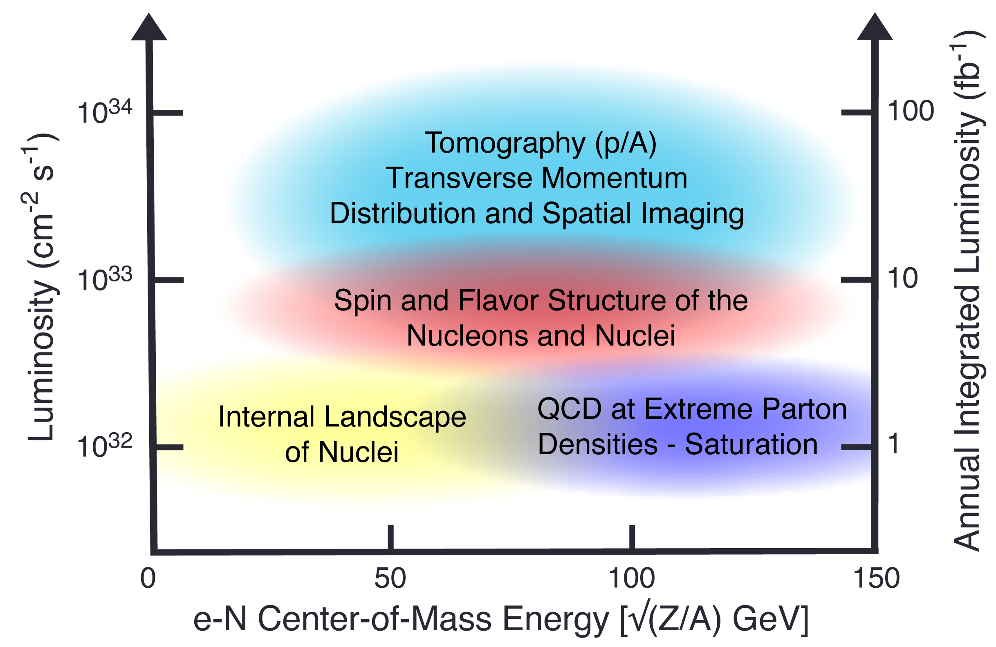
EIC Science Reach for ep vs Deferred Scope
+
EIC Full Capability
Implementation of Class 1 items (Scenario 1)
5 GeV x 100 GeV
From the March 27th GM:
https://indico.bnl.gov/event/31936/
+
EIC
RF for 7nC/bunch
+
EIC
RF for 7nC/bunch
no 394 MHz crab cavities
+
+
+
+
Average Luminosity (cm⁻² s⁻¹)
+
EIC
Implementation of all Class 1 & 2 Items (Scenario 2)
RF for 7nC/bunch
no 394 MHz crab cavities
no low energy cooling
no 41 GeV bypass
+
+
+
+
+
+
+
+
+
+
EIC (rejected)
RF for 7nC/bunch
no 394 MHz crab cavities
no low energy cooling
no 41 GeV bypass
no Beam Accumulator Ring (rejected)
+
+
e-p Center-of-Mass Energy [GeV]

Slide 31
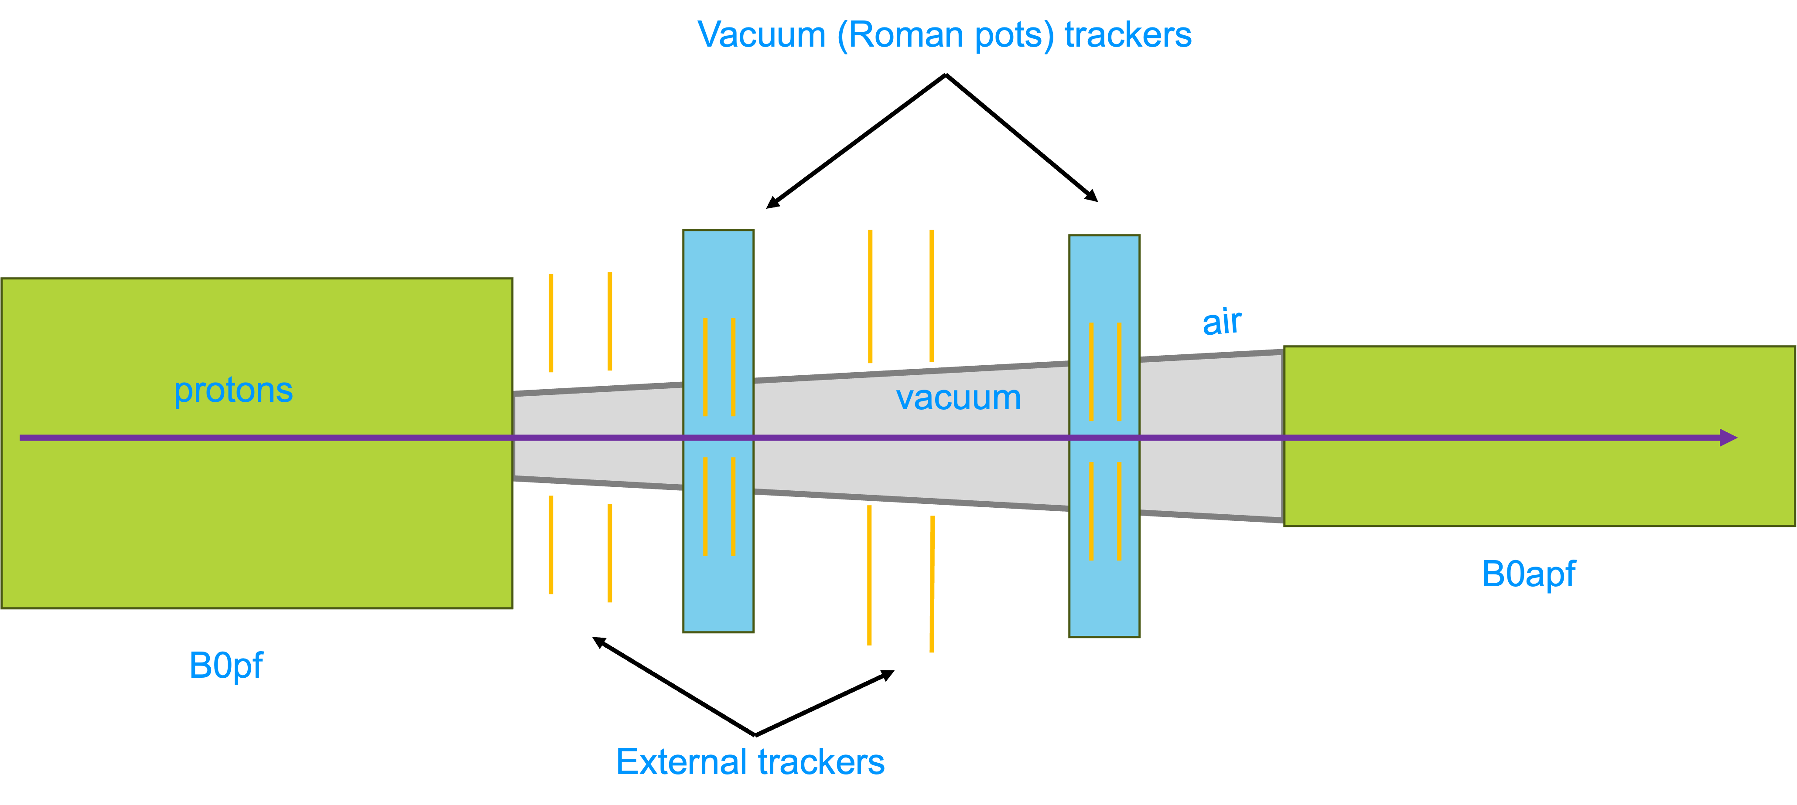
(Potential) New IR layout to reduce Risk and Cost of SC Magnets
Magnet apertures mostly come from transverse momentum requirement to capture particles with pT < 1.3 GeV in forward detectors → see slide 3
General Idea: Capture transverse momentum earlier between B0ApF and B0pF
→ Add space between B0pF and B0ApF and Increase B0pF integrated field
  → Integral field from B0pF of 2.4 T·m
  → reduce B0 aperture to 15 mrad and remove trackers and ECal
1.5 m after B0pF for detector hardware → Roman Pots, Off momentum detectors and B0 detectors
Important;
  Need sufficient separation between circulating beam and ZDC
  Need sufficient separation between HSR and ESR at crab cavities
Investigate right now if there is a real gain to apertures, if we transport only the 4mrad neutron cone to the ZDC
PbWO4
calorimeter
From the March 27th GM:
https://indico.bnl.gov/event/31936/

Slide 32
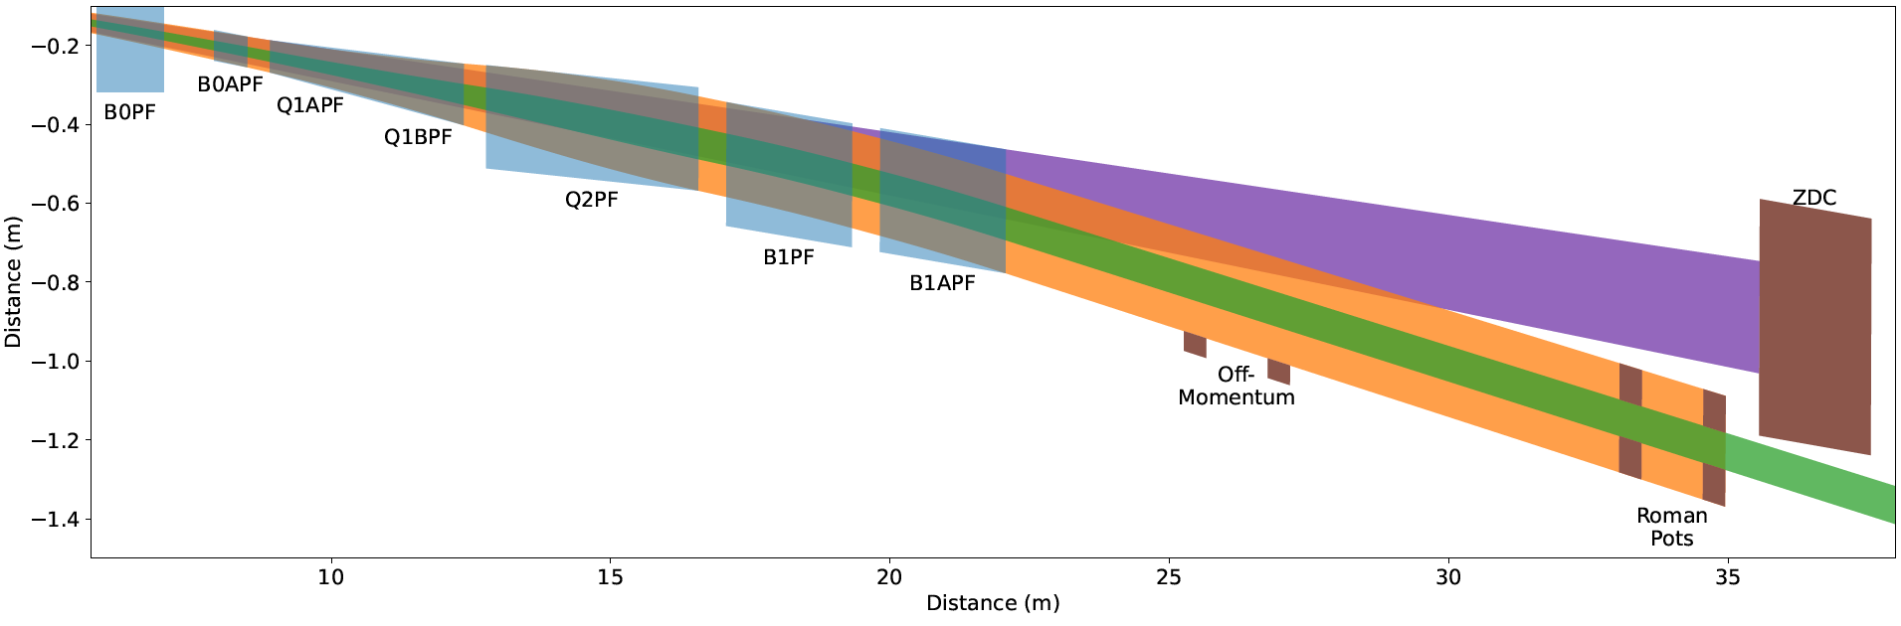
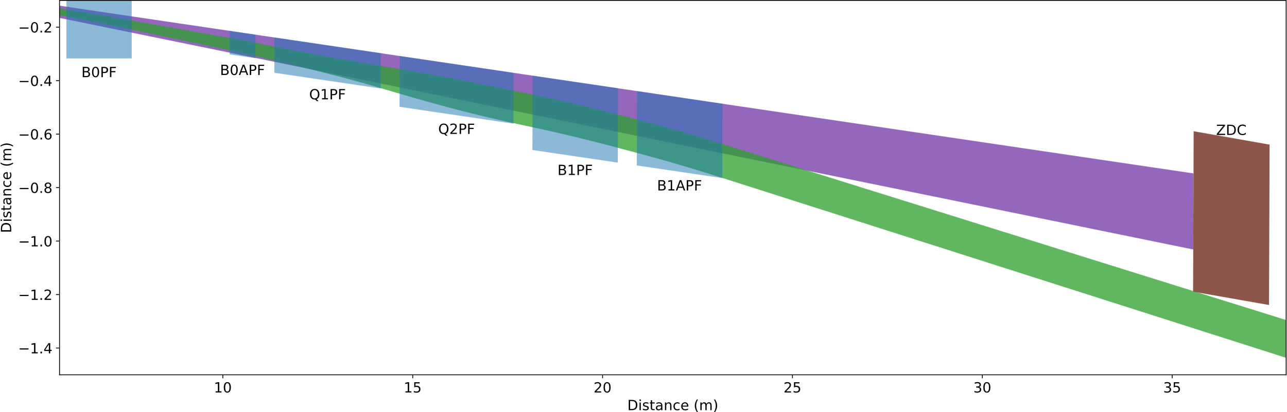
From Now to Layout 3
Add 1.5 m of drift between B0pF and B0ApF for detector
No longer need to transmit high transverse momentum particles
Still must transmit neutral cone
Reduce magnet apertures. Will also reduce quadrupole lengths.
Minimum B0pF integrated gradient 2.4 T·m
B0pF uses the same basic design as the existing one
Remaining magnets have ESR edge along the neutral cone
  Apertures are not aligned
Retain B1pF/B1ApF lengths, common design
Keep fields at beam tube to 4.5 T
Keep ZDC and downstream layout the same
Tried a solution without B0ApF, all bending in B0pF
  B0pF probably too long, difficult quench protection
Haven’t run complete suite of configurations, did some educated guessing → Correct within 20%?
Now
Nothing is decided !!!!!
Will only be done, if there is a significant gain in making the magnets simpler and there is no significant loss in science
New
From the March 27th GM:
https://indico.bnl.gov/event/31936/
Still need to investigate luminosity consequences
March 17, 2026
J. Scott Berg

Slide 33
Update on Reviews – Path to Baselining CD-2
Preliminary Design Reviews (60% design maturity equivalent, called PDR, PDR2 or PDR3, pending the subsystem)
  PDR2: Silicon Tracking Detectors (6.03.01.02.01) – Jan. 27-28, 2026
  PDR2: Polarimetry (6.03.01.11) – February 18, 2026
  Peer Review: DAQ-Slow Controls (6.03.01.08.02) – May 2026 – Separated from electronics/DAQ to ensure integration in collider common platform, we only have Slow Controls Integration and the controls relies on scope in various areas
  PDR3: IR Integration and Auxiliary Detectors (6.03.01.10) – April 20, 2026 – Low-Q2, ZDC, includes 6.10.14 lumi detector
  PDR3: IR Integration and Auxiliary Detectors (6.03.01.10) – July (?) 2026 – B0, RPs, OMDs – Exact Dates TBD
  PDR2: AC-LGAD-based Particle Identification Detectors (6.10.04; BTOF, FTOF, common systems) – June 3-4, 2026
Final Design Reviews (FDR):
  FDR: Backward EM Calorimetry (6.03.01.04.01) – May 26, 2026
  More FDRs planning ongoing – see next slide
Project Reviews:
  Detector Baseline Readiness Review Feb 3 – 5, 2026
  BNL Director’s Review – Comprehensive, Mar. 9-12, 2026
  DOE OPA Status Review April 28-May 1, 2026 → September 15-18, 2026
  DAC – Summer/Fall 2026 – aim is to let DAC review all (PDR and DAC) recommendations that need completion by CD-2 and the status towards CD-3
  CD2 IPR & ICR Fall 2026?
Other Meetings:
  7th RRB Meeting: June 9-10, 2026 – MEXT, Tokyo
From the March 27th GM:
https://indico.bnl.gov/event/31936/

Slide 34
Update on Reviews – Planning for CD-3
Final Design Reviews (FDR):
  FDR 6.03.01.04.01: Backward EM Calorimetry – May 26, 2026
Planning for Final Design Reviews before CD-3: (dates given are what was before in P6 and what is now)
  FDR 6.03.01.02.01: MPGDs – January 2027 → move to March 2027
  FDR 6.03.01.02.02: SVTs – August 2027
  FDR: hpDIRC – August 2026 → hpDIRC, dRICH and pfRICH – February 2027
  FDR: dRICH – January 2027 → hpDIRC, dRICH and pfRICH – February 2027
  FDR: pfRICH – February 2027 → hpDIRC, dRICH and pfRICH – February 2027
  FDR: TOF – June 2027
  FDR: Barrel EM Calorimetry – September 2026
  FDR: Forward EM Calorimetry – September 2026 → combine with Barrel HCAL and LFHCAL?
  FDR: Barrel HCAL – October 2026 → September 2026, combine with Forward EMCal and LFHCAL?
  FDR: LFHCAL – September 2026 → combine with Forward EM Cal and Barrel HCAL?
  FDR: Magnet Cryo – link to integral review with accelerator/cryo, July 2026
  FDR 6.03.01.07: Electronics – September 2026 → Electronics and DAQ/Computing September 2026
  FDR 6.03.01.08: DAQ/Computing – July 2026 → Electronics and DAQ/Computing September 2026
  FDR: I3 Barrel Detector Structures – February 2027
  FDR: I3 Detector Infrastructure and Utilities Integration – July 2027
  Missing: FDR: Installation (includes also Magnet Installation)
  FDR: Auxiliary Detectors, B0 – July 2027 → B0 and RP/OMD – July 2027
  FDR: Auxiliary Detectors, RP/OMD – July 2027 → BO and RP/OMD
  FDR: Auxiliary Detectors, ZDC – July 2027 → ZDC, lumi & low-Q2 – April 2027
  FDR: Auxiliary Detectors, Low-Q2 – March 2027 → ZDC, lumi & low-Q2 – April 2027
  FDR: Auxiliary Detectors, Lumi Monitor – October 2026 → ZDC, lumi & low-Q2 – April 2027
  FDR 6.03.01.11.02: Hadron Polarimetry – March 2027 → Hadron and Electron Polarimetry – May 2027
  FDR 6.03.01.11.01: Electron Polarimetry – May 2027 → Hadron and Electron Polarimetry – May 2027
  Missing: (FDR or perhaps rather) Peer Review: Commissioning – November 2027
  FDR: HRPPDs – September 2026
  FDR: Mirrors & Aerogel – September 2026
  FDR: GEMs & PCBs – needs results of 1st and likely 2nd engineering test article → Remove from CD-3C
Assumption: DET CD-3 in Q1/FY28
→ DOE Review ~ October 2027
FDRs need completion ~ July 2027
BUT: There are subsystems that benefit from FDR this CY might there be a CD-3C. E.g., EM calorimetry, forward HCAL, gaseous-based PID detectors, and scope such as HRPPDs, SiPM boards
PEMP deliverable - objective 2.1:
“Prepare a table of design reviews necessary to attain CD-2 and CD-3 for each subproject indicating what reviews have covered which scope and when, and when future reviews of specified scope will occur. Actively maintain this table. Indicate scope by citing work breakdown structure elements.”
From the March 27th GM:
https://indico.bnl.gov/event/31936/

Slide 35
Conclusions
The collaboration is making progress on the priorities outlined in Jan.
The ongoing reviews are a process through which the EIC project works to establish the project baseline.
  Support for the review process by the collaboration/CAMs has been tremendous!
  Be ready to engage with the project to support the EIC science mission
It is critically important that we work to communicate the importance of EIC science to the community!
  The Early Science whitepaper and NIMA Special Issue are how we will do this
The hectic pace of the reviews, as well as baselining and creating the implementation plan can generate a lot of noise. We have to stay the course and stay focused on the EIC science mission.

Slide 36
What Would You Like to See?
We’d like to make these General Meetings as useful as possible to everyone in the collaboration. We also recognize that the meetings held in the US/Europe time and Asia time don’t have to be identical.
What would make these meetings more useful to you?
What would you like to see more of?

Slide 37


Slide 38
Status of the Special Issue
Special Issue form filed with Elsevier Jan 2026
Organization:
  Spokesperson is Executive Guest Editor
  Coordinators are Co-Guest Editors
    Will manage submissions from their areas and manage reviews with an Elsevier editor
Special Issue is currently open for submissions
Planning for publications to be Open Access
  Based on agreements with corresponding author institutions

Slide 39
High Level Summary of Where We Are
EIC Mission Need Parameters
A high degree of beam polarization* (~70%) for electrons and light ions
Availability of ion beams from deuterons to the heaviest stable nuclei
Variable center of mass energies ~20–100 GeV,
upgradable to ~140 GeV (e-p)
High collision luminosity* ~10³³–10³⁴ cm⁻² s⁻¹
Possibly more than one interaction region (* avg over a fill)
The EIC project must develop a baseline that:
  Addresses the EIC CD-0 Mission Need Statement
  Start early science within 10 years
  Costs less than ~$3B
A baseline that meets these conditions was not presented at the Director’s Review.
  When we discussed the EIC baseline at the Collaboration Meeting, I stated “The collaboration must have an opportunity to respond to changes to the baseline that affect EIC science”
  The project is working diligently to put together a combined EIC Portfolio (Project, R&R, NYS…) and operations (implementation) plan that meets EIC Mission Need
    While this doesn’t yet affect mission need it will likely impact early science
    It may mean some redesign or rethinking to reduce cost/risk
    We need to be realistic about how both ePIC and the EIC will turn on!
  The EIC Project needs to get everything into P6 and use it as a tool
  On the positive side – there has been tremendous technical progress
EIC Project Management to meet with DOE April 21st
  Both (former) HEP and NP DOE personnel to attend

Slide 40
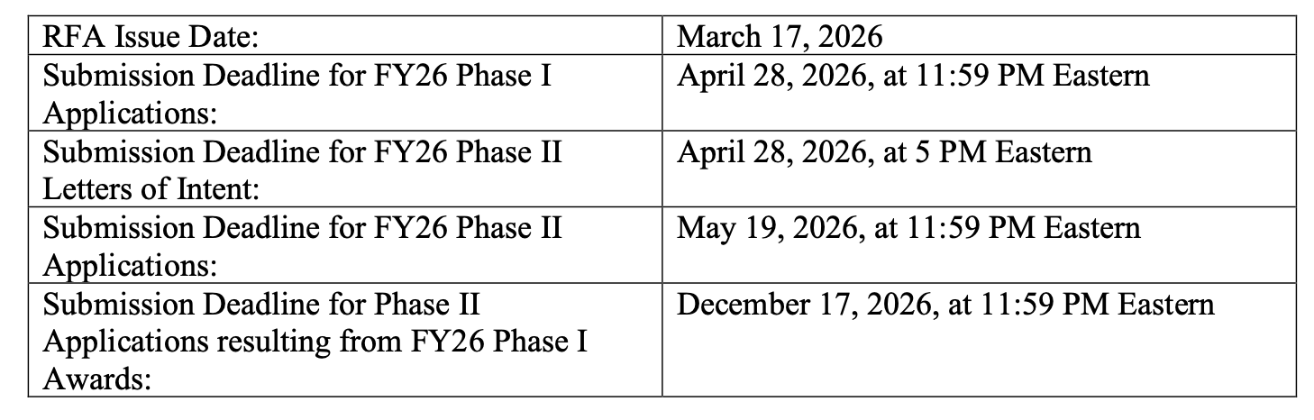
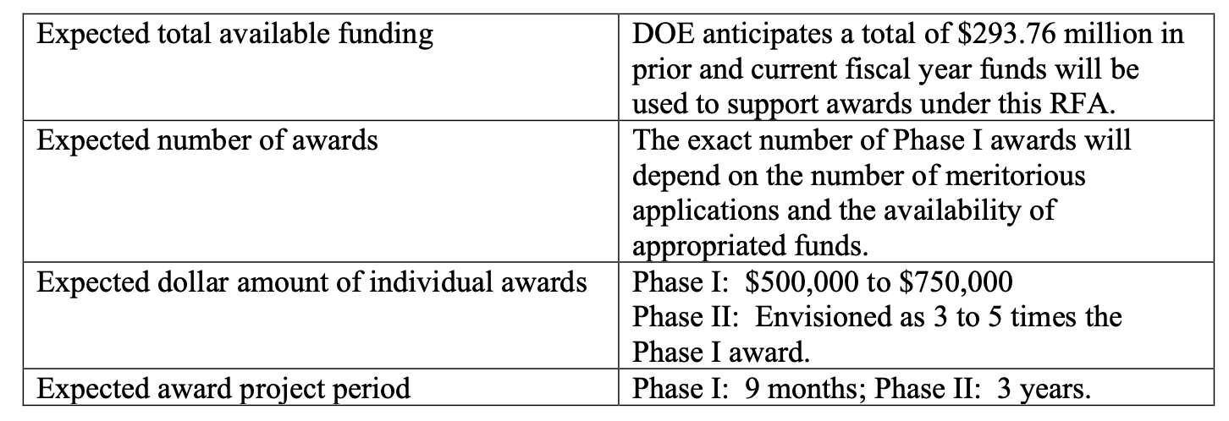
Soliciting applications from interdisciplinary teams addressing the Genesis Mission Challenges to accelerate scientific discovery and R&D workflows using novel AI models and frameworks.

Slide 41

ePIC and the Genesis Mission
Working to provide a way to coordinate efforts in ePIC, match up people and proposals. Shared spreadsheet here.
Markus hosted a discussion on coordinating ePIC efforts on the Genesis Mission after the March 25th S&C Meeting.
The Genesis Mission is an opportunity for ePIC. Success depends on alignment with our priorities. We should actively coordinate proposals now.
Opportunities:
Broader engagement with and in ePIC Software & Computing,
Expand our workforce.
Increase visibility of AI within ePIC.
Challenges:
Impact depends on alignment with ePIC priorities.

Slide 42
Research Funding
As many are aware, DOE NP research budgets are anticipated to decline in FY26
As discussed by Sharon Stephenson in APS DNP Business Meeting:
  18% reduction in NP Research Budget
  Redirect of ~10% for Genesis Mission
We anticipate this will create hardships for both university and lab research groups working on ePIC
ePIC Leadership needs to be able to communicate clearly the impact that this will have on engagement in ePIC and readiness for baselining and construction
Please contact the SP Office to let us know if budget cuts are forcing you to reduce your commitment to ePIC

Slide 43
Request to the EIC Project
The outcome of the project baselining exercise can affect the EIC science program in multiple ways:
  Changes the scope of the DET subproject
  Changes to the ASR, EIN and ISR subprojects (EIC performance)
The collaboration must have an opportunity to respond to changes to the baseline that affect EIC science
We have discussed with Jim Yeck, David Dean, and Abhay a process by which the collaboration is charged to provide a formal, written response on the impact to EIC science once the preliminary baseline is established
  The timescale for this will be VERY short!
We hope to have a better understanding of the baselining implications for the EIC collider at the collaboration meeting.
  Today the focus is on the detector.

Slide 44

ePIC Resources
Public Website - https://www.bnl.gov/eic/epic.php
Mailing Lists – https://lists.bnl.gov/mailman/listinfo
Indico Agenda - https://indico.bnl.gov/category/402/
  ePIC Software and Computing: https://indico.bnl.gov/category/435/
Wiki - https://wiki.bnl.gov/EPIC
ePIC Software Training:
  Landing Page: https://eic.github.io/documentation/landingpage.html
  Tutorials: https://eic.github.io/documentation/tutorials.html
Mattermost: https://chat.epic-eic.org
ePIC Zenodo Community: https://zenodo.org/communities/epic

Slide 45


EICUG Membership
The EICUG is a vital organization to promote the interests of the EIC community!
  Without the EICUG we would never have gotten far enough to form ePIC!
Please register your institution!
Check with your EICUG IB representative to get registered as a member
https://www.eicug.org/content/join.html

Slide 46
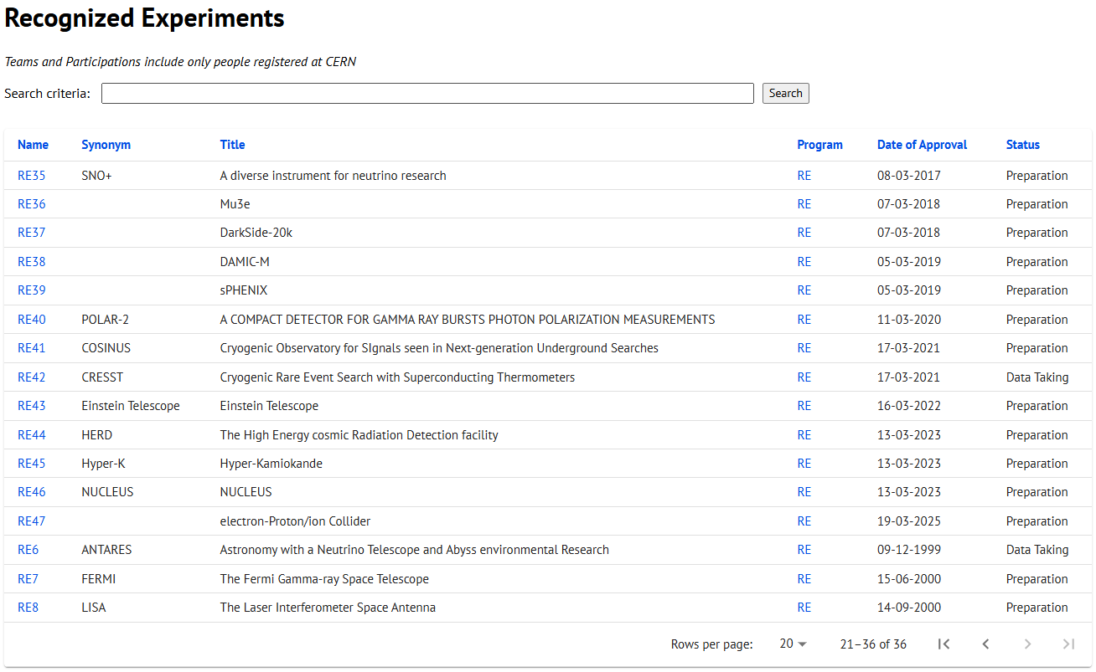
CERN Recognized Experiment Status: RE47
ePIC now appears in the CERN Grey Book database as RE47:
https://greybook.cern.ch/experiment/recognized
Two steps to get ePIC Collaborators registered at CERN:
CC Representative needs to register as team leader with
CERN Users Office:
  https://usersoffice.web.cern.ch/
  https://usersoffice.web.cern.ch/team-leaders-corner
  Users.Office@cern.ch
CC member can then certify registrations of team members
Contact us if you run into problems!

