Slide 1

ePIC Collaboration News
J. Lajoie, S. Dalla Torre
April 24th, 2026

Slide 2
Hey John, start the recording….

Slide 3
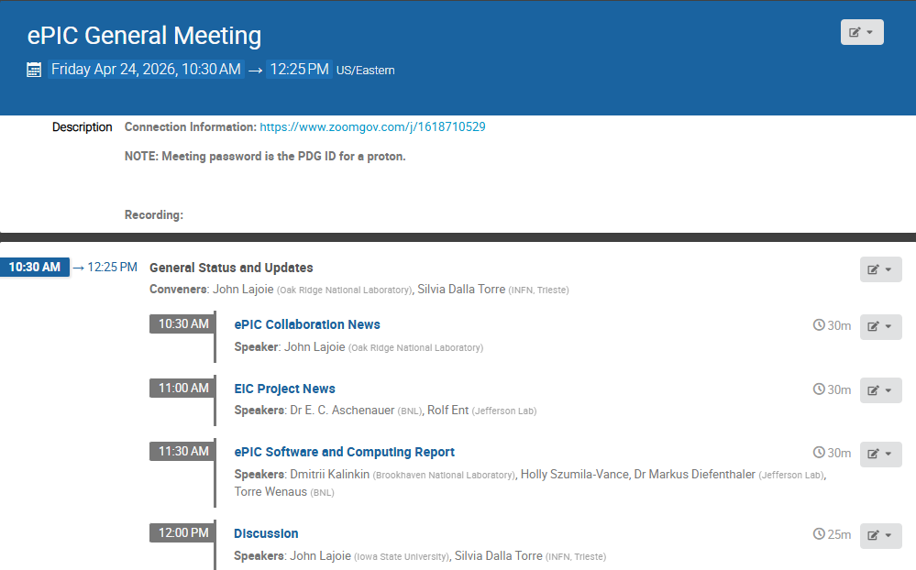
Agenda
Collaboration and Project News
Report from Software and Computing

Slide 4
ePIC NIMA Special Issue
Plan to publish a super-set of the material prepared for the pTDR
ePIC Overview Paper
Subsystem technical papers (derived from pTDR)
Physics performance paper (derived from pTDR)
Early Science Whitepaper
Early Science Physics Appendices
BSM/EW Physics Performance Paper
Streaming Computing Model Paper
Overall 30+ publications
This Special Issue will be an important tool to communicate to the NP community the depth, breadth and excitement for EIC science.
Discussions to follow in the PAC and TIC meetings.

Slide 5
Special Issue Discussions
The contents and format of the special issue are beginning to take shape!
Physics Analysis Coordination Meeting:
Discussion within the April 14th PAC Meeting:
https://indico.bnl.gov/event/32328/
Expecting:
Early Science Whitepaper, 4 ES papers from the WG’s, BSM+ EW paper
Technical and Integration Council Meeting:
Discussion within the April 20th TIC Meeting
https://indico.bnl.gov/event/31905/
Thoughtful discussion around creating a combined set of subsystem, technology and test beam performance papers.
e.g. separate EMCal papers, but a common HCAL paper
Separate ASIC contributions?
Software and Computing:
Will publish the Streaming Computing Model paper in the NIMA Special Issue
Dedicated software and simulation paper
SP Office has also invited “outside” contributions:
EIC polarimetry groups invited to contribute
In discussions with EPIOS consortium

Slide 6
Beam Background Challenges for the ePIC Subsystems
News from the TIC
Motivations:
Background studies needed for pre TDR (subsystems and physics studies)
The project needs a feedback about the current scheme of collimation and shielding
Kick-off : TIC meeting on February 23Rd, 2026
Initial progress report based on the current simulation campaign: TIC meetings on March 30th and April 13th
Coordination of the test beam activities
Overview of the 2026 ePIC testbeams at CERN (TIC meeting February 23rd):
The coordination effort has made possible to accommodate all ePIC needs!
Status and plans for the coming testbeam efforts:
LHFCAL, TIC meeting March 9th
pfRICH, dRICH, TIC meeting April 20th^{th}
MPGDs, AC-LGAD, TIC meeting April 27th

Slide 7
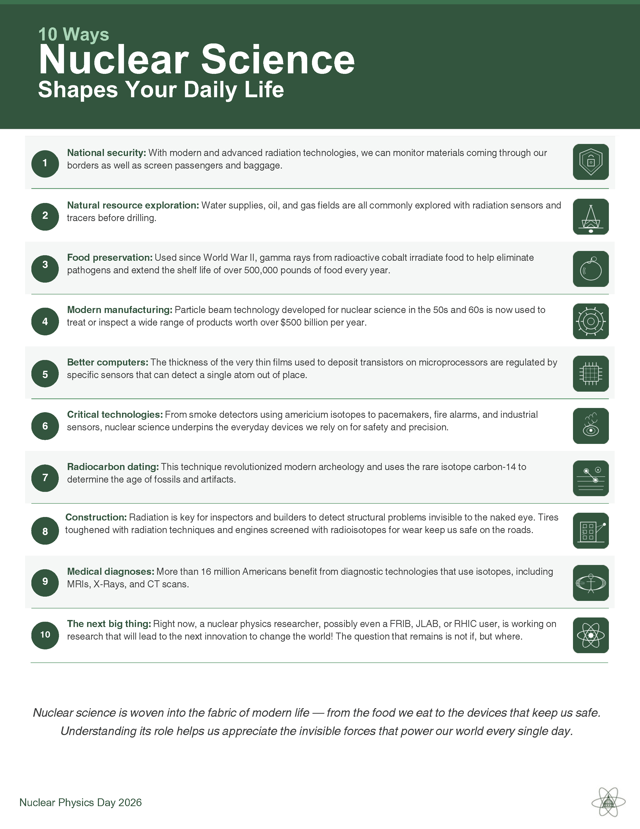
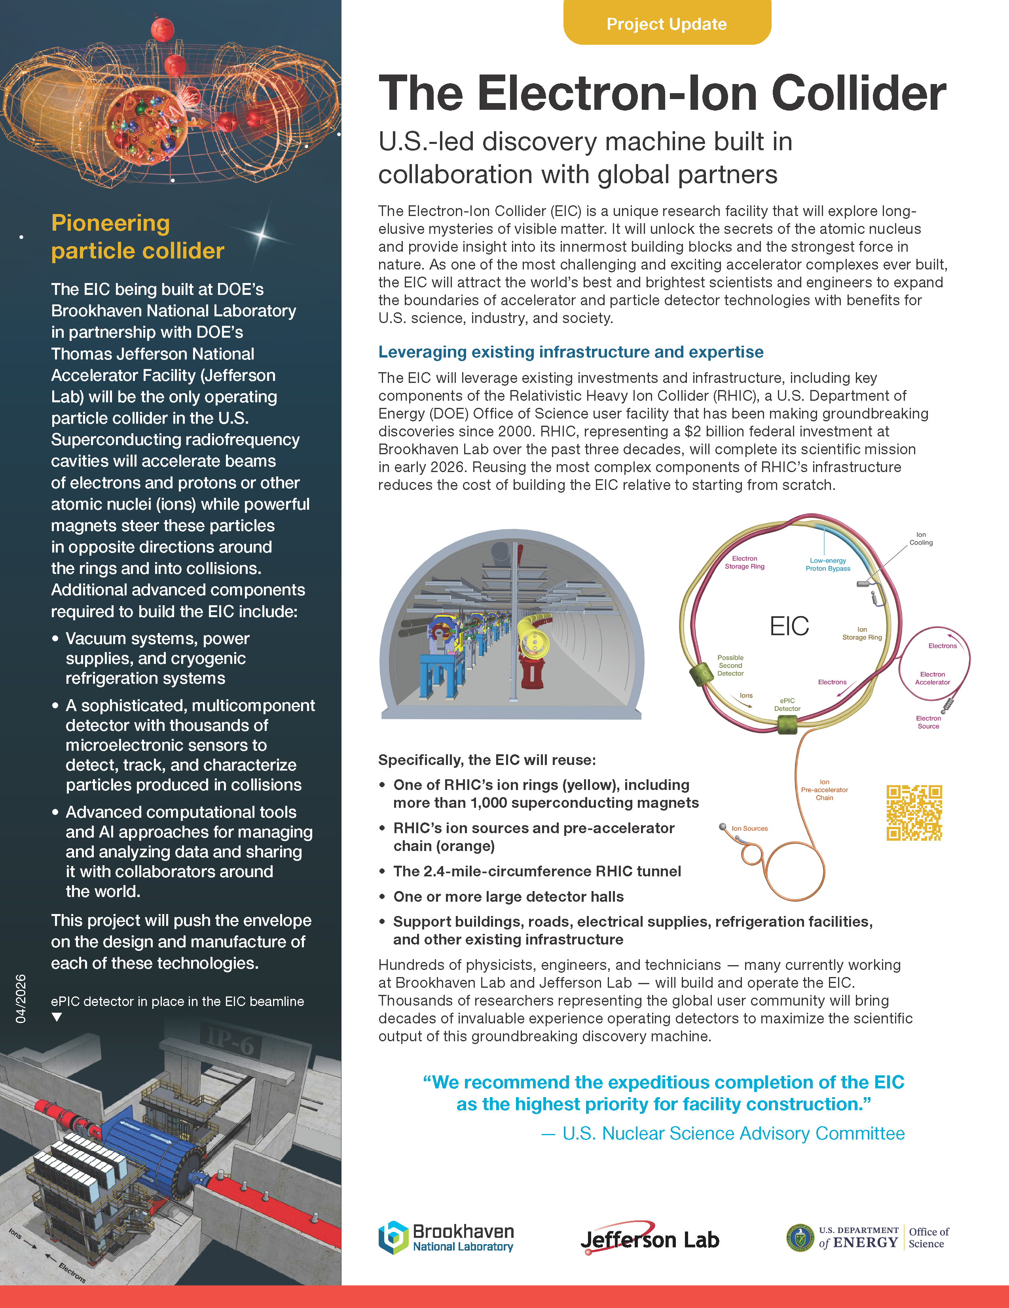
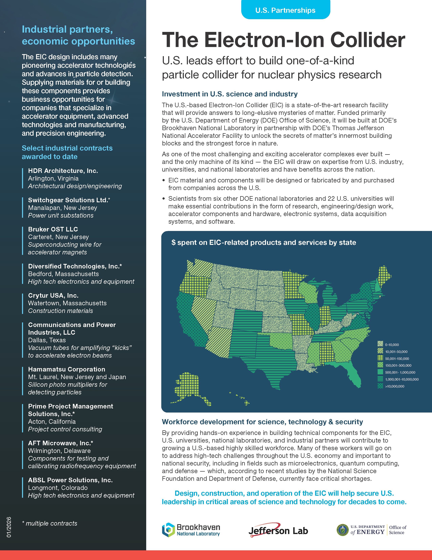
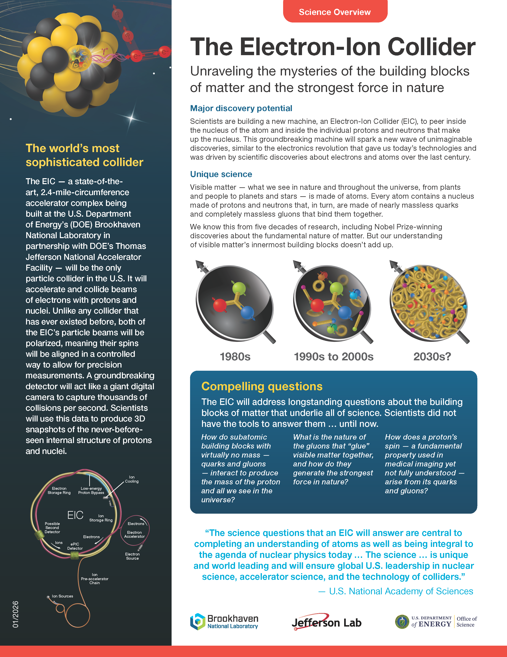
DC Nuclear Physics Day
100+ nuclear physicists descended on Washington DC on April 21st to inform congressional representatives about the importance of nuclear physics and ask for continued support for DOE SC, Office of Nuclear Physics, and NSF.
By all accounts a lot of very good conversations with staffers on a wide variety of topics important to DOE SC, NP, Genesis and EIC.

Slide 8
Discoverability and Reusability for the preTDR and Beyond
Announced March 2nd
We are excited to announce the upcoming online only ePIC Software & Computing Workshop on “Discoverability and Reusability for the preTDR and Beyond”. This workshop will take place Wednesday, April 29th with presentations on the current strategies for software discoverability and will be an open discussion with the community to gather feedback and refine priorities. We invite all in the ePIC Collaboration and EIC Community to join to learn about the current efforts and contribute to the discussions. Please find the agenda and registration on indico: https://indico.bnl.gov/event/31760/
We look forward to your participation,
Holly Szumila-Vance, Stephen Kay, and Sasha Prozorov on behalf of the ePIC User Learning WG

Slide 9
Upcoming ePIC Software Tutorial – ePIC File Access with Rucio
This tutorial will discuss the use of Rucio to find ePIC simulation data, including the usage of metadata tags. Specific use cases will be explored.
05/05/26 (Tuesday 5th of May 2026), 0930-1130 Eastern Daylight Time (GMT-4) https://indico.bnl.gov/event/32515/
Join the Software Tutorials channel on Mattermost for tutorial updates and discussion of tutorial material - https://chat.epic-eic.org/main/channels/software-tutorials

Slide 10

(Following the 7th RRB June 9-10th at MEXT)
https://indico2.riken.jp/event/5568/
Registration now open!

Slide 11
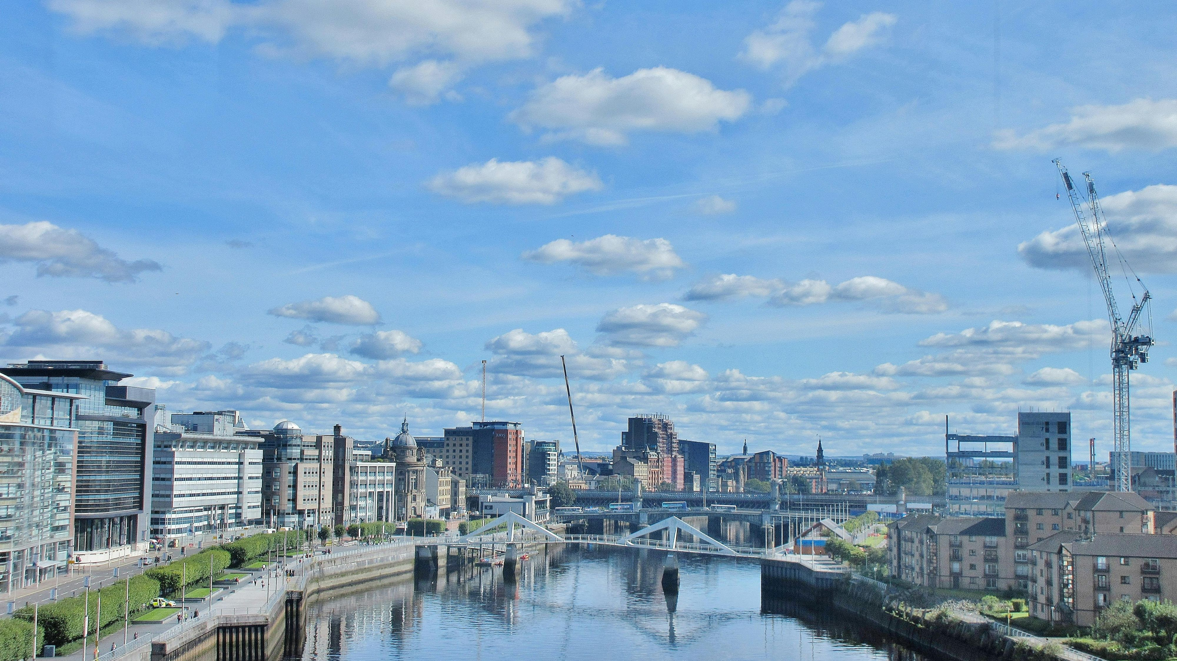
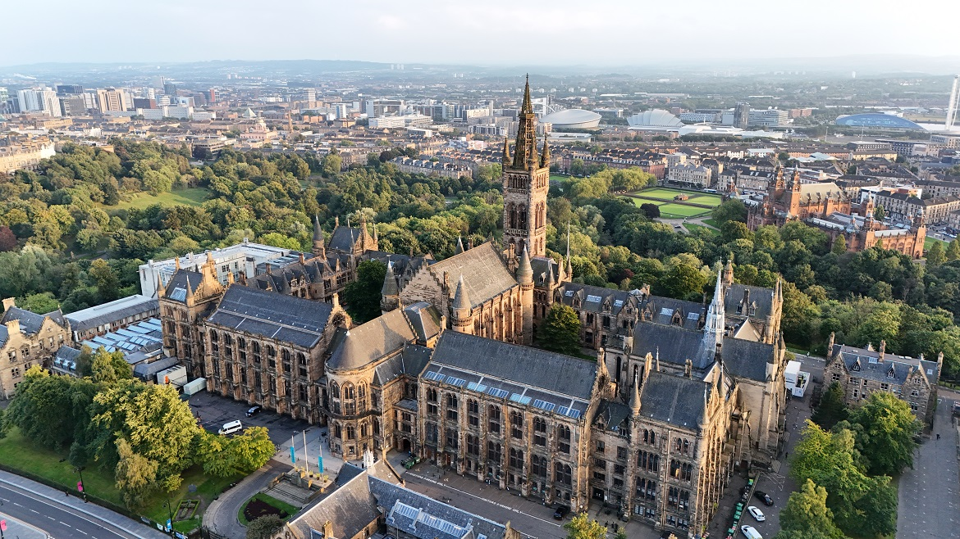
Summer 2026 Joint EICUG/ePIC Meeting
The Summer 2026 joint EICUG/ePIC meeting will be held at the University of Glasgow July 13-17th , 2026.
Indico w/information and Registration: https://indico.bnl.gov/event/31808/
Registration Now Open!

Slide 12
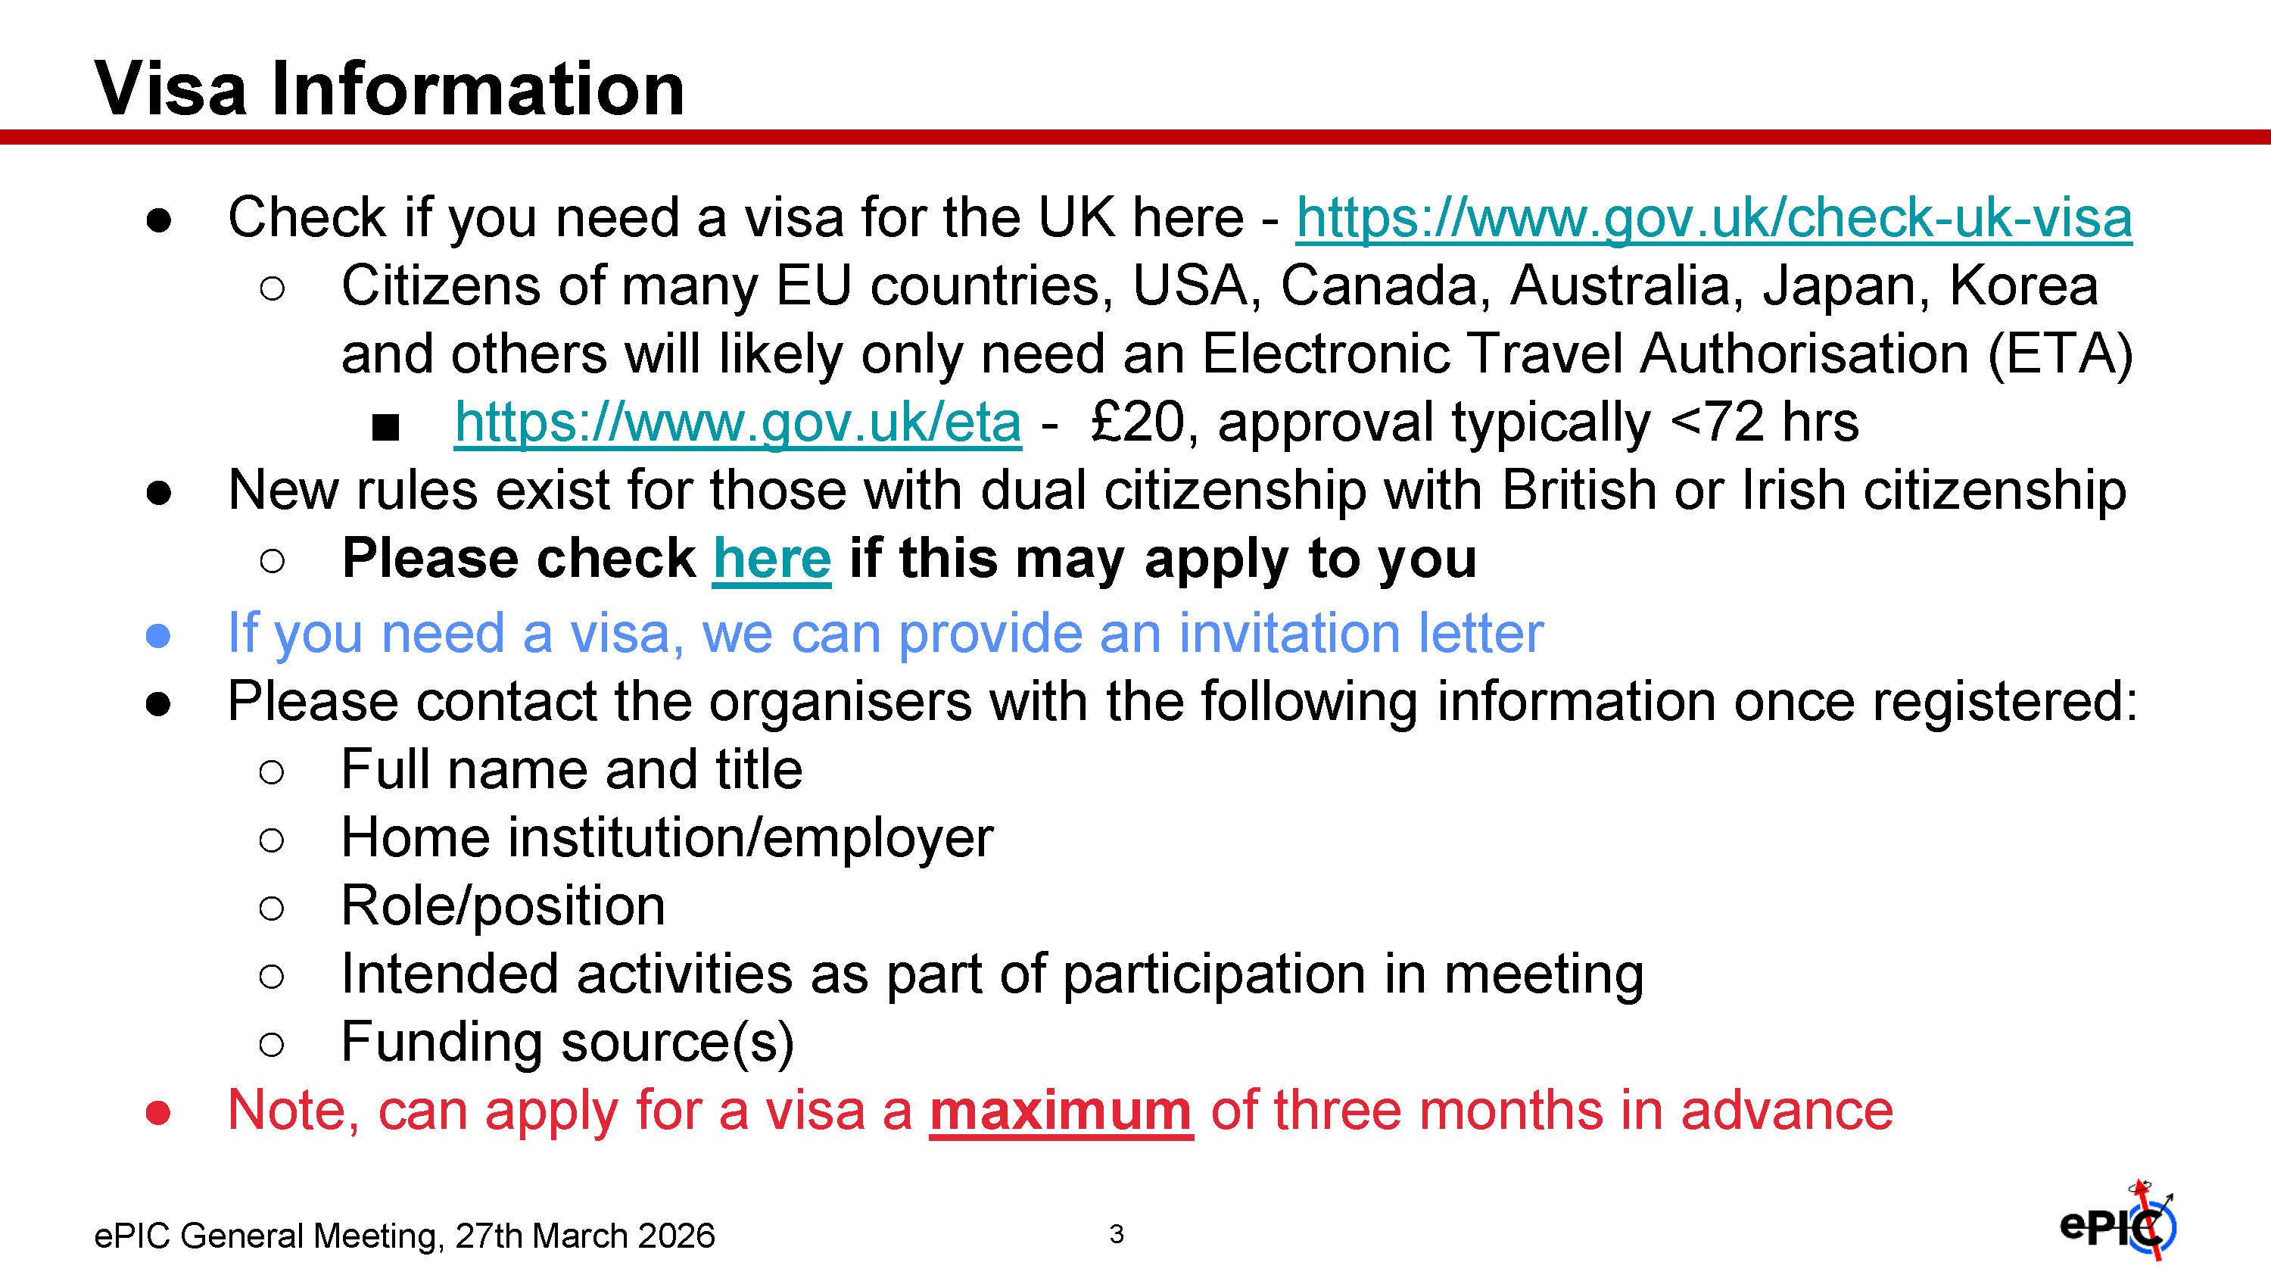

Slide 13
Upcoming CC Meeting
Open Meeting: Friday, May 29th @ 10:30AM ET
This is an open meeting – everyone welcome
Preliminary agenda:
Report from the CTC
Presentation from institutions applying for membership
Publication policies – author lists / limited-author papers
Policy updates – first draft proposals
The policy updates and publication policy discussions will be very important! We will be moving forward very soon with author lists for the pTDR and ePIC Special Issue publications!

Slide 14
Roles and Responsibilities for Collaborative Tools
We have deliberately taken a measured approach to collaborative tools in ePIC:
Don’t lock in decisions before we understand the need!
Avoid locking ourselves into a single provider
Existing Tools:
Membership Database (Phonebook): CC Office
Website* and Social Media: Joint SP and CC Offices
Software Development (GitHub, GitHub Pages for documentation, Mattermost*): Software and Computing Coordination
Document Management (Zenodo): Physics Analysis, Software and Computing, and Technical Coordination
Indico Sections: relevant office (SP,CC, Coord, Convener, DSL, etc.)
Mailing Lists: relevant office (including DSC/WG’s)
* = Items for which collaboration members are supporting the costs

Slide 15
Future Developments in Collaborative Tools
Works in Progress:
Hardware Database: Technical Coordination w/EIC Project
Workflow tools in dev/testing with CTC: Brian Page/CTC
ePIC Collaborative Tools: BNL LDRD
Working on Invenio RDM Demonstrator
AI-Enabled Collaborative Tools: BNL LDRD
Ongoing Discussions:
Support for AI tools
LLM’s, coding agents, etc.
…
Discussion of Collaborative Tools with ECSJI April 28th
Some/all of this is within the ECSJI scope

Slide 16
How do we want collaborative tools to evolve?
Does the collaboration still want to maintain independence amid concerns over potential regulations that inhibit our use of these tools?
We currently have a mix, is this balance OK?
What is the dividing line between what we feel we should control, and what we are willing to rely on the lab for?
How do we fund the necessary expenses?
- OR -
Is the collaboration more comfortable with relying more on BNL/JLab for the collaborative tools we need?
BNL currently supports the phone book, Indico, social media (EIC), and the mailing lists
Federated login works well for the phone book, eliminates need for host lab account
LDRD efforts at BNL are concluding at the end of this year. If we delay adopting this may have implications for what is available in the future.

Slide 17


Upcoming Conferences
Ongoing Development in a Proximity-Focusing RICH Detector for ePIC at the Electron-Ion Collider | Jihee Kim
Heavy-Flavor Studies with the ePIC Experiment at the Electron-Ion Collider | Shyam Kumar
Preliminary cooling tests for the ePIC Silicon Vertex Tracker Inner Barrel | Rosario Turrisi
Design and development status of Silicon Vertex Tracker for ePIC experiment | MariaTeresa Camerlingo
ePIC PID Performance in SIDIS Processes | Lorenzo Polizzi
SIDIS Studies at ePIC | Susanna Costanza
Projected High Precision Measurements on the Spin Structure g1 for the Proton and the Neutron at EIC | Win Lin
The G-RWELL Endcap Tracker of the ePIC Experiment | Stefano Gramigna
Particle Physics at the BNL Electron-Ion Collider | Alessandro Tricoli
Forward Particle Identification at the EIC with the ePIC dRICH Detector | Simone Vallarino
Development of Streaming Data Reconstruction for ePIC Experiment at EIC | Takuya Kumaoka
Scaling ePIC Simulation Production: Distributed Workflow and Data Management | Sakib Rahman
The ePIC Streaming Computing Model | Holly Szumila
Exploring Potential Pathways to Accelerated ePIC Detector Simulations | Sakib Rahman
ePIC User Learning Training and Documentation Strategies | Sasha Prozorov

Slide 18
Upcoming Events 2026
DIS 2026, Bologna Italy, May 4th-8th
CC Meeting Friday, May 29th
EIC RRB & EIC-Asia Meeting, Tokyo, June 9th – 13th
EIC Early Science Whitepaper Due – July
Collaboration Meeting July 13-17th @ University of Glasgow
DOE OPA review of the EIC Project Sept. 13-15th
ePIC NIM-A Special Issue Submissions – Oct
ePIC Software and Computing Review – Oct 13-14th
Plus: Numerous PDR/FDR reviews – see Project News

Slide 19


Slide 20
Collaboration Goals for the first half of 2026
Support the EIC project and ePIC Technical Design:
Close the design loop with ePIC simulations
Advance the pTDR in preparation for CD-2
Respond to review recommendations
Complete the Early Science whitepaper
Progress in developing a multi-year plan for ePIC Software and Computing
Begin submissions to the NIMA Special Issue

Slide 21
Current Recurring Expenses
Monthly Google Cloud expenses for Mattermost server
Roughly $100CAD every month
Registration of ePIC domain names
Yearly $45US (renews in July)
Potential future charges:
Cloud resources for AI computing/agents
Collaborator currently supporting some exploratory work
Also brings in discussion of “AI policy” (not for today)
Do we need additional (paid) features in GitHub?
…

Slide 22

ePIC Resources
Public Website - https://www.bnl.gov/eic/epic.php
Mailing Lists – https://lists.bnl.gov/mailman/listinfo
Indico Agenda - https://indico.bnl.gov/category/402/
ePIC Software and Computing: https://indico.bnl.gov/category/435/
Wiki - https://wiki.bnl.gov/EPIC
ePIC Software Training:
Landing Page: https://eic.github.io/documentation/landingpage.html
Tutorials: https://eic.github.io/documentation/tutorials.html
Mattermost: https://chat.epic-eic.org
ePIC Zenodo Community: https://zenodo.org/communities/epic

Slide 23


EICUG Membership
The EICUG is a vital organization to promote the interests of the EIC community!
Without the EICUG we would never have gotten far enough to form ePIC!
Please register your institution!
Check with your EICUG IB representative to get registered as a member
https://www.eicug.org/content/join.html

Slide 24
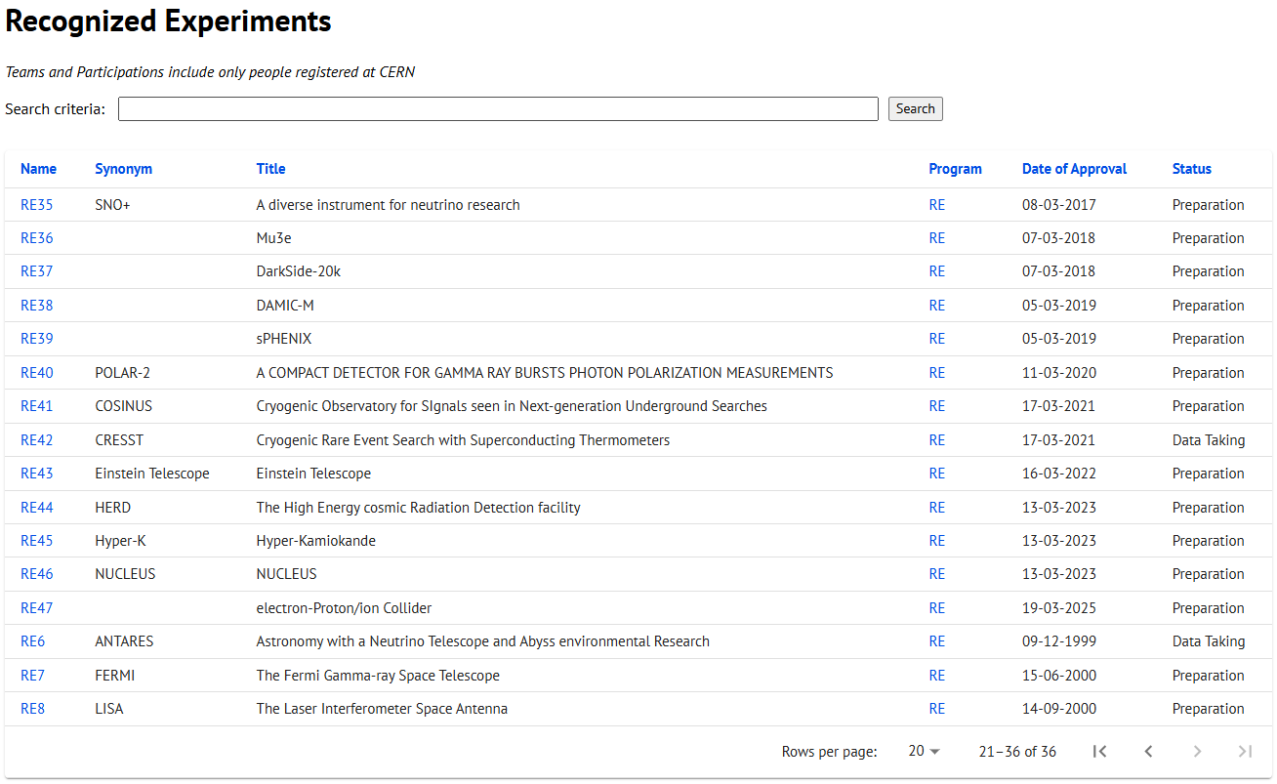
CERN Recognized Experiment Status: RE47
ePIC now appears in the CERN Grey Book database as RE47: https://greybook.cern.ch/experiment/recognized
Two steps to get ePIC Collaborators registered at CERN:
CC Representative needs to register as team leader with CERN Users Office:
https://usersoffice.web.cern.ch/
https://usersoffice.web.cern.ch/team-leaders-corner
Users.Office@cern.ch
CC member can then certify registrations of team members
Contact us if you run into problems!

