Slide 1
EIC Project News
E.C. Aschenauer (BNL), R. Ent (JLab)
Co-Associate Directors for the EIC Experimental Program
ePIC Bi-Weekly General Meeting
March 27th, 2026

Slide 2
Update on Reviews – Path to Baselining CD-2
Preliminary Design Reviews (60% design maturity equivalent, called PDR, PDR2 or PDR3, pending the subsystem)
PDR2: Silicon Tracking Detectors (6.03.01.02.01) – Jan. 27-28, 2026
PDR2: Polarimetry (6.03.01.11) – February 18, 2026
Peer Review: DAQ-Slow Controls (6.03.01.08.02) – May 2026 – Separated from electronics/DAQ to ensure integration in collider common platform, we only have Slow Controls Integration and the controls relies on scope in various areas
PDR3: IR Integration and Auxiliary Detectors (6.03.01.10) – April 20, 2026 – Low-Q2, ZDC, includes 6.10.14 lumi detector
PDR2: AC-LGAD-based Particle Identification Detectors (6.10.04; BTOF, FTOF, common systems) – June 3-4, 2026
PDR3: IR Integration and Auxiliary Detectors (6.03.01.10) – July (?) 2026 – B0, RPs, OMDs – Exact Dates TBD
Final Design Reviews (FDR):
FDR: Backward EM Calorimetry (6.03.01.04.01) – May 26, 2026
More FDRs planning ongoing – see next slide
Project Reviews:
Detector Baseline Readiness Review Feb 3 – 5, 2026
BNL Director’s Review – Comprehensive, Mar. 9-12, 2026
DOE OPA Status Review April 28-May 1, 2026 → September 15-18, 2026
DAC – Summer/Fall 2026 – aim is to let DAC review all (PDR and DAC) recommendations that need completion by CD-2 and the status towards CD-3
CD2 IPR & ICR Fall 2026?
Other Meetings:
7th RRB Meeting: June 9-10, 2026 – MEXT, Tokyo

Slide 3
Update on Reviews – Planning for CD-3
Final Design Reviews (FDR):
FDR 6.03.01.04.01: Backward EM Calorimetry – May 26, 2026
Planning for Final Design Reviews before CD-3: (dates given are what was before in P6 and what is now)
FDR 6.03.01.02.01: MPGDs – January 2027 → move to March 2027
FDR 6.03.01.02.02: SVTs – August 2027
FDR: hpDIRC – August 2026 → hpDIRC, dRICH and pfRICH – February 2027
FDR: dRICH – January 2027 → hpDIRC, dRICH and pfRICH – February 2027
FDR: pfRICH – February 2027 → hpDIRC, dRICH and pfRICH – February 2027
FDR: TOF – June 2027
FDR: Barrel EM Calorimetry – September 2026
FDR: Forward EM Calorimetry – September 2026 → combine with Barrel HCAL and LFHCAL?
FDR: Barrel HCAL – October 2026 → September 2026, combine with Forward EMCal and LFHCAL?
FDR: LFHCAL – September 2026 → combine with Forward EM Cal and Barrel HCAL?
FDR: Magnet Cryo – link to integral review with accelerator/cryo, July 2026
FDR 6.03.01.07: Electronics – September 2026 → Electronics and DAQ/Computing September 2026
FDR 6.03.01.08: DAQ/Computing – July 2026 → Electronics and DAQ/Computing September 2026
FDR: I3 Barrel Detector Structures – February 2027
FDR: I3 Detector Infrastructure and Utilities Integration – July 2027
Missing: FDR: Installation (includes also Magnet Installation)
FDR: Auxiliary Detectors, B0 – July 2027 → B0 and RP/OMD – July 2027
FDR: Auxiliary Detectors, RP/OMD – July 2027 → BO and RP/OMD
FDR: Auxiliary Detectors, ZDC – July 2027 → ZDC, lumi & low-Q2 – April 2027
FDR: Auxiliary Detectors, Low-Q2 – March 2027 → ZDC, lumi & low-Q2 – April 2027
FDR: Auxiliary Detectors, Lumi Monitor – October 2026 → ZDC, lumi & low-Q2 – April 2027
FDR 6.03.01.11.02: Hadron Polarimetry – March 2027 → Hadron and Electron Polarimetry – May 2027
FDR 6.03.01.11.01: Electron Polarimetry – May 2027 → Hadron and Electron Polarimetry – May 2027
Missing: (FDR or perhaps rather) Peer Review: Commissioning – November 2027
FDR: HRPPDs – September 2026
FDR: Mirrors & Aerogel – September 2026
FDR: GEMs & PCBs – needs results of 1st and likely 2nd engineering test article → Remove from CD-3C
Assumption: DET CD-3 in Q1/FY28
→ DOE Review ~ October 2027
FDRs need completion ~ July 2027
BUT: There are subsystems that benefit from FDR this CY might there be a CD-3C. E.g., EM calorimetry, forward HCAL, gaseous-based PID detectors, and scope such as HRPPDs, SiPM boards

Slide 4
Fulvia Pilat (ORNL), Wolfram Zeuner (KIT), Gerrit Van Nieuwenhuizen (BNL), Eugene Chudakov (JLab) April 20, 2026
Closeout Report
Preliminary (60%) Design and Safety Review of the EIC Auxiliary Detectors (Zero Degree Calorimeter, Low-Q2 taggers and Luminosity system)

Slide 5
Responses to Charge Questions
Are the technical performance requirements appropriately defined and complete for this stage of the project?
YES
Are the plans for the various sub-systems appropriately documented and complete for this stage of the project?
YES, for documentation.
However, detailed plans and timeline towards CD2 were not presented.
Are the current plans for the detector likely to achieve the technical performance requirements, with a low risk for cost increases, schedule delays, and technical problems?
YES, for technical performance
NO, for cost and schedule (see comments)
Are the schedule assumptions for the fabrication of the various sub-systems and assembly plans reasonable and consistent with the overall detector schedule?
YES, but detailed plans on how to go from R&D to production were not presented
Have ESH&Q and QA considerations been adequately incorporated into the plans at their present stage?
YES, for QA.
A comprehensive ESH&Q plan for the ancillary systems referring to the overall Project ESH&Q plan was not presented
Have the recommendations from previous reviews been adequately addressed?
Partly. Some of the recommendations from the previous review were not explicitly discussed, but probably due to change in systems scope and timeline

Slide 6
Recommendations
Prior to CD2, develop a plan for access and installation in collaboration with the accelerator
Develop a comprehensive ESH&Q project plan and refer to that in all forthcoming reviews (including CD2)
Prior to CD2, develop a detailed production plan for the auxiliary systems
Conclusion
The Committee thanks the project for a well organized and efficient review
We congratulate the Project team for the good progress in Auxiliary Systems since the last review
A focused effort will be necessary to be ready for CD2 later in 2026

Slide 7
Meeting in DC with new DOE NHEP Office

Slide 8
Who and What?
Attendance:
Representatives from the new High-Energy and Nuclear Physics Office, both from HEP and NP
Lab Directors (BNL and JLab)
EIC Project Staff (BNL and JLab)
Remote: Federal Project Director and Deputies (BNL Site Office)
General topics:
Introductions
EIC Project Context
Director’s Review of Outcomes
Response to Director’s Review and Program Guidance
Supporting the EIC Portfolio
Path Forward to DOE IPR
Challenges and Summary
Main goal: Seeking alignment on charge and scope for September EIC Project Review

Slide 9
Summary
Productive meeting with good and constructive discussions on EIC path forward
Large engagement of Office of High-Energy and Nuclear Physics staff
Desire to implement less subprojects: Infrastructure, Detector, “Other” (Accelerator)
Kudos for trying to get a grasp of full EIC costs (including portfolio and deferrals to EIC operations)
Project that funding for BNL/EIC will not likely grow much in next few years from what is in FY26 and projected for FY27 ($200M in President’s Budget for EIC Project, $140M for BNL Ops).
Desire to get something in construction for EIC as soon as possible. That something is likely:
Infrastructure subproject (but limited to phase-1 scope that is ready)
to stay in phase with NY State funds and scope
CD-3C long-lead procurement package but limited to ensure affordability
Realization of need to keep detector funding moving
Ensure EIC community remains engaged and continue to make progress
Yet realization that large in-kind contribution for detector remains a risk for baselining
Direct work priority for EIC:
establishing a credible integrated resource-loaded P6 schedule for full EIC Project
aligning requirements, scope, and cost with the $3B Total Project Cost target & annual funding profiles
working with DOE/HENP on further detailing the planning and charge for September Review

Slide 10
IR Layout Update

Slide 11
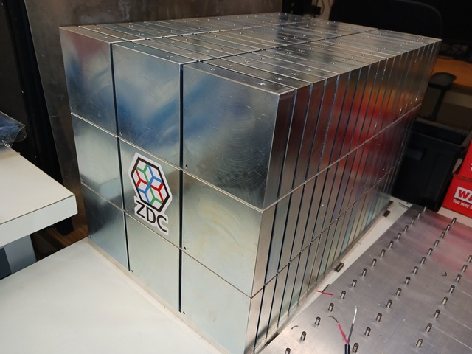
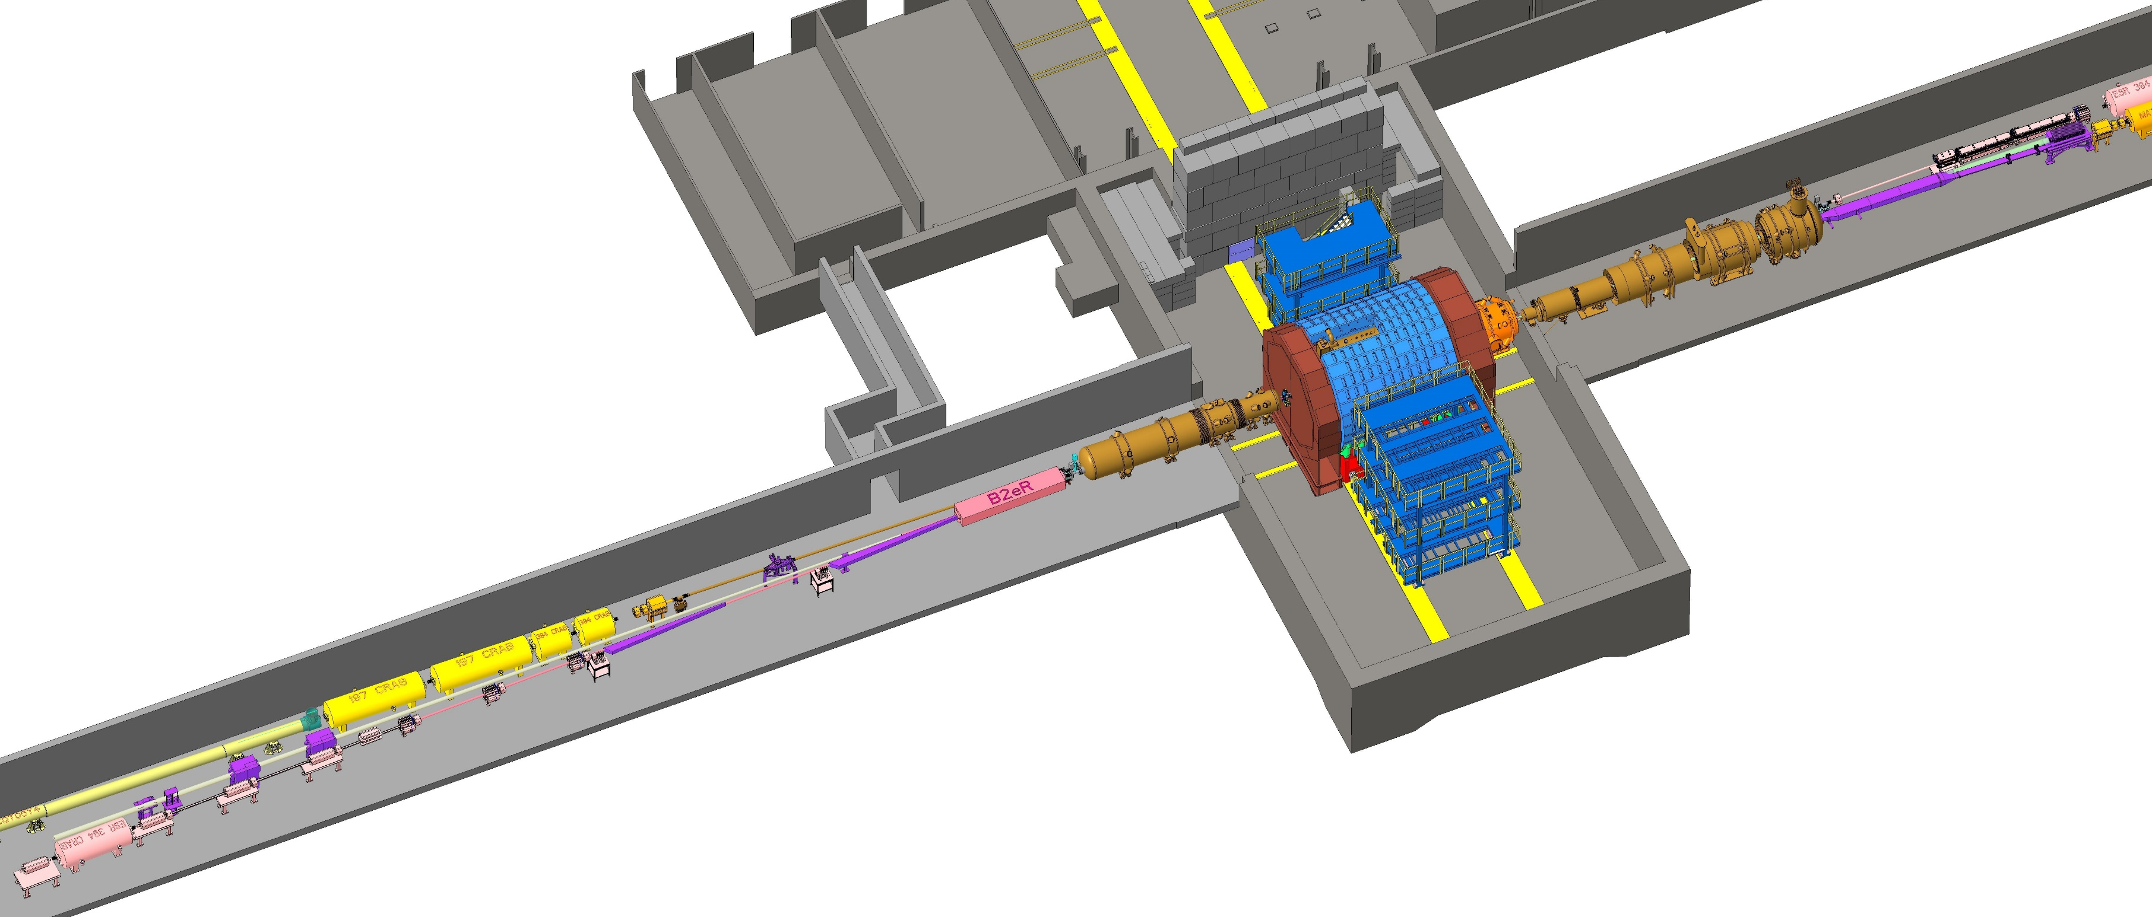
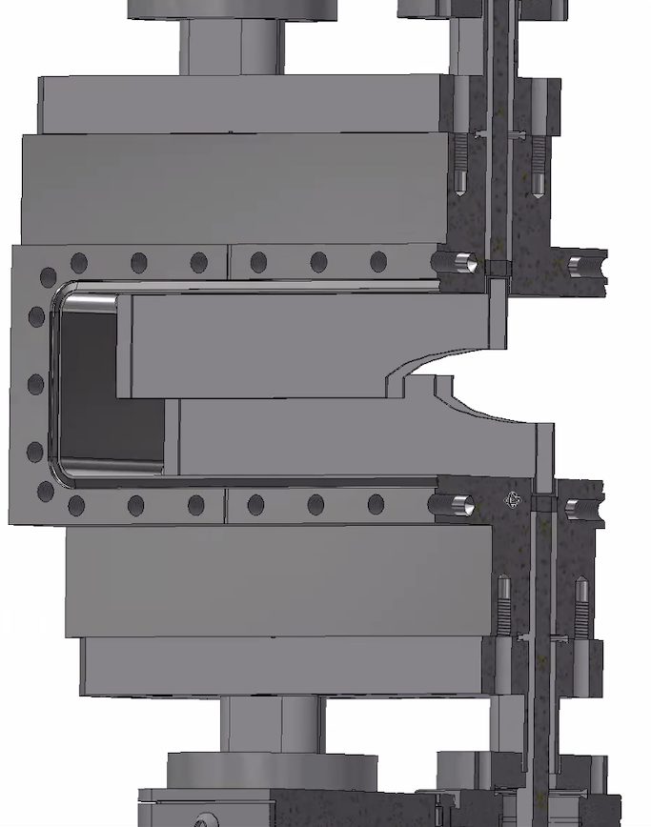

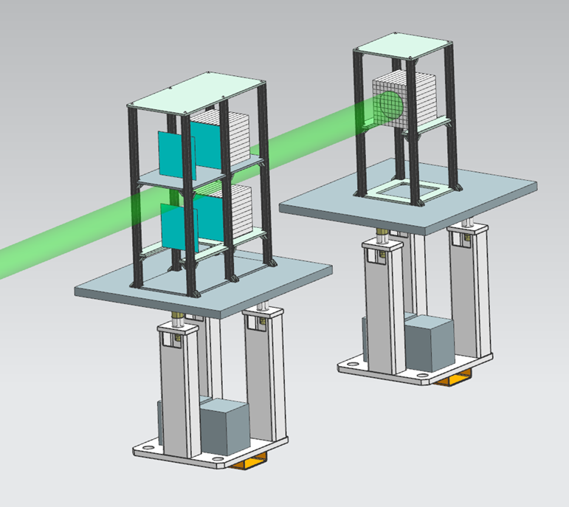
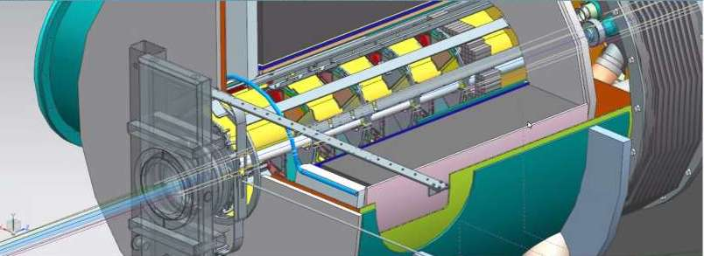
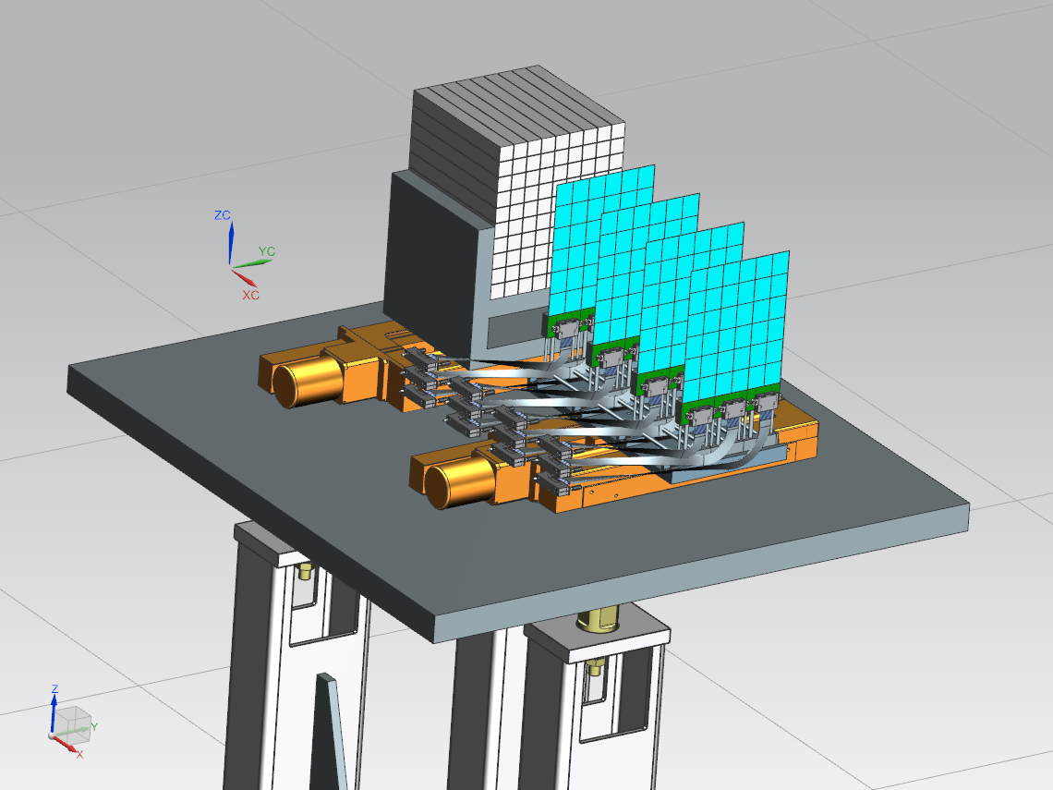
Current IR Layout
Zero Degree Calorimeter
e beam
Roman Pots and
Off-Momentum Detectors
B0 Magnet Spectrometer
p/A beam
Luminosity System
 | Particles | Angle [mrad] |  | Distance from IP
B0-tracker | Charged particles Photons ( tagged) | 5.5 - 20 |  | ca 6-7 m
Off-momentum | Charged particles | 0-5.0 | 0.4< xL< 0.65 | ca 23-25 m
Roman Pots | Protons Light nuclei | 0*-5.0 | 0.6 < xL< 0.95 | ca 27-30 m
ZDC | Neutrons Photons | 0-4.0 (5.5) |  | ca 35 m
Low-Q2 Taggers

Slide 12
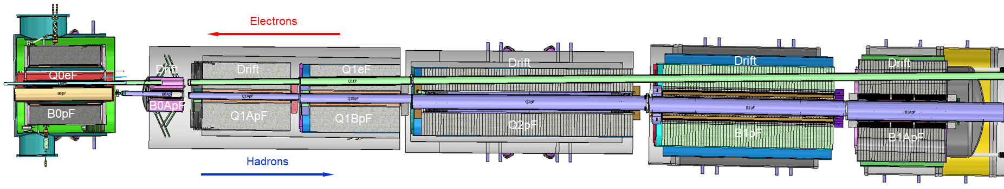
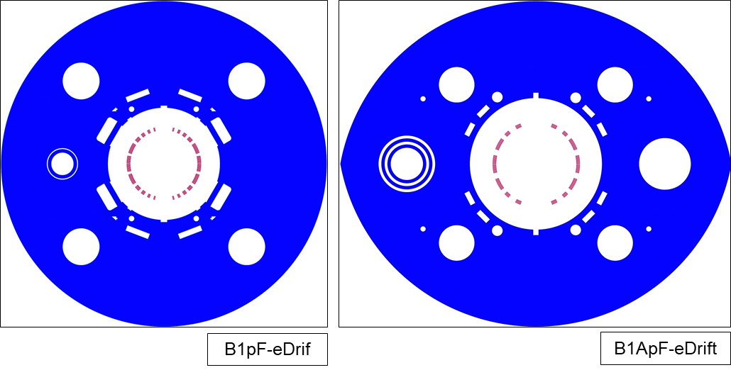
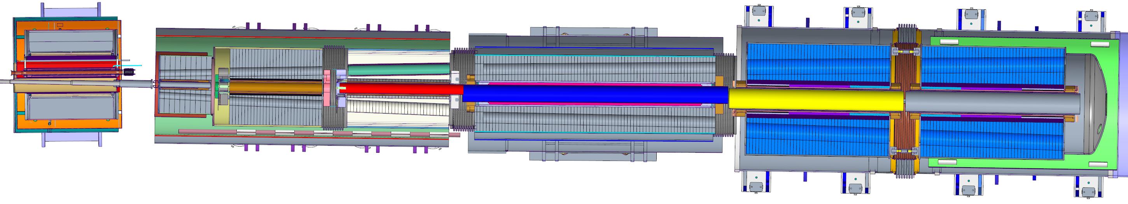
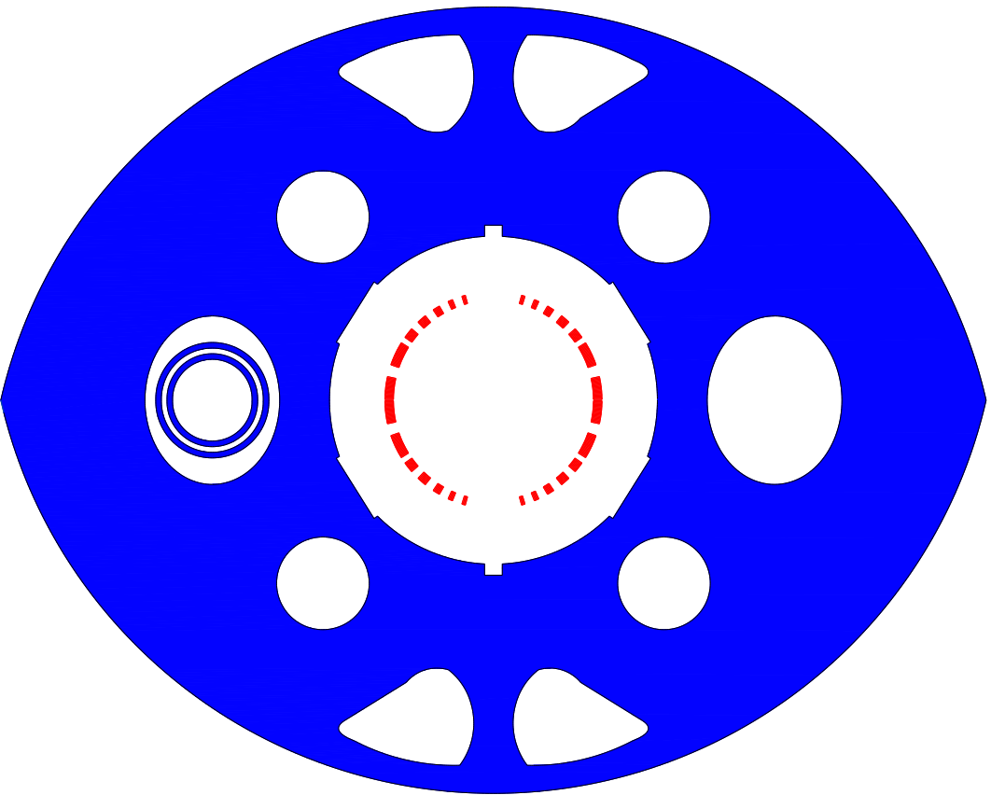
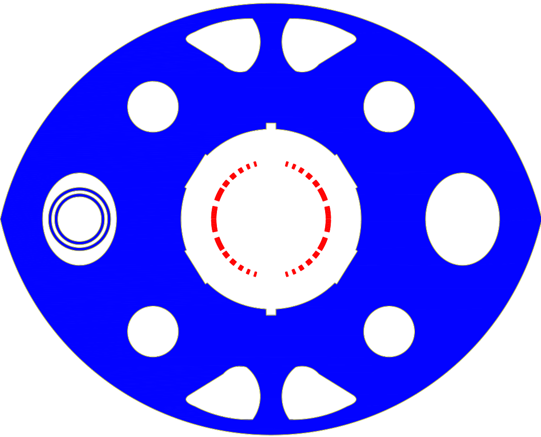
From layout 1 to layout 2
Thanks to P. Ferracin
Layout 1
Weight of B1pF magnet couldn’t be handled by existing crane infrastructure
Two different designs
Layout 2
Weight compatible with existing crane
Common designs: identical coils (and aligned)

Slide 13
From layout 1 to layout 2
Thanks to P. Ferracin
Layout 1
Misaligned beam tubes and tight space in B0ApF/Q1ApF/Q1BpF -→ welding extremely challenging
Layout 2
HRS beam tube aligned in B0ApF/Q1ApF/Q1BpF
B1pF/B1ApF and 8-10% reduction of aperture in B0ApF, Q1Apf, B1pF, B1ApF
Significant reduction of B0ApF field

Slide 14
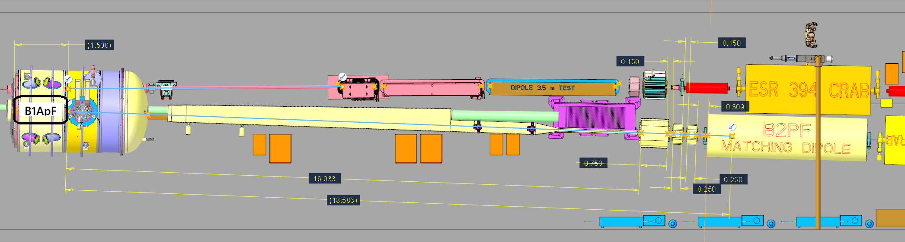
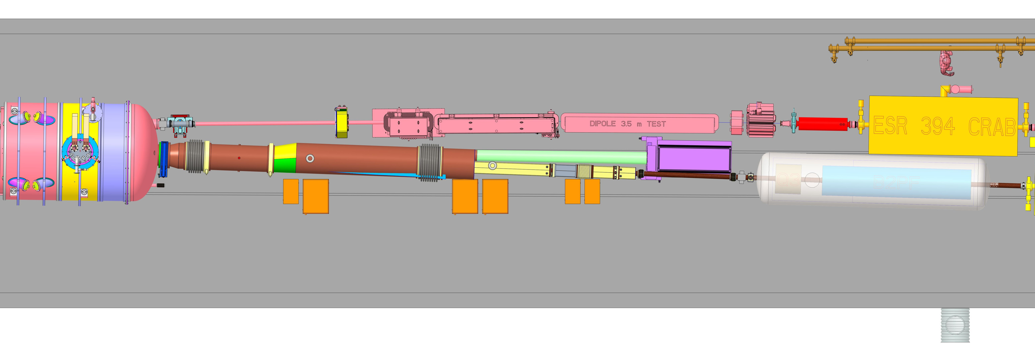
From layout 1 to layout 2
Thanks to P. Ferracin
Layout 1
The B2pF magnet with field of nearly 7 T, and no space to increase its length
Operational temperature: 1.9 K
The warm Q3 and correctors without a design yet, and again, very tight space
Layout 2
Shorter superconducting Q3
Longer B2pF, lower field and operating at 4.5 K

Slide 15
Investigation of layout 3
Thanks to P. Ferracin
Add a drift between B0pF and B0ApF to provide space for detectors
No longer need to transmit high transverse momentum particles
Still must transmit neutral cone
Reduce magnet apertures
Layout 2
Layout 3a
Layout 3b

Slide 16
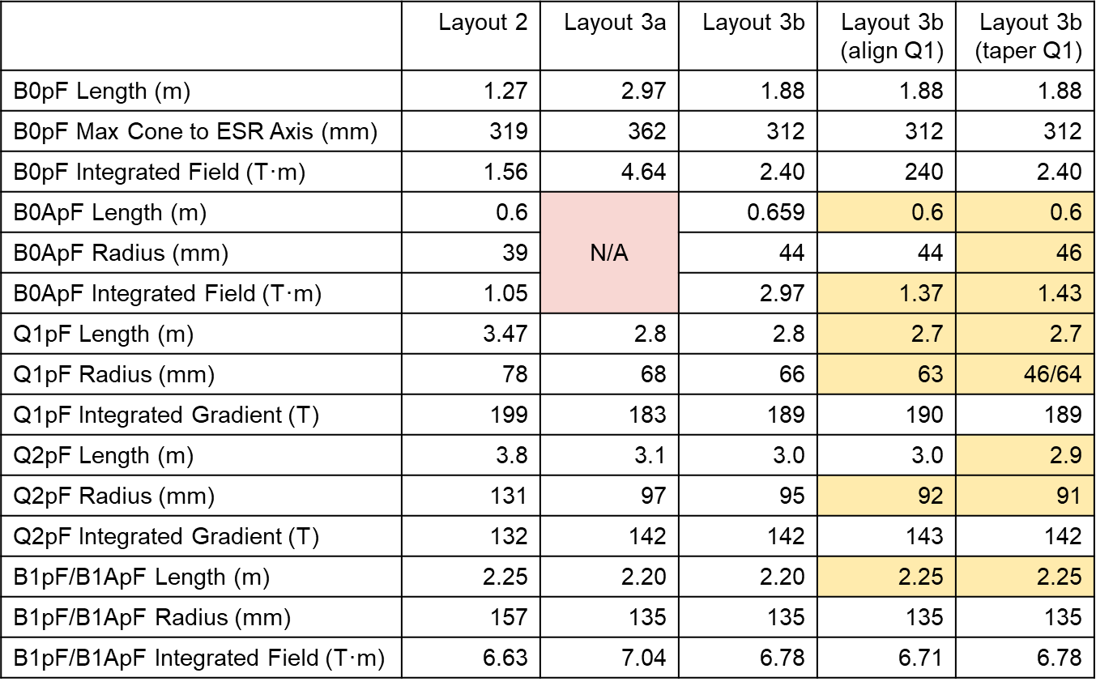
Investigation of layout 3
Thanks to P. Ferracin
Layout 2
Two layout 3 options
One less aggressive (3b, with B0Apf)
Cost/risk reduction in B1/B1A
Q2: smaller apertures but some challenges in terms of field quality and margin
Q1: option of a single Q1 Rutherford cable
B0 and B0A more difficult but they seems doable
One more aggressive (3a, without B0Apf)
Similar situation for B1/B1A and Q1/Q2
One less magnet (B0A) but still a corrector package
“New” B0pF, not necessarily more difficult, but definitely new….
The “sextupole issue” could play a role….
However, putting everything together
It is unclear if this can actually result in major cost savings.
It is not fully explored, so risks related to possible hidden showstoppers exist.
For example, we did not look much into the electron optics (Q1eF?) for layout 3
Layout 2 we are really close to a completed design, which currently appears feasible, well optimized, and without showstoppers.
Layout 3a
No major change in IR Layout
all but the same B1pf and B1Apf is already implemented in dd4hep since a long time
→ no impact on science as acceptance remains identical
Layout 3b

Slide 17


