Slide 1
Monitoring
We already had good monitong for the H2GCROC
I made (gleaned from what we have in many of the pfRICH setups) one for the CAEN
And I have a not yet very useful skeleton for the AstroPix
Please keep in mind that there doesn’t have to be just one monitoring project – if you want to play, make yourself a home and code away. Also, the names that I picked (like caen_bic) are not set in stone
To pull from the corresponding monitoring stream:
Start without a parameter, like “bash caen_bic.sh”
Open the right stream:
pmonitor is resilient; it will soldier on across runs (obviously) but also across restarts of the rcdaq_server
Also read the manual - https://www.phenix.bnl.gov/~purschke/rcdaq/pmonitor_doc.pdf
rcdaqopen("localhost:3") // caen is 3
pstart();

Slide 2
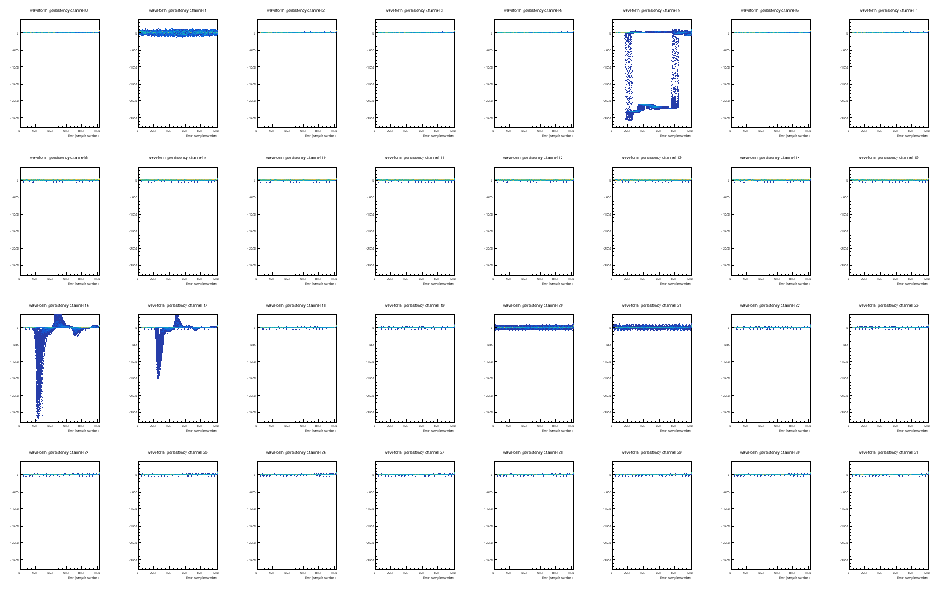
CAEN first
Look at http://localhost:13666/ePIC_BIC/132
I line up the 2x16 CAEN units as 32 channels, and fill the “persistency plots”
I also extracted the factory calibration from the other "64720" unit, built it in
Added a “plot (offset,x, y)” routine to make a “grid plot”, here plot(0,8,4):
It’s a good start I think…
Remember the pupdate(c,15) commands from the manual to make a “billboard display”

Slide 3
Astro
It’s just a simple-minded skeleton so far
So the data are organized as what I call “units” (“hit” doesn’t seem right)
You ask how many units there are, and the request one by one
Packet 13001 162 -1 (ePIC Packet) 350 (IDASTROV1)
Nr of units: 57
# | layer id payload location iscol ts ToT fpga_ts
0 | 1 2 4 15 1 6 172 3470798771
1 | 1 2 4 18 0 6 194 3470798331
2 | 1 3 4 13 1 8 112 3877904470
3 | 1 3 4 11 0 8 136 3877904030
4 | 1 3 4 14 1 23 51 4179419255
5 | 1 3 4 15 0 23 73 4179418815
6 | 1 2 4 9 1 74 234 4281312475
7 | 1 2 4 9 0 74 254 4281312035
8 | 1 2 4 6 1 76 500 3576212816
. . .

Slide 4
Astro API
Here is a rundown of how you request the fields
Note that the call for “fpga_ts” is different, this is a 64bit ”long long” return
This is a “human-readable” API so one can see what we request. But there is a string comparison involved. There is a faster alternative
for (int unit = 0; unit < p->iValue(0,"NR_UNITS"); unit++)
{
layer = p->iValue( unit,"LAYER");
ID = p->iValue( unit,"ID");
Payload = p->iValue( unit,"PAYLOAD");
location = p->iValue( unit,"LOCATION");
iscol = p->iValue( unit,"ISCOL");
timestamp = p->iValue( unit,"TIMESTAMP");
tot = p->iValue( unit,"TOT");
fpga_ts = p->lValue(unit);
}

Slide 5
Astro API
Faster (no string comparison) but less readable version
This is faster but will likely need some comments.
for (int unit = 0; unit < p->iValue(0,"NR_UNITS"); unit++)
{
layer = p->iValue( unit,1);
ID = p->iValue( unit,2);
Payload = p->iValue( unit,3);
location = p->iValue( unit,4);
iscol = p->iValue( unit,5);
timestamp = p->iValue( unit,6);
tot = p->iValue( unit,7);
fpga_ts = p->lValue(unit);
}

Slide 6
Sorted units!
In my mind, the processing of the column/row data amounts to a coincidence processor
See if you have a col/row pair within a small time distance
So you line up all units by time to make this happen easily
I sort them by layer – timestamp – {row/col}, in a way going the order you read text
I know there is a lot of existing code, but I would treat this as a coinc. processor- “does this unit have a partner at a timestamp delta < some_threshold?”
If not, the search for a partner for this unit stops, as the times for all others can only be larger
(this is standard coincidence processing in PET, btw)
But I do not want to re-invent the wheel…
This is faster but will likely need some comments.

Slide 7
Sorted units!
Packet 13001 162 -1 (ePIC Packet) 350 (IDASTROV1)
Nr of units: 57
# | layer id payload location iscol ts ToT fpga_ts
0 | 1 2 4 15 1 6 172 3470798771
1 | 1 2 4 18 0 6 194 3470798331
2 | 1 3 4 13 1 8 112 3877904470
3 | 1 3 4 11 0 8 136 3877904030
4 | 1 3 4 14 1 23 51 4179419255
5 | 1 3 4 15 0 23 73 4179418815
6 | 1 2 4 9 1 74 234 4281312475
7 | 1 2 4 9 0 74 254 4281312035
8 | 1 2 4 6 1 76 500 3576212816
9 | 1 2 4 30 0 76 518 3576212376
10 | 1 3 4 14 1 87 142 45722013
11 | 1 3 4 15 0 87 164 45721573
< lines deleted >
40 | 2 0 4 17 1 12 1223 3495421963
41 | 2 0 4 31 0 12 1242 3495421523
42 | 2 3 4 27 1 17 78 3878817899
43 | 2 3 4 21 0 17 99 3878817459
44 | 2 2 4 8 1 56 197 4144976000
45 | 2 2 4 8 0 56 217 4144975560
46 | 2 1 4 28 1 114 239 3911435462
47 | 2 1 4 27 0 114 257 3911435022
Layer 1
Layer 2

Slide 8
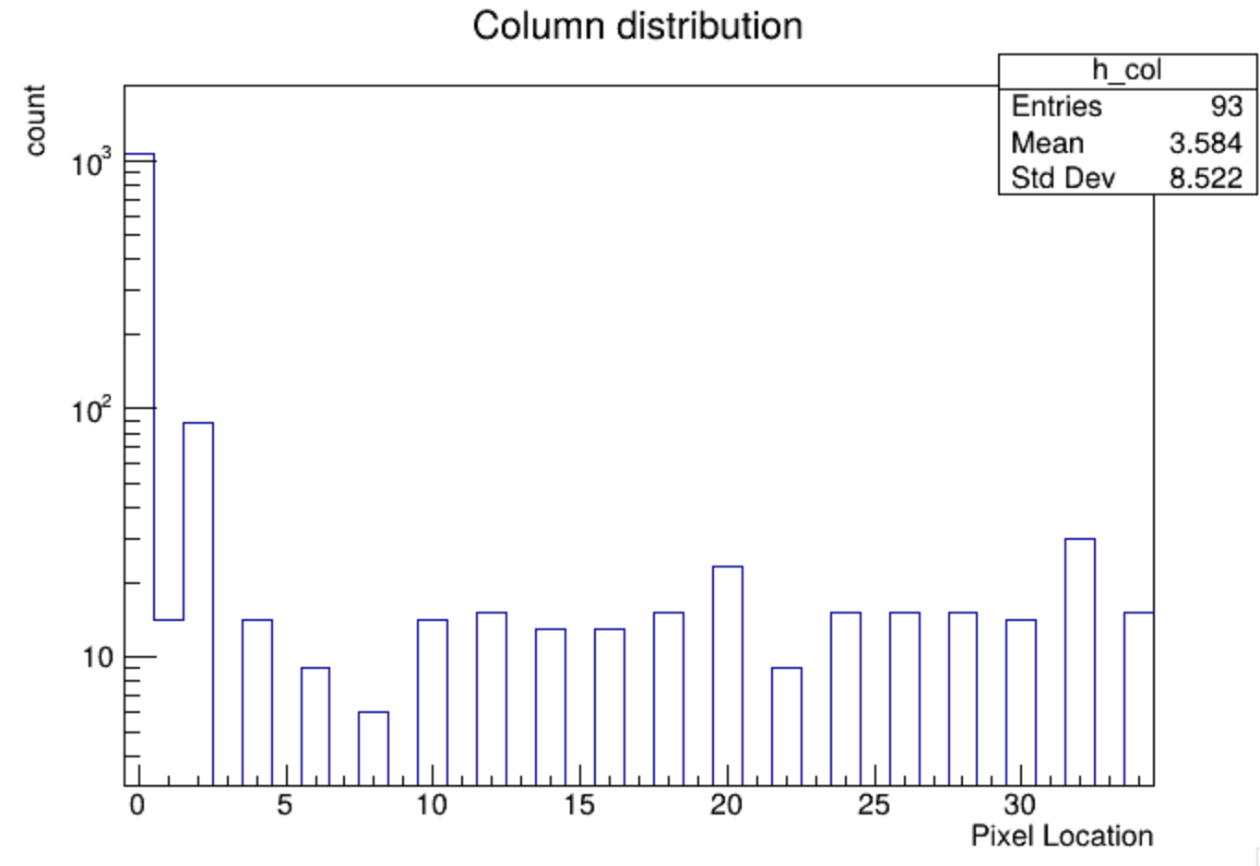
Silly project just to get going…
I historgram the col and row values (silly I know)
Packet *p = e->getPacket(13001);
if (p)
{
for (int unit = 0; unit < p->iValue(0,"NR_UNITS"); unit++)
{
if ( p->iValue(unit,"ISCOL") == 0) // is a row
{
h_row->Fill(unit, p->iValue(unit,"LOCATION"));
}
else
{
h_col->Fill(unit, p->iValue(unit,"LOCATION"));
}
}
delete p;
}

