Slide 1
RHIC – The heavy ion story
Wolfram Fischer
(Only a short while ago: System Commissioner – Injection; Commissioner – A Team)
9 July 2026, RHICfest
Notes:
30 min = 30 slides

Slide 2

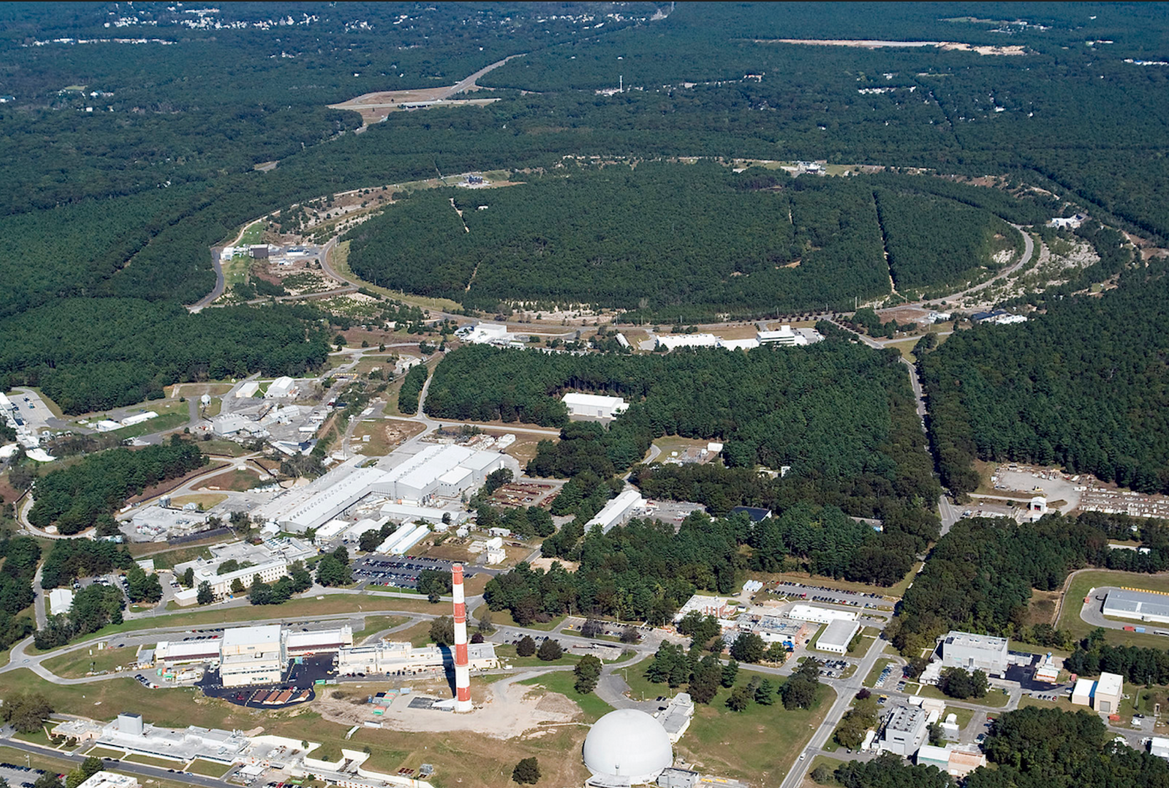
Relativistic Heavy Ion Collider
New York City

Slide 3
Contents
Before RHIC:
  The Alternating Gradient Synchrotron (AGS) and Isabelle/CBA
RHIC
  Design choices – more from Steve Tepikian, Jie Wei
  Performance evolution
  Accelerator Science and Technology legacy
  (Polarized beam story – presentation by Thomas Roser)
After RHIC:
  The Electron-Ion Collider

Slide 4
Before RHIC:
AGS and Isabelle/CBA

Slide 5
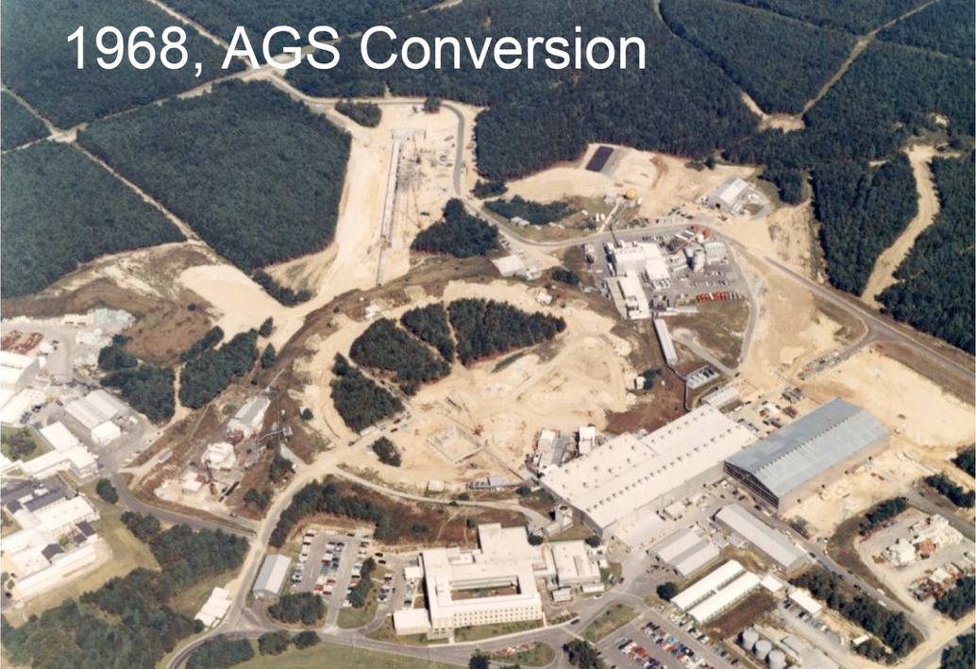
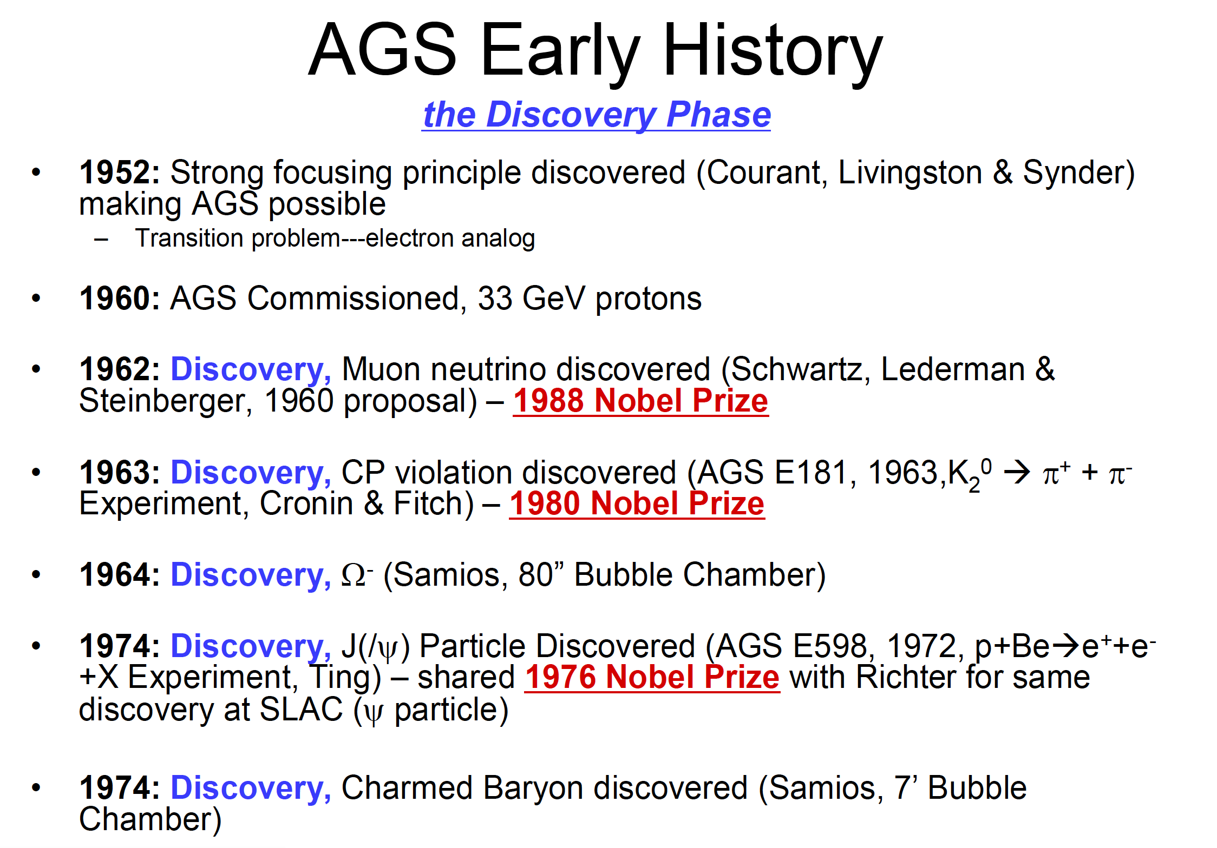
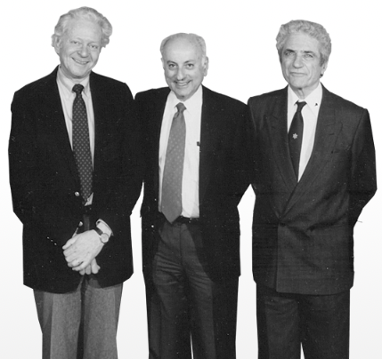
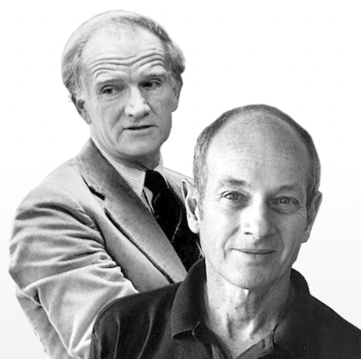
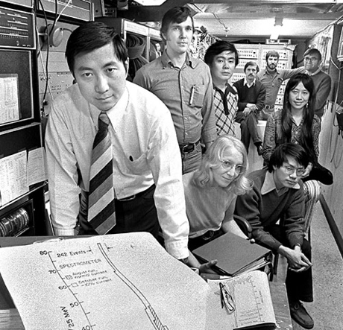
No 200 MeV Linac yet (1970)
No 1.5 GeV Booster yet (1990)
1959: CERN PS
[Y.Y. Lee, ”50 years of the BNL AGS”, 14th Intl. Conf. on Accelerator and Beam Utilization, Gyeongju, Korea (2010).]

Slide 6
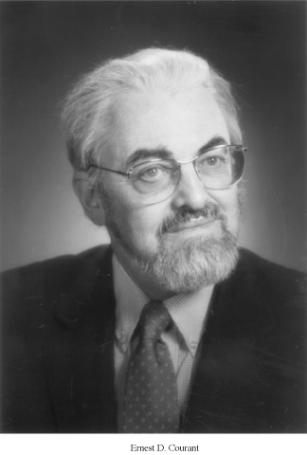
ISABELLE collider proposal
Early 1970 studies for 200+200 GeV proton-proton collider
superconducting magnets
(enough to see W, Z – discovered at SppS with 270+270 GeV in 1983)
3.8 km circumference, 6 intersections, AGS as injector
At the same time Fermilab started working on the Tevatron
Tunnel, office building, He cryo plant built (updated and in use for EIC)
Only one working dipole prototype (Mark V) – sc cable issues
In 1982 Isabelle became CBA (Colliding Beam Accelerator),
with working magnets
1983 canceled in favor of SSC – W and Z were discovered at SppS
(SSC itself canceled in 1993)
BNL quickly build a heavy ion physics program with AGS
Ions from Tandem Van de Graaff, transfer line to AGS 1986
Ernest Courant
1920-2020
[Ernest D. Courant, “Accelerators, colliders, and snakes”, Annu. Rev. Nucl. Sci. 2003. 53:1-37]

Slide 7
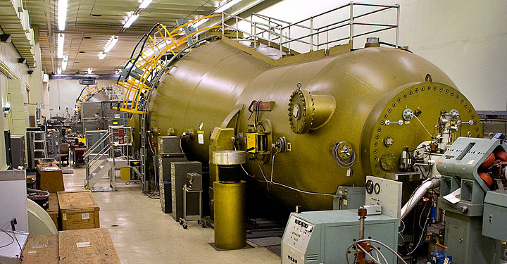
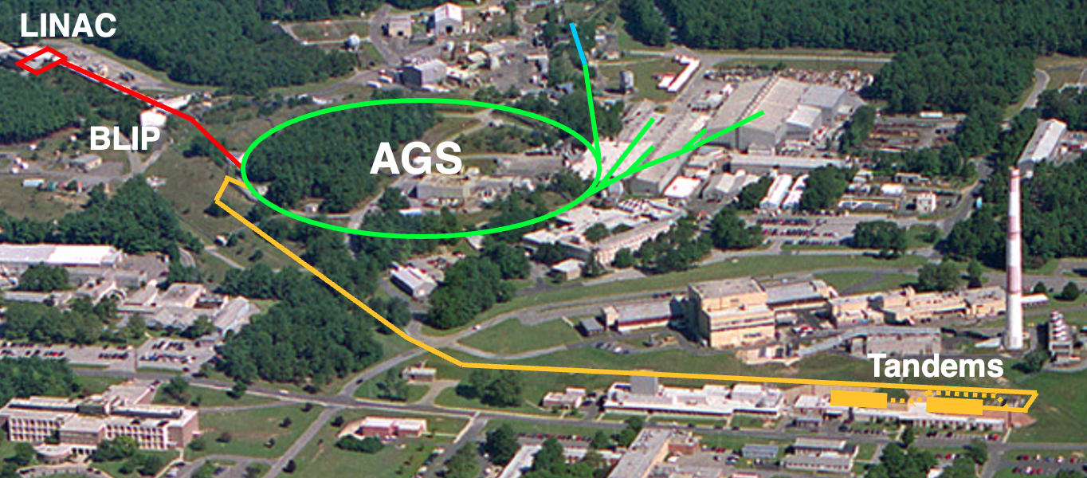
Heavy ion program at AGS
Fixed target experiments
RF
Tandem Van de Graaff
Completed in 1970 for NP studies
RHIC pre-injector until 2011 (now EBIS)
2 electrostatic accelerators
32 MV (= 2x16 MV) voltage
>40 ion species p to Au
Heavy Ion Transfer Line (HITL), operational 1985
Notes:
No EBIS, NSRL, AtR, Tandems pic

Slide 8
RHIC Design energy – luminosity – flexibility

Slide 9
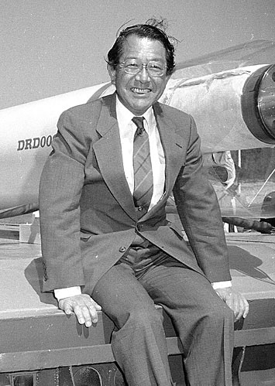
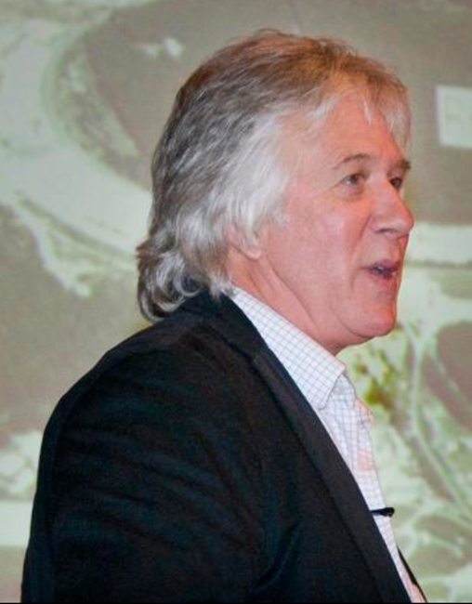

Relativistic Heavy Ion Collider
1984 began to think about heavy ion collider
~100 GeV/nucleon,
dipoles ~3.5 T (5 T for ISABELLE/CBA)
transfer line from Tandem, develop heavy ion
beams in AGS, with heavy ion experiments
1991 construction begins
2000 first collisions
Satoshi Ozaki
Mike Harrison
Tom Ludlam
[Ernest D. Courant, “Accelerators, colliders, and snakes”, Annu. Rev. Nucl. Sci. 2003. 53:1-37]

Slide 10
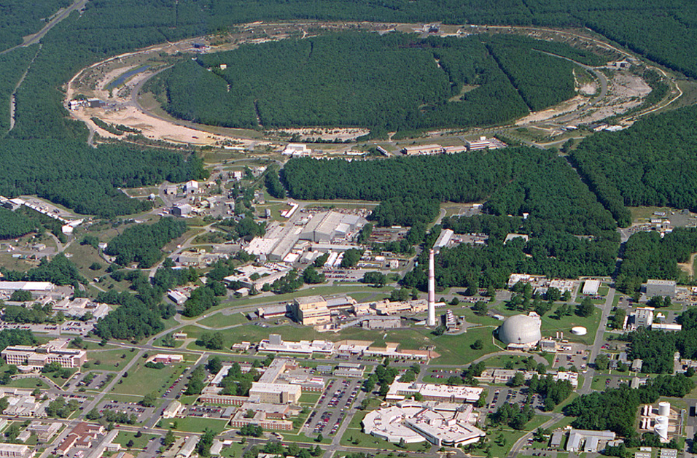
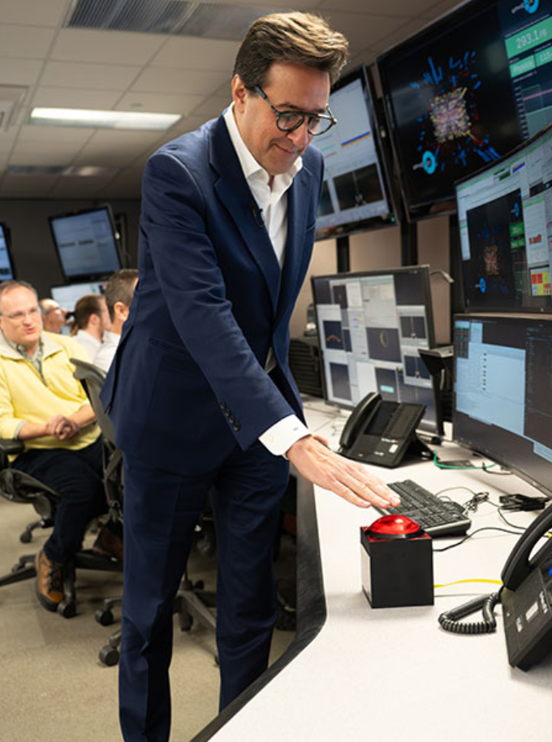
Relativistic Heavy Ion Collider – main parameters
Polarized Jet Target
(PHOBOS)
Electron lenses
RHIC
(BRAHMS)
Electron cooling
(s)PHENIX
RF
STAR
Collisions : 12 Jun 2000 – 6 Feb 2026
Circumference : 3.8 km
Max dipole field : 3.5 T
Energy : 255 GeV polarized p
: 100 GeV/nucleon Au
Species : ph to U (incl. asymmetric)
Experiments : BRAHMS, PHOBOS, pp2pp, AnDY,
RHICf, PHENIX, STAR, sPHENIX
LINAC
NSRL
EBIS
Booster
BLIP
AGS
TPL
Tandems
DOE Under Secretary for Science
Dario Gil ending last RHIC store
(oxygen-oxygen)

Slide 11
RHIC Design Manual
reached L_{avg} = 88×10²⁶ cm⁻²s⁻¹ (44x design)
reached L_{avg} = 24.8×10³¹ cm⁻²s⁻¹ (25x design) with P_{avg} = 57%

Slide 12
Important design choices
2 rings (almost independent) => flexibility
Dipole first IR => flexibility (only 6 common magnets,
ran at burn-off limit, more focusing not very helpful)
3.5 T dipole field => high enough to create QGP (wasn’t really known), low enough to control cost/performance risk
Crossing transition => was a risk with sc magnets
(issue with electron clouds, could be resolved)
Nested IR PS (ok but not easy)
(Stainless steel pipe not coated => was ok for RHIC, not EIC)
Notes:
New slide, 9 Apr 2026

Slide 13
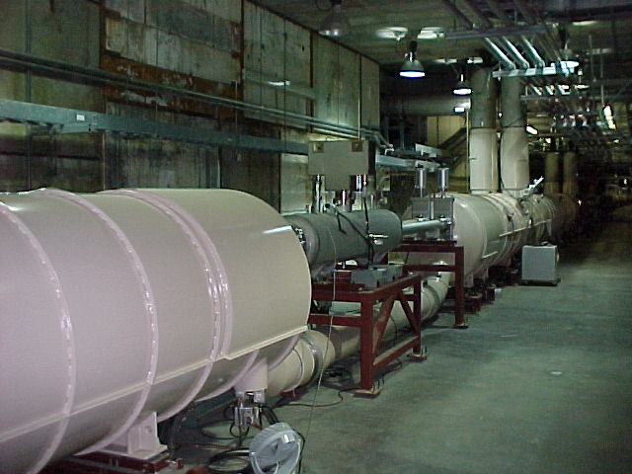
RHIC Design Manual (July 1998)
DX dipoles
L_{mag} = 3.7 m, B_{max} = 4.3 T
large aperture
(18 cm coil ID)
only magnets that
need training
(~5 for IR6/8 only)
IR design with beam splitting DX dipoles first
← Interaction Point
D0,Q1—Q3
DX dipole
Notes:
MAKE REAL CALCULATION FOR DX MOVE

Slide 14
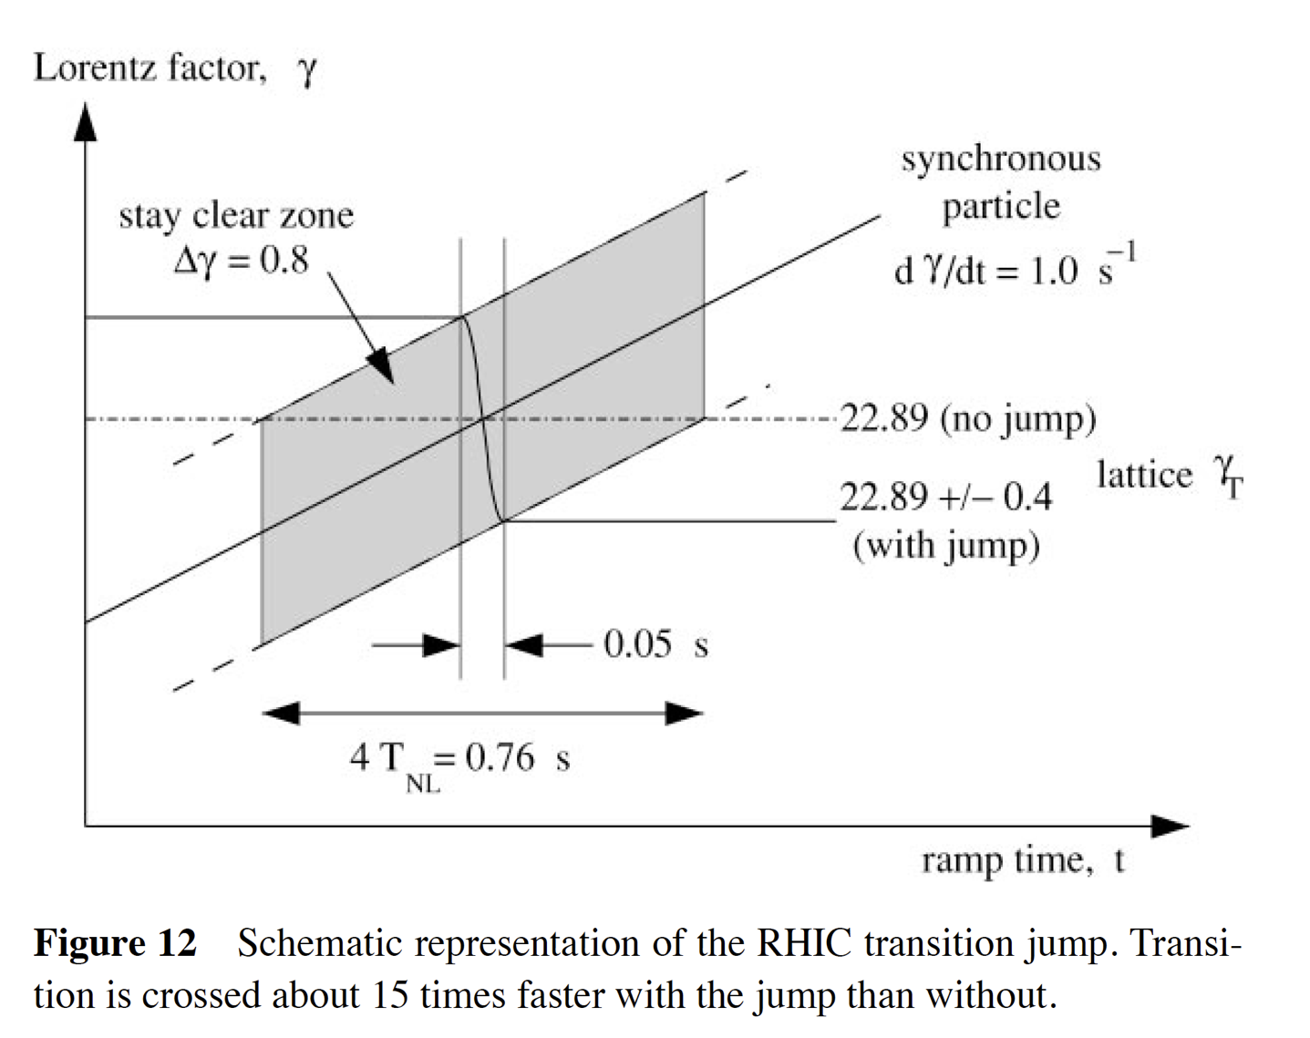
Transition crossing – with sc magnets
Topic of Jie Wei’s
PhD thesis (1989)
Did limit intensity
for some time:
Initially no gamma-t quads
Electron clouds
Instabilities
[M. Harrison, S. Peggs, and T. Roser, “The RHIC accelerator”, Annu. Rev. Nucl. Sci. 2002. 52:425-369]

Slide 15
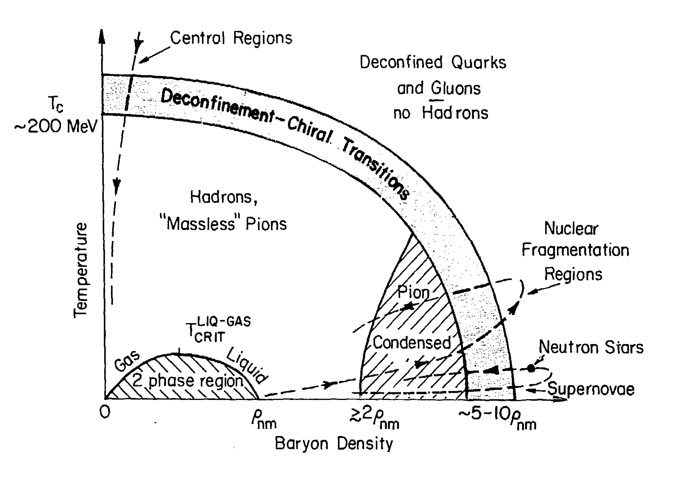
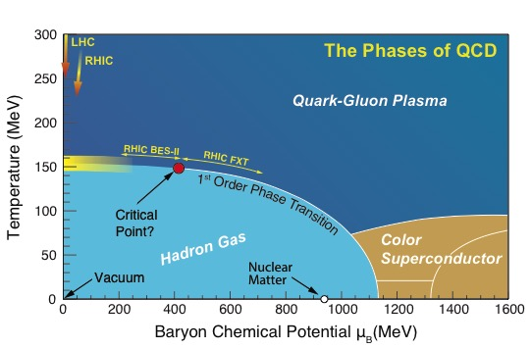
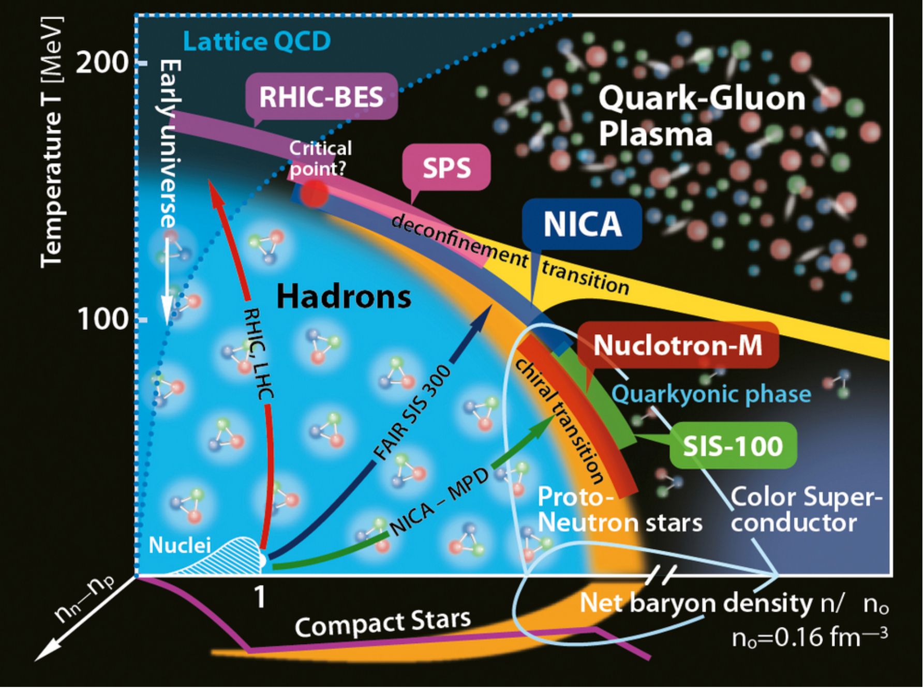
RHIC CDR, 1986
Claudia Ratti,
University of Houston

Slide 16
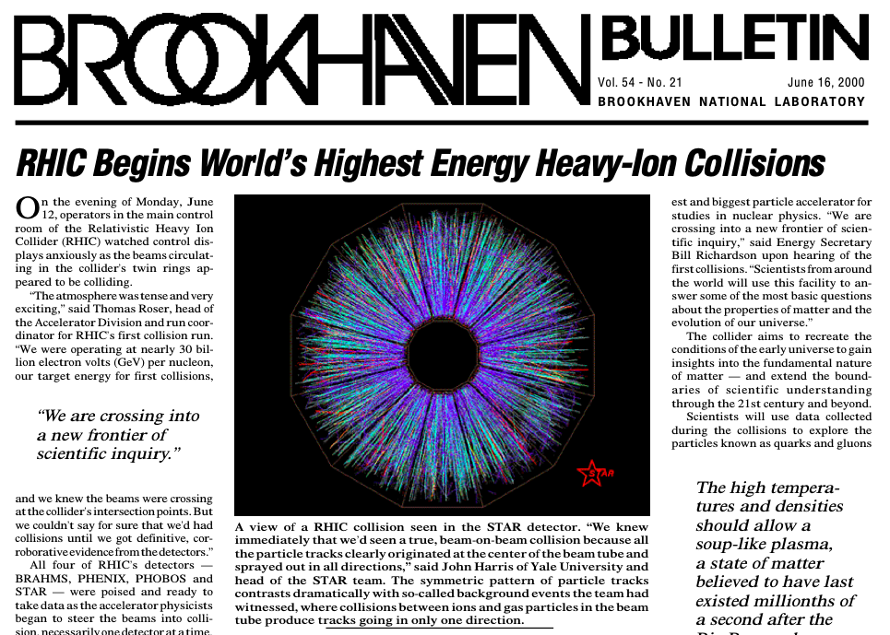
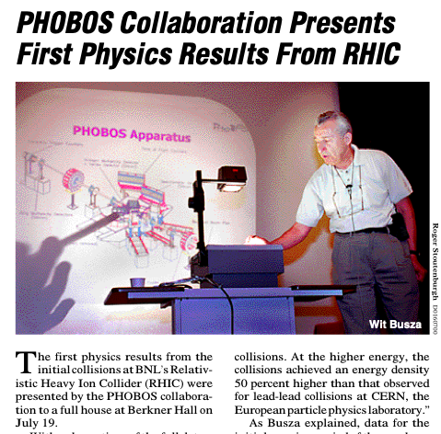

Slide 17
RHIC performance evolution luminosity

Slide 18
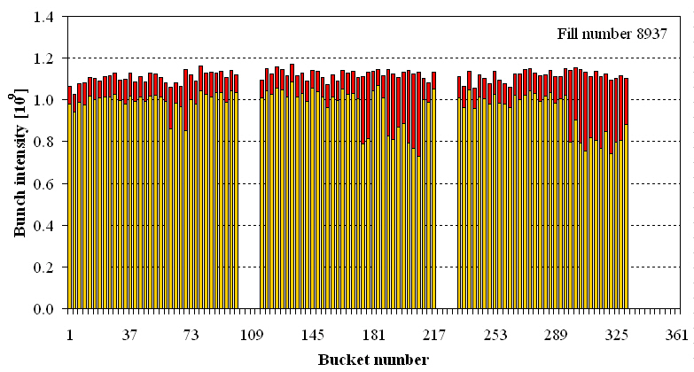
Luminosity limits – ions, high energy
Bunch intensity N_{b}, limited by injectors
EBIS, bunch merges in Booster and AGS
transition instability
Intrabeam scattering
luminosity lifetime
stochastic cooling
Lattice with small β* and large off-momentum dynamic aperture
with hourglass factor ≈0.5 at end of store limits potential
ran with β* = 0.7 m vs. 1.0 m design
Goal is to have burn-off as the dominant beam loss mechanism.

Slide 19
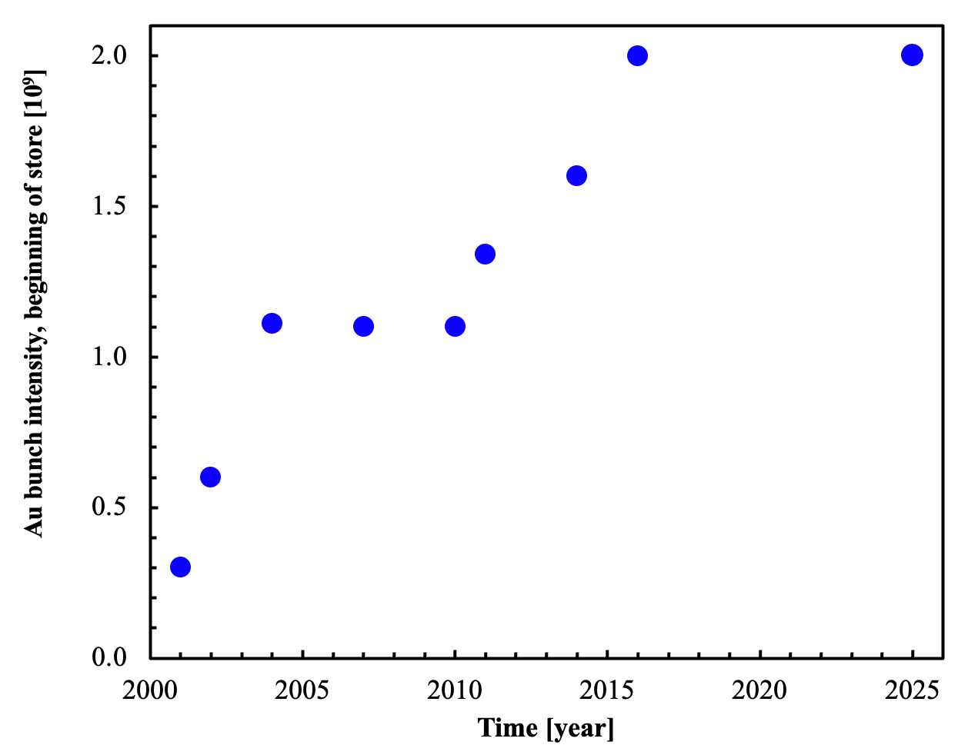
Au bunch intensity evolution
γ_{t}-jump, octupoles at transition
111 bunches
scrubbing with protons
43 bunches
EBIS, Booster 4g2g1, AGS 8g4g2 merge
AGS 12g6g2 merge
Final Run-25
Main limits:
- injectors output
- e-cloud in RHIC
transition instability
incoherent effects
44x L_{peak}
_{(all other things equal)}

Slide 20
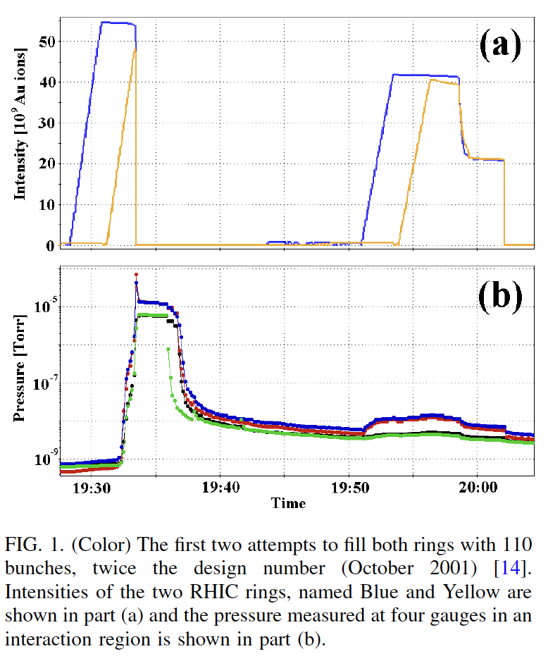
Electron clouds
E-clouds limited RHIC intensity beginning in 2001 through:
dynamic pressure rise, tune shifts, transition instabilities, and possible emittance growth
Electron detector signals tracked ΔP; measured ΔQ + simulations => cloud densities of ~10¹¹–10¹² m⁻³
Mitigations
• Large scale NEG-coated warm
beam pipes (most effective)
• In-situ baking
• Solenoids (local)
• Optimized bunch patterns
• Pre-pumped cold sections
• Beam scrubbing
• Longer bunches
Outcome
• Reduced ΔP by orders of magnitude
• Remained an operational consideration,
(transition, locations that could not be baked or coated)
Bunch intensity in train with intentional gaps
before and after crossing transition energy
ΔP

Slide 21
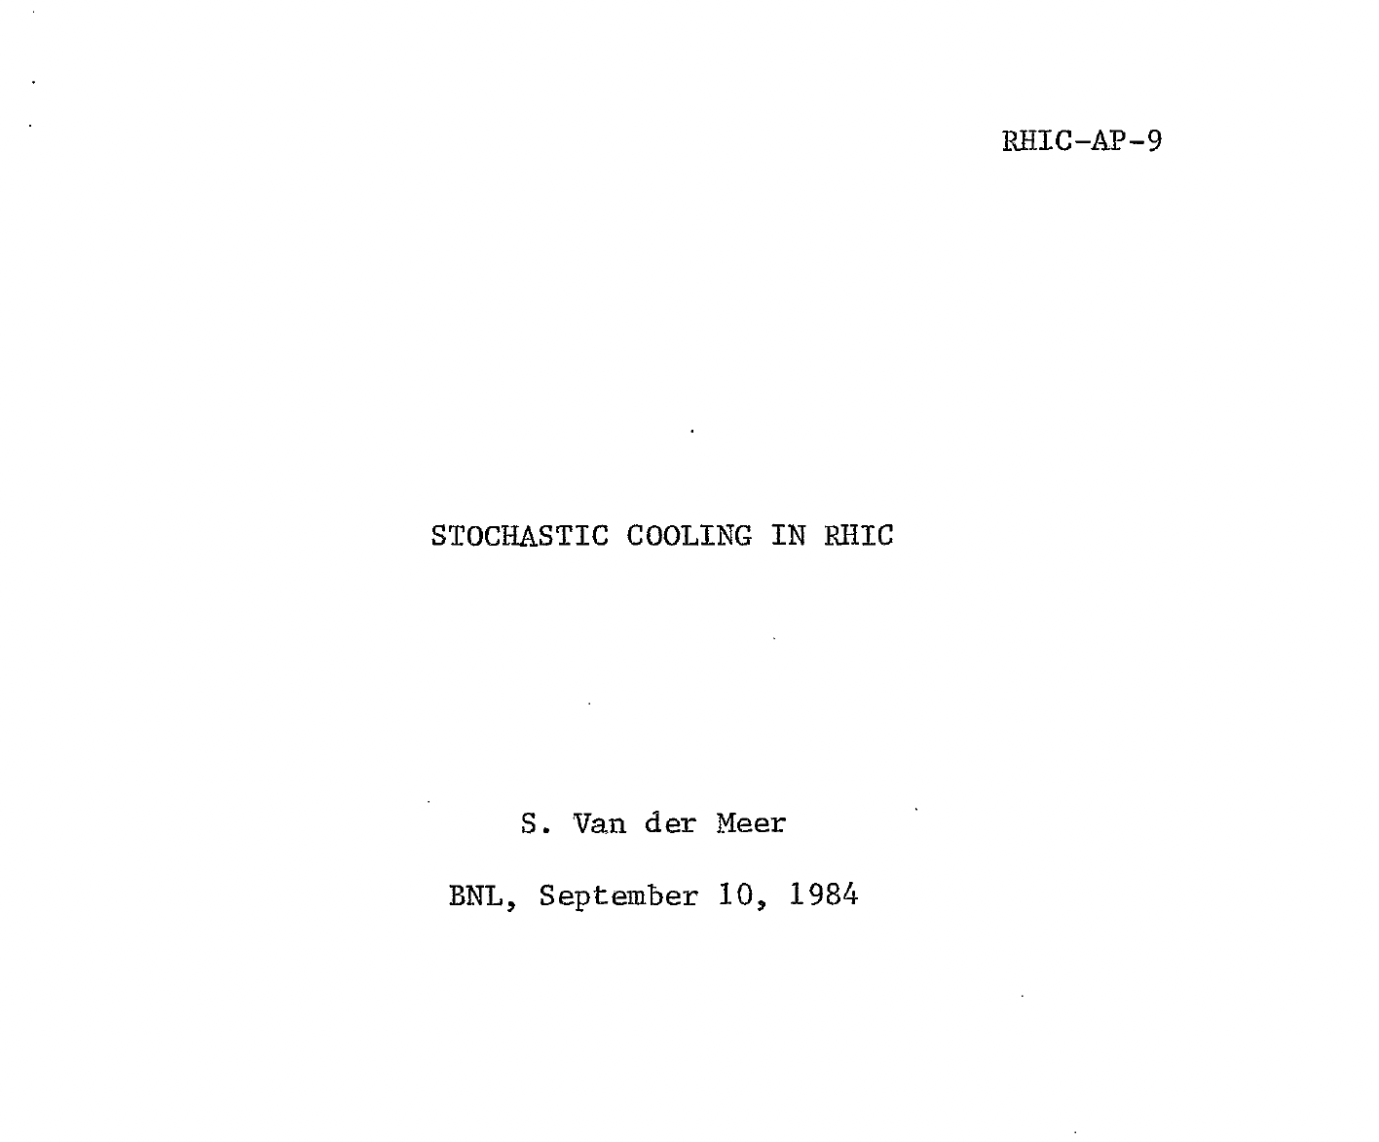
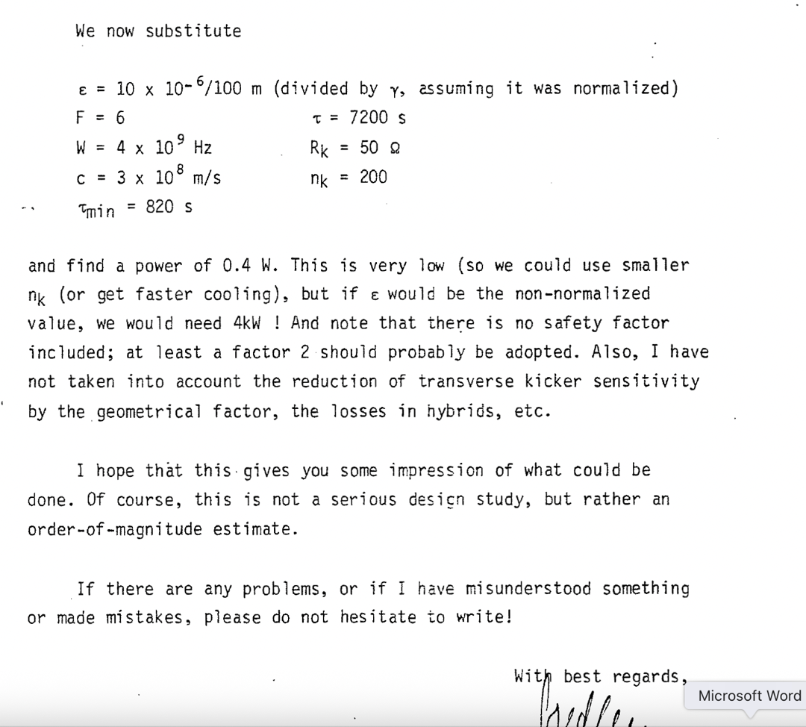
Early interest in cooling for RHIC
Simon Van der Meer, 1984

Slide 22
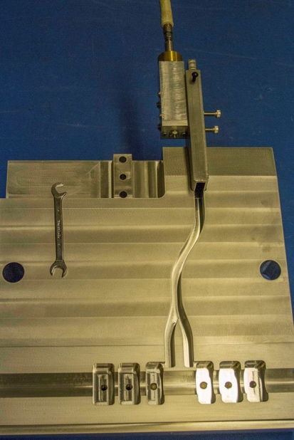
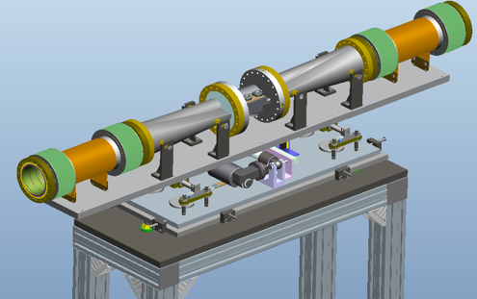
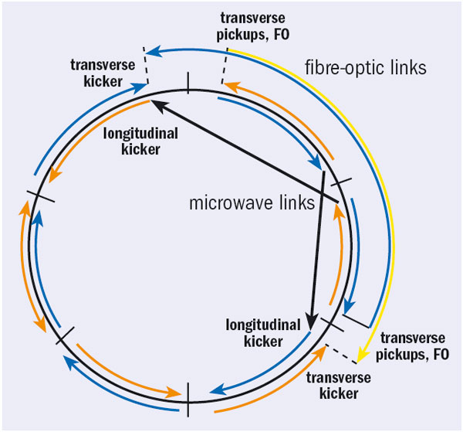
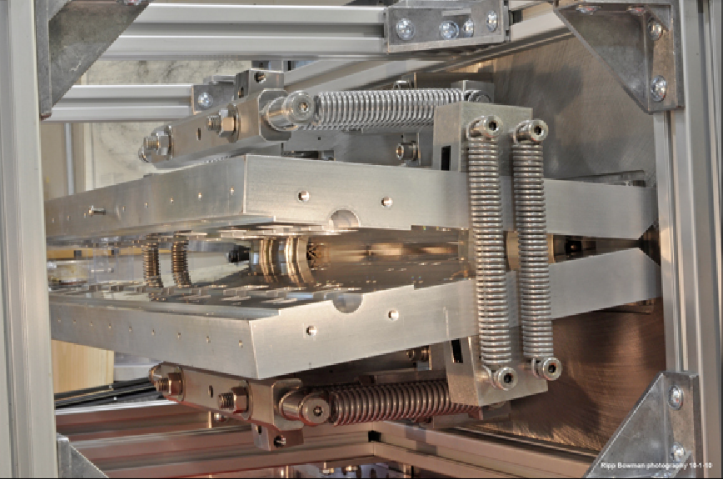
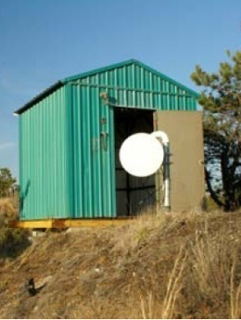
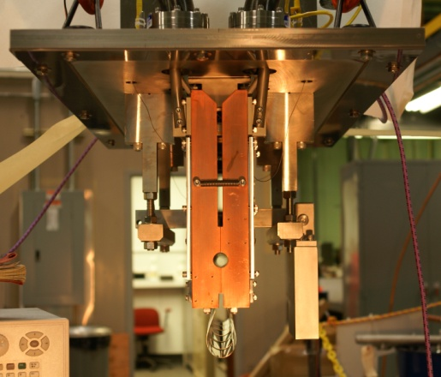
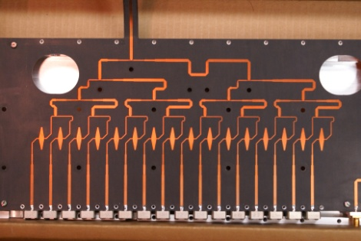
3D stochastic cooling for heavy ions
longitudinal
kicker cavity
(half side with
waveguides)
longitudinal pickup
horizontal kicker
(open)
horizontal and
vertical pickups
vertical
kicker
(closed)
5-9 GHz, cooling times ~1 h
M. Brennan, M. Blaskiewicz, F. Severino, PRL 100 174803 (2008); K. Mernick PRSTAB, PAC, EPAC
Notes:
Frequency range: 5-8 GHz transverse, 6-9 GHz longitudinal

Slide 23
RHIC Run-14 Full 3D Cooling
Increase in initial luminosity
result of larger bunch intensity
Increase in luminosity lifetime
result of 3D bunched beam cooling, >90% burn-off
2014, End of
stochastic cooling upgrade
2007, Beginning of
stochastic cooling upgrade
More detail in presentation by Mike Blaskiewicz

Slide 24
Operation at burn-off limit in U+U
97% of intensity burned off at L_{max}
Burn-off dominated operation allows for
determination of total U+U cross section
– and comparison with calculation (mostly QED)
(published in Phys. Rev. C) =>

Slide 25
How did stochastic cooling change heavy ion collider operation?
Increased in luminosity lifetime from ~2.5 h Au+Au up to infinite
Allowed for increase in bunch intensity L ~ N_{b}²
Increased optimum store length from 4 to 8 h for Au+Au,
resulting in more time in collision, less time refilling
Can tolerate emittance growth during acceleration (from IBS, transition instabilities) as long as no intensity is lost
Operation close to burn-off limit, full use of accelerated intensity
Allowed flat luminosity for alternating species (Ru+Ru/Zr+Zr)

Slide 26
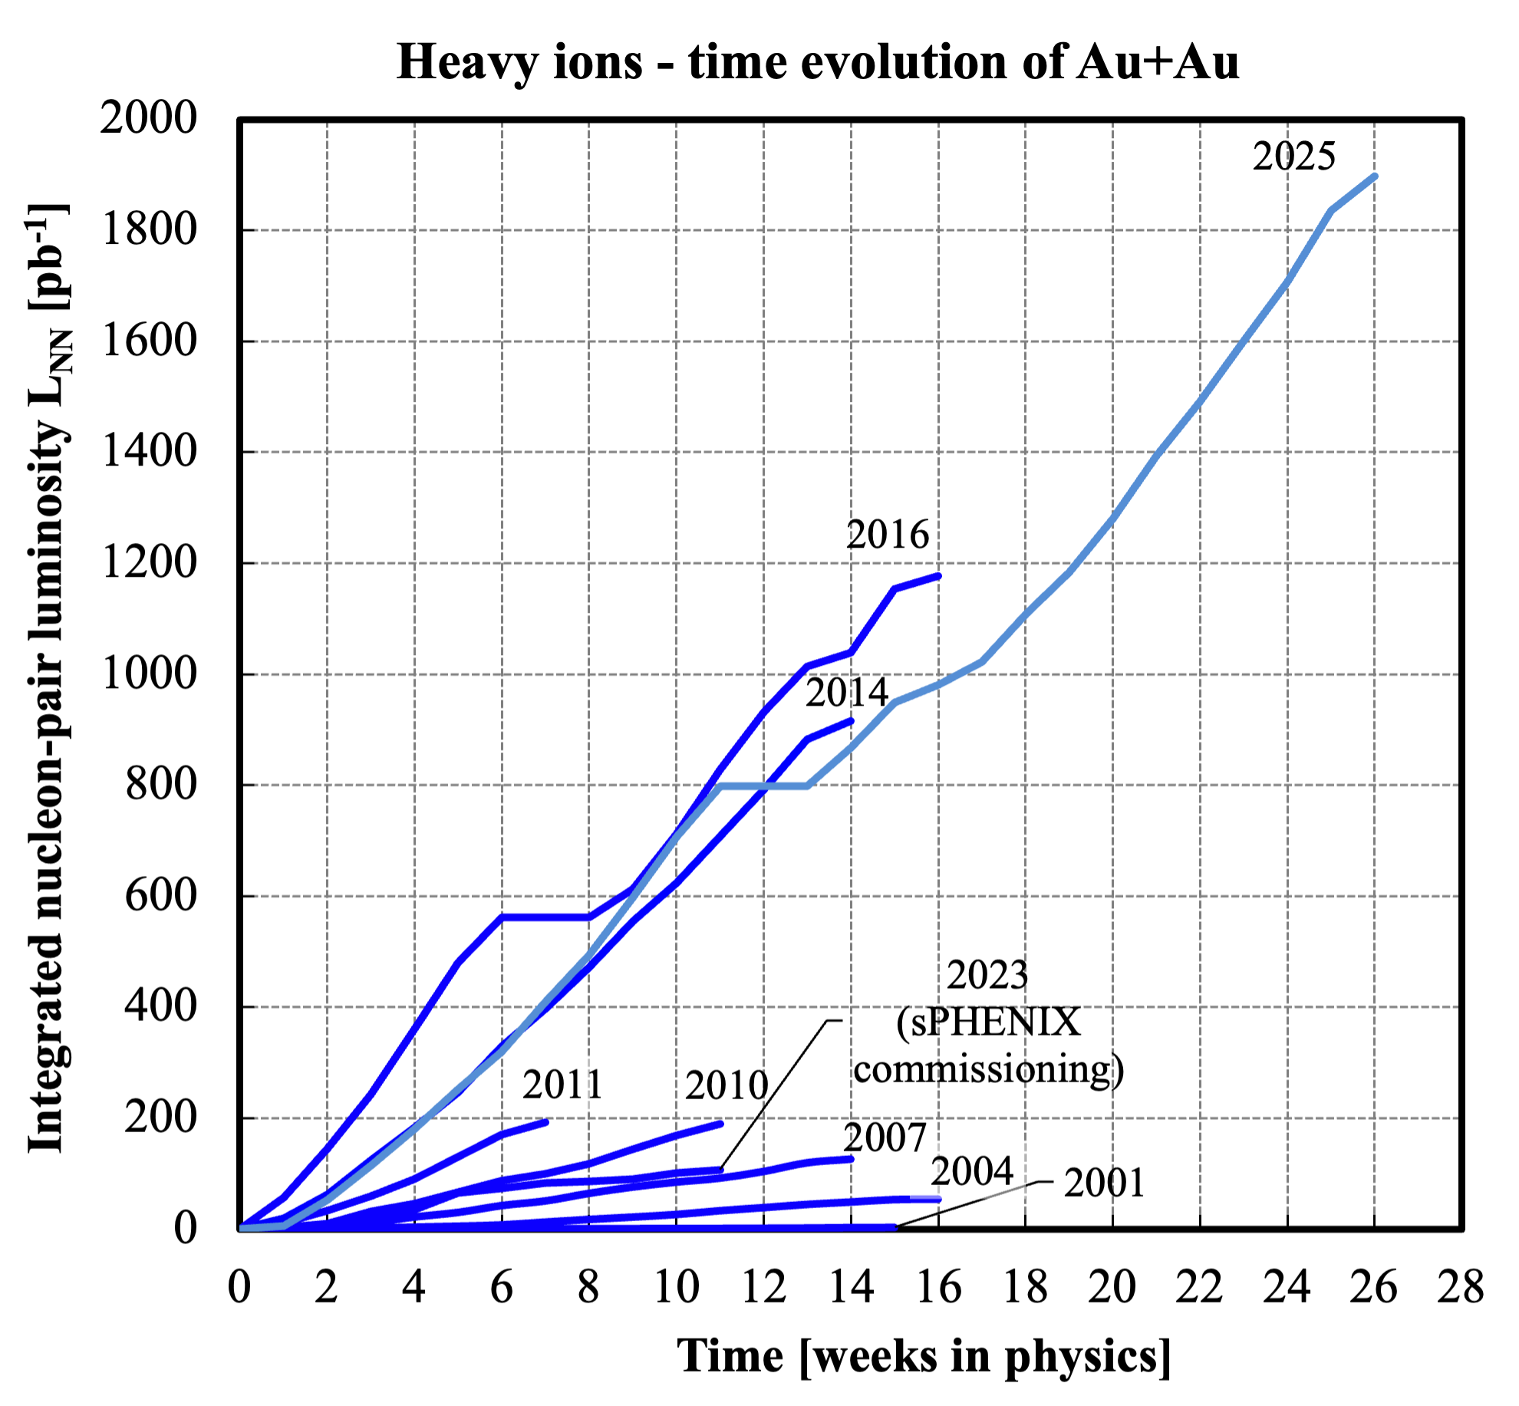
Final Run-25
15 weeks Run-1 could be done
later in 1/2 day (200x faster)

Slide 27
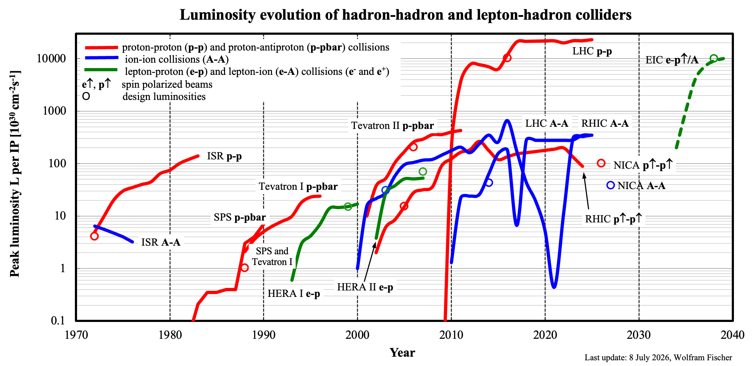
L_{RHIC, Au} ≥ L_{LHC, Pb} with γ_{LHC, Pb} ~ 27x γ_{RHIC, Au}

Slide 28
RHIC performance evolution flexibility

Slide 29
RHIC performance – flexibility
Medium heavy (Cu+Cu, O+O)
Asymmetric collisions (p↑+Au, d+Au, h+Au, Cu+Au)
U+U (non-spherical)
Zr+Zr / Ru+Ru (same A = 95, max different ΔZ = 4)
Au+Au luminosity at 3.85 to 9.8 GeV/nucleon
(Beam Energy Scan, including a fixed target program)
only ion combination
shared between
RHIC and LHC are
O+O and p+p
(polarized in RHIC)

Slide 30
Beam control – x,y + Q/Q’ feedbacks on ramp
0.3
Blue orbits
M. Minty,
A. Marusic et al.
x_{mean}
x_{rms}
x,y_{rms} ≈ 20 μm, 5% of arc beam size (!)
Orbit [mm]
Orbit feedback on every
ramp allows for
Smaller y_{rms} (smaller
imperfection resonance
strength)
Ramp reproducibility
(have 24 h orbit variation)
Tune/coupling feedback
on every ramp allows for
Acceleration near Q_{y} = 2/3
(better P transmission
compared to higher tune)
y_{mean}
y_{rms}
-0.2
0.7
Q_{x}
Tune
Q_{y}
ΔQ_{y} = 0.006
Q_{y} = 2/3
0.66
Notes:
Fillno 15443, one of best stores

Slide 31
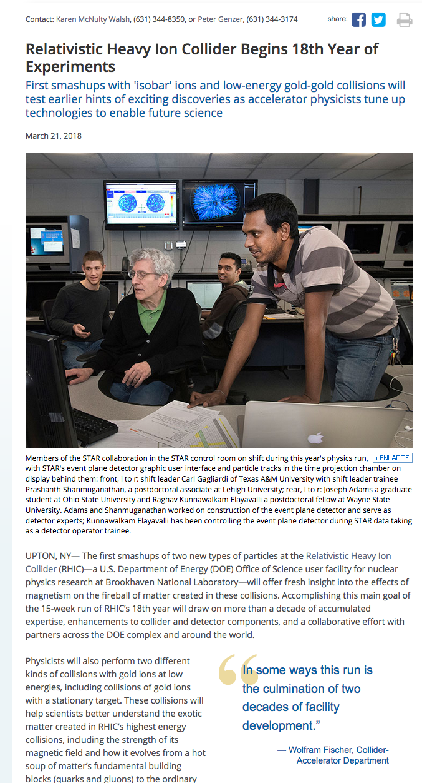
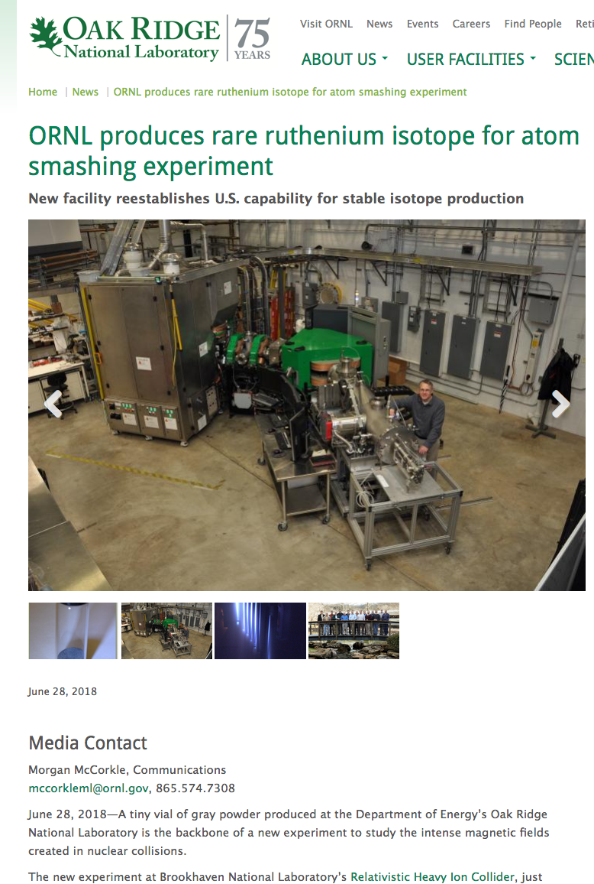
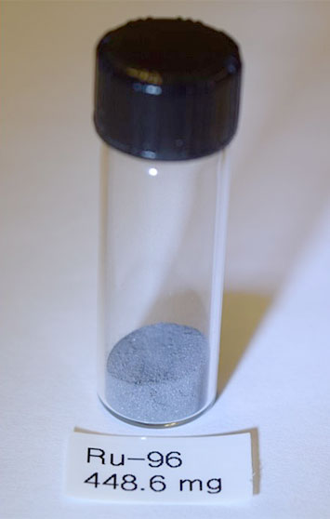
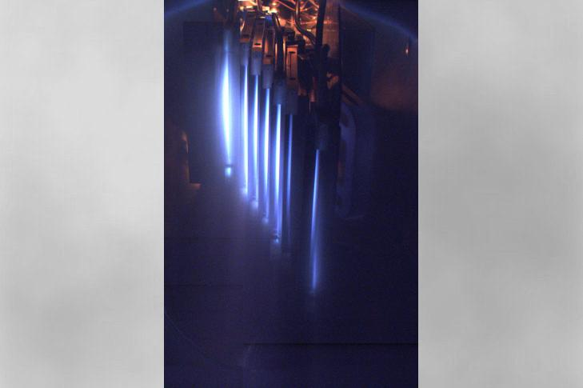
Run-18 Zr+Zr/Ru+Ru – same A, different Z (CME)
Zr-96/Ru-96
Extraordinary help from DOE, ORNL, RIKEN
for source material and preparation
Ru isotopes

Slide 32
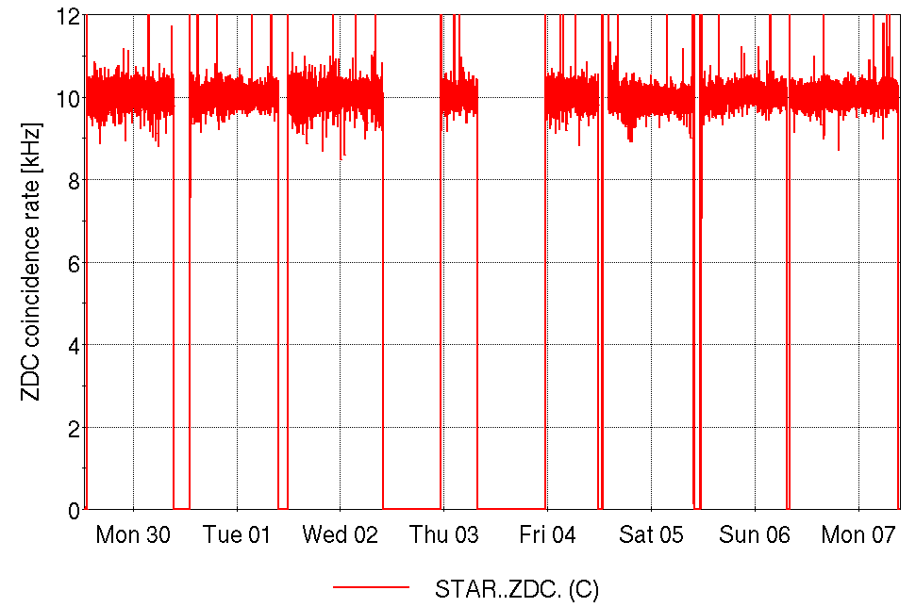
Run-18 Zr+Zr/Ru+Ru at 100 GeV/nucleon
Store-by-store species change and flat luminosity of 21.5×10²⁶ cm⁻²s⁻¹
20 h nominal store length (WEEK: 30-Apr-18 to 07-May-18)
Run Coordinator: Greg Marr
Zr+Zr
Zr+Zr
Zr+Zr
Zr+Zr
Ru+Ru
Ru+Ru
Ru+Ru
Ru+Ru
CeC PoP
dedicated
scheduled
maintenance

Slide 33
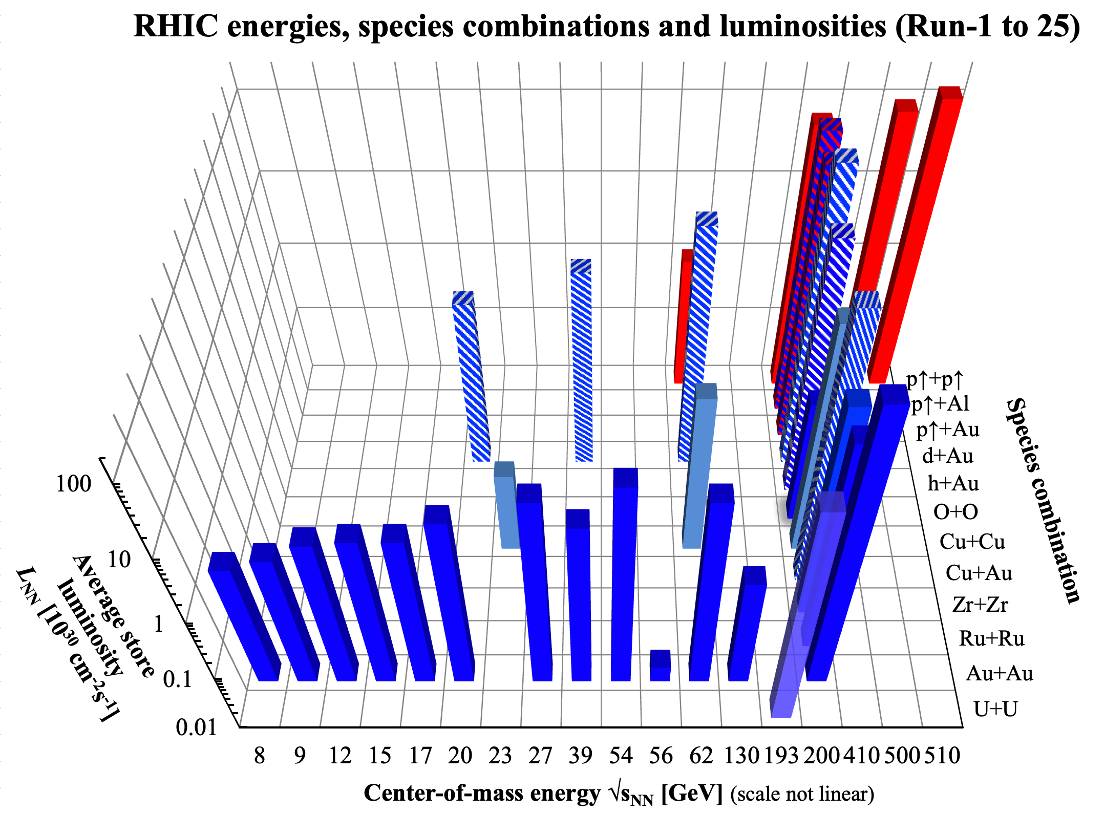
Used stochastic or
electron cooling in
1 or 2 beams
L design
L design
nominal injection

Slide 34
RHIC performance evolution energy – down to 30% of design injection energy
Notes:
Design dipole current 568 A for GeV/n 97 GeV/n Au injection; dipole current at 190 A for 3.85 GeV/n Au injection; nominal injection lowered to 470 A dipole current

Slide 35
Low-Energy RHIC electron Cooling (LEReC) for the
Beam Energy Scan I and II (BES-I, II)
Au+Au collisions
down to 3.85 GeV/n
(40% of CoM energy at
nominal injection,
30% of design)
Luminosity really low:
Space charge
Intrabeam scattering
Magnetic field errors (also
time dependent)
Large beam with losses
BES-II goal of 4x luminosity
over 3.85 – 9.8 GeV/n
(highest energy is nominal injection)
Designed cooler for
2 lowest energies
BES-I in 2010/11/14
BES-II: 10x increase
in the number of events
[2015 NSAC Long Range Plan for Nuclear Science]
Notes:
Picture from 2015 NSAC long-range plan

Slide 36
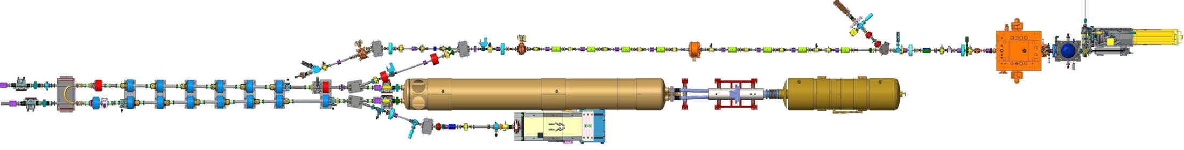



LEReC Accelerator
(100 meters of beamlines with the DC Gun, high-power fiber laser, 5 RF systems, including one SRF, many magnets and instrumentation)
704 MHz
Cu Deflector Cavity
704 MHz SRF
Booster Cavity
Cathode
loading system
Transport
Beamline
RF Diagnostic Beamline
Merger
Beamline
Injection beam dump
704 MHz
Cu Cavity
2.1 GHz
Cu Cavity
9 MHz
Cu Cavity
COOLING
in Yellow RHIC ring
e⁻
e⁻
e⁻
RHIC TRIPLET
RHIC DX
DC
e⁻ Gun
COOLING
in Blue RHIC ring
LF solenoid
HF solenoid
Transport solenoid
ERL solenoid
Quad corrector
Trim corrector
Corrector 3.8 ID
Corrector 6.0 ID
BPM 2.4 ID
BPM 4.8 ID
Bellows
Ion pump
180°
Bending
Magnet
Extraction beam line
High-Power Beam Dump
* NOT to scale
More in presentation by Alexei Fedotov

Slide 37
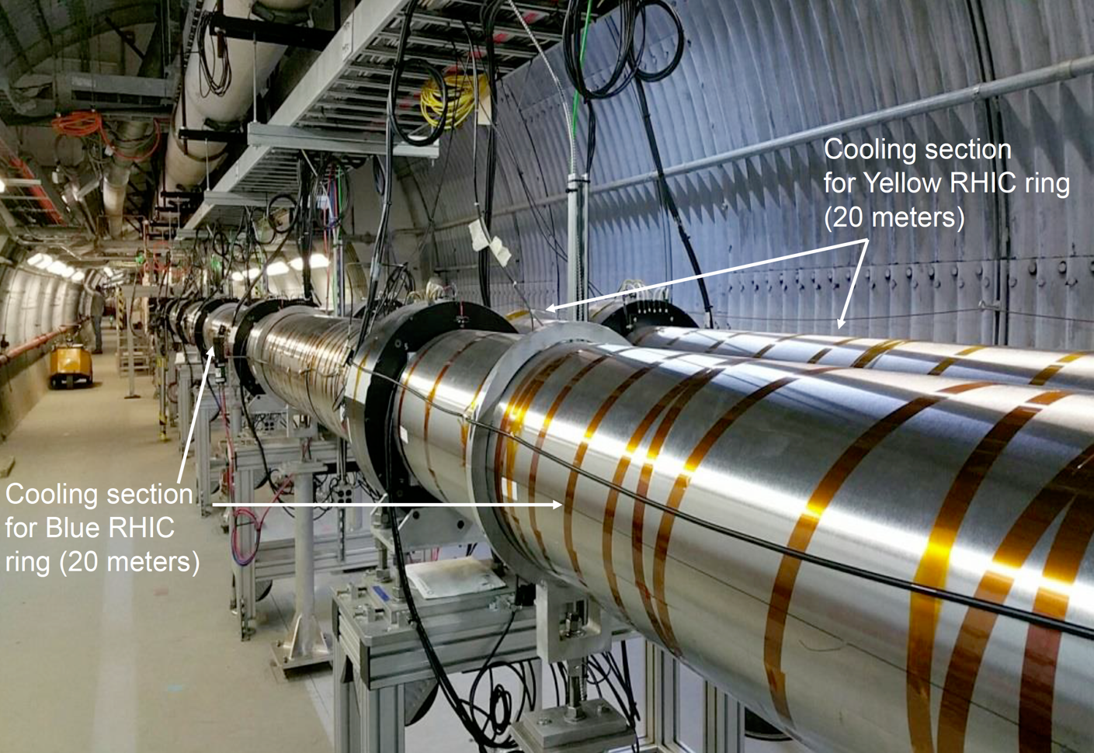
Low Energy RHIC electron Cooler
LEReC operational electron cooler:
  utilizes RF-accelerated electron bunches
  uses non-magnetized electron beam
  (no magnetization at the cathode and no continuous solenoidal field in cooling section)
LEReC approach to cooling is directly scalable to high-energies – pre-cooler in EIC at injection
A.V. Fedotov et al., “Experimental demonstration of hadron beam … “, PRL 124, 084801 (2020)]

Slide 38
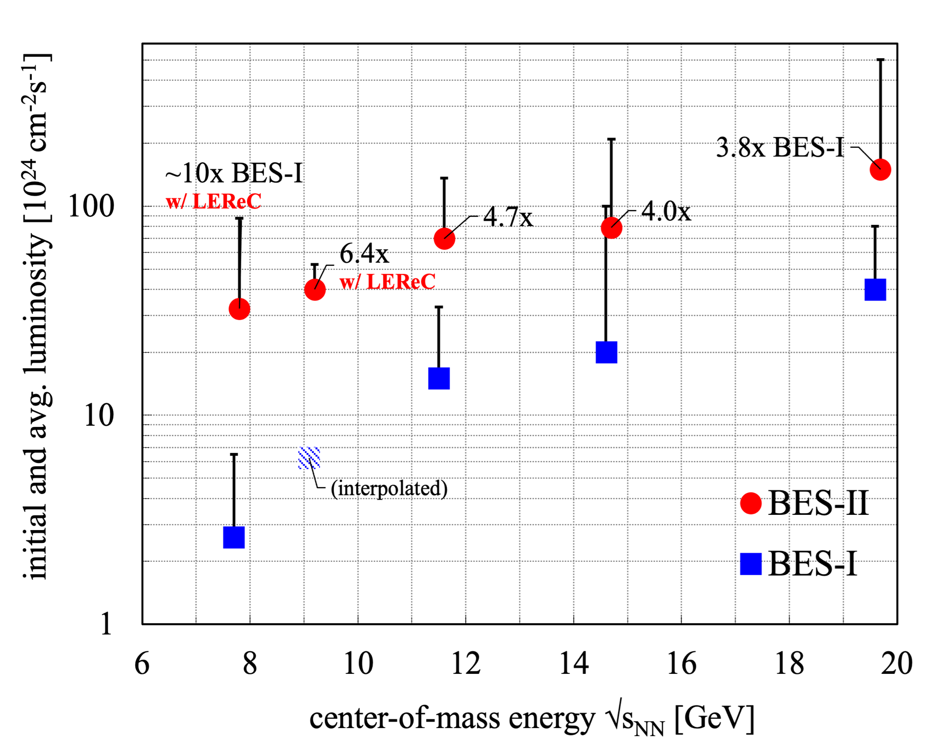
BES-I vs BES-II luminosity
Run Coordinator: Chuyu Liu (Run-19 to 21)
3rd year
2nd year
1st year
Goal was
L_{avg} (BES-II) = 4x L_{avg} (BES-I)

Slide 39
Run-25 … to the finish line

Slide 40
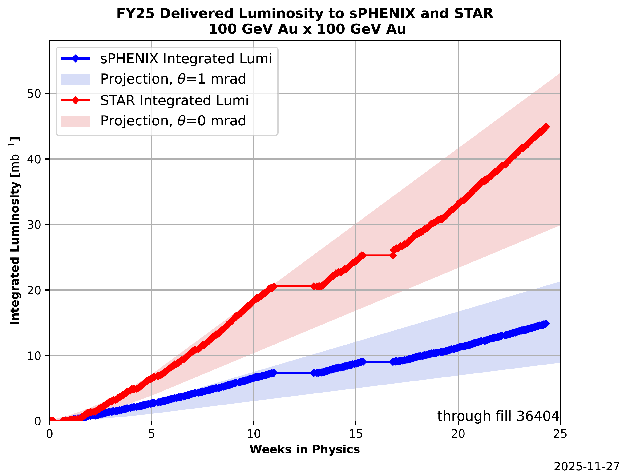
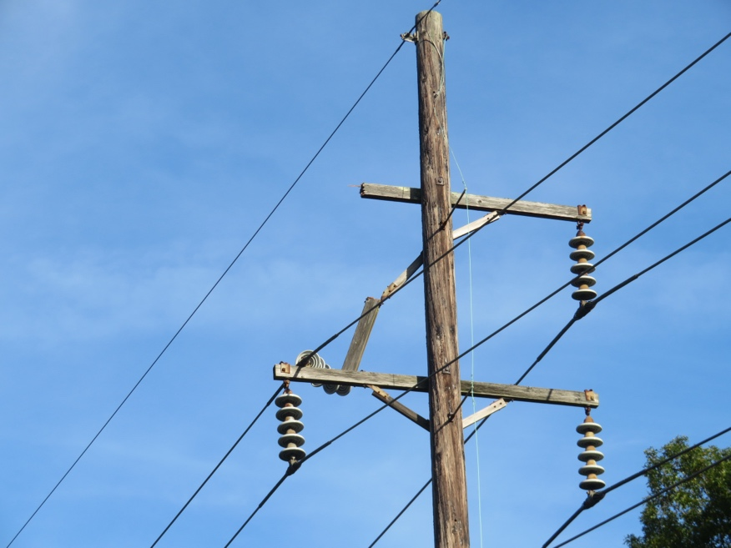
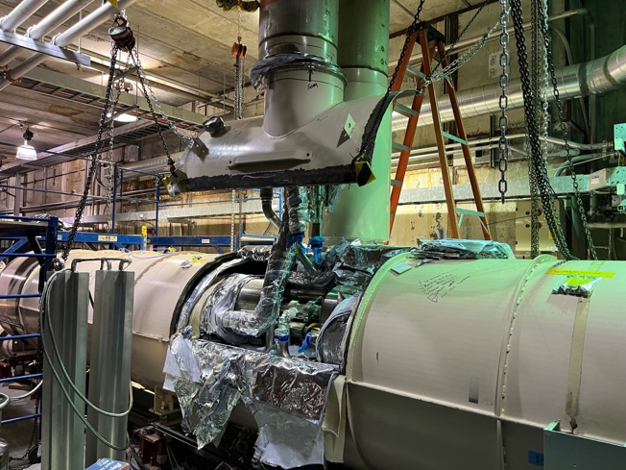
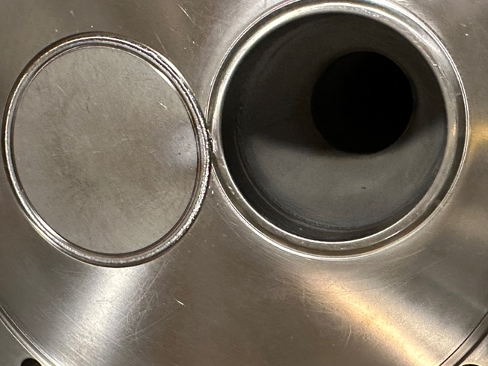
Final
Run-25
Au+Au
damaged 69 kV power line
repair shut off Central Cryo Plant
required managing helium inventory
15 days
Run Coordinator:
Travis Shrey
[μb⁻¹]
short in superconducting bus
repair required partial warm-up
opened several cryostats
65 days
unsynchronized beam abort
Yellow abort vacuum repair
14 days

Slide 41
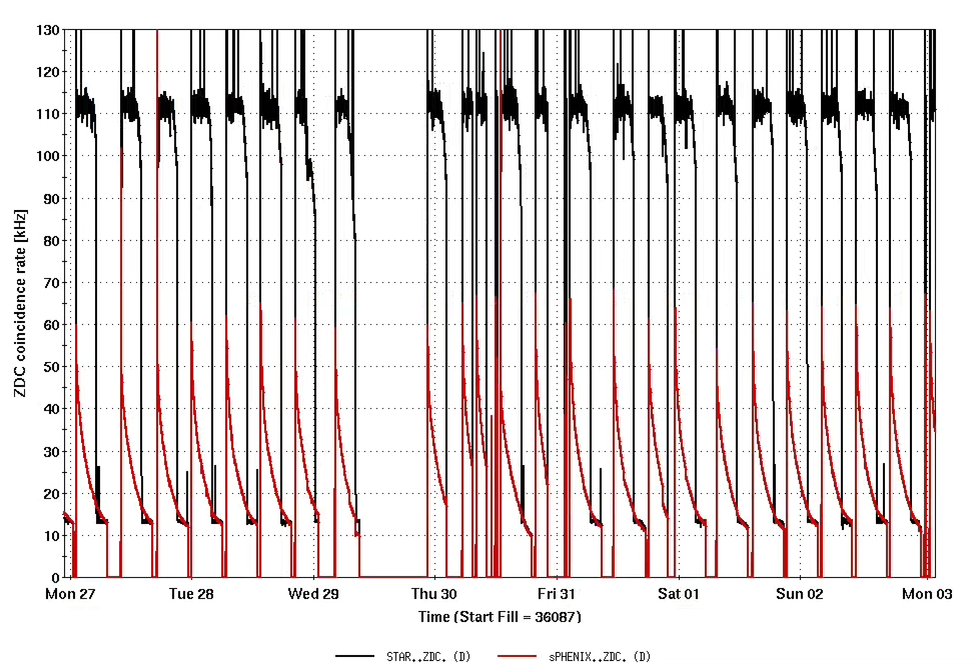
Run-25 STAR and sPHENIX event rates
Maintenance
day
STAR
0 mrad crossing angle
sPHENIX
1 mrad crossing angle
Oct/Nov 2025

Slide 42
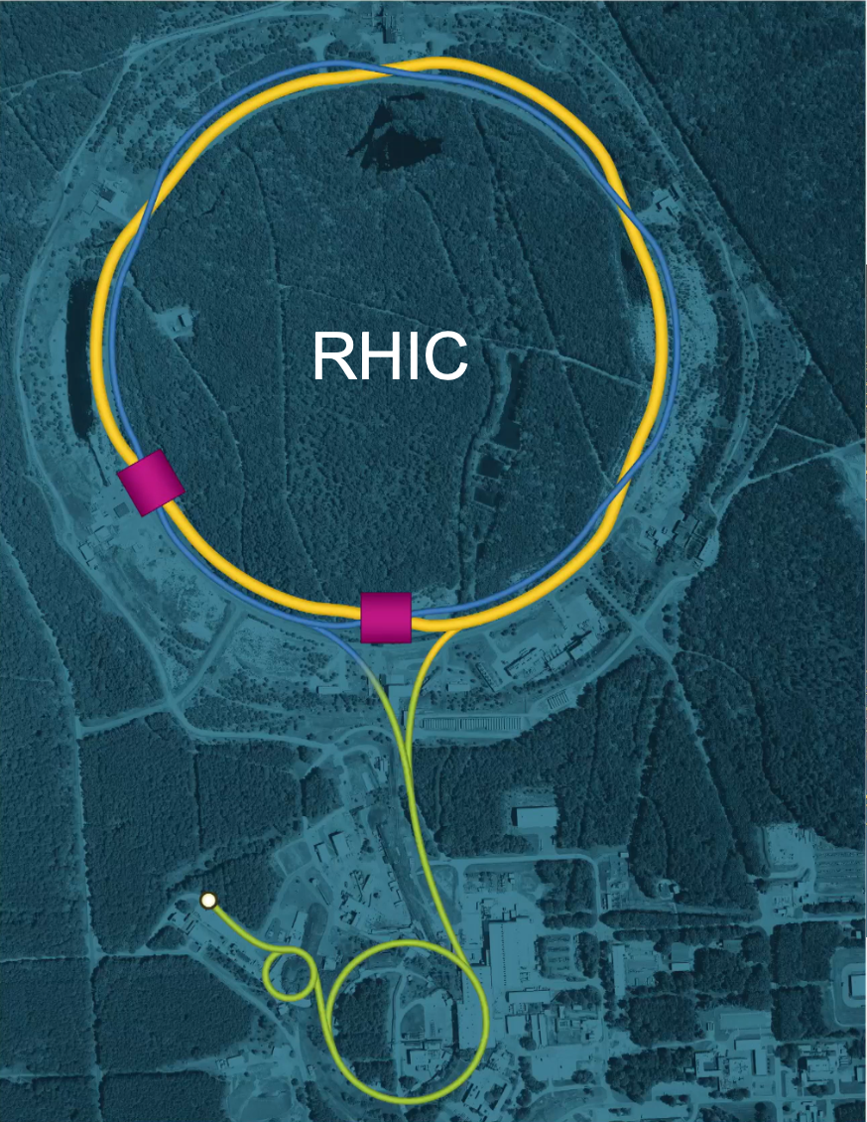
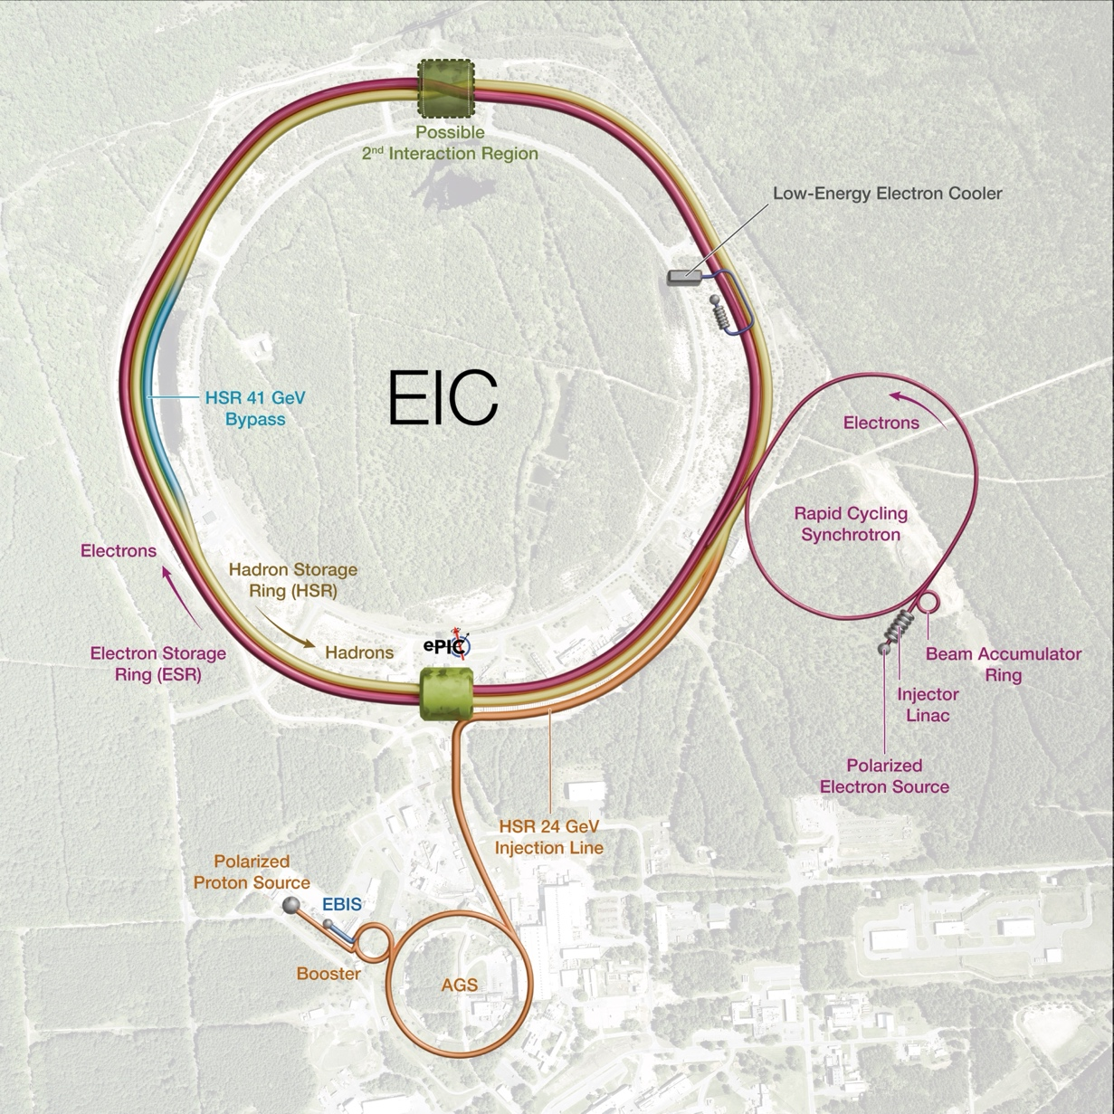

From RHIC to EIC
RHIC
p↑ – U
Au: 3.85-100 GeV
p↑ 60% polarization
EIC
Protons: 40 – 275 GeV
Electrons: 5 – 18 GeV

Slide 43

RHIC’s 25 years of physics …
Great design – allowed for significant upgrades
Evolving physics program, strong community
and funding agency support – DOE NP
Full energy Au+Au L_{avg} = 44x design
New: bunched-beam stochastic cooling
Only p↑+p↑ collider, L_{avg} = 1.3x design,
P ~ 57% (70% design)
New: p polarization preservation to high energy
12 species combinations (incl. asymmetric),
18 center-of-mass energies, low-abundance isotopes
New: built-in flexibility, high-intensity high-brightness ion/p↑ sources, x,y+Q/Q’ feedbacks
Extended energy range slightly above;
and significantly below nominal injection
New: electron cooling with RF accelerated e-beam
RHIC operation concluded 6 February 2026
Most of RHIC complex will be re-used for the Electron-Ion Collider
Hadron injectors, RHIC tunnel, Yellow ring (part of Blue), Technical Infrastructure, New technologies above
Nominal injection
[APS DPB Newsletter on RHIC: https://engage.aps.org/dpb/resources/newsletters/25-newsletter/2025-f7]

