Slide 1
Prolog: from ADD to RHIC
Jie Wei
FRIB Laboratory, Michigan State University

Slide 2
A Timeline of RHIC Early Days
Project
People
1983: NSAC identified a dedicated heavy-ion collider as the highest priority for NP research
1984: RHIC proposal submitted making use of the ISABELLE tunnel
1986: Accelerator Development Department (ADD) formed
1990: RHIC construction approved
1991: RHIC project groundbreaking
1999: RHIC construction complete; AGS and RHIC merged as C-AD
2000: RHIC in operation
1986: E. Forsyth chairs ADD
1988: A.G. Ruggiero heads RHIC Accelerator Physics
1989: S. Ozaki heads RHIC Project
1991: M. Harrison Heads RHIC Accelerator
1992: S. Peggs heads RHIC Accelerator Physics

Slide 3
RHIC “Yellow Book” and Activities at Bldg. 1005

Slide 4
J. Wei worked on RHIC since 1986
1986: Prof. C.N. Yang called E.D. Courant, then I joined ADD as a Ph. D student working mostly with S.Y. Lee
S.Y. Lee asked me to work on RHIC transition crossing, warning me that I’d not get a Ph. D on this topic as it has been well studied since 1950s
I wrote codes TIBETAN, and found the yellow book design parameter led to 70%+ beam loss at transition
This made H. Hahn to apologize, and I got my Ph. D
J. Wei, Ph. D dissertation, Stony Brook, 1989

Slide 5
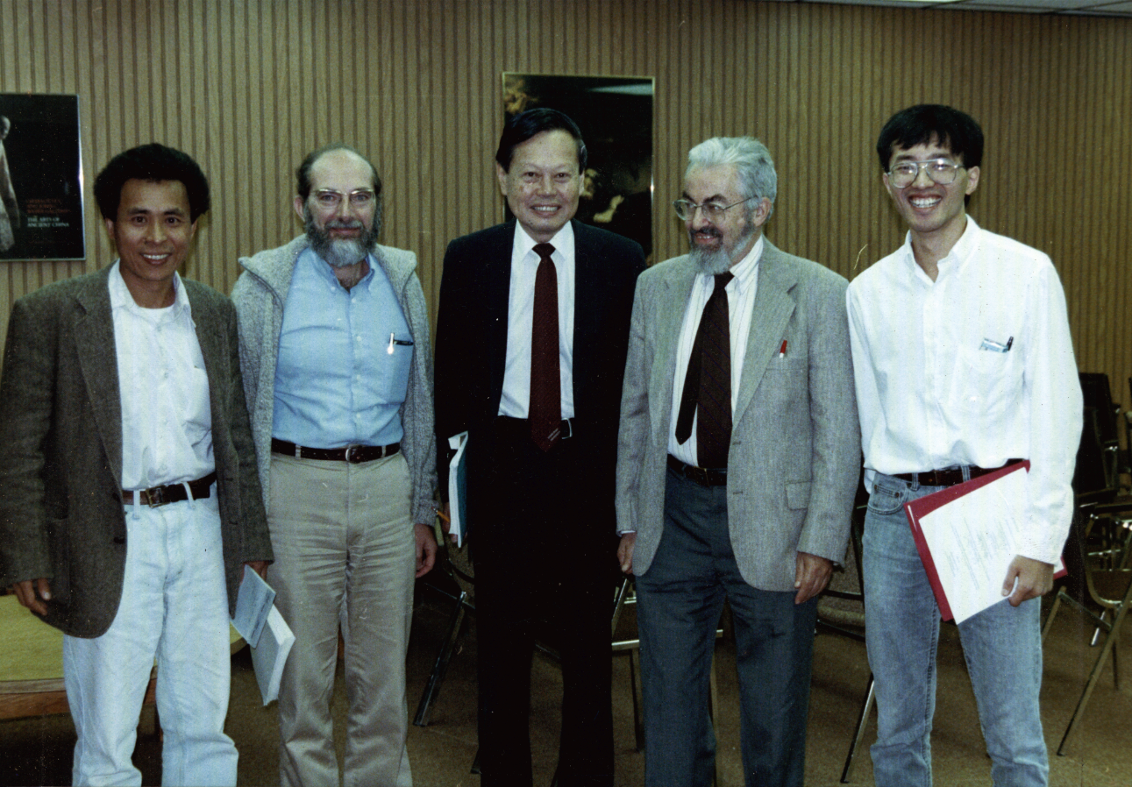
I got my Ph. D (1989)!
S.Y. Lee J. Kirz C.N. Yang E.D. Courant J. Wei

Slide 6
Work on Intrabeam Scattering and Beam Loss
Learned IBS from G. Parzen but unable to estimate beam loss
Sandro introduced me to coasting beam Fokker-Planck equations
I extended F-P formalism to bunched beam, predicted 40% beam loss – “RHIC will be a dirty machine”
We identified stochastic cooling as the mitigation, not everybody liked it
  S. Ohnuma thought it would be dreadful if RHIC had to rely on stochastic cooling to work
J. Wei, “Stochastic cooling with a double RF system”, EPAC 1992, p.833

Slide 7
Work on Bunched Beam Stochastic Cooling
Sandro introduced stochastic cooling from CERN to RHIC
Puzzled by Tevatron’s failure in bunched beam cooling – overpowered by coherent signal
My theoretical work showed stochastic cooling working for RHIC
Not everyone believed it – a senior physicist said: “stochastic cooling only cools the tail, electron cooling cools the core”
M. Brennan and M. Blaskiewicz carried on to make it successful!
J. Wei and A.G. Ruggiero, “Beam life-time with intra-beam scattering and stochastic cooling”, PAC 1991, p.1869

Slide 8
Learned To Be a Technical Leader from Mike Harrison
Mike chose to stay on the same floor as all other accelerator physicists (3rd floor of Bldg. 1005)
Mike is always calm, visionary, practical, and understanding
Mike allowed me to have fun with my “hobby” – working on crystalline beams with Andy Sessler, X.-P. Li, and H. Okamoto
…
Mike came to Michigan to help me – reviewing FRIB before project baseline

Slide 9
Learned To Be an “Accelerator Physicist” from Steve Peggs
Steve taught me accelerator physics is far beyond beam dynamics
He insisted on “expected errors” and avoided “specifications” on 1700+ RHIC magnets – philosophically justifying roles of accelerator physicists
Steve believed in Tech Notes – this was how RHIC was built upon
…

Slide 10
And So Much Fun with So Many Colleagues …
N. Malitsky, R. Talman, F. Dell, S. Peggs, F. Pilat, T. Satogata, L. Schachinger, S. Tepikian, D. Trbojevic, C.G. Trahern, J. Wei, “A proposed flat yet hierarchical accelerator lattice object model”, Particle Accelerators, Vol. 55, pp. 313--327 (1996).
J. Wei and R. Talman, “Theorem on magnet fringe field”, Particle Accelerators, Vol. 55, pp. 339--344 (1996).
W. Fischer, W.W. MacKay, S. Peggs, and J. Wei, “Emittance growth in RHIC during injection”, Particle Accelerators, Vol. 58, pp. 181-191 (1997).
H. Hahn, E. Forsyth, H. Foelsche, M. Harrison, J. Kewisch, G. Parzen, S. Peggs, E. Raka, A. Ruggiero, A. Stevens, S. Tepikian, P. Thieberger, D. Trbojevic, J. Wei, E. Willen, S. Ozaki, S.Y. Lee, “The RHIC design overview”, Nuclear Instruments and Methods in Physics Research, Vol. A 499, 245 - 263 (2003).
J. Wei, W. Fischer, and P. Manning, editors, “Beam Halo Dynamics, Diagnostics, and Collimation”, AIP Conference Proceedings 693 (Melville, New York, 2003).
J.M. Brennan, M. Blaskiewicz, J. Wei, “Possibilities for stochastic cooling at RHIC”, Nuclear Instruments and Methods in Physics Research A 532 (2004) 335 – 339.
M. Blaskiewicz, J. Wei, A. Luque, and H. Schamel, “Longitudinal solitons in bunched beams”, Physical Review ST-Accel. Beams, Vol. 7, 044402 (2004).
L. Wang, M. Blaskiewicz, J. Wei, W. T. Weng, K. Ohmi, R. Macek, “Mechanism of electron multipacting with a long-bunch proton beam”, Physical Review E, Vol 70, 036501 (2004).
…

Slide 11
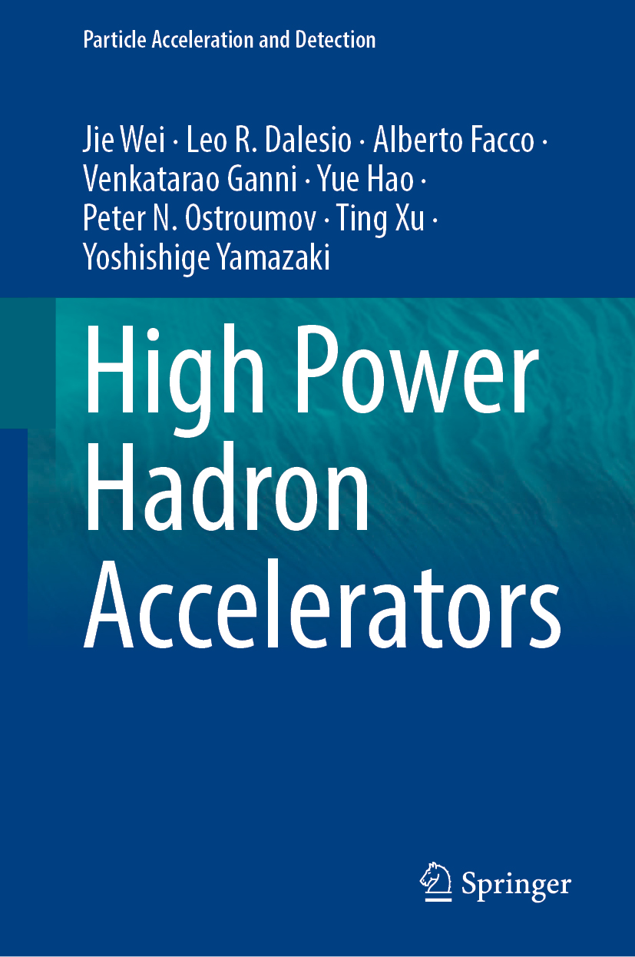
Summary
RHIC days were the “Good Old Days …”
I have been most fortunate to start my career at RHIC learning to be an accelerator physicist and a technical leader, carrying on to SNS, CSNS/CPHS, and FRIB
It has been a true pleasure to have lifelong friends and colleagues; the memories built and the work accomplished together – I will always cherish
Advertisement: High Power Hadron Accelerators | Springer Nature Link

